Slide 1
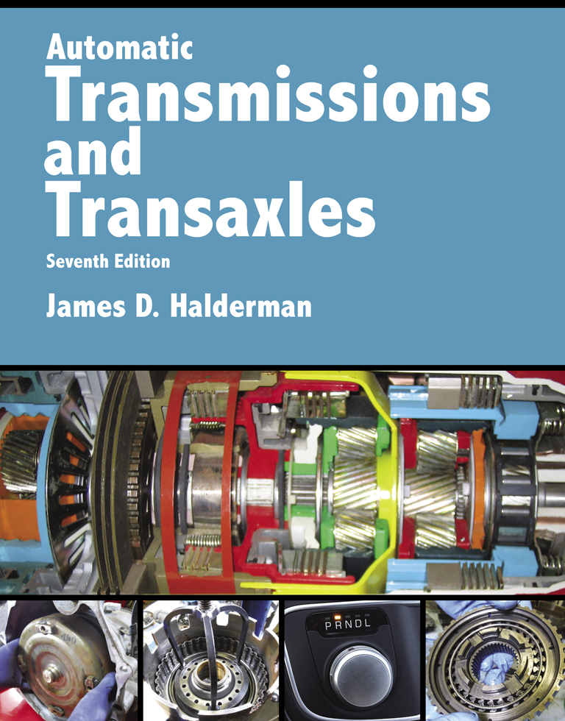
Automatic Transmissions and Transaxles
Seventh Edition
Chapter 6
Power Flow Through Transmission Gear Sets

Slide 2
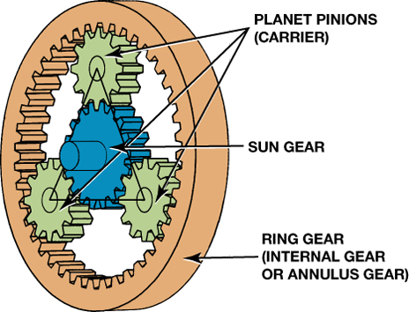
FIGURE 6–1 A typical planetary gear set showing the terms that are used to describe each member.

Slide 3
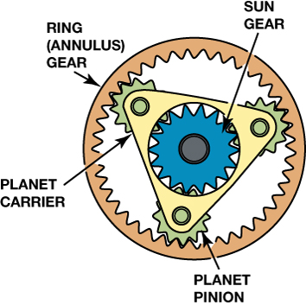
FIGURE 6–2 A typical planetary gear set showing the planet carrier which supports all of the pinion gears (also called planet pinion gears).

Slide 4
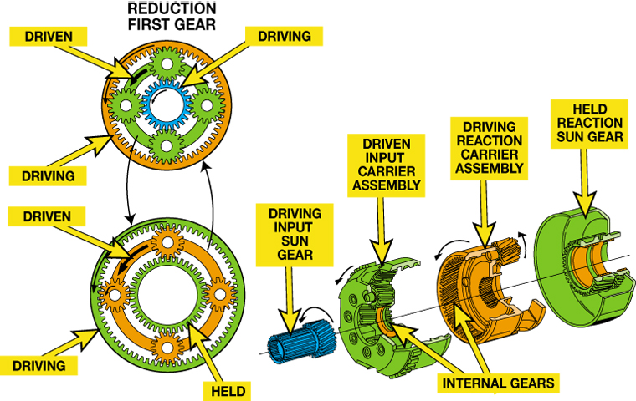
FIGURE 6–3 A typical planetary gear set showing the components and the action/reaction that occurs.

Slide 5
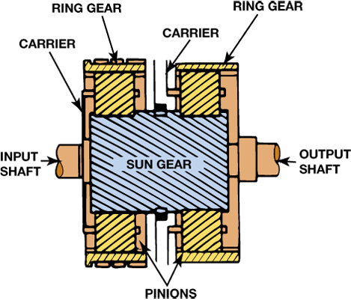
FIGURE 6–4 A Simpson planet gear set is composed of two ring gears and two planet carrier assemblies that share one sun gear.

Slide 6
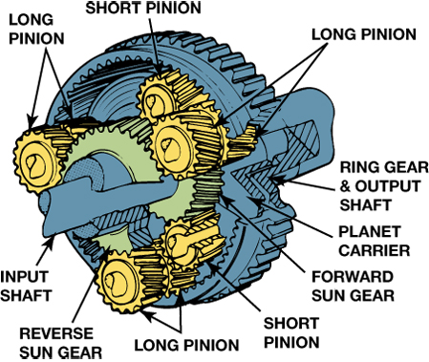
FIGURE 6–5 A Ravigneaux gear set is composed of two sun gears, one planet carrier that supports two sets of pinion gears, and a single ring gear.

Slide 7
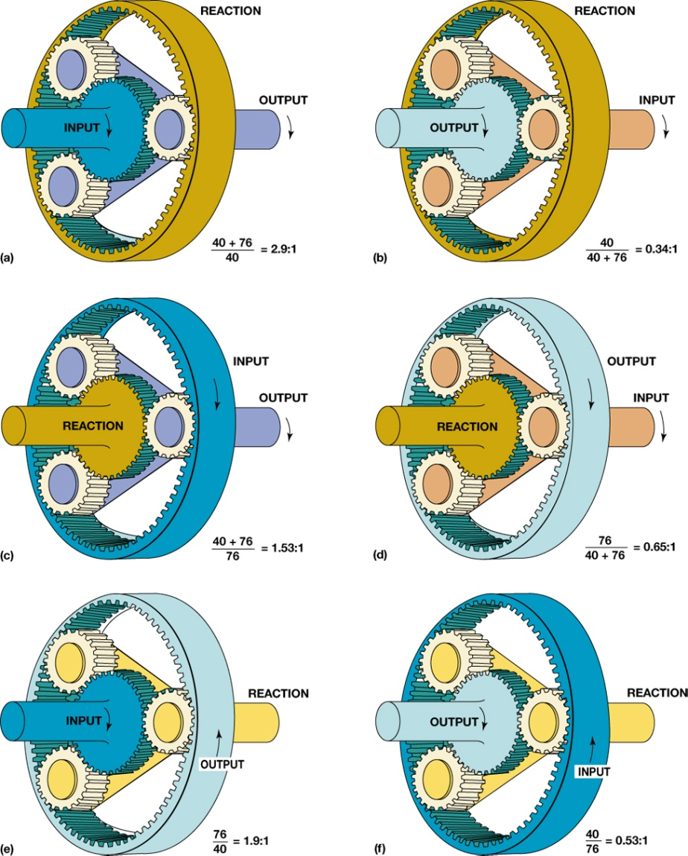
FIGURE 6–6 The gear ratio through a planetary gear set depends on which part is driven, which part is held, and which part is the output. The formula used to calculate the ratio is included with each illustration. Each gear set uses a 40-tooth sun gear and a 77-tooth ring gear.

Slide 8
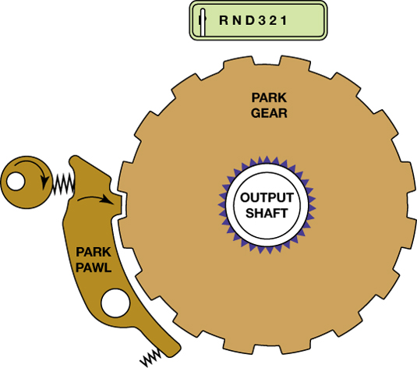
FIGURE 6–7 The parking pawl engages and locks the output shaft to the transmission case.

Slide 9
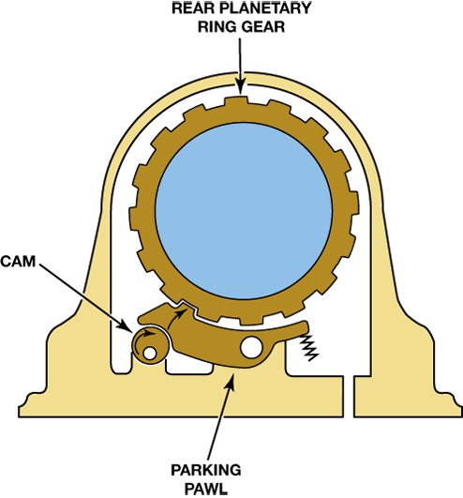
FIGURE 6–8 When the control rod is moved, the locking cam pushes the pawl into engagement with the parking gear.

Slide 10
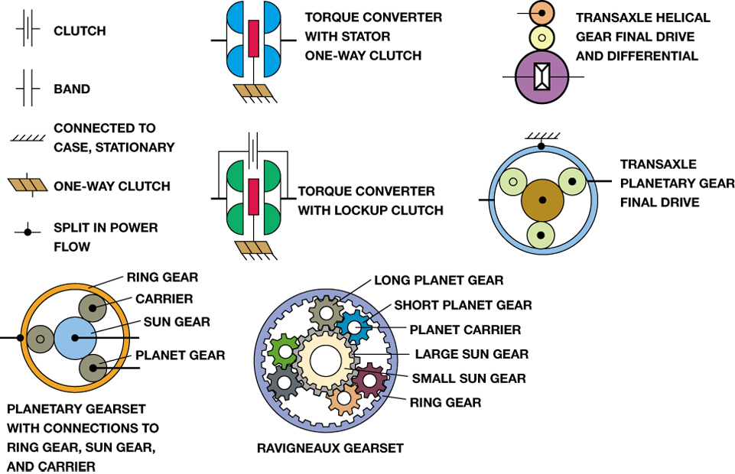
FIGURE 6–9 Common symbols used in the transmission schematics to illustrate the various parts.

Slide 11
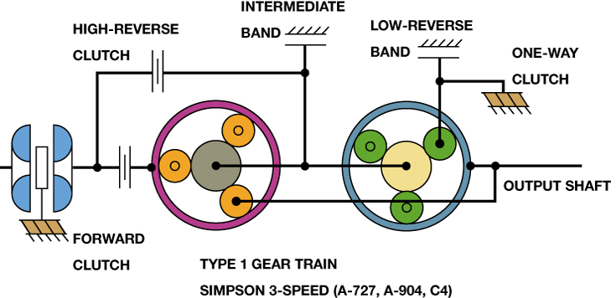
FIGURE 6–10 Type 1 gear set is a three-speed Simpson gear train that uses bands to hold the sun gear and reaction carrier. Note that the reaction carrier can also be held by a one-way clutch.

Slide 12
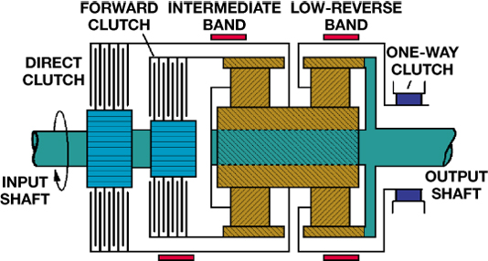
FIGURE 6–11 The one-way clutch of this type 1 gear set serves as the reaction member in first gear with the gear selector in Drive (D1). The low-reverse band is applied in manual first (M1) to allow engine compression braking.

Slide 13
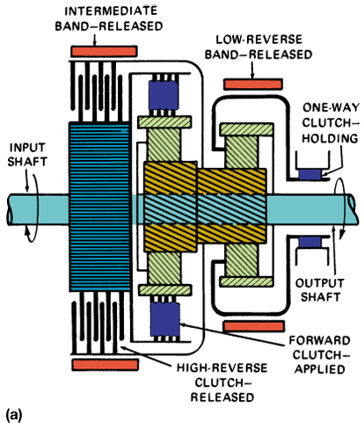
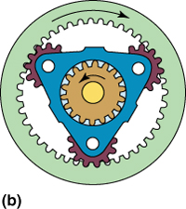
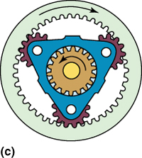
FIGURE 6–12 (a) In drive low (D1), the front ring gear is driven while the rear carrier is held by the one-way clutch. A reverse reduction occurs in both (b) the front unit and (c) the rear unit.

Slide 14
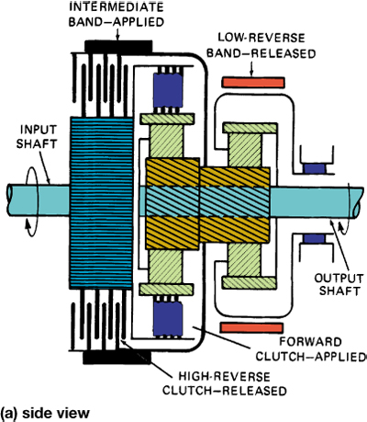
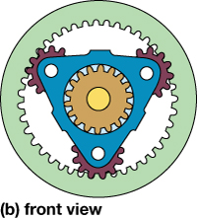
FIGURE 6–13 In second gear, the ring gear is driven while the sun gear is held, and the planet gears walk around the sun gear and force the carrier to revolve at a reduced speed.

Slide 15
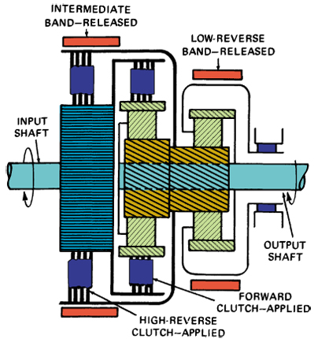
FIGURE 6–14 In third gear, both driving clutches are applied so two members (the ring and sun gears) of the same gear set are driven. This locks the gears and produces a 1:1 gear ratio.

Slide 16
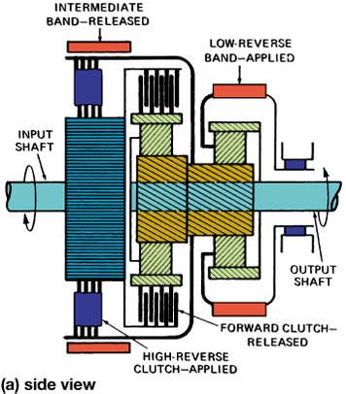
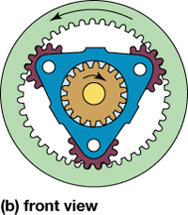
FIGURE 6–15 In reverse, the sun gear is driven while the carrier is held. The planet gears act as idlers and cause the ring gear to revolve in a reverse direction at a reduced speed.

Slide 17
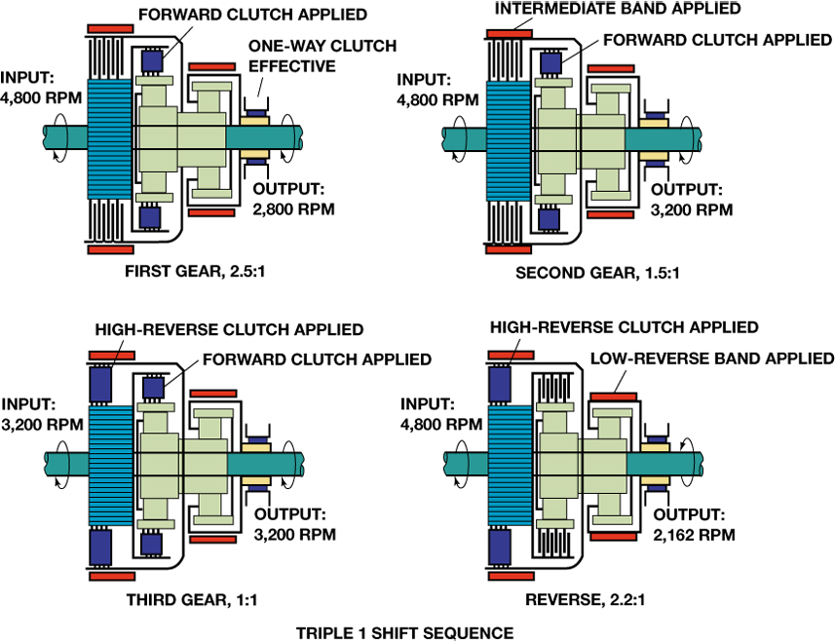
FIGURE 6–16 The full-throttle shift sequence for a type 1 transmission showing the apply devices and the output shaft speed at the 1–2 and 2–3 upshifts. Reverse is also shown.

Slide 18
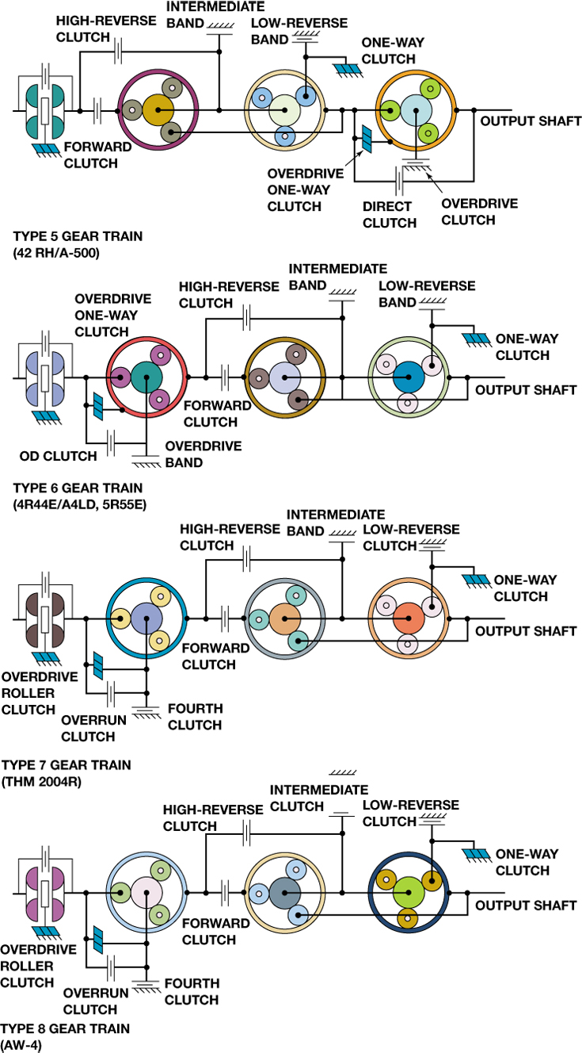
FIGURE 6–17 Types 5, 6, 7, and 8 gear sets illustrate the different four-speed gear train arrangements that combine a Simpson three-speed gear set with an overdrive unit.

Slide 19
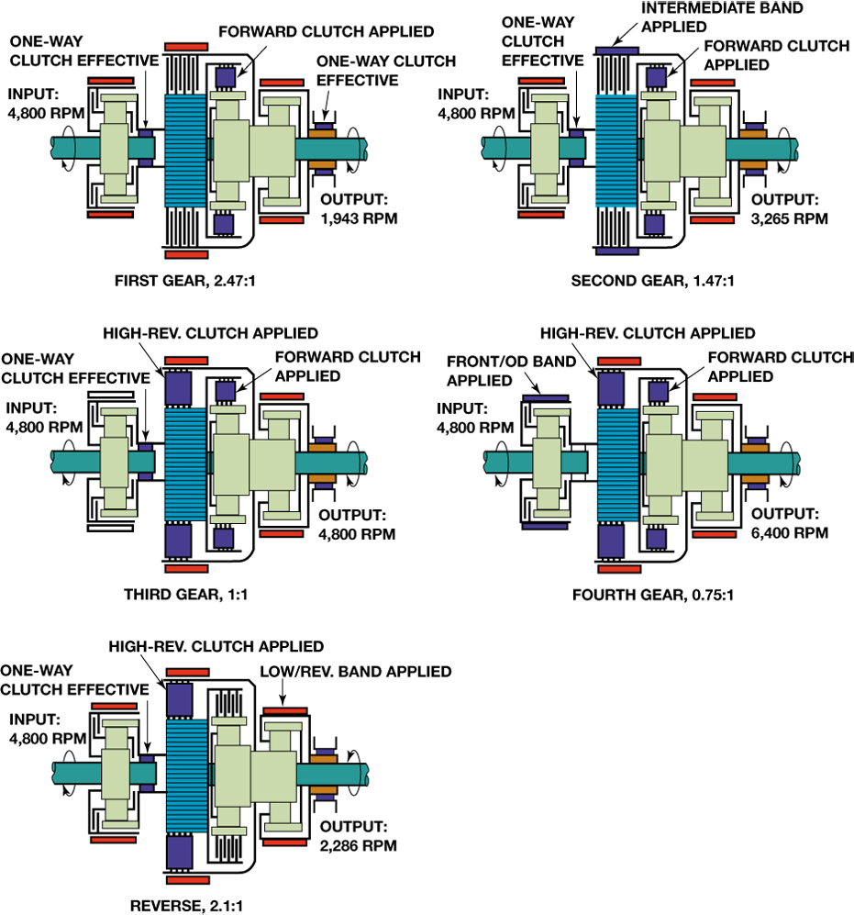
FIGURE 6–18 The full-throttle shift sequence for a type 6 transmission showing the apply devices and the output shaft speed at the 1–2, 2–3, and 3–4 upshifts, plus reverse.

Slide 20
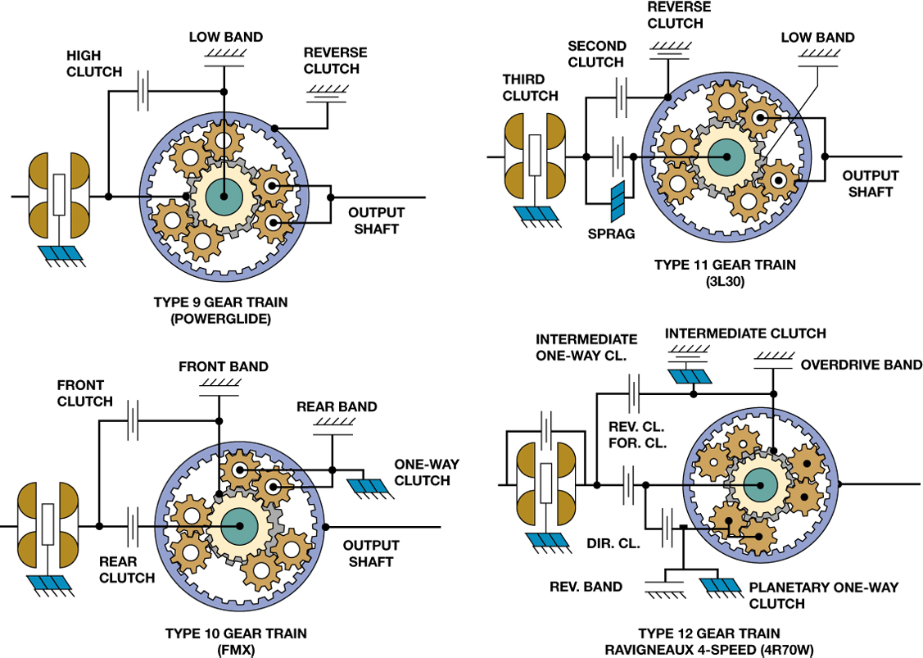
FIGURE 6–19 Types 9, 10, 11, and 12 gear sets illustrate the different three- and four-speed gear train arrangements that use a single Ravigneaux gear set.

Slide 21
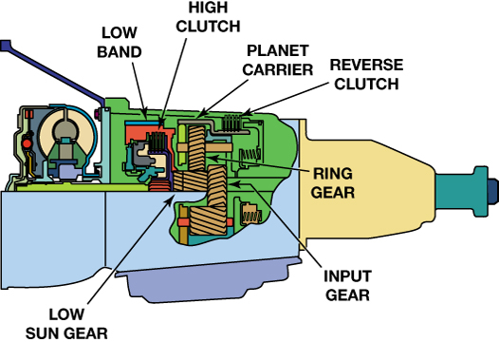
FIGURE 6–20 When a Powerglide is in low gear, the low band is applied to hold the low sun gear stationary. At this time, the long pinions will be driven by the input sun gear and walk around the low sun gear to drive the carrier.

Slide 22
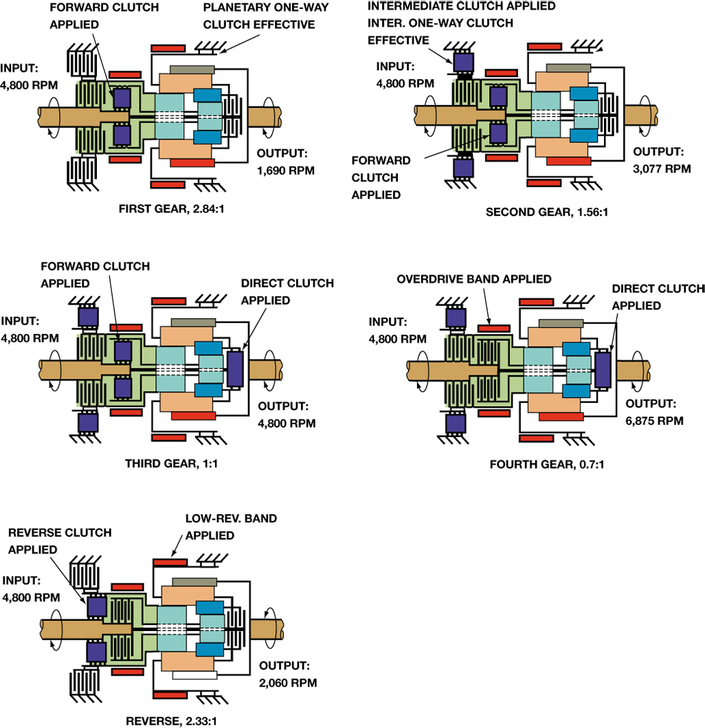
FIGURE 6–21 The full-throttle shift sequence for a type 12 transmission showing the apply devices and the output shaft speed at the 1–2, 2–3, and 3–4 upshifts and reverse.

Slide 23
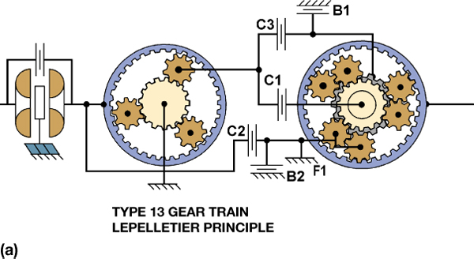
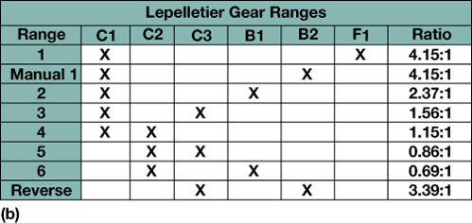
FIGURE 6–22 (a) A schematic view of a type 13, LePelletier six-speed gear set (b) and a clutch application chart.

Slide 24
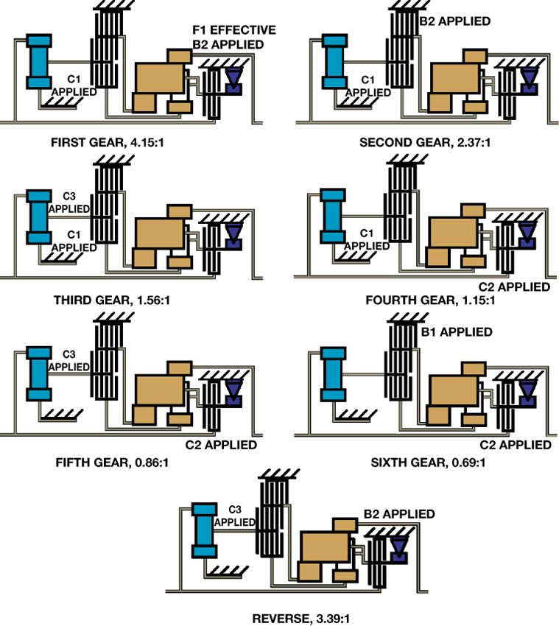
FIGURE 6–23 A type 13 shift sequence.

Slide 25
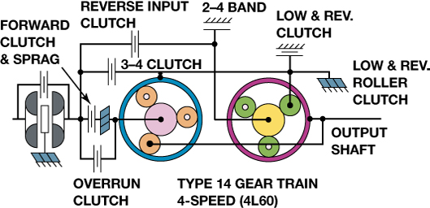
FIGURE 6–24 A schematic view of a type 14, GM 4L60-E four-speed gear set.

Slide 26
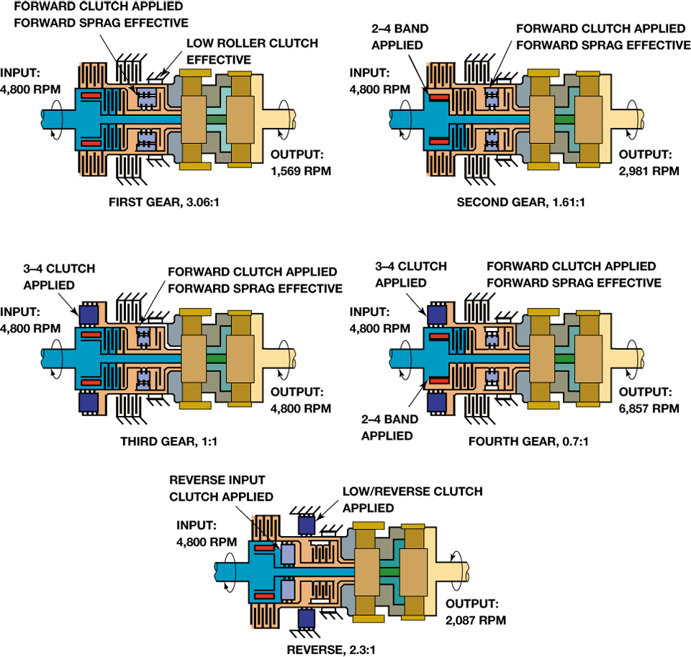
FIGURE 6–25 The full-throttle shift sequence for a type 14, 4L60 transmission showing the apply devices and the output shaft speed at the 1–2, 2–3, and 3–4 upshifts and reverse.

Slide 27
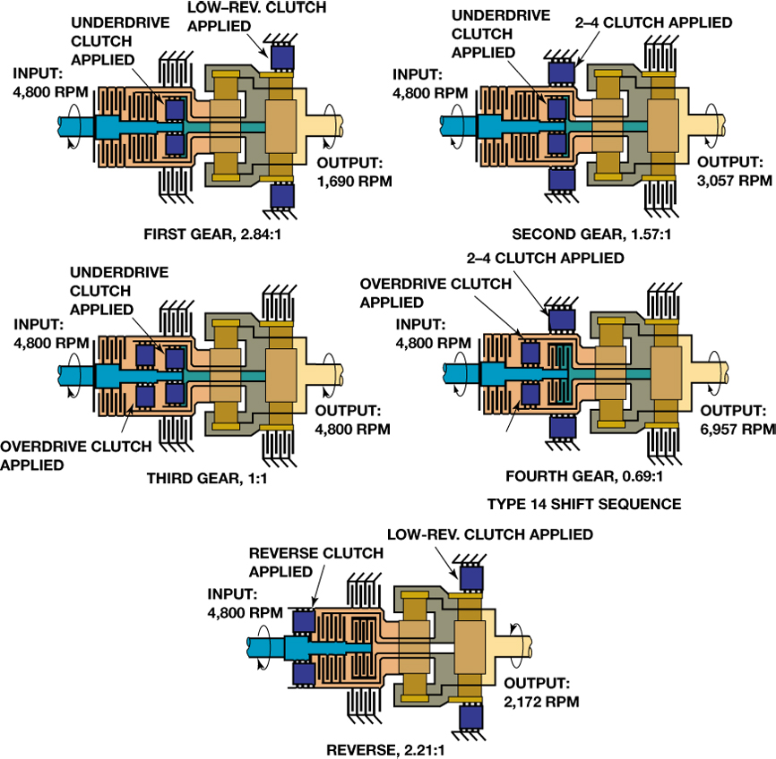
FIGURE 6–26 The full-throttle shift sequence for a type 15, 41TE transmission showing the apply devices and the output shaft speed at the 1–2, 2–3, and 3–4 upshifts and reverse.

Slide 28
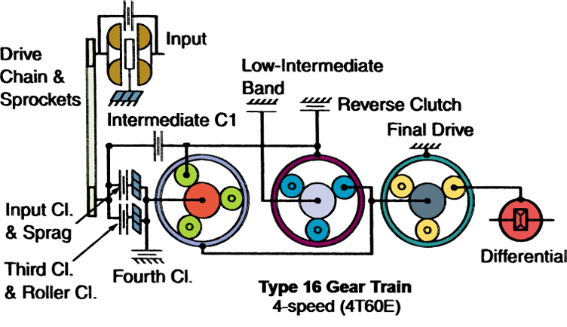
FIGURE 6–27 A schematic view of a type 16, GM 4T60 four-speed gear set. The Ford AX4N gear set is similar.

Slide 29
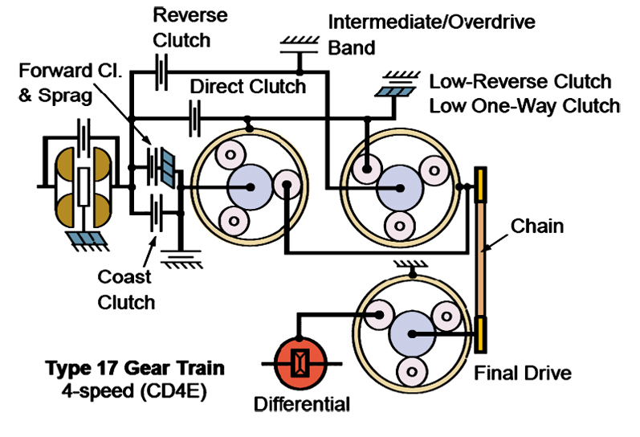
FIGURE 6–28 A schematic view of a type 17, Ford CD4E four-speed gear set.

Slide 30
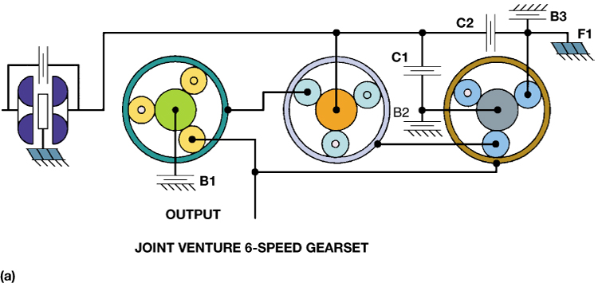
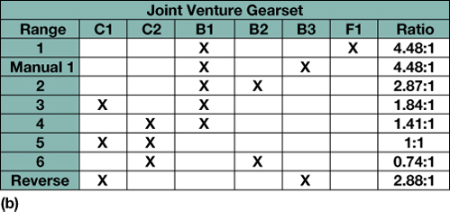
FIGURE 6–29 (a) A schematic view of (a) a type 18, joint venture six-speed gear set and (b) a clutch application chart.

Slide 31
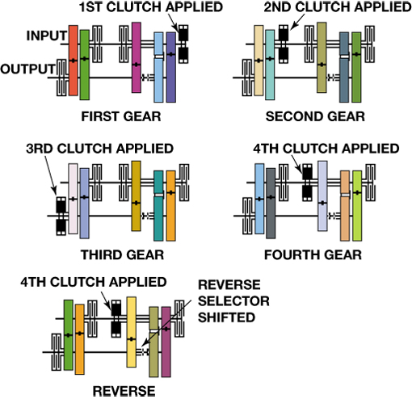
FIGURE 6–30 The shift sequence for a type 19, four-speed transmission showing the apply devices.

