Slide 1
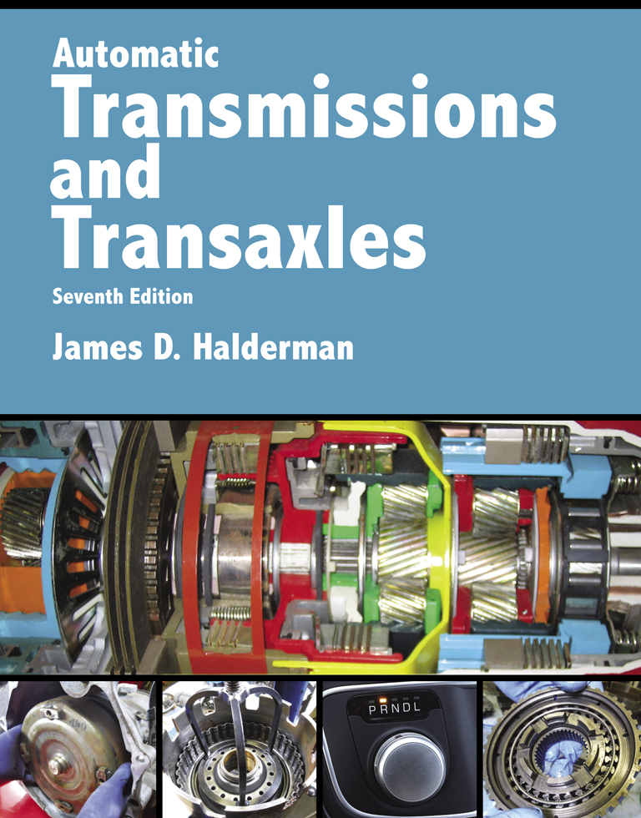
Automatic Transmissions and Transaxles
Seventh Edition
Chapter 5
Torque Converters

Slide 2
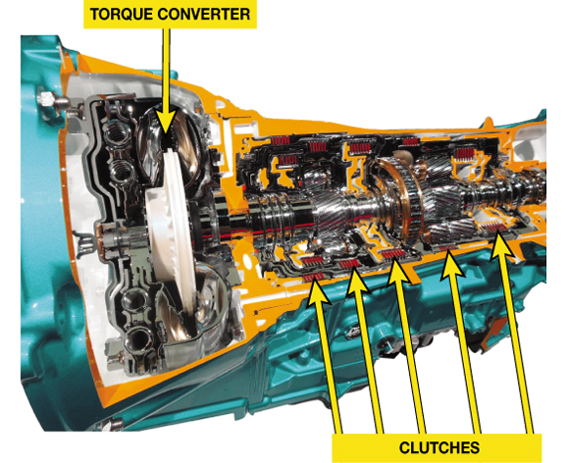
FIGURE 5–1 A cutaway of an eight speed automatic transmission showing the torque converter and the clutches needed to engage all eight forward speeds, plus reverse.

Slide 3
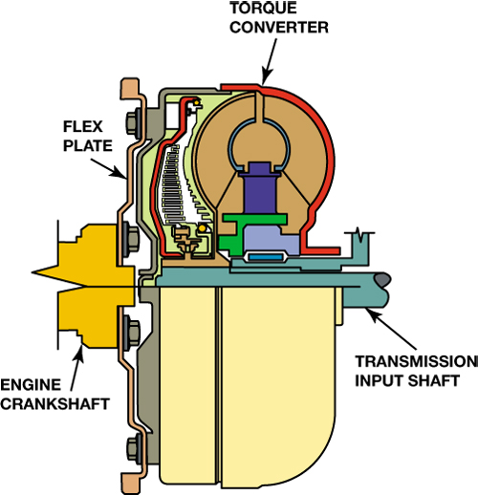
FIGURE 5–2 The torque converter bolts to the flexplate which is attached to the engine crankshaft and rotates at engine speed.

Slide 4
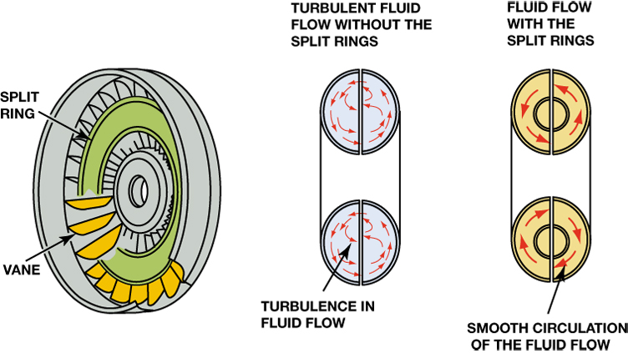
FIGURE 5–3 The split rings in the impeller and turbine help to direct the flow of fluid and improve the efficiency of the torque converter by reducing turbulence.

Slide 5
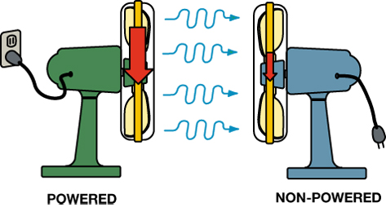
FIGURE 5–4 Two fans can be used to show how fluid, or air in the case of fans instead of automatic transmission fluid, can be used to transfer energy. If one fan is operating, which represents the impeller, the blades of a second fan (turbine) will be rotated by the flow of air past the fan that is unplugged, causing the blades to rotate.

Slide 6
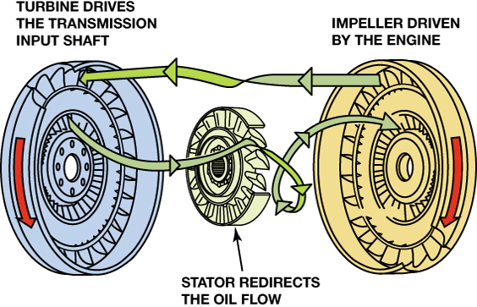
FIGURE 5–5 A torque converter is made from three parts: The impeller is located at the transmission end, attached to the housing, and is driven by the engine. The turbine is located at the engine side and is driven by the fluid flow from the impeller and drives the input shaft of the transmission. The stator redirects the flow to improve efficiency and multiply torque.

Slide 7
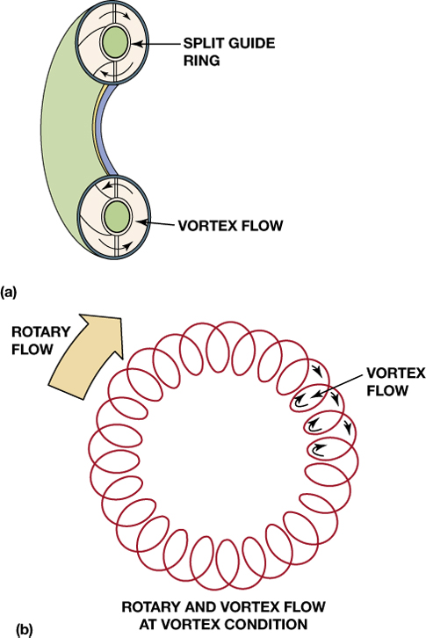
FIGURE 5–6 (a) The fluid flowing around the guide ring is called vortex flow. (b) The fluid flow around the converter is called rotary flow.

Slide 8
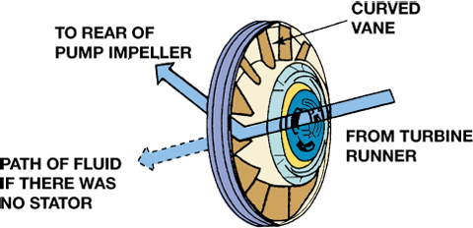
FIGURE 5–7 The fluid flow from the turbine is turned in the same direction as the impeller by the stator vanes.

Slide 9
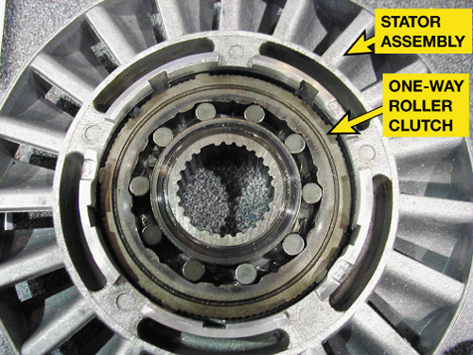
FIGURE 5–8 A stator contains a one-way roller clutch which locks it from rotating in one direction and allows it to rotate freely in the opposite direction.

Slide 10
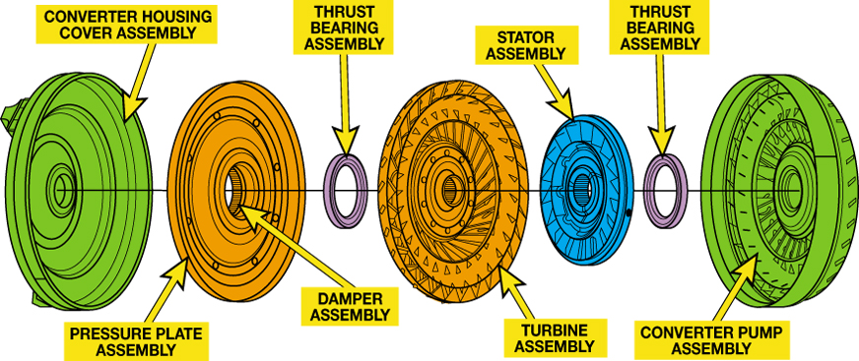
FIGURE 5–9 An expanded view of a typical torque converter assembly showing the torque converter clutch (TCC).

Slide 11
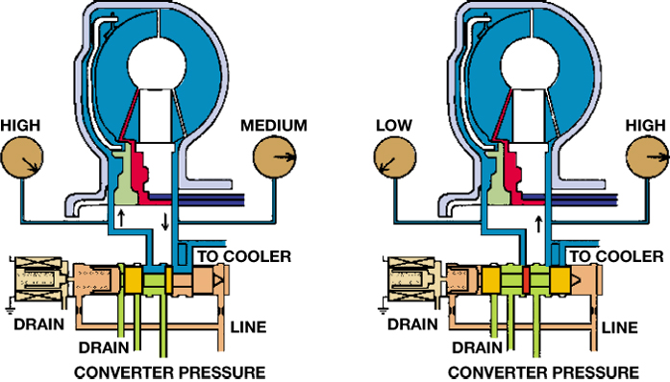
FIGURE 5–10 TCC releases fluid flows through the center of the turbine shaft to the front of the clutch disc (left). Pressure to apply the clutch enters between the converter hub and the stator support (right).

Slide 12
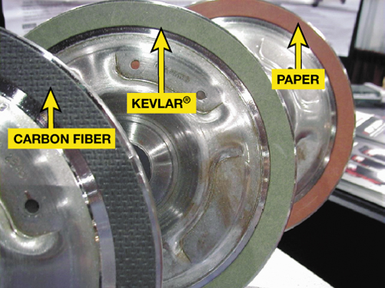
FIGURE 5–11 Torque converter clutch friction material is determined by the vehicle manufacturer to provide the needed coefficient of friction. For example, many older units use a paper-type friction material because they are fully applied or released, whereas most newer units use a synthetic material such as Kevlar® or carbon fiber because the torque converter clutch is pulsed on and off, therefore requiring a more robust material for long service life.

Slide 13
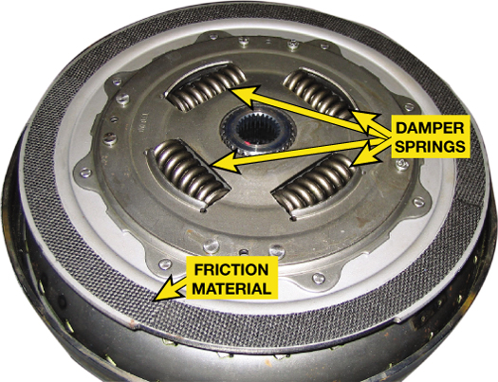
FIGURE 5–12 The damper springs used in many torque converter clutches are similar to the damper springs used in clutch discs used with a manual transmission.

Slide 14
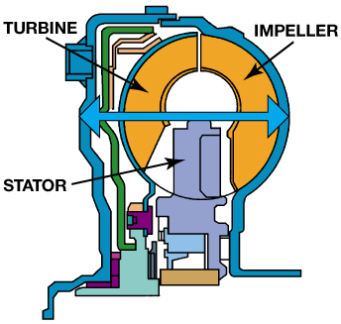
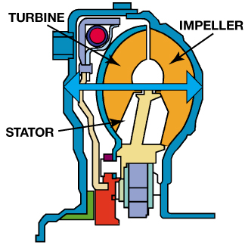
FIGURE 5–13 Most torque converters have a round cross section (top). Some new transmissions use a shorter, elliptical, squashed converter (bottom) that is about 13% shorter than a round style.

Slide 15
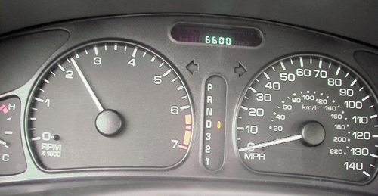
FIGURE 5–14 This 4-cylinder General Motors vehicle has a stall speed of about 2350 RPM. Notice that the gear selector is in drive and the speedometer is reading zero.

Slide 16
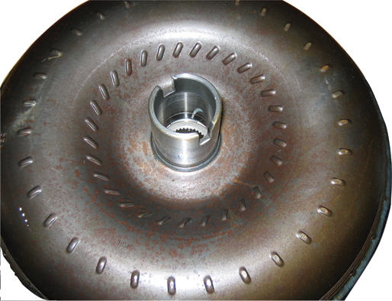
FIGURE 5–15 Visually check the pump drive notches or tangs for damage and the hub sealing surface for wear.

Slide 17
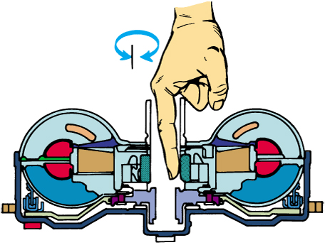
FIGURE 5–16 A stator clutch can be checked by reaching into the hub so a finger contacts the splines. The splines should rotate in one direction but not in the other.

Slide 18
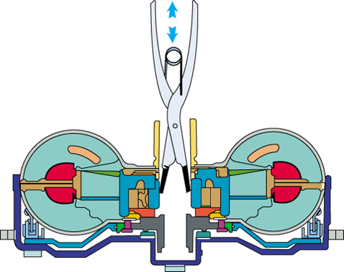
FIGURE 5–17 A quick end-play check can be made by gripping the turbine or stator splines and trying to move the turbine or stator in and out.

Slide 19
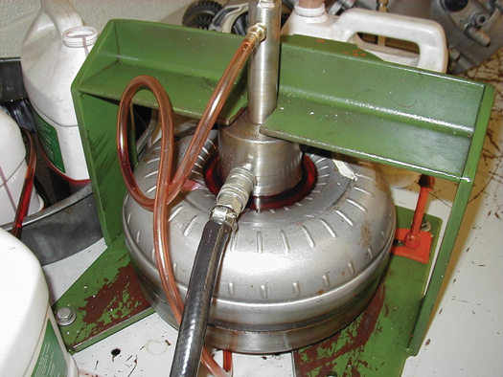
FIGURE 5–18 A leak-test fixture has been placed on the torque converter. It will be filled with ATF and then inspected for leaks.

Slide 20
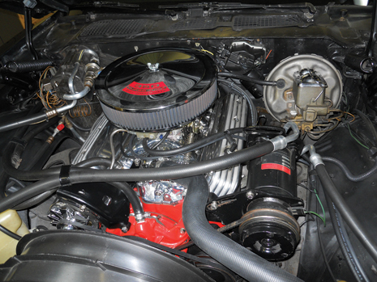
1 A restored 1971 Chevrolet Camaro has an aftermarket high-lift camshaft and does not idle correctly in drive with the stock torque converter.

Slide 21
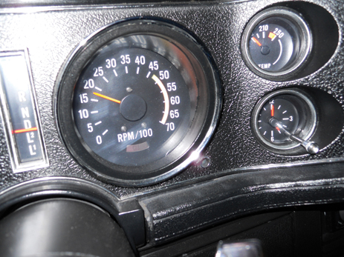
2 The stall speed of the stock torque converter was tested at 1850 RPM, which is normal for a stock engine but not for an engine equipped with a high-performance camshaft.

Slide 22
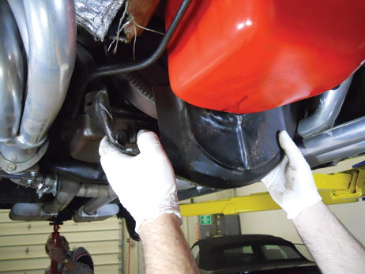
3 The inspection cover is removed.

Slide 23
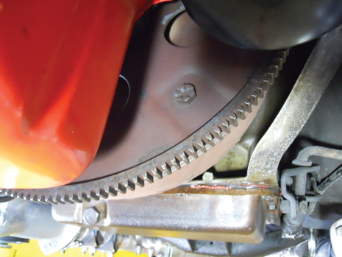
4 The torque converter retaining bolts are removed requiring the engine be rotated using a flywheel turning tool.

Slide 24
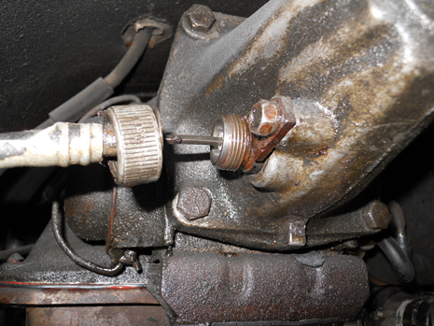
5 The speedometer cable was removed.

Slide 25
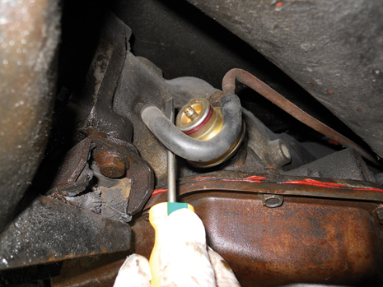
6 The vacuum hose to the modulator valve was removed.

Slide 26
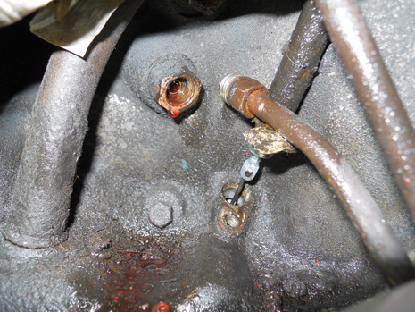
7 The cooling lines and the dip stick tube are removed.

Slide 27
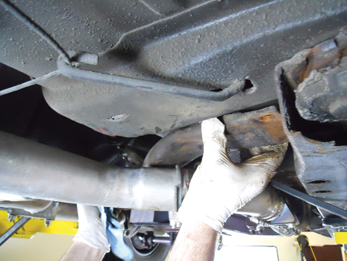
8 After removing the driveshaft, the cross member was unbolted and removed after supporting the transmission using a transmission jack.

Slide 28
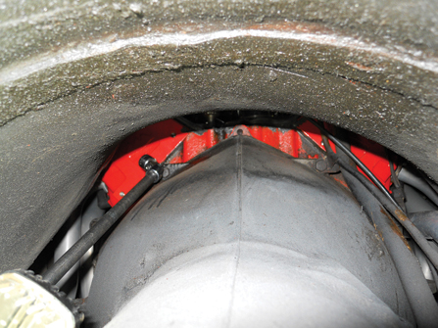
9 The bell housing bolts were removed using a long extension and a swivel socket.

Slide 29
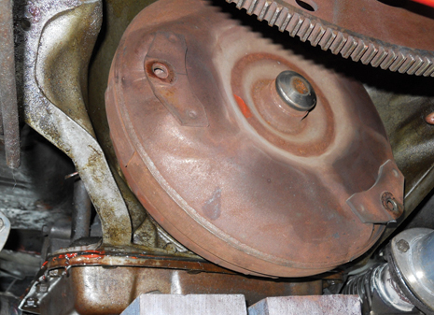
10 The transmission is removed from the engine with the torque converter still in place.

Slide 30
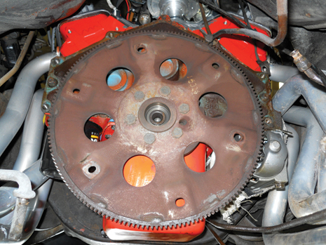
11 The flexplate was inspected for cracks or worn ring gear teeth and found to be normal.

Slide 31
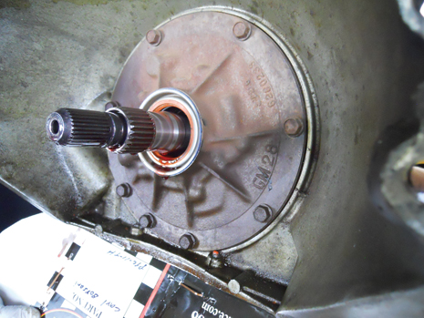
12 The torque converter was removed and the front seal was found to be leaking. All seals were replaced on this transmission before it was returned to the customer.

Slide 32
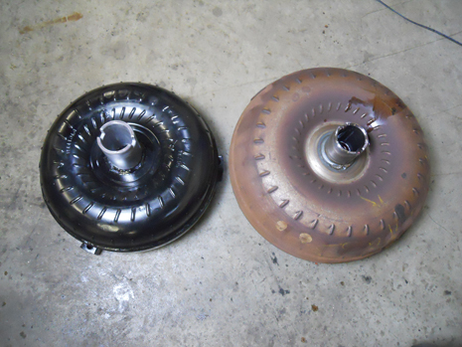
13 The new replacement higher stall speed converter is on the left, which is noticeably smaller in diameter than the stock converter

Slide 33
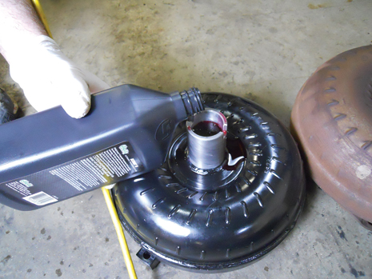
14 The new torque converter is filled with ATF before being installed.

Slide 34
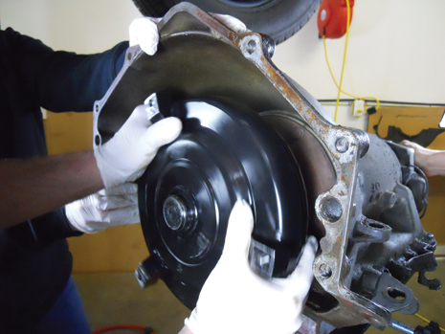
15 The torque converter is wiggled back and forth to ensure that all of the splines are engaged.

Slide 35
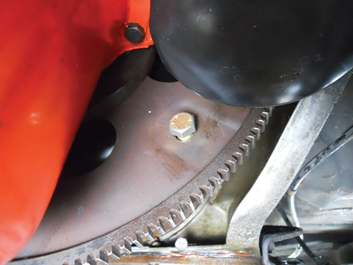
16 The holes in the flexplate were enlarged so that the new larger torque converter bolts would fit.

Slide 36
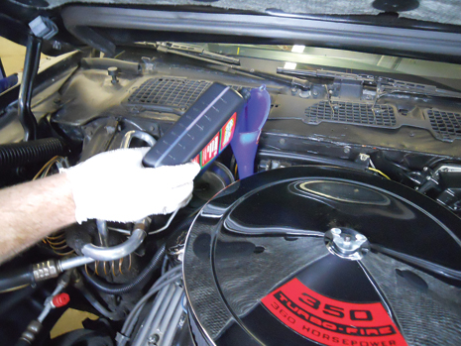
17 The transmission was installed and all parts reconnected, then the transmission was filled to the proper level with the specified ATF.

Slide 37
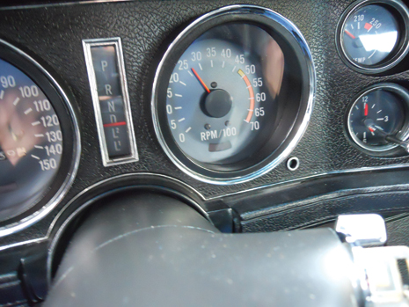
18 The stall speed was retested and the new converter is 2350 RPM, which worked well for this engine. The customer was very happy with the results.

