Slide 1
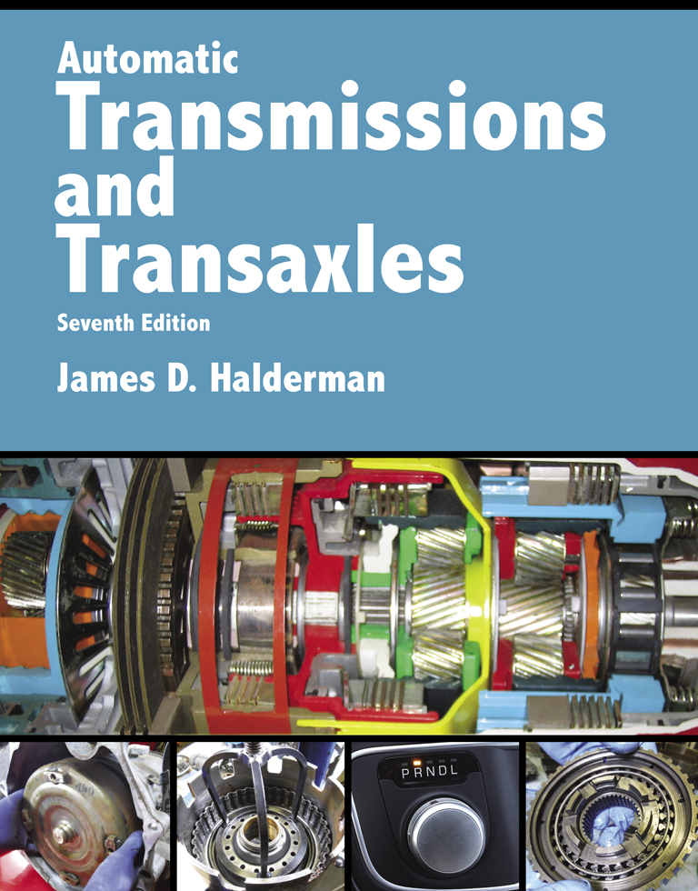
Automatic Transmissions and Transaxles
Seventh Edition
Chapter 4
Hydraulic Control Valves and Solenoids

Slide 2
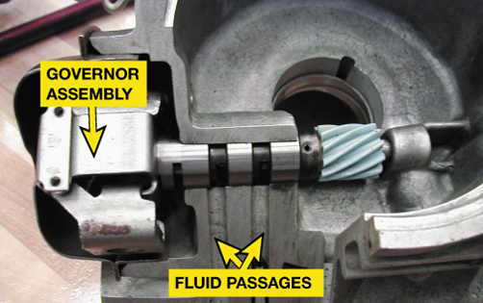
FIGURE 4–1 A governor assembly is used on older hydraulically controlled automatic transmissions/transaxles to control shift points based on vehicle speed.

Slide 3
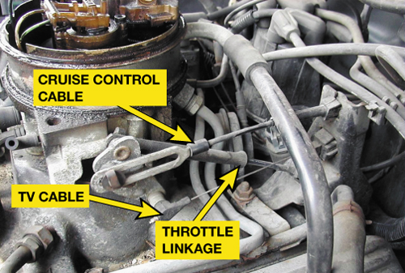
FIGURE 4–2 The throttle valve (TV) cable on a 4L60 transmission.

Slide 4
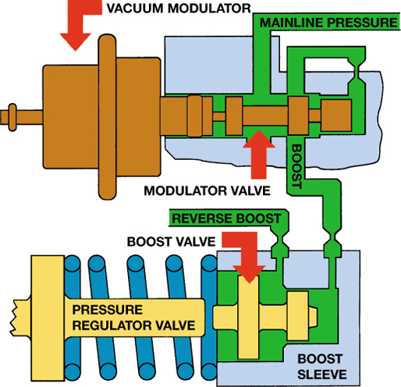
FIGURE 4–3 A vacuum modulator moves the modulator valve depending on the vacuum of the engine. A heavy load on the engine causes the vacuum to be lower than when the engine is operating under a light load. The spool valve applies mainline pressure to the boost sleeve of the pressure regulator valve, which causes the mainline pressure to increase.

Slide 5
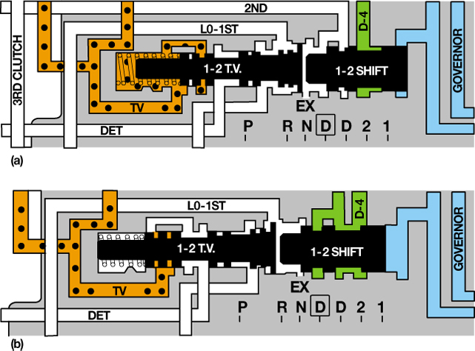
FIGURE 4–4 (a) As the speed increases, governor pressure increases and is applied to the 1–2 shift valve. (b) When the 1–2 shift valve moves, the fluid is directed to 2nd clutch and the shift is completed.

Slide 6
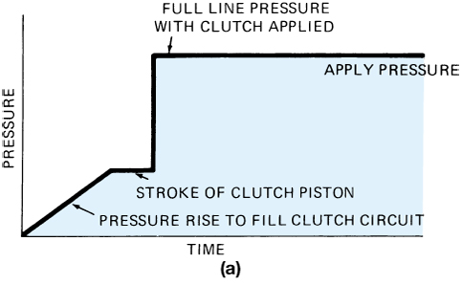
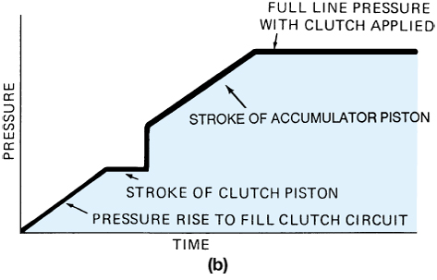
FIGURE 4–5 (a) When a clutch applies, fluid pressure rises gradually until the circuit is filled and the piston strokes to take up the clearance; then there is a rapid increase to line pressure. (b) An accumulator can be placed into the circuit to slow this pressure rise and soften clutch application.

Slide 7
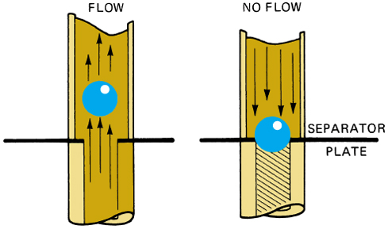
FIGURE 4–6 A check valve is opened by fluid flow in one direction (left) and closes when the fluid tries to flow in the reverse direction.

Slide 8
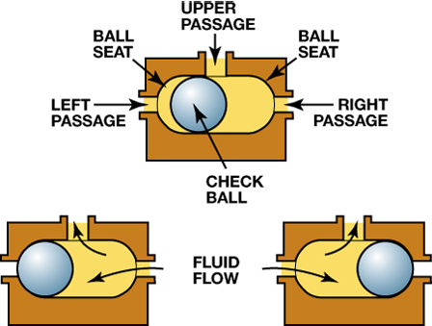
FIGURE 4–7 Check balls are used in the valve body to allow hydraulic circuits to share a common passage.

Slide 9
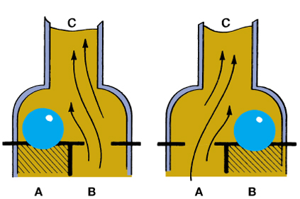
FIGURE 4–8 When fluid flows through this shuttle valve from port B to port C, the check ball moves over to close port A (left). Fluid flow from port A will close port B (right).

Slide 10
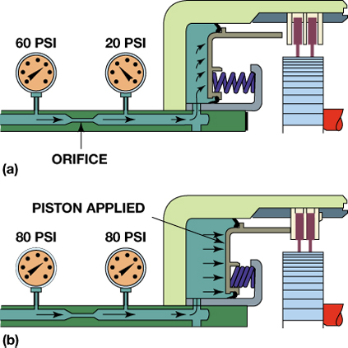
FIGURE 4–9 (a) An orifice will cause a pressure drop as fluid flows through; (b) when the flow stops, the pressure on both sides of the orifice will be the same.

Slide 11
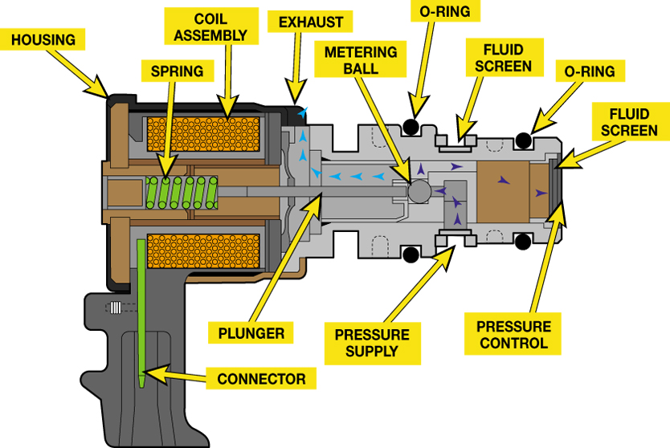
FIGURE 4–10 A typical automatic transmission solenoid showing the coil assembly where the magnetic field and the metering ball and plunger that works against the force of the spring.

Slide 12
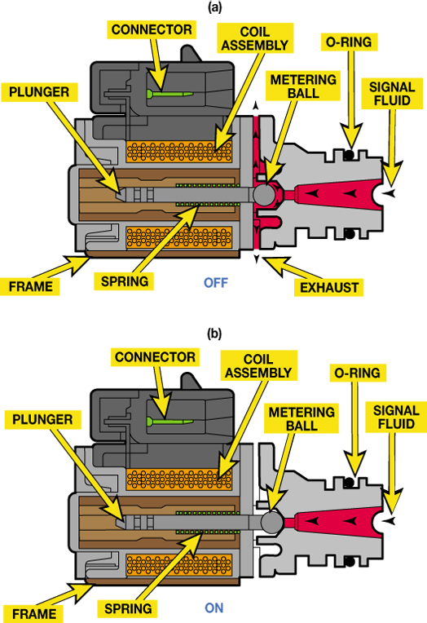
FIGURE 4–11 (a) In this example, the solenoid is commanded off, metering ball is off its seat and allows fluid to flow. (b) When the solenoid is on, the metering ball is seated preventing fluid flow.

Slide 13
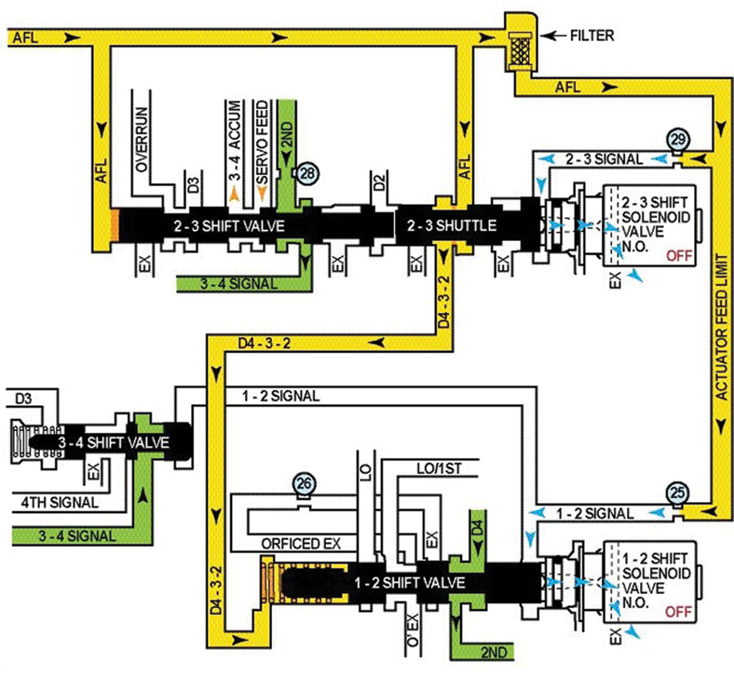
FIGURE 4–12 Shift solenoids are commanded on and off by the PCM/TCM as needed to make a shift.

Slide 14
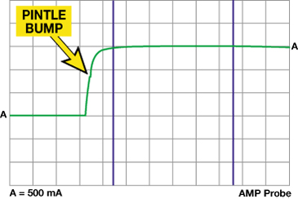
FIGURE 4–13 A scope waveform showing the opening of a solenoid using a current clamp around the solenoid feed wire. The hump is created when the core of the solenoid moves which creates a slight counter electromotive force (EMF) causing the slight hump in the current waveform.

Slide 15
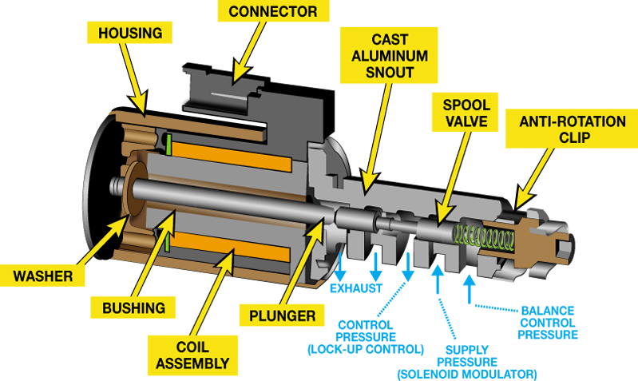
FIGURE 4–14 A linear solenoid is pulse-width modulated plus the spool valve moves in proportion to the pulse-width signal form the PCM/TCM.

Slide 16
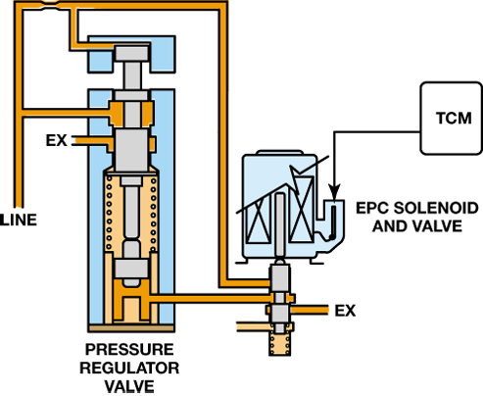
FIGURE 4–15 The TCM controls the EPC solenoid to change the pressure regulator valve to adjust line pressure.

Slide 17
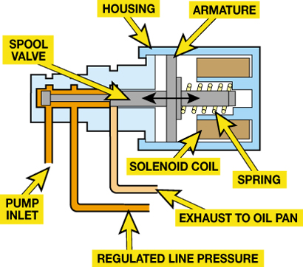
FIGURE 4–16 The pressure control solenoid controls the mainline pressure, which is in turn controlled by the powertrain control module (PCM) or the transmission control module (TCM), by applying pressure to the spring side of the pressure regulator valve.

Slide 18
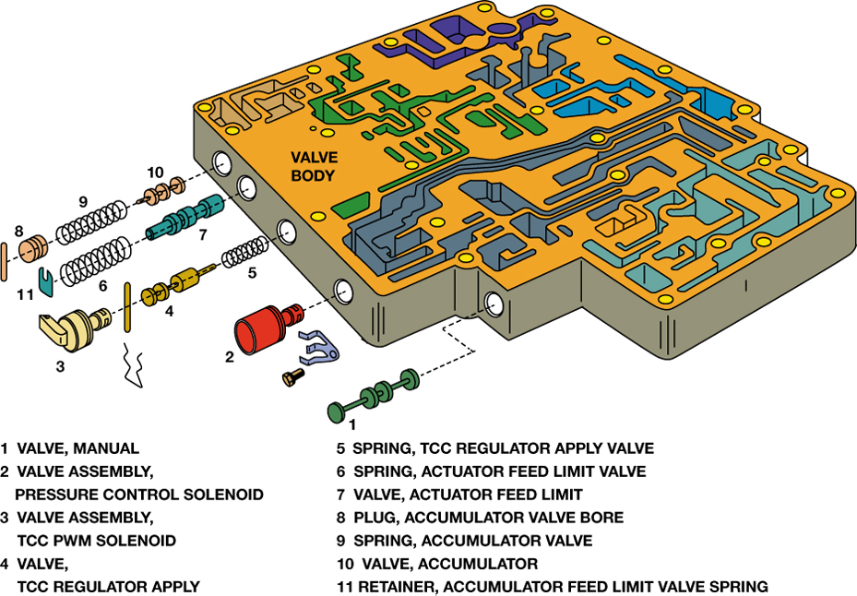
FIGURE 4–17 A typical valve body showing some of the valves and solenoids as well as the clips and pins used to retain the parts in the valve body.

