Slide 1
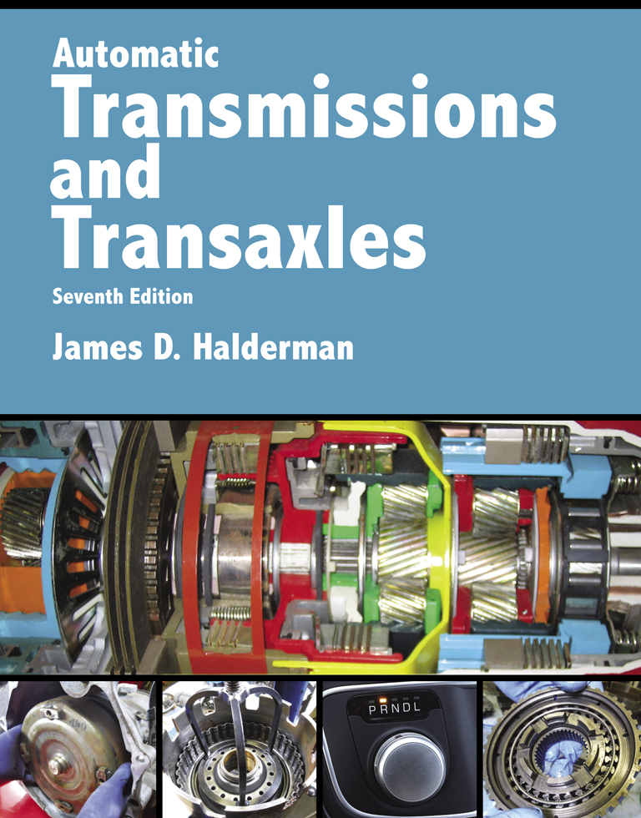
Automatic Transmissions and Transaxles
Seventh Edition
Chapter 3
Automatic Transmission/ Transaxle Hydraulic System

Slide 2
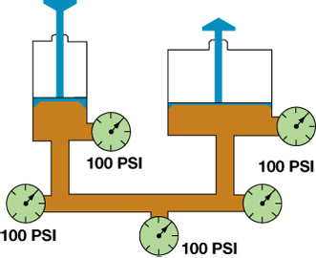
FIGURE 3–1 Fluid pressure is transmitted undiminished in all directions. Note that the pressure is equal throughout the system.

Slide 3
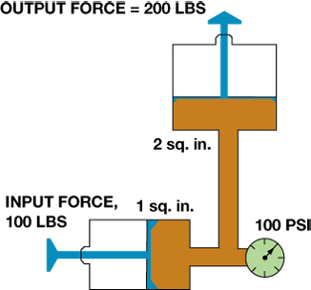
FIGURE 3–2 A 100 lb force applied on an input piston that has an area of 1 sq. in. will produce a fluid pressure of 100 PSI.

Slide 4
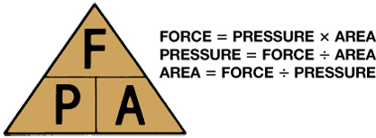
FIGURE 3–3 A simple memory triangle can be used to help remember the commonly used hydraulic formulas.

Slide 5
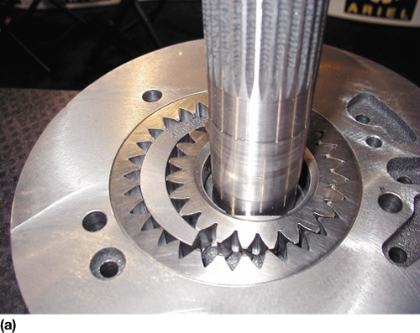
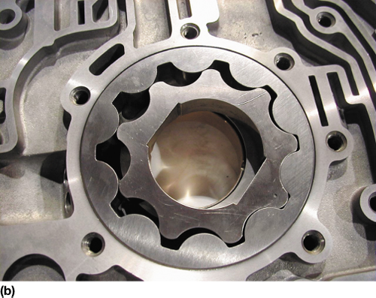
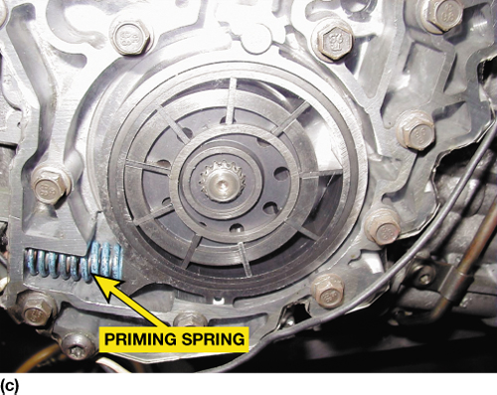
FIGURE 3–4 (a) Gear-type pump. (b) Gerotor-type pump. (c) Vane-type pump.

Slide 6
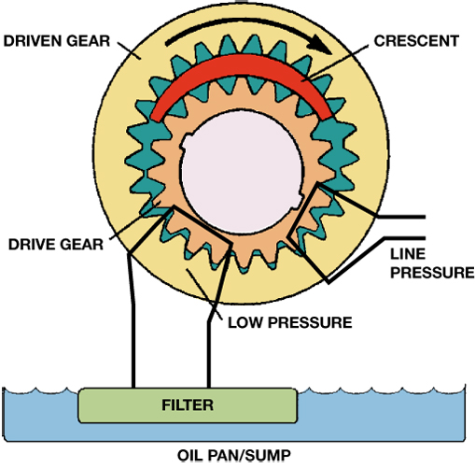
FIGURE 3–5 As a pump rotates, a low pressure (vacuum) is created as the pumping members move apart in one area, and atmospheric pressure will force fluid into this area. Pressure is created where the pumping members move together.

Slide 7
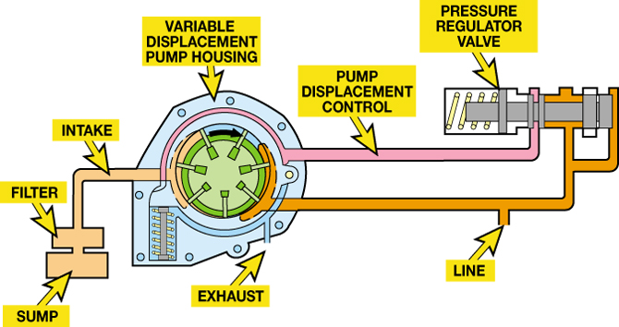
FIGURE 3–6 A variable displacement vane-type pump. The slide is moved to the high output position by a spring and decreased pressure comes from the pressure regulator valve.

Slide 8
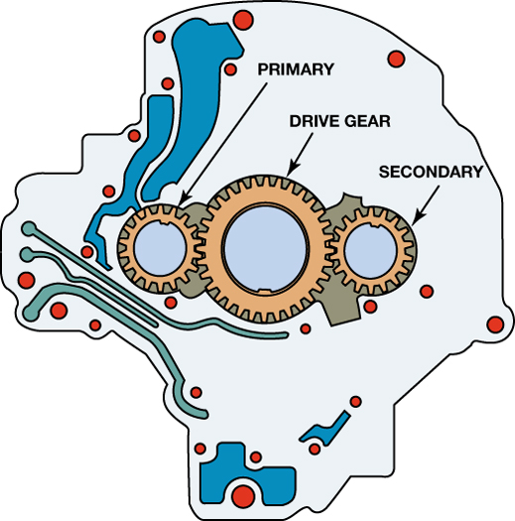
FIGURE 3–7 A dual-stage, external gear pump. Both stages are used at low engine speeds to produce enough fluid for the transmission’s needs. At higher engine speeds, the output of the secondary stage is vented.

Slide 9
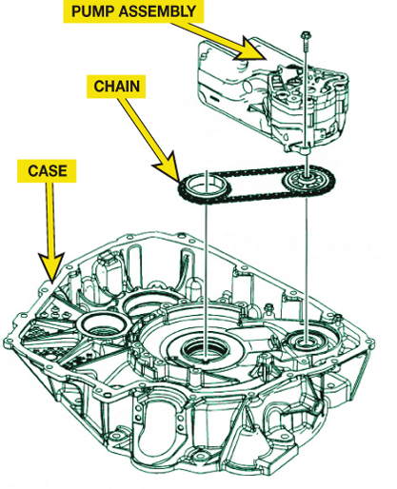
FIGURE 3–8 A chain-driven pump allows the transaxle to be shorter compared to a conventional pump that is driven by the torque converter.

Slide 10
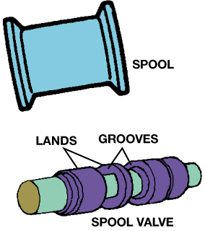
FIGURE 3–9 A spool valve resembles a spool for thread (top).

Slide 11
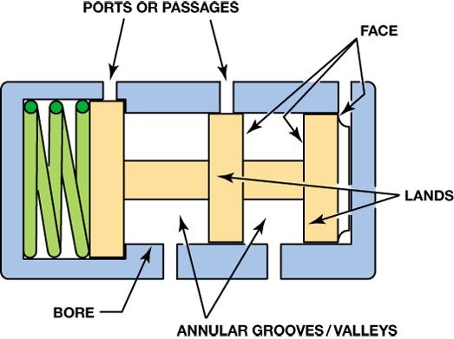
FIGURE 3–10 A spool valve and its bore. Note the names of the various parts.

Slide 12
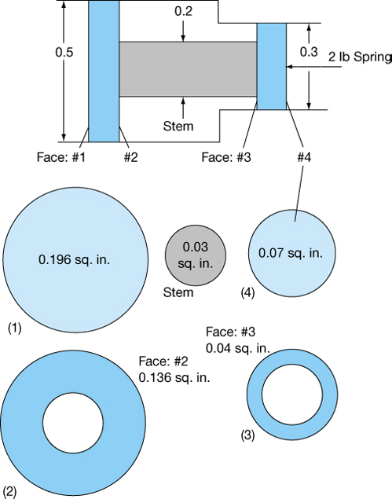
FIGURE 3–11 This valve spool has four possible hydraulic reaction faces. The areas are calculated like those of any other circular surface using the formula πr².

Slide 13
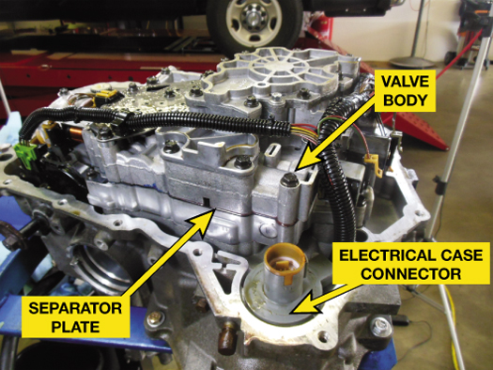
FIGURE 3–12 A typical valve body as installed on a GM 4T65-E transaxle.

Slide 14
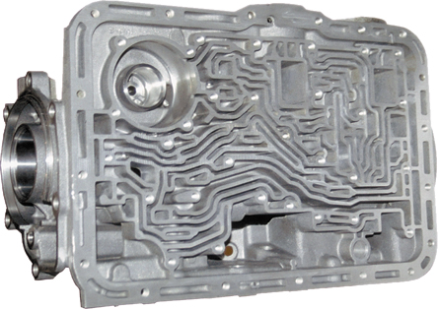
FIGURE 3–13 A typical upper valve body showing the fluid passages (“worm holes”).

Slide 15
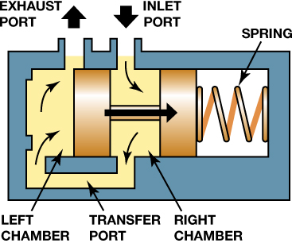
FIGURE 3–14 When pressure on the face of the pressure regulator valve overcomes spring force, the valve moves to open the exhaust port.

Slide 16
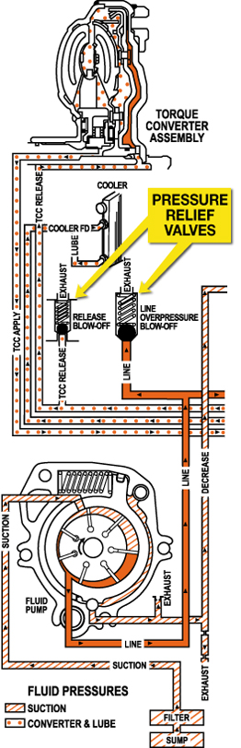
FIGURE 3–15 Typical pressure relief valves as found in the pump circuit.

Slide 17
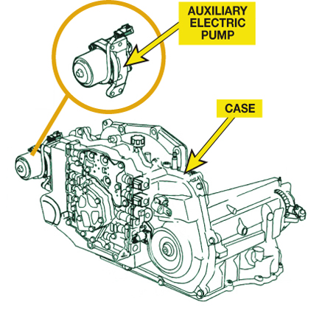
FIGURE 3–16 A GM 4T45-E uses an auxiliary electric pump to maintain hydraulic pressure when the engine stops during a stop-start event.

Slide 18
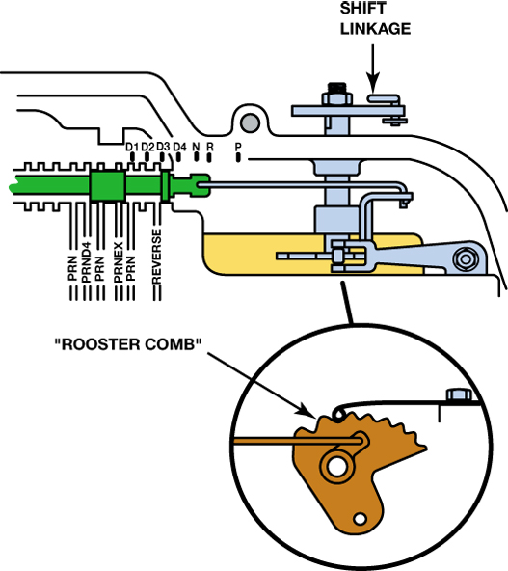
FIGURE 3–17 A rooster comb is the detent that helps retain the manual valve in the various positions in the valve body.

Slide 19
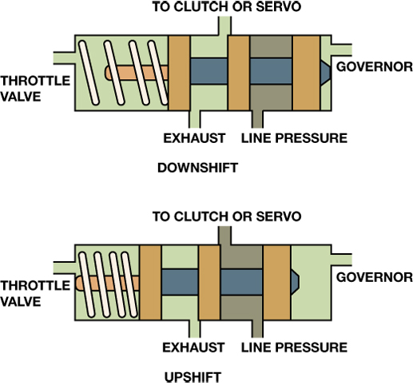
FIGURE 3–18 A typical shift valve has a spring to move the valve to a downshift position where the throttle pressure works with this spring. When governor pressure gets high enough, the valve will move to an upshift position.

Slide 20
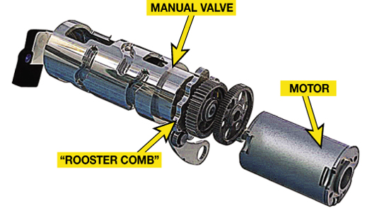
FIGURE 3–19 Some automatic transmissions, such as this VW/Audi unit use an electric motor to move the manual valve inside the transaxles itself. Other vehicles use an external actuator to move the manual valve. Check service information for the exact method used on the vehicle being serviced.

Slide 21
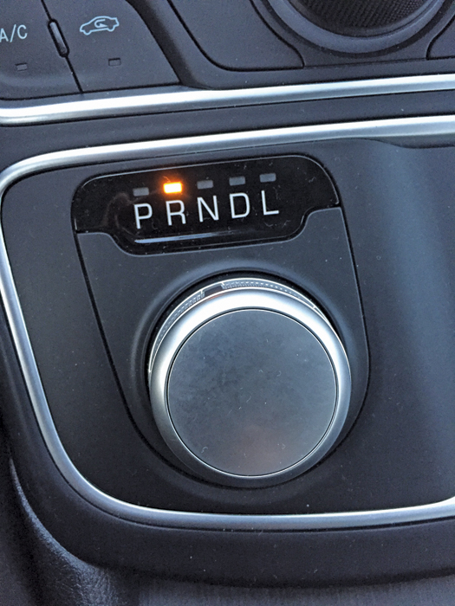
FIGURE 3–20 A rotary knob type electronic shifter used on a Chrysler 200.

Slide 22
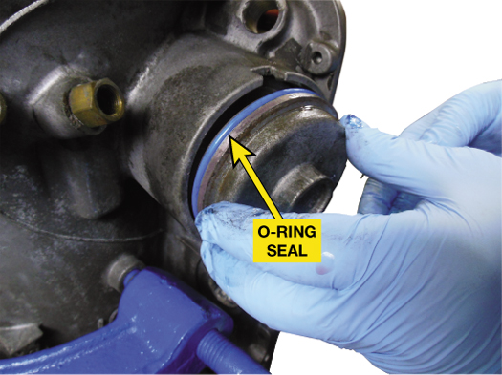
FIGURE 3–21 A new O-ring seal being installed on a cover.

Slide 23
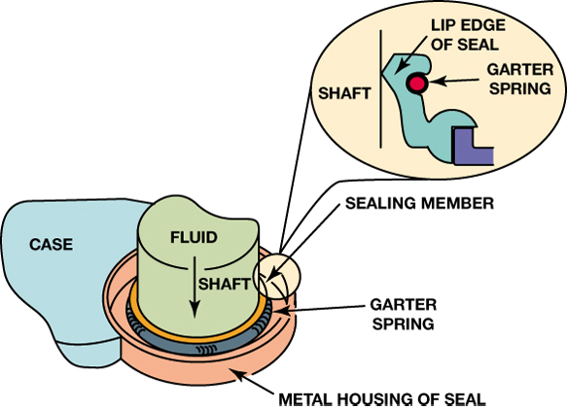
FIGURE 3–22 The sealing member of a metal-clad lip seal makes a dynamic seal with the rotating shaft while the metal case forms a static seal with the transmission case.

Slide 24
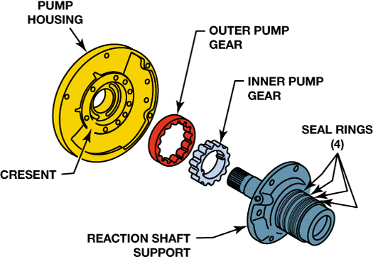
FIGURE 3–23 Sealing rings are used to seal the passages between stationary and rotating members. For example, the seal rings at the right keep the fluid flow from the pump to the front clutch from escaping.

Slide 25
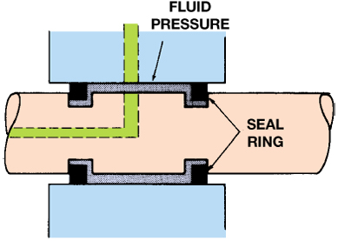
FIGURE 3–24 Fluid pressure forces a sealing ring outward in both directions to make firm contact with the side of the groove and outer diameter of the bore.

Slide 26
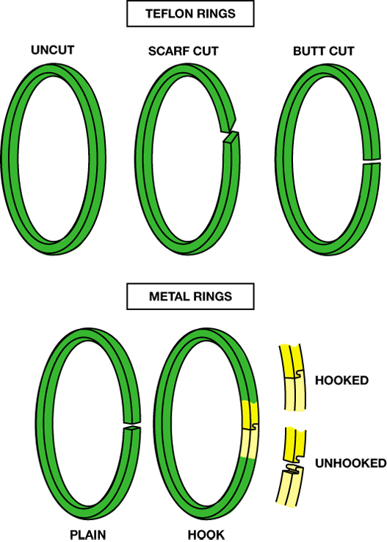
FIGURE 3–25 Metal seal rings (bottom) have plain or hooked ends. Teflon rings (top) are either uncut, scarf cut, or butt cut.

Slide 27
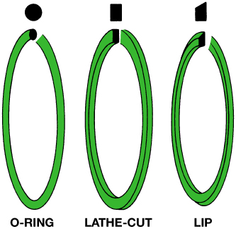
FIGURE 3–26 Clutch and servo piston seals are usually O-rings, lathe-cut rings, or lip seals.

