Slide 1

Automatic Transmissions and Transaxles
Seventh Edition
Chapter 17
Transmission/Transaxle Assembly and Installation

Slide 2
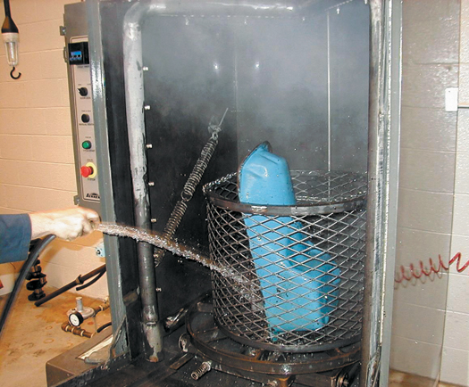
FIGURE 17–1 A pressure jet washer is similar to a large industrial-sized dishwasher. This type of cleaning unit can be used for most automotive components including engines and transmissions. Each part is then rinsed with water to remove chemicals or debris that may remain there while it is still in the tank.

Slide 3
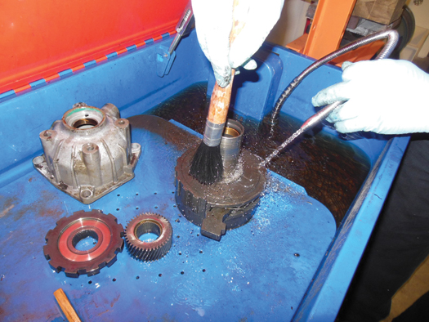
FIGURE 17–2 Transmission parts being cleaned in a water-based solvent cleaning tank.

Slide 4
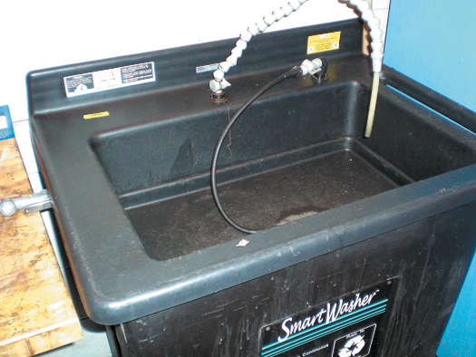
FIGURE 17–3 A microbial cleaning tank uses microbes to clean grease and oil from parts.

Slide 5
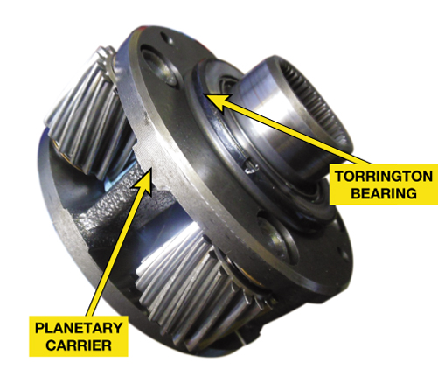
FIGURE 17–4 A Torrington bearing used to absorb thrust loads on a planetary gear set.

Slide 6
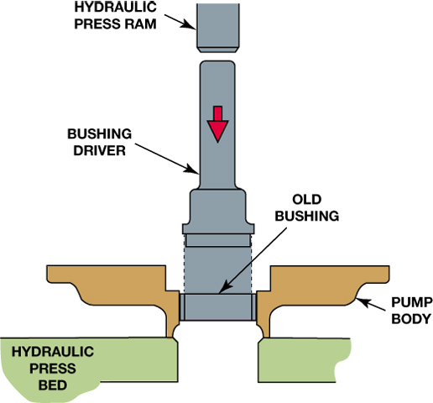
FIGURE 17–5 Worn pump bushings can be removed using a hydraulic press and a tool that applies force only to the bushing.

Slide 7
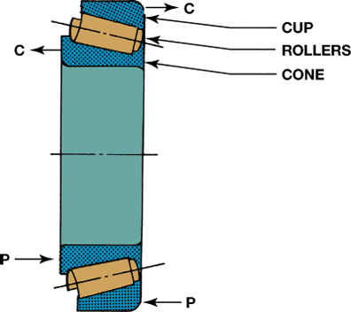
FIGURE 17–6 The cup, rollers, and cone of a tapered roller bearing are machined at an angle as shown. This allows them to resist a thrust in the direction indicated by the P arrows. The bearing is preloaded in this direction; any clearance at the sides of the bearing (C arrows) is called free play.

Slide 8
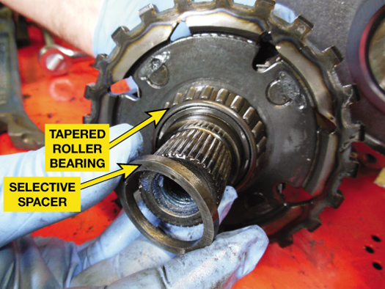
FIGURE 17–7 The selective spacer used at the final drive on a Chrysler 41TE. This unit uses two tapered roller bearings facing each other to support the final drive.

Slide 9
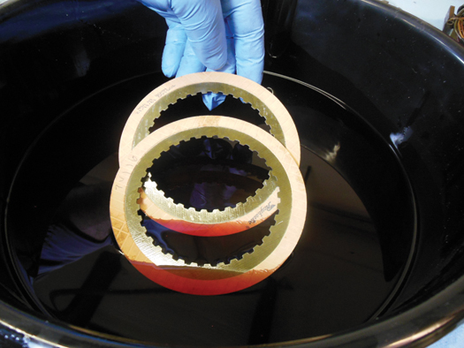
FIGURE 17–8 All lined friction material should be submerged in a shallow pan of ATF and allowed to soak before being installed in the automatic transmission/transaxle.

Slide 10
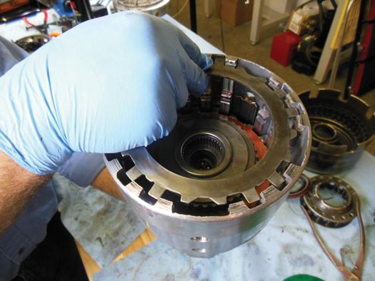
FIGURE 17–9 Steel plates can usually be reused if no faults are found during a visual inspection.

Slide 11
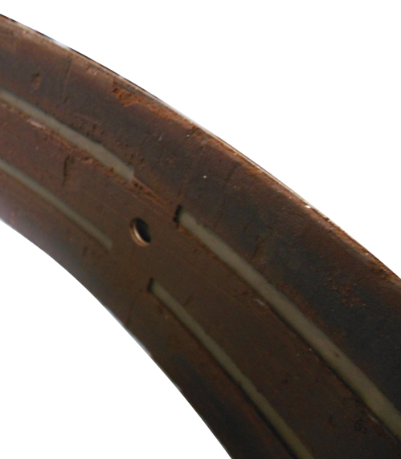
FIGURE 17–10 A badly chipped and pitted band. This band requires replacement.

Slide 12
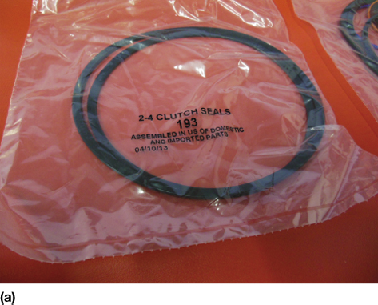
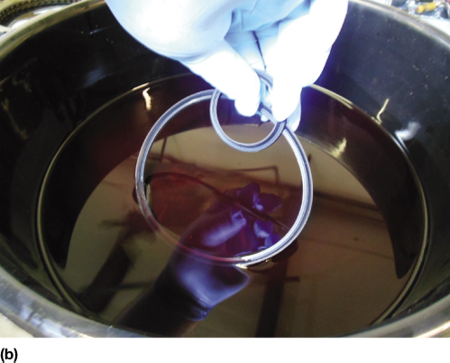
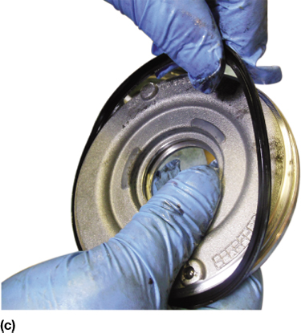
FIGURE 17–11 (a) Piston seals as supplied in an overhaul (OH) kit. (b) These seals are being lubricated in ATF before installation. (c) Installing a lip seal.

Slide 13
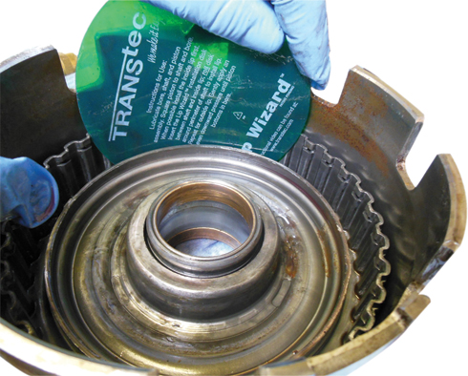
FIGURE 17–12 A round flat plastic ring is often included in overhaul kits and makes seal installation easier.

Slide 14
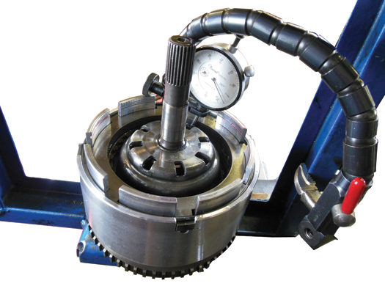
FIGURE 17–13 A dial indicator is set up to measure clutch pack clearance and then it is air checked to verify proper operation.

Slide 15
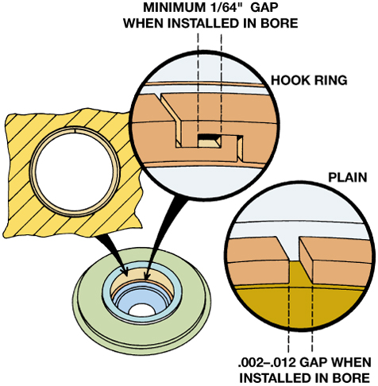
FIGURE 17–14 A metal sealing ring has been hooked and placed into its bore. It should enter with a slight pressure and make full contact with the bore. There should be a slight gap at the ends of the ring as shown.

Slide 16
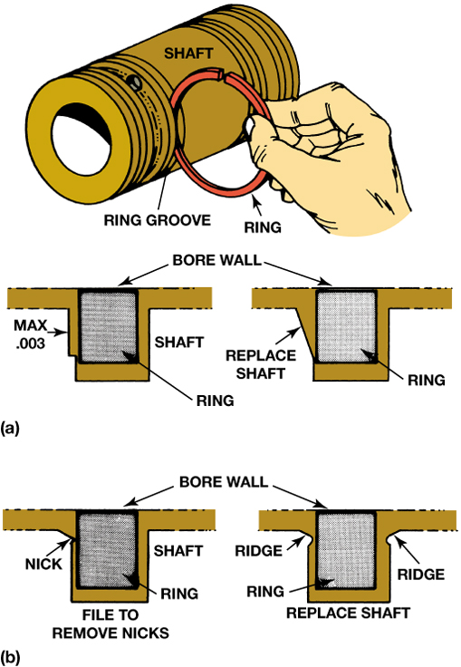
FIGURE 17–15 (a) Side clearance of a metal sealing ring is checked by placing the ring into the groove and measuring the clearance using a feeler gauge. (b) While making this check, look for damage to the seal groove.

Slide 17
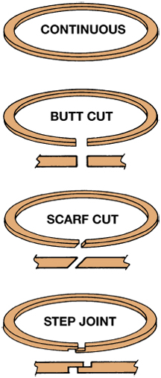
FIGURE 17–16 Four styles of Teflon rings; the uncut, continuous ring requires special tools for installation. The other styles are placed into the groove with overlapping ends positioned properly.

Slide 18
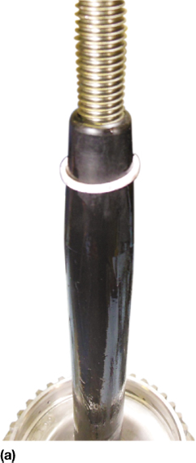
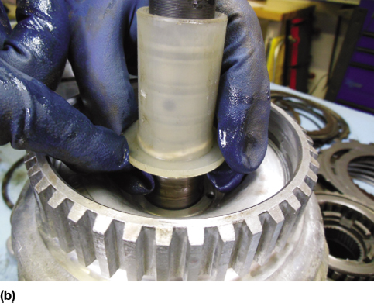
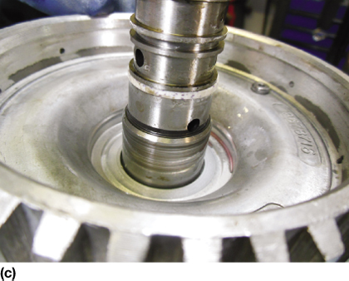
FIGURE 17–17 (a) Using a seal installation tool allows the seal to slide down over the shaft without harming the seal. (b) After the seal has been placed in the groove, use a sizing tool to reduce the size of the seal. (c) The seal after it has been sized.

Slide 19
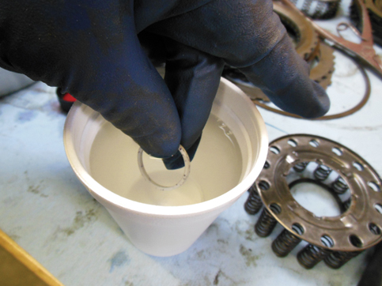
FIGURE 17–18 Using water that has been heated in a microwave to help soften a Teflon sealing ring before installing it on the shaft.

Slide 20
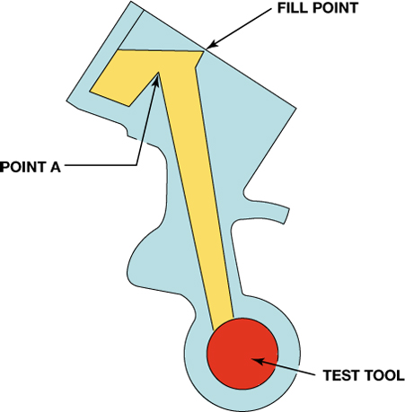
FIGURE 17–19 Filling the passage with ATF and then seeing how long it takes for the fluid to leak down to point A. A test tool instead of the component can be used to check for leakage around a bore if available.

Slide 21
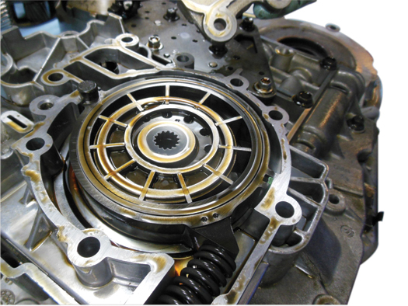
FIGURE 17–20 A pump assembly after the cover has been removed.

Slide 22
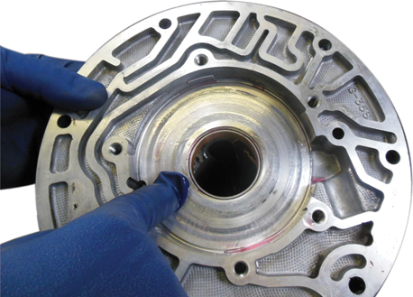
FIGURE 17–21 The pump housing should be inspected for wear and replaced if grooved or damaged.

Slide 23
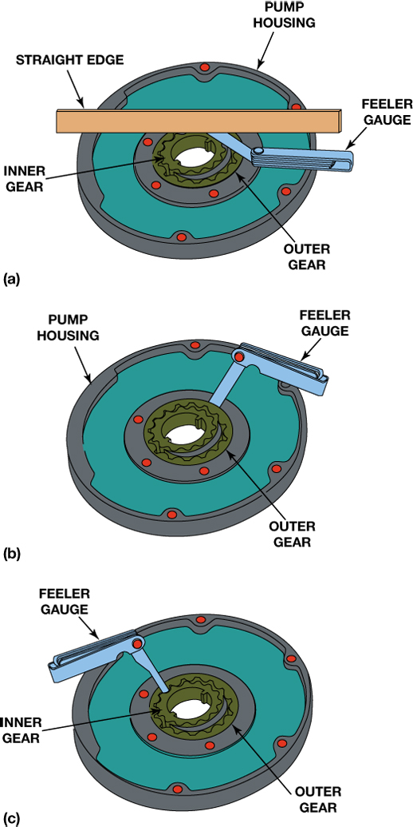
FIGURE 17–22 Clearance checks of the pump gears include (a) end clearance, (b) gear-to-housing clearance, and (c) gear-tooth clearance.

Slide 24
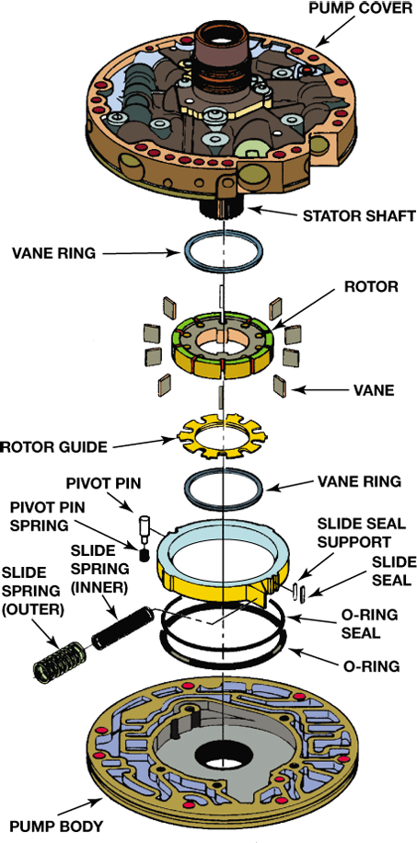
FIGURE 17–23 An exploded view of a vane-type pump. Wear checks include the rotor, vanes, slide, pump body, and pump cover.

Slide 25
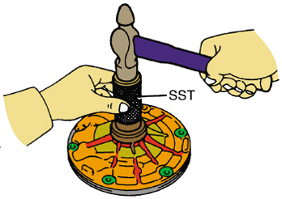
FIGURE 17–24 A new front seal is being installed using a seal driver which is a special service tool (SST).

Slide 26
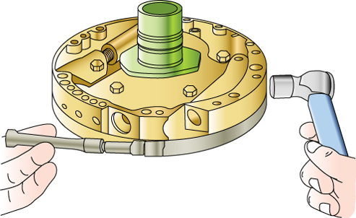
FIGURE 17–25 Using an alignment band to assemble both pump halves to ensure proper alignment. Many experts recommend lightly tapping the outer edges of the pump while tightening the clamp.

Slide 27
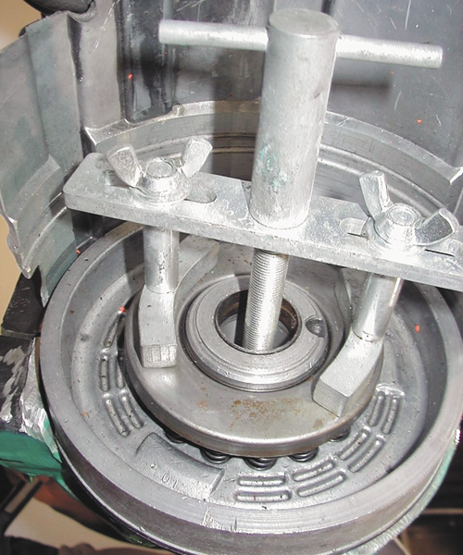
FIGURE 17–26 A compressor tool is usually necessary to compress the springs of the clutch piston to remove and install the snap ring.

Slide 28
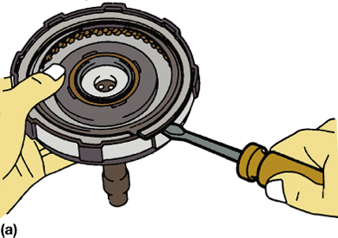
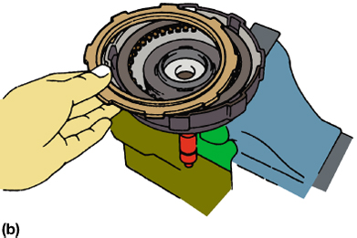
FIGURE 17–27 (a) The large snap ring can usually be removed using a screwdriver or a seal pick, and then (b) the pressure plate and clutch plates can be removed.

Slide 29
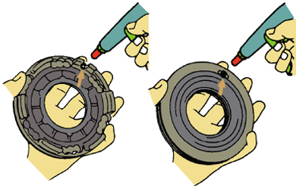
FIGURE 17–28 The check ball should be free to move inside its cage. It should also seal low-pressure airflow in one direction (left) and leak in the other (right).

Slide 30

FIGURE 17–29 All new friction plates should be soaked in ATF for at least 20 minutes or until bubbles no longer rise to the surface of the shallow pan of ATF.

Slide 31
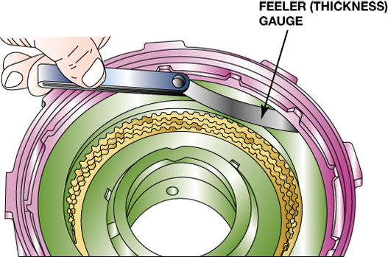
FIGURE 17–30 All clutch packs should be checked for proper clearance. Here, a feeler (thickness) gauge is used to check the clearance to make sure it is within factory specifications.

Slide 32
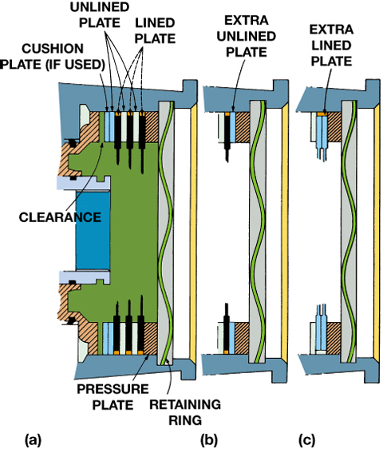
FIGURE 17–31 (a) and (b) Clutch clearance can be reduced by adding an extra unlined plate, or (c) lined plate. If two lined plates are next to each other as in (c), clearance can be increased by shaving the lining off one or both adjacent sides of the two lined plates.

Slide 33
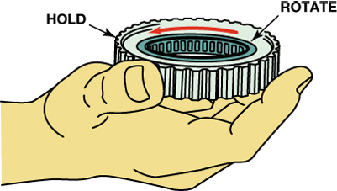
FIGURE 17–32 Service information states that this one-way roller clutch should be installed as shown. Check by holding the outer race so that the inner race is free to rotate counterclockwise as shown.

Slide 34
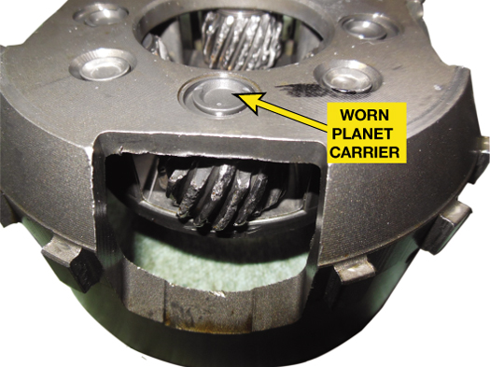
FIGURE 17–33 This planetary gear set is excessively worn and wear metal from this failure has likely contaminated many other parts in the transmission.

Slide 35
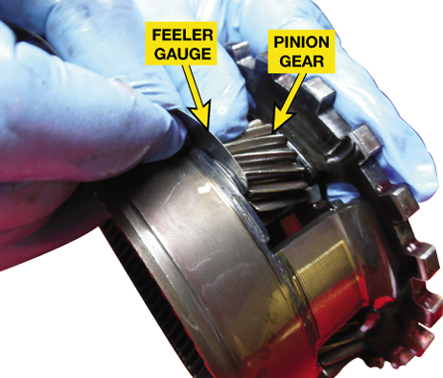
FIGURE 17–34 Using a feeler gauge to measure the pinion gear side clearance.

Slide 36
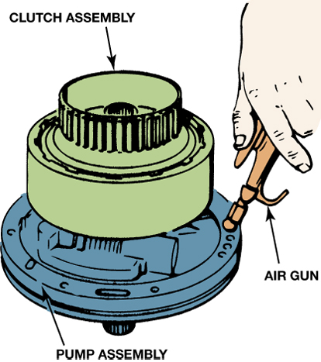
FIGURE 17–35 Air testing a clutch pack before installing it into an automatic transmission or transaxle.

Slide 37
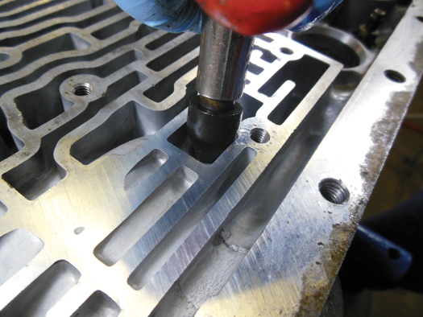
FIGURE 17–36 Using a rubber-tipped air nozzle in a passage to check the operation of a clutch or band.

Slide 38
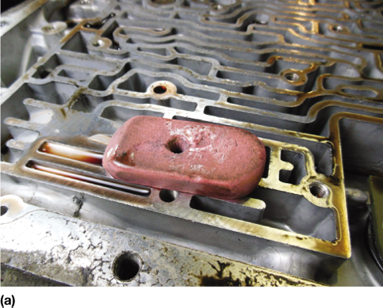
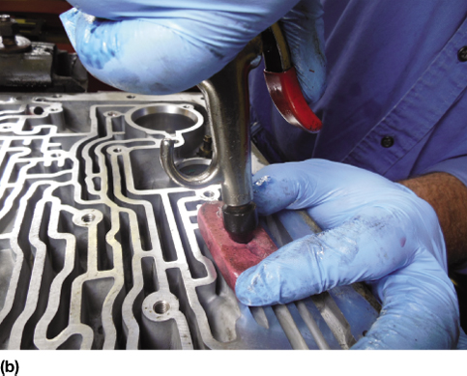
FIGURE 17–37 (a) An eraser with a hole drilled through it used to seal passages during an air test. (b) Using an air nozzle and the eraser to test hydraulic circuits at the valve body.

Slide 39
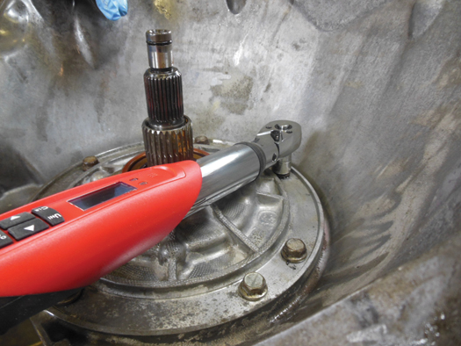
FIGURE 17–38 Using an electronic torque wrench to tighten the pump retaining bolts to factory specifications.

Slide 40
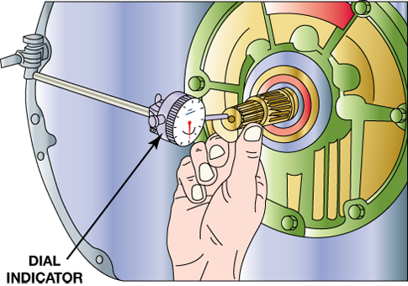
FIGURE 17–39 A dial indicator being used to measure the end play of an input shaft. If the end play is not within factory specifications, the unit may not have been assembled correctly.

Slide 41
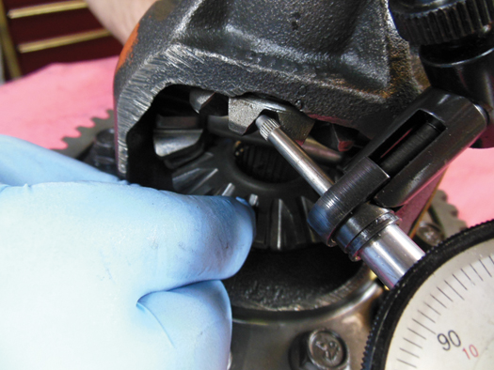
FIGURE 17–40 Checking gear clearance using a dial indicator on a final drive assembly on a Chrysler 41TE transaxle.

Slide 42
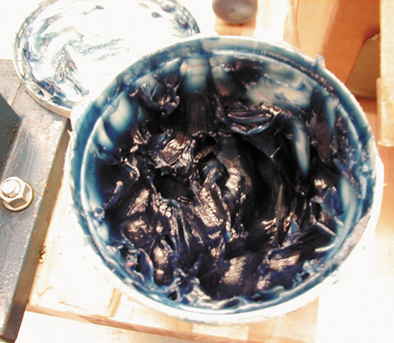
FIGURE 17–41 Blue assembly lube.

Slide 43
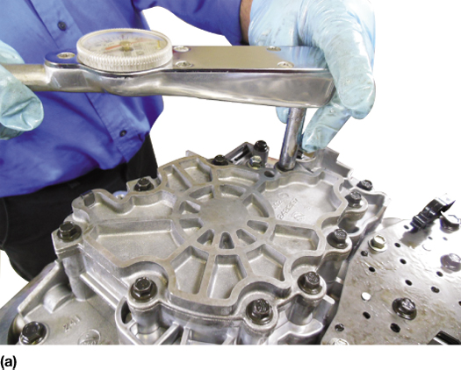
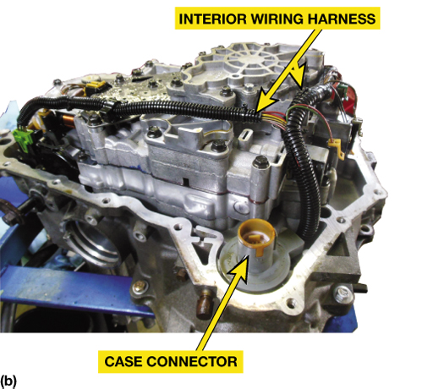
FIGURE 17–42 (a) The valve body retaining bolts being torqued to factory specifications. (b) After the valve body has been installed, the interior wiring harness and case connector are installed. This unit is ready for the filter and pan to be installed.

Slide 44
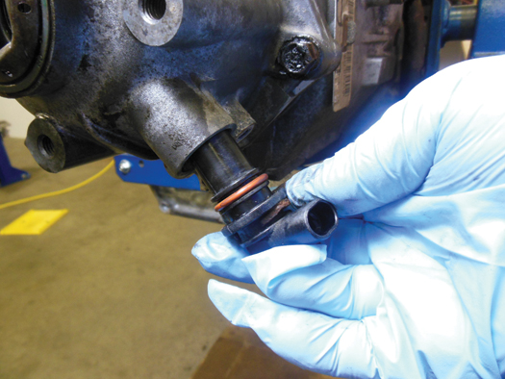
FIGURE 17–43 Installing an output speed sensor that has been equipped with a new O-ring seal.

Slide 45
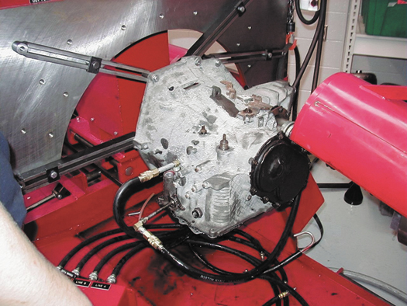
FIGURE 17–44 An electric motor-driven dynamometer being used to check the operation of a 41TE transaxle.

Slide 46

FIGURE 17–45 A gasoline-powered dynamometer being used to test a rear-wheel-drive automatic transmission.

Slide 47

FIGURE 17–46 Check the linkage for proper adjustment so that the shift interlock works correctly and the PRNDL is aligned with the transmission range switch.

Slide 48

FIGURE 17–47 A screen shot on a Snap-on Solus scan tool showing where to clear the adaptives prior to test driving the vehicle after an overhaul.

Slide 49

1 After cleaning all of the parts, read, understand and follow the instructions that come with the overhaul kit.

Slide 50

2 A new seal is installed.

Slide 51

3 All bearings and thrust washers should be lubricated with assembly lube during assembly.

Slide 52

4 The band is installed after soaking in ATF.

Slide 53

5 All of the seals being laid out and compared before being installed. They too should be covered with ATF or assembly lube before being installed.

Slide 54

6 All friction discs should be soaked in ATF for at least 20 minutes or until the bubbles stop.

Slide 55

7 All piston seals are replaced as part of the overhaul procedure. The piston is then installed using a lip seal plastic disc to help prevent the seal lip from curling over during installation.

Slide 56

8 Assembling a clutch pack with soaked frictions and then steel plates.

Slide 57

9 The return springs have to be compressed before installing the retaining ring.

Slide 58

10 The drive chain being installed after checking that the black link is up the same way it was when it was disassembled.

Slide 59

11 Before assembling the valve body, always check the valve body gasket labeled “V” and the gasket that goes against the case, label “C” to make sure that they match the ones that were removed when the unit was disassembled.

Slide 60

12 All fasteners should be tightened to factory specifications using a torque wrench.

