Slide 1

Automatic Transmissions and Transaxles
Seventh Edition
Chapter 16
Valve Body Service

Slide 2
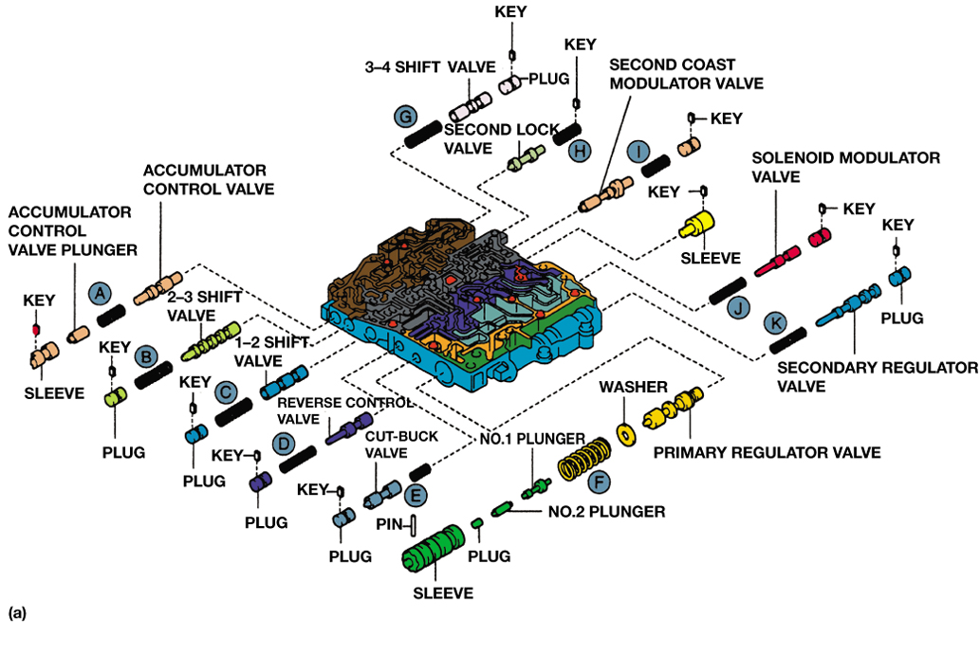
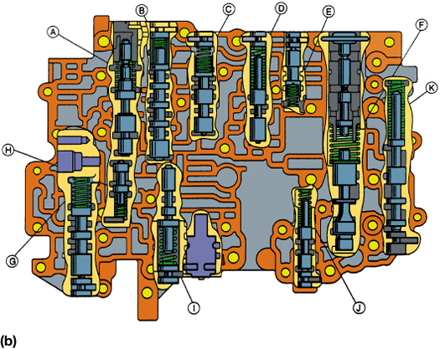
FIGURE 16–1 (a) An exploded and (b) cutaway view of the valve body from a four-speed transaxle. Note the various valve groups and how they are retained in their bore.

Slide 3
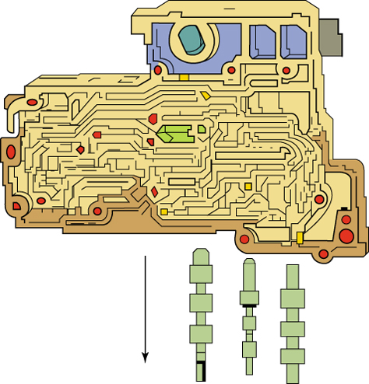
FIGURE 16–2 If the valve body is moved to a vertical position, steel valves should slide freely from the bore. Be prepared to catch the valves when making this check.

Slide 4
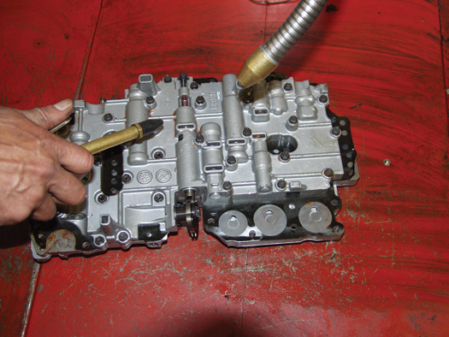
FIGURE 16–3 A valve body being washed and air dried in a parts washer. It will be cleaned again when the two major parts are separated.

Slide 5
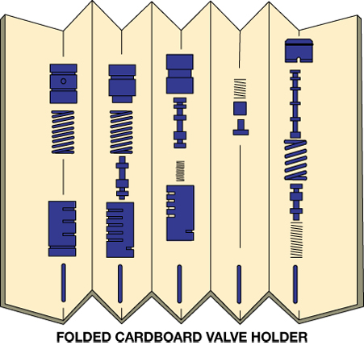
FIGURE 16–4 A sheet of stiff paper has been folded to create this simple valve holder. Note that a valve group can be placed in order and be labeled.

Slide 6
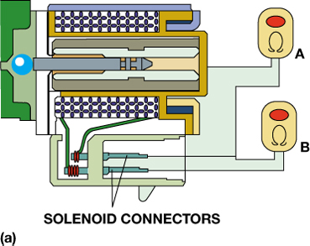
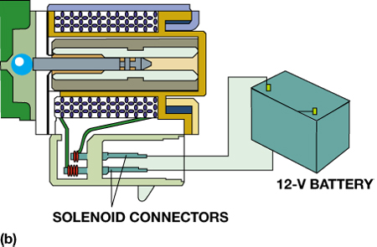
FIGURE 16–5 (a) Ohmmeter A is checking for a grounded solenoid coil; the reading should be infinite. Ohmmeter B is measuring the coil resistance; it should be within the specifications for this solenoid. (b) Connecting a solenoid to a 12-V battery should cause it to operate. Make sure the battery is connected using the correct polarity in case the solenoid has an internal diode.

Slide 7
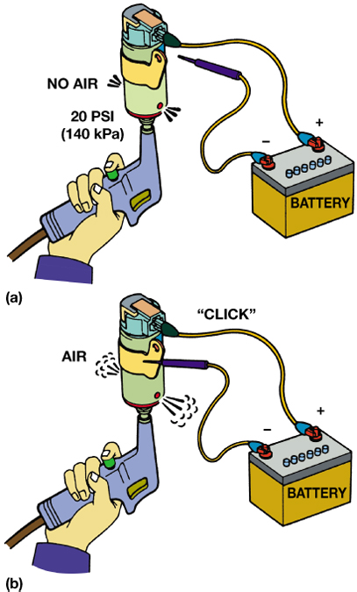
FIGURE 16–6 Air should not be able to flow through this solenoid if it is not activated. If it is connected to a 12-V battery, it should make a “click,” and air should be able to flow through it.

Slide 8
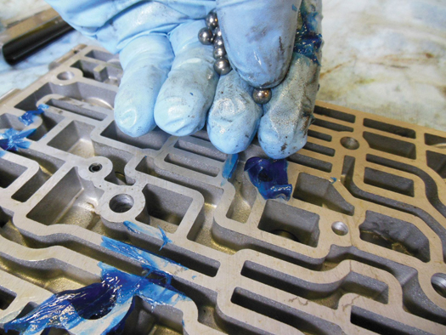
FIGURE 16–7 Using assembly lube is a great way to keep check balls in place during the reassembly of the valve body.

Slide 9
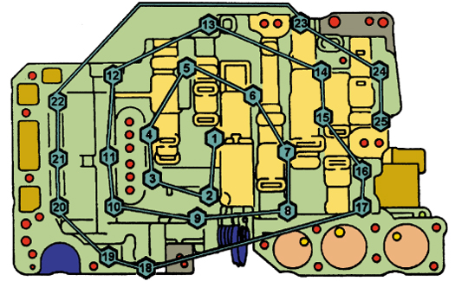
FIGURE 16–8 The valve body bolts should be tightened in order, starting from the center and working in an outward spiral.

Slide 10
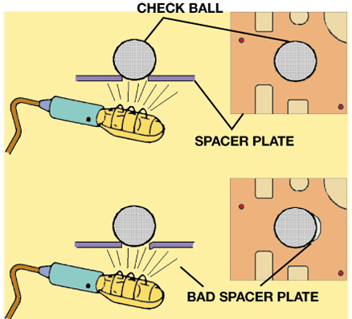
FIGURE 16–9 A check ball should seal off light from coming through the spacer plate. A problem is indicated if light shines through an opening alongside of the check ball.

Slide 11
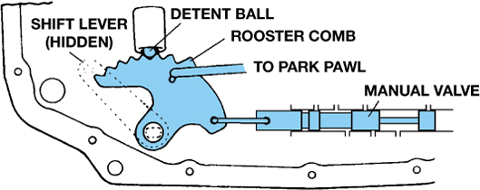
FIGURE 16–10 The manual valve is moved by the shift lever and held in position by the detent lever (cam).

