Slide 1

Automatic Transmissions and Transaxles
Seventh Edition
Chapter 15
Transmission/Transaxle Removal and Disassembly

Slide 2
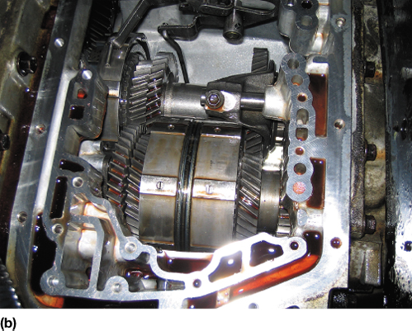
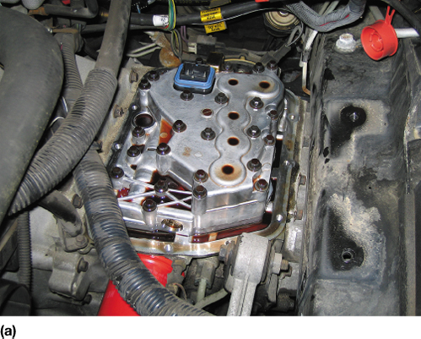
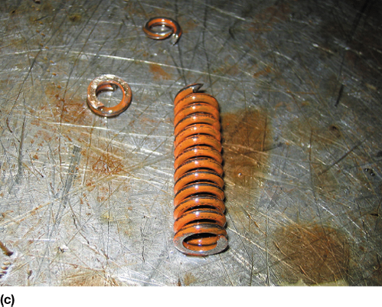
FIGURE 15–1 (a) This Saturn did not shift correctly and one technician was ready to replace the unit. However, another technician thought that the problem could be due to a fault in the valve body. (b) Removing the valve body shows the non-planetary gears used in the Saturn automatic transaxle. (c) The valve body was disassembled and a broken pressure regulator spring was found to be the cause of the customer concern.

Slide 3
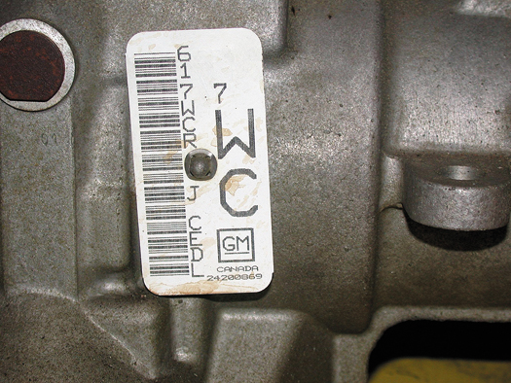
FIGURE 15–2 A transmission identification number on the side of the unit. The information on this tag is needed when ordering parts, as there are often several versions of the same transmission used in similar vehicles and the differences could affect the parts needed.

Slide 4
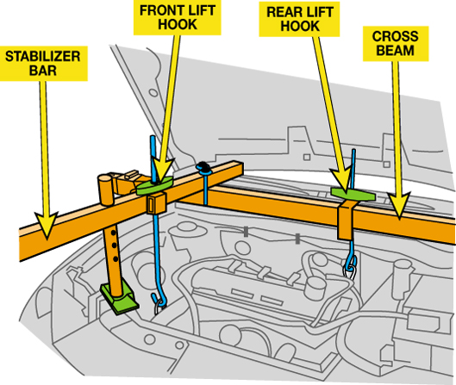
FIGURE 15–3 A holding fixture being used on this front-wheel-drive vehicle to support the engine when the transaxle is removed.

Slide 5
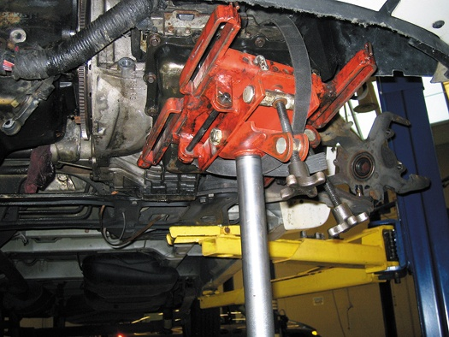
FIGURE 15–4 A transaxle being supported by a transmission jack prior to removal of the unit from underneath the vehicle.

Slide 6
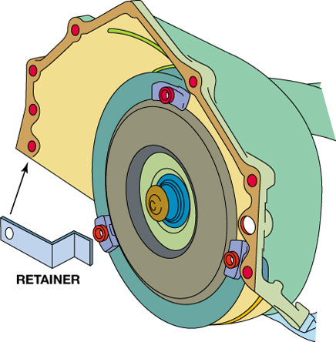
FIGURE 15–5 When the transmission/transaxle is being removed from the vehicle, either remove the torque converter or install a retaining bracket to keep it from falling off the splines.

Slide 7
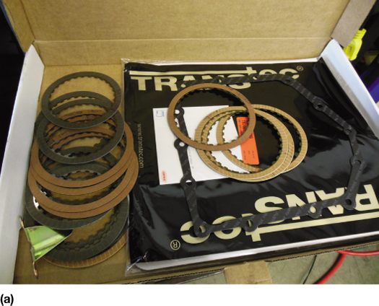
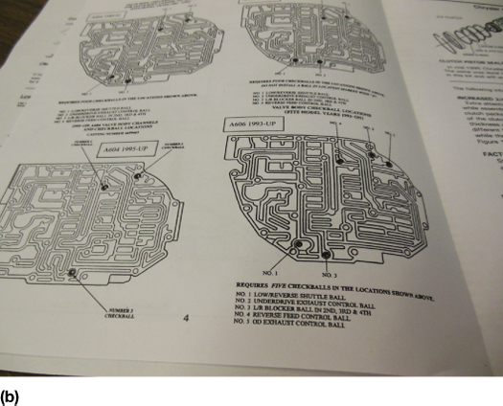
FIGURE 15–6 (a) A Typical automatic transaxle overhaul kit for a Chrysler 41TE. (b) The kit includes instructions and diagrams to help identify the unit being overhauled so that the correct parts are used from the kit.

Slide 8
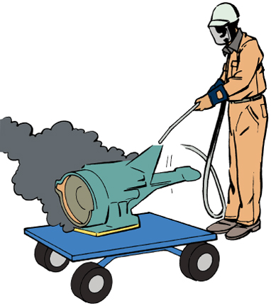
FIGURE 15–7 A power washer being used to remove the road grime from the unit before it is disassembled.

Slide 9
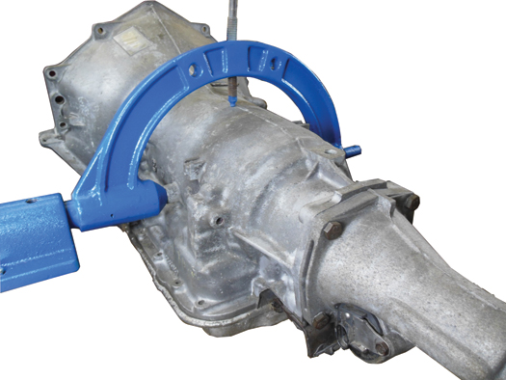
FIGURE 15–8 Using a holding fixture is the preferred method to use when disassembling and assembling an automatic transmission/transaxle. It allows the unit to be tilted and rotated as needed to get access to the internal and external components.

Slide 10
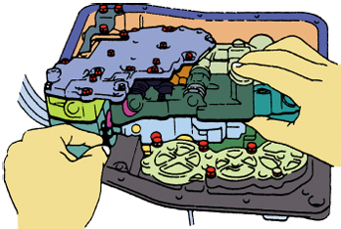
FIGURE 15–9 The valve body can be removed after the pan has been removed.

Slide 11
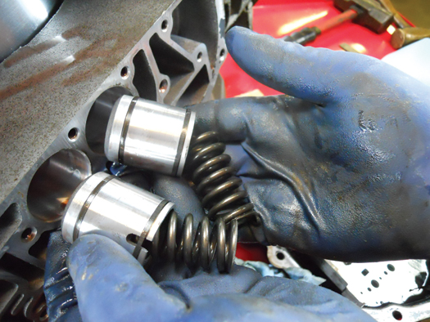
FIGURE 15–10 The accumulators used in a Chrysler 41TE look the same but use different springs.

Slide 12
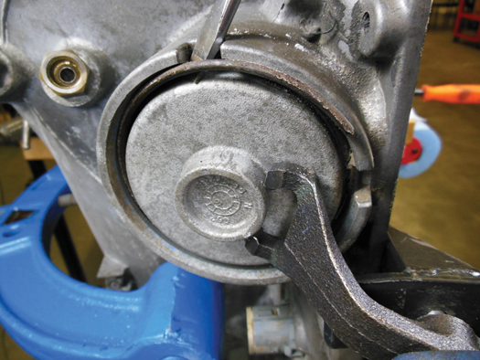
FIGURE 15–11 A round retaining ring being removed after the accumulator piston plate/cover has been compressed using a compressing tool.

Slide 13
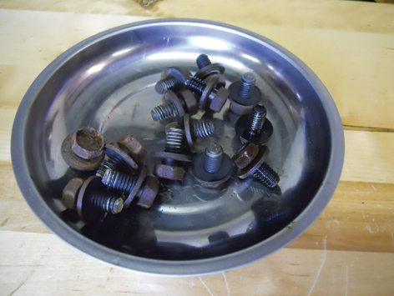
FIGURE 15–12 Magnetic trays are an excellent tool to help keep fasteners organized so they do not get misplaced. Some technicians use a separate tray for the fasteners from each major component such as the valve body bolts.

Slide 14
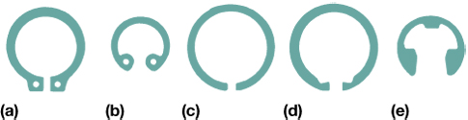
FIGURE 15–13 The most common types of retaining rings are (a) external pin type, (b) internal pin type, (c) plain external, (d) plain internal, and (e) E-clip.

Slide 15
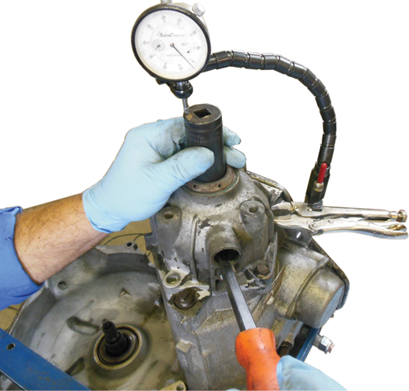
FIGURE 15–14 Using a dial indicator to check the end play before the transmission is disassembled.

Slide 16
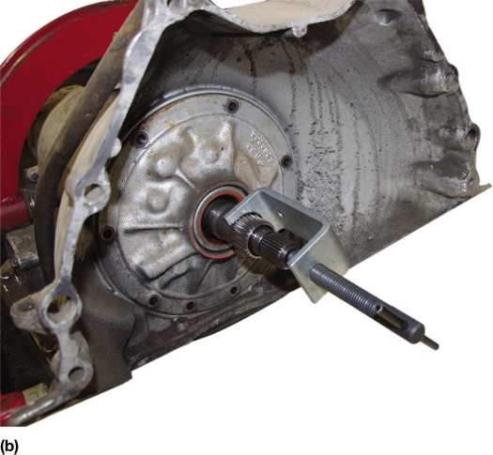
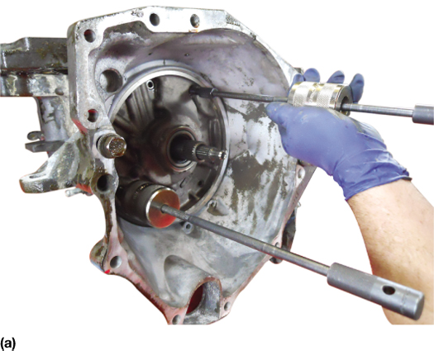
FIGURE 15–15 (a) Two slide hammers are used to removed the pump in some transmissions/transaxles. (b) A special puller being used to remove the pump.

Slide 17
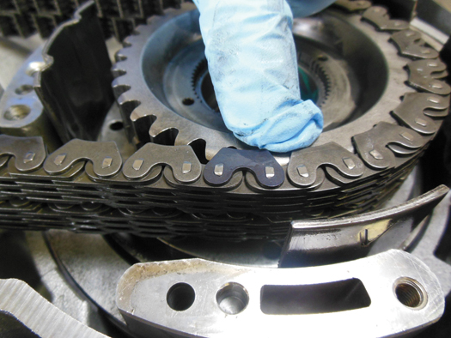
FIGURE 15–16 The master link in this GM 4T65-E is facing upward and is colored black.

Slide 18
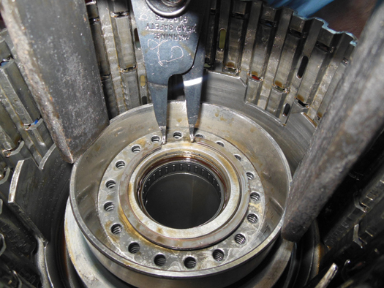
FIGURE 15–17 A snap ring being removed after the clutch piston has been compressed to allow access to the snap ring on this GM 4T65-E transaxle.

Slide 19
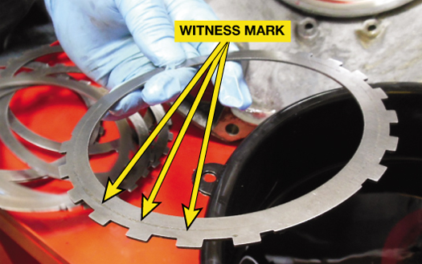
FIGURE 15–18 Witness marks are sometimes hard to see but there is often wear when two parts operate together, and should be reinstalled in the same position.

Slide 20
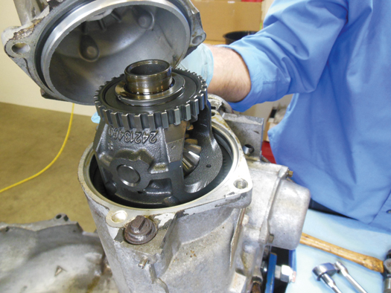
FIGURE 15–19 The final drive assembly on a GM 4T65-E.

Slide 21
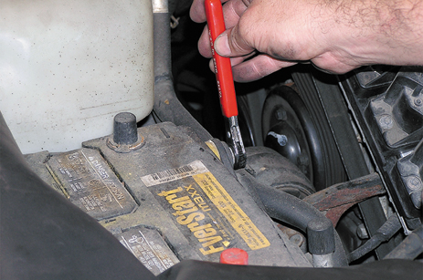
1 For safety purposes, remove the negative battery cable before starting the transaxle removal procedure.

Slide 22
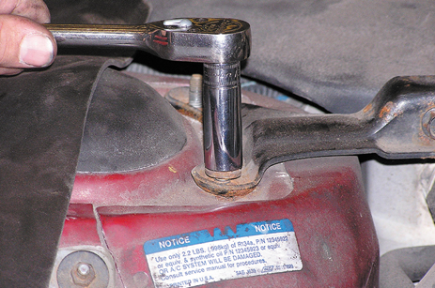
2 Remove engine bay cross members that may interfere with access to the transaxle fasteners.

Slide 23
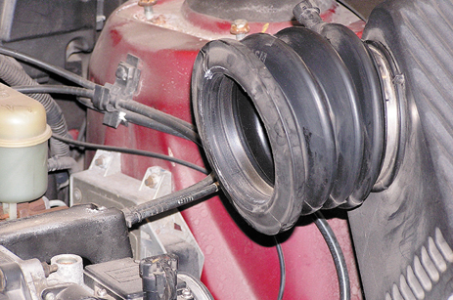
3 Remove the air intake and air filter assembly, which is covering the transaxle in this vehicle.

Slide 24
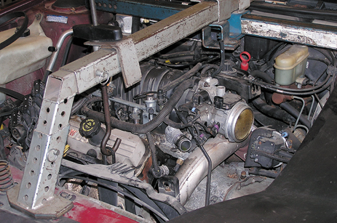
4 Install a support for the engine.

Slide 25
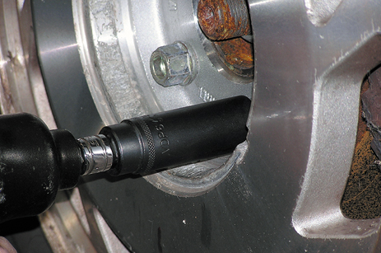
5 Safely hoist the vehicle and remove the wheels.

Slide 26
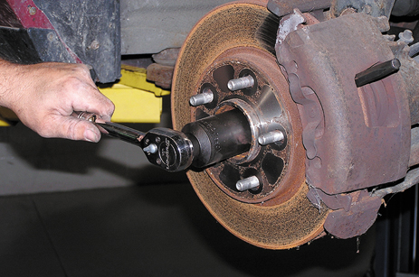
6 Remove the retaining nut from the drive axle shaft.

Slide 27
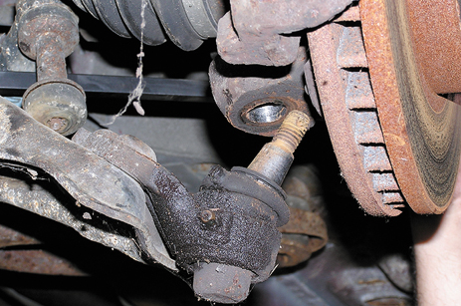
7 Disconnect the lower ball joint on the front-wheel-drive vehicle to allow removal of the drive axle shaft.

Slide 28
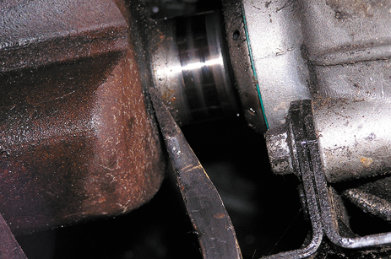
8 Remove the drive axle shaft from the transaxle using a pry bar.

Slide 29
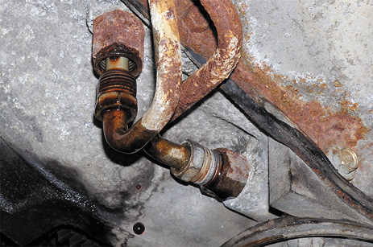
9 Disconnect the cooler lines from the transaxle using a line wrench.

Slide 30
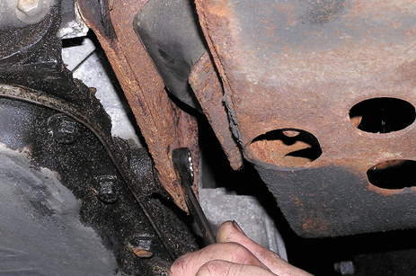
10 Unbolt the torque converter from the flexplate, then remove the transaxle mounts.

Slide 31
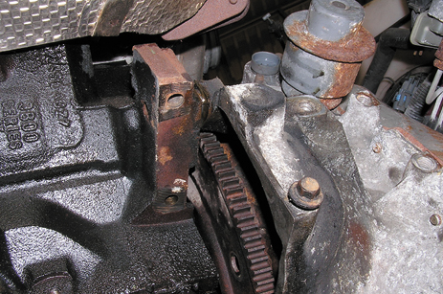
11 With the transaxle supported on a transmission jack, remove the retaining bolts from the bell housing.

Slide 32
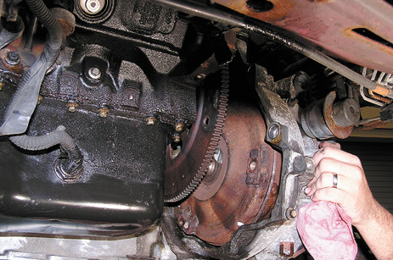
12 Carefully remove the transaxle from the vehicle.

Slide 33
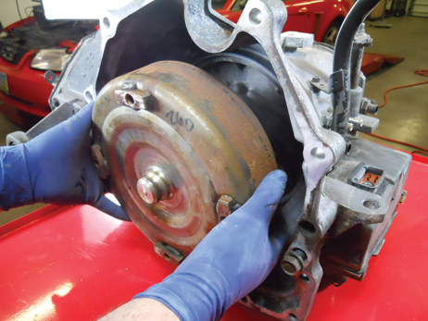
1 The torque converter is removed.

Slide 34
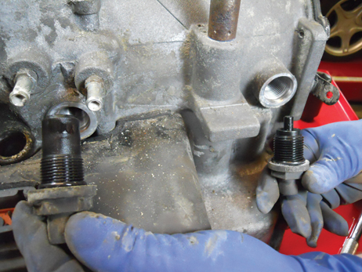
2 The input (left) and output (right) speed sensors are being removed. They are different sizes so they can’t be mixed up.

Slide 35
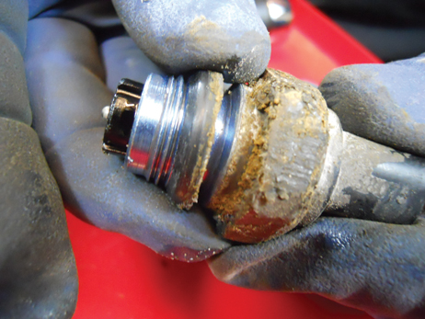
3 A pressure sensor sealing ring being removed.

Slide 36
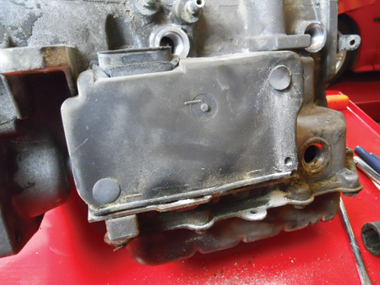
4 The cover for the TCM is made of rubber and is attached to the case using plastic “Christmas tree”-type clips.

Slide 37
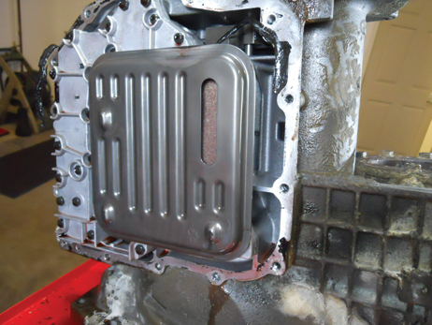
5 After the pan has been removed, the filter can be accessed and then removed before removing the valve body assembly.

Slide 38
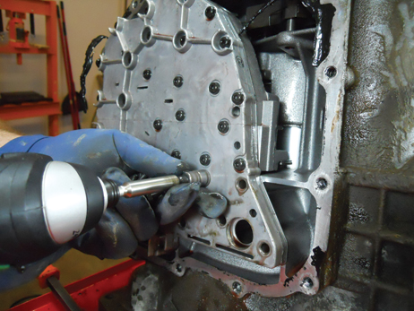
6 Removing the valve body.

Slide 39
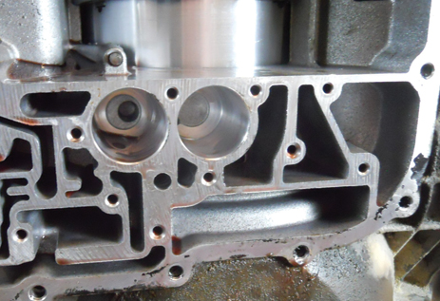
7 The accumulator bores are checked for wear after removing the accumulator pistons.

Slide 40
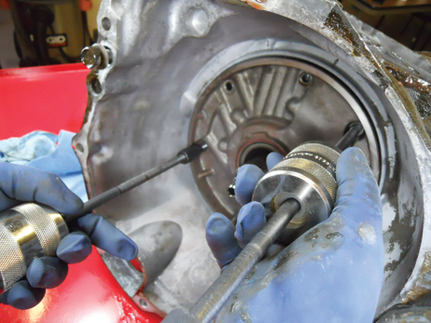
8 The pump is being removed using two slide hammers.

Slide 41
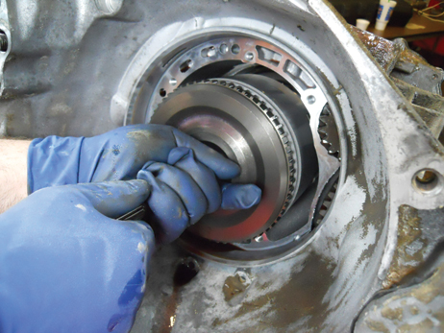
9 The input clutch assembly is being removed.

Slide 42
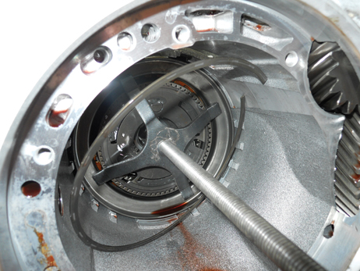
10 The 2/4 clutch return spring is being compressed so the retaining ring can be removed.

Slide 43
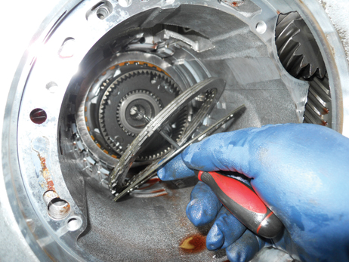
11 Removing the 2/4 clutch pack assembly.

Slide 44
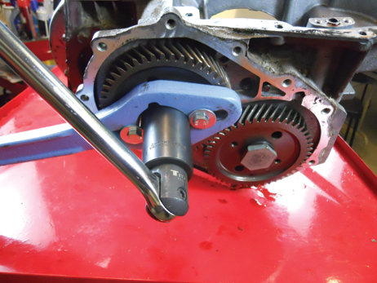
12 The rear carrier assembly is removed after the retaining bolts are removed.

Slide 45
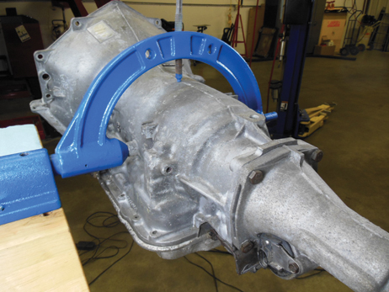
1 Before disassembling, it is preferred that the unit be mounted on a holding fixture.

Slide 46
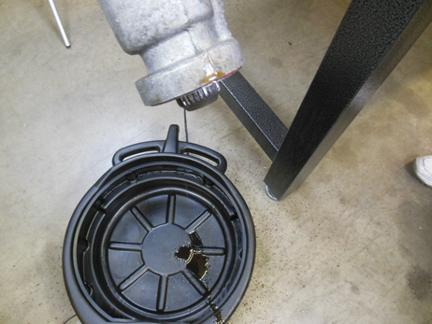
2 The unit is tipped and fluid drained. The fluid looked burned and watery.

Slide 47
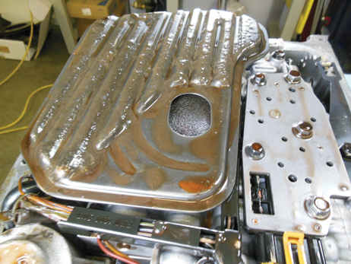
3 After removing the pan, the filter is removed.

Slide 48

4 When the magnetic vehicle speed sensor was removed, it showed lots of metal filings which indicates that something is worn or damaged inside the unit.

Slide 49

5 The pressure switch manifold being removed prior to removing the valve body.

Slide 50

6 The pump assembly is being removed from the unit.

Slide 51

7 Removing the input housing and shaft assembly.

Slide 52

8 The cause of the metal shavings was found to be an excessively worn planet carrier.

Slide 53

9 The reaction carrier and shaft with internal bushing being removed.

Slide 54

10 Removing a snap ring used to retain the low-reverse clutch assembly.

Slide 55

11 Removing the second gear apply piston assembly from the side of the case.

Slide 56

12 Visual inspection of the fluid in this unit shows that it has been overheated and, of course, there are hard parts needed to return this unit to useful service.

