Slide 1
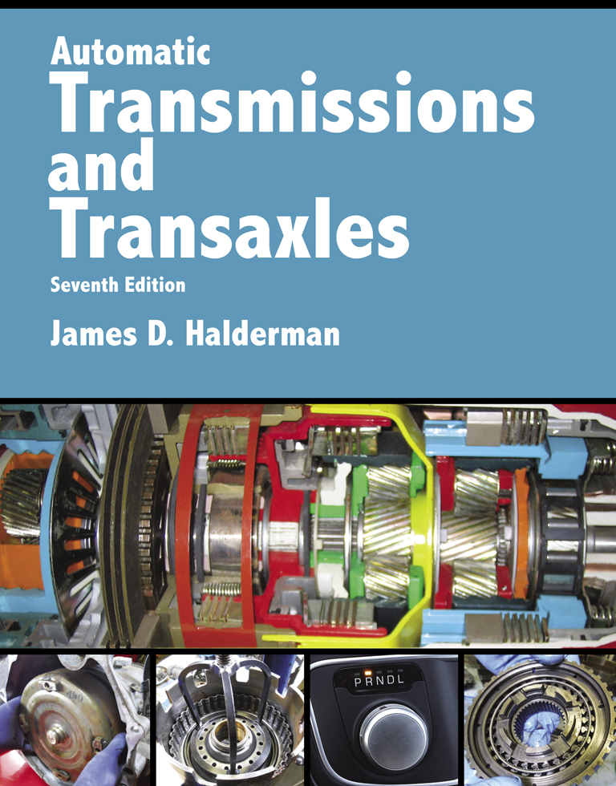
Automatic Transmissions and Transaxles
Seventh Edition
Chapter 14
In-Vehicle Transmission/ Transaxle Service

Slide 2
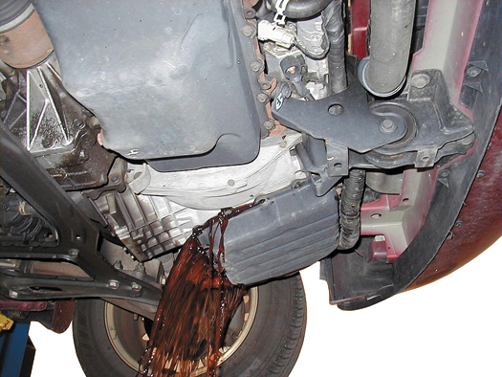
FIGURE 14–1 Draining the fluid from an automatic transaxle by allowing the fluid to flow into a container after most of the retaining bolts have been removed.

Slide 3
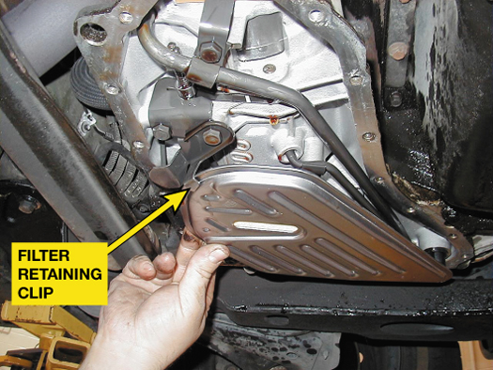
FIGURE 14–2 Always check that the filter is secured by a clip or other fastener to keep it from dropping out of its position.

Slide 4
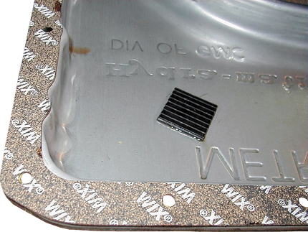
FIGURE 14–3 In this case, the cork-rubber gasket is glued to the pan and is ready to be installed. The retaining bolts need to be tightened in sequence, but be aware that over-tightening will cause a leak. Also, some manufacturers recommend using only an RTV sealer, but never use an RTV sealer and a gasket together.

Slide 5
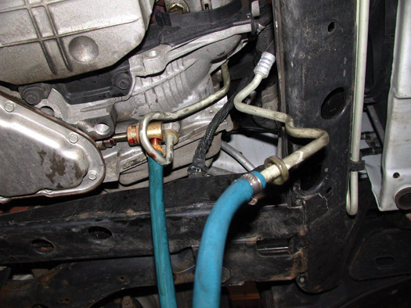
FIGURE 14–4 The lines from the fluid exchange machine can often be connected to the cooling lines from underneath the vehicle as on this front-wheel-drive General Motors vehicle.

Slide 6
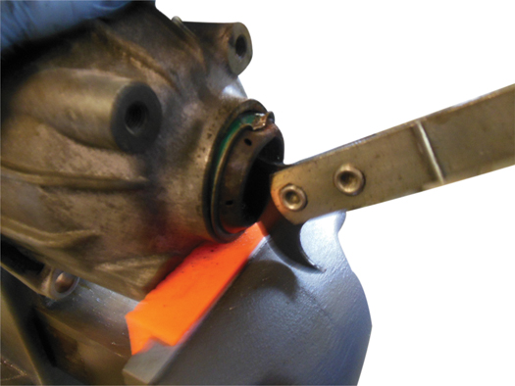
FIGURE 14–5 This seal is being removed using a seal puller.

Slide 7
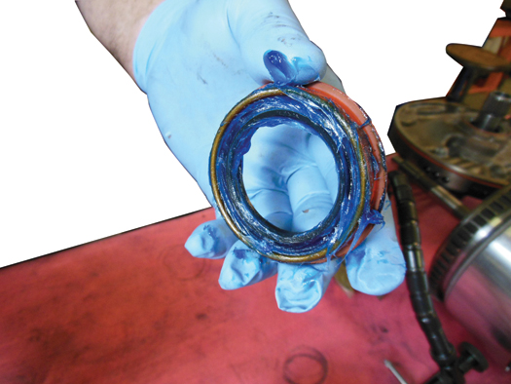
FIGURE 14–6 The lip of the seal around the garter spring is packed with assembly lube to help keep the spring from falling out when it is driven into the transmission housing.

Slide 8
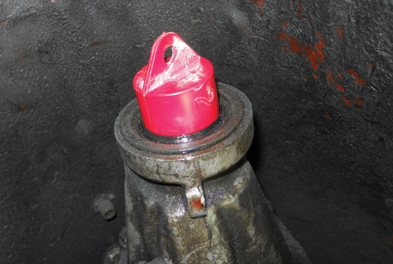
FIGURE 14–7 Using a plug helps prevent fluid loss when the driveshaft is removed.

Slide 9
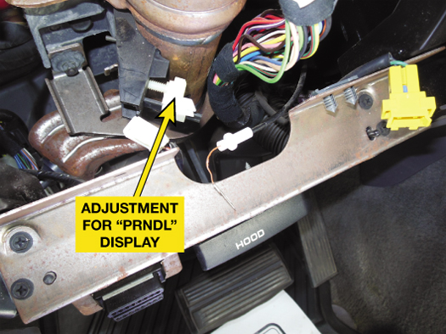
FIGURE 14–8 The position for the pointer (“PRNDL” display) on this Dodge truck is adjustable.

Slide 10
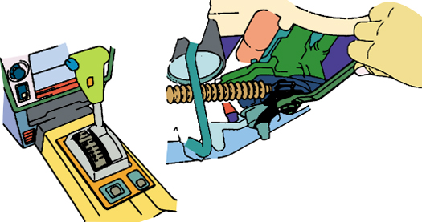
FIGURE 14–9 The manual shift lever is in park. The linkage is being tightened to lock the adjustment in after making sure that the transmission is in park.

Slide 11
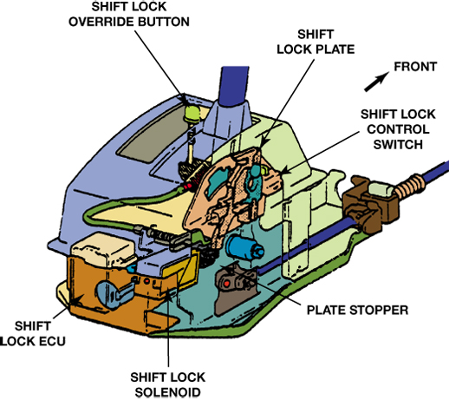
FIGURE 14–10 This shift lock mechanism includes a solenoid that can mechanically hold the shift lock plate. Note the shift lock override button that can be used to release the shift lock.

Slide 12
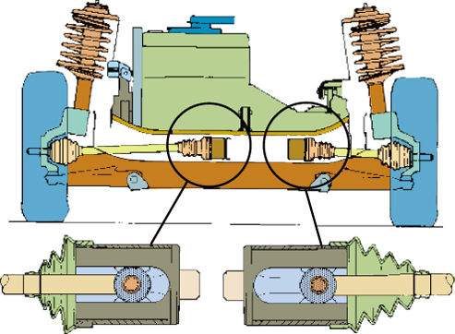
FIGURE 14–11 The enlarged views of the inner CV joints show that the engine and transaxle are misaligned; they should be moved toward the right.

Slide 13
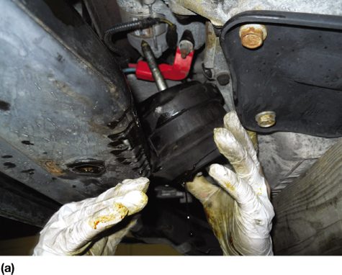
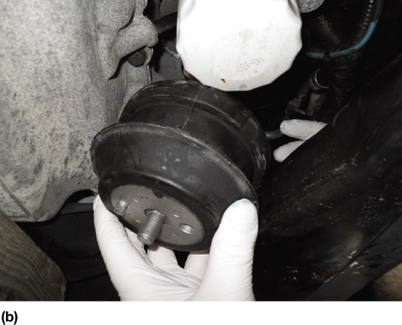
FIGURE 14–12 (a) The old front engine mount contained hydraulic fluid. The oil was leaking from the split in the mount. (b) The new original equipment (OE) mount ready to be installed.

Slide 14
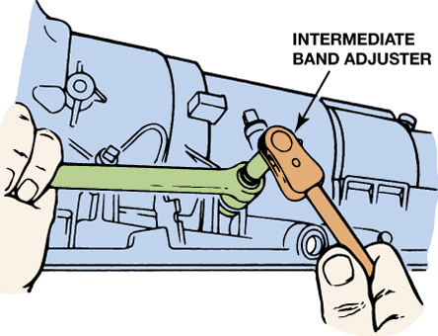
FIGURE 14–13 Adjusting the intermediate band on a Ford A4LD transmission.

Slide 15
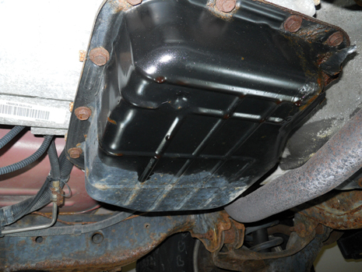
1 The owner of this Dodge pickup complained that automatic transmission fluid was leaking from the pan gasket.

Slide 16
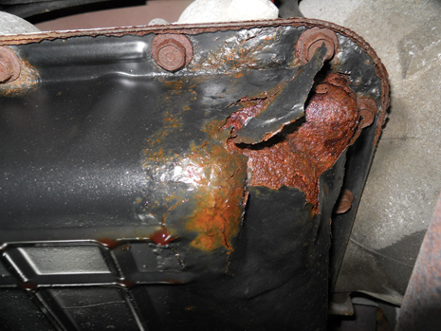
2 The transmission fluid leak is found to be from small holes that had rusted through the steel pan.

Slide 17
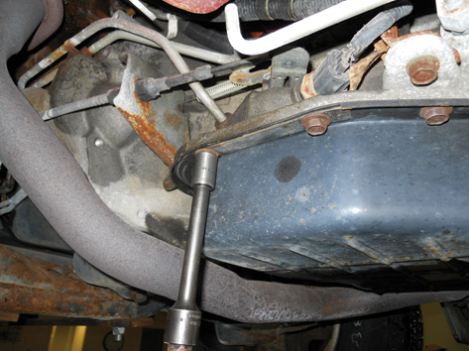
3 The retaining bolts being removed from the pan.

Slide 18
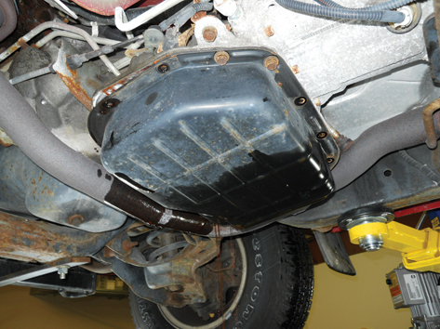
4 The retaining bolts on one side are kept attached and then loosened to allow fluid to drain from one side of the pan.

Slide 19
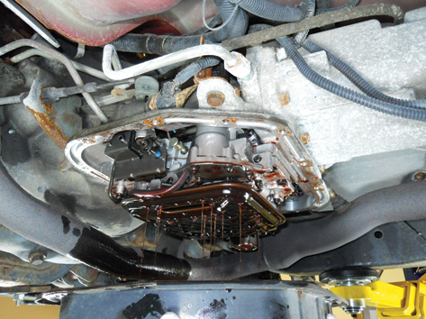
5 The pan is then gently lowered and the ATF is caught dripping from the valve body.

Slide 20
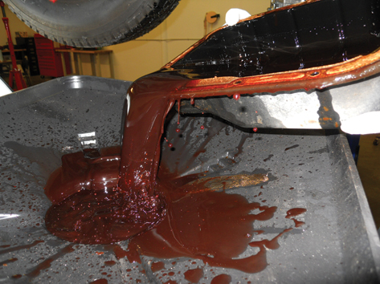
6 The pan is then emptied into an oil drain unit.

Slide 21
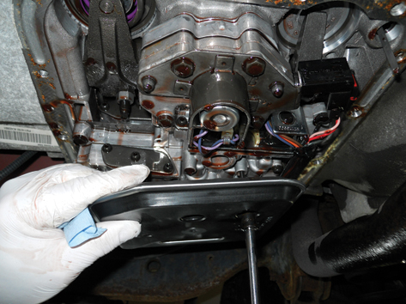
7 The old filter is removed.

Slide 22
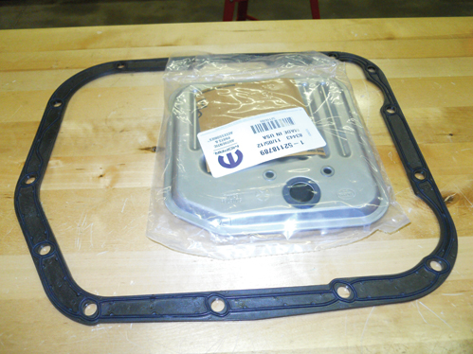
8 The shop purchased a new original equipment filter and a new, improved transmission pan gasket.

Slide 23
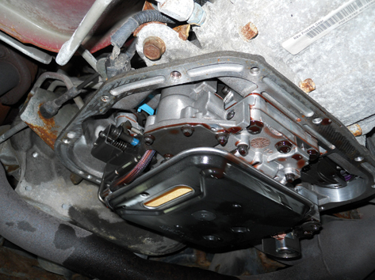
9 The new filter is installed.

Slide 24
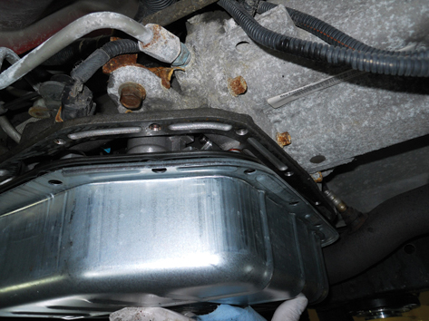
10 The replacement pan is installed and the fasteners tightened to factory specifications. The new pan is galvanized steel compared to painted steel on the original.

Slide 25
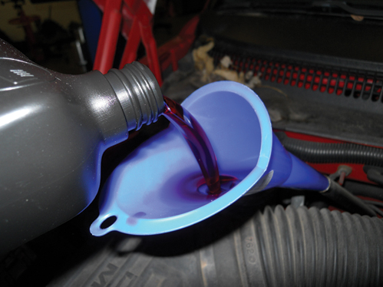
11 The specified ATF is installed.

Slide 26
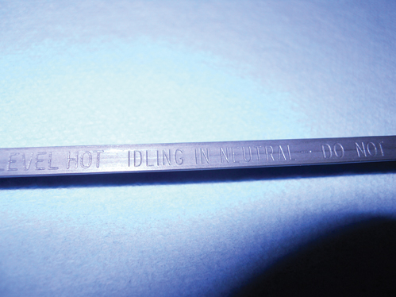
12 The level is checked with the engine running and the gear selector in neutral as per the instructions on the dipstick.

