Slide 1

Automatic Transmissions and Transaxles
Seventh Edition
Chapter 13
Transmission Condition Diagnosis

Slide 2
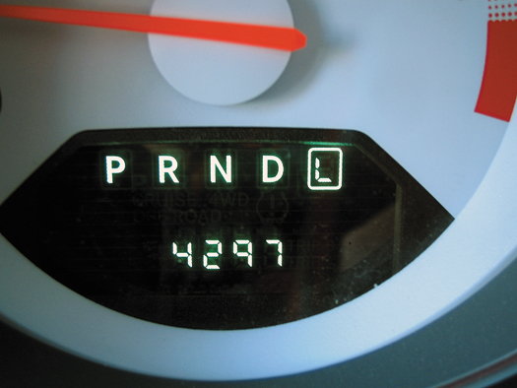
FIGURE 13–1 Selecting all of the shift modes of an automatic transmission/transaxle helps pinpoint the area where the fault is located.

Slide 3
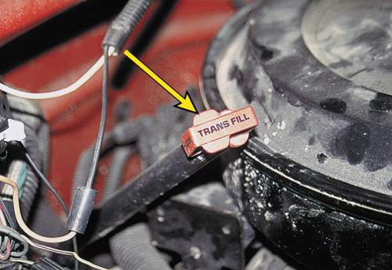
FIGURE 13–2 A typical automatic transmission dipstick (fluid level indicator). Many use a clip to keep it from being forced upward due to pressure changes inside the automatic transmission. A firm seal also helps keep water from getting into the fluid, which can cause severe damage to the clutches and bands.

Slide 4
FIGURE 13–3 The “add” mark on most automatic transmission dipsticks indicates the level is down 0.5 quart (0.5 L). Always follow the instructions stamped or printed on the dipstick.

Slide 5
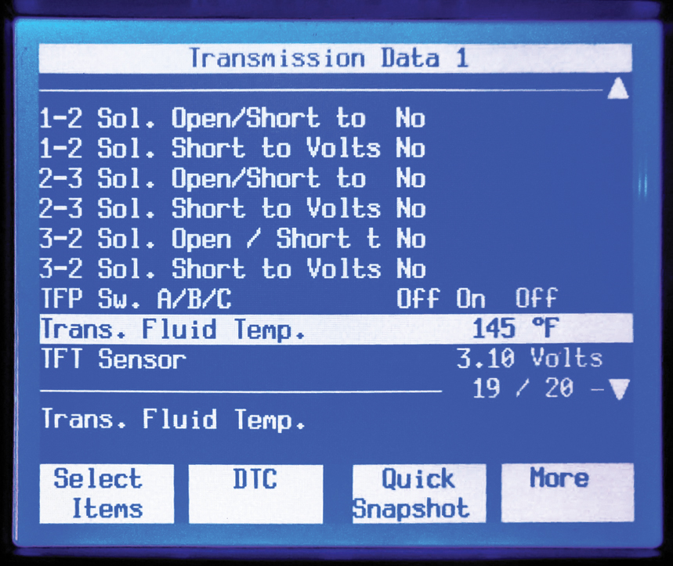
FIGURE 13–4 The temperature of the automatic transmission fluid is displayed on a factory or factory-level scan tool. It may require that the vehicle be driven under a load for the fluid to reach the specified temperature and can often not be achieved by simply allowing the engine to idle.

Slide 6
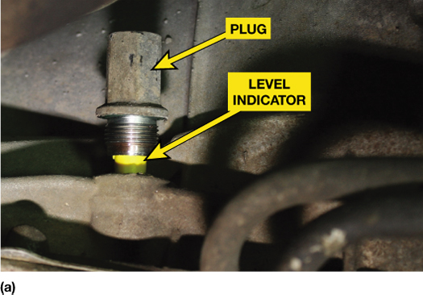
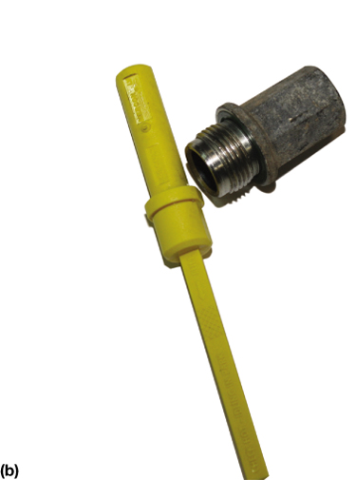
FIGURE 13–5 (a) The fluid level indicator is reached from under the vehicle on this Ford 6R80 rear-wheel-drive transmission. (b)The level indicator can be removed after removing the plug, and then the fluid level can be read on the stick.

Slide 7
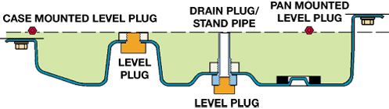
FIGURE 13–6 Fluid level on sealed units (without a dipstick) is checked by removing the level plug, which can be mounted in the bottom or side of the pan or in the case. It is normal for some fluid to drip from this type of level indicator because normal operation of the transmission causes fluid to fill the stand pipe.

Slide 8
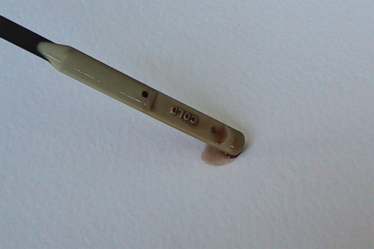
FIGURE 13–7 Fluid condition can be checked by placing a sample on clean, white, absorbent paper. Clean fluid will spread out and leave only a wet stain. Dirty fluid will leave deposits of foreign material.

Slide 9
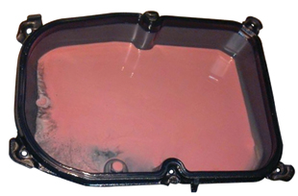
FIGURE 13–8 If the ATF looks like a strawberry milkshake, then the transmission/transaxle will require to be overhauled and the source of the coolant or the water found and corrected.

Slide 10
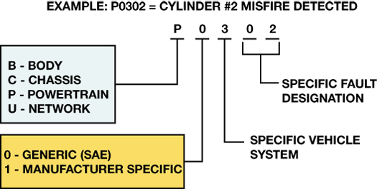
FIGURE 13–9 OBD-II DTC identification format.

Slide 11
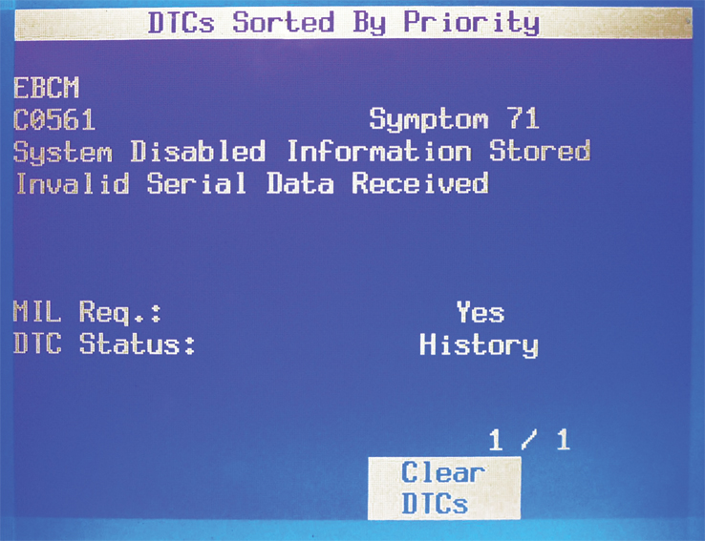
FIGURE 13–10 A “C” diagnostic trouble code was stored along with a note “symptom 71” which gives additional information about the possible cause of this serial data fault code being set.

Slide 12
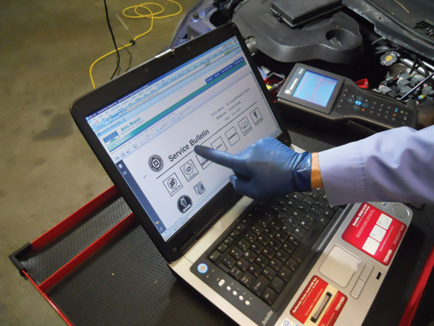
FIGURE 13–11 After checking for stored diagnostic trouble codes (DTCs), the wise technician checks service information for any technical service bulletins (TSBs) that may relate to the vehicle being serviced.

Slide 13
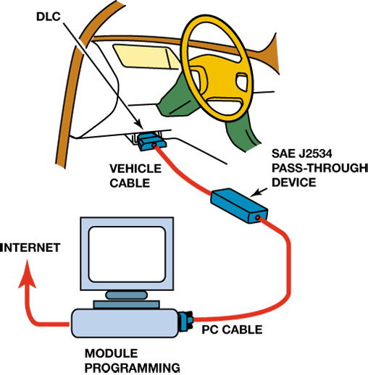
FIGURE 13–12 The J2534 pass-through reprogramming system does not need a scan tool to flash the PCM on most 2004 and newer vehicles.

Slide 14
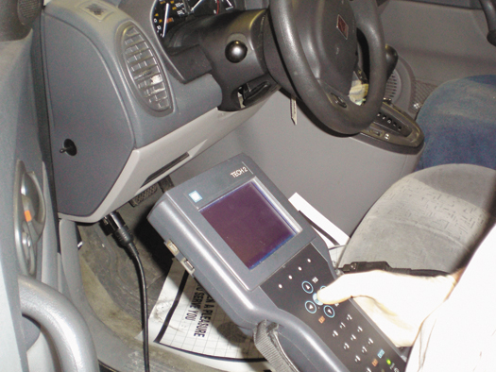
FIGURE 13–13 A TECH 2 scan tool is the factory scan tool used on General Motors vehicles.

Slide 15
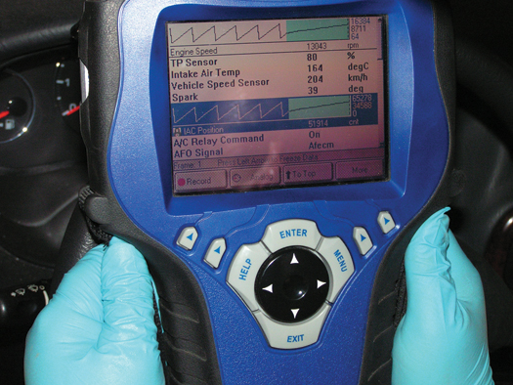
FIGURE 13–14 An OTC Genisys being used to troubleshoot a vehicle. This scan tool can be used on most makes and models of vehicles and is capable of diagnosing other computer systems in the vehicles such as automatic transmissions.

Slide 16
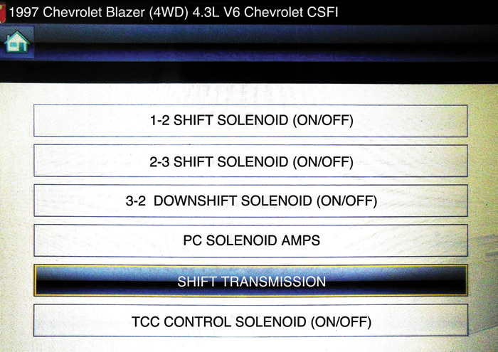
FIGURE 13–15 A Snap-on scan tool is able to shift the transmission and display pressure control (PC) solenoid current (amperes).

Slide 17
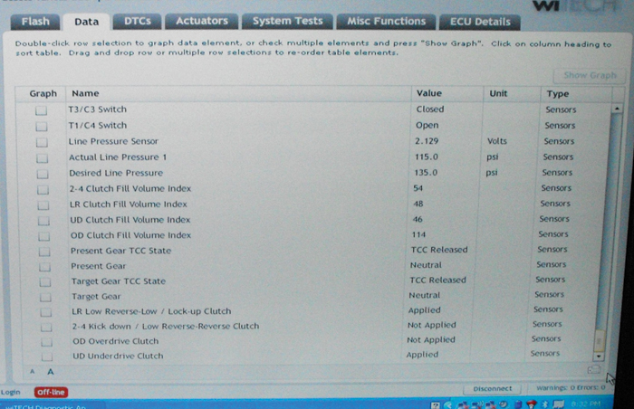
FIGURE 13–16 The clutch fill volume index as displayed on a Chrysler wiTECH scan tool.

Slide 18
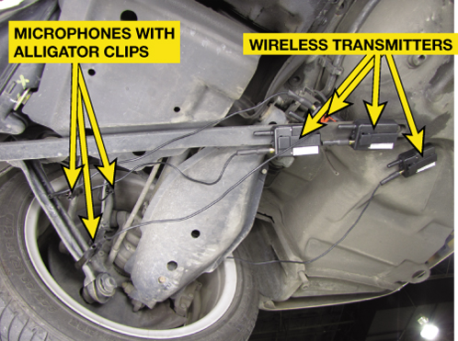
FIGURE 13–17 Chassis ear microphones attached to various under-vehicle components using the integral clamps. The sound is transmitted wirelessly to the receiver inside the vehicle where an assistant technician can listen for noises while the vehicle is being driven.

Slide 19
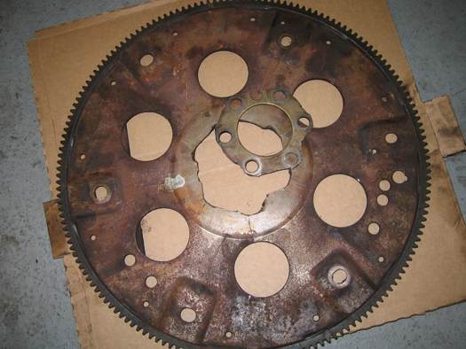
FIGURE 13–18 A broken flexplate that made a lot of noise and then the engine would not crank when it finally broke.

Slide 20
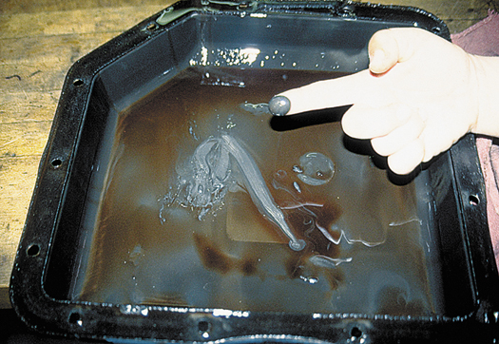
FIGURE 13–19 This is a normal amount of wear material in the bottom of an automatic transmission pan.

Slide 21
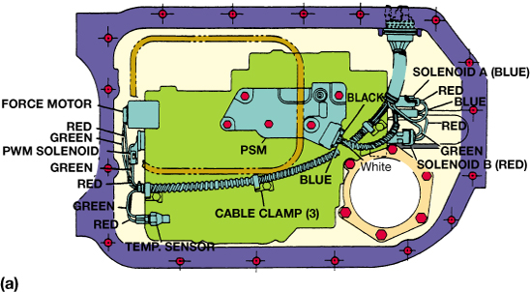
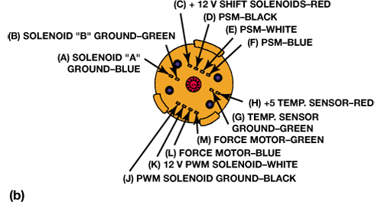
FIGURE 13–20 A visual inspection of the transmission electrical connector ensures that the terminals are clean and in good condition as well as being completely engaged.

Slide 22

FIGURE 13–21 TCM terminals 16 and 17 receive B+ when the transmission relay is energized.

Slide 23
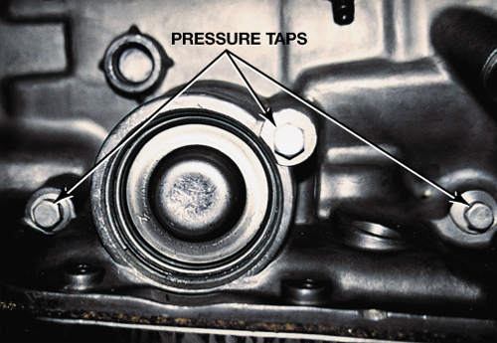
FIGURE 13–22 The locations (taps) for connecting a pressure gauge to measure the pressure of the various hydraulic circuits are usually found on the side of the automatic transmission/transaxle. Check service information for the exact locations for the vehicle being tested.

Slide 24
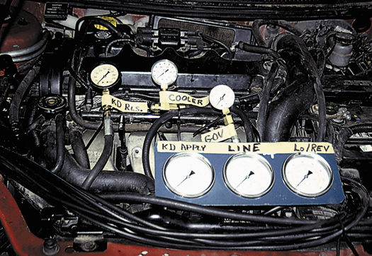
FIGURE 13–23 Six pressure gauges are installed on this vehicle to show students how the pressures vary and how the gauges can be used to find faults or possible problem areas before the unit is removed and disassembled.

Slide 25
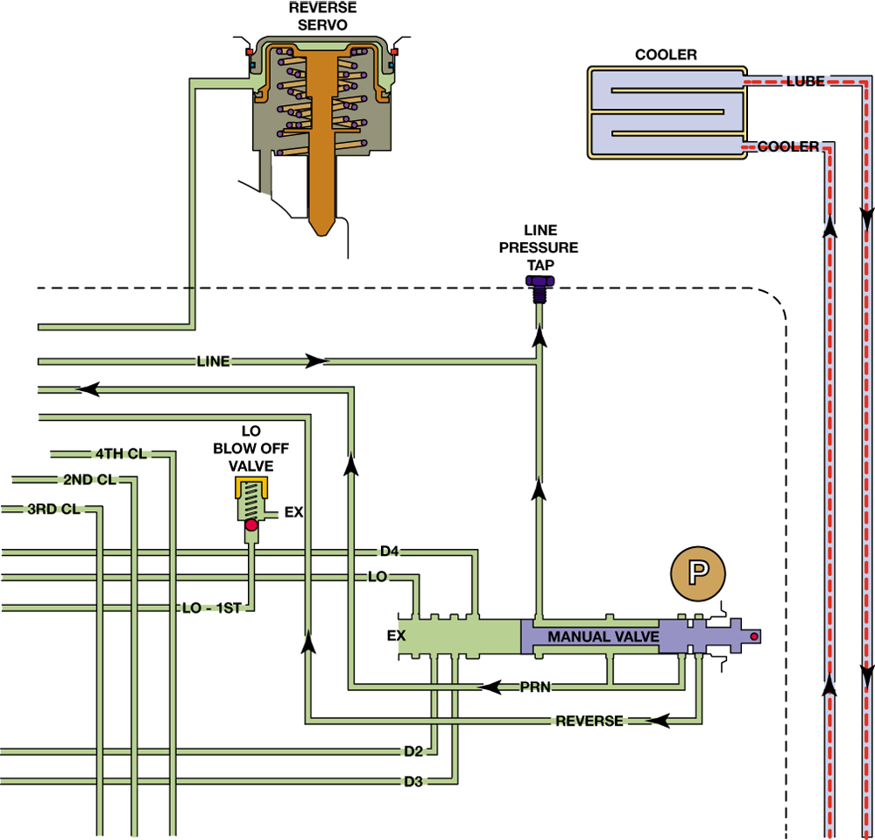
FIGURE 13–24 A portion of a typical hydraulic schematic showing part of the hydraulic system and pressure tap.

Slide 26
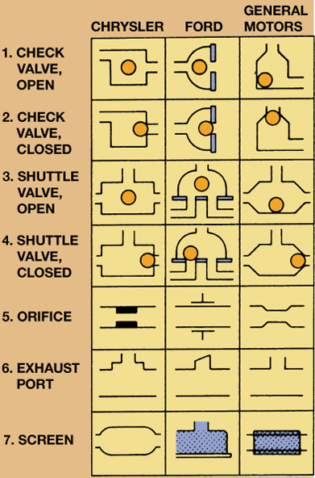
FIGURE 13–25 Hydraulic symbols used by domestic vehicle manufacturers.

