Slide 1
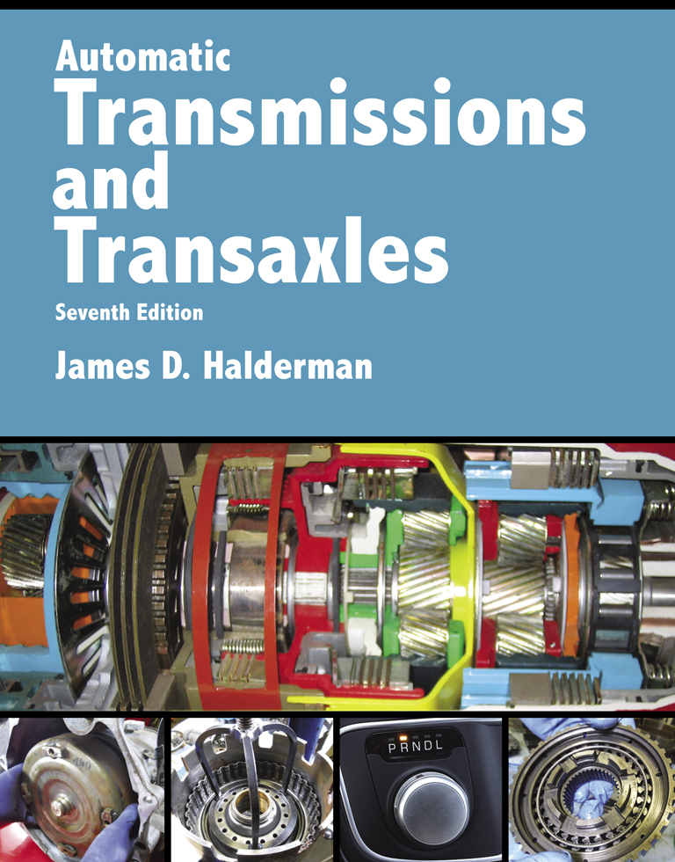
Automatic Transmissions and Transaxles
Seventh Edition
Chapter 12
Dual Clutch Automatic Transmissions/
Transaxles

Slide 2
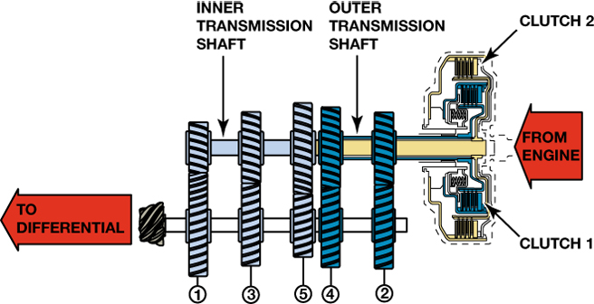
FIGURE 12–1 A dual clutch automatic uses the best features of an automatic transmission without the power loss of a torque converter.

Slide 3
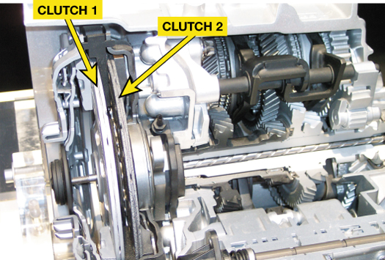
FIGURE 12–2 Dual clutch automatic transaxles that use two dry clutches. The larger clutch drives the odd number gear ratios (first, third, and fifth) and the smaller clutch drives the even numbered gear ratios (second, fourth, and sixth).

Slide 4
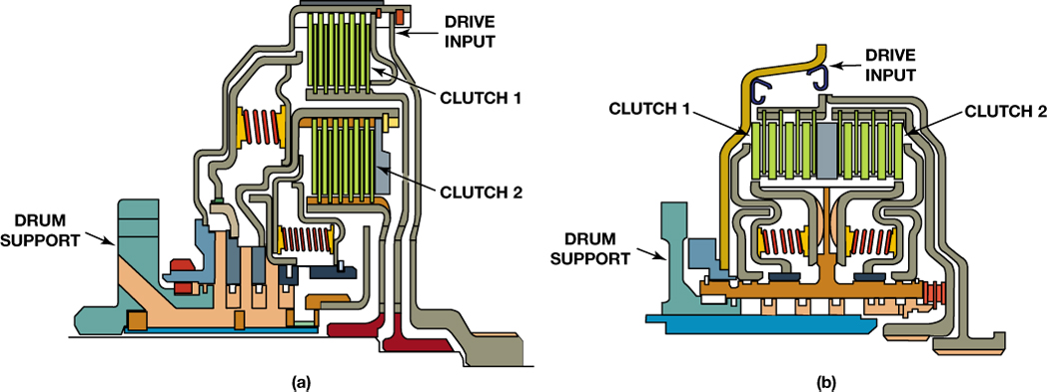
FIGURE 12–3 (a) A concentric (nested) clutch design, the assembly is shorter in length but taller in height. (b) A parallel clutch design is longer but has a smaller diameter drum assembly.

Slide 5
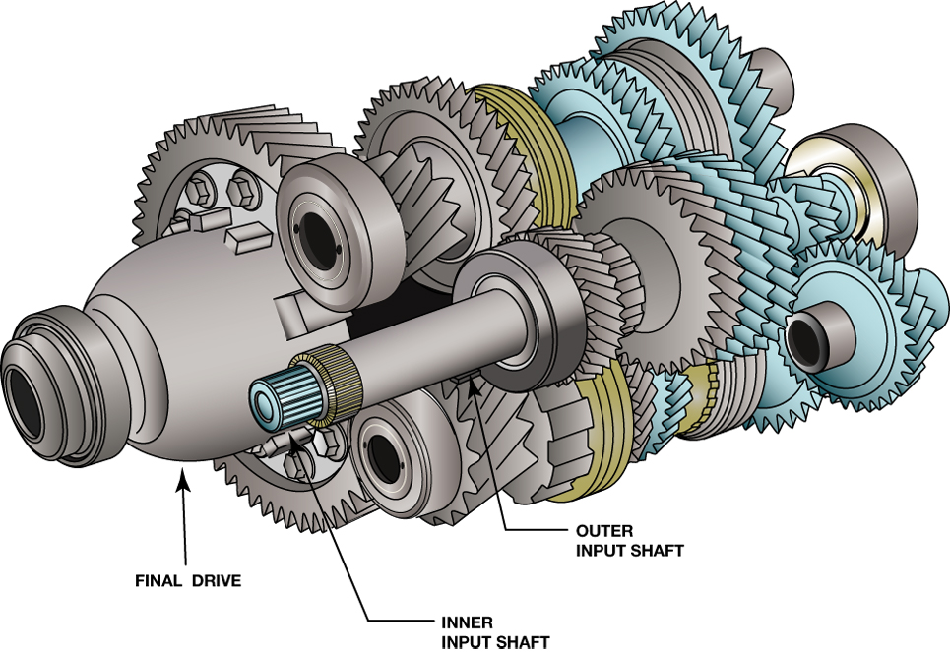
FIGURE 12–4 Notice the two concentric input shafts. Each shaft is splined to a clutch.

Slide 6
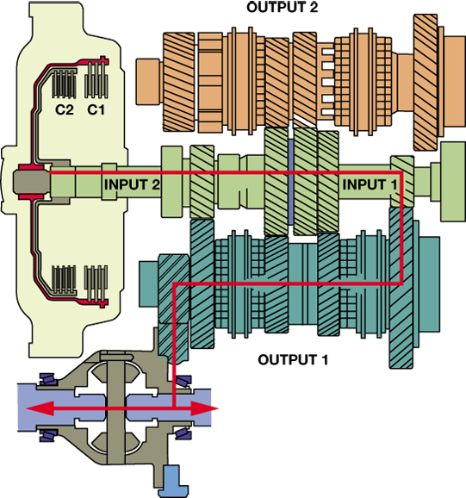
FIGURE 12–5 First gear engaged using clutch 1 (C1) to transmit engine torque.

Slide 7
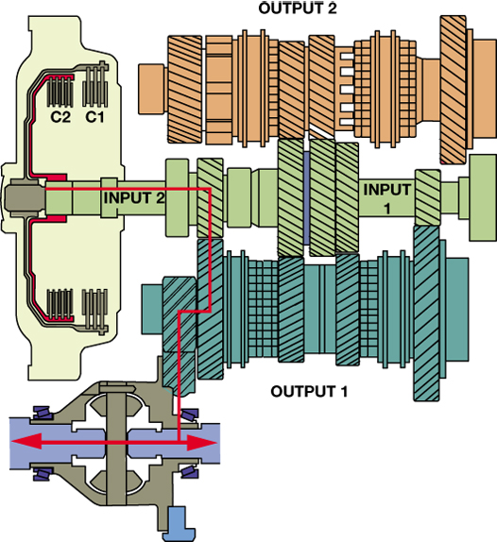
FIGURE 12–6 Second gear engaged using clutch 2 (C2) to transmit engine torque.

Slide 8
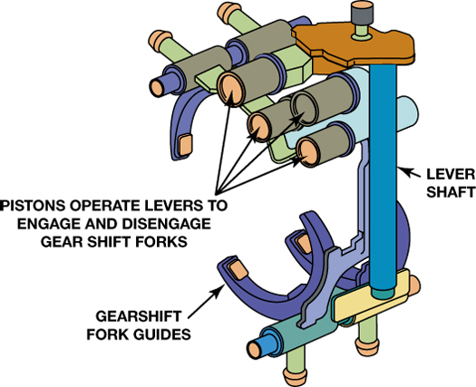
FIGURE 12–7 The shift forks are similar to those used in a manual transmission but are moved using hydraulic pistons.

Slide 9
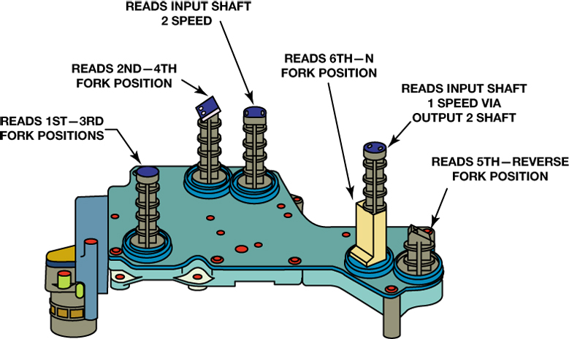
FIGURE 12–8 Fork position and shaft speed sensors are used as inputs to the TCM.

Slide 10
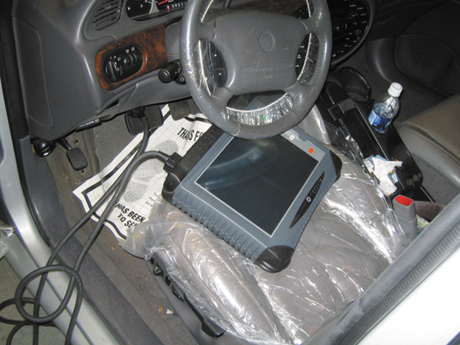
FIGURE 12–9 The use of a factory or a factory-level aftermarket scan tool is often needed to diagnose the dual clutch transmission system.

