Slide 1
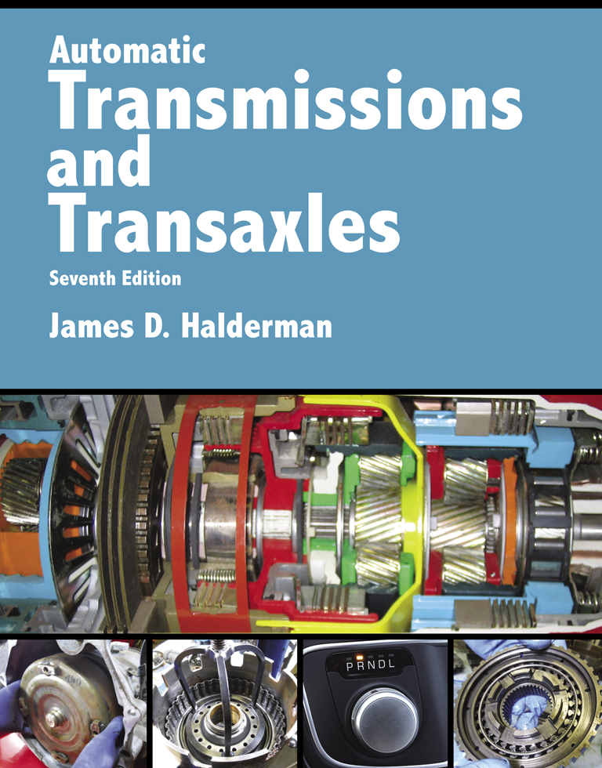
Automatic Transmissions and Transaxles
Seventh Edition
Chapter 11
Continuously Variable Transmissions

Slide 2
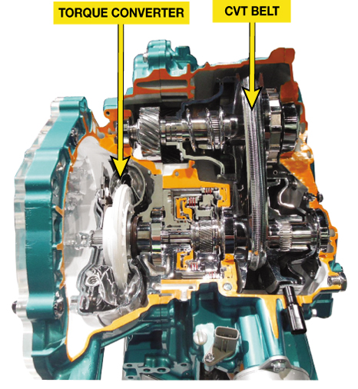
FIGURE 11–1 A typical CVT transaxle cutaway showing the torque converter and CVT belt.

Slide 3
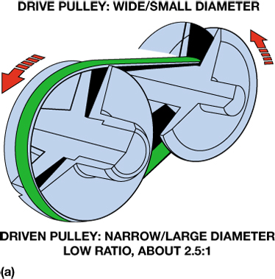
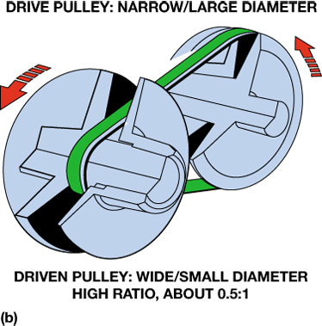
FIGURE 11–2 A belt and pulley CVT uses variable-width pulleys to provide an infinite number of speed ratios.

Slide 4
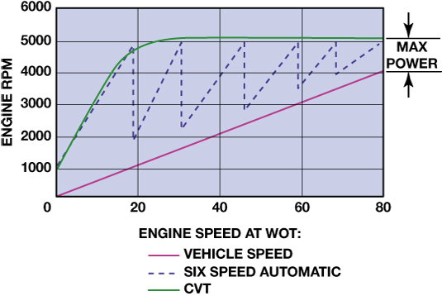
FIGURE 11–3 Engine speed and vehicle speed of a CVT transaxle compared to a typical six-speed conventional automatic transaxle.

Slide 5
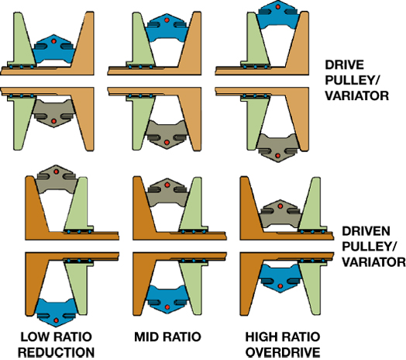
FIGURE 11–4 The drive pulley is wide while the driven pulley is narrow for a low ratio vehicle start (left). The ratio changes by making the drive pulley narrow and the driven pulley wider.

Slide 6
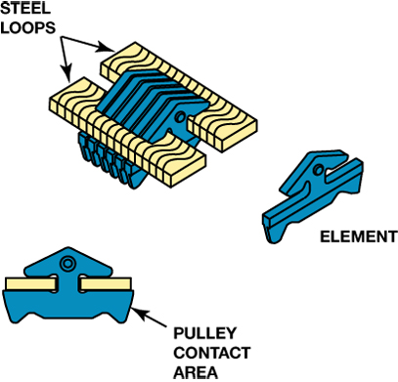
FIGURE 11–5 A Typical push-type CVT belt construction.

Slide 7
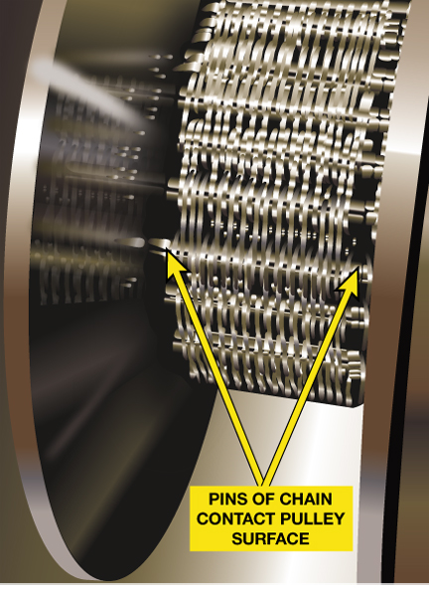
FIGURE 11–6 The pull chain looks similar to a silent chain.

Slide 8
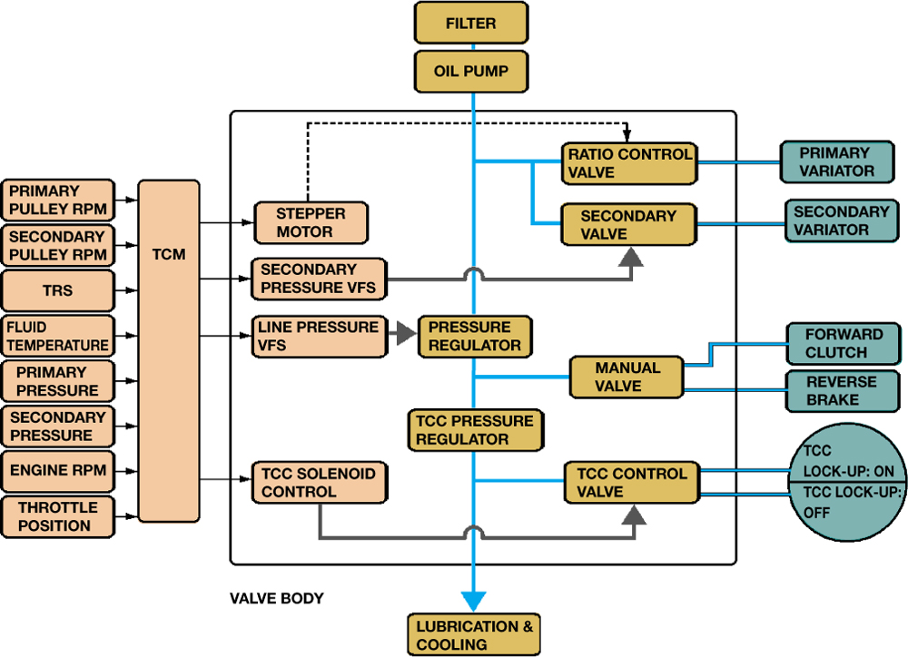
FIGURE 11–7 Block diagram showing the relationship between the TCM, electrical actuators, valve body, and hydraulic actuators for a CVT transmission.

Slide 9
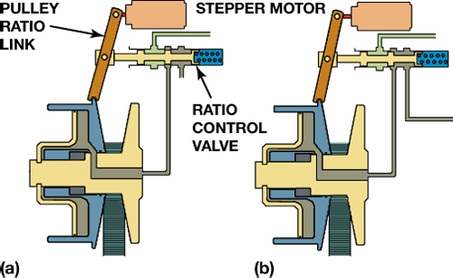
FIGURE 11–8 (a) The stepper motor and pulley ratio link with the CVT in low ratio. (b) The stepper motor has extended, moving the ratio link and ratio control valve; this should cause the primary pulley to become narrower to produce a higher ratio.

Slide 10
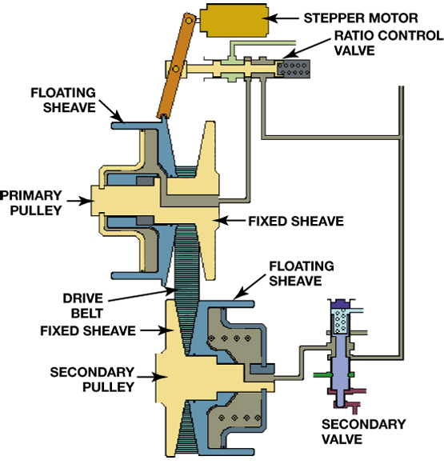
FIGURE 11–9 Movement of either the stepper motor or primary floating sheave will move the ratio control valve to add or remove fluid from the primary pulley. The secondary valve maintains the necessary pulley pressure on the drive belt.

Slide 11
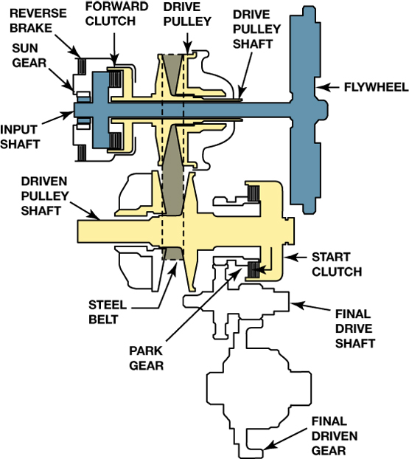
FIGURE 11–10 Honda CVT power flow in park (P) and neutral (N).

Slide 12
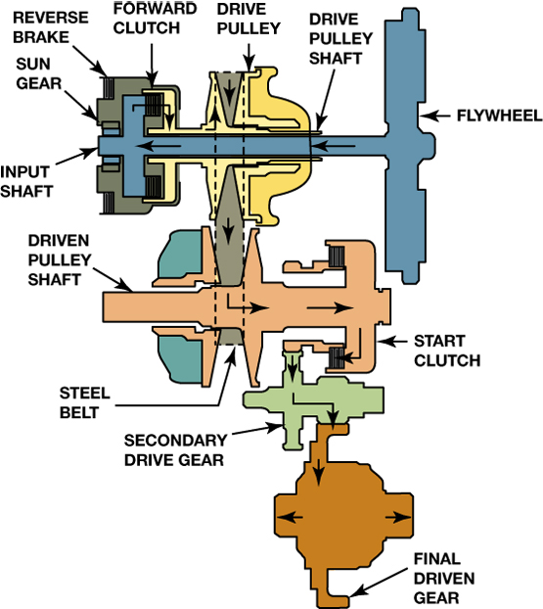
FIGURE 11–11 Honda CVT operation in drive (D) or low (L).

Slide 13
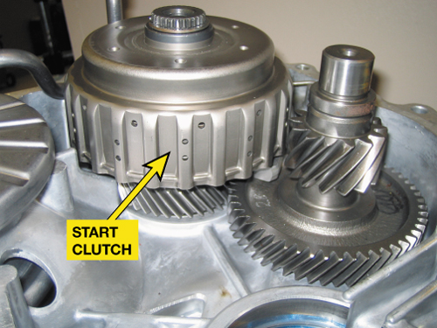
FIGURE 11–12 Location of the Honda CVT start clutch. The start clutch has been eliminated and replaced by a torque converter in newer models.

Slide 14
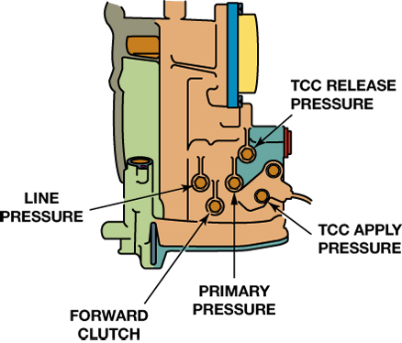
FIGURE 11–13 The pressure tap locations as found on a Dodge Caliber CVT transaxle.

Slide 15

FIGURE 11–14 Using the exact fluid recommended by the vehicle manufacturer is the preferred choice when servicing a CVT transaxles.

Slide 16
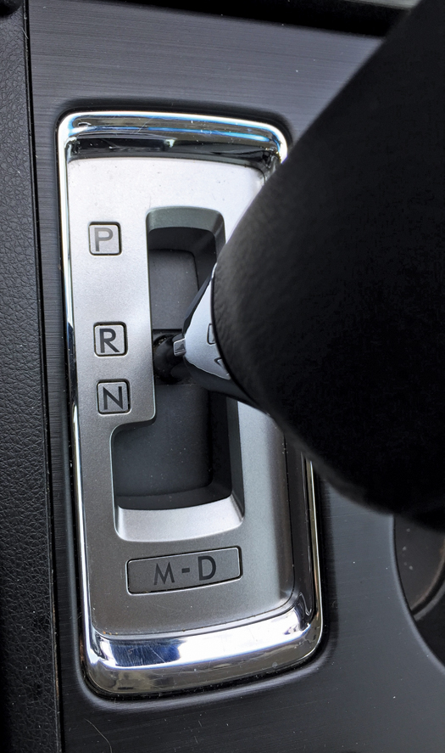
FIGURE 11–15 The “fix” to the customer concern was to perform a relearn procedure using the gear selector following the instructions found in a TSB.

