Slide 1
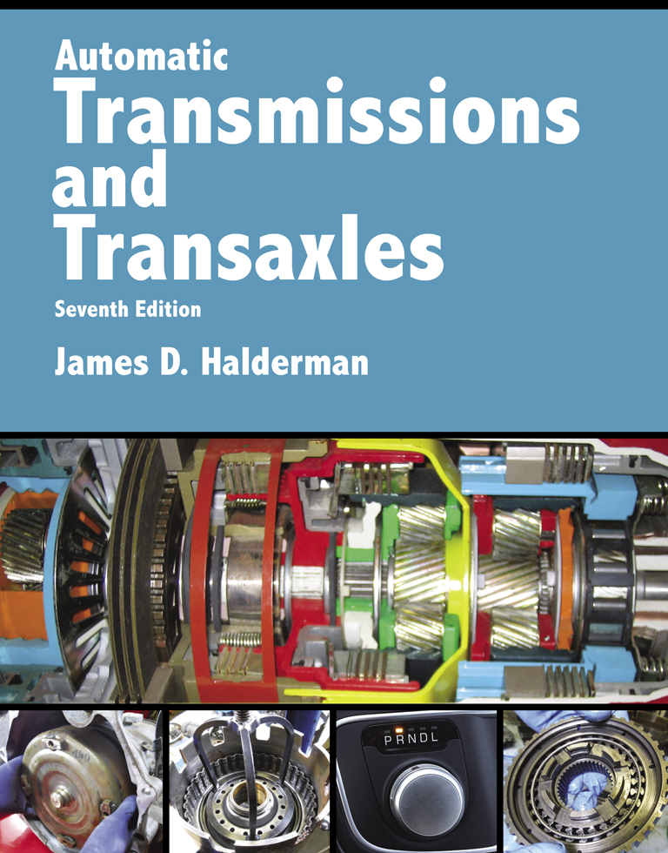
Automatic Transmissions and Transaxles
Seventh Edition
Chapter 10
Hybrid Electric Vehicle Transmissions and Transaxles

Slide 2
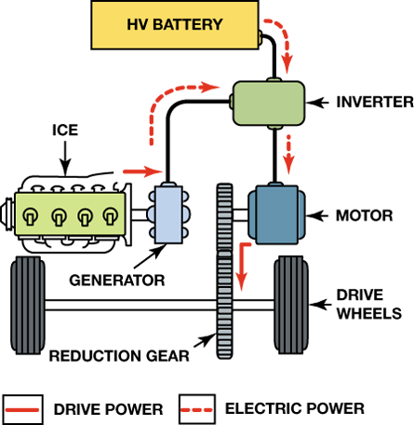
FIGURE 10–1 The power flow in a typical series-hybrid vehicle.

Slide 3
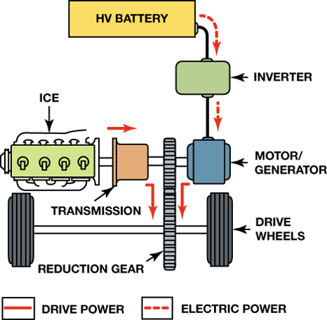
FIGURE 10–2 The power flow in a typical parallel-hybrid vehicle.

Slide 4
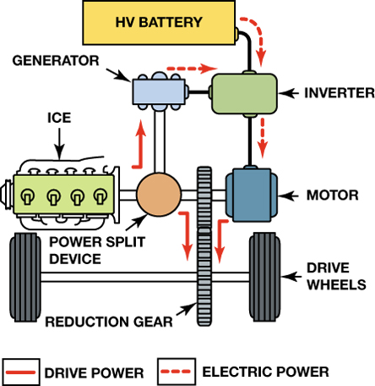
FIGURE 10–3 A series–parallel hybrid design allows the ­vehicle to operate in electric motor mode only or in combination with the internal combustion engine.

Slide 5
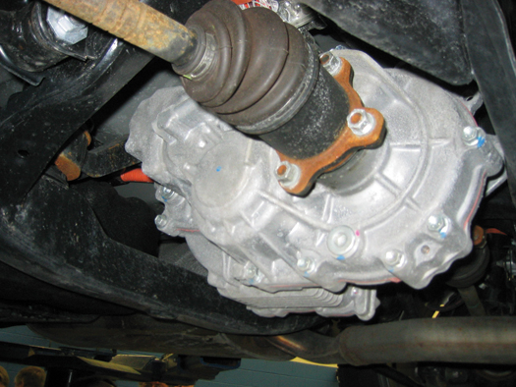
FIGURE 10–4 The rear electric motor on a Lexus RX400h SUV.

Slide 6
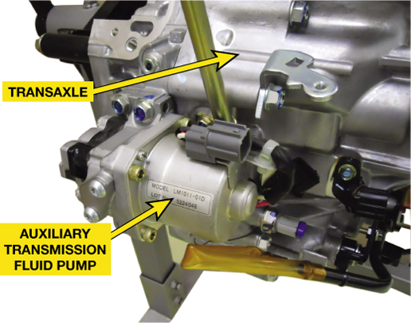
FIGURE 10–5 Honda Accord Hybrid auxiliary transmission fluid pump. This pump operates only when the ICE enters idle stop (stop–start) mode.

Slide 7
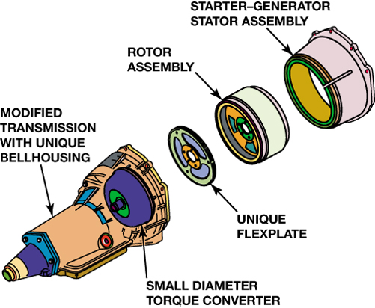
FIGURE 10–6 Integrated starter–generator (ISG) assembly adapted to a production 4L60E transmission. Note that the torque converter diameter is smaller to fit inside the rotor assembly.

Slide 8
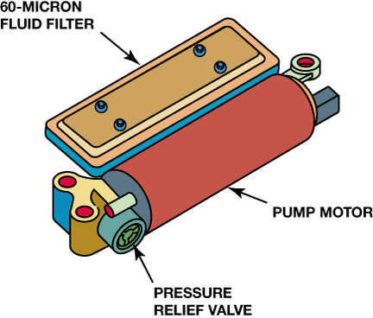
FIGURE 10–7 Electric secondary fluid pump from a 4L60E transmission in a GM hybrid pickup.

Slide 9
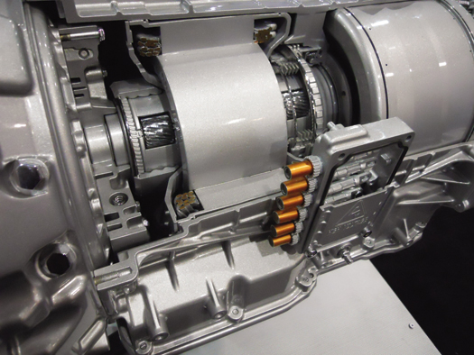
FIGURE 10–8 The two-mode transmission has orange high-voltage cables entering the unit to carry electric energy from the high-voltage battery pack to propel the vehicle and also to charge the battery during deceleration.

Slide 10
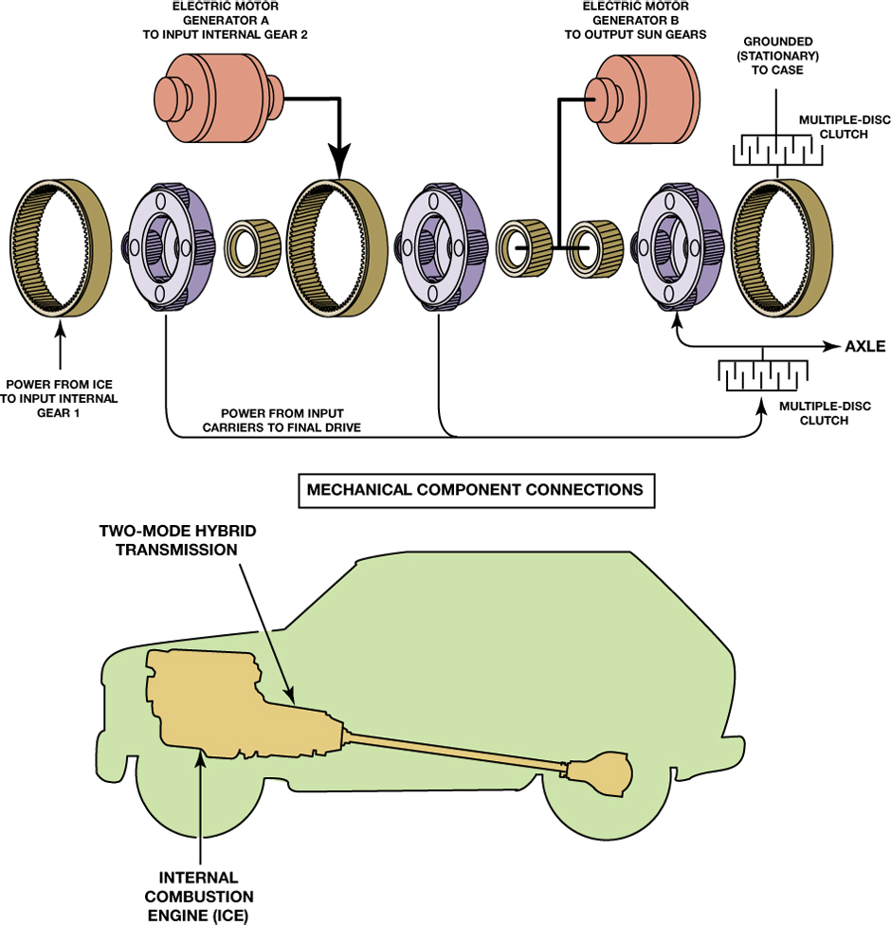
FIGURE 10–9 Using three planetary gear sets, the ICE can be maintained in the most efficient speed of about 2000 RPM under most operating conditions. The ICE powers only the the front ring gear in any mode and all three planet sets are locked together (#3 being the output set) when the rear clutch activates Hi-Mode. In low mode, the rear ring gear is grounded for deep reduction. The mode is determined by the two rear clutches.

Slide 11
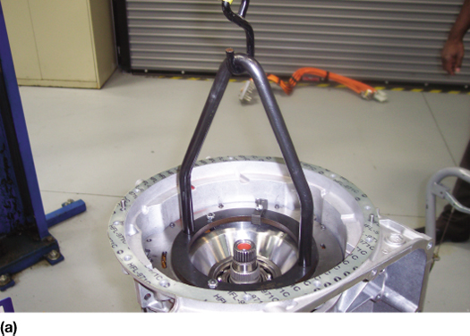
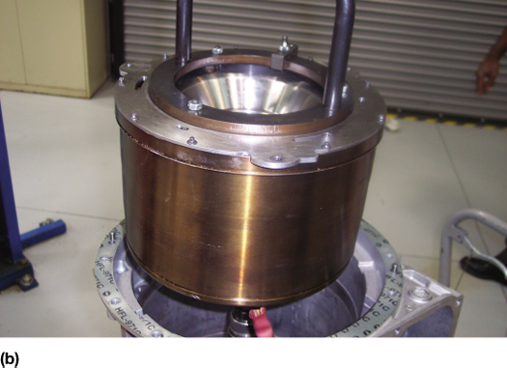
FIGURE 10–10 (a) Disassembly of the 2ML70 transmission requires the use of a lift or engine hoist to remove the motor assembly. (b) The motor assembly after being removed for the transmission.

Slide 12
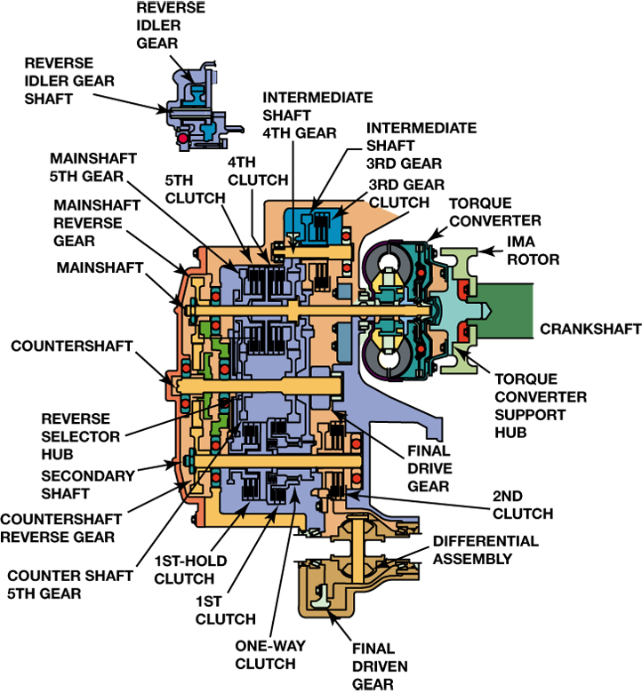
FIGURE 10–11 Cutaway view of Honda Accord Hybrid automatic transmission.

Slide 13
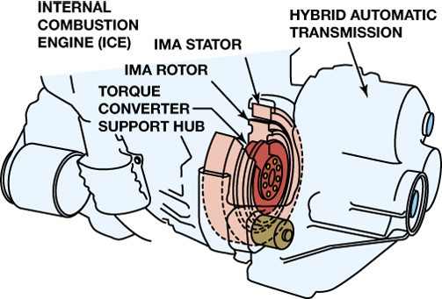
FIGURE 10–12 Honda Accord Hybrid power train, including 3.0-liter V6, IMA assembly, and 5-speed automatic transmission.

Slide 14
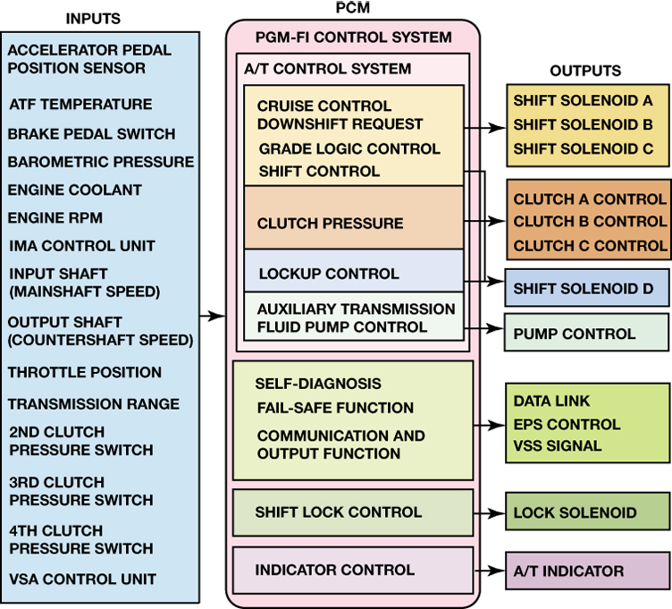
FIGURE 10–13 Control schematic for a Honda Accord Hybrid automatic transmission. Note that all sensor inputs are shown to the left of the PCM, while the output signals and actuators are shown on the right.

Slide 15
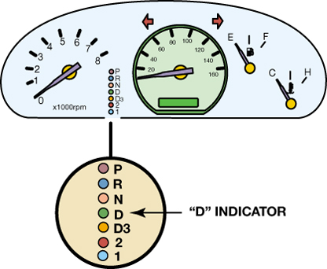
FIGURE 10–14 The Honda Accord Hybrid will alert the driver of a transmission malfunction by flashing the “D” indicator on the instrument panel.

Slide 16
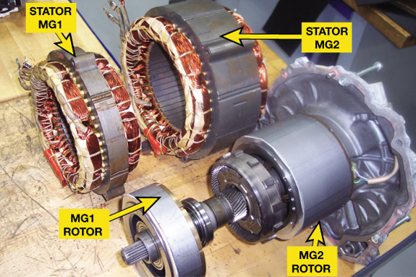
FIGURE 10–15 The Toyota Hybrid System uses two electric motor/generators (MG1 and MG2) and an ICE, all connected together by a power-split device, which is a simple planetary gear set.

Slide 17
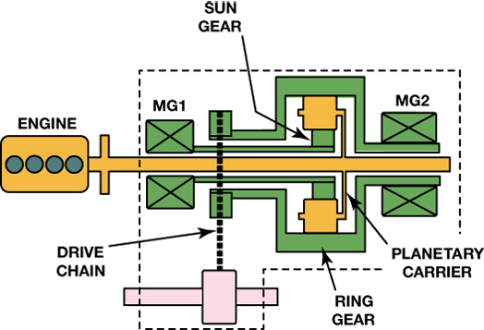
FIGURE 10–16 The power-split device from the Toyota Hybrid System. Note that the vehicle will move only when MG2 (and the ring gear) is turning.

Slide 18
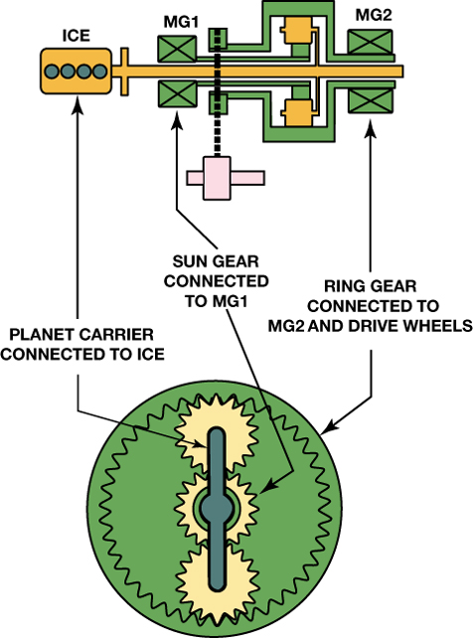
FIGURE 10–17 The planetary gear set used in the Toyota Hybrid System (THS) has 2.6 times the number of teeth in its ring gear as it has in its sun gear. This means that the ICE (attached to the planet carrier) will send 72% of its torque to the ring gear (drive wheels), and 28% of its torque to the sun gear (MG1).

Slide 19
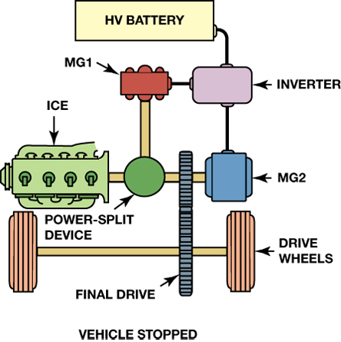
FIGURE 10–18 When the vehicle is stopped, the ICE is shut off along with both motor/generators.

Slide 20
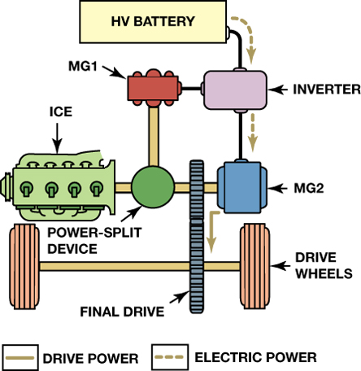
FIGURE 10–19 Under light acceleration, power is sent to MG2 to move the vehicle.

Slide 21
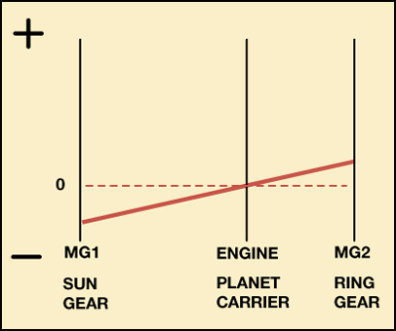
FIGURE 10–20 Light acceleration—the engine is stopped (0 RPM), MG2 is turning forward (+), and MG1 is turning backward (–).

Slide 22
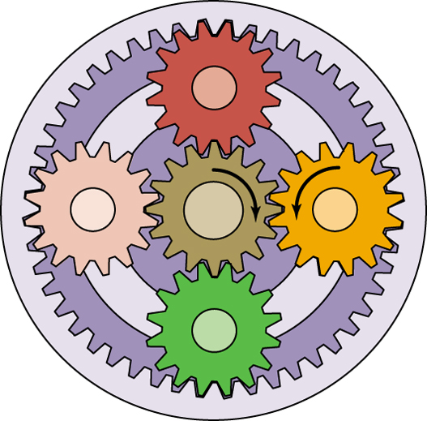
FIGURE 10–21 To start the ICE, MG1 (sun) acts as a motor and turns clockwise (CW), causing the planet carrier (attached to the ICE) to also turn CW.

Slide 23
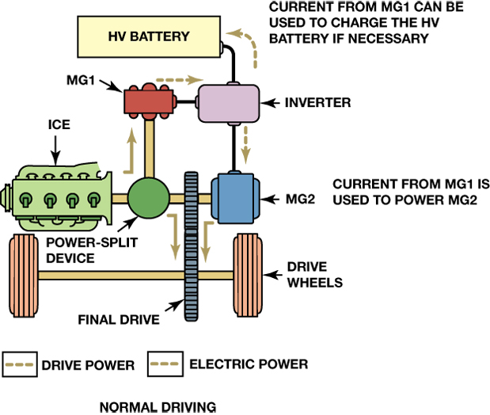
FIGURE 10–22 Normal driving—the ICE is now running and some of its torque is used to drive MG1. Electricity generated by MG1 is used to power MG2 or recharge the HV battery.

Slide 24
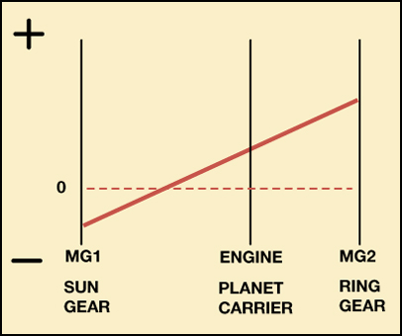
FIGURE 10–23 Normal driving—the engine is running, MG2 is turning forward (+), and MG1 is turning backward (−).

Slide 25
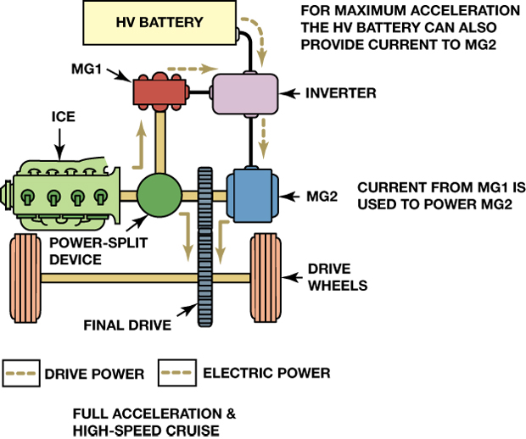
FIGURE 10–24 Full-throttle acceleration and high-speed cruise—with greater demand for acceleration, power from MG1 is combined with power from the HV battery to generate higher output from MG2. It is also possible to configure MG2 as a generator and send its power to MG1 (which then acts as a motor).

Slide 26
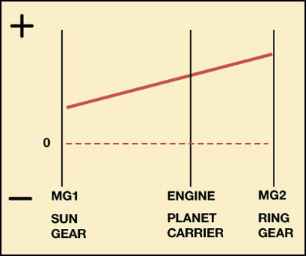
FIGURE 10–25 Full-throttle acceleration and high-speed cruise—this graph shows MG1 acting as a motor using power from MG2. This increases the speed of the ICE, allowing it to produce higher output.

Slide 27
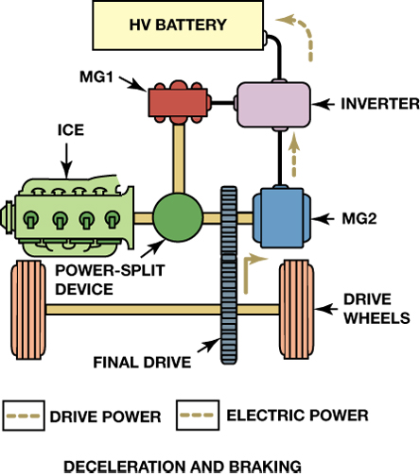
FIGURE 10–26 Deceleration and braking—MG2 is configured as a generator and recharges the HV battery.

Slide 28
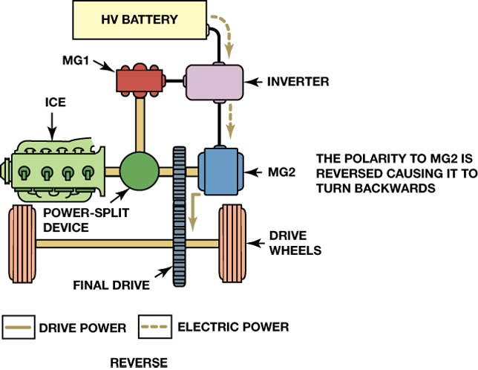
FIGURE 10–27 Reverse—MG2 alone is used to move the car in reverse. This is accomplished by reversing the direction of MG2.

Slide 29
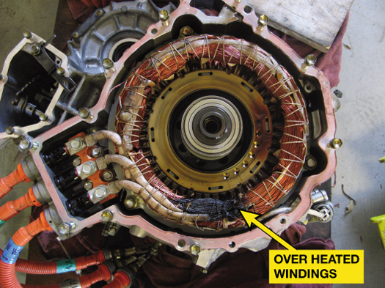
FIGURE 10–28 Excessive heat created in the electric motors must be controlled and proper maintenance of the cooling system is important for long life to help avoid overheating motor windings as shown.

Slide 30
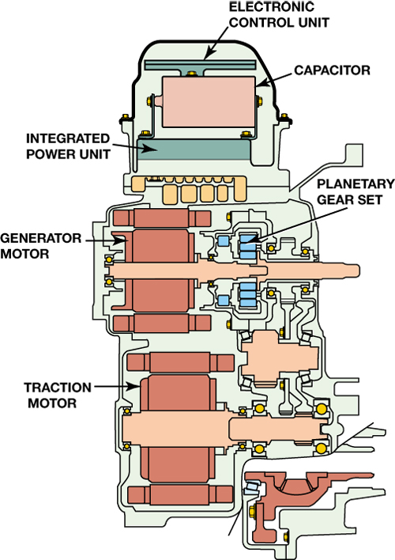
FIGURE 10–29 Cutaway view of the Ford Escape Hybrid transaxle.

Slide 31
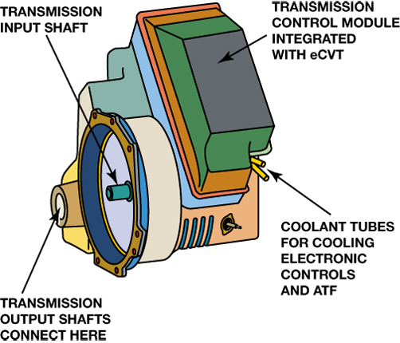
FIGURE 10–30 The Ford Escape Hybrid transaxle operates very similar to the one used in the Toyota Hybrid System, but is constructed very differently.

Slide 32
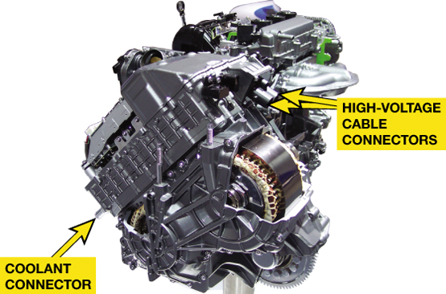
FIGURE 10–31 A Ford eCVT transaxle assembly showing the electrical connectors on the top of the assembly.

Slide 33
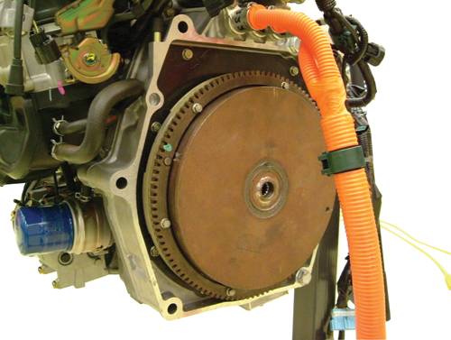
FIGURE 10–32 The Honda CVT is connected directly to the ICE through a drive plate and flywheel mechanism.

Slide 34
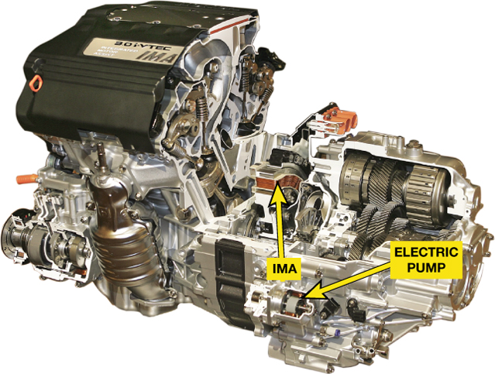
FIGURE 10–33 The Honda Accord V-6 hybrid electric vehicle uses a Honda non-planetary gear type automatic transaxle equipped with a small electric pump motor to maintain hydraulic fluid pressure during idle stop operation.

Slide 35
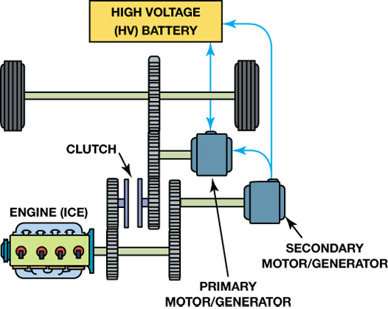
FIGURE 10–34 The primary motor/generator is used to propel the vehicle and the secondary motor/generator is used to start the engine and charge the high-voltage battery.

Slide 36
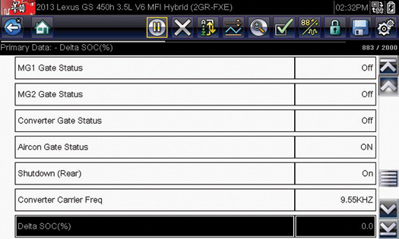
FIGURE 10–35 Some scan tool data may or may not be helpful unless there are codes or sub-codes that can lead to the source of a problem. For example, on this Lexus hybrid system, the screen capture shows that high voltage battery modules do not have an difference between them which eliminates the high voltage battery pack from being a concern.

