Slide 1
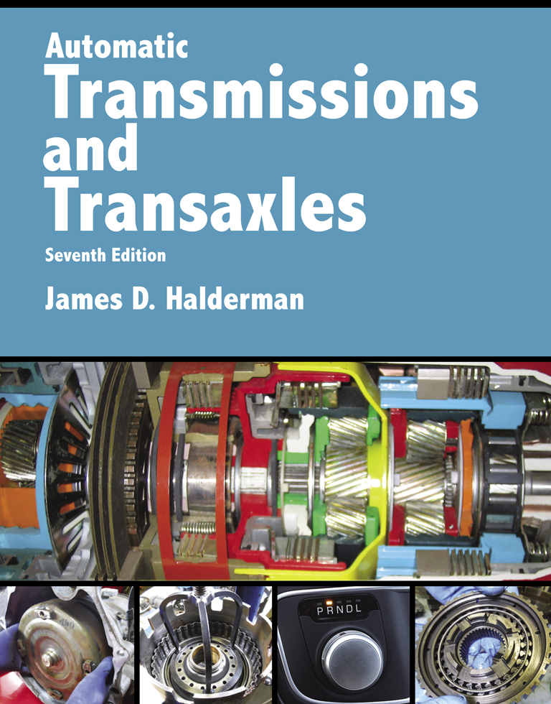
Automatic Transmissions and Transaxles
Seventh Edition
Chapter 1
Introduction to Drivetrains

Slide 2
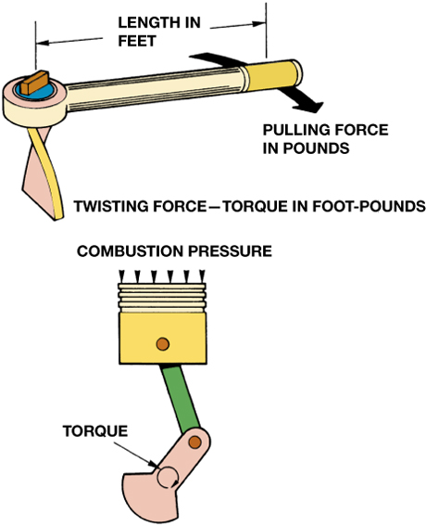
FIGURE 1–1 Torque, a twisting force, is produced when you pull on a wrench. An engine produces torque at the crankshaft as combustion pressure pushes the piston downward.

Slide 3
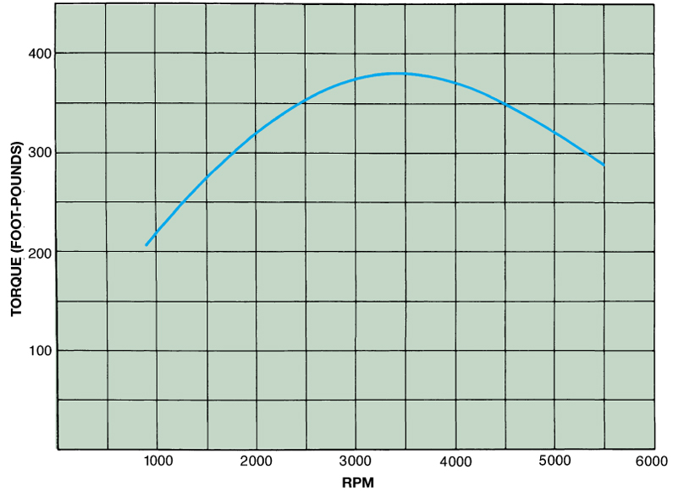
FIGURE 1–2 The torque produced by a 5.7 L engine as plotted on a graph. Note that the engine begins producing usable torque at 1000 to 1200 RPM and a maximum torque (381 ft-lb) at 3500 RPM. The torque produced by the engine decreases at higher RPM due to a decrease in volumetric efficiency.

Slide 4
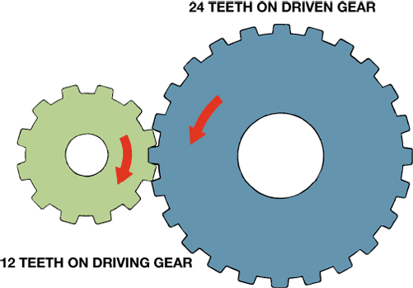
FIGURE 1–3 Gear ratio is determined by dividing the number of teeth of the driven (output) gear (24 teeth) by the number of teeth on the driving (input) gear (12 teeth). The ratio illustrated is 2:1.

Slide 5
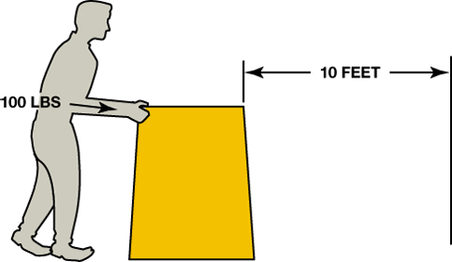
FIGURE 1–4 Work is calculated by multiplying force times distance. If you push 100 pounds 10 feet, you have done 1,000 foot-pounds of work.

Slide 6
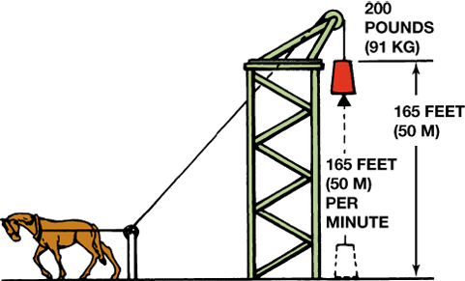
FIGURE 1–5 One horsepower is equal to 33,000 foot-pounds (200 lbs × 165 ft) of work per minute.

Slide 7
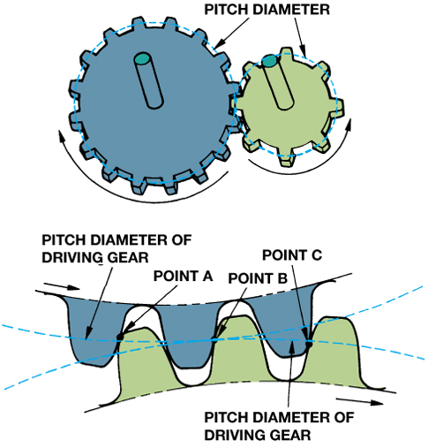
FIGURE 1–6 The pitch diameter is the effective diameter of the gear. Note how the contact points slide on the gear teeth as they move in and out of contact.

Slide 8
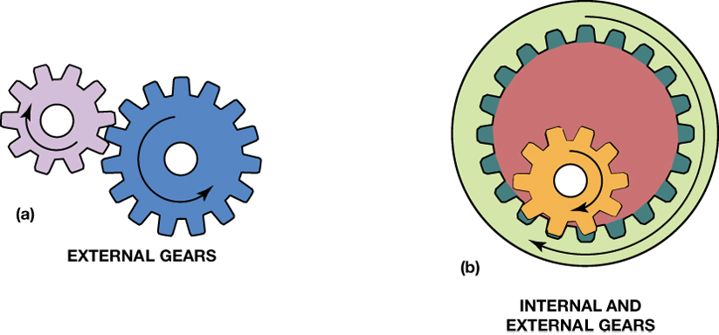
FIGURE 1–7 (a) When one external gear drives another, the direction of rotation is always reversed. (b) When an external gear drives an internal gear, the two gears will rotate in the same direction.

Slide 9
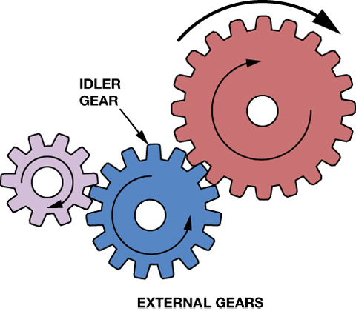
FIGURE 1–8 An idler gear reverses the direction of rotation so that the driving and driven gears rotate in the same direction.

Slide 10
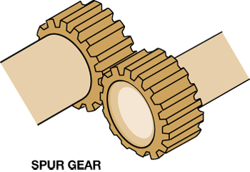
FIGURE 1–9 The teeth of a spur gear are cut parallel to the shaft, and this produces a straight pressure between the driving and the driven gear teeth.

Slide 11
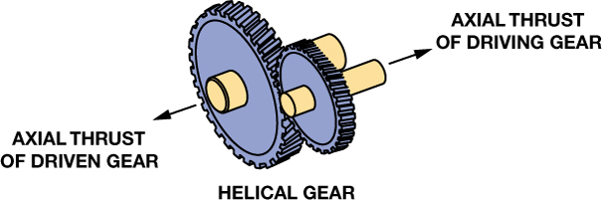
FIGURE 1–10 The teeth of a helical gear are cut on a slant, and this produces an axial or side thrust.

Slide 12
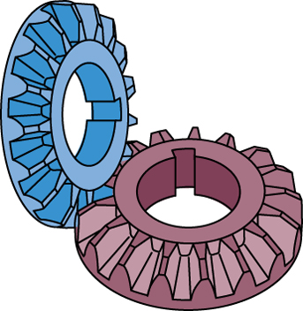
FIGURE 1–11 Bevel gears are commonly used in differentials.

Slide 13
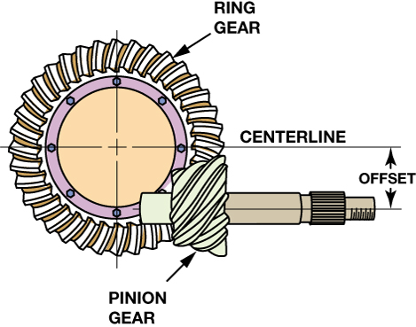
FIGURE 1–12 A hypoid gear set uses a pinion gear that is located below the centerline of the ring gear and is commonly used in drive axles.

Slide 14
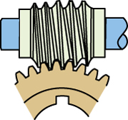
FIGURE 1–13 A worm gear set is also used to transmit power between angled shafts.

Slide 15
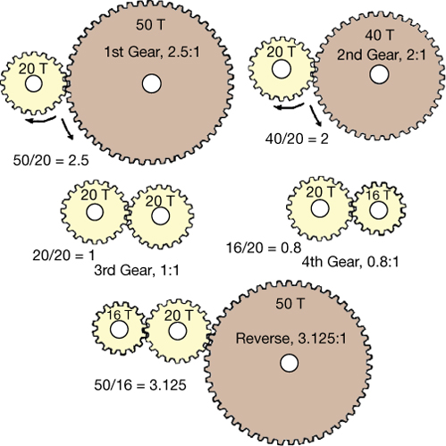
FIGURE 1–14 The gear ratio is determined by dividing the number of teeth on the driven (output) gear by the number of teeth on the driving (input) gear.

Slide 16
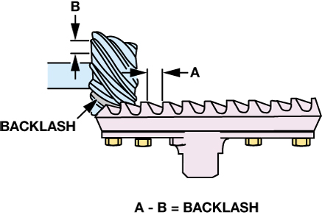
FIGURE 1–15 Backlash is the clearance between the teeth of two meshing gears. There has to be some clearance (backlash) to prevent the gears from getting into a bind condition when they are transmitting torque.

Slide 17
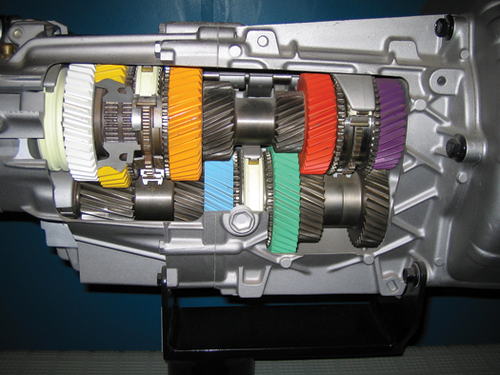
FIGURE 1–16 A manual transmission provides several gear ratios and a method to shift them.

Slide 18
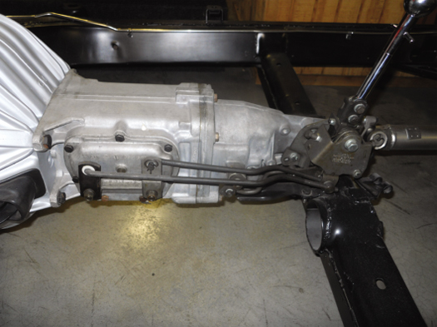
FIGURE 1–17 A Muncie four-speed manual transmission on a restored muscle car is an example of a close-ratio manual transmission.

Slide 19
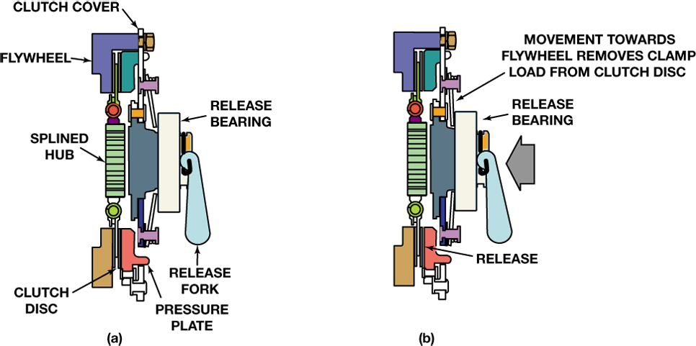
FIGURE 1–18 (a) A clutch cover (pressure plate assembly) is bolted onto the flywheel with the clutch disc between them. The release bearing and fork provide a method to release (disengage) the clutch. (b) When the clutch is engaged, the disc is squeezed against the flywheel by the pressure plate. Releasing the clutch separates the disc from the flywheel and pressure plate.

Slide 20
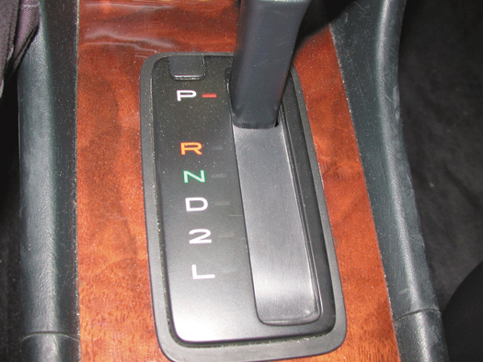
FIGURE 1–19 The gear selector is often called the “PRNDL,” pronounced “prindle,” regardless of the actual letters or numbers used.

Slide 21
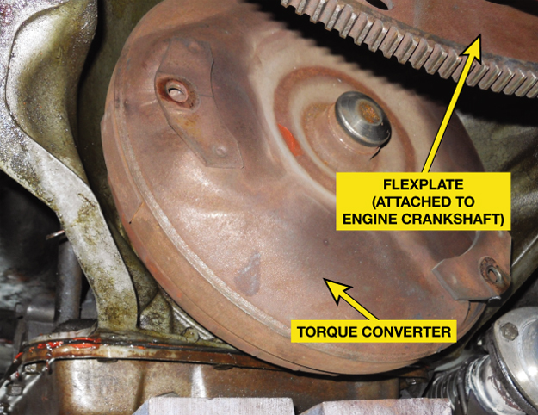
FIGURE 1–20 A torque converter is attached to the engine crankshaft and the other end is splined to the input shaft of the automatic transmission. The torque converter is used to transmit engine torque to the transmission, yet slip when the engine is at idle speed.

Slide 22
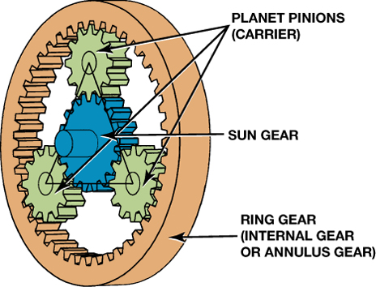
FIGURE 1–21 A typical planetary gear set showing the terms that are used to describe each member.

Slide 23
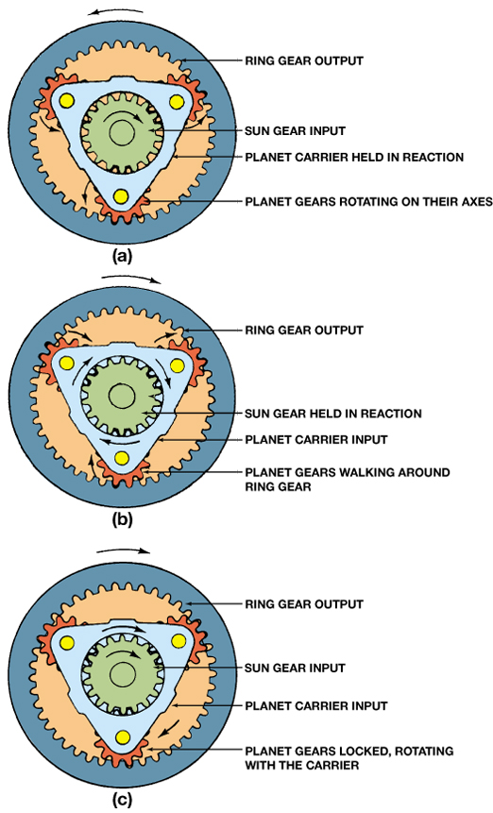
FIGURE 1–22 (a) If the planet carrier is held with the sun gear rotating, the planet gears simply rotate in the carrier and act as idler gears between the sun and ring gears. (b) If the sun or ring is held, the planet gears will walk around that stationary gear; they rotate on their shafts as the carrier rotates. (c) If two parts are driven and no parts are held, the planet gears are stationary on their shafts, and the whole assembly rotates as a unit.

Slide 24
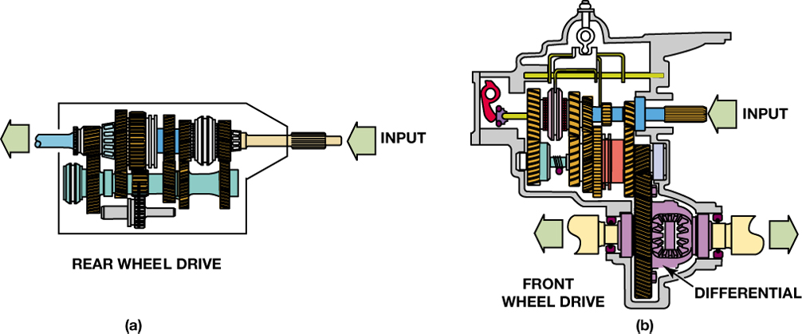
FIGURE 1–23 A RWD drivetrain uses a transmission to provide the necessary gear ratio and a single driveshaft to transfer power to the rear axle (a). A FWD drivetrain uses a transaxle that combines the transmission’s final drive, and differential (b). A driveshaft is used for each front drive wheel.

Slide 25
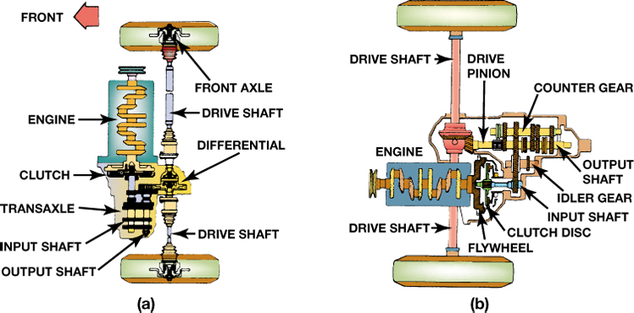
FIGURE 1–24 Transverse (a) and longitudinal (b) mounted front-wheel-drive (FWD) drivetrains.

Slide 26
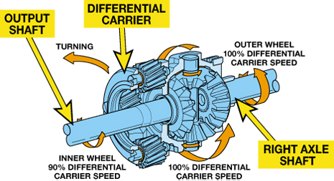
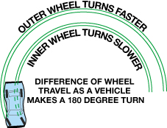
FIGURE 1–25 What happens when a vehicle makes a turn.

Slide 27
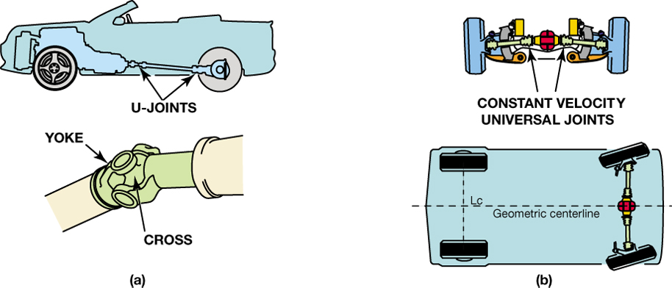
FIGURE 1–26 (a) A rear-wheel-drive (RWD) driveshaft uses a pair of universal joints to allow the rear axle to move up and down. (b) A front-wheel-drive (FWD) driveshaft uses a pair of constant-velocity joints to allow the front wheels to move up and down and steer.

Slide 28
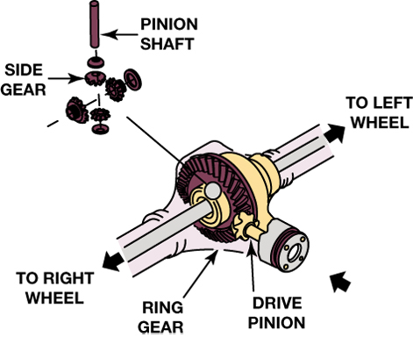
FIGURE 1–27 A drive axle includes a ring and pinion gear to produce a lower gear ratio. The drive axle also turns the power flow 90° and a differential (differential pinion and side gears) to allow the drive wheels to rotate at different speeds.

Slide 29
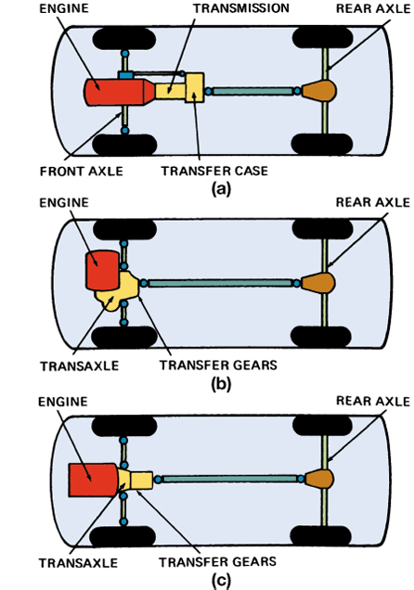
FIGURE 1–28 Three major 4WD configurations. The traditional form (a) uses a transfer case to split the torque for the front and rear drive axles. Both (b) and (c) are typical AWD configurations.

