Slide 1
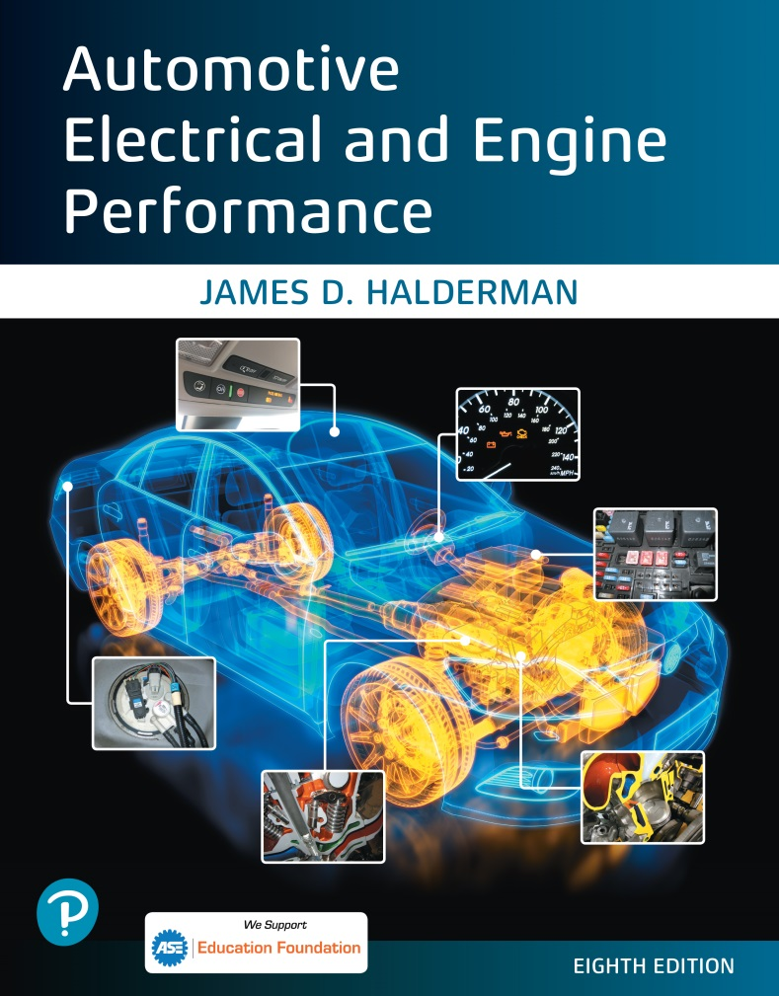
Automotive Electrical and Engine Performance
Eighth Edition
Chapter 09
Wiring Schematics and Circuit Testing
Copyright © 2020, 2016 Pearson Education, Inc. All Rights Reserved

Slide 2
Figure 9.1 The center wire is a solid color wire, meaning that the wire has no other identifying tracer or stripe color. The two end wires could be labeled “B L U/W H T,” indicating a blue wire with a white tracer or stripe

Slide 3
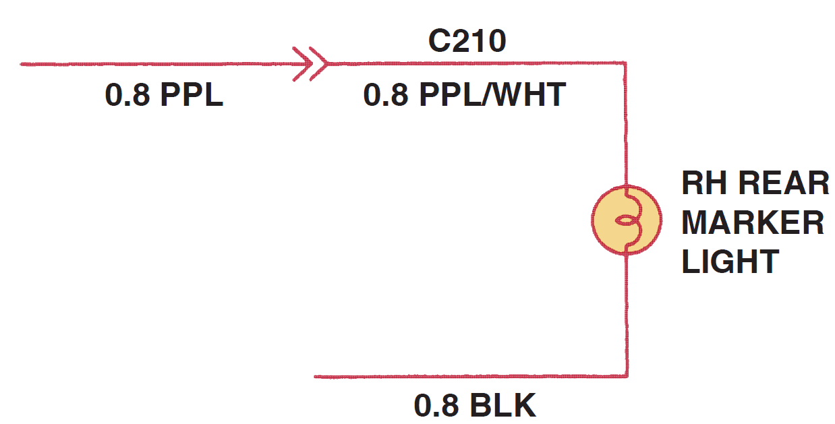
Figure 9.2 Typical section of a wiring diagram. Notice that the wire color changes at connection C210. The “0.8” represents the metric wire size in square millimeters

Slide 4
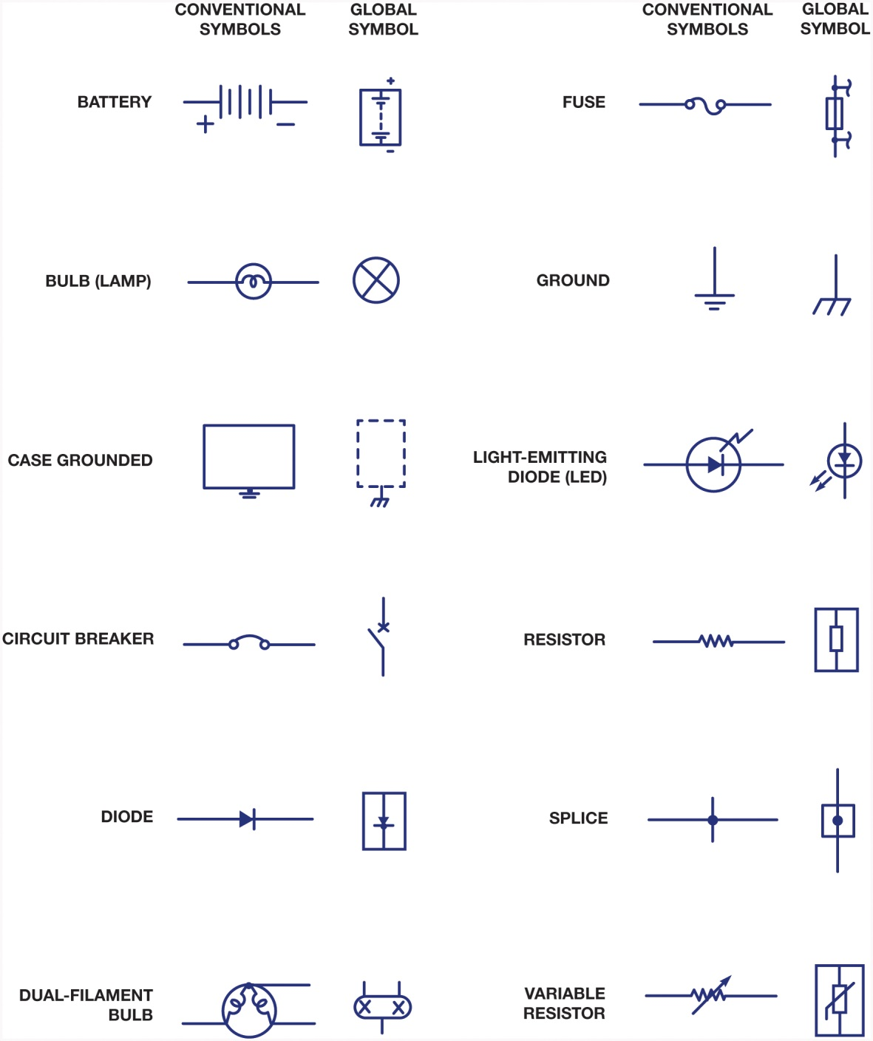
Figure 9.3 Typical electrical and electronic symbols used in automotive wiring and circuit diagrams. Both the conventional and the global symbols are shown side-by-side to make reading schematics easier. The global symbols are used by many vehicle manufacturers

Slide 5
Figure 9.4 In this typical connector, note that the positive terminal is usually a female connector

Slide 6
Figure 9.5 The symbol for a battery. The positive plate of a battery is represented by the longer line and the negative plate by the shorter line. The voltage of the battery is usually stated next to the symbol

Slide 7
Figure 9.6 The ground symbol on the left represents an earth ground. The ground symbol on the right represents a chassis ground

Slide 8
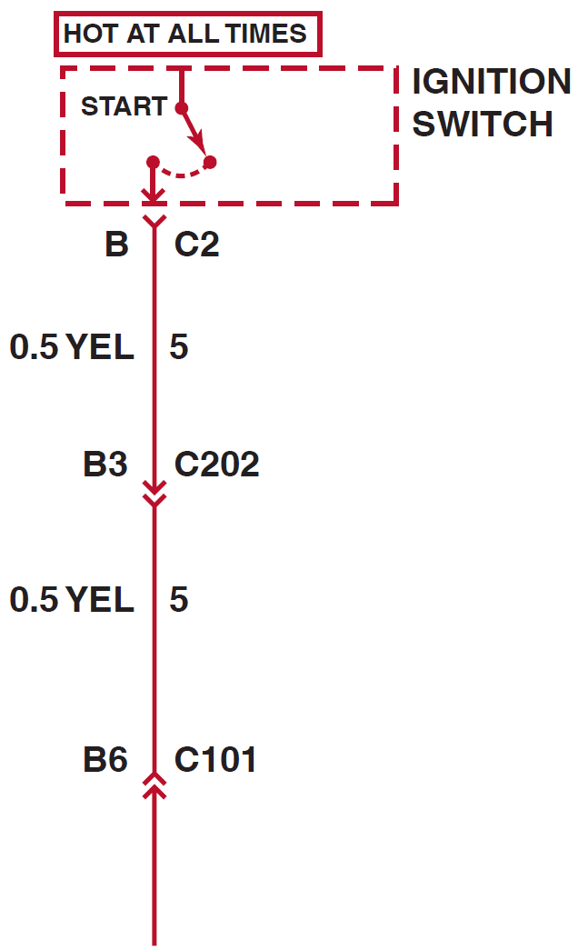
Figure 9.7 Starting at the top, the wire from the ignition switch is attached to terminal B of connector C2, the wire is 0.5 mm² (20-gauge A W G), and is yellow. The circuit number is 5. The wire enters connector C202 at terminal B3

Slide 9
Figure 9.8 The electrical terminals are usually labeled with a letter or number

Slide 10
Figure 9.9 Two wires that cross at the dot indicate that the two are electrically connected

Slide 11
Figure 9.10 Wires that cross, but do not electrically contact each other, are shown with one wire bridging over the other

Slide 12
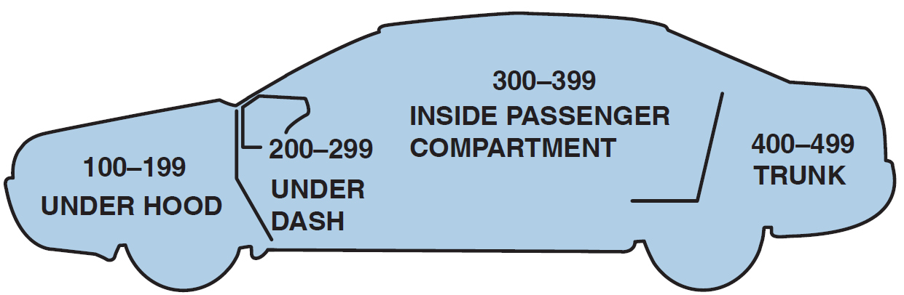
Figure 9.11 Connectors (C), grounds (G), and splices (S) are followed by a number, generally indicating the location in the vehicle. For example, G209 is a ground connection located under the dash

Slide 13
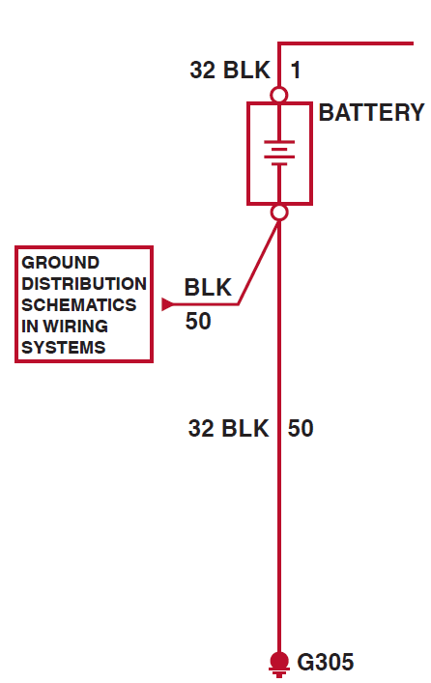
Figure 9.12 The ground for the battery is labeled G305 indicating the ground connector is located in the passenger compartment of the vehicle. The ground wire is black (B L K), the circuit number is 50, and the wire is 32 mm² (2-gauge A W G)

Slide 14
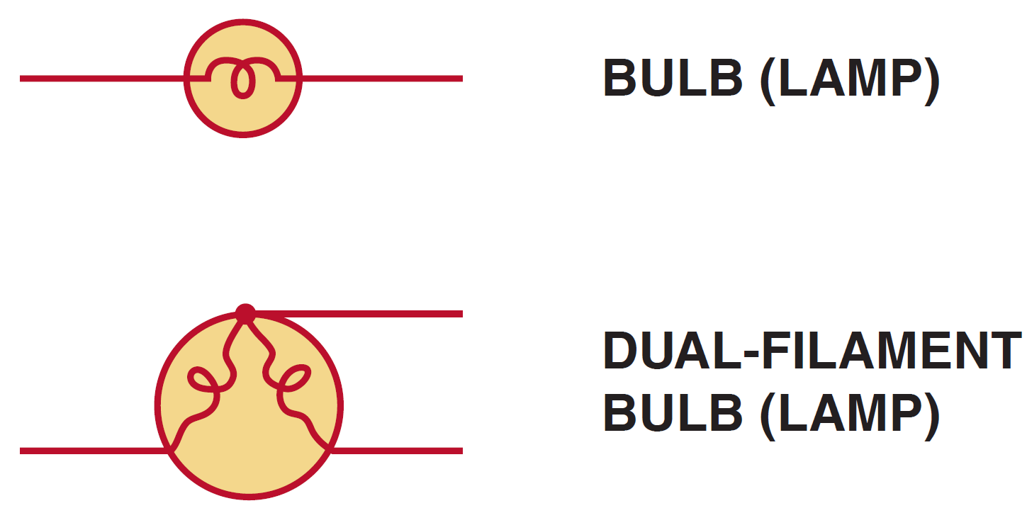
Figure 9.13 The symbol for lightbulbs shows the filament inside a circle, which represents the glass ampoule of the bulb

Slide 15
Figure 9.14 An electric motor symbol shows a circle with the letter M in the center and two black sections that represent the brushes of the motor. This symbol is used even though the motor is a brushless design

Slide 16
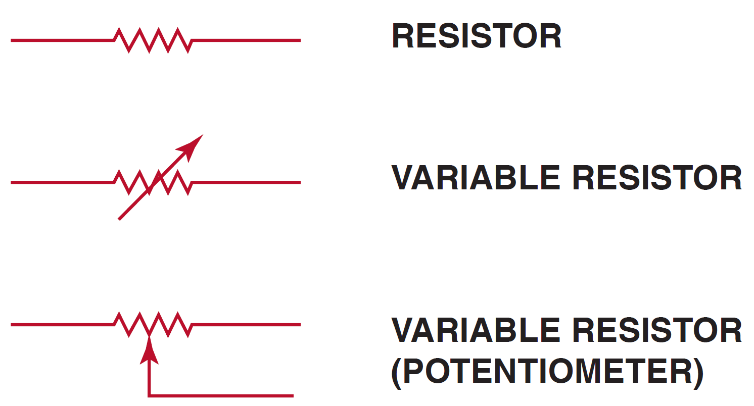
Figure 9.15 Resistor symbols vary depending on the type of resistor

Slide 17
Figure 9.16 A rheostat uses only two wires—one is connected to a voltage source and the other is attached to the movable arm

Slide 18
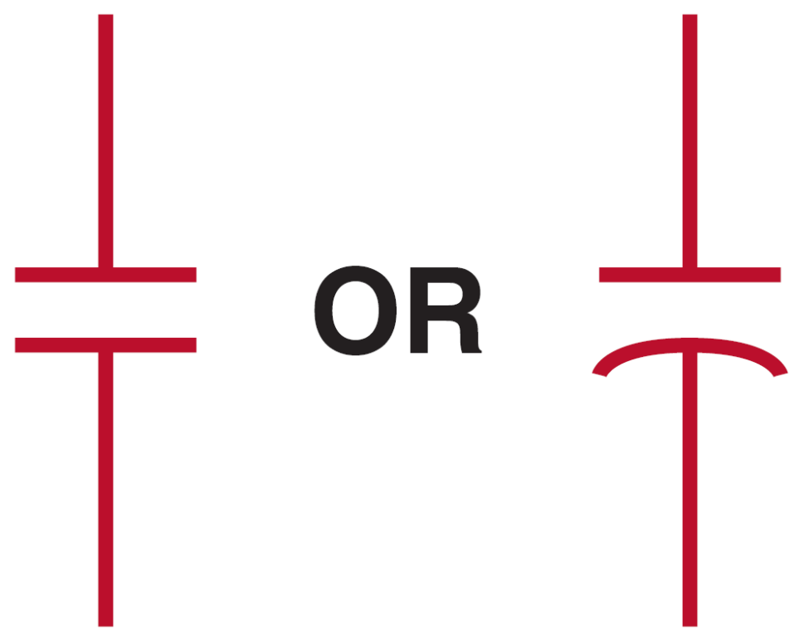
Figure 9.17 Symbols used to represent capacitors. If one of the lines is curved, the capacitor being used has a polarity, while the one without a curved line can be installed in the circuit without concern about polarity

Slide 19
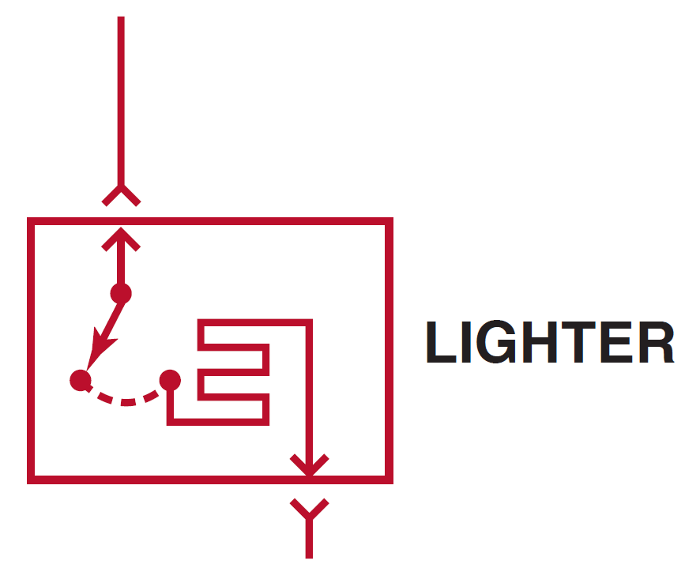
Figure 9.18 The grid-like symbol represents an electrically heated element

Slide 20
Figure 9.19 A dashed outline represents a portion (part) of a component

Slide 21
Figure 9.20 A solid box represents an entire component

Slide 22
Figure 9.21 This symbol represents a component that is case grounded

Slide 23
Figure 9.22 (a) A symbol for a single-pole, single-throw (S P S T ) switch. This type of switch is normally open (N.O.) because nothing is connected to the terminal that the switch is contacting in its normal position. (b) A single-pole, double-throw (S P D T ) switch has three terminals

Slide 24
Figure 9.22 (c) A double-pole, single-throw (D P S T ) switch has two positions (off and on) and can control two separate circuits. (d) A double-pole, double-throw (D P D T ) switch has six terminals—three for each pole
Note: Both (c) and (d) also show a dotted line between the two arms indicating that they are mechanically connected, called a “ganged switch.”

Slide 25
Figure 9.23 (a) A symbol for a normally open (N.O.) momentary switch. (b) A symbol for a normally closed (N.C.) momentary switch

Slide 26
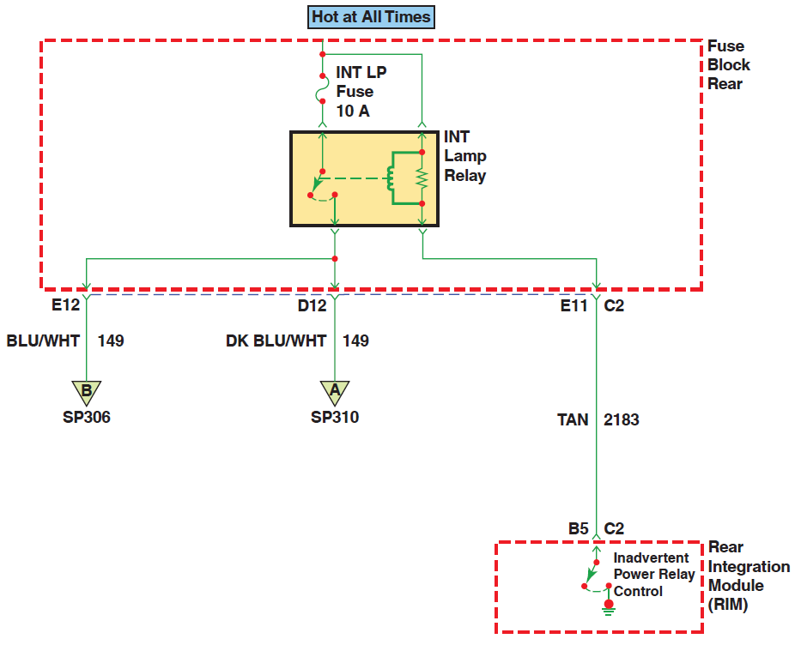
Figure 9.24 Color the parts of the circuit that have 12 volts, then take it to the vehicle to see if power is available at each location marked

Slide 27
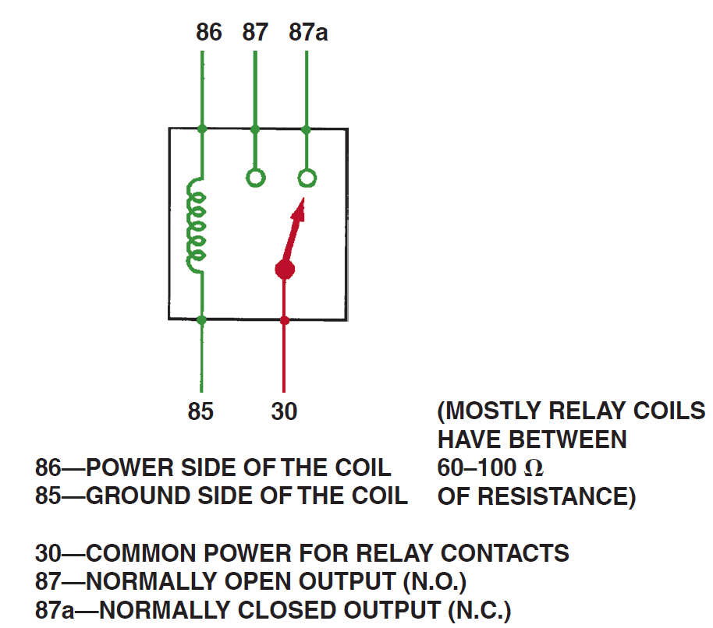
Figure 9.25 A relay uses a movable arm to complete a circuit whenever there is a power at terminal 86 and a ground at terminal 85. A typical relay only requires about 1/10 ampere through the relay coil. The movable arm then closes the contacts (#30 to #87) and can relay 30 amperes or more

Slide 28
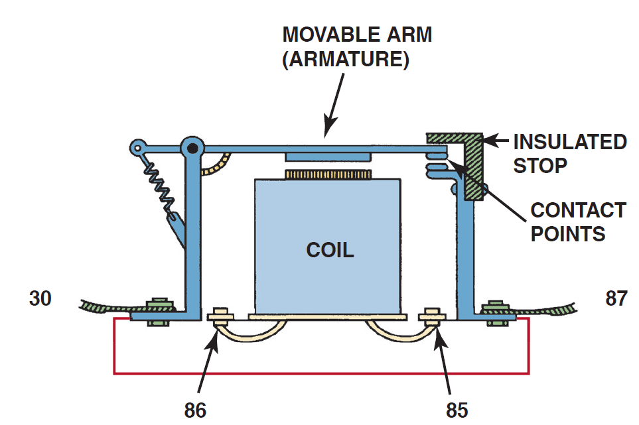
Figure 9.26 A cross-sectional view of a typical four-terminal relay. Current flowing through the coil (terminals 86 and 85) causes the movable arm (called the armature) to be drawn toward the coil magnet. The contact points complete the electrical circuit connected to terminals 30 and 87

Slide 29
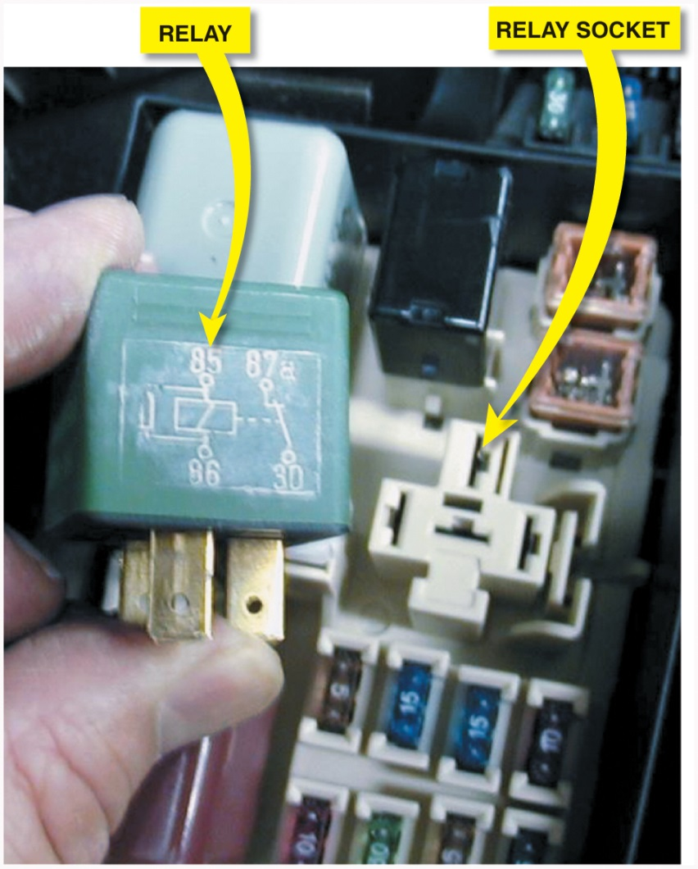
Figure 9.27 A typical relay showing the schematic of the wiring in the relay

Slide 30
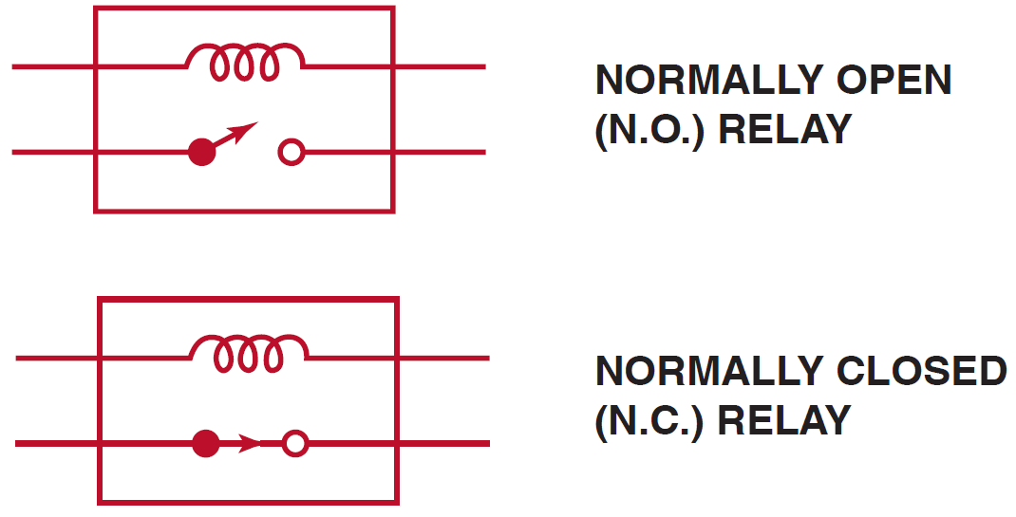
Figure 9.28 All schematics are shown in their normal, nonenergized position

Slide 31
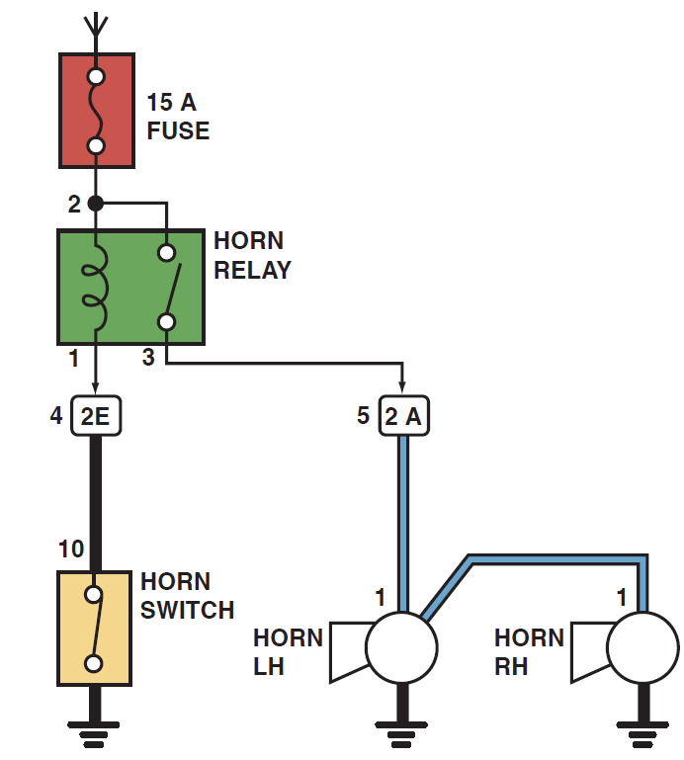
Figure 9.29 A typical horn circuit. Note that the relay contacts supply the heavy current to operate the horn when the horn switch simply completes a low-current circuit to ground, causing the relay contacts to close

Slide 32
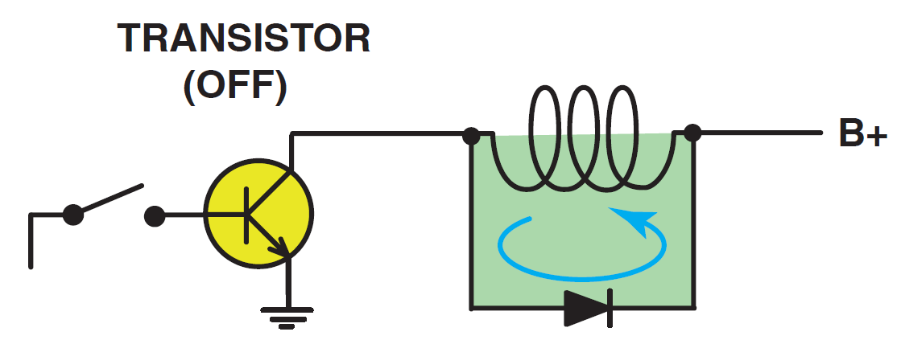
Figure 9.30 When the relay or solenoid coil current is turned off, the stored energy in the coil flows through the clamping diode and effectively reduces voltage spike

Slide 33
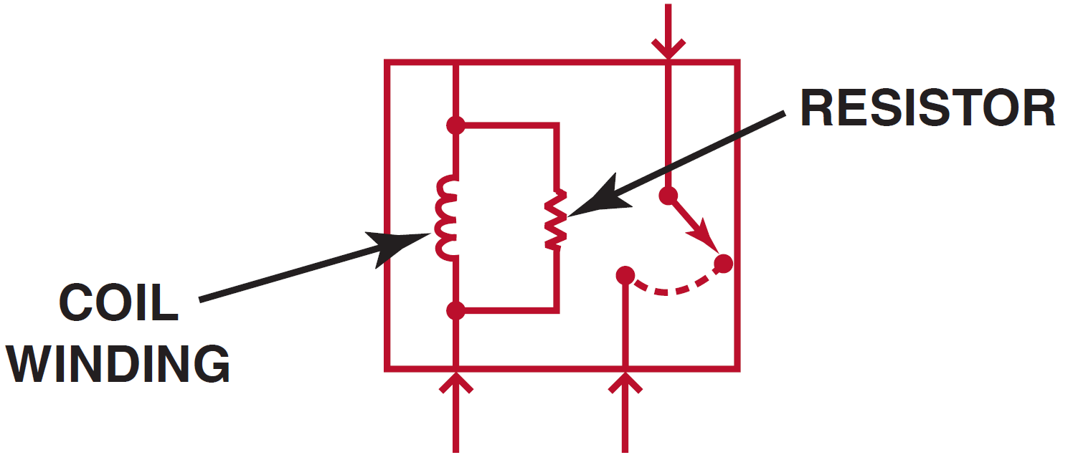
Figure 9.31 A resistor used in parallel with the coil windings is a common spike reduction method used in many relays

Slide 34
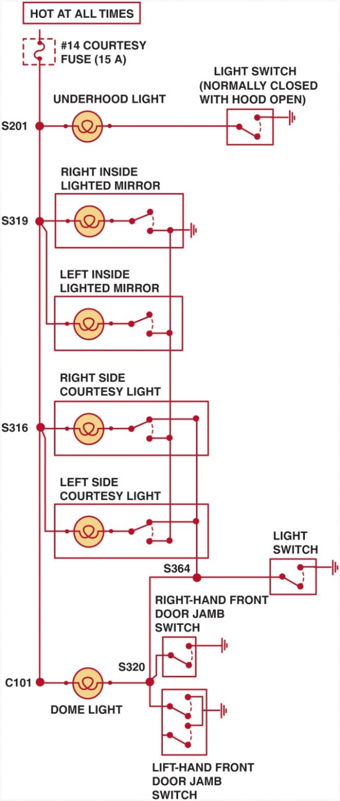
Figure 9.32 A typical wiring diagram showing multiple switches and bulbs powered by one fuse

Slide 35
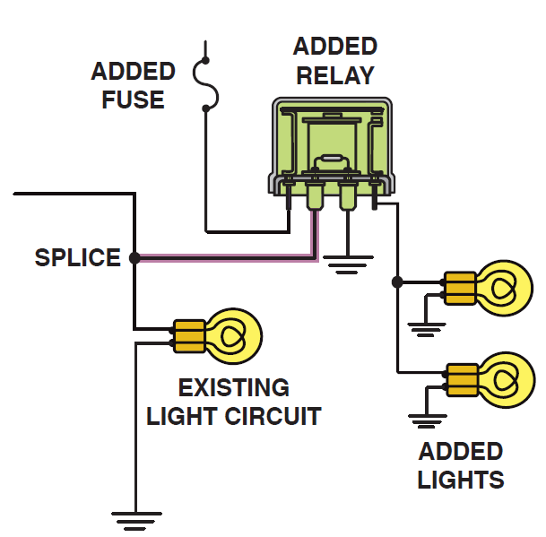
Figure 9.33 To add additional lighting, simply tap into an existing light wire and connect a relay. Whenever the existing light is turned on, the coil of the relay is energized. The arm of the relay then connects power from another circuit (fuse) to the auxiliary lights without overloading the existing light circuit

Slide 36
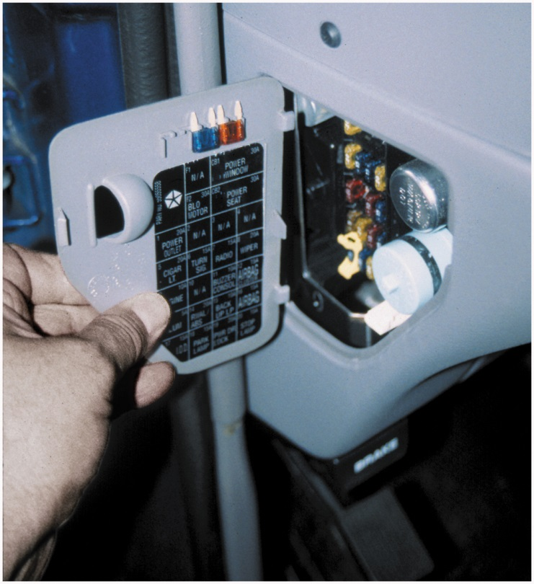
Figure 9.34 Always check the simple things first. Check the fuse for the circuit you are testing. Maybe a fault in another circuit controlled by the same fuse could have caused the fuse to blow. Use a test light to check that both sides of the fuse have voltage

Slide 37
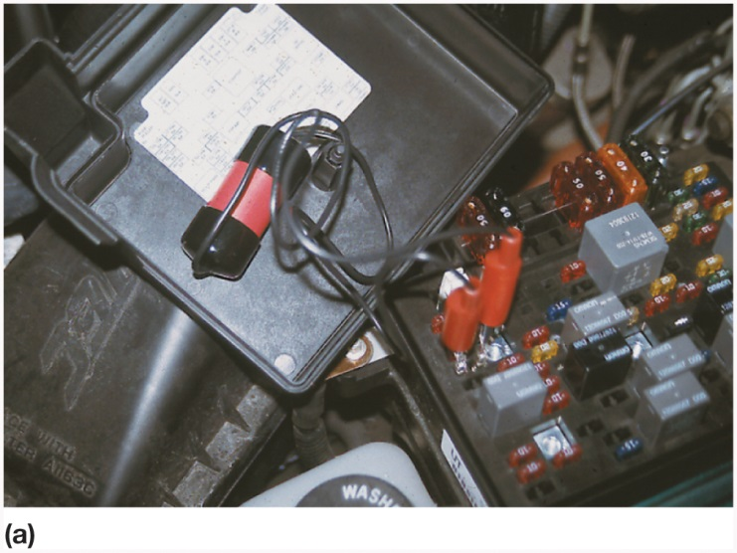
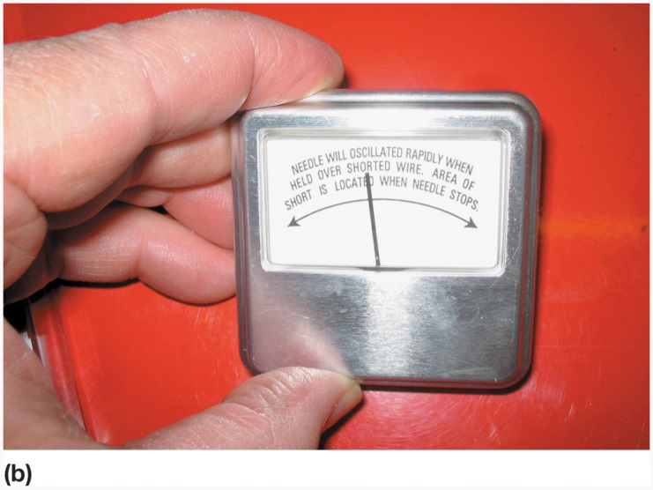
Figure 9.35 (a) After removing the blown fuse, a pulsing circuit breaker is connected to the terminals of the fuse (b) The circuit breaker causes current to flow, then stop, then flow again, through the circuit up to the point of the short-to-ground. By observing the Gauss gauge, the location of the short is indicated near where the needle stops moving due to the magnetic field created by the flow of current through the wire

Slide 38
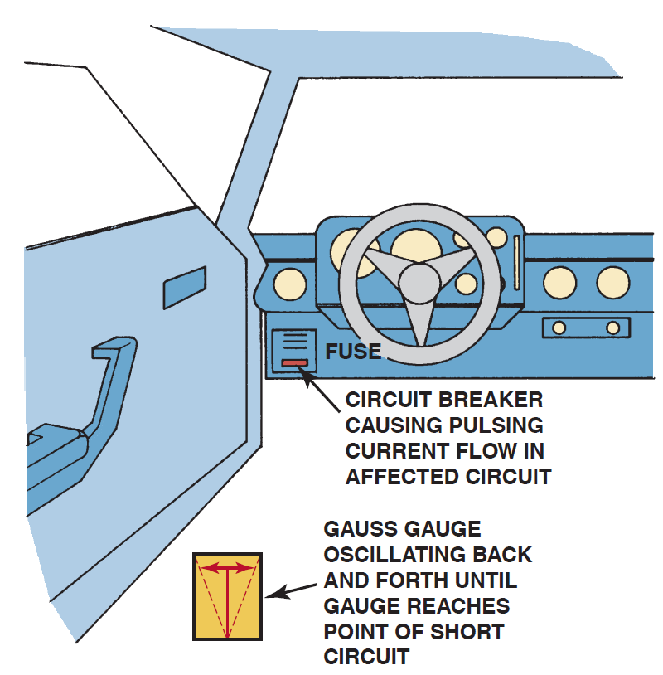
Figure 9.36 A Gauss gauge can be used to determine the location of a short circuit even behind a metal panel

Slide 39
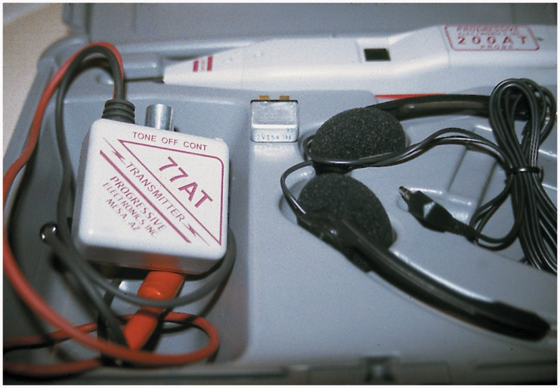
Figure 9.37 A tone generator–type tester used to locate open circuits and circuits that are shorted-to-ground. Included with this tester is a transmitter (tone generator), receiver probe, and headphones for use in noisy shops

Slide 40
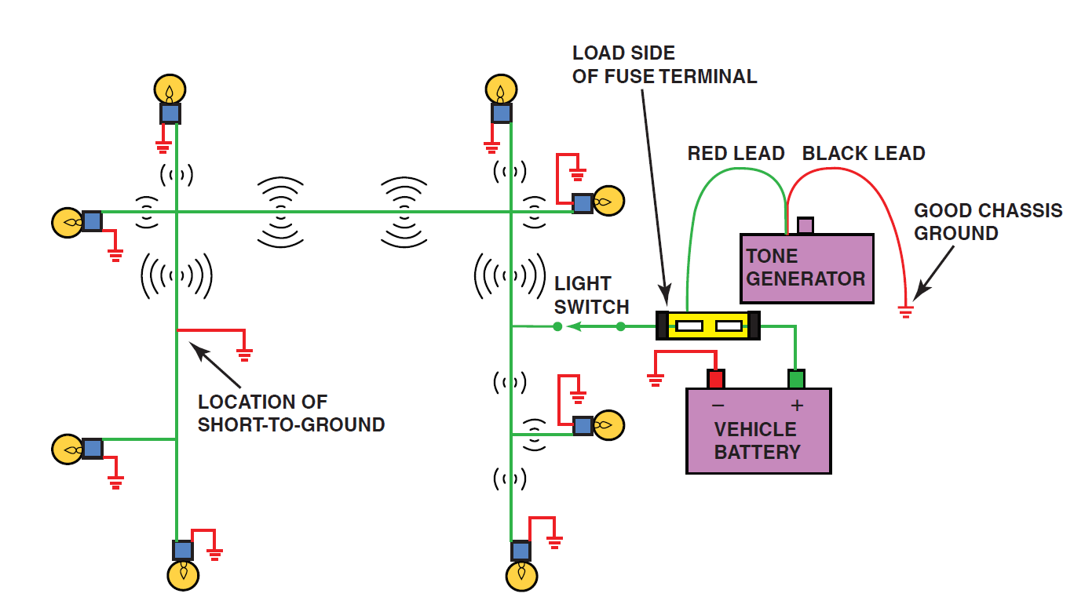
Figure 9.38 To check for a short-to-ground using a tone generator, connect the black transmitter lead to a good chassis ground and the red lead to the load side of the fuse terminal. Turn the transmitter on and check for tone signal with the receiver. Using a wiring diagram, follow the strongest signal to the location of the short-to-ground. There will be no signal beyond the fault, either a short-to-ground as shown or an open circuit

Slide 41
Figure 9.39 Anti-static spray can be used by customers to prevent being shocked when they touch a metal object like the door handle

Slide 42
Copyright

