Slide 1
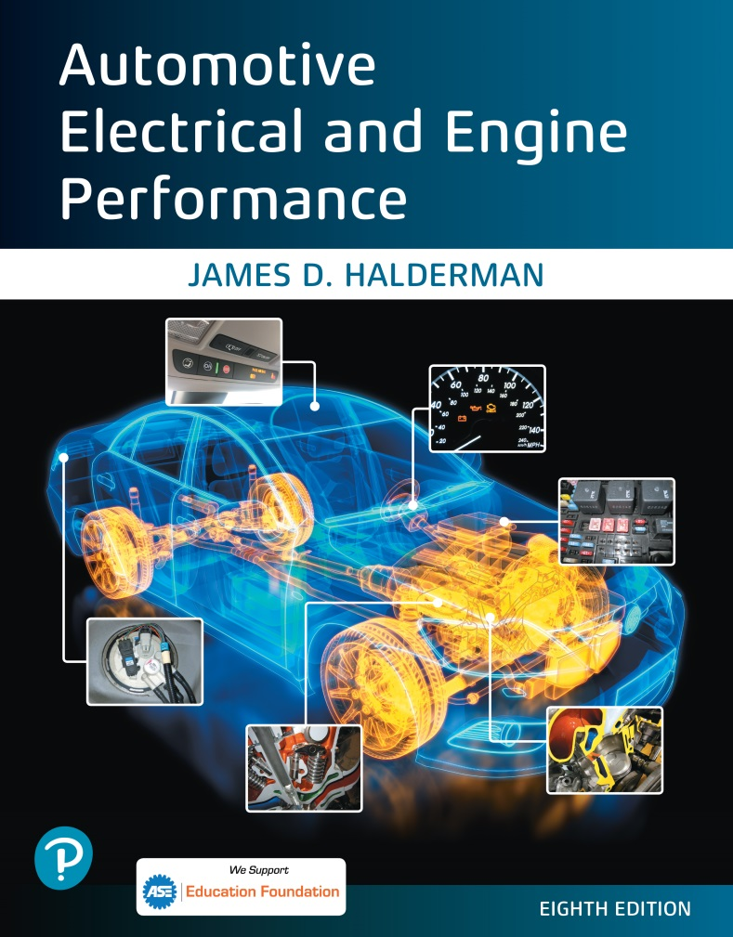
Automotive Electrical and Engine Performance
Eighth Edition
Chapter 08
Automotive Wiring and Wire Repair
Copyright © 2020, 2016 Pearson Education, Inc. All Rights Reserved

Slide 2
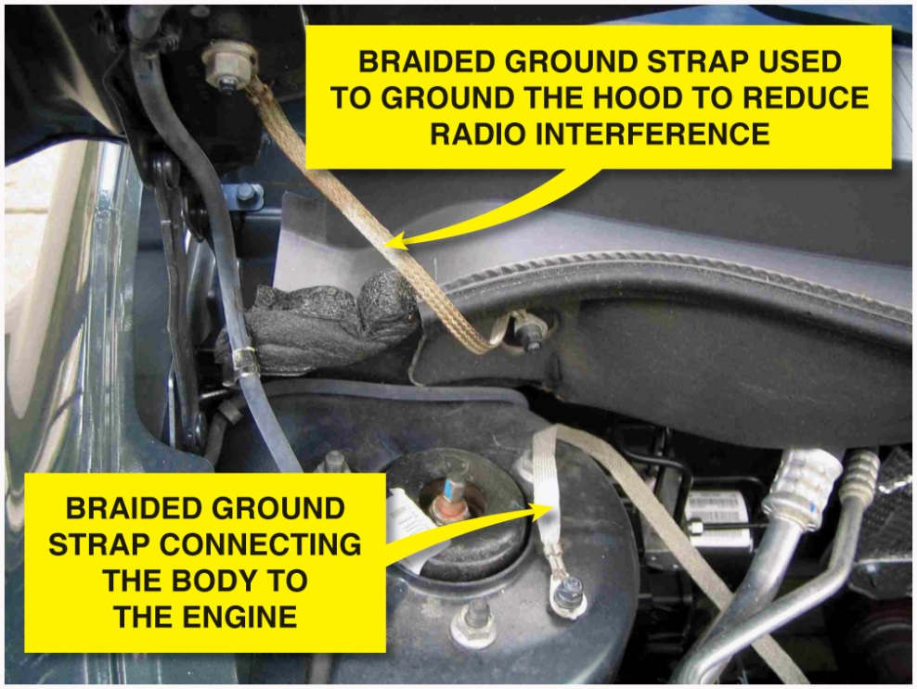
Figure 8.1 All lights and accessories are grounded to the body of the vehicle. Body ground wires, such as this one, are needed to conduct all of the current from these components back to the negative terminal of the battery. The body ground wire connects the body to the engine. Most battery negative cables attach to the engine

Slide 3
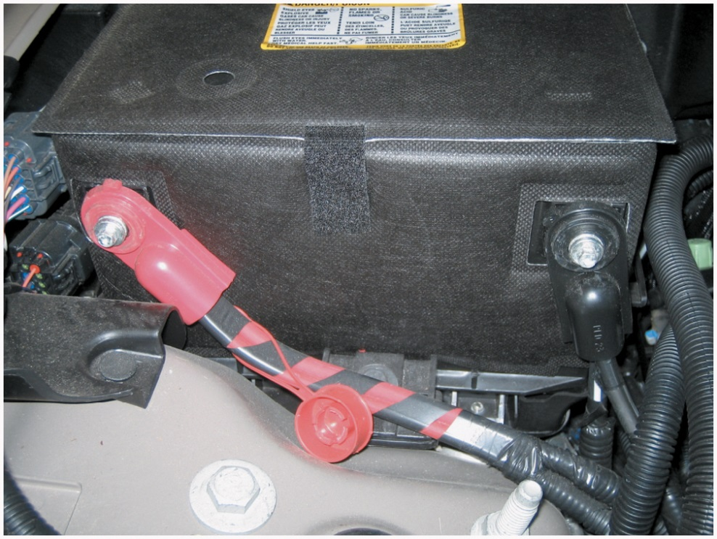
Figure 8.2 Battery cables are designed to carry heavy starter current and are usually 4-gauge or larger wire. Note that this battery has a thermal blanket covering to help protect the battery from high underhood temperatures. The wiring is also covered with a plastic conduit called split-loom tubing

Slide 4
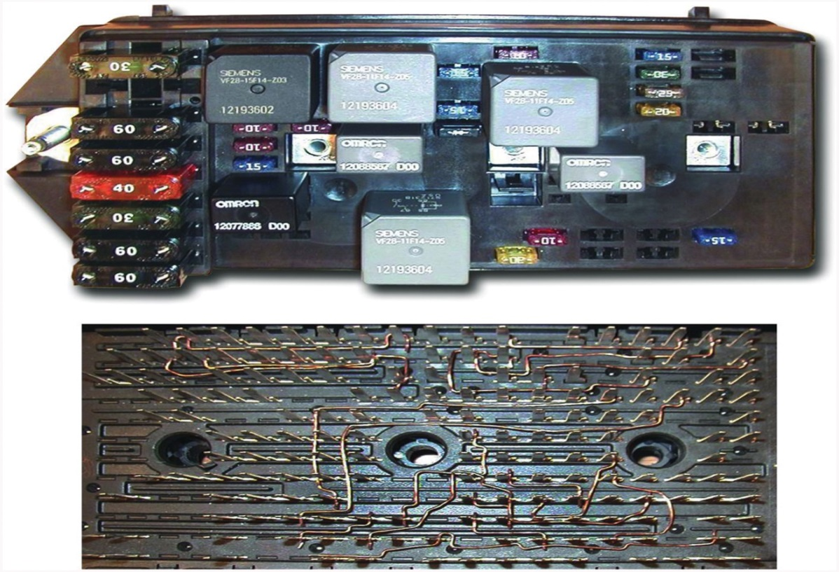
Figure 8.3 A typical Underhood Electrical Center (U H E C). Most are referred to as an “intelligent power distribution box” or a “smart junction box” because underneath (lower figure) are wires that join the circuits from the maxi fuses to other fuses and to or from relays. Because of these interconnected circuits, if there is a fault due to a collision or water intrusion, most experts suggest replacing the entire assembly rather than trying to repair the assembly. Always check service information for the exact procedures to follow when working with an underhood fuse panel

Slide 5
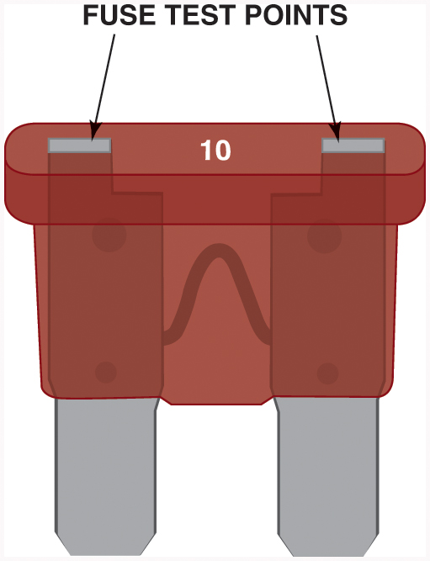
Figure 8.4 Blade-type fuses can be tested through openings in the plastic at the top of the fuse

Slide 6
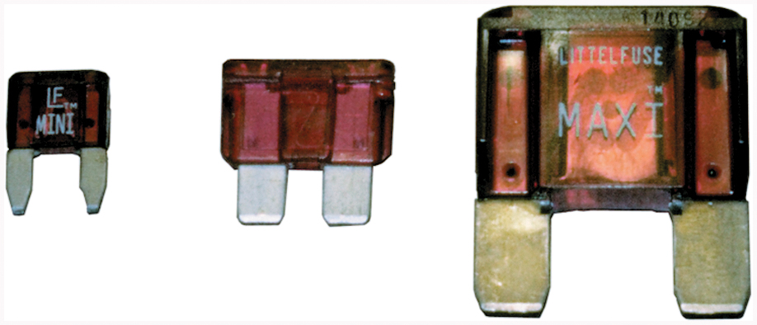
Figure 8.5 Three sizes of blade-type fuses: mini on the left, standard or A T O type in the center, and maxi on the right

Slide 7
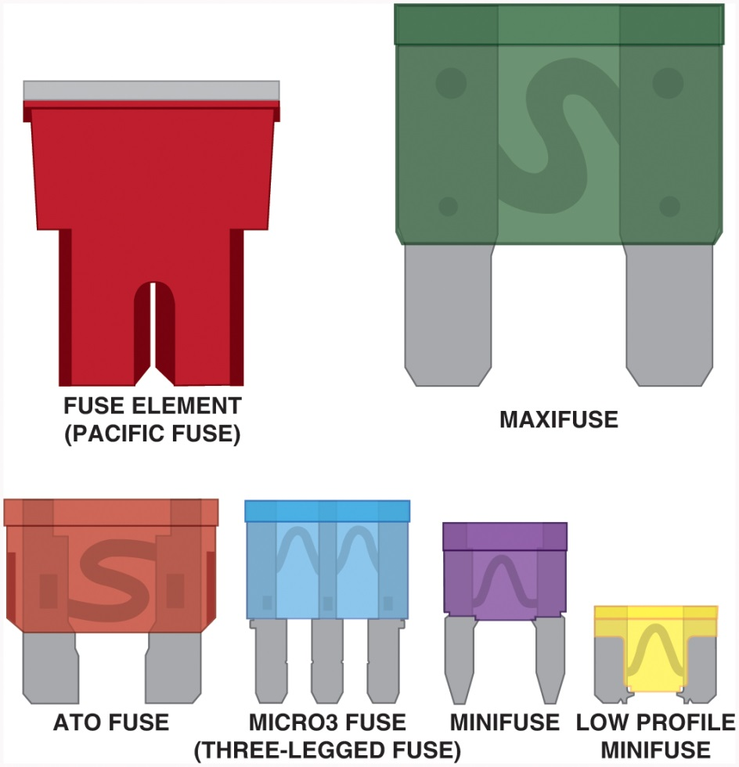
Figure 8.6 A comparison of the various types of protective devices used in most vehicles

Slide 8
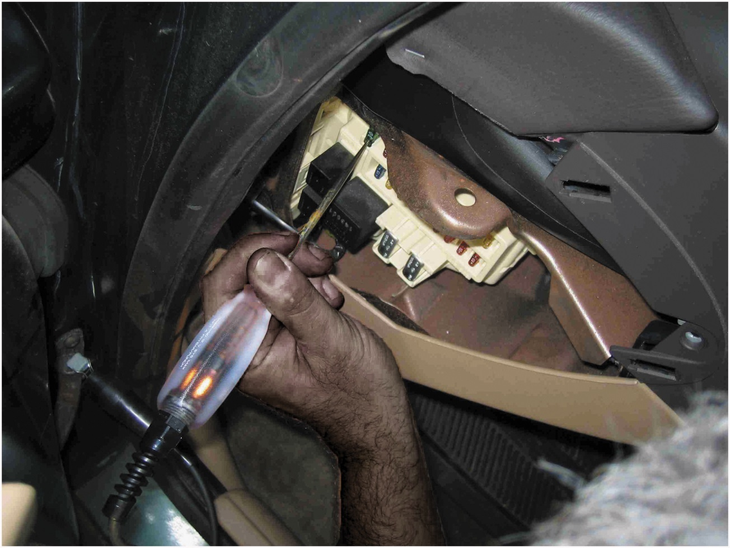
Figure 8.7 To test a fuse, use a test light to check for power at the power side of the fuse. The ignition switch and lights may have to be on before some fuses receive power. If the fuse is good, the test light should light on both sides (power side and load side) of the fuse

Slide 9
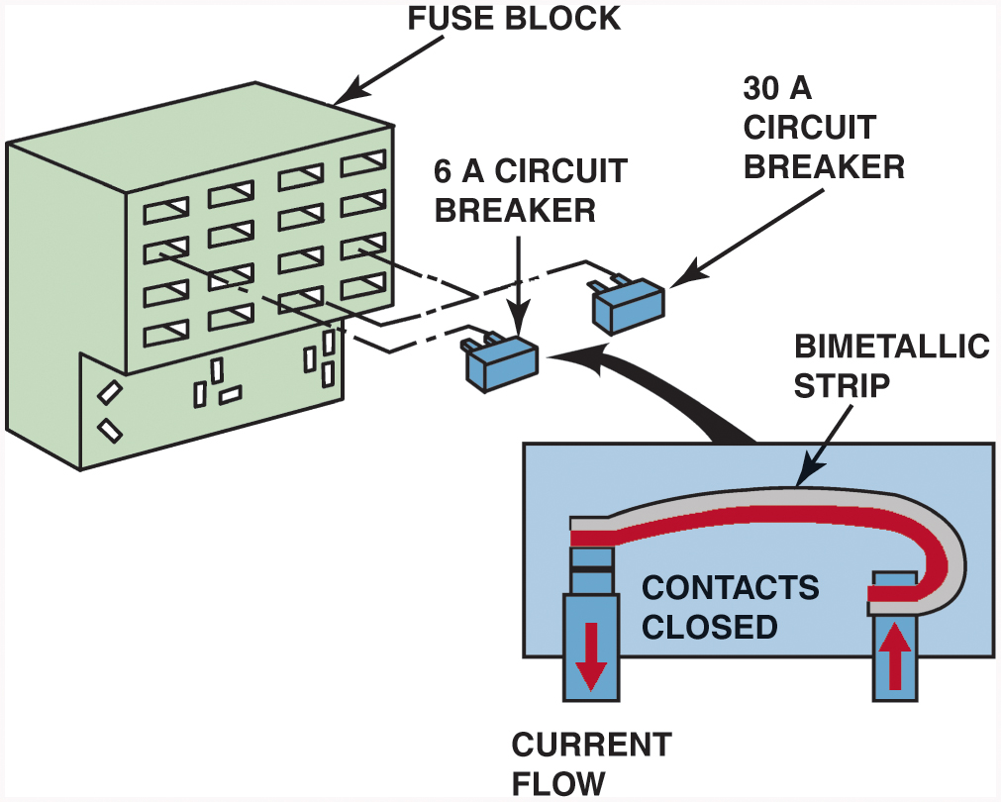
Figure 8.8 Typical blade circuit breaker fits into the same space as a blade fuse. If excessive current flows through the bimetallic strip, the strip bends and opens the contacts and stops current flow. When the circuit breaker cools, the contacts close again, completing the electrical circuit

Slide 10
Figure 8.9 Electrical symbols used to represent circuit breakers

Slide 11
Figure 8.10 (a) The normal operation of a P T C circuit protector such as in a power window motor circuit showing the many conducting paths. With normal current flow, the temperature of the P T C circuit protector remains normal

Slide 12
Figure 8.10 (b) When current exceeds the amperage rating of the P T C circuit protector, the polymer material that makes up the electronic circuit protector increases in resistance. As shown, a high-resistance electrical path still exists even though the motor will stop operating as a result of the very low current flow through the very high resistance. The circuit protector will not reset or cool down until voltage is removed from the circuit

Slide 13
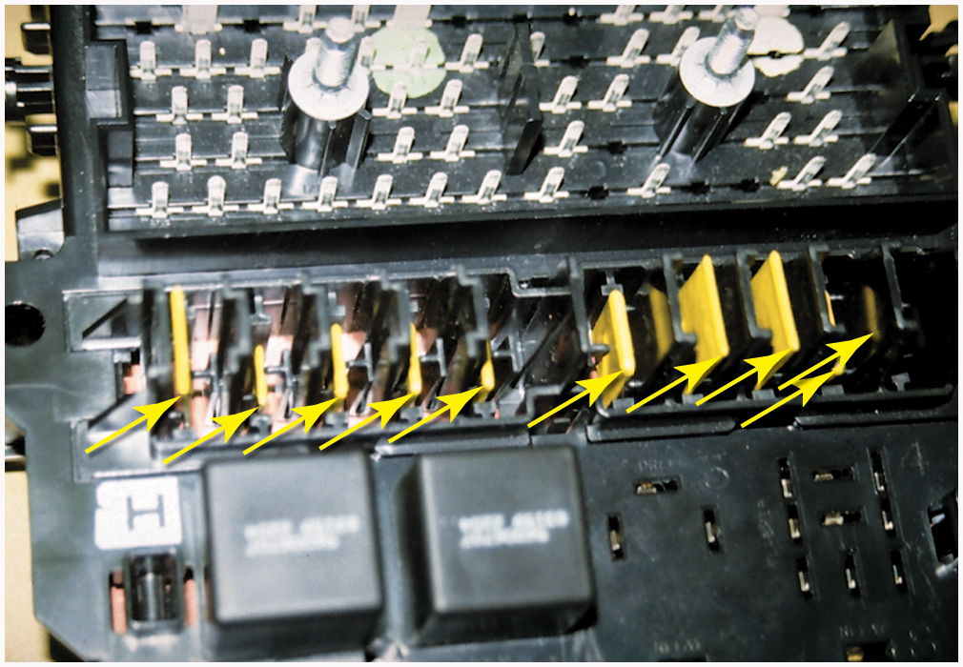
Figure 8.11 P T C circuit protectors are used extensively in the power distribution center of this Chrysler vehicle

Slide 14
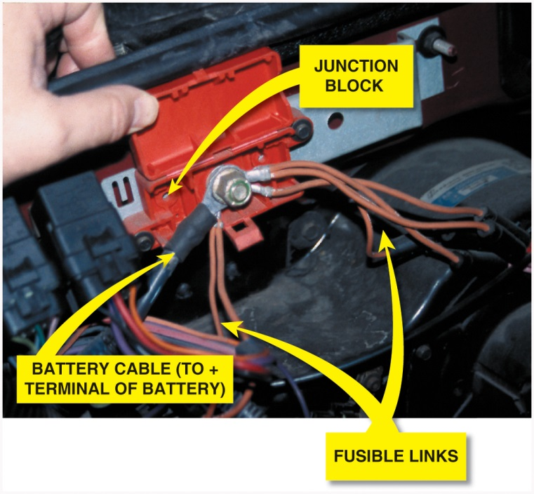
Figure 8.12 Fusible links are usually located close to the battery and are usually attached to a junction block. Notice they are only 6 to 9 inches long and feed more than one fuse from each fusible link

Slide 15
Figure 8.13 A 125-ampere-rated mega fuse used to protect the circuit from the alternator

Slide 16
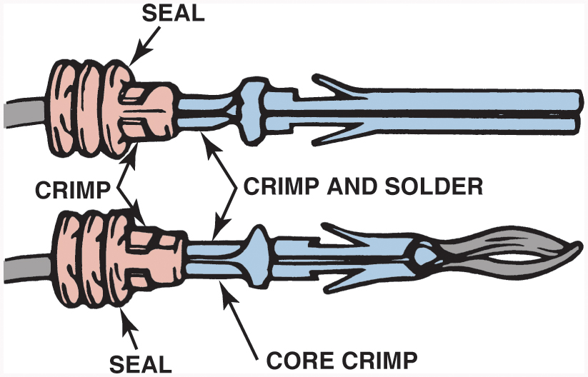
Figure 8.14 Some terminals have seals attached to help seal the electrical connections

Slide 17
Figure 8.15 Separate a connector by opening the lock and pulling the two apart

Slide 18
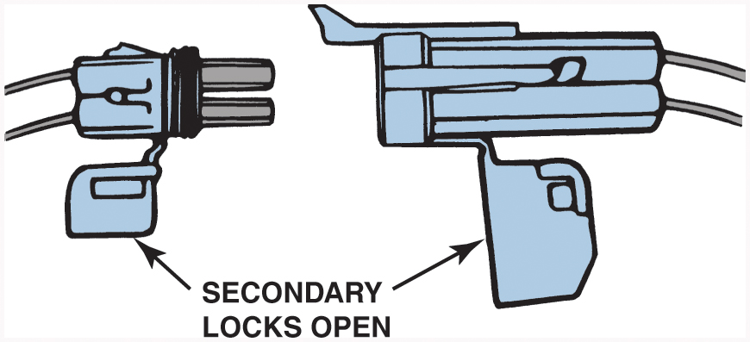
Figure 8.16 The secondary locks help retain the terminals in the connector

Slide 19
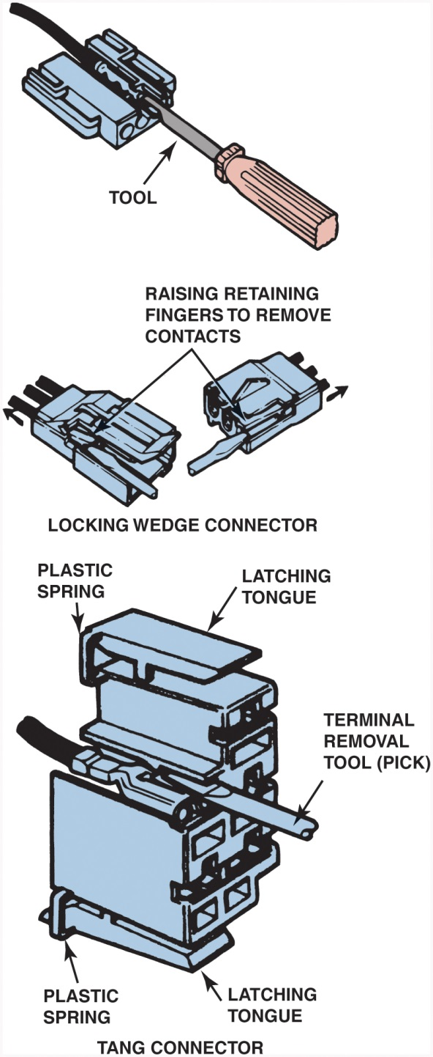
Figure 8.17 Use a small removal tool, sometimes called a pick, to release terminals from the connector

Slide 20
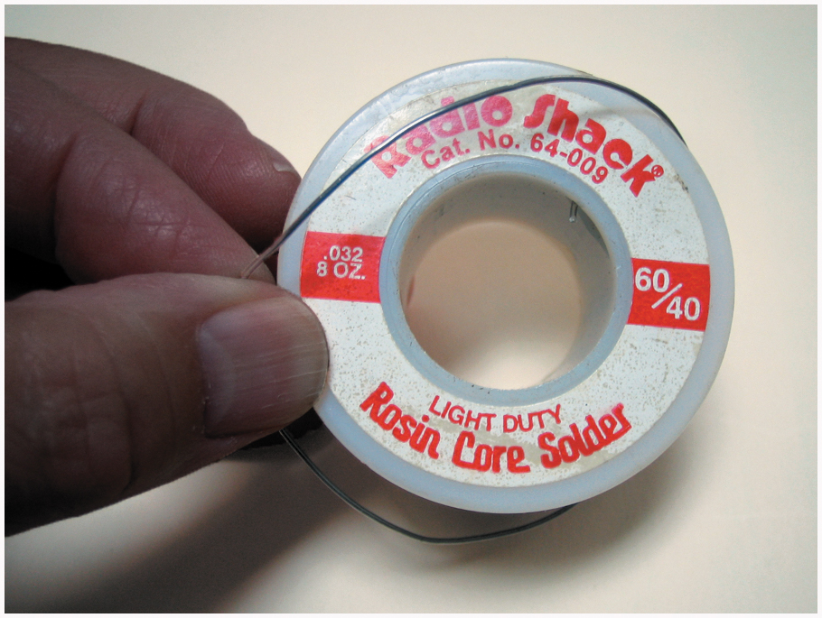
Figure 8.18 Always use rosin-core solder for electrical or electronic soldering. Also, use small-diameter solder for small soldering irons. Use large-diameter solder only for large-diameter (large-gauge) wire and higher-wattage soldering irons (guns)

Slide 21
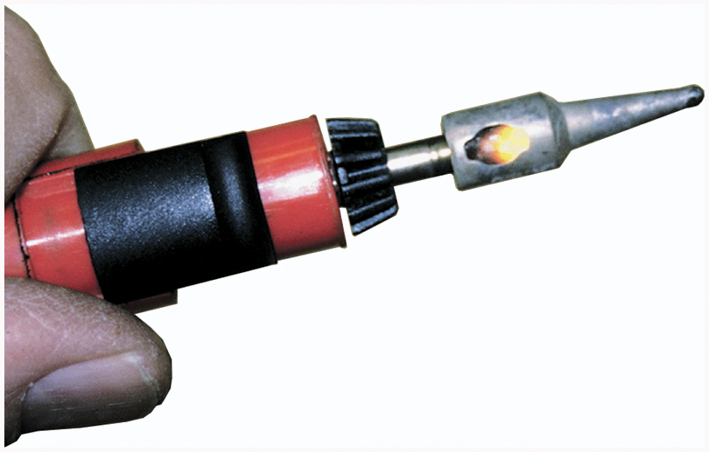
Figure 8.19 A butane-powered soldering tool. The cap has a built-in striker to light a converter in the tip of the tool. This handy soldering tool produces the equivalent of 60 watts of heat. It operates for about 1/2 hour on one charge from a commonly available butane refill dispenser

Slide 22
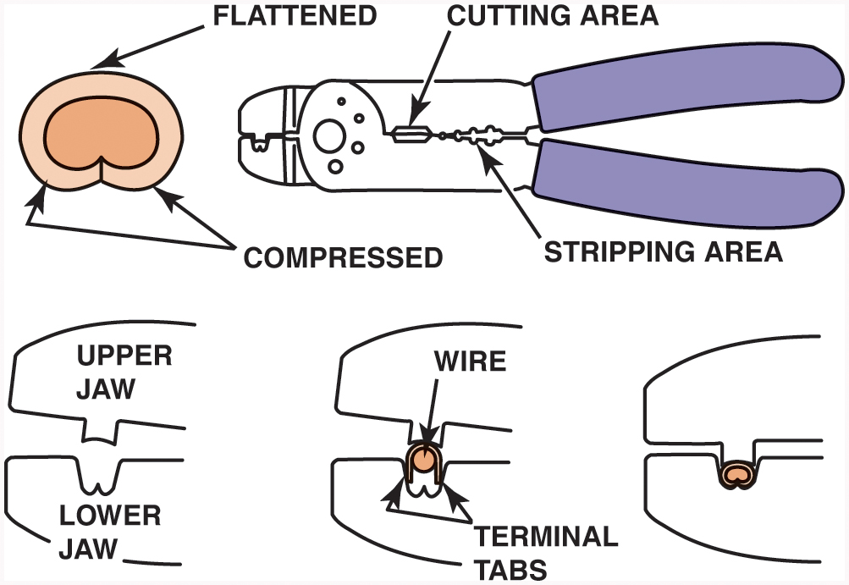
Figure 8.20 Notice that to create a good crimp the open part of the terminal is placed in the jaws of the crimping tool toward the anvil or the W-shape part

Slide 23
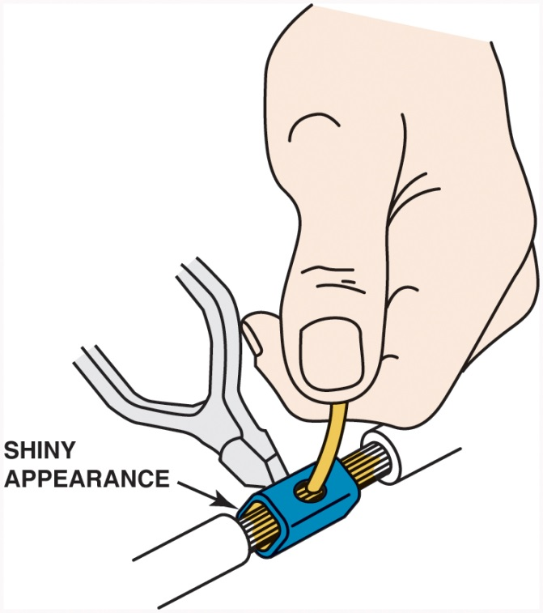
Figure 8.21 All hand-crimped splices or terminals should be soldered to be assured of a good electrical connection

Slide 24
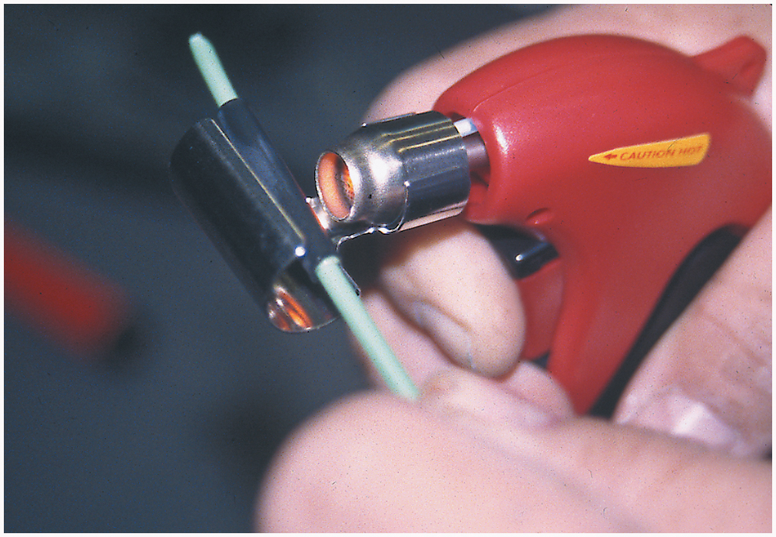
Figure 8.22 A butane torch especially designed for use on heat shrink applies heat without an open flame, which could cause damage

Slide 25
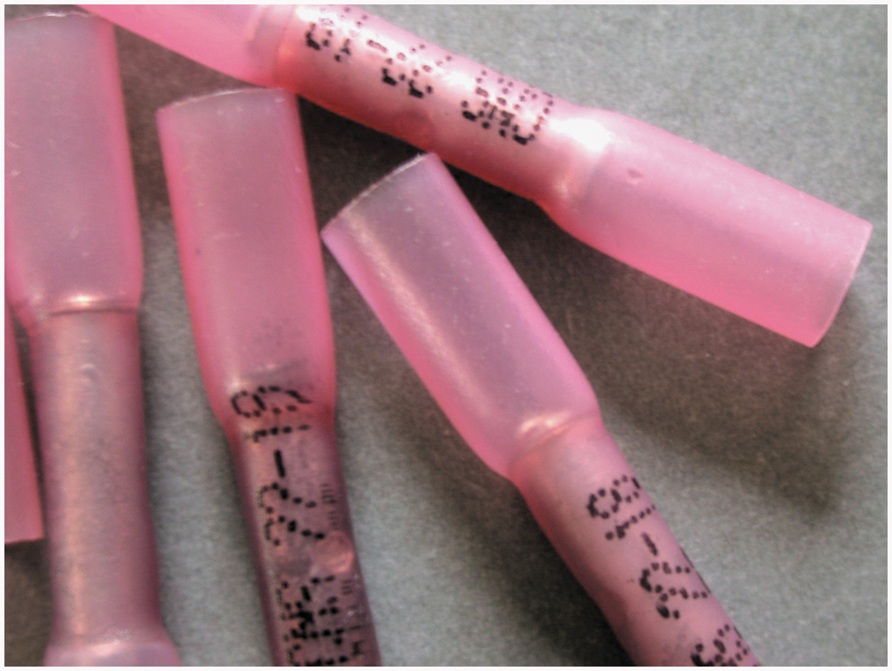
Figure 8.23 A typical crimp-and-seal connector. This type of connector is first lightly crimped to retain the ends of the wires and then it is heated. The tubing shrinks around the wire splice, and thermoplastic glue melts on the inside to provide an effective weather-resistant seal

Slide 26
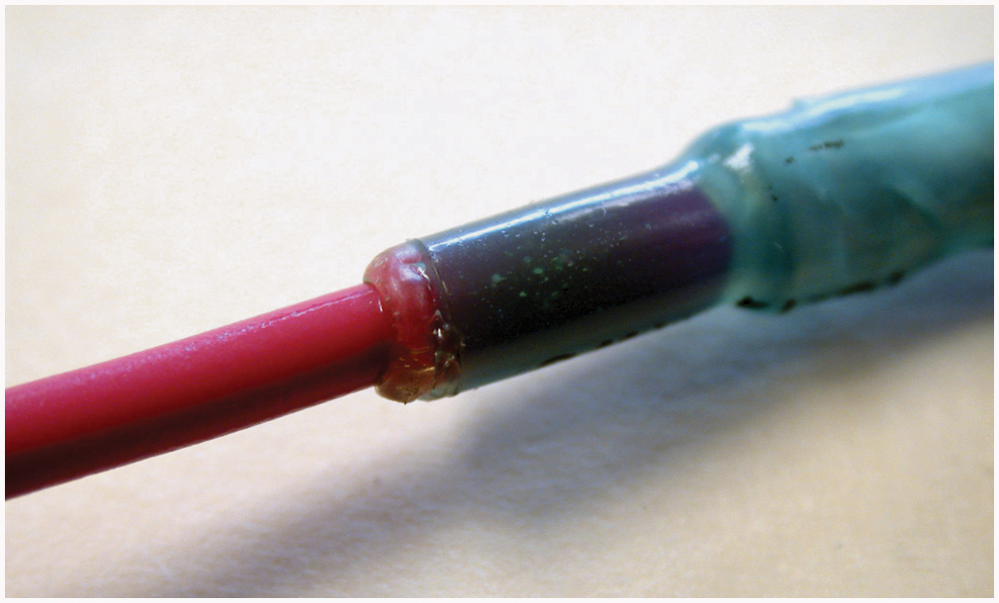
Figure 8.24 Heating the crimp-and-seal connector melts the glue and forms an effective seal against moisture

Slide 27
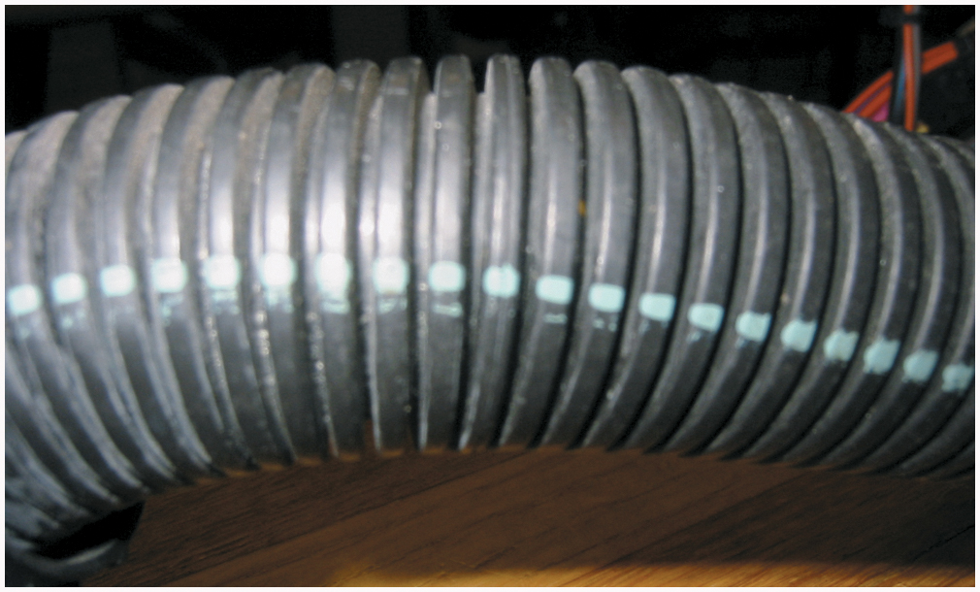
Figure 8.25 Conduit that has a paint stripe is constructed of plastic that can withstand high underhood temperatures

Slide 28
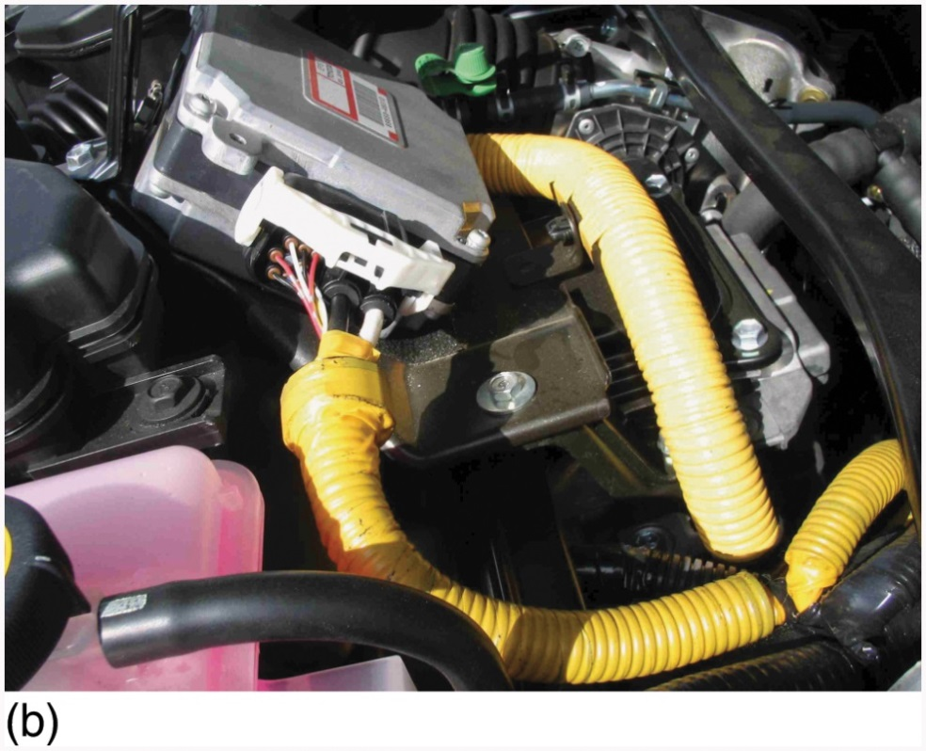
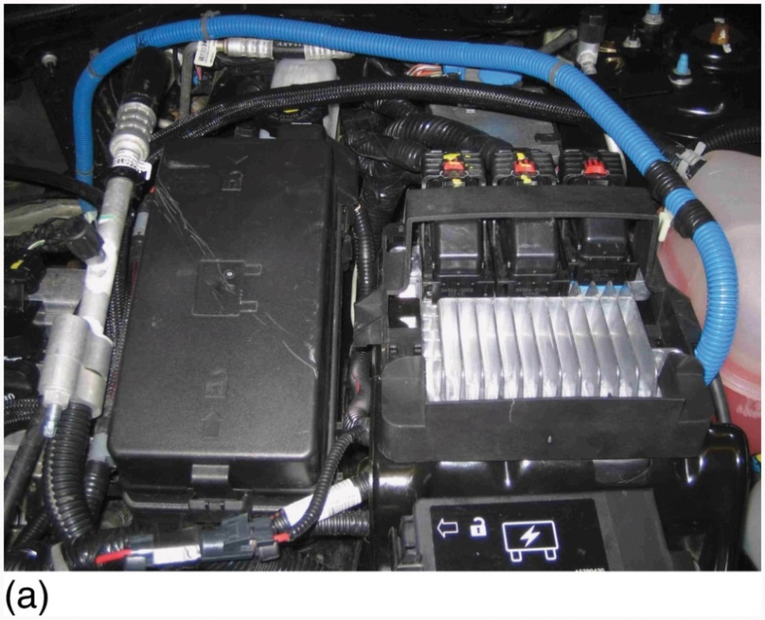
Figure 8.26 (a) Blue conduit is used to cover circuits that carry up to 42 volts (b) Yellow conduit can also be used to cover 42-volt wiring

Slide 29
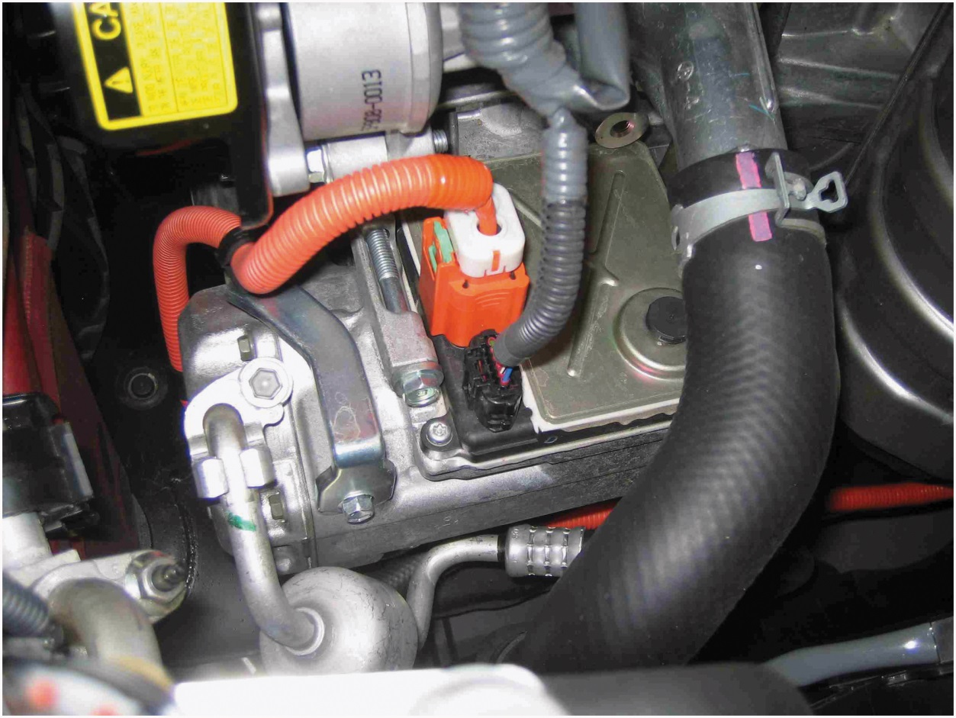
Figure 8.27 Always follow the vehicle manufacturer’s instructions which include the use of linesman’s (high-voltage) gloves if working on circuits that are covered in orange conduit

Slide 30
Copyright

