Slide 1
Automotive Electrical and Engine Performance
Eighth Edition
Chapter 46
Fuel Cells and Advanced Technologies
Copyright © 2020, 2016 Pearson Education, Inc. All Rights Reserved

Slide 2
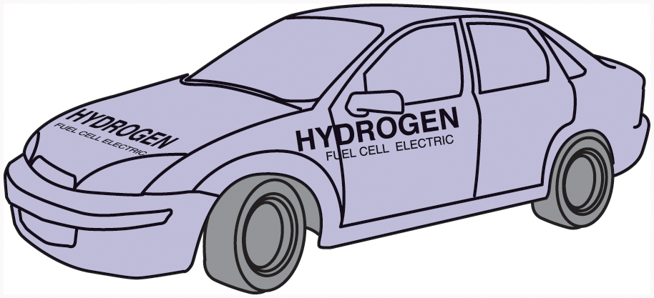
Figure 46.1 Ford Motor Company has produced a number of demonstration fuel-cell vehicles based on the Ford Focus

Slide 3
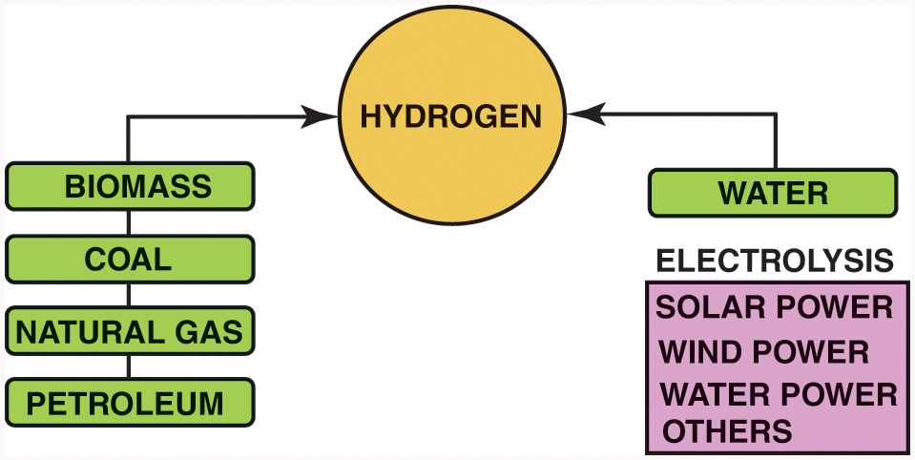
Figure 46.2 Hydrogen does not exist by itself in nature. Energy must be expended to separate it from other, more complex materials

Slide 4
Figure 46.3 The Mercedes-Benz B-Class fuel-cell car was introduced in 2005

Slide 5
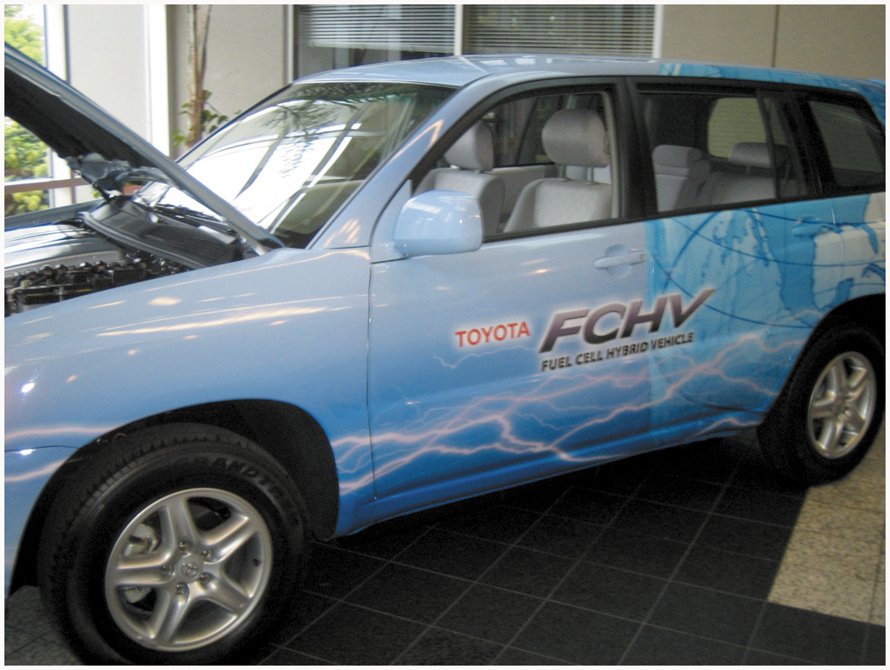
Figure 46.4 The Toyota F C H V is based on the Highlander platform and uses much of Toyota’s Hybrid Synergy Drive (H S D) technology in its design

Slide 6
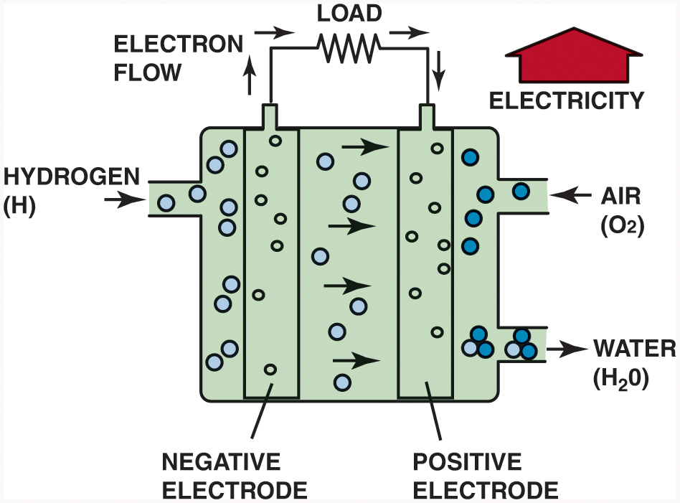
Figure 46.5 The polymer electrolyte membrane allows only H⁺ ions (protons) to pass through it. This means that electrons must follow the external circuit and pass through the load to perform work

Slide 7
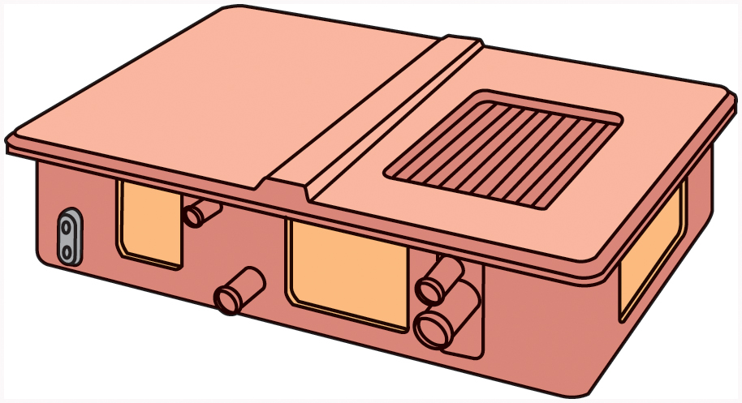
Figure 46.6 A fuel-cell stack is made up of hundreds of individual cells connected in series

Slide 8
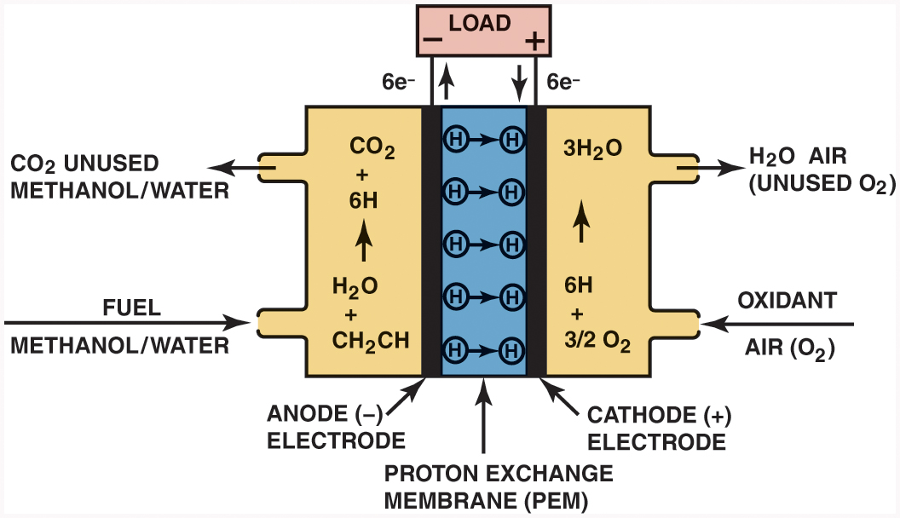
Figure 46.7 A direct methanol fuel cell uses a methanol/ water solution for fuel instead of hydrogen gas

Slide 9
Figure 46.8 A direct methanol fuel cell can be refueled similar to a gasoline-powered vehicle

Slide 10
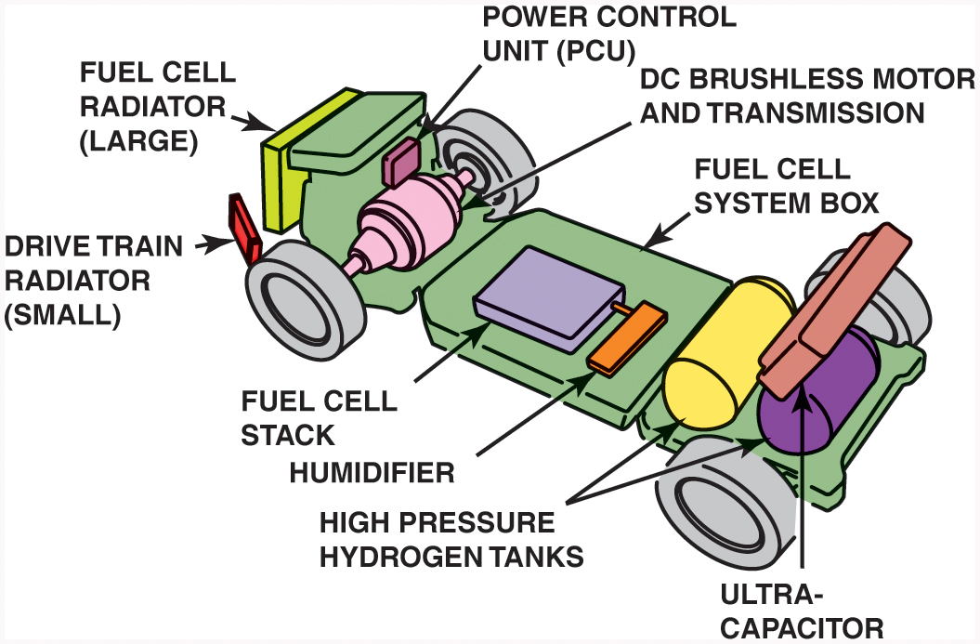
Figure 46.9 Powertrain layout in a Honda F C X fuel-cell vehicle. Note the use of a humidifier behind the fuel-cell stack to maintain moisture levels in the membrane electrode assemblies

Slide 11
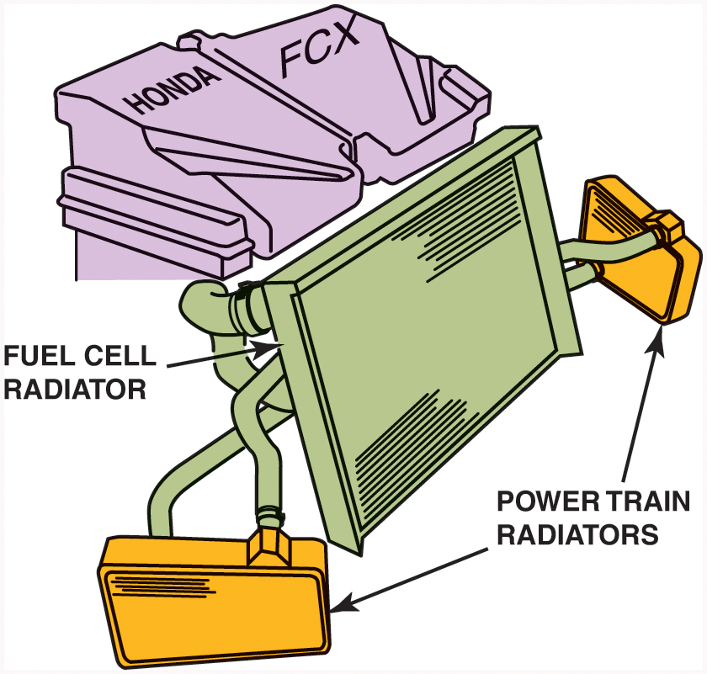
Figure 46.10 The Honda F C X uses one large radiator for cooling the fuel cell and two smaller ones on either side for cooling drivetrain components

Slide 12
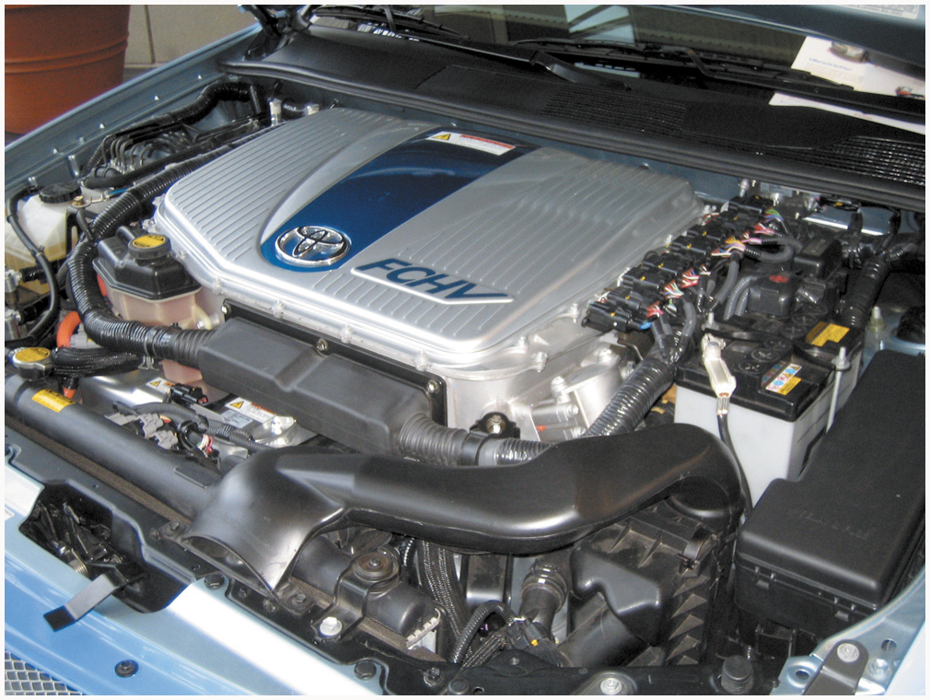
Figure 46.11 Space is limited at the front of the Toyota F C H V engine compartment, so an auxiliary heat exchanger is located under the vehicle to help cool the fuel-cell stack

Slide 13
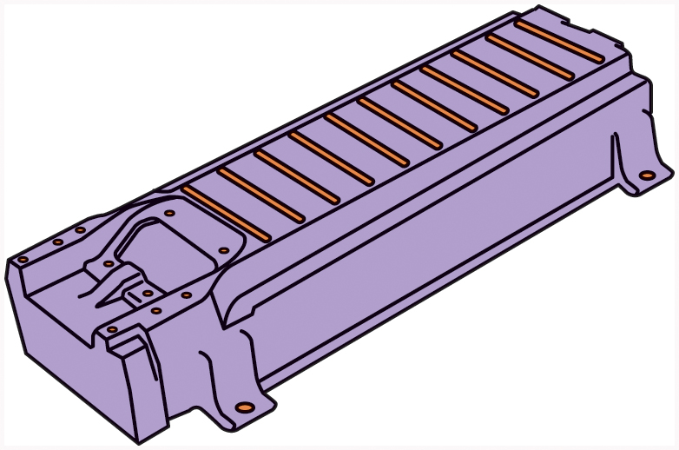
Figure 46.12 The secondary battery in a fuel-cell hybrid vehicle is made up of many individual cells connected in series, much like a fuel-cell stack

Slide 14
Figure 46.13 The Honda ultracapacitor module and construction of the individual cells

Slide 15
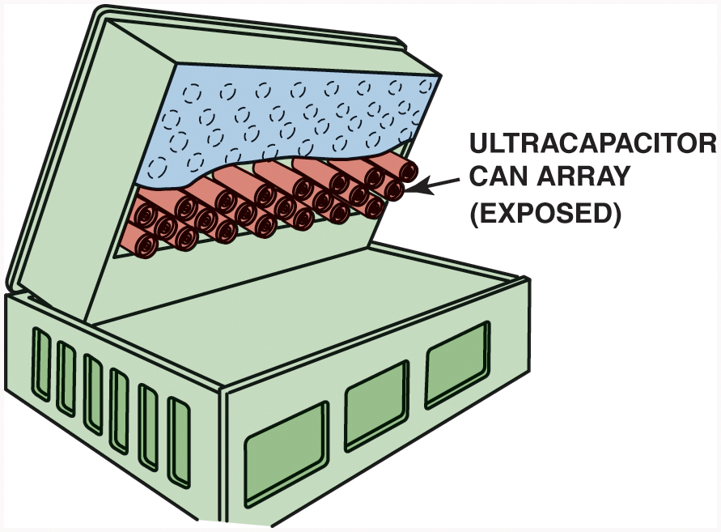
Figure 46.14 An ultracapacitor can be used in place of a high-voltage battery in a hybrid electric vehicle. This example is from the Honda F C X fuel-cell hybrid vehicle

Slide 16
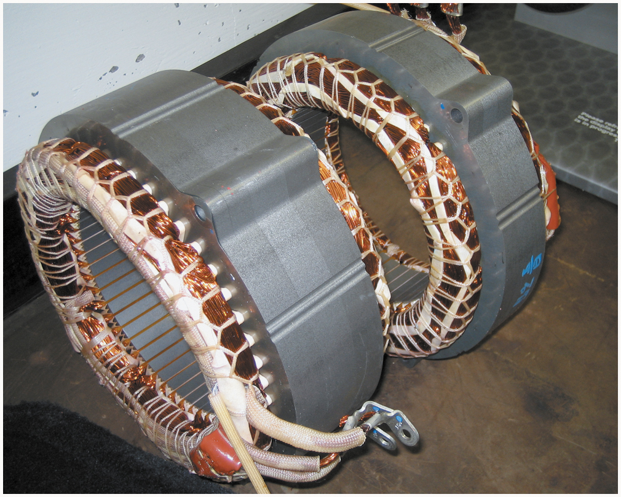
Figure 46.15 Drive motors in fuel-cell hybrid vehicles often use stator assemblies similar to ones found in Toyota hybrid electric vehicles. The rotor turns inside the stator and has permanent magnets on its outer circumference

Slide 17
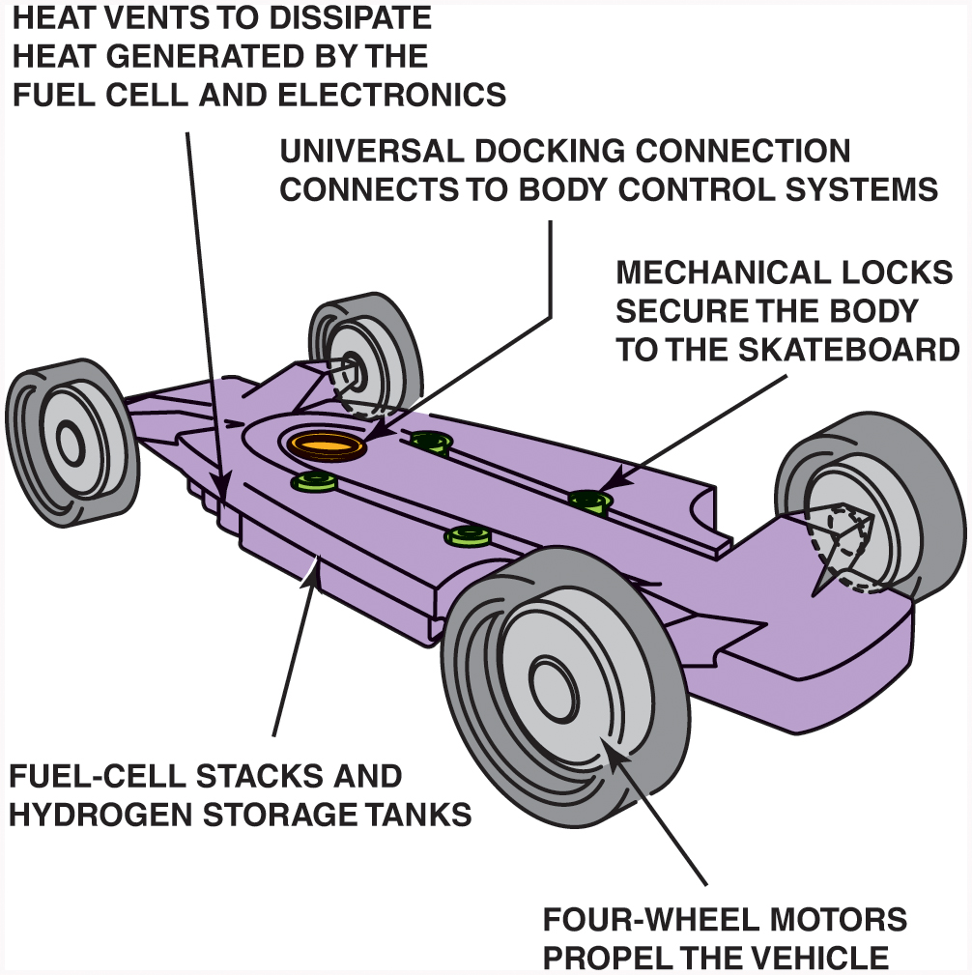
Figure 46.16 The General Motors “Skateboard” concept uses a fuel-cell propulsion system with wheel motors at all four corners

Slide 18
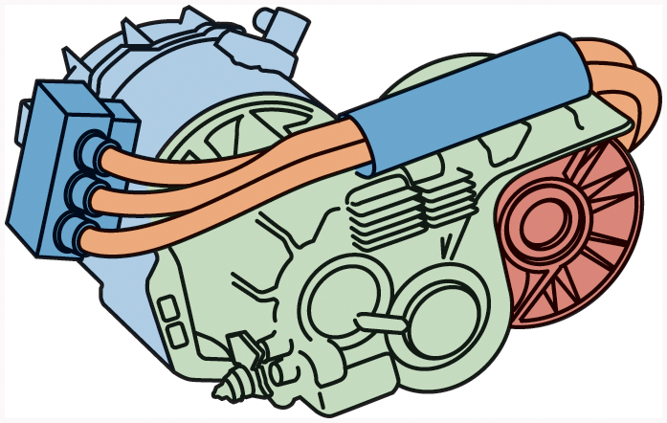
Figure 46.17 The electric drive motor and transaxle assembly from a Toyota F C H V. Note the three orange cables, indicating that this motor is powered by high-voltage three-phase alternating current

Slide 19
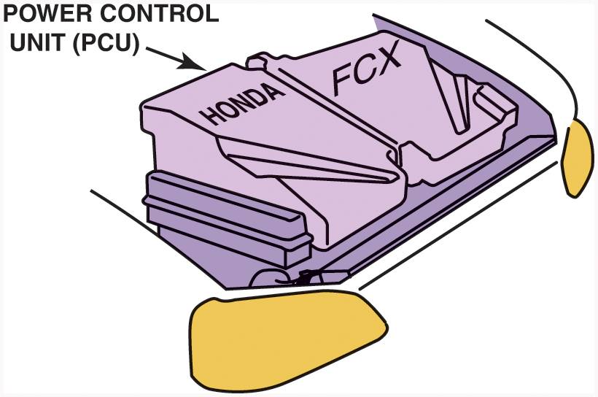
Figure 46.18 The power control unit (P C U) on a Honda F C X fuel-cell hybrid vehicle is located under the hood

Slide 20
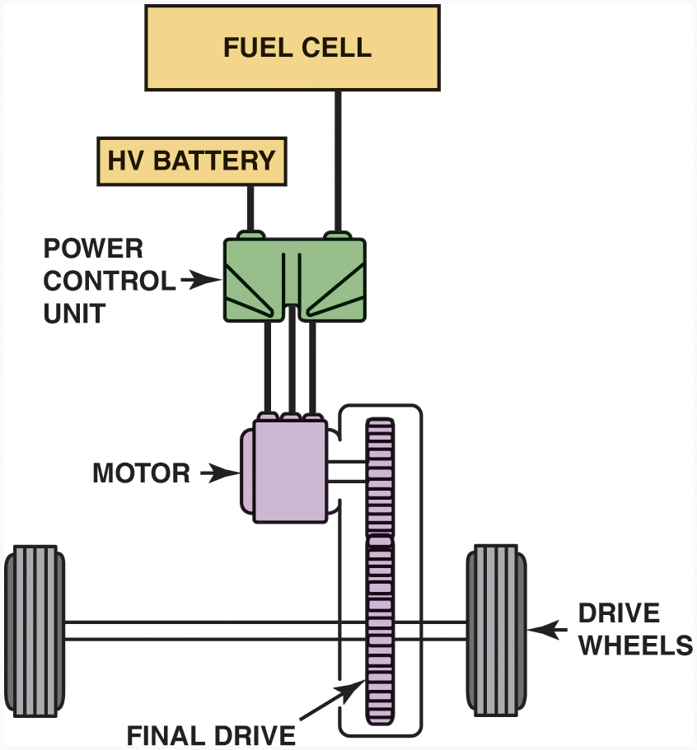
Figure 46.19 Toyota’s FCHV uses a power control unit that directs electrical energy flow between the fuel cell, battery, and drive motor

Slide 21
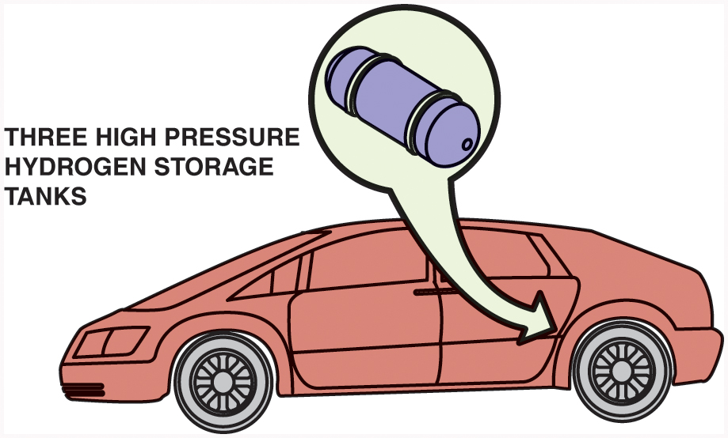
Figure 46.20 This G M fuel-cell vehicle uses compressed hydrogen in three high-pressure storage tanks

Slide 22
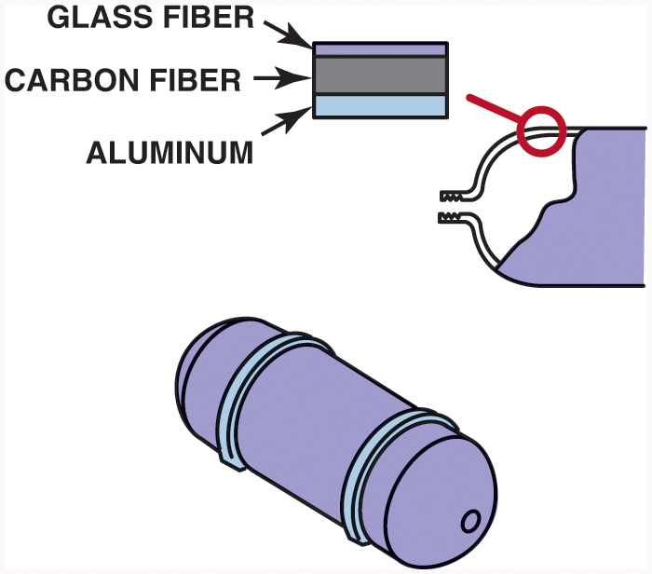
Figure 46.21 The Toyota FCHV uses high-pressure storage tanks that are rated at 350 bar. This is the equivalent of 5,000 pounds per square inch

Slide 23
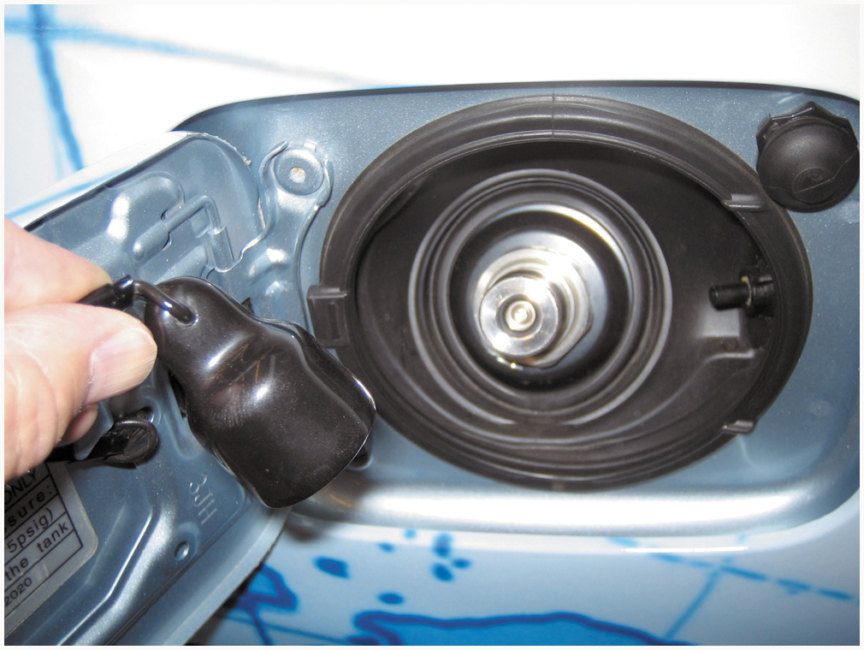
Figure 46.22 The high-pressure fitting used to refuel a fuel-cell hybrid vehicle

Slide 24
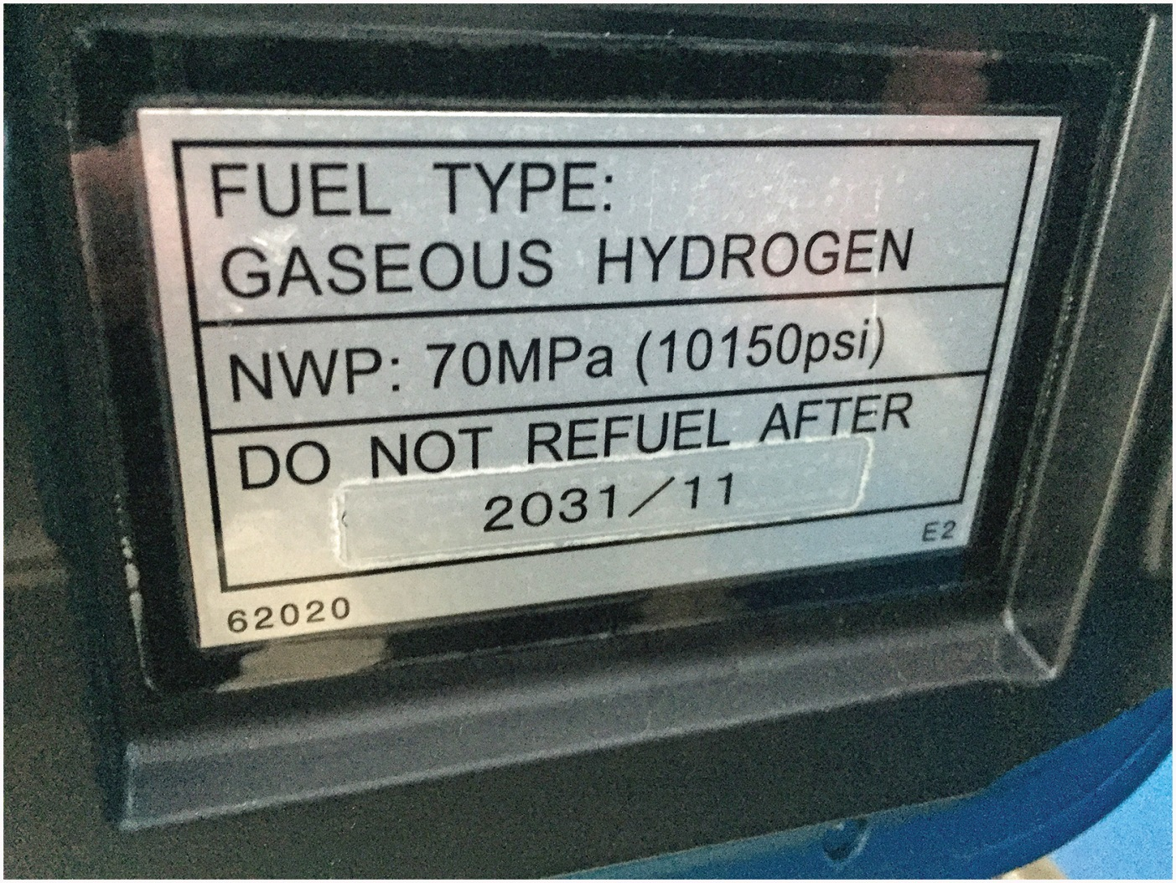
Figure 46.23 Note that high-pressure hydrogen storage tanks must be replaced in 2031

Slide 25
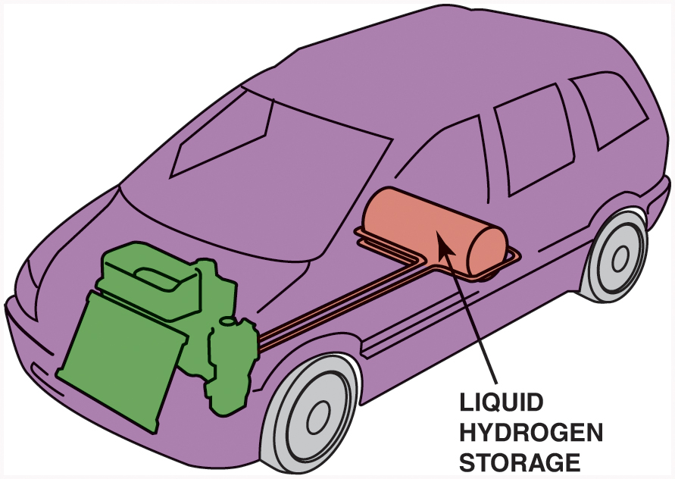
Figure 46.24 GM’s Hydrogen3 has a range of 249 miles when using liquid hydrogen

Slide 26
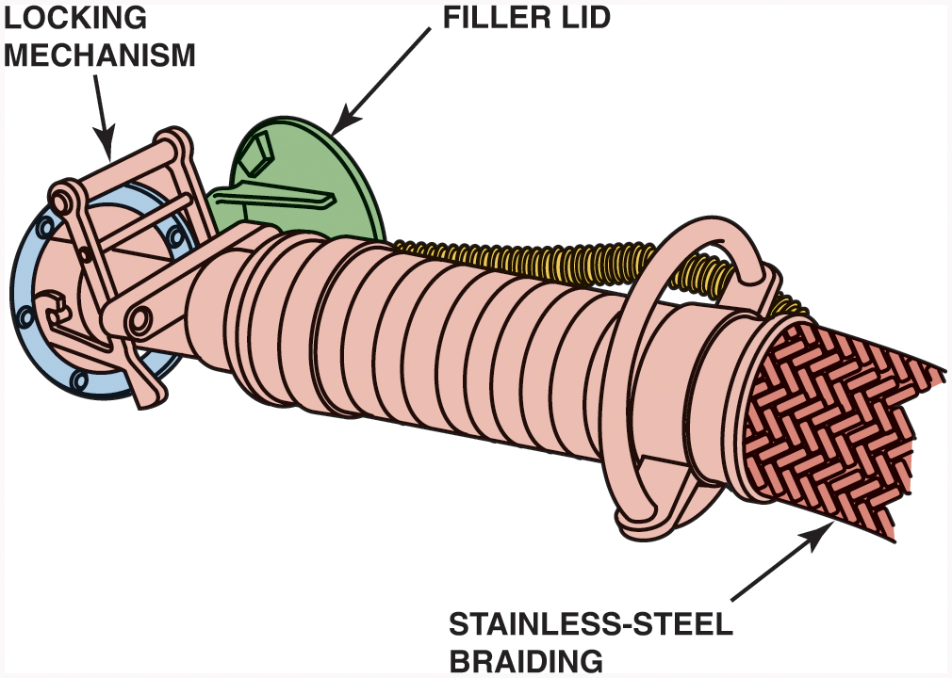
Figure 46.25 Refueling a vehicle with liquid hydrogen

Slide 27
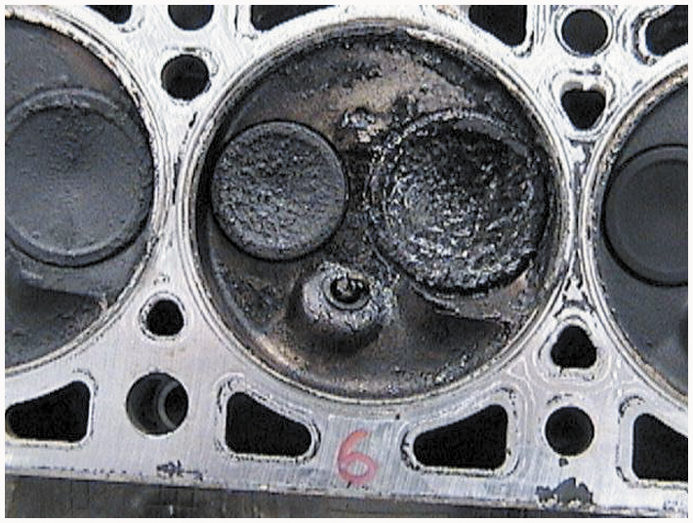
Figure 46.26 Carbon deposits, such as these, are created by incomplete combustion of a hydrocarbon fuel

Slide 28
Figure 46.27 Both diesel and conventional gasoline engines create exhaust emissions due to high peak temperatures created in the combustion chamber. The lower combustion temperatures during H C C I operation result in high efficiency with reduced emissions

Slide 29
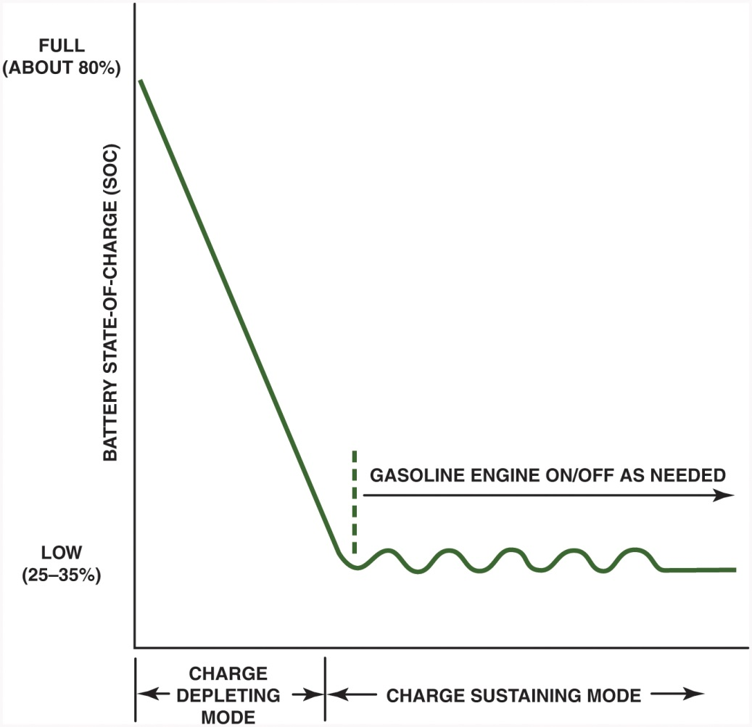
Figure 46.28 After the Chevrolet Volt has been charged, it uses the electrical power stored in the high-voltage battery to propel the vehicle and provide heating and cooling for 25 to 50 miles (40 to 80 km). Then the gasoline engine starts and maintains the S O C between 25% and 35%. The gasoline engine cannot fully charge the high-voltage batteries but rather the vehicle has to be plugged in to provide a higher S O C level

Slide 30
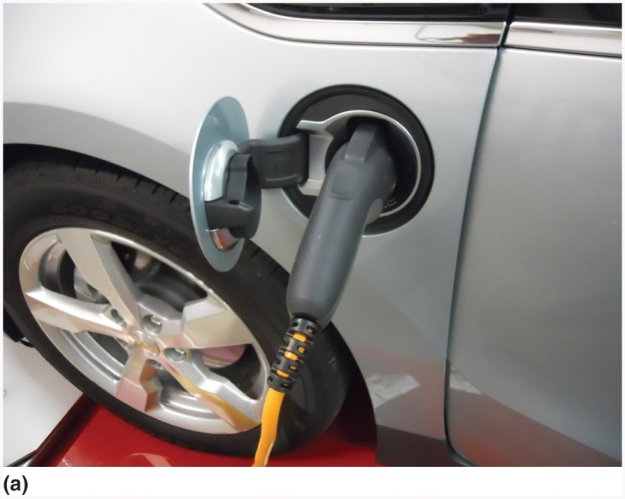
Figure 46.29 (a) The Chevrolet Volt is charged using a standard SAE 1772 connector using either 110 or 220 volts

Slide 31
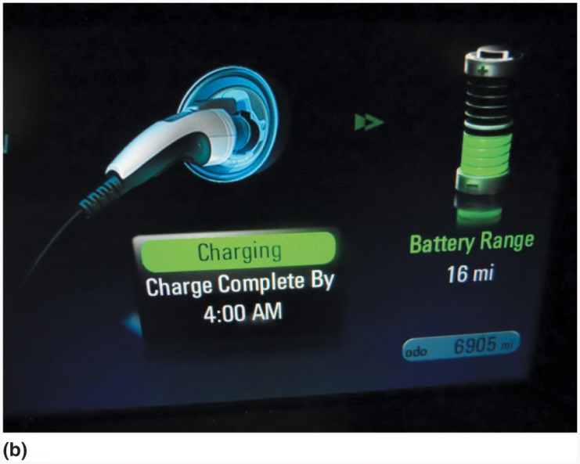
Figure 46.29 (b) After connecting the charging plug, a light on the top of the dash turns green and the dash display shows the estimated time when the high-voltage battery will be fully charged and the estimated current range using battery power alone

Slide 32
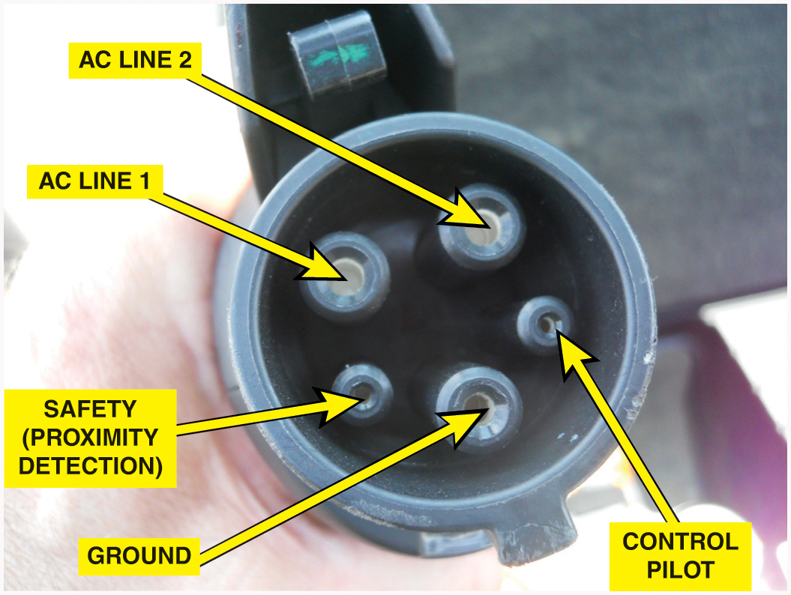
Figure 46.30 The S A E J 1772 plug is used on most electric and plug-in hybrid electric vehicles and is designed to work with Level 1 (110 to 120 V) and Level 2 (220 to 240 V) charging

Slide 33
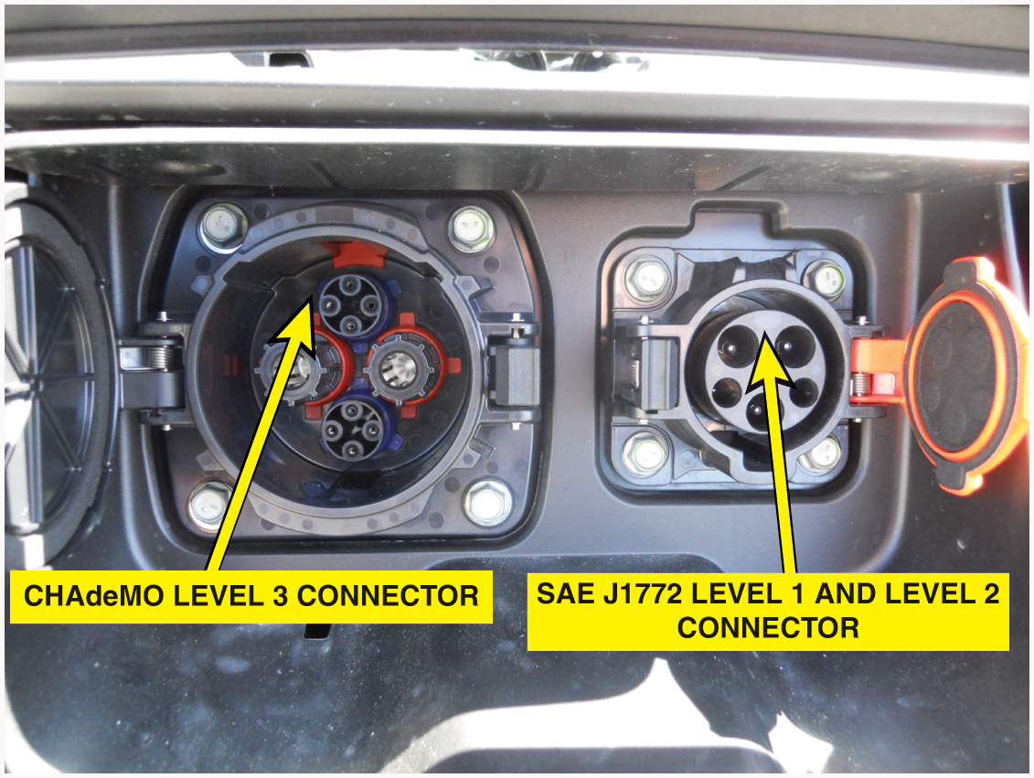
Figure 46.31 A Nissan Leaf electric vehicle charging ports located at the front of the vehicle under a hinged door for easy access

Slide 34
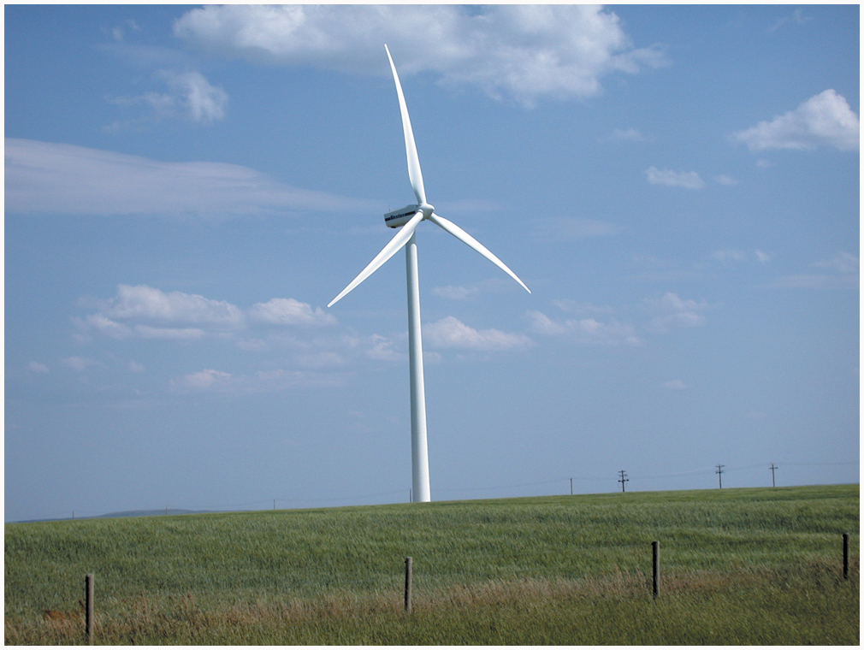
Figure 46.32 A typical wind generator that is used to generate electricity

Slide 35
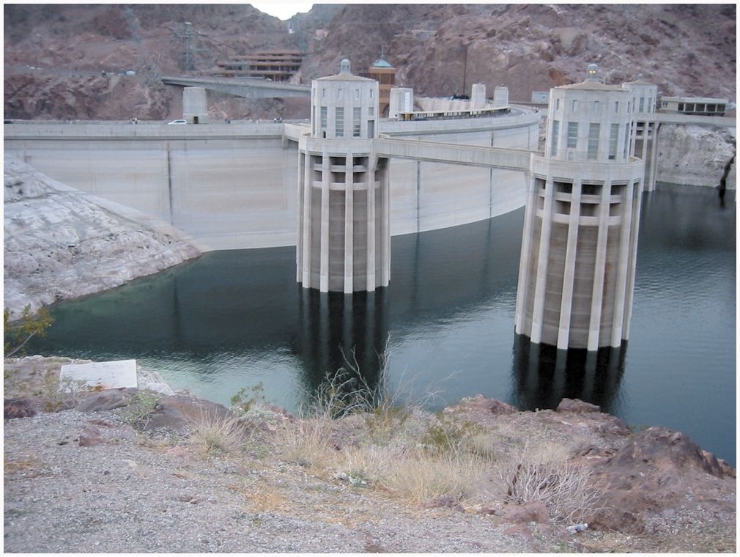
Figure 46.33 The Hoover Dam in Nevada/Arizona is used to create electricity for use in the southwestern United States

Slide 36
Copyright

