Slide 1
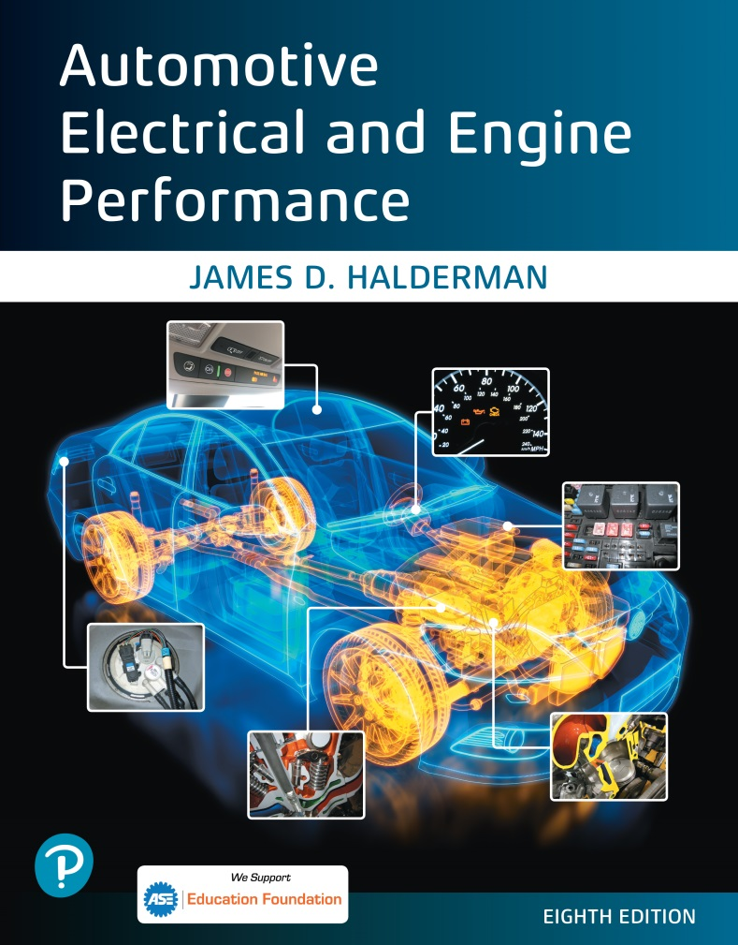
Automotive Electrical and Engine Performance
Eighth Edition
Chapter 43
On-board Diagnosis
Copyright © 2020, 2016 Pearson Education, Inc. All Rights Reserved

Slide 2
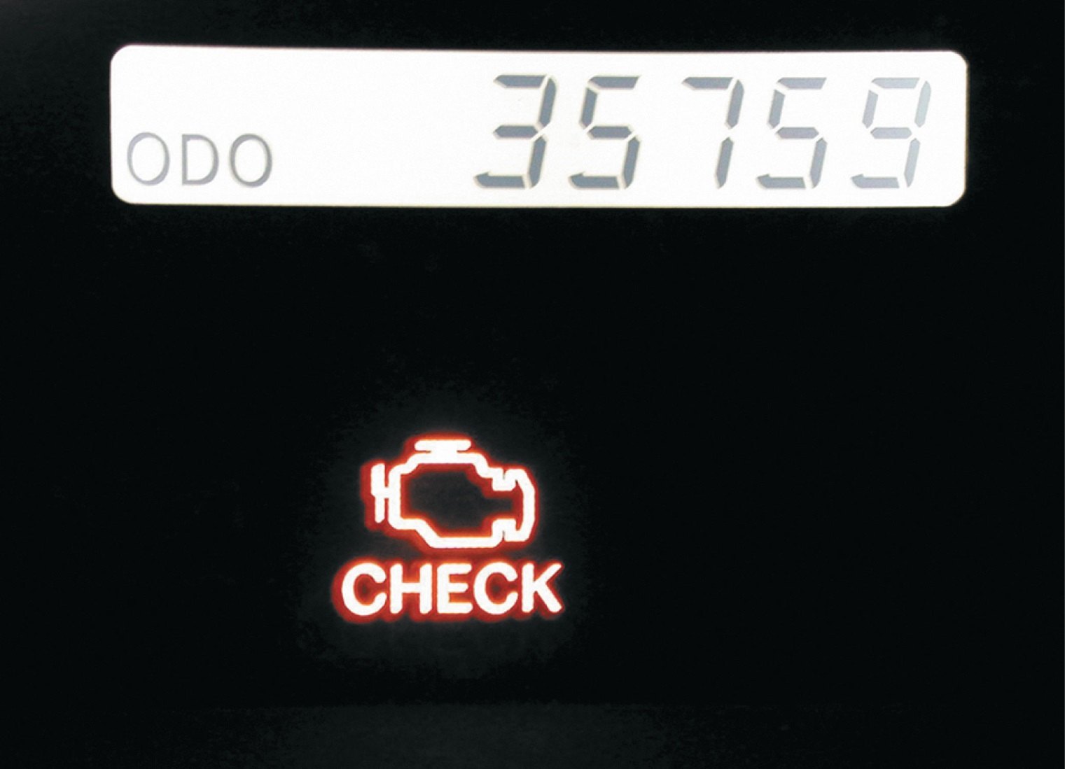
Figure 43.1 A typical malfunction indicator lamp (M I L) often labeled “check engine” or “service engine soon” (S E S)

Slide 3
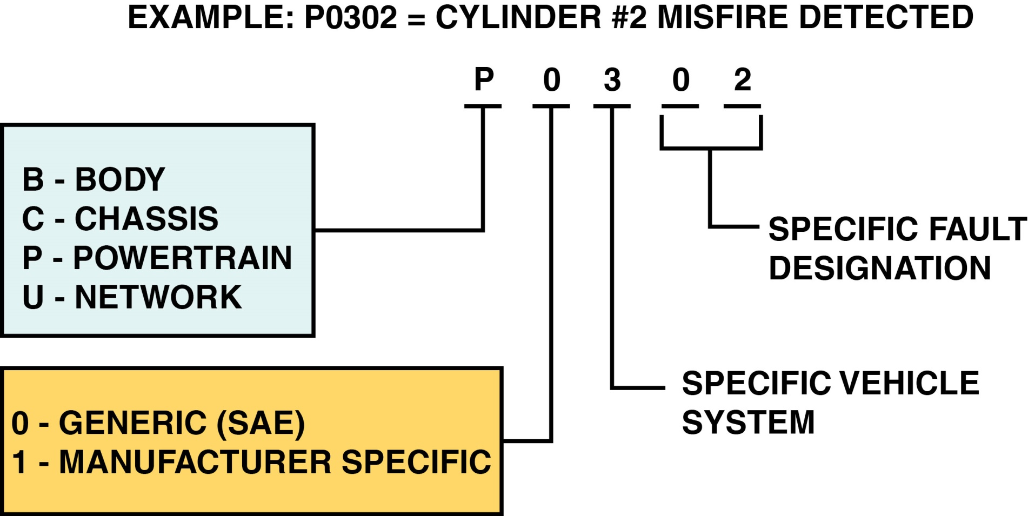
Figure 43.2 O B D-II D T C identification format

Slide 4
Copyright

