Slide 1
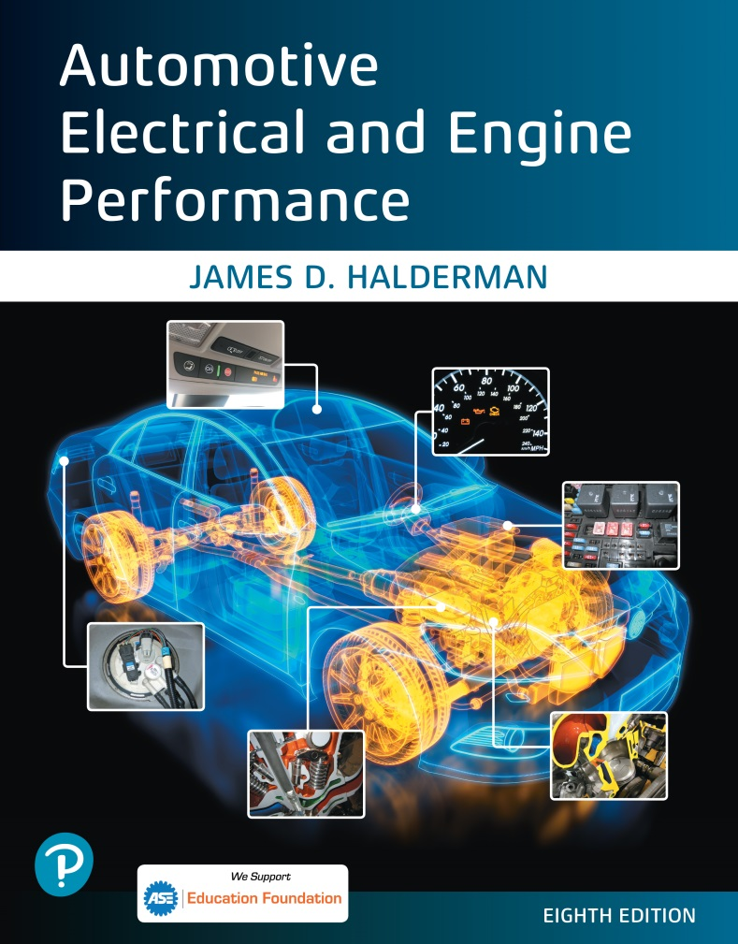
Automotive Electrical and Engine Performance
Eighth Edition
Chapter 41
Vehicle Emissions Standards, and Testing
Copyright © 2020, 2016 Pearson Education, Inc. All Rights Reserved

Slide 2
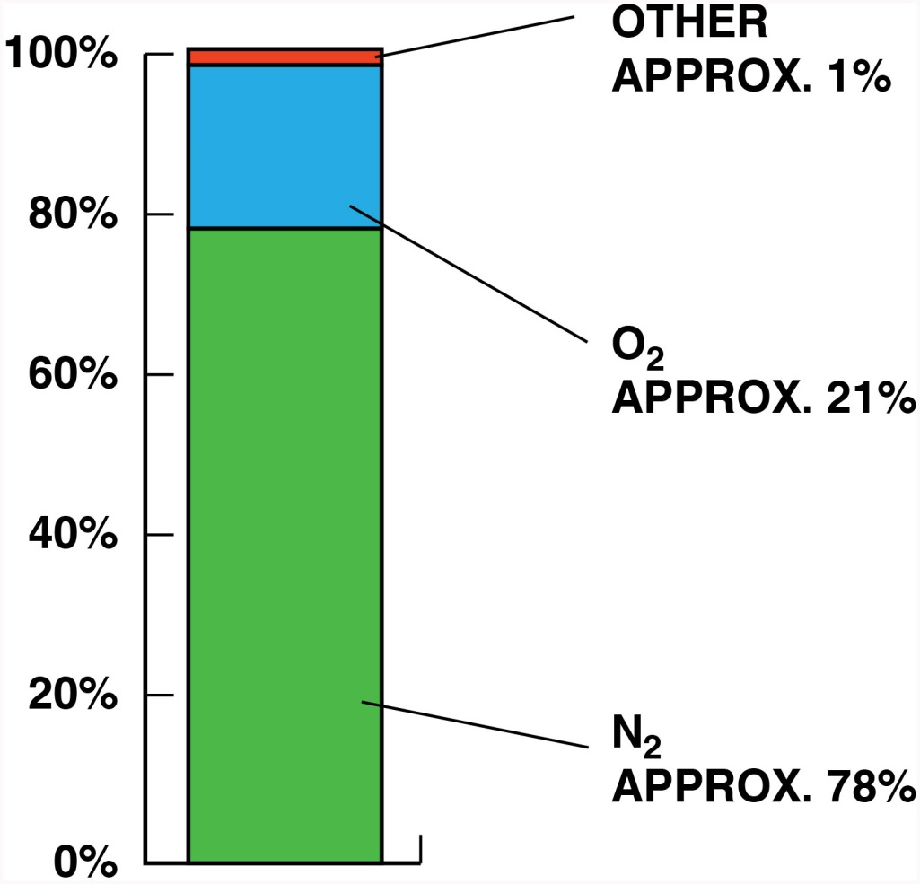
Figure 41.1 The air entering the engine consists of mostly nitrogen (78%) with about 21% oxygen and about 1% other gases

Slide 3
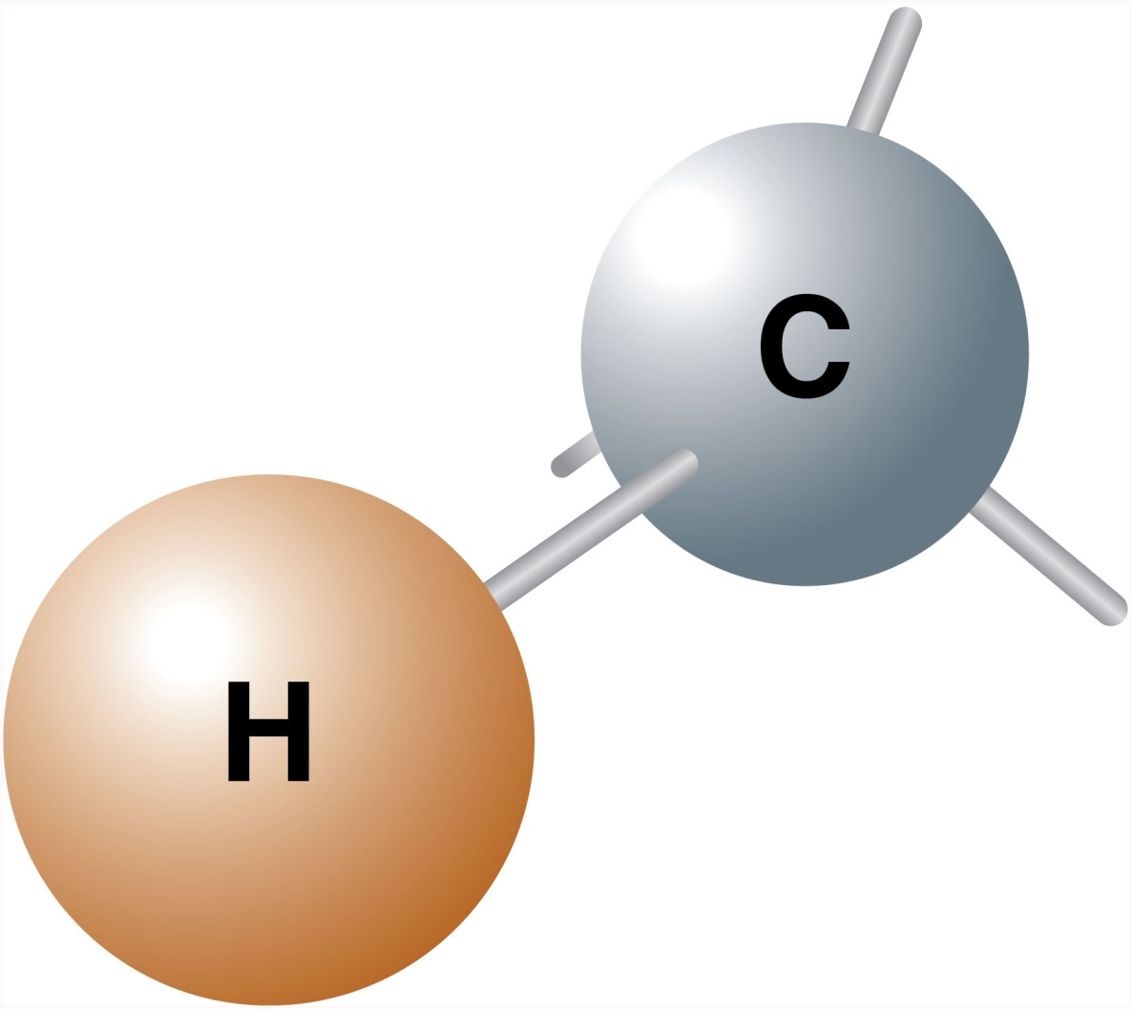
Figure 41.2 Hydrocarbons can include many combinations of hydrogen and carbon

Slide 4
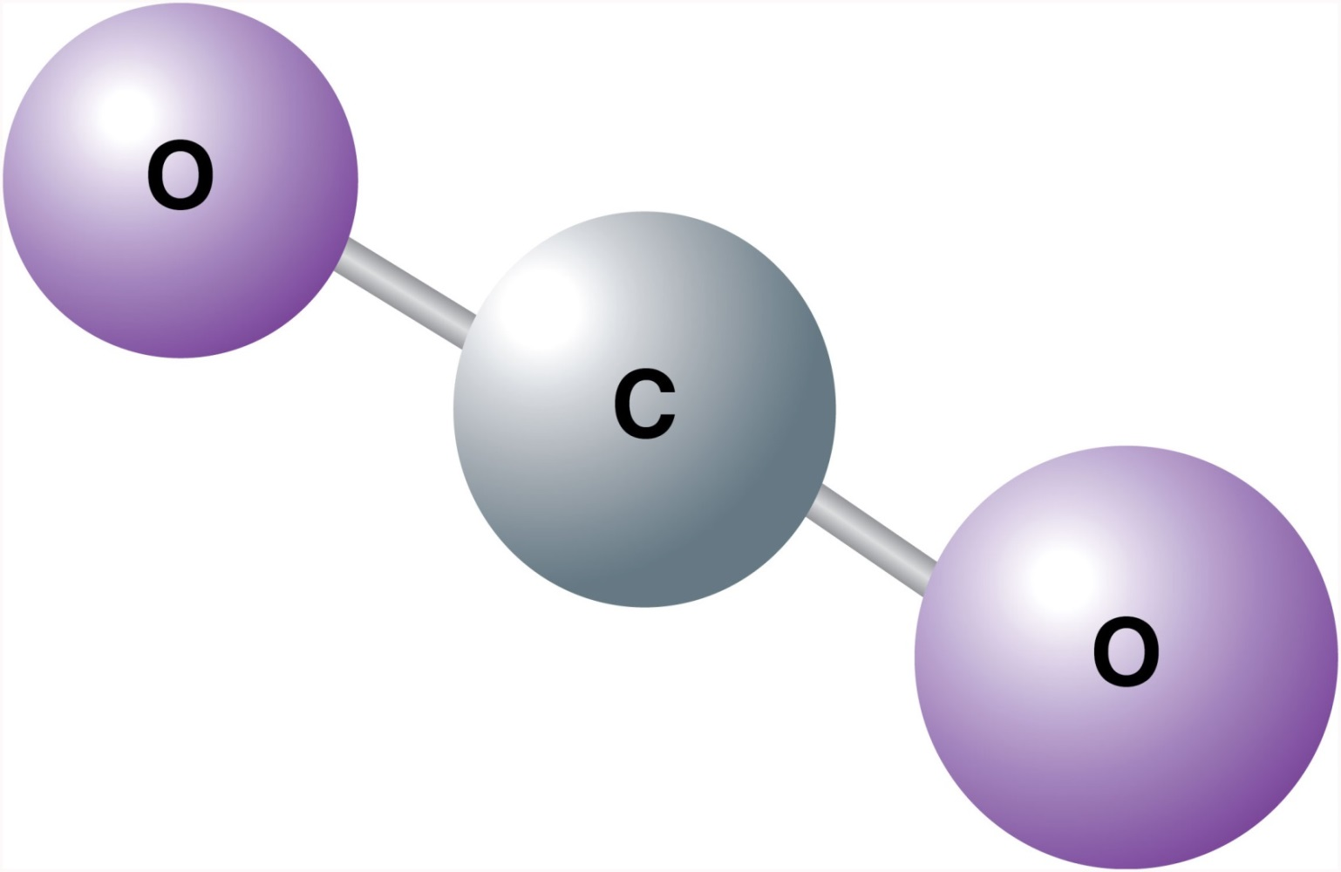
Figure 41.3 Carbon dioxide has two oxygen atoms attached to the one carbon atom and is a stable molecule

Slide 5
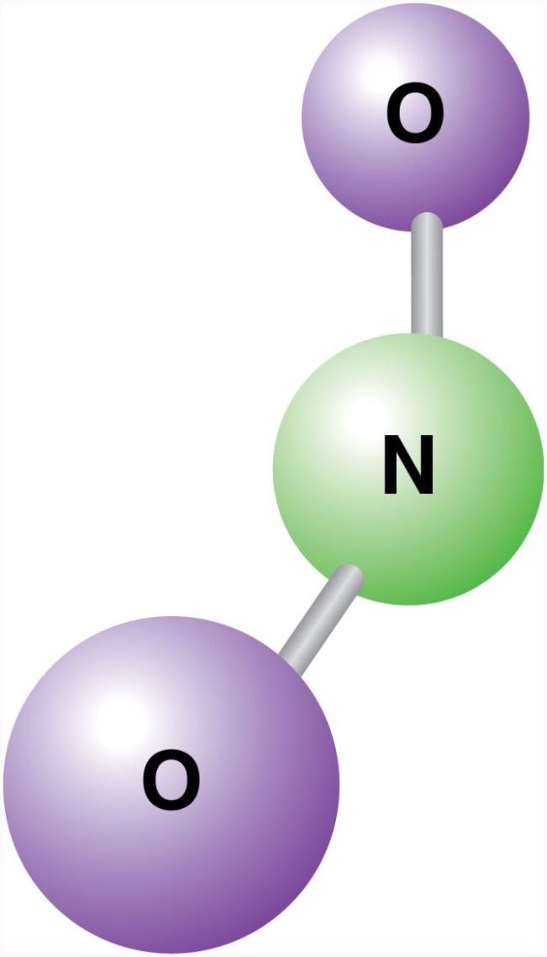
Figure 41.4 NO and NO₂ shown together are referred to as NO_{x}

Slide 6
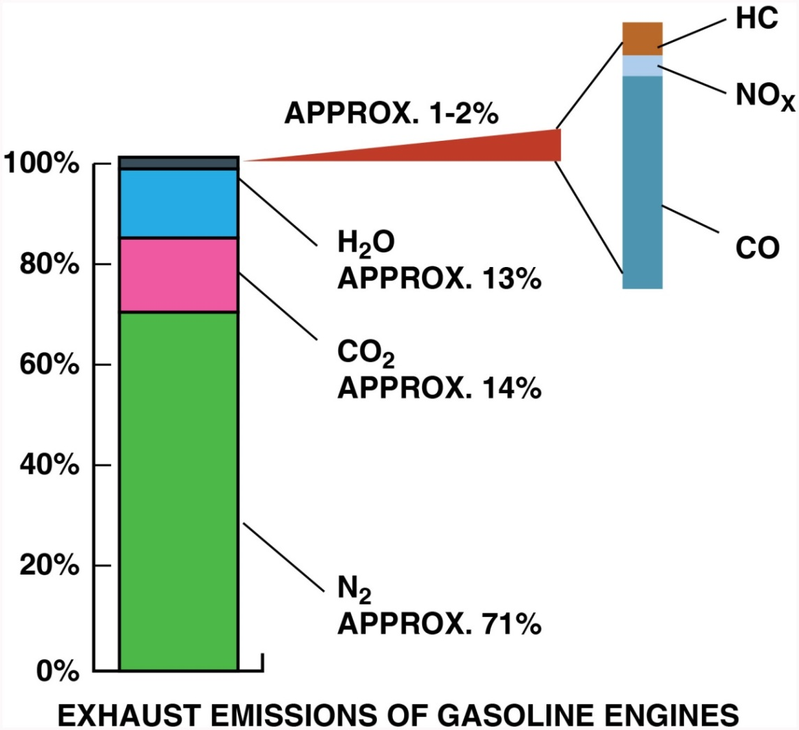
Figure 41.5 A chart showing that about 13% of the exhaust emissions is water (H₂O) in the form of steam

Slide 7
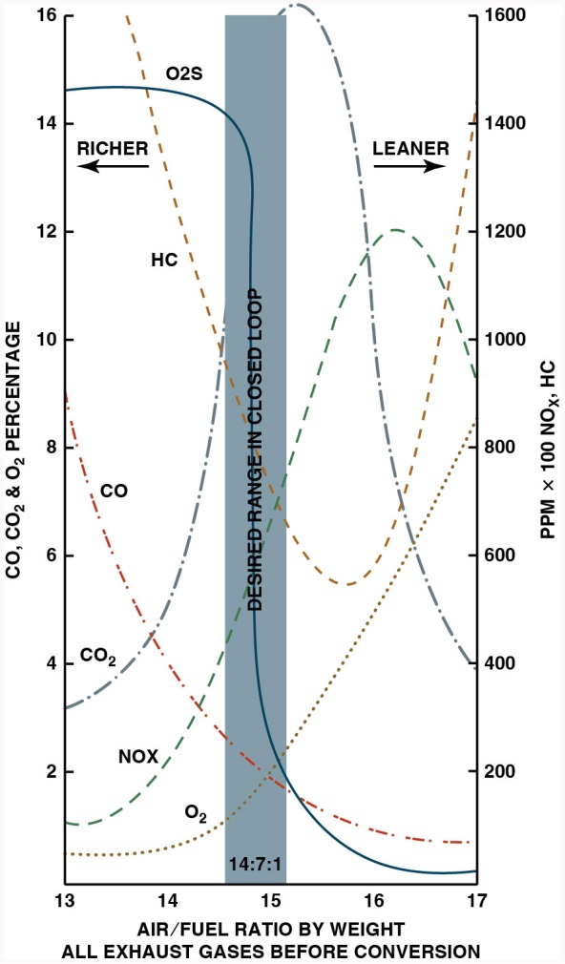
Figure 41.6 Exhaust emissions are very complex. When the air–fuel mixture becomes richer, some exhaust emissions are reduced, while others increase

Slide 8
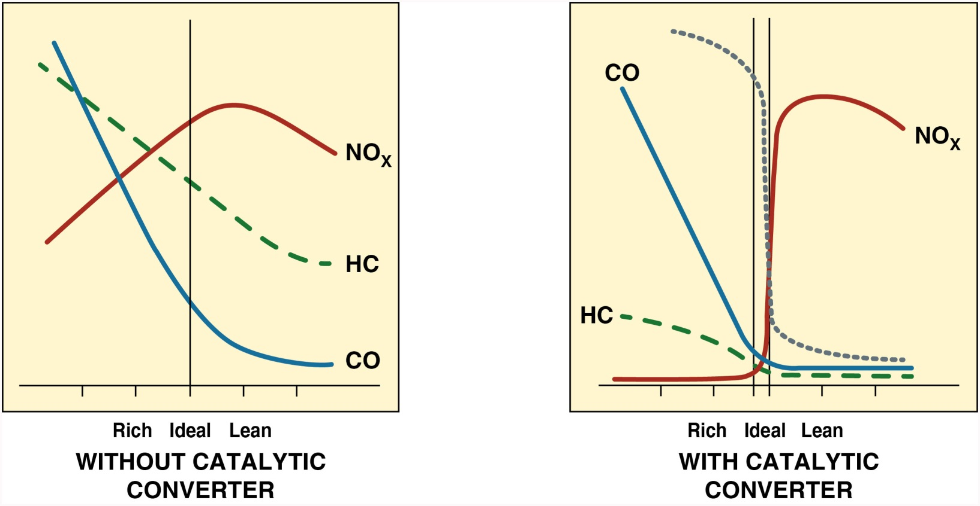
Figure 41.7 The image on the left shows exhaust gases exiting an engine without a catalytic converter with rich exhaust being toward the left of the vertical line and lean exhaust to the right of the line. The image on the right shows the exhaust after it has been treated by the catalytic converter

Slide 9
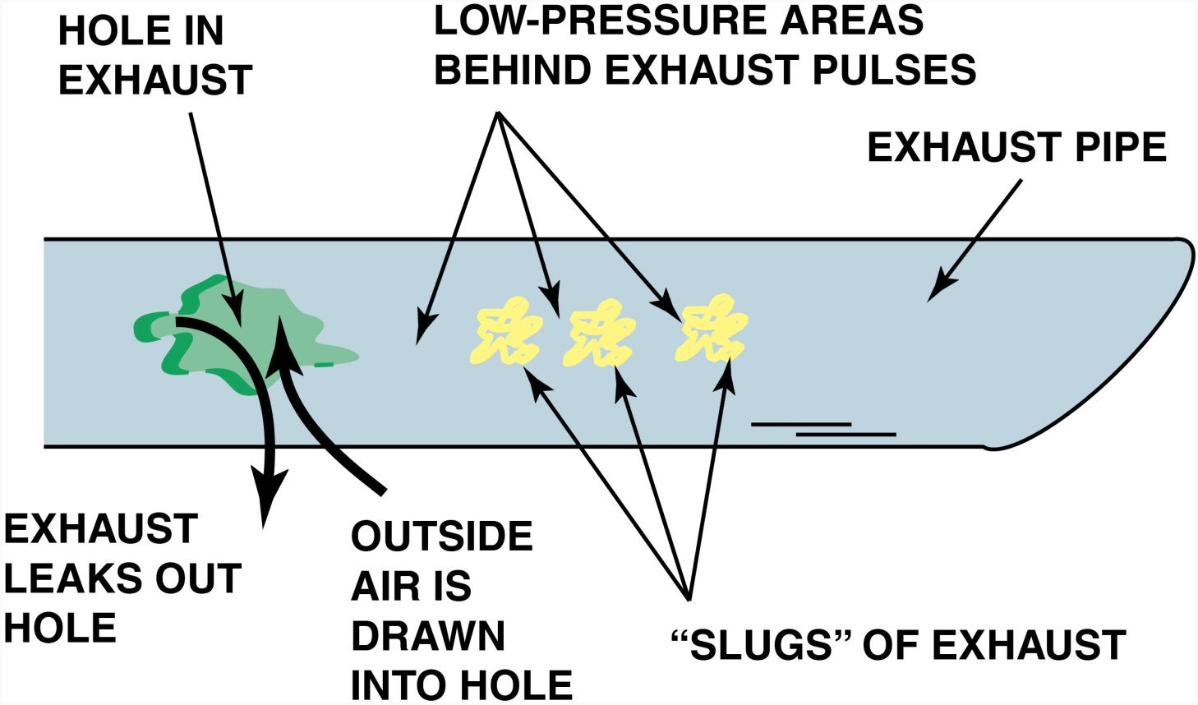
Figure 41.8 A hole in the exhaust system can cause outside air (containing oxygen) to be drawn into the exhaust system. This extra oxygen can be confusing to a service technician because the extra O2 in the exhaust stream could be misinterpreted as a too-lean air–fuel mixture

Slide 10
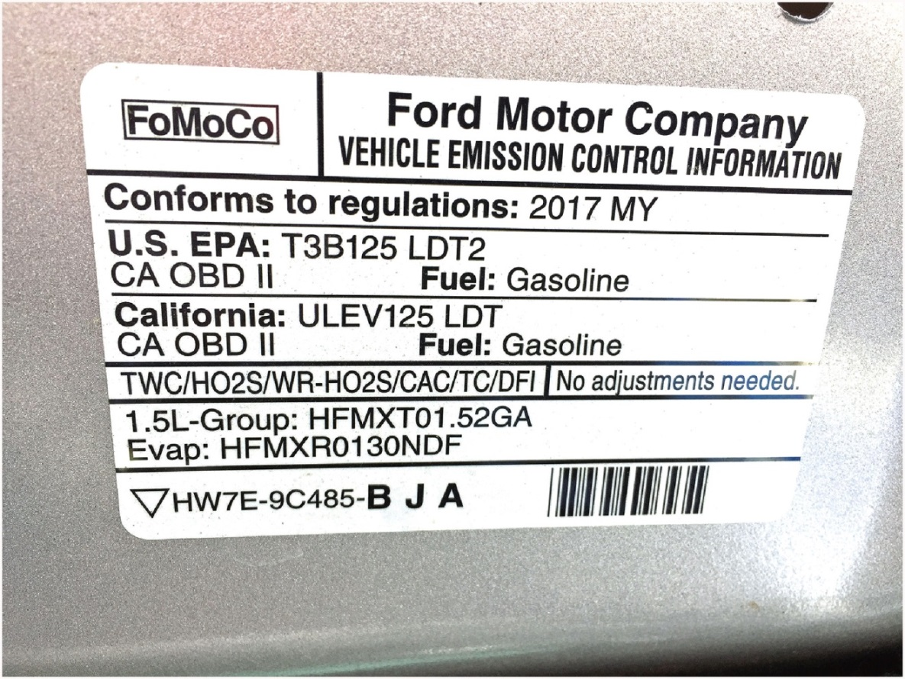
Figure 41.9 A vehicle emission control information (V E C I) sticker for a vehicle showing that is meets Tier 3, Bin 1 (T2B3) E P A rating and California U L E V 125 standard

Slide 11
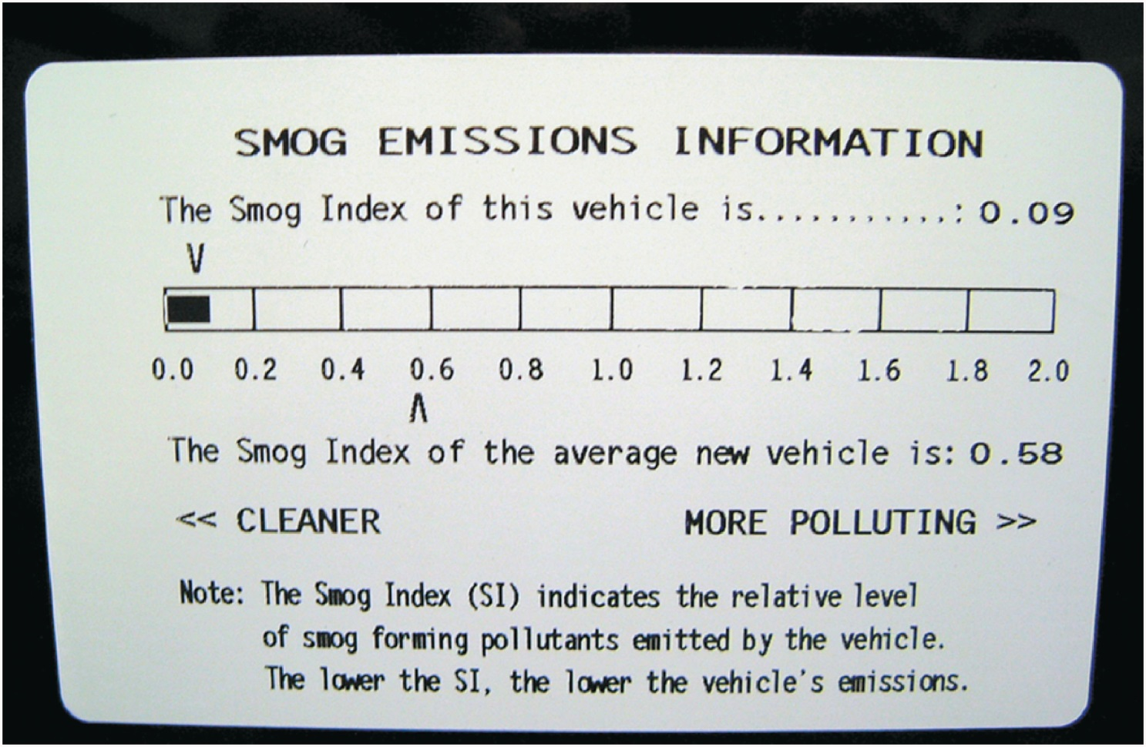
Figure 41.10 This label on a Toyota Camry hybrid shows the relative smog-producing emissions, but this does not include CO₂, which may increase global warming

Slide 12
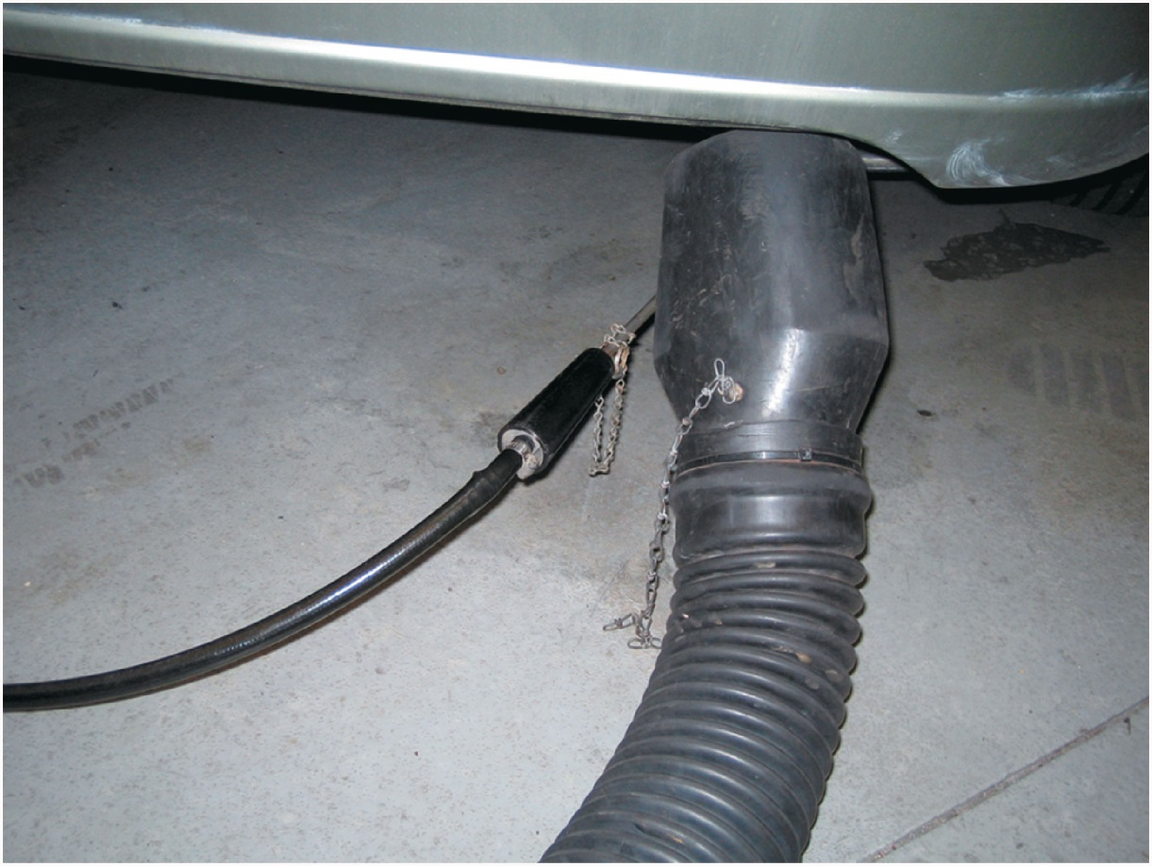
Figure 41.11 A partial stream sampling exhaust probe being used to measure exhaust gases in parts per million (p p m) or percent (%)

Slide 13
Copyright

