Slide 1
Automotive Electrical and Engine Performance
Eighth Edition
Chapter 40
Fuel-injection System Diagnosis and Service
Copyright © 2020, 2016 Pearson Education, Inc. All Rights Reserved

Slide 2
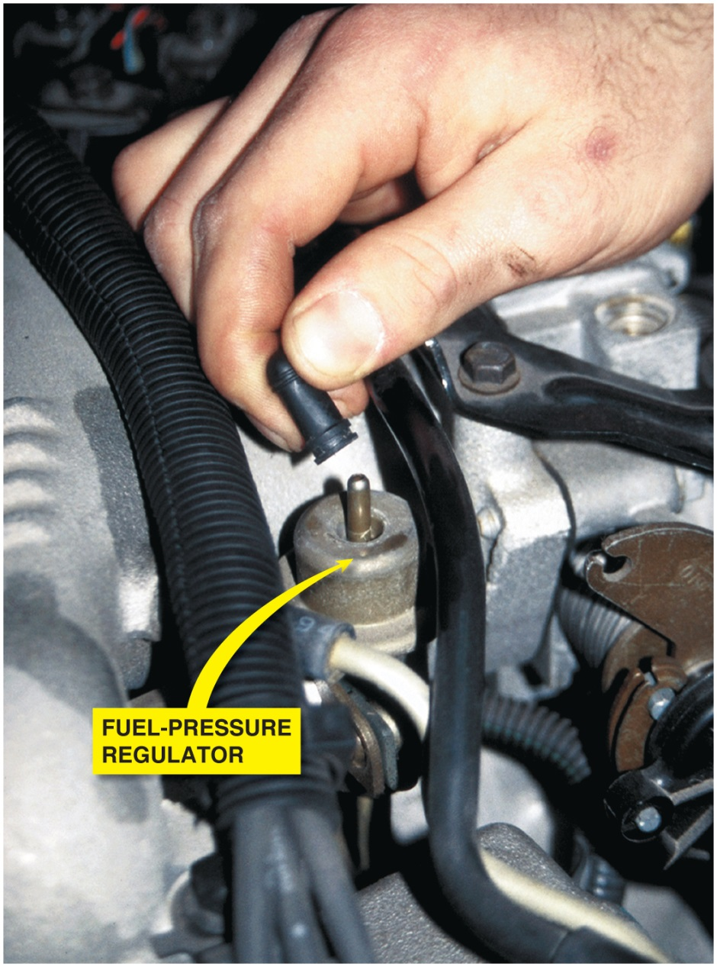
Figure 40.1 If the vacuum hose is removed from the fuel-pressure regulator when the engine is running, the fuel pressure should increase. If it does not increase, the fuel pump is not capable of supplying adequate pressure or the fuel-pressure regulator is defective. If gasoline is visible in the vacuum hose, the regulator is leaking and should be replaced

Slide 3
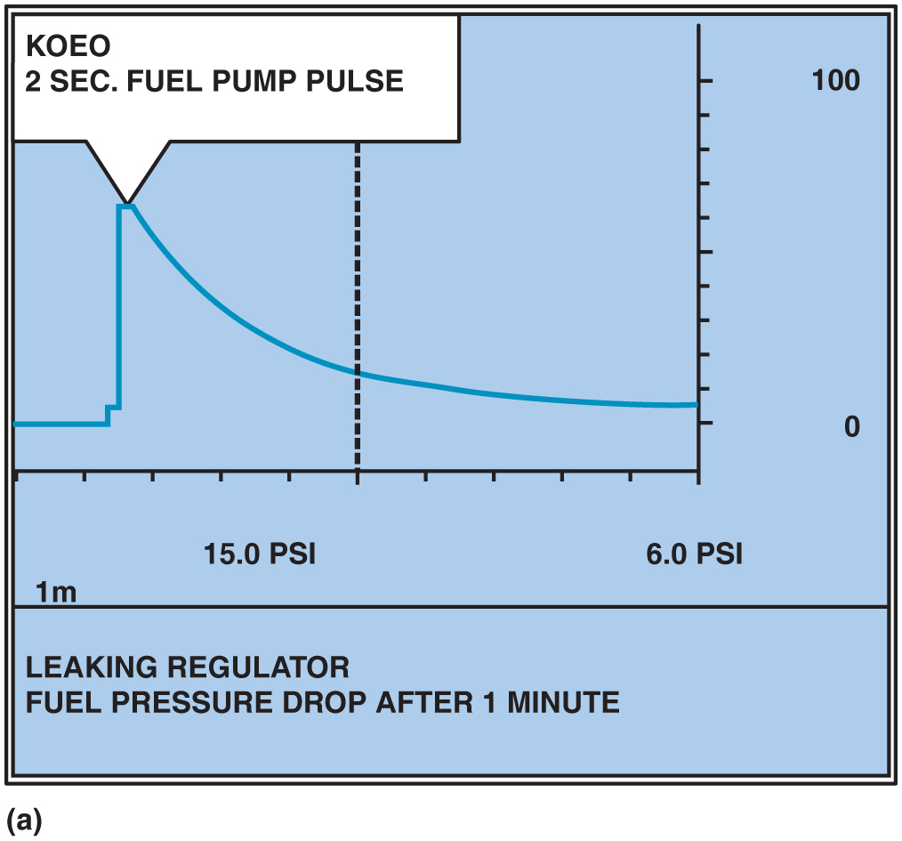
Figure 40.2 (a) A fuel-pressure graph after key on, engine off (K O E O) on a throttle body injection (T B I) system

Slide 4
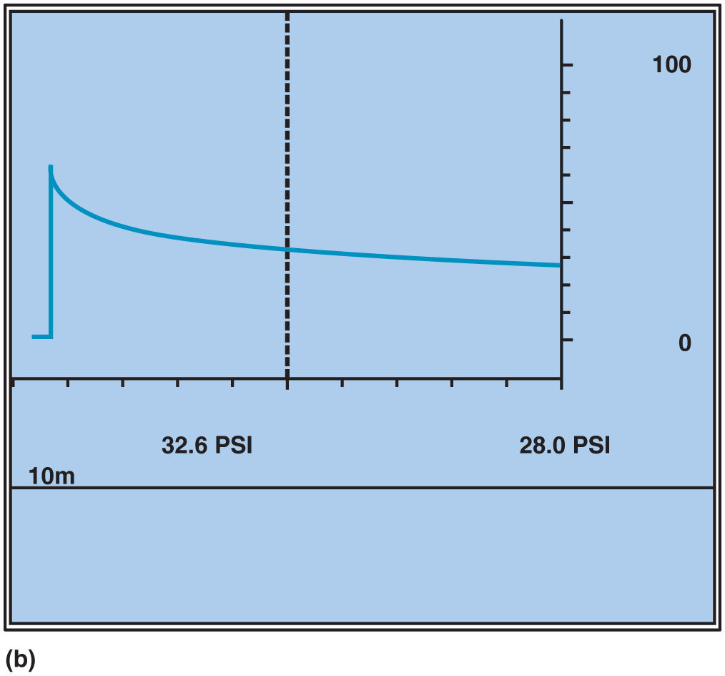
Figure 40.2 (b) Pressure drop after 10 minutes on a normal port fuel-injection system

Slide 5
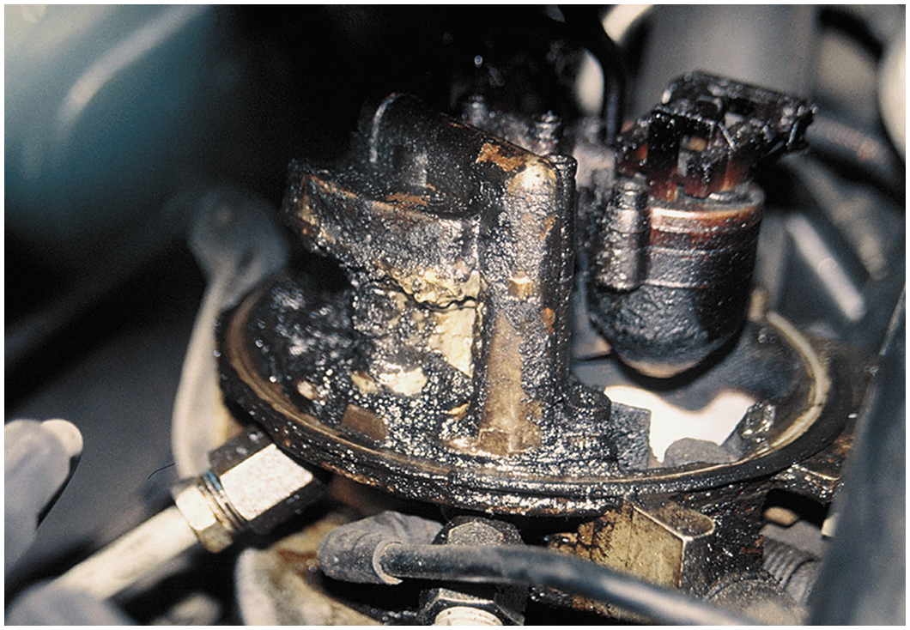
Figure 40.3 A clogged positive crankcase ventilation (P C V) system caused the engine oil fumes to be drawn into the air cleaner assembly. This is what the technician discovered during a visual inspection

Slide 6
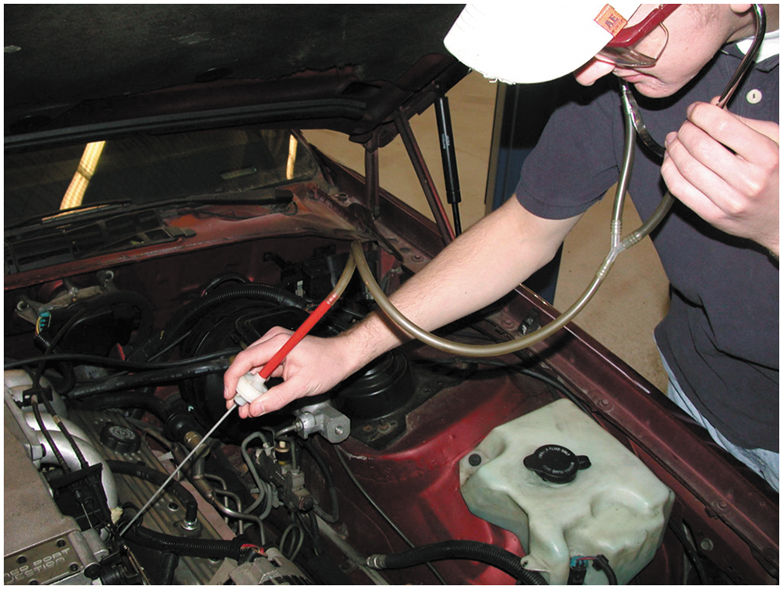
Figure 40.4 All fuel injectors should make the same sound with the engine running at idle speed. A lack of sound indicates a possible electrically open injector or a break in the wiring. A defective computer could also be the cause of a lack of clicking (pulsing) of the injectors

Slide 7
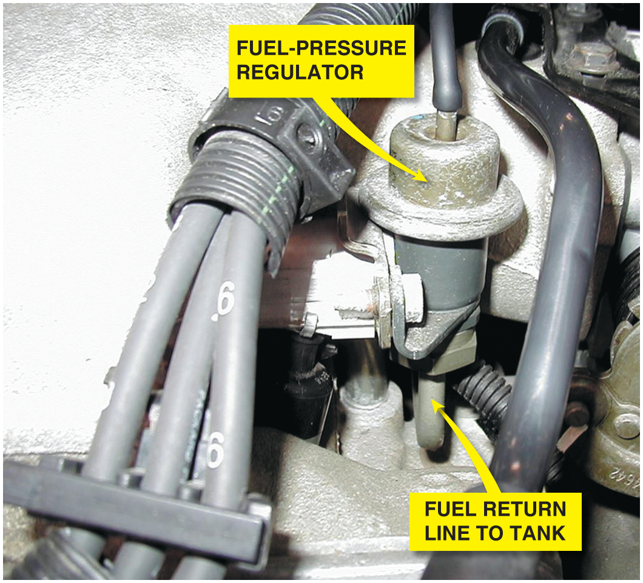
Figure 40.5 Fuel should be heard returning to the fuel tank at the fuel return line if the fuel-pump and fuel-pressure regulator are functioning correctly

Slide 8
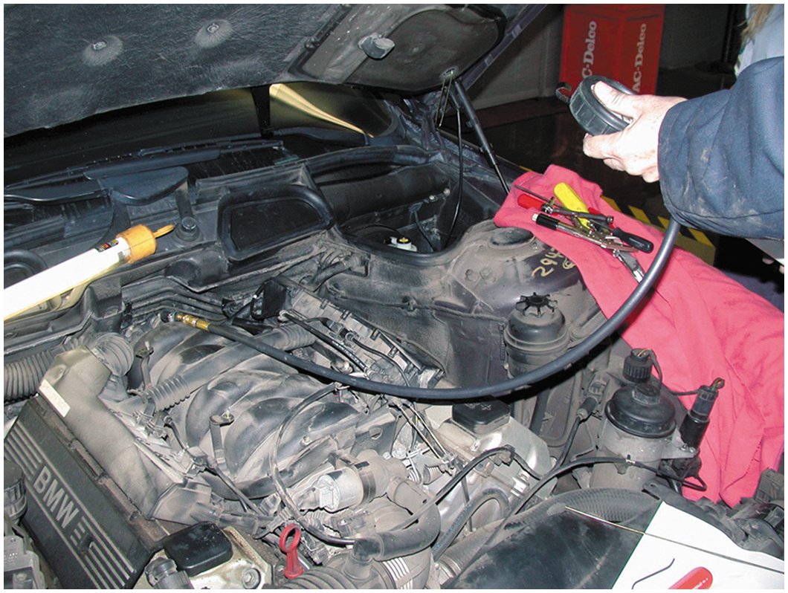
Figure 40.6 Checking the fuel pressure using a fuel-pressure gauge connected to the Schrader valve

Slide 9
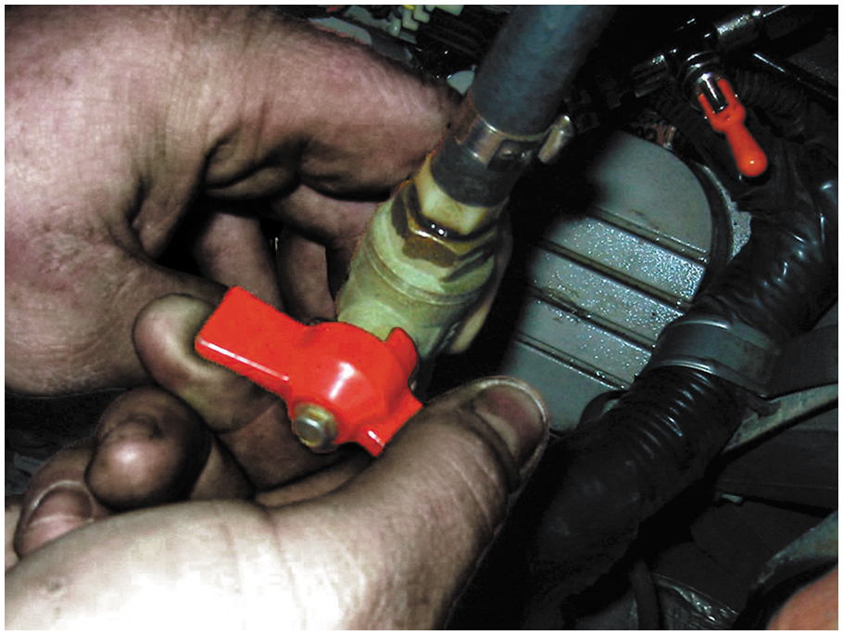
Figure 40.7 Shutoff valves must be used on vehicles equipped with plastic fuel lines to isolate the cause of a pressure drop in the fuel system

Slide 10
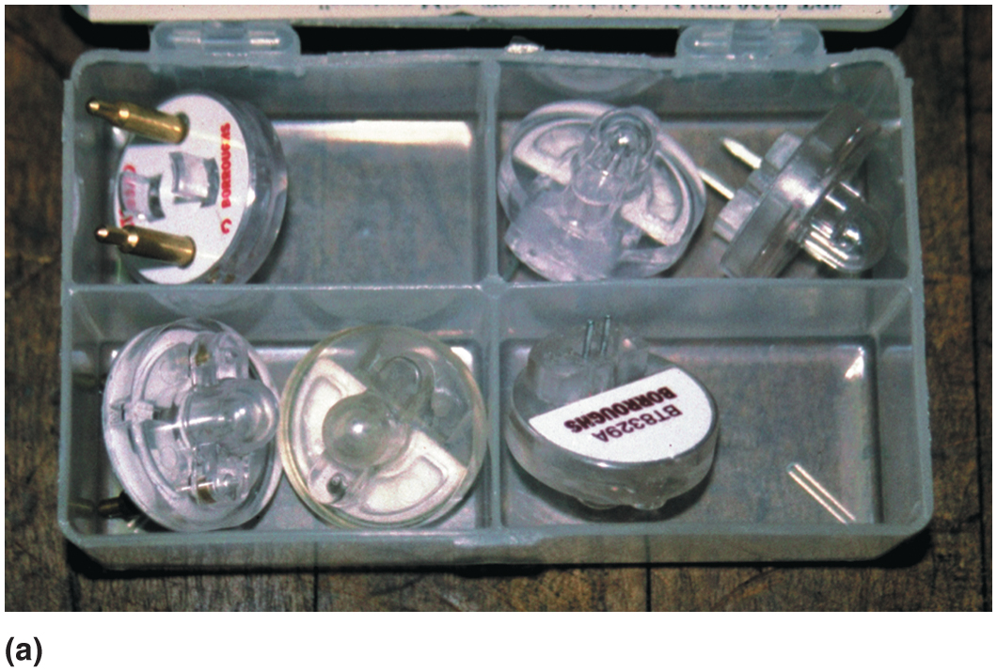
Figure 40.8 (a) Noid lights are usually purchased as an assortment so that one is available for any type or size of injector wiring connector

Slide 11
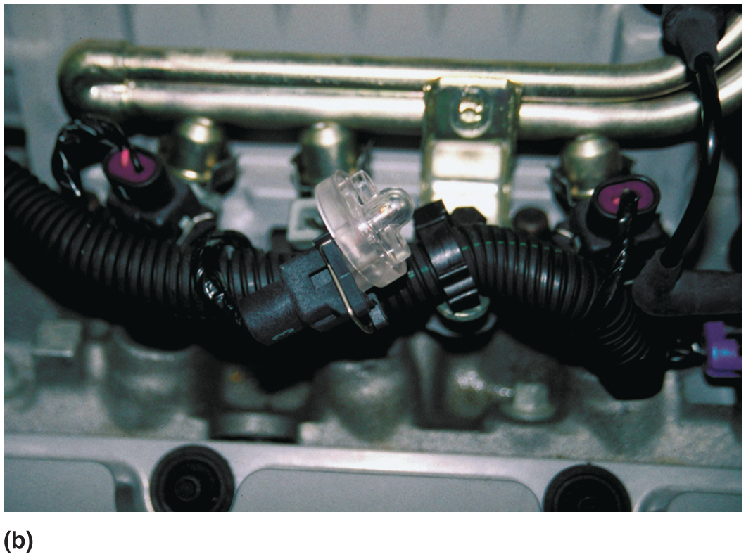
Figure 40.8 (b) The connector is unplugged from the injector and a noid light is plugged into the injector connector. The noid light should flash when the engine is being cranked if the power circuit and the pulsing to ground by the computer are functioning okay

Slide 12
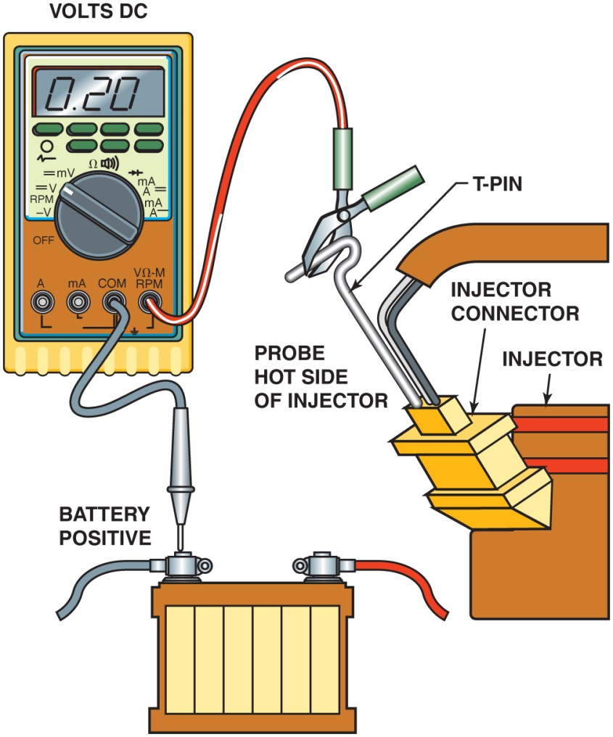
Figure 40.9 Use a D M M set to read D C volts to check the voltage drop of the positive circuit to the fuel injector. A reading of 0.5 volt or less is generally considered to be acceptable

Slide 13
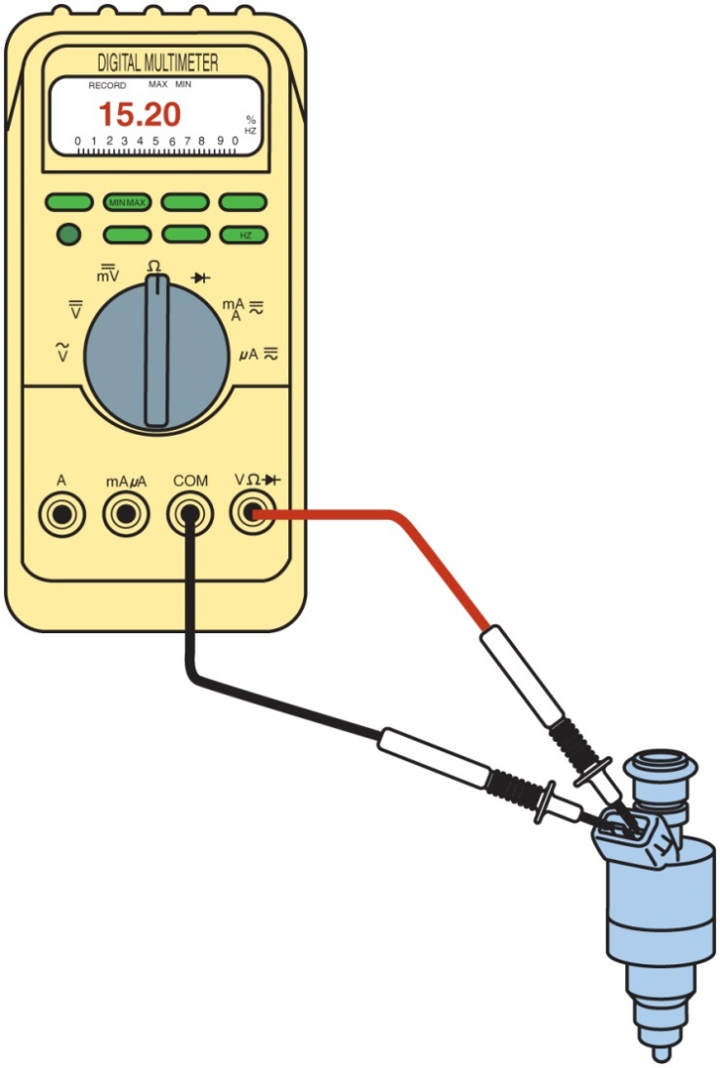
Figure 40.10 Connections and settings necessary to measure fuel-injector resistance

Slide 14
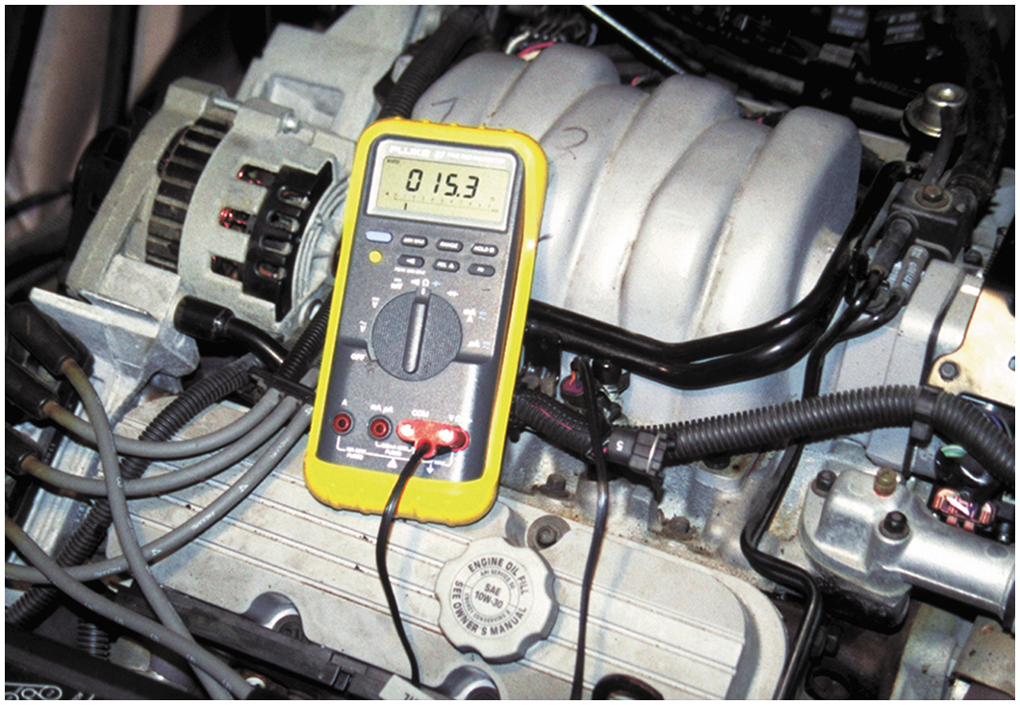
Figure 40.11 To measure fuel-injector resistance, a technician constructed a short wiring harness with a double banana plug that fits into the V and C O M terminals of the meter and an injector connector at the other end. This setup makes checking resistance of fuel injectors quick and easy

Slide 15
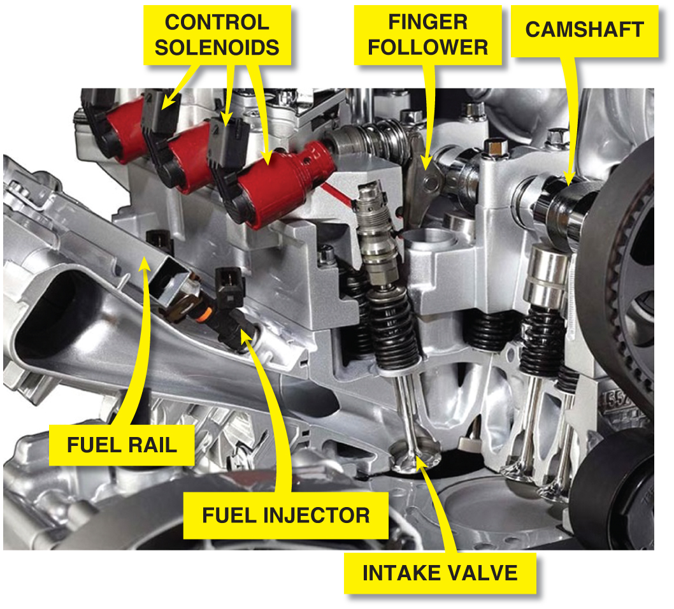
Figure 40.12 In a multiair engine design, the exhaust valves are opened by the exhaust camshaft lobes. Intake valves are opened by the high-pressure engine oil, the high pressure being produced by a lobe-actuated piston and controlled by a P C M-controlled solenoids

Slide 16
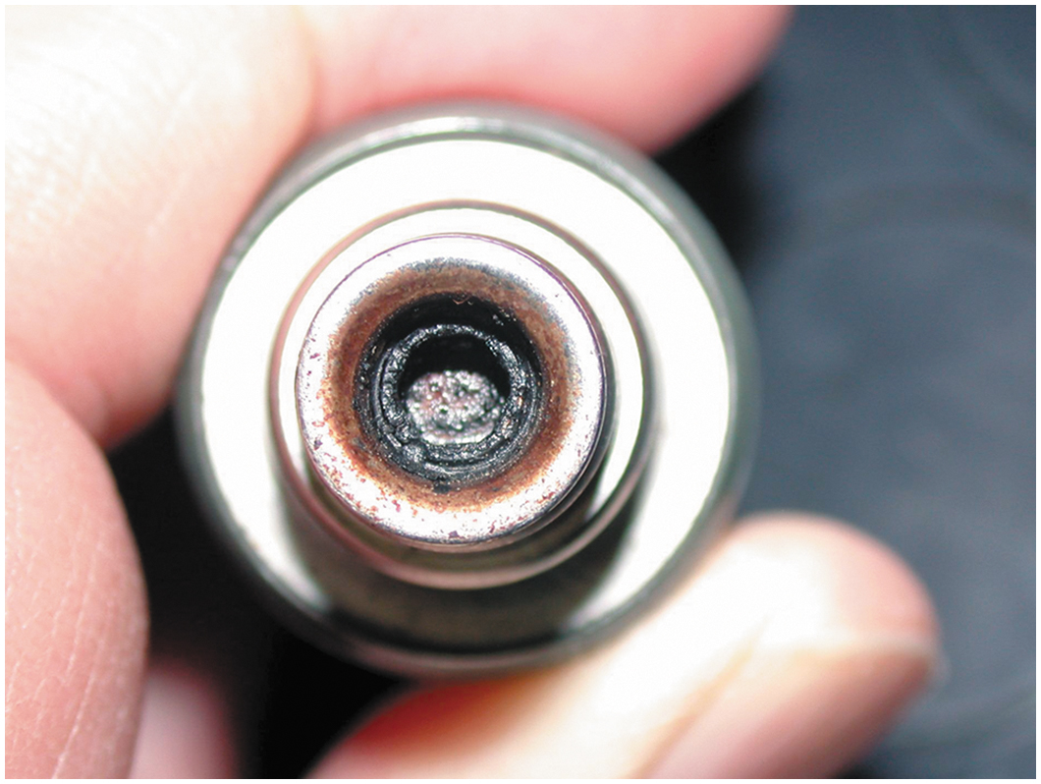
Figure 40.13 If an injector has the specified resistance, this does not mean that it is okay. This injector had the specified resistance, yet it did not deliver the correct amount of fuel because it was clogged

Slide 17
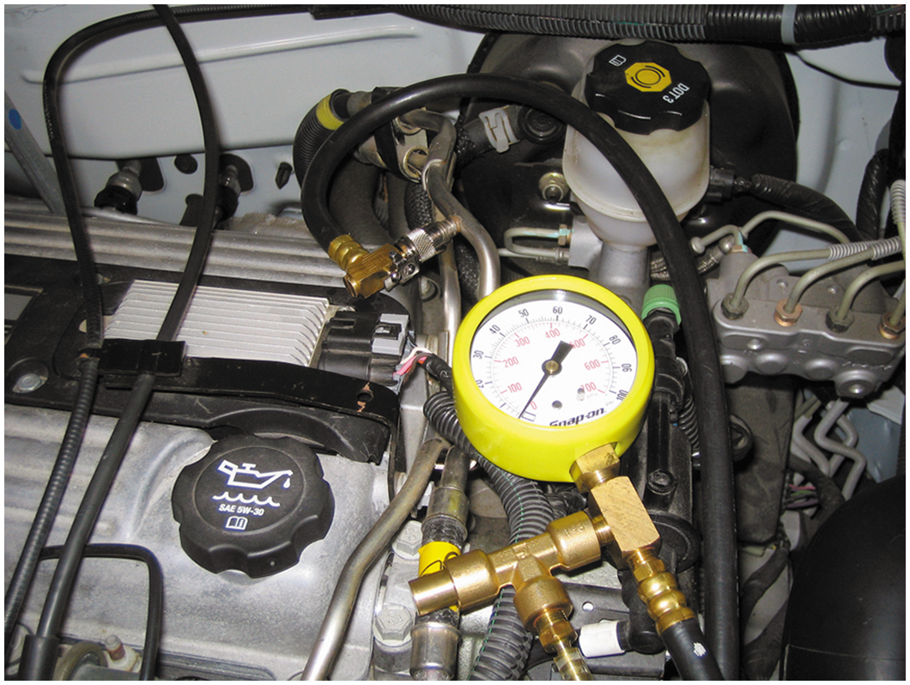
Figure 40.14 Connect a fuel-pressure gauge to the fuel rail at the Schrader valve

Slide 18
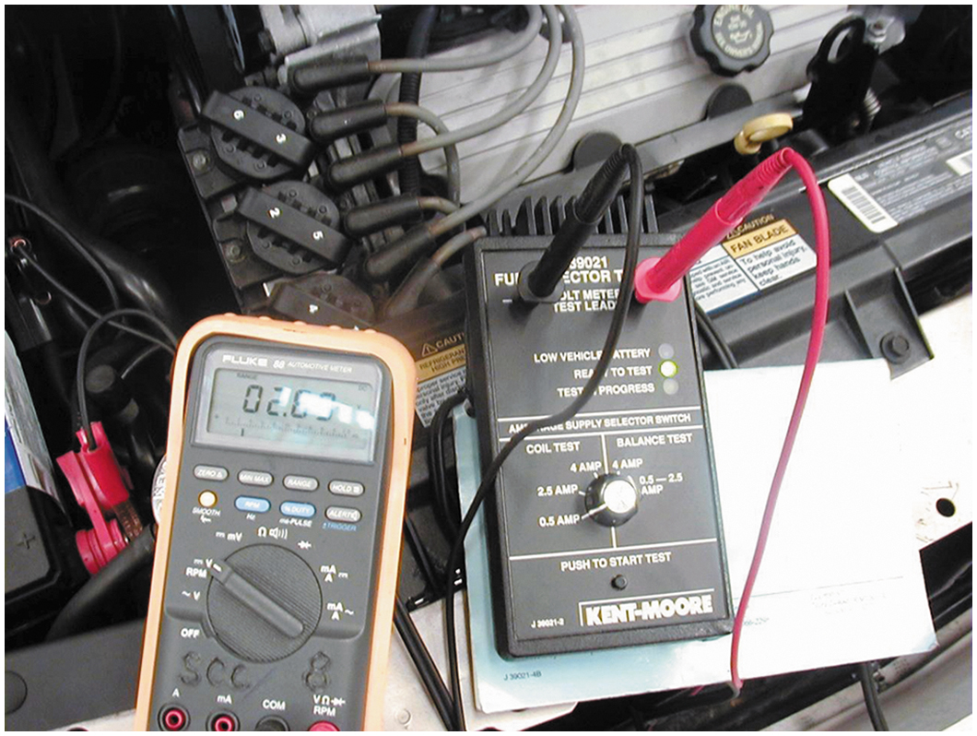
Figure 40.15 An injector tester being used to check the voltage drop through the injector while the tester is sending current through the injectors. This test is used to check the coil inside the injector. This same tester can be used to check for equal pressure drop of each injector by pulsing the injector on for 500 ms

Slide 19
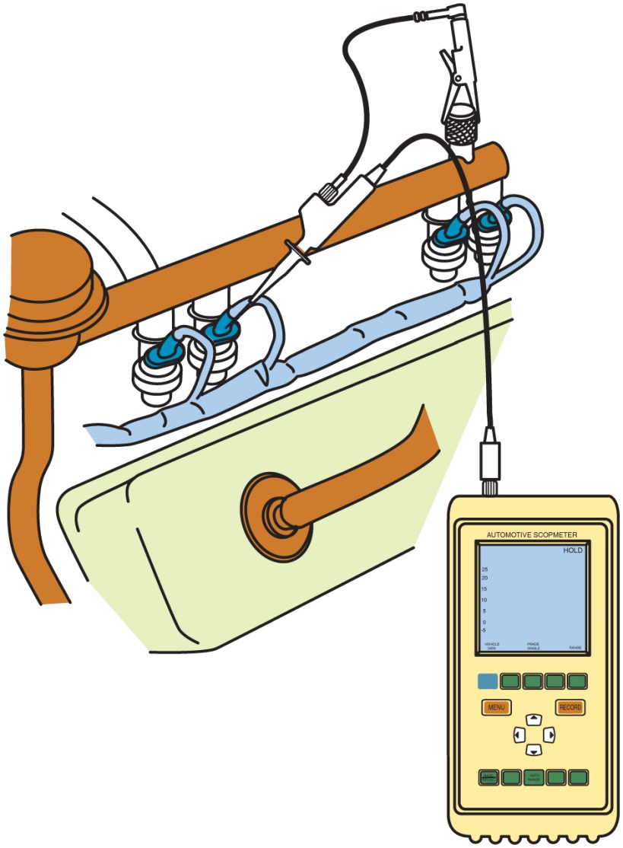
Figure 40.16 A D S O can be easily connected to an injector by carefully back-probing the electrical connector

Slide 20
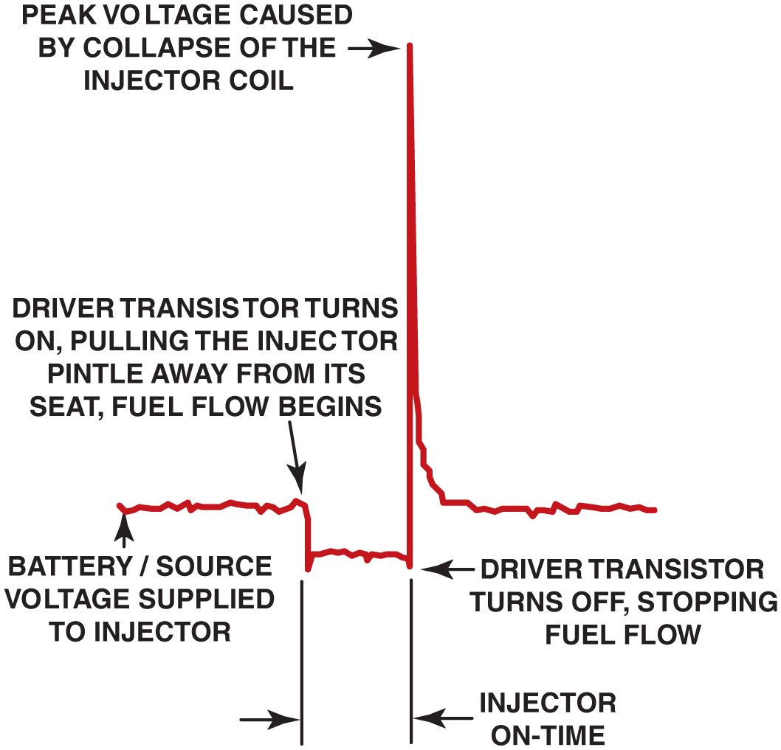
Figure 40.17 The injector on-time is called the pulse width

Slide 21
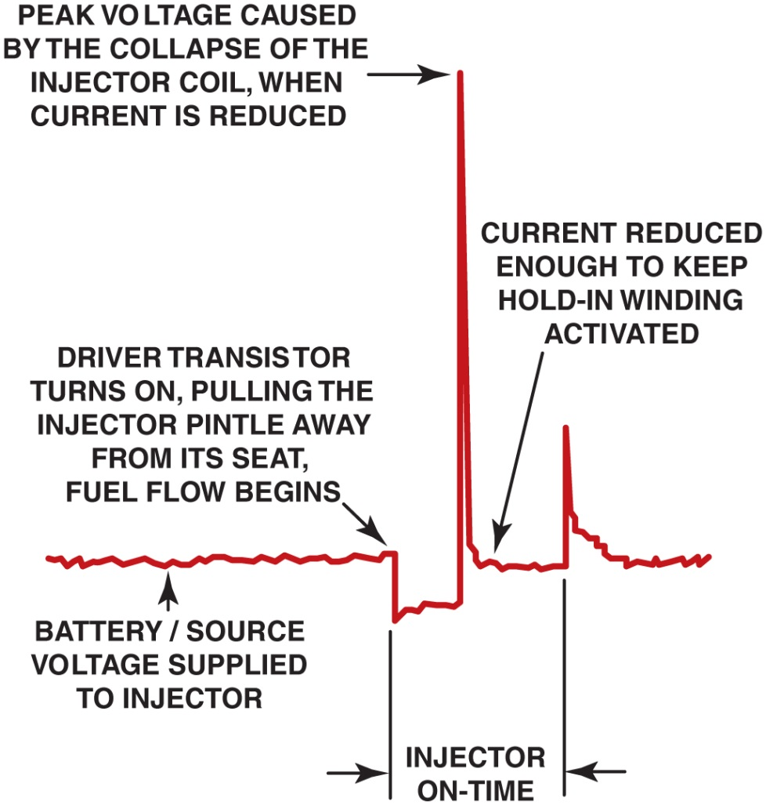
Figure 40.18 A typical peak-and-hold fuel-injector waveform. Most fuel injectors that measure less than 6 ohms will usually display a similar waveform

Slide 22
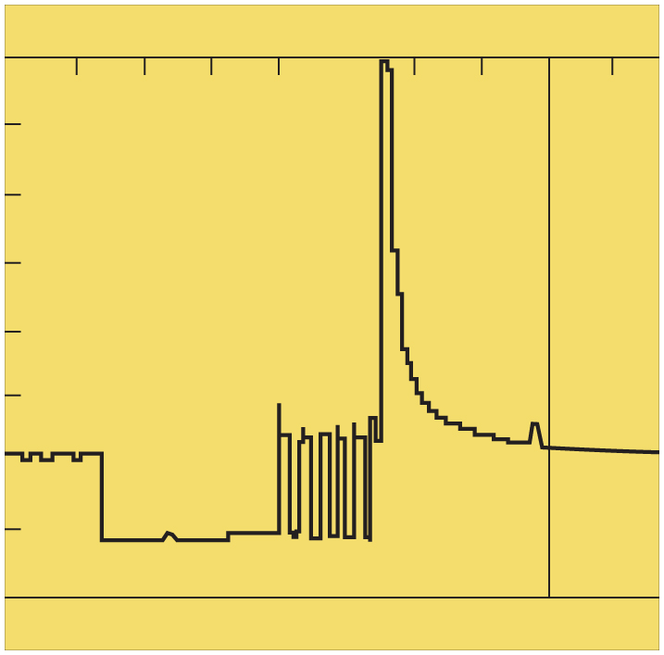
Figure 40.19 A waveform of a pulse-width modulated fuel injector. At the end, when the voltage is removed, there is an inductive spike created similar to the spike created but other types of injectors

Slide 23
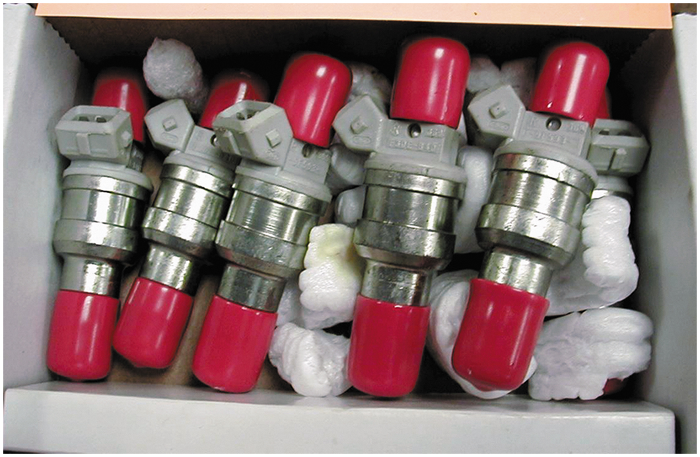
Figure 40.20 A set of six reconditioned injectors. The sixth injector is barely visible at the far right

Slide 24
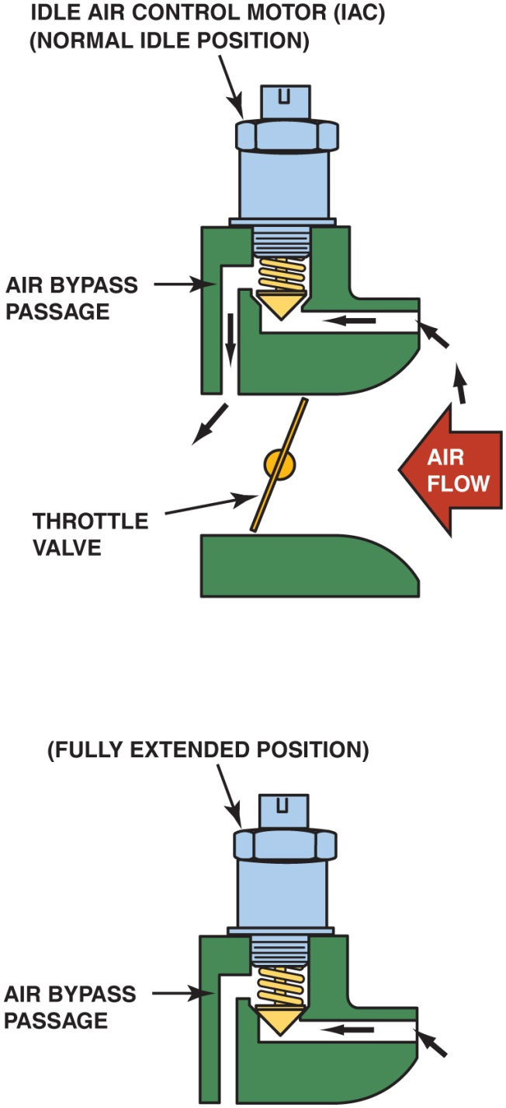
Figure 40.21 An I A C controls idle speed by controlling the amount of air that passes around the throttle plate. More airflow results in a higher idle speed

Slide 25
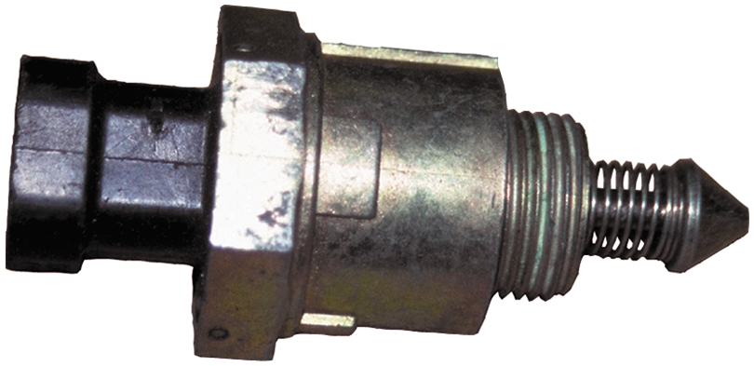
Figure 40.22 A typical I A C

Slide 26
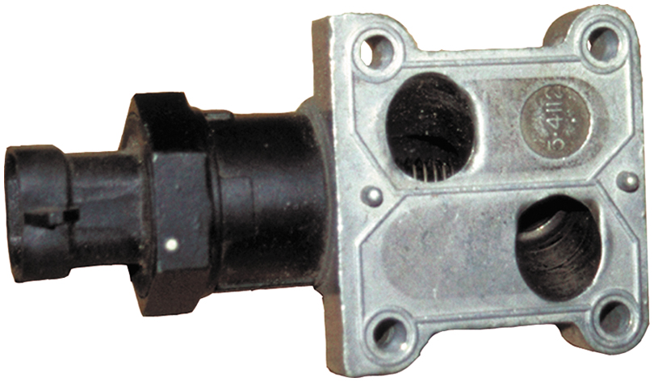
Figure 40.23 Some I A C units are purchased with the housing as shown. Carbon buildup in these passages can cause a rough or unstable idling or stalling

Slide 27
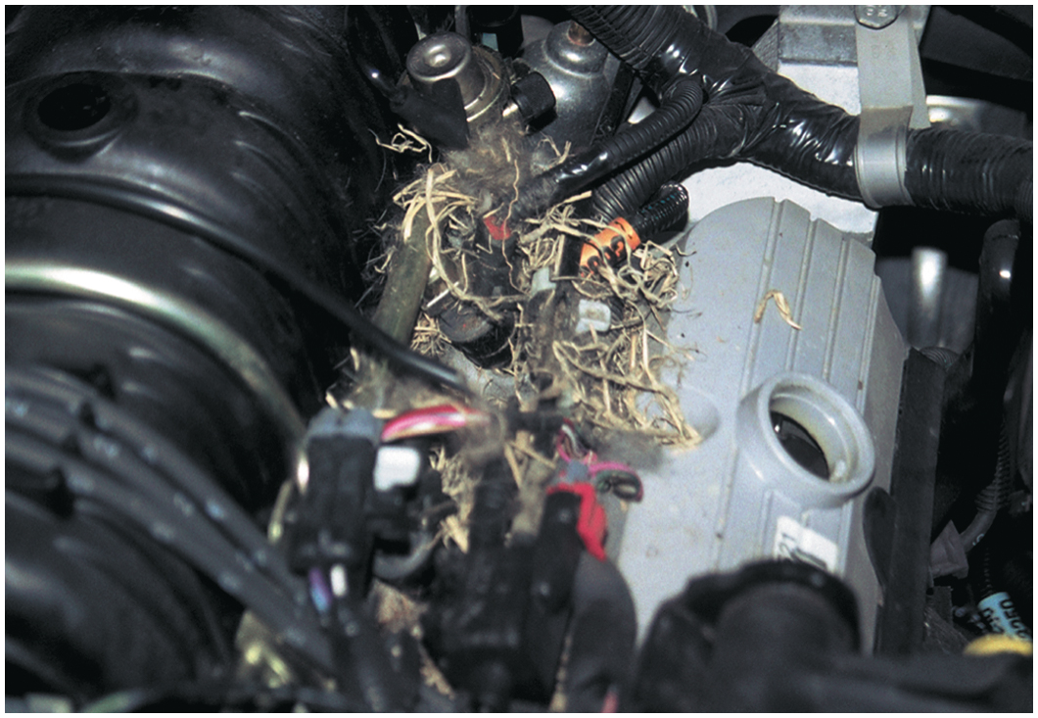
Figure 40.24 When the cover is removed from the top of the engine, a mouse or some other animal nest is visible. The animal had already eaten through a couple of injector wires. At least the cause of the intermittent misfire was discovered

Slide 28
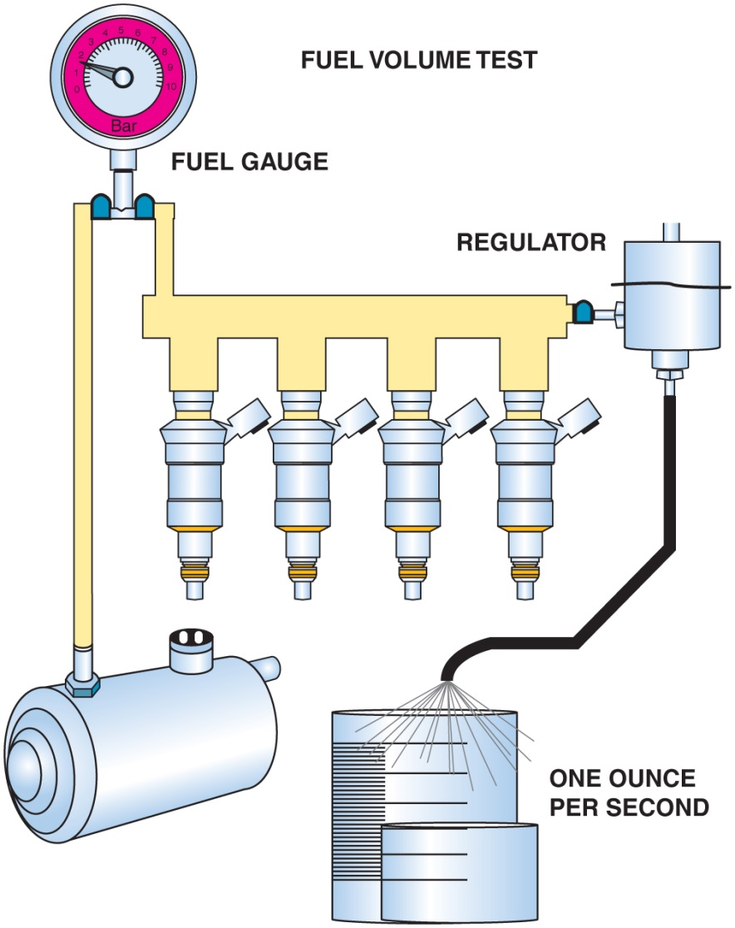
Figure 40.25 Checking fuel-pump volume using a hose from the outlet of the fuel-pressure regulator into a calibrated container

Slide 29
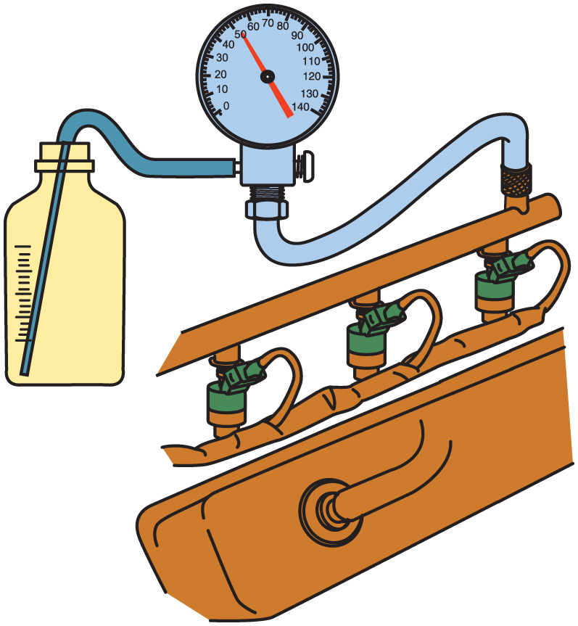
Figure 40.26 Testing fuel-pump volume using a fuel-pressure gauge with a bleed hose inserted into a suitable container. The engine is running during this test

Slide 30
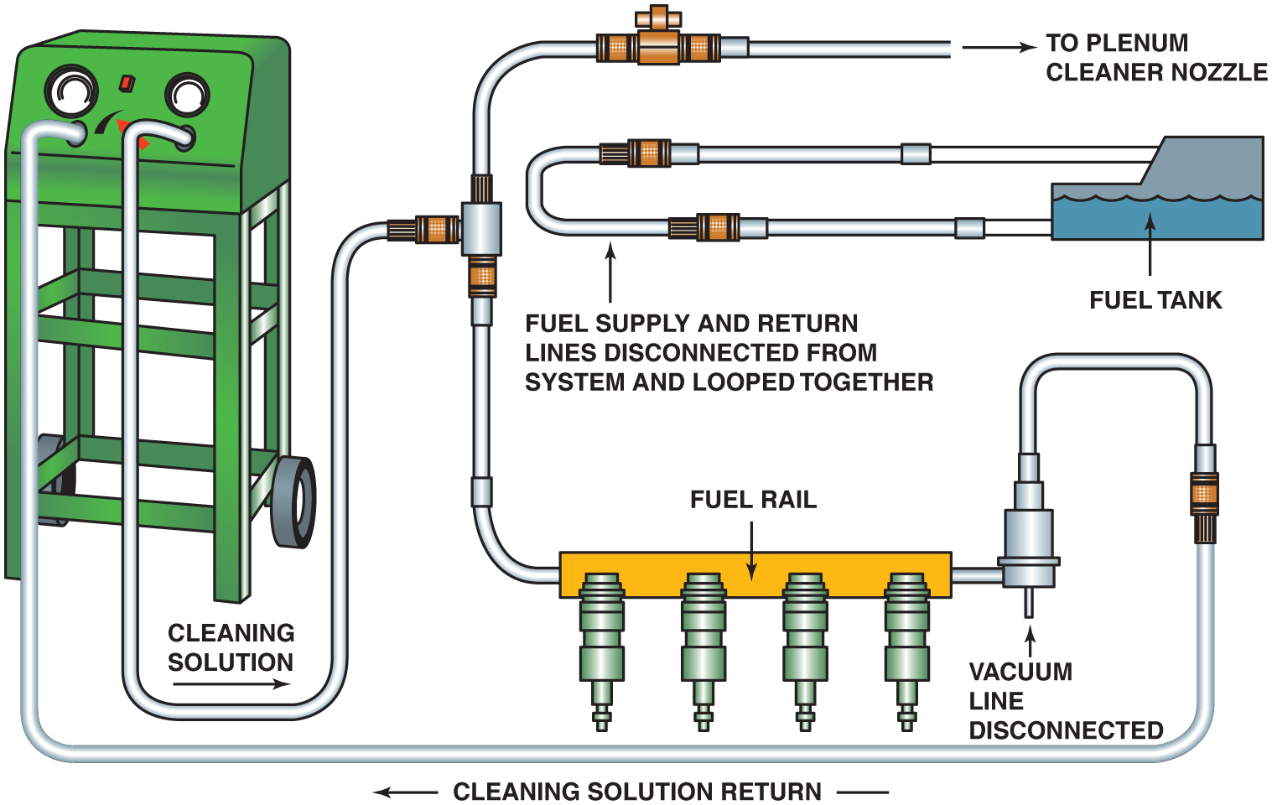
Figure 40.27 A typical two-line cleaning machine hookup, showing an extension hose that can be used to squirt a cleaning solution into the throttle body while the engine is running on the cleaning solution and gasoline mixture

Slide 31
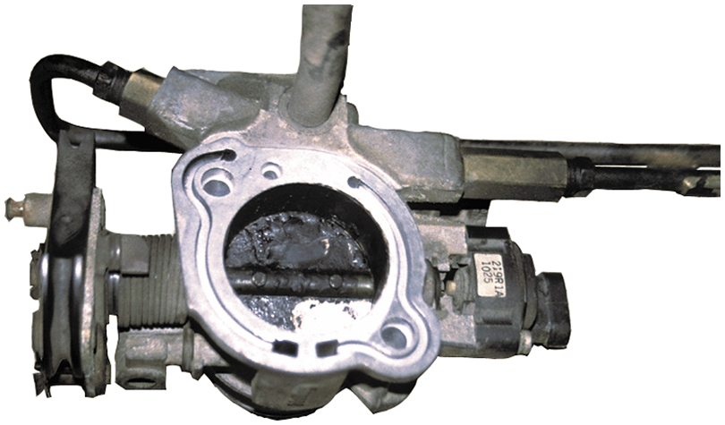
Figure 40.28 To thoroughly clean a throttle body, it is sometimes best to remove it from the vehicle. The throttle plate may need to be cleaned if the engine tends to stall, hesitate or has a rough idle

Slide 32
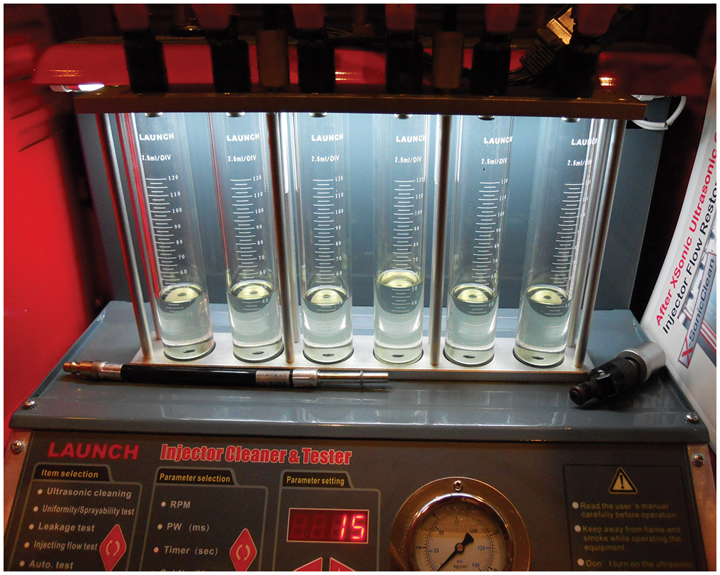
Figure 40.29 The amount each injector is able to flow is displayed in glass cylinders are each injector for a quick visual check

Slide 33
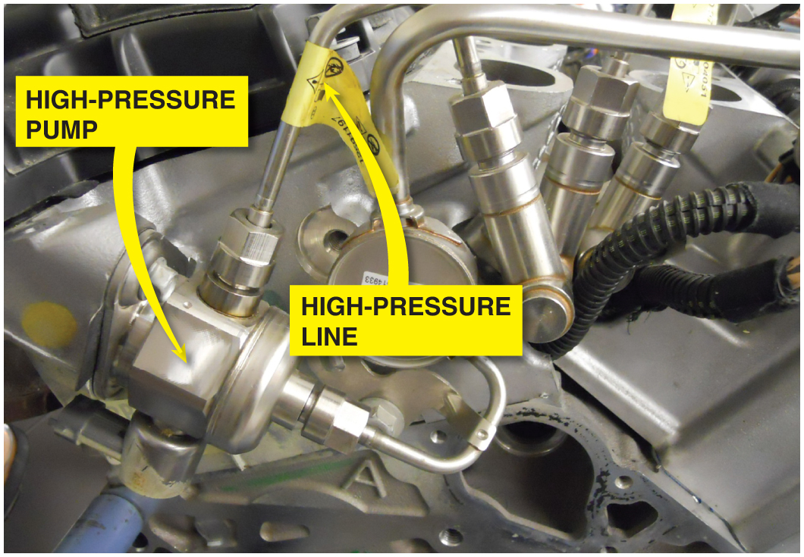
Figure 40.30 The line that has the yellow tag is a high-pressure line and this line must be replaced with a new part if removed even for a few minutes to gain access to another part

Slide 34
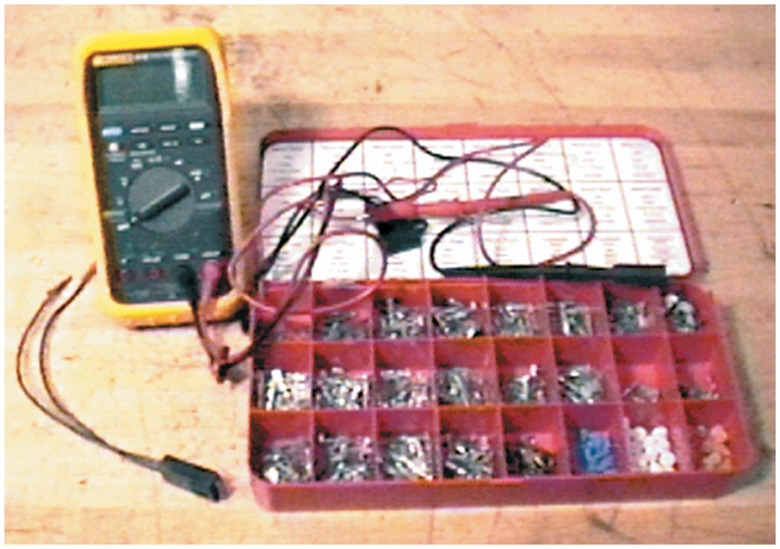
FUEL-PUMP RELAY CIRCUIT DIAGNOSIS 1

Slide 35
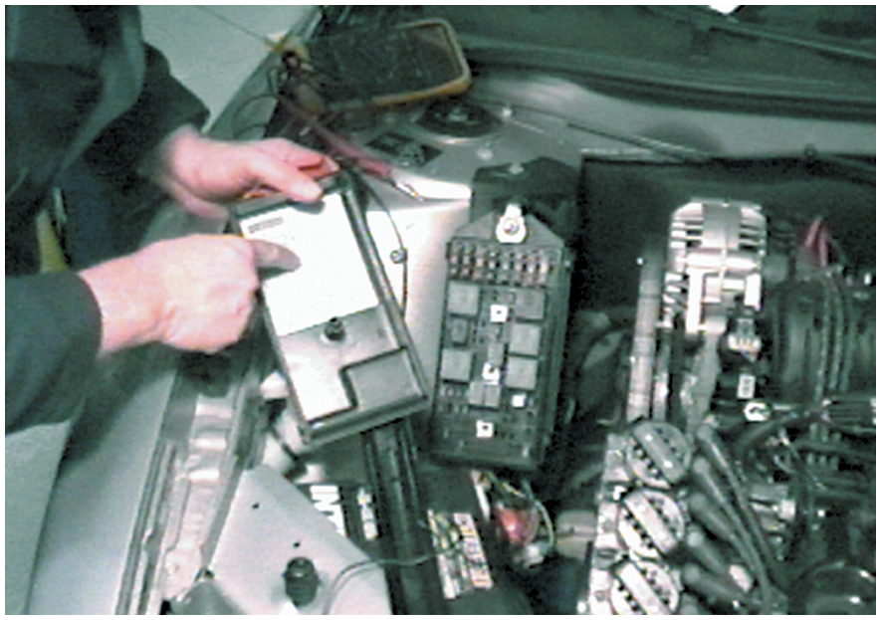
FUEL-PUMP RELAY CIRCUIT DIAGNOSIS 2

Slide 36
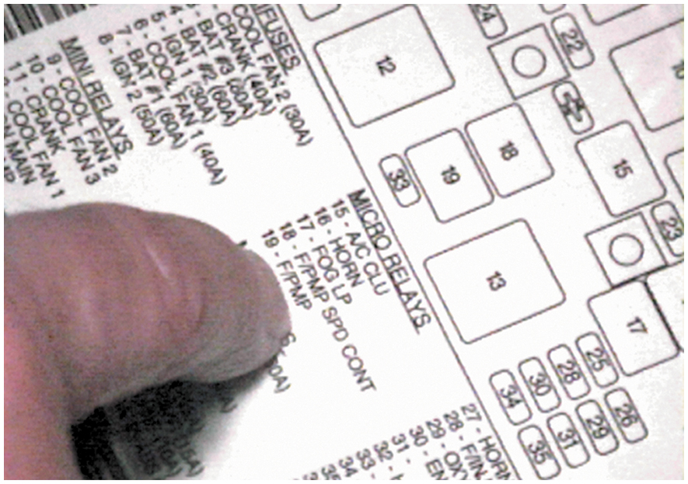
FUEL-PUMP RELAY CIRCUIT DIAGNOSIS 3

Slide 37
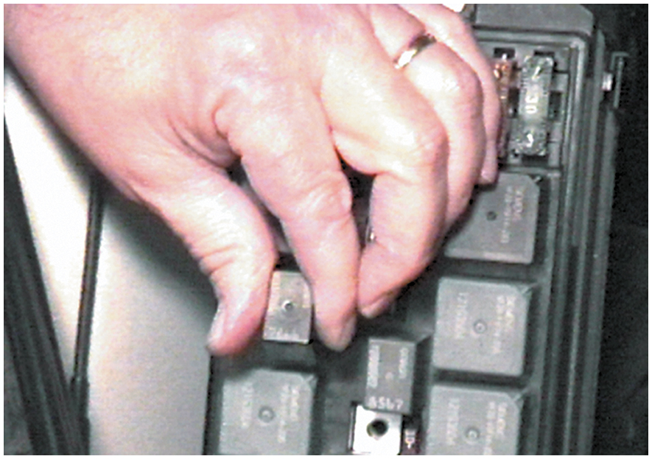
FUEL-PUMP RELAY CIRCUIT DIAGNOSIS 4

Slide 38
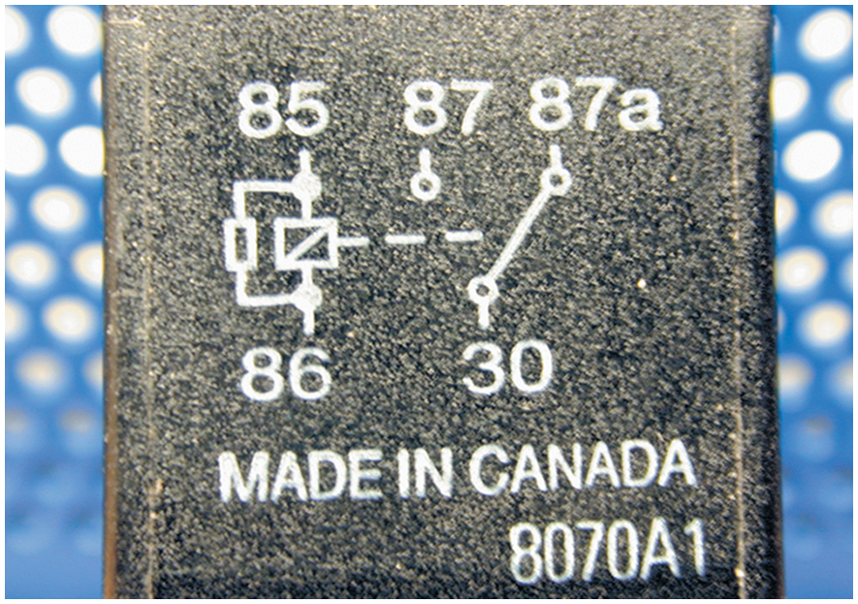
FUEL-PUMP RELAY CIRCUIT DIAGNOSIS 5

Slide 39
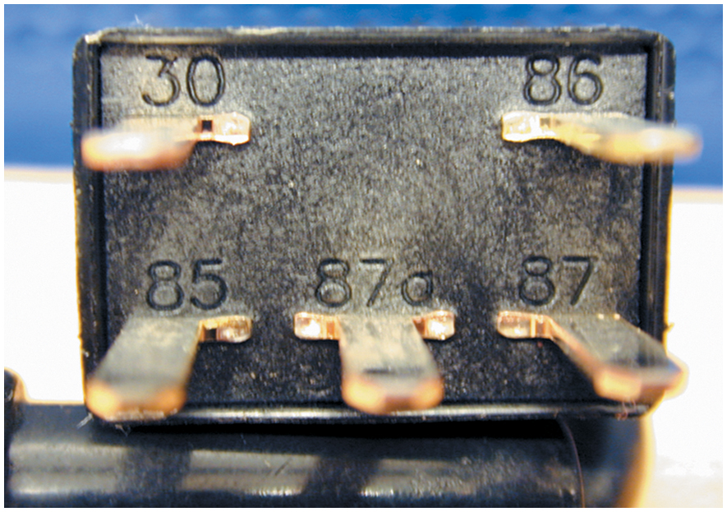
FUEL-PUMP RELAY CIRCUIT DIAGNOSIS 6

Slide 40
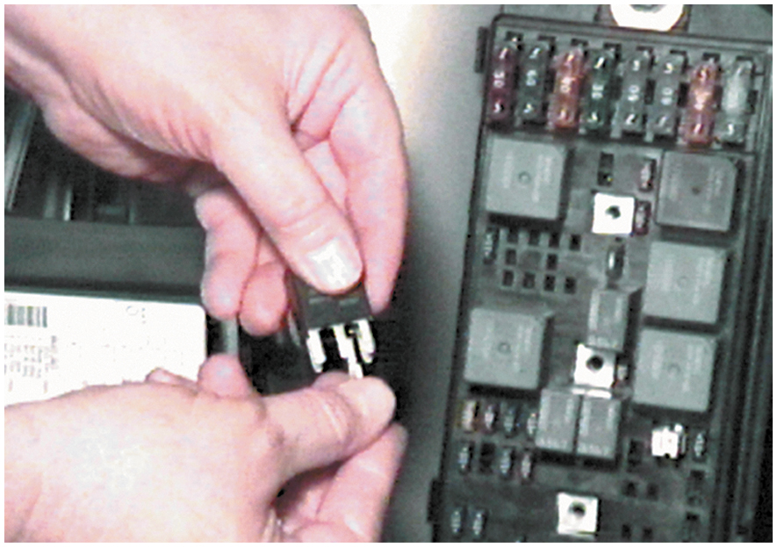
FUEL-PUMP RELAY CIRCUIT DIAGNOSIS 7

Slide 41
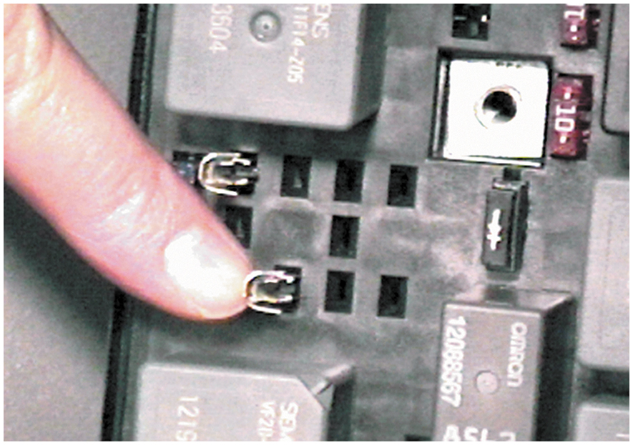
FUEL-PUMP RELAY CIRCUIT DIAGNOSIS 8

Slide 42
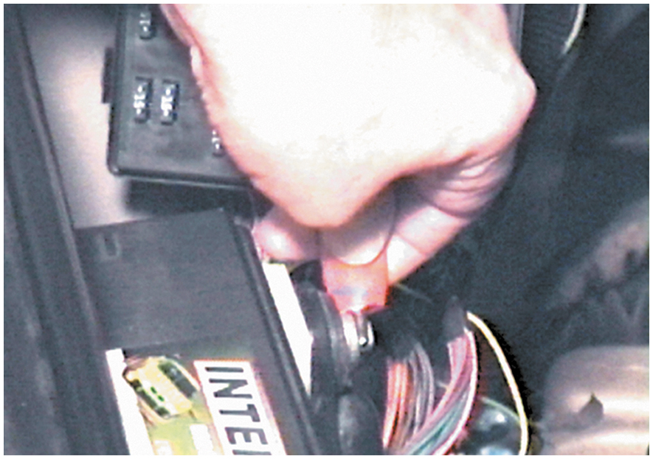
FUEL-PUMP RELAY CIRCUIT DIAGNOSIS 9

Slide 43
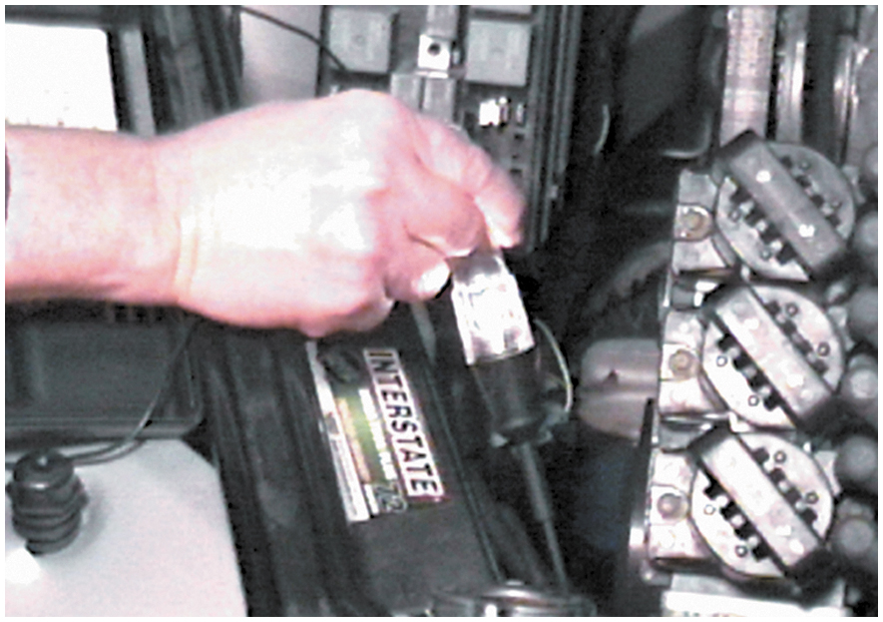
FUEL-PUMP RELAY CIRCUIT DIAGNOSIS 10

Slide 44
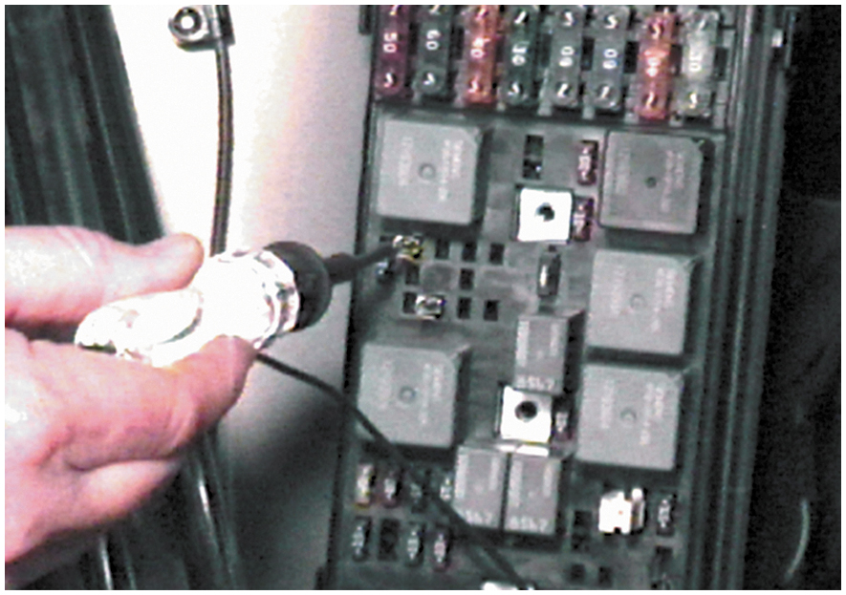
FUEL-PUMP RELAY CIRCUIT DIAGNOSIS 11

Slide 45
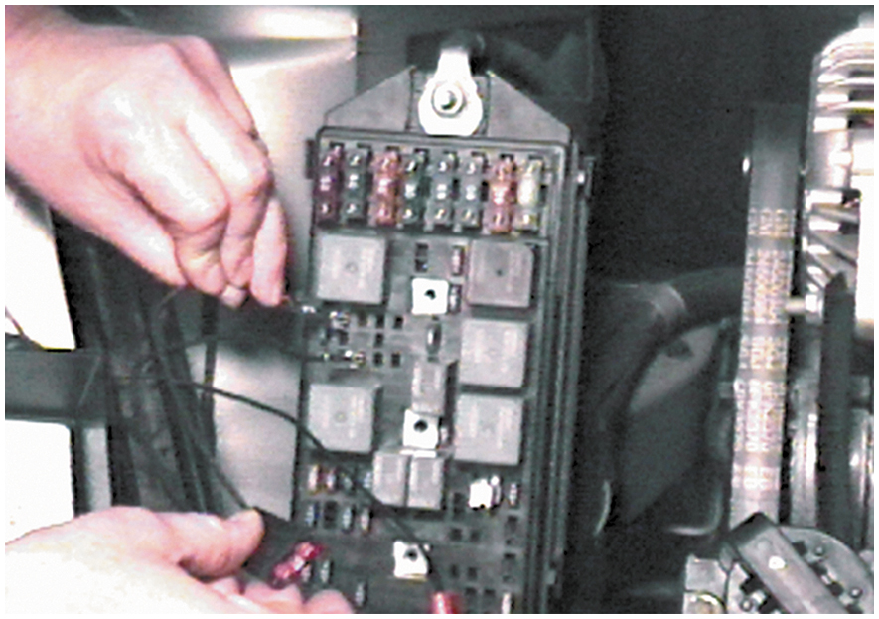
FUEL-PUMP RELAY CIRCUIT DIAGNOSIS 12

Slide 46
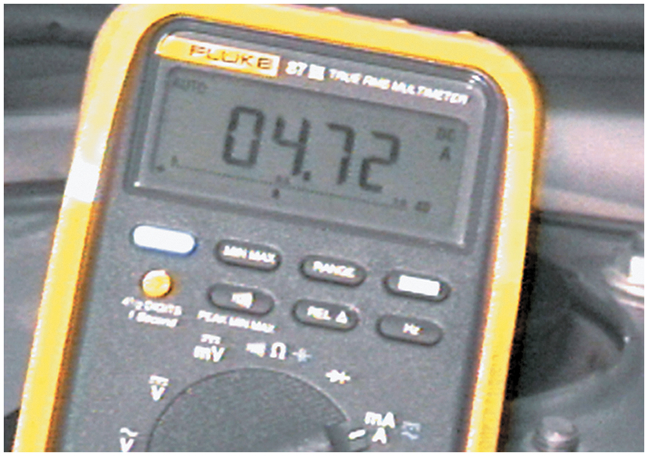
FUEL-PUMP RELAY CIRCUIT DIAGNOSIS 13

Slide 47
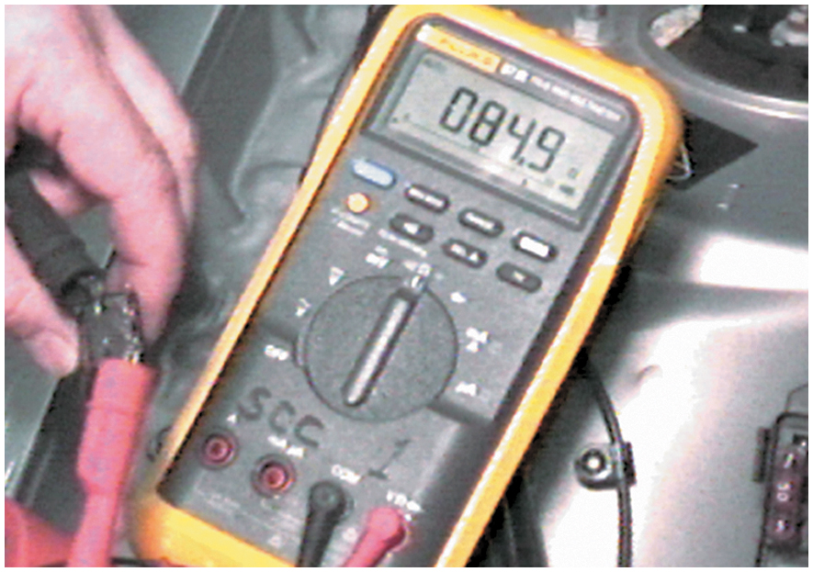
FUEL-PUMP RELAY CIRCUIT DIAGNOSIS 14

Slide 48
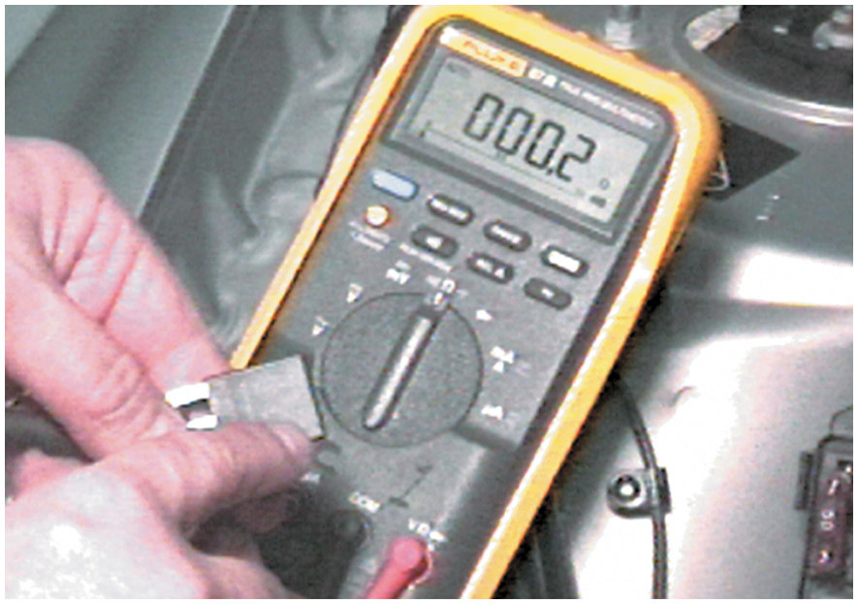
FUEL-PUMP RELAY CIRCUIT DIAGNOSIS 15

Slide 49
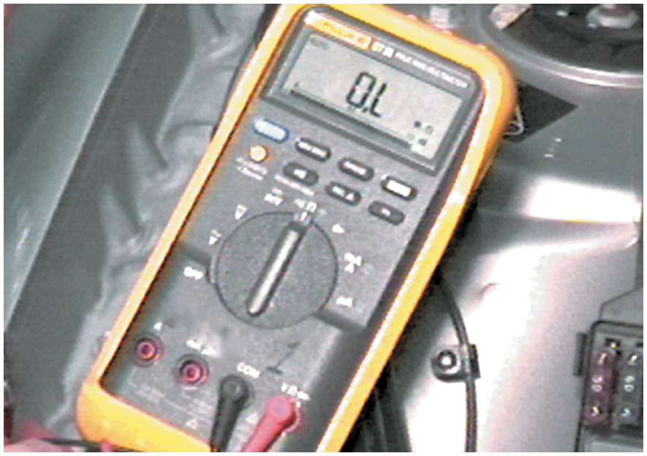
FUEL-PUMP RELAY CIRCUIT DIAGNOSIS 16

Slide 50
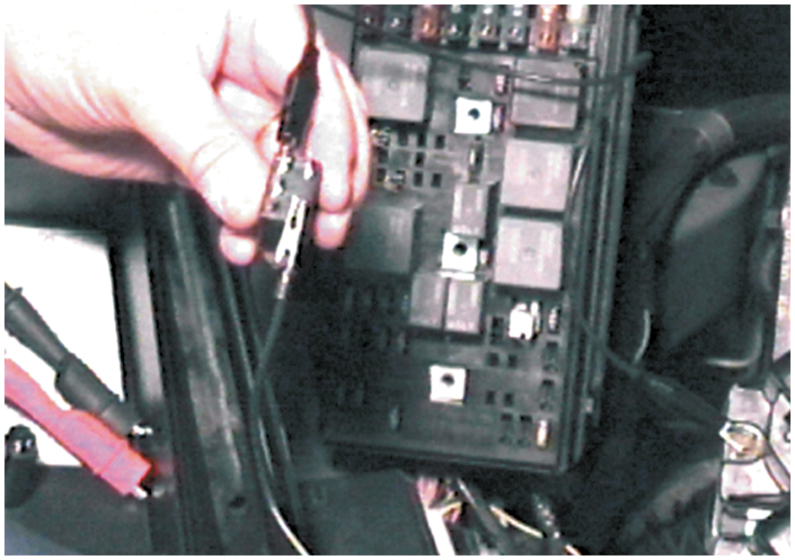
FUEL-PUMP RELAY CIRCUIT DIAGNOSIS 17

Slide 51
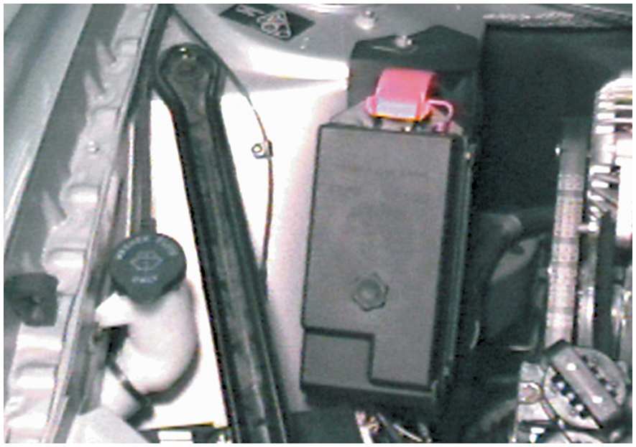
FUEL-PUMP RELAY CIRCUIT DIAGNOSIS 18

Slide 52
FUEL INJECTOR CLEANING 1

Slide 53
FUEL INJECTOR CLEANING 2

Slide 54
FUEL INJECTOR CLEANING 3

Slide 55
FUEL INJECTOR CLEANING 4

Slide 56
FUEL INJECTOR CLEANING 5

Slide 57
FUEL INJECTOR CLEANING 6

Slide 58
FUEL INJECTOR CLEANING 7

Slide 59
FUEL INJECTOR CLEANING 8

Slide 60
FUEL INJECTOR CLEANING 9

Slide 61
FUEL INJECTOR CLEANING 10

Slide 62
FUEL INJECTOR CLEANING 11

Slide 63
FUEL INJECTOR CLEANING 12

Slide 64
Copyright

