Slide 1
Automotive Electrical and Engine Performance
Eighth Edition
Chapter 38
Gasoline Direct-Injection Systems
Copyright © 2020, 2016 Pearson Education, Inc. All Rights Reserved

Slide 2
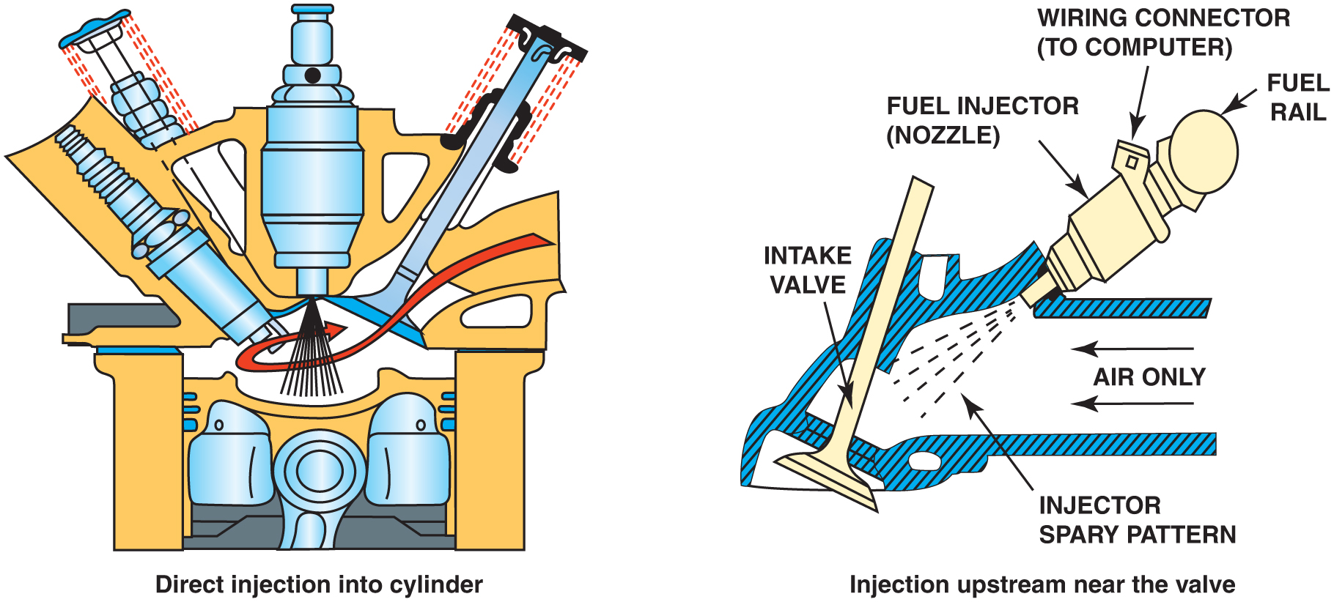
Figure 38.1 A comparison of a port fuel injection system (right) to a gasoline direct injection (G D I) system on the left

Slide 3
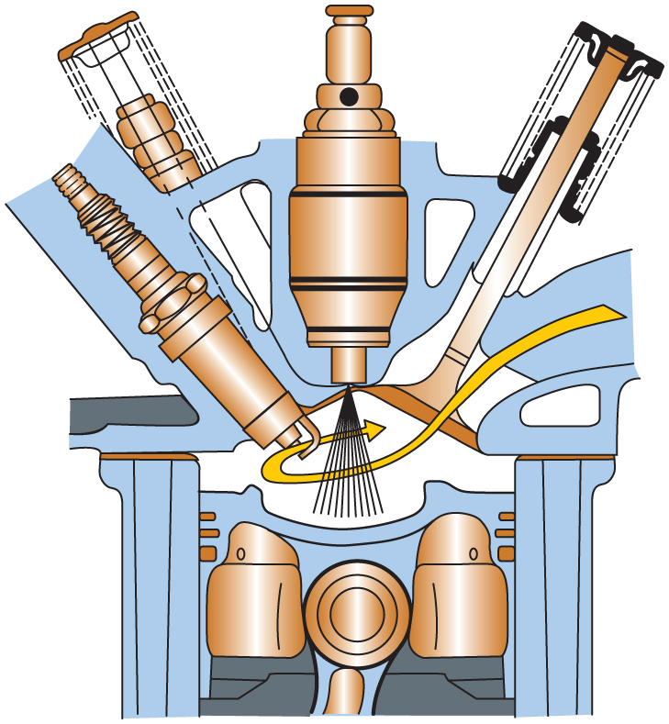
Figure 38.2 A gasoline direct-injection system injects fuel under high pressure directly into the combustion chamber

Slide 4
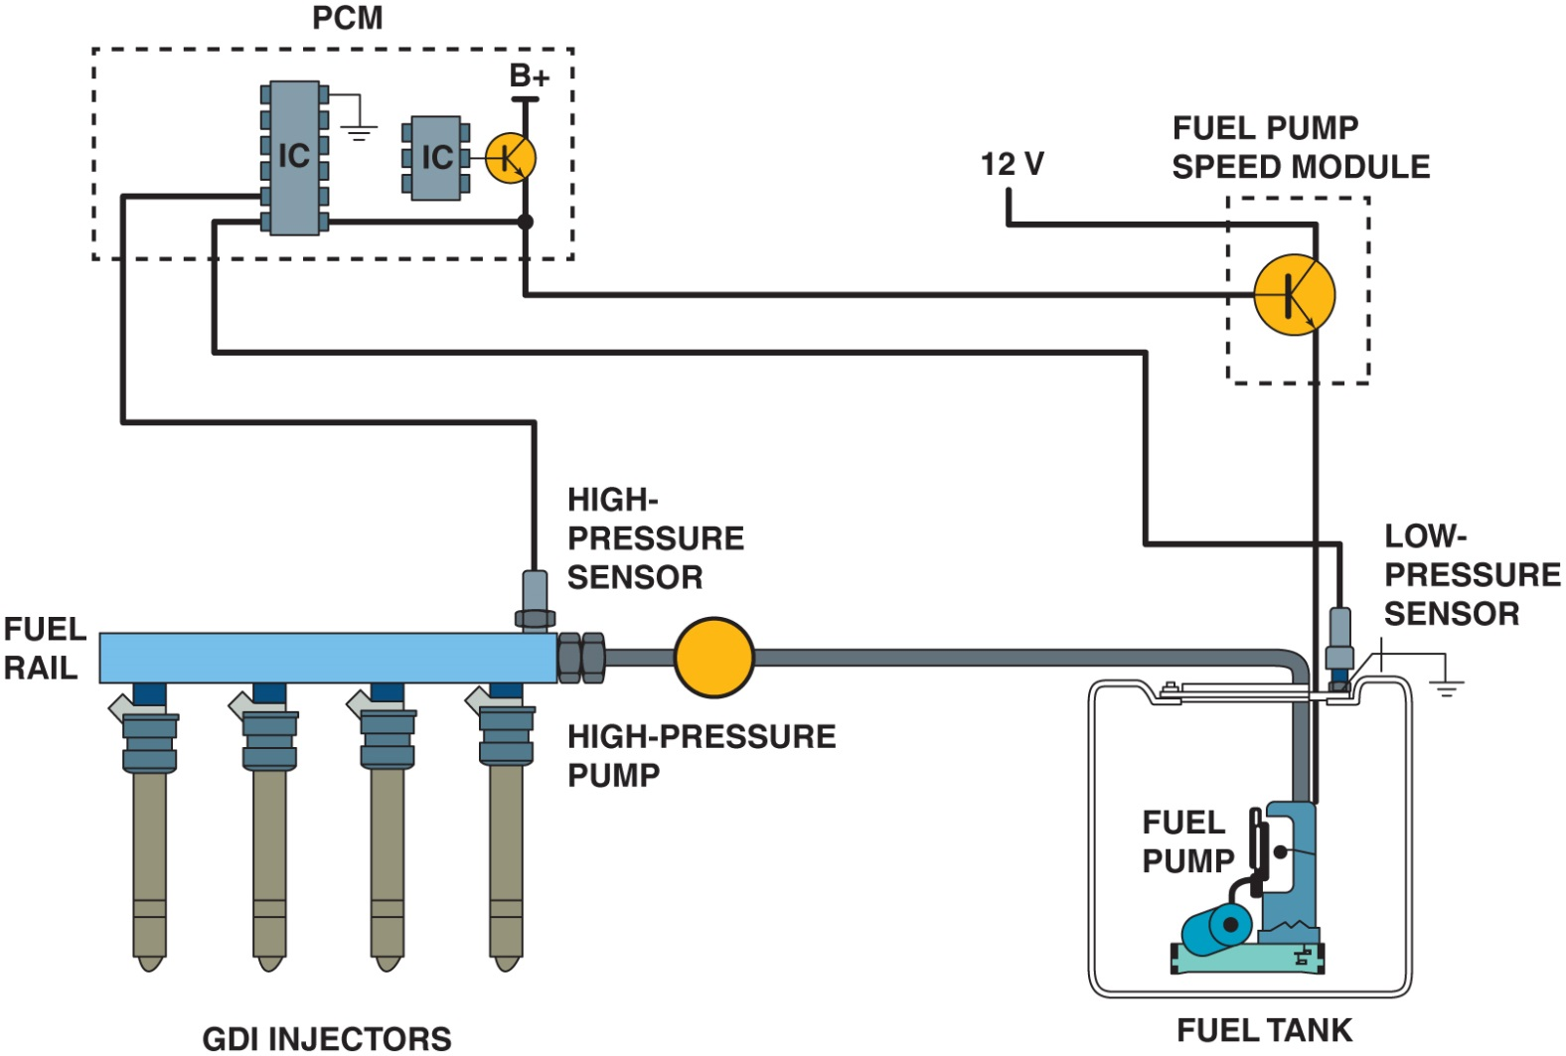
Figure 38.3 A G D I system uses a low-pressure pump in the gas tank similar to other types of fuel-injection systems. The P C M controls the pressure of the high-pressure pump using sensor inputs

Slide 5
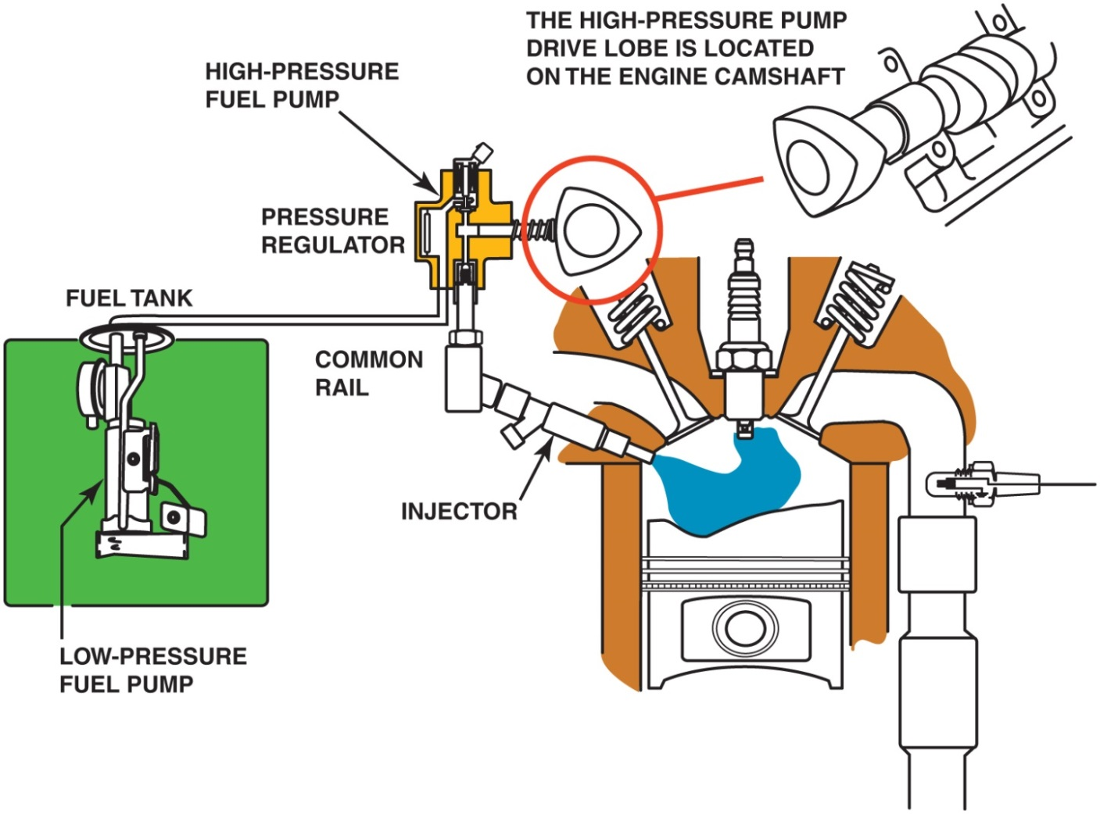
Figure 38.4 A typical direct-injection system uses two pumps—one low-pressure electric pump in the fuel tank and the other a high-pressure pump driven by the camshaft. The high-pressure fuel system operates at a pressure as low as 500 PSI during light load conditions and as high as 2,900 P S I under heavy loads

Slide 6
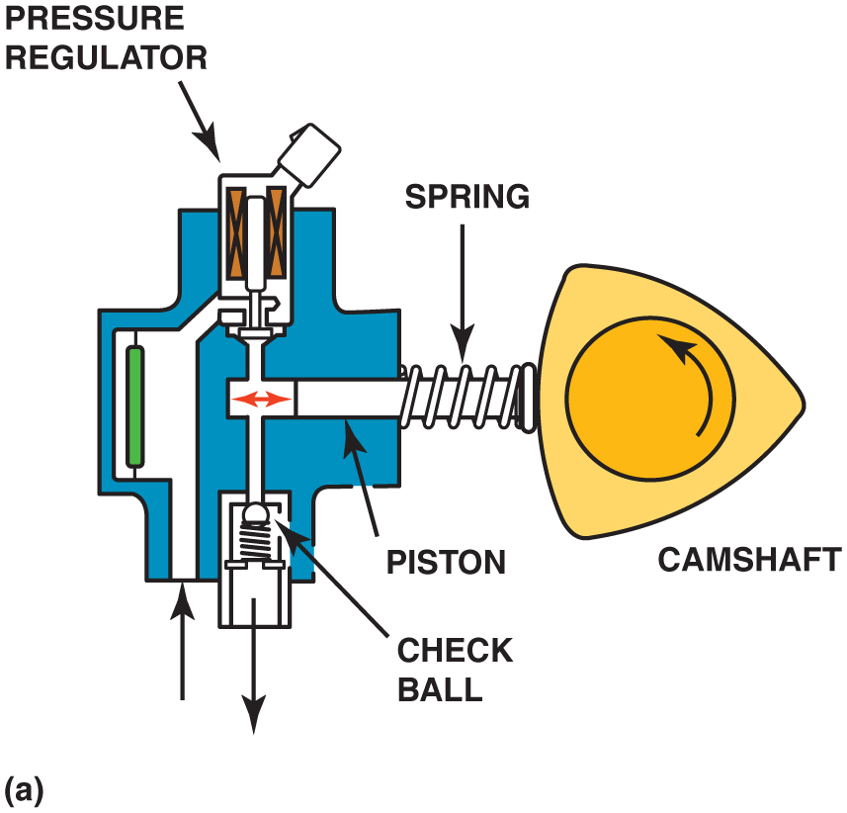
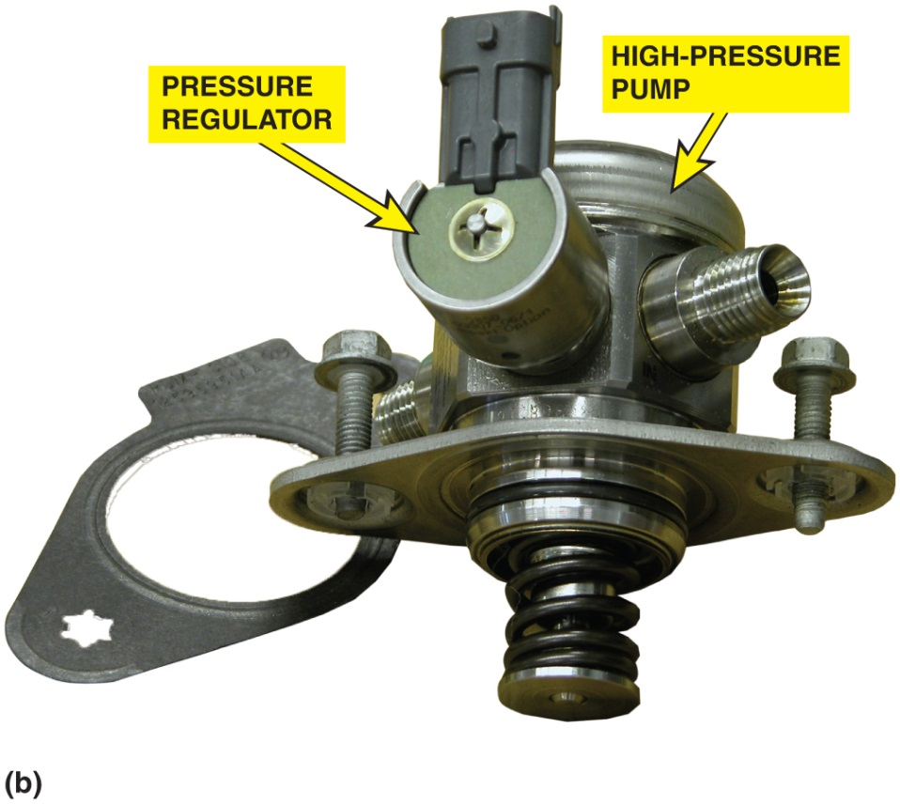
Figure 38.5 (a) A typical camshaft-driven high-pressure pump used to increase fuel pressure to 2,000 P S I or higher. (b) The high-pressure pump assembly removed from the engine. Many G D I engines use a roller where the high-pressure pump rides against the cam lobes to help reduce friction and wear

Slide 7
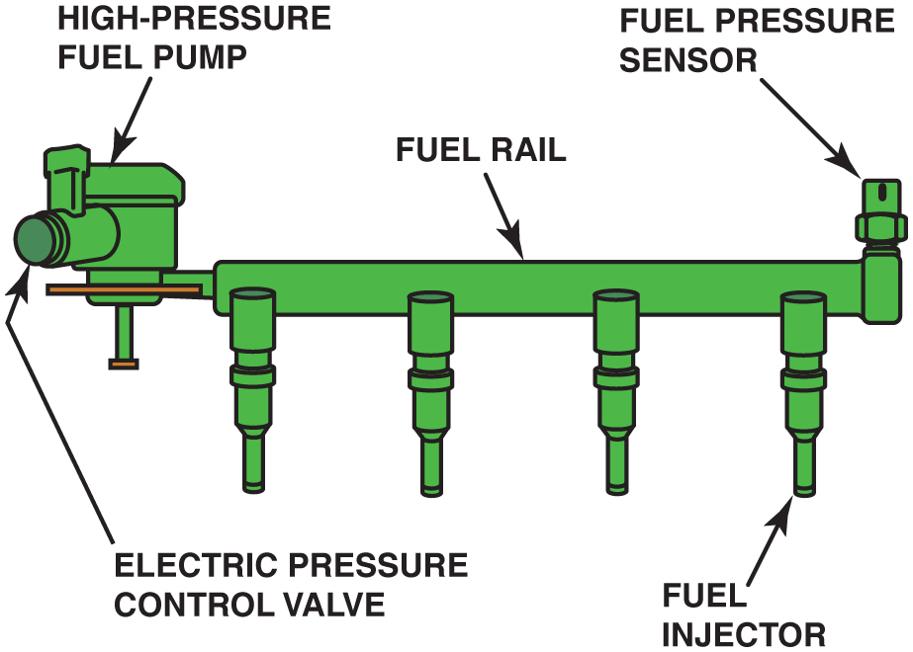
Figure 38.6 A G D I fuel rail and pump assembly with the electric pressure control valve

Slide 8
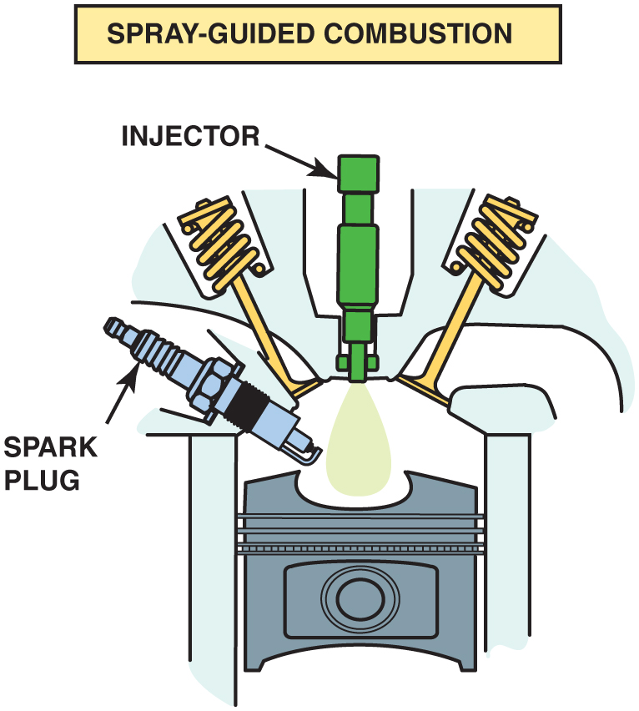
Figure 38.7 In this design, the fuel injector is at the top of the cylinder and sprays fuel into the cavity of the piston

Slide 9
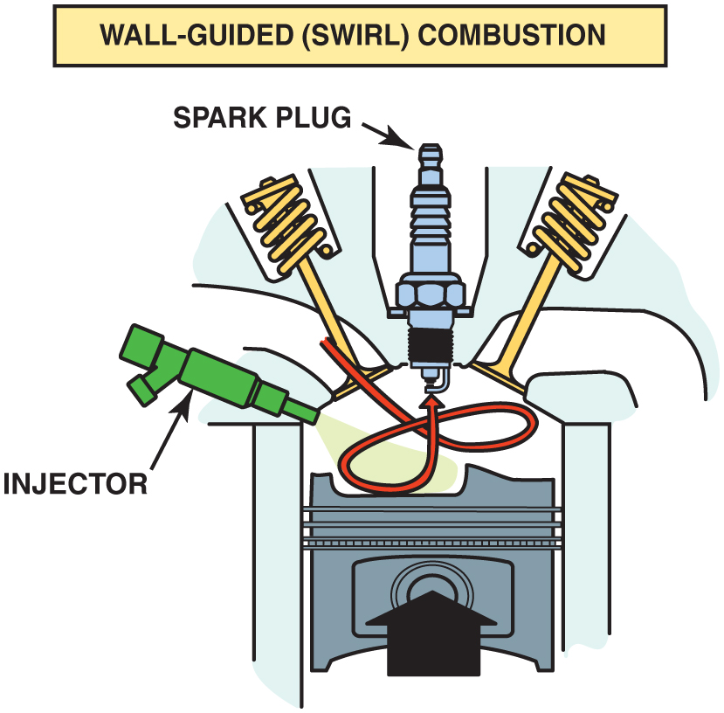
Figure 38.8 The side injector combines with the shape of the piston to create a swirl as the piston moves up on the compression stroke

Slide 10
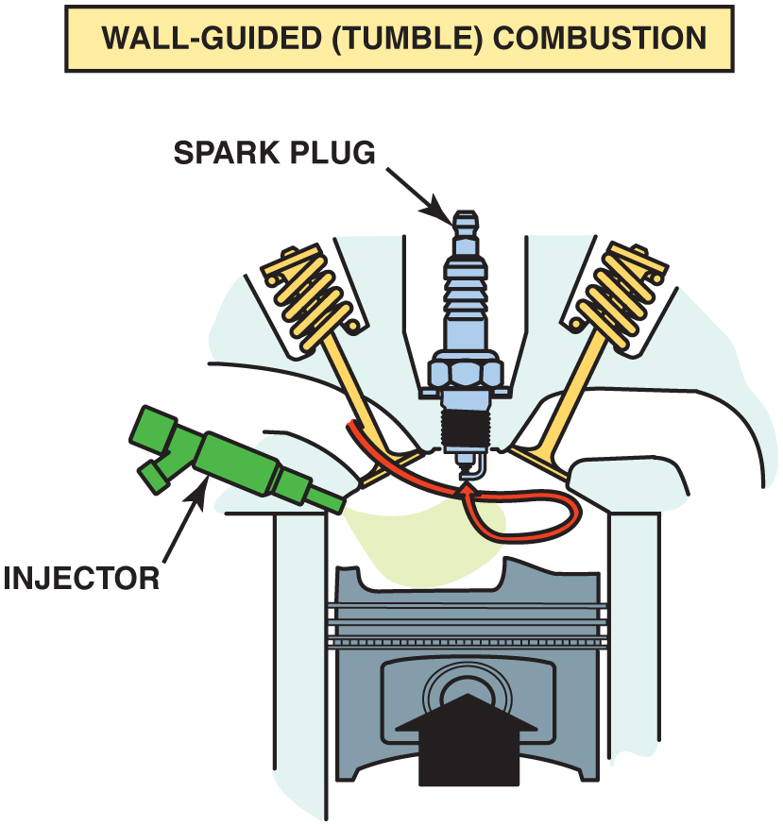
Figure 38.9 The piston creates a tumbling force as it moves upward

Slide 11
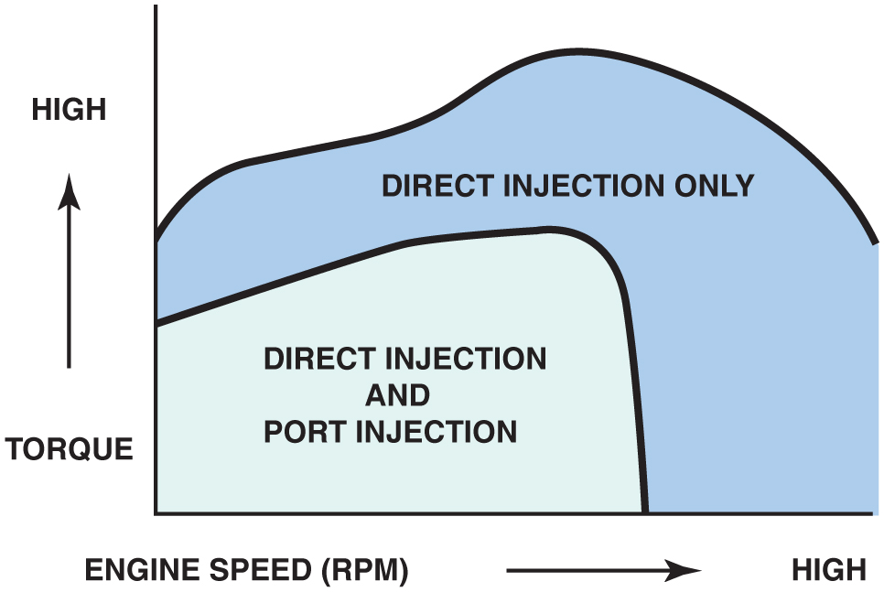
Figure 38.10 Notice that there are conditions when the port fuel injector, located in the intake manifold, and the gasoline direct injector, located in the cylinder, both operate to provide the proper air–fuel mixture

Slide 12
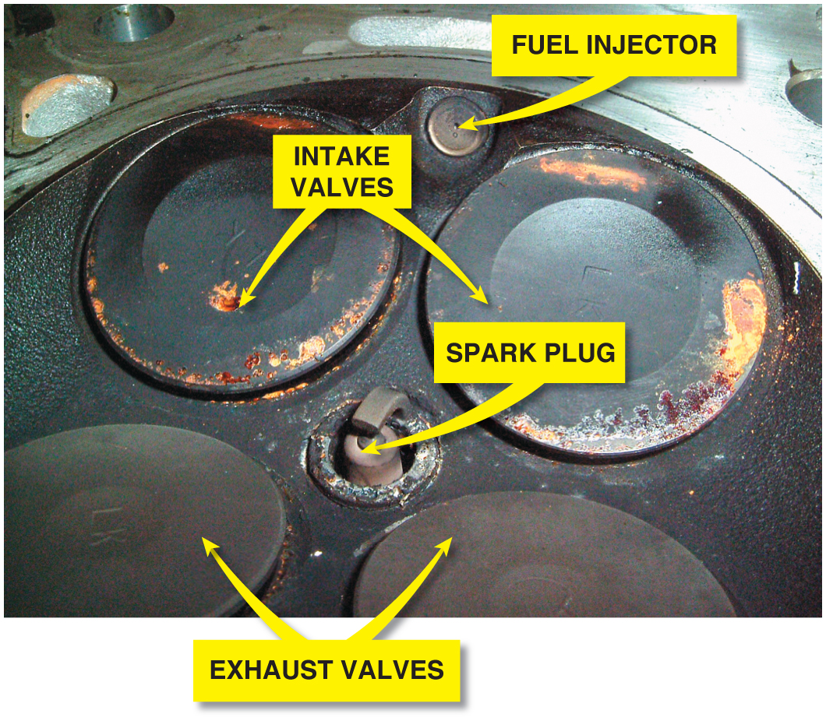
Figure 38.11 There may become a driveability issue because the G D I injector is exposed to combustion carbon and fuel residue

Slide 13
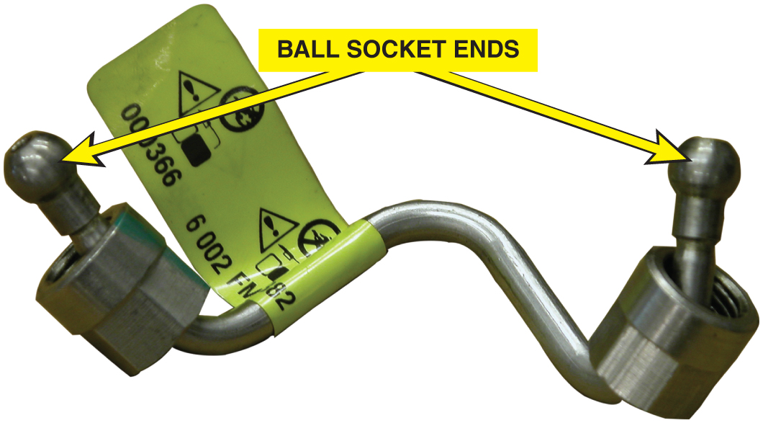
Figure 38.12 The high-pressure lines use a ball and socket connection. The ball end deforms when the line is tightened and must be replaced with a new part whenever it is removed

Slide 14
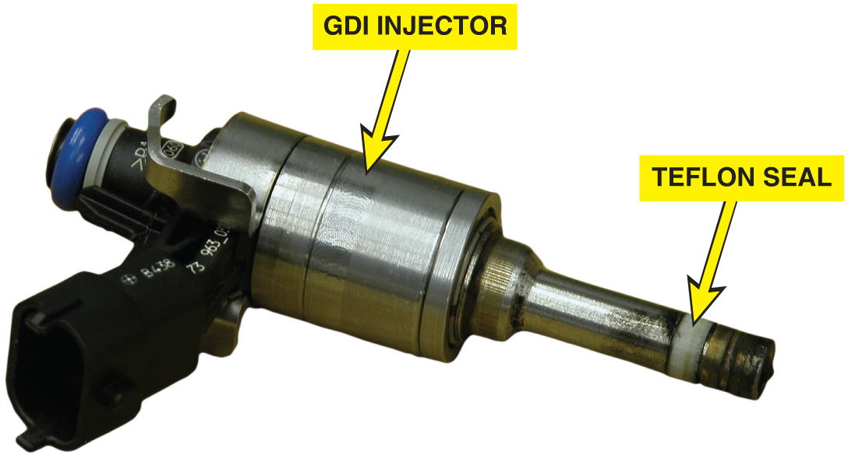
Figure 38.13 Whenever a G D I fuel injector is removed, a new Teflon seal must be installed to ensure a leak-free connection in the combustion chamber

Slide 15
Copyright

