Slide 1
Automotive Electrical and Engine Performance
Eighth Edition
Chapter 35
Oxygen Sensors
Copyright © 2020, 2016 Pearson Education, Inc. All Rights Reserved

Slide 2
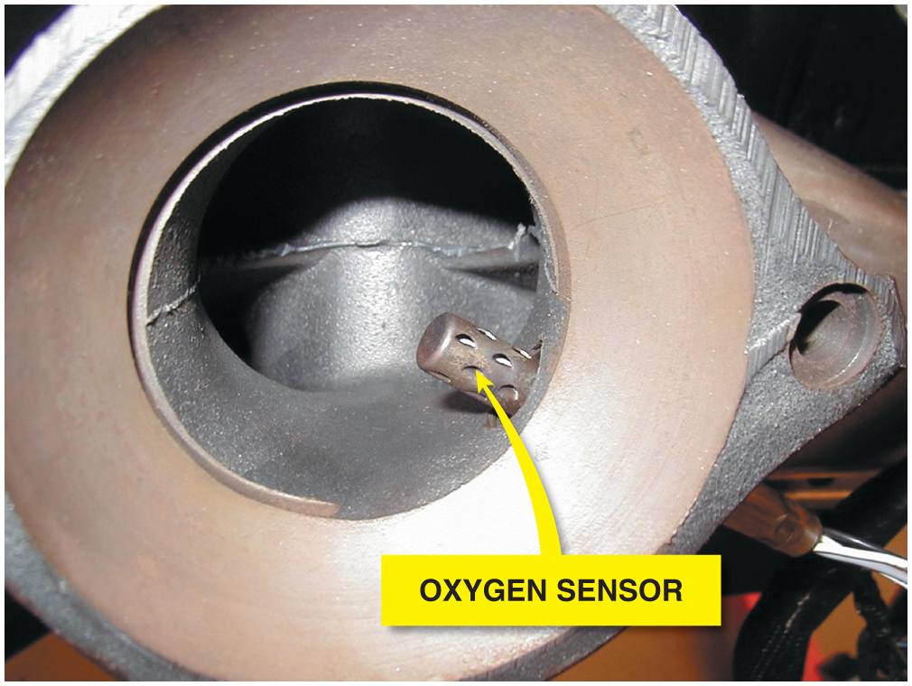
Figure 35.1 Many oxygen sensors are located in the exhaust manifold near its outlet so that the sensor can detect the air-fuel mixture in the exhaust stream for all cylinders that feed into the manifold

Slide 3
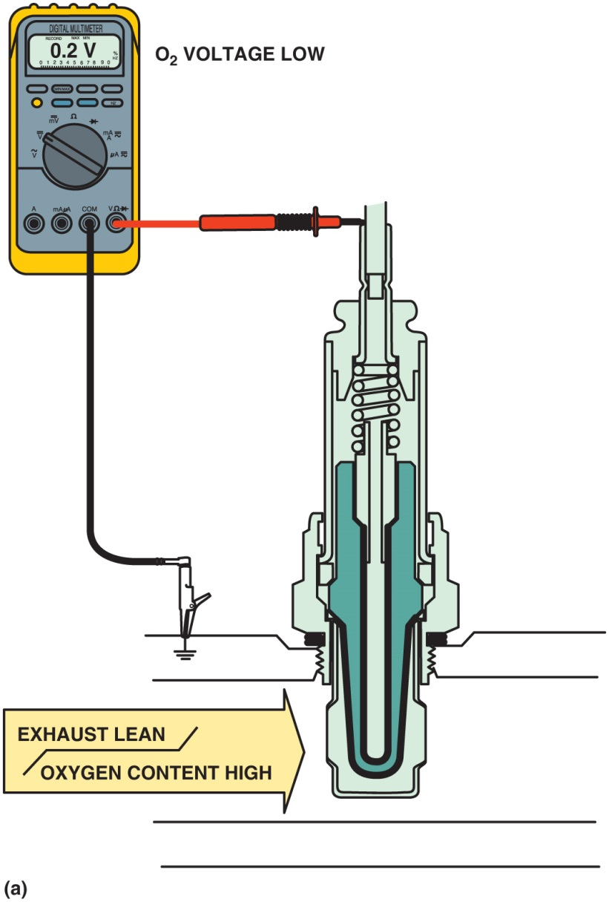
Figure 35.2 (a) When the exhaust is lean, the output of a zirconia oxygen sensor is below 450 m V

Slide 4
Figure 35.2 (b) When the exhaust is rich, the output of a zirconia oxygen sensor is above 450 m V

Slide 5
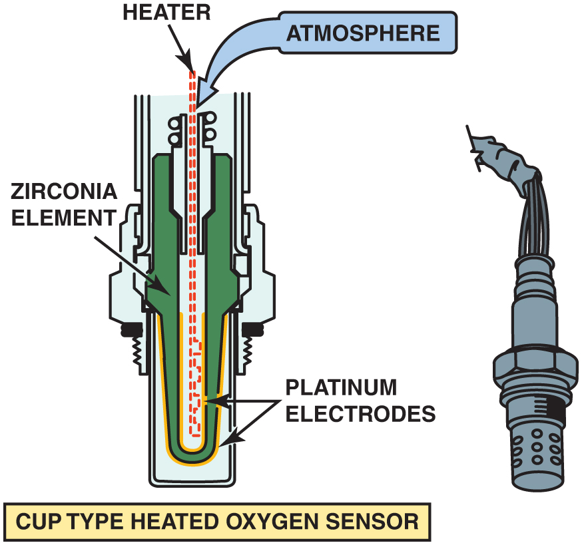
Figure 35.3 Most conventional zirconia oxygen sensors and some wide-band oxygen sensors use the cup (finger) type of design

Slide 6
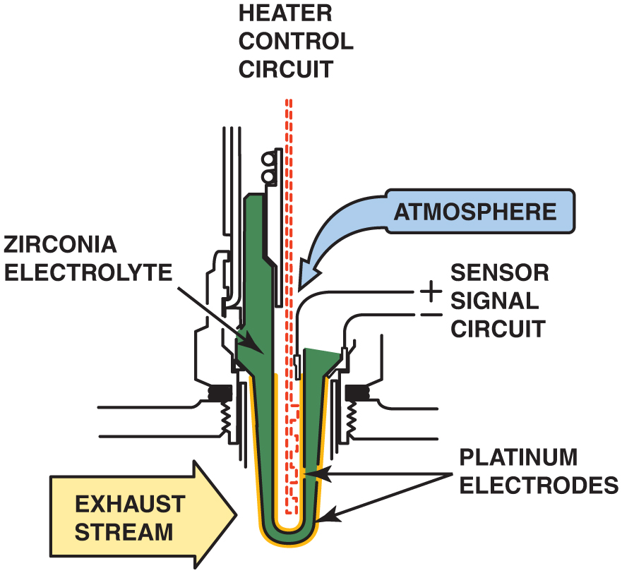
Figure 35.4 A typical heated zirconia oxygen sensor, showing the sensor signal circuit that uses the outer (exhaust) electrode as the negative and the ambient air side electrode as the positive

Slide 7
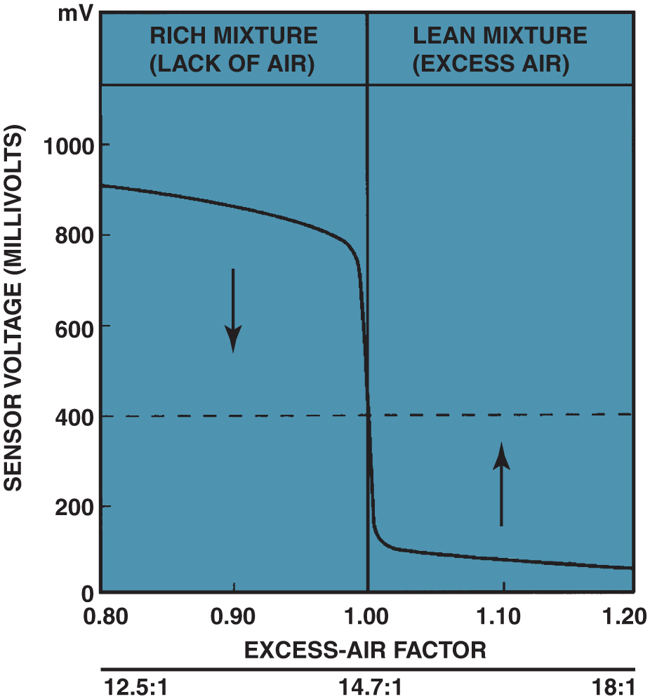
Figure 35.5 The oxygen sensor provides a quick response at the stoichiometric air-fuel ratio of 14.7:1

Slide 8
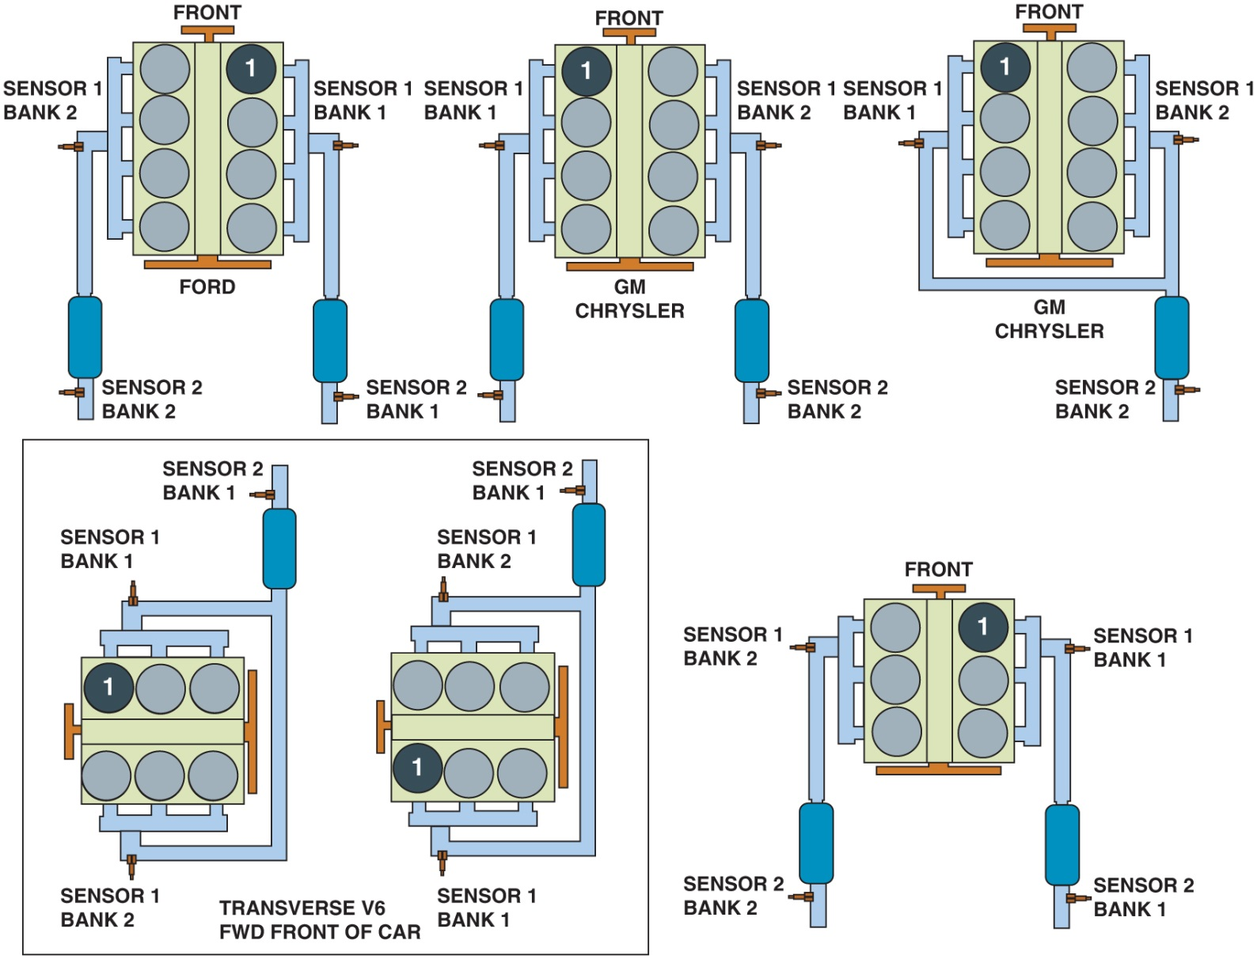
Figure 35.6 Number and label designations for oxygen sensors. Bank 1 is the bank where cylinder 1 is located

Slide 9
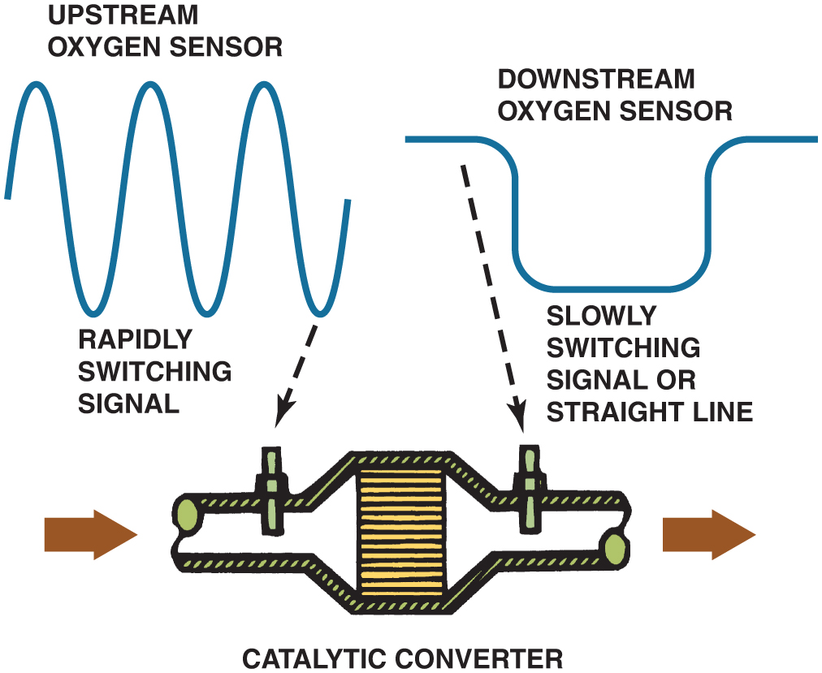
Figure 35.7 The O B D -II catalytic converter monitor compares the signals of the upstream and downstream oxygen sensor to determine converter efficiency

Slide 10
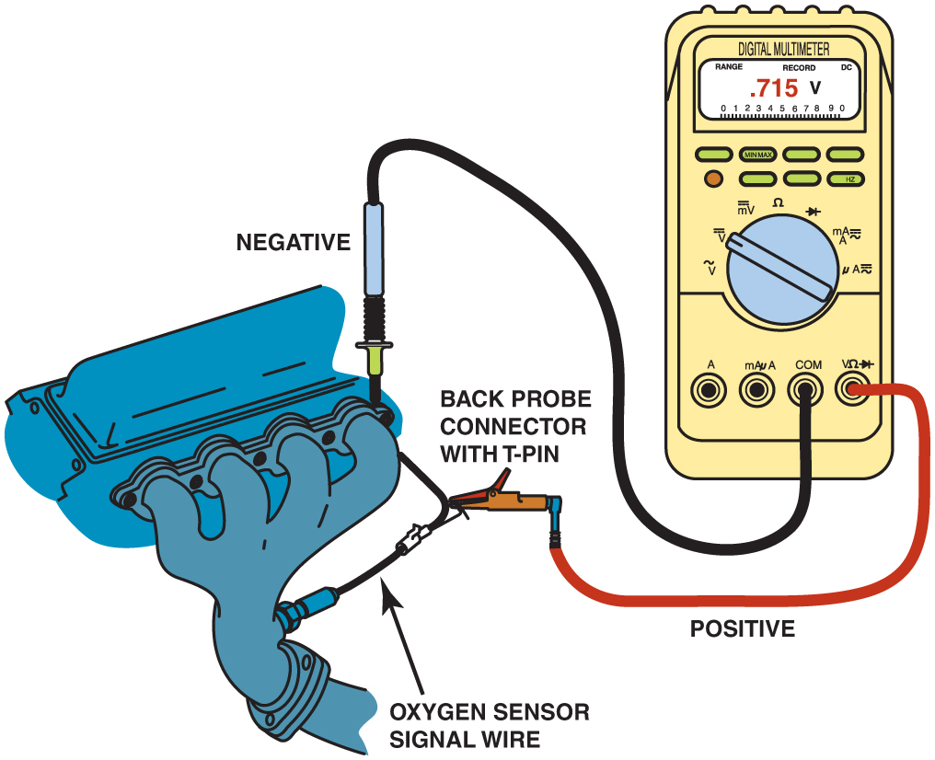
Figure 35.8 Testing an oxygen sensor using a D M M set on D C volts. With the engine operating in closed loop, the oxygen voltage should read over 800 mV and lower than 200 mV and be constantly fluctuating

Slide 11
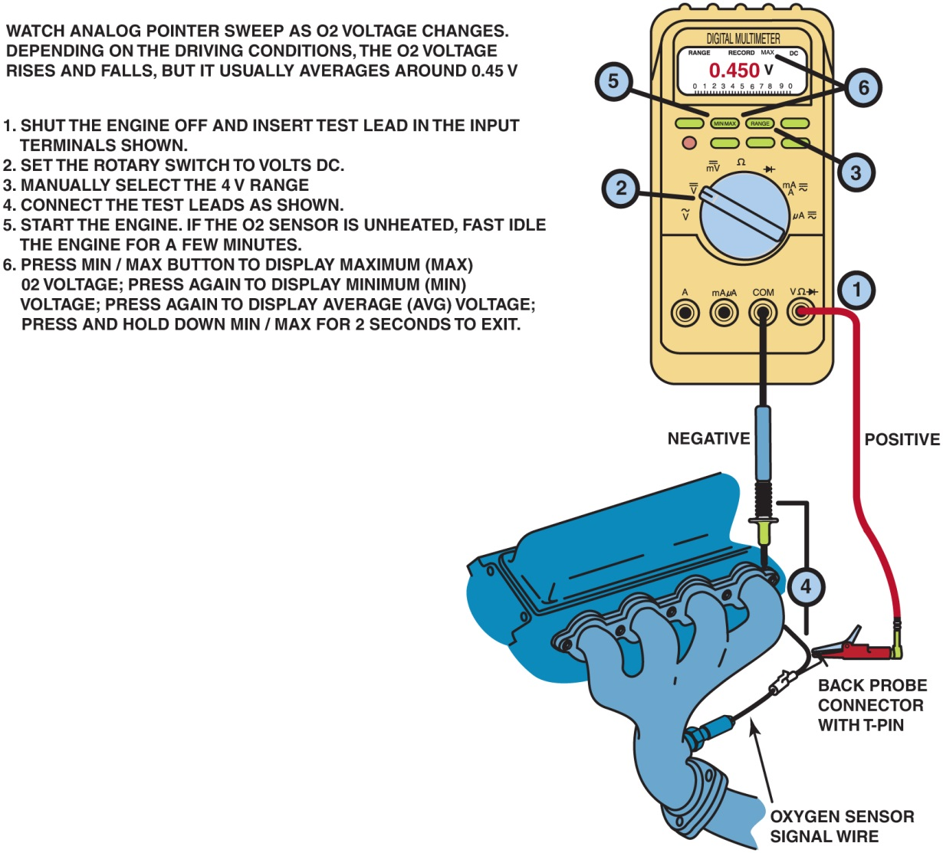
Figure 35.9 Using a digital multimeter to test an oxygen sensor using the M I N /M A X record function of the meter

Slide 12
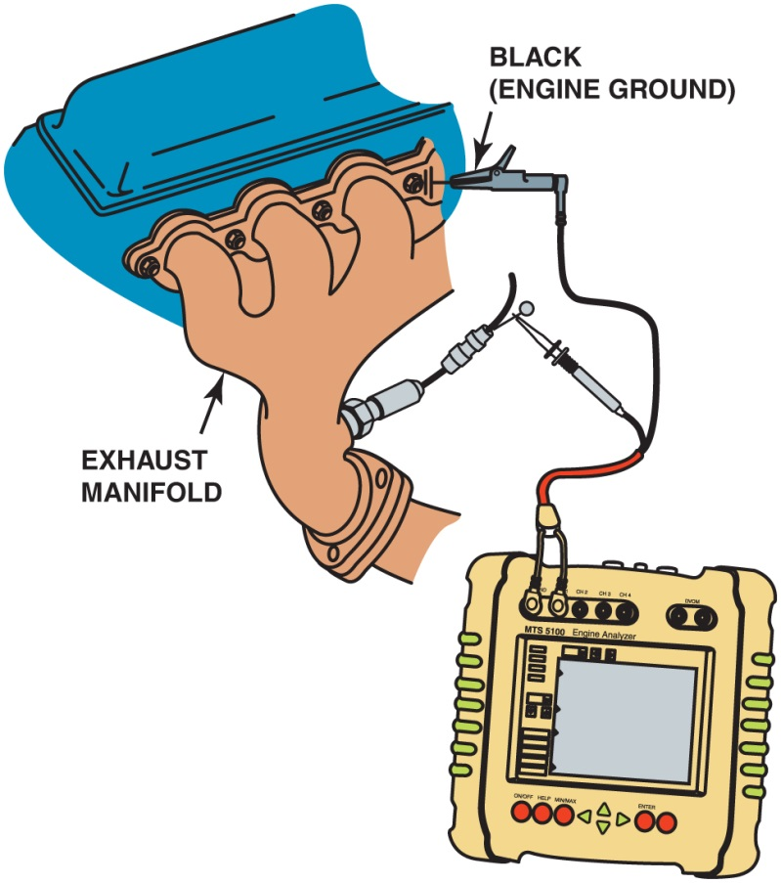
Figure 35.10 Connecting a handheld digital storage oscilloscope to an oxygen sensor signal wire. Check the instructions for the scope as some require the use of a filter to be installed in the test lead to reduce electromagnetic interference that can affect the oxygen sensor waveform

Slide 13
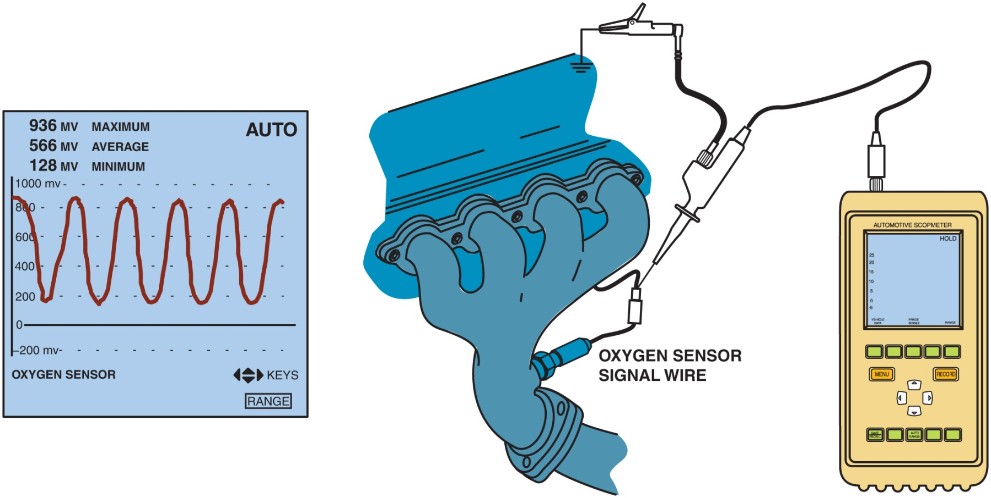
Figure 35.11 The waveform of a good oxygen sensor as displayed on a digital storage oscilloscope (D S O). Note that the maximum reading is above 800 m V and the minimum reading is less than 200 m V

Slide 14
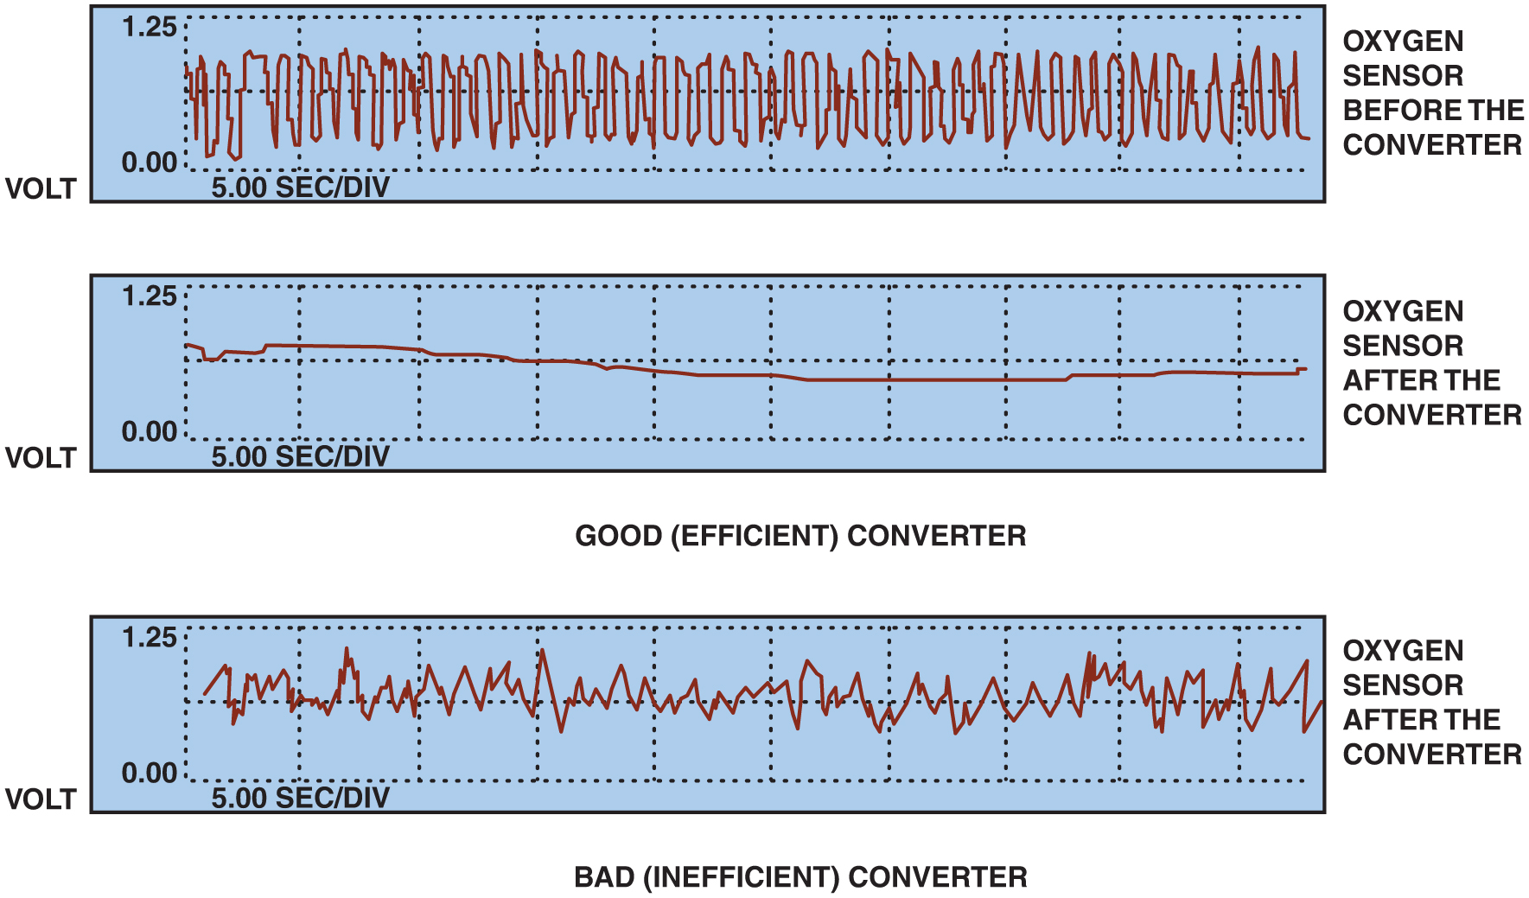
Figure 35.12 The post-catalytic converter oxygen sensor should display very little activity if the catalytic converter is efficient

Slide 15
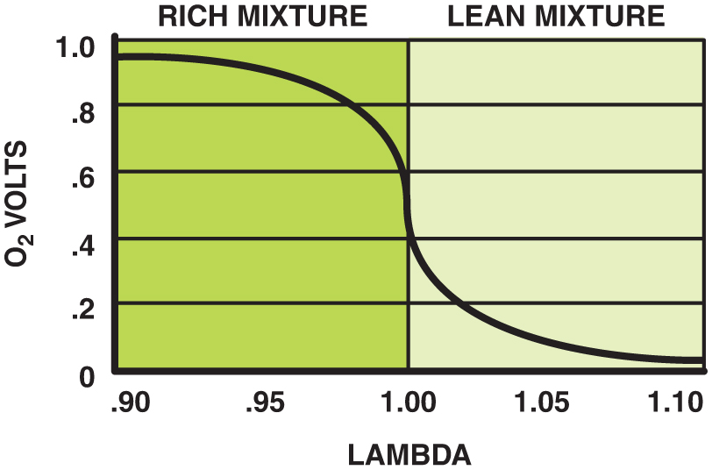
Figure 35.13 A conventional zirconia oxygen sensor can only reset to exhaust mixtures that are richer or leaner than 14.7:1 (lambda 1.00)

Slide 16
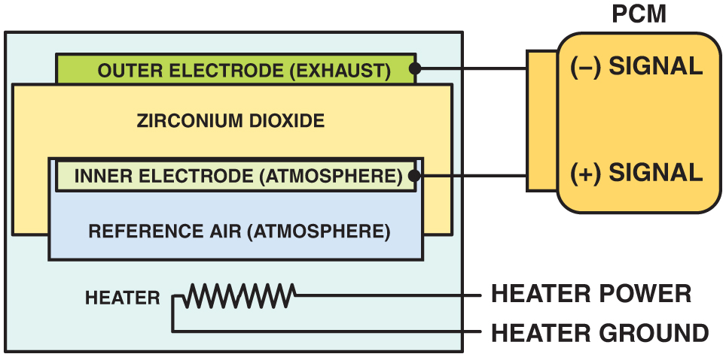
Figure 35.14 A planar design zirconia oxygen sensor places all of the elements together, which allows the sensor to reach operating temperature quickly

Slide 17
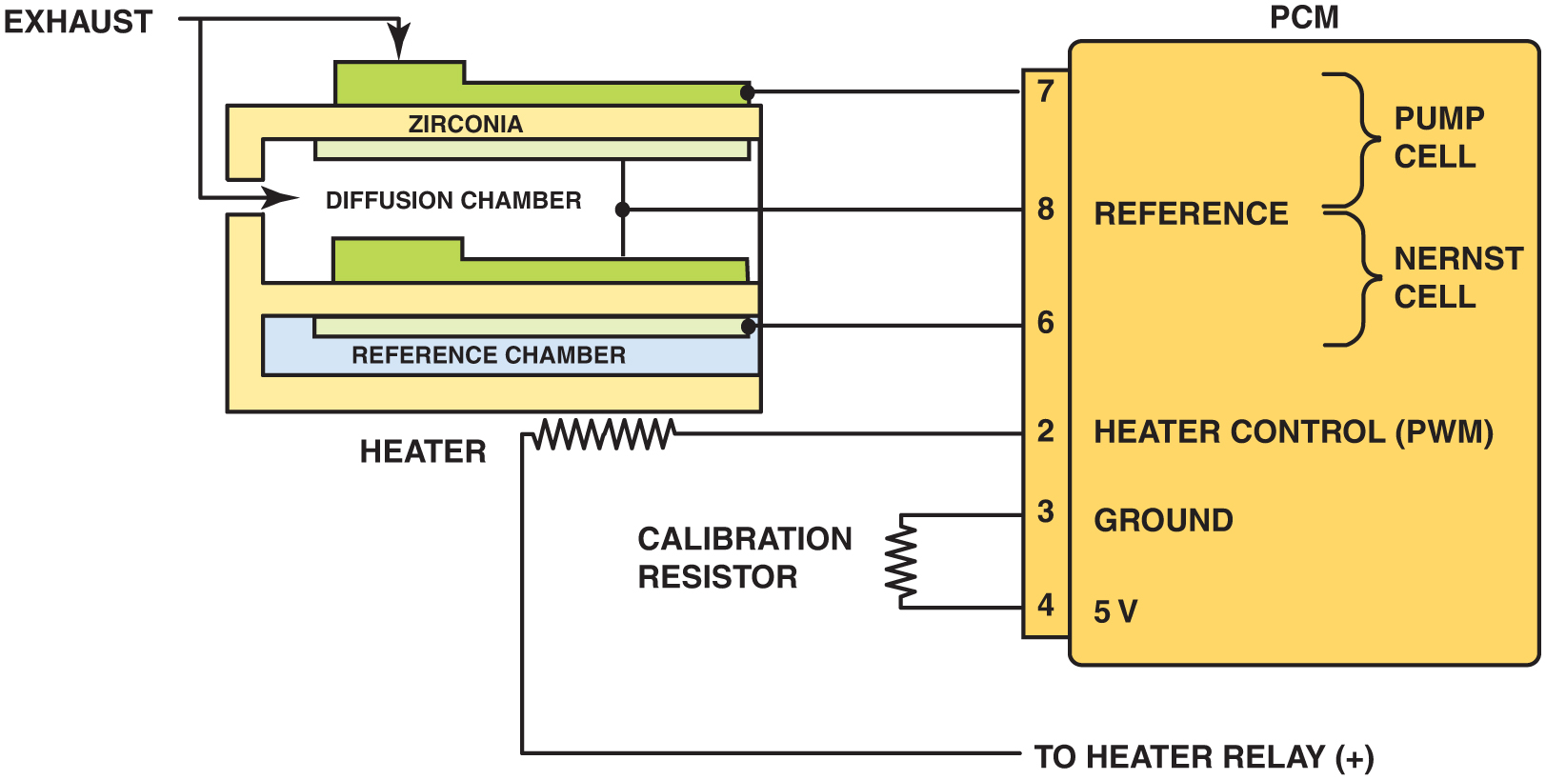
Figure 35.15 The reference electrodes are shared by the Nernst cell and the pump cell

Slide 18
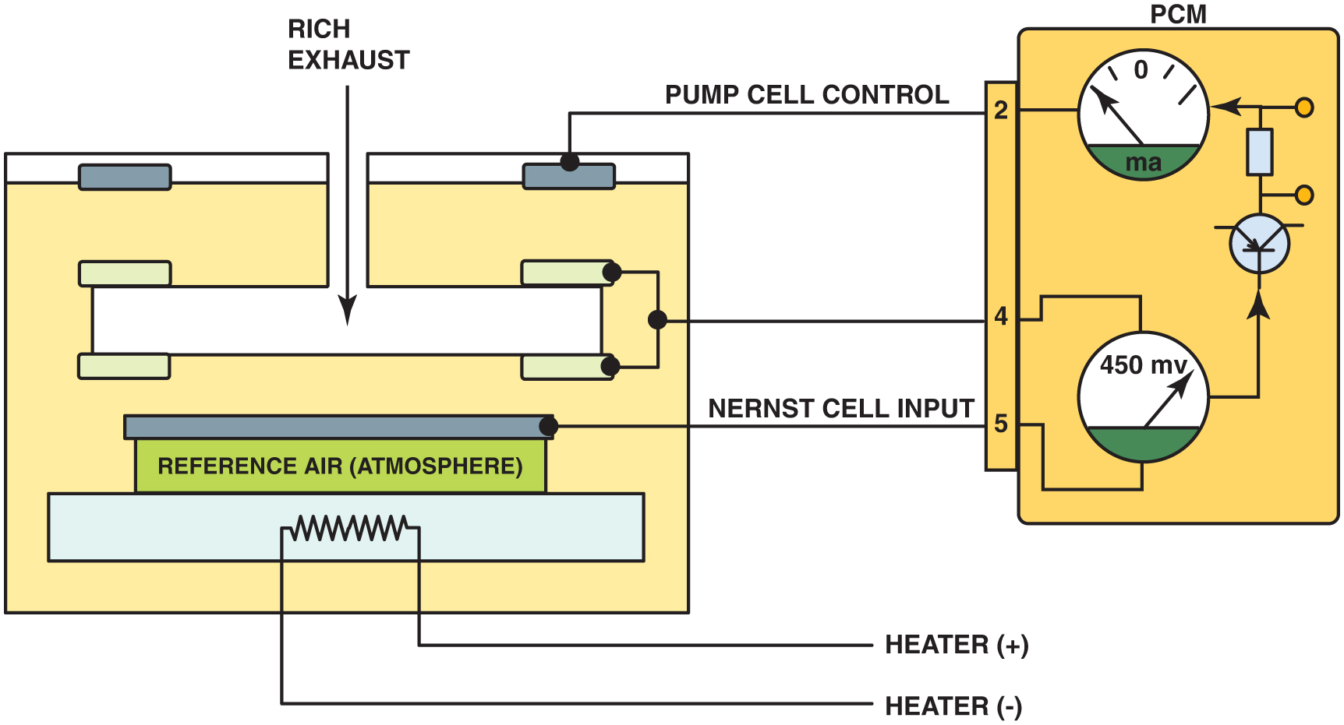
Figure 35.16 When the exhaust is rich, the P C M applies a negative current into the pump cell

Slide 19
Figure 35.17 When the exhaust is lean, the P C M applies a positive current into the pump cell

Slide 20
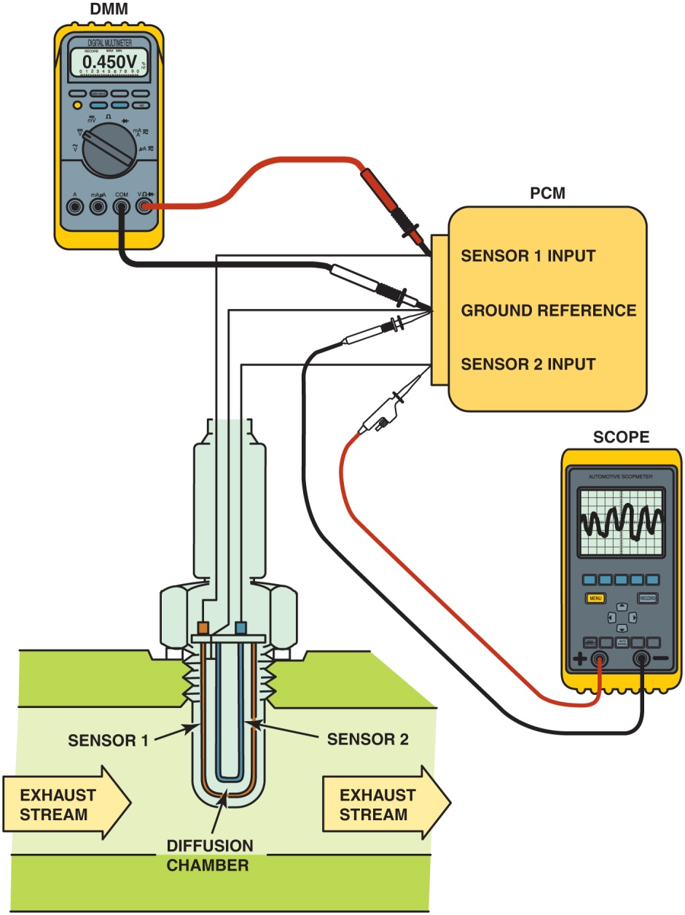
Figure 35.18 Testing a dual cell wide-band oxygen sensor can be done using a voltmeter or a scope. The meter reading is attached to the Nernst cell and should read stoichiometric (450 mV) at all times. The scope is showing activity to the pump cell with commands from the P C M to keep the Nernst cell at 14.7:1 air-fuel ratio

Slide 21
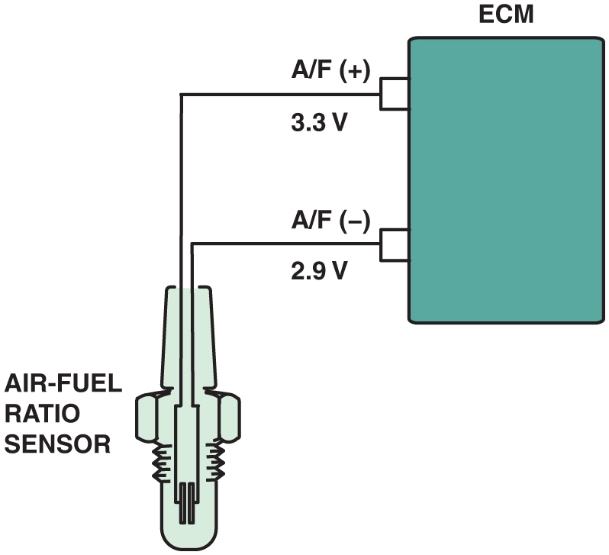
Figure 35.19 A single cell wide-band oxygen sensor has four wires with two for the heater and two for the sensor itself. The voltage applied to the sensor is 0.4 V (3.3 – 2.9 = 0.4) across the two leads of the sensor

Slide 22
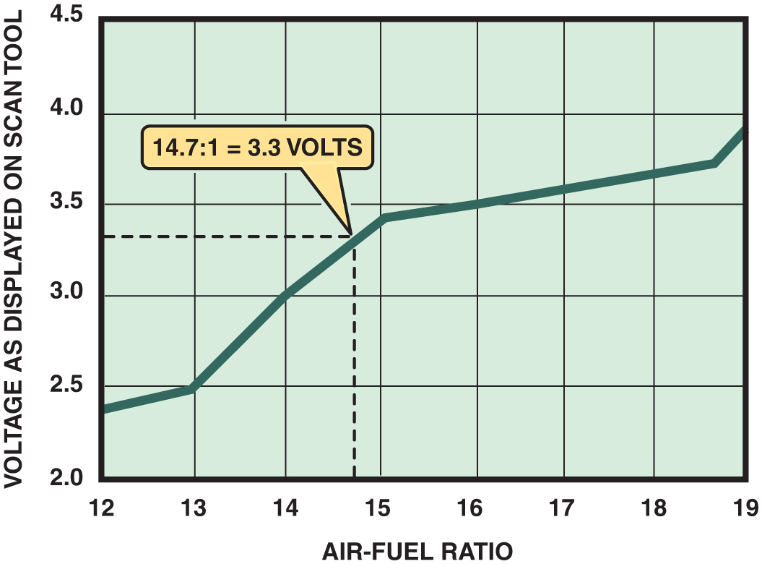
Figure 35.20 A scan tool can display various voltages, but will often show 3.3 V because the P C M is controlling the sensor through applying a low current to the sensor to achieve balance

Slide 23
Copyright

