Slide 1
Automotive Electrical and Engine Performance
Eighth Edition
Chapter 33
M A P/B A R O Sensors
Copyright © 2020, 2016 Pearson Education, Inc. All Rights Reserved

Slide 2
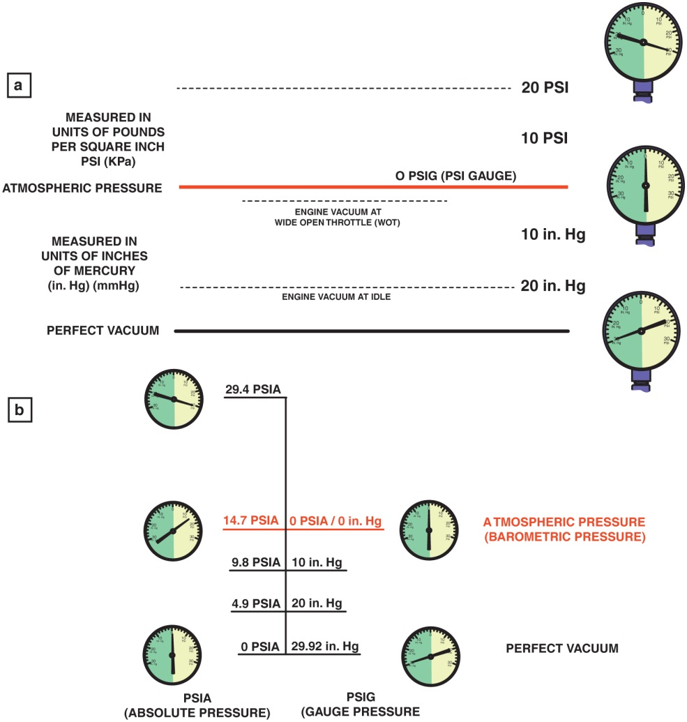
Figure 33.1 (a) As an engine is accelerated under a load, the engine vacuum drops. This drop in vacuum is actually an increase in absolute pressure in the intake manifold. A M A P sensor senses all pressures greater than that of a perfect vacuum. (b) The relationship between absolute pressure, vacuum, and gauge pressure

Slide 3
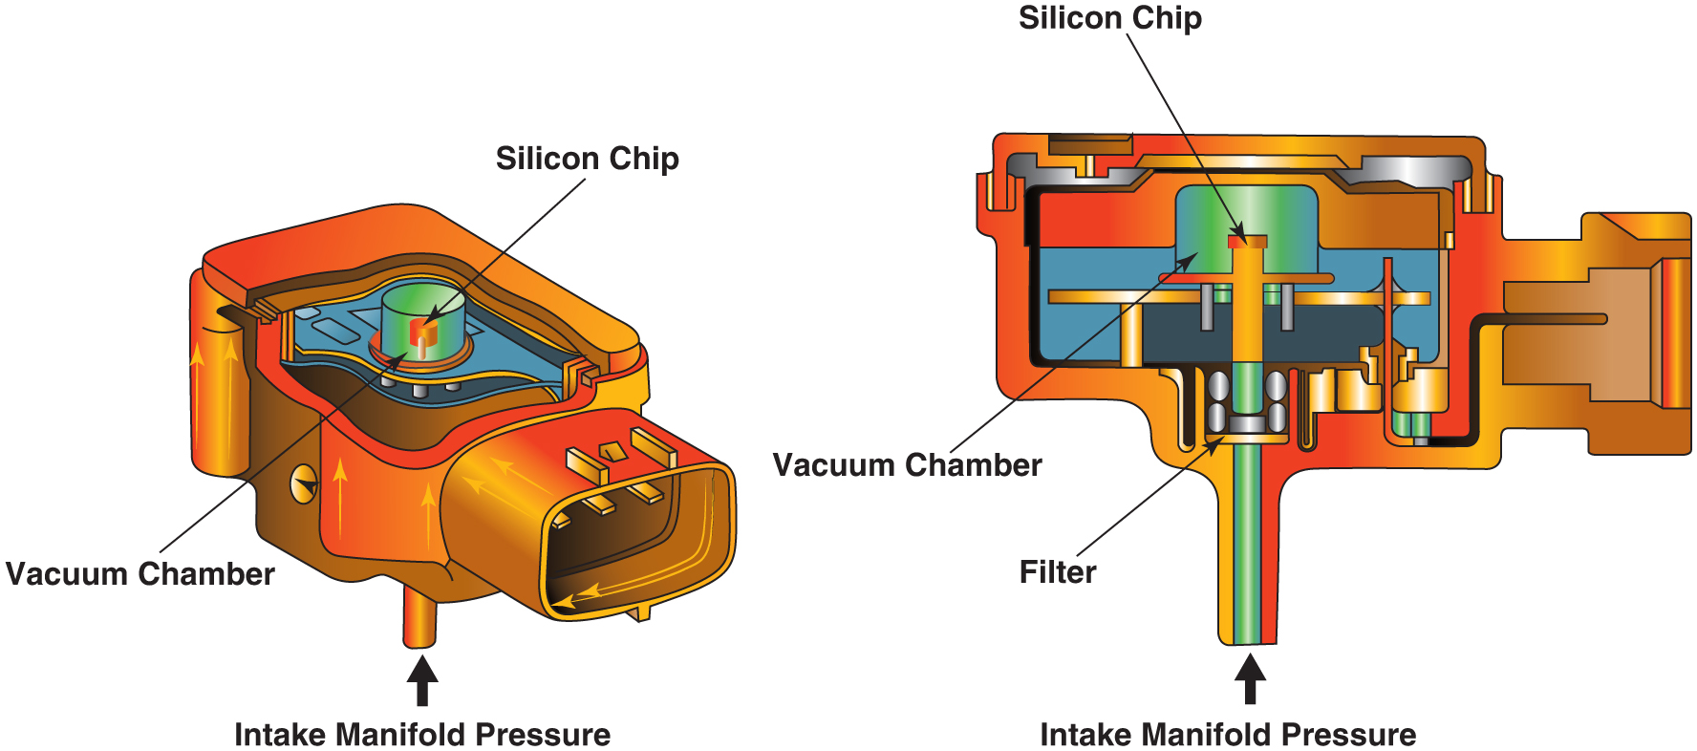
Figure 33.2 (a) A M A P sensor compares the absolute pressure in the intake manifold to a perfect vacuum. The deflection of the silicon chip is converted to a an absolute pressure reading by the electronics in the sensor itself

Slide 4
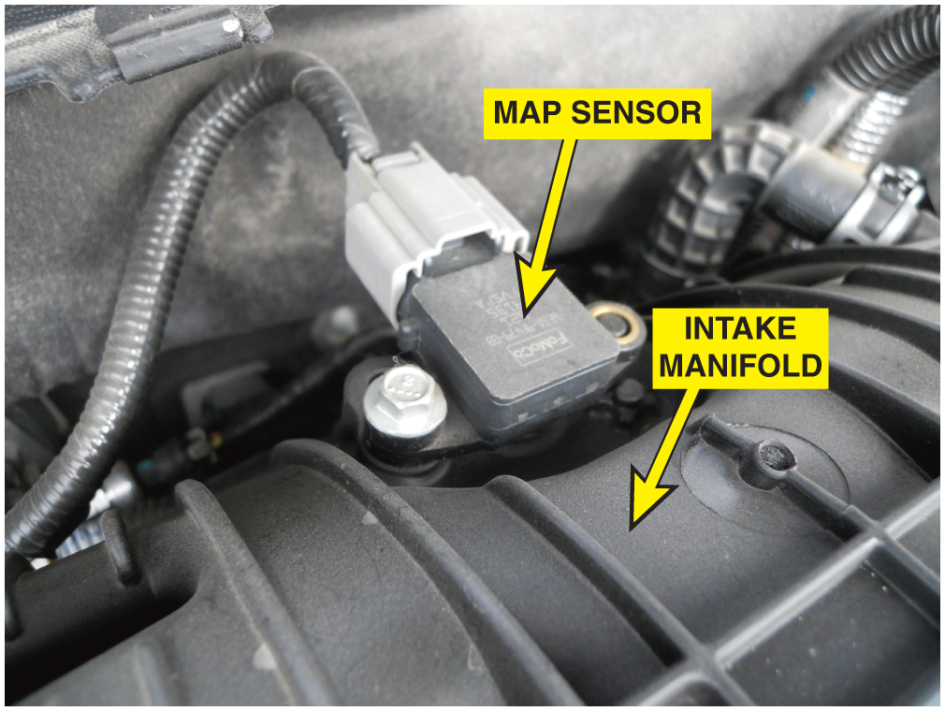
Figure 33.3 A typical MAP sensor installed in the intake manifold

Slide 5
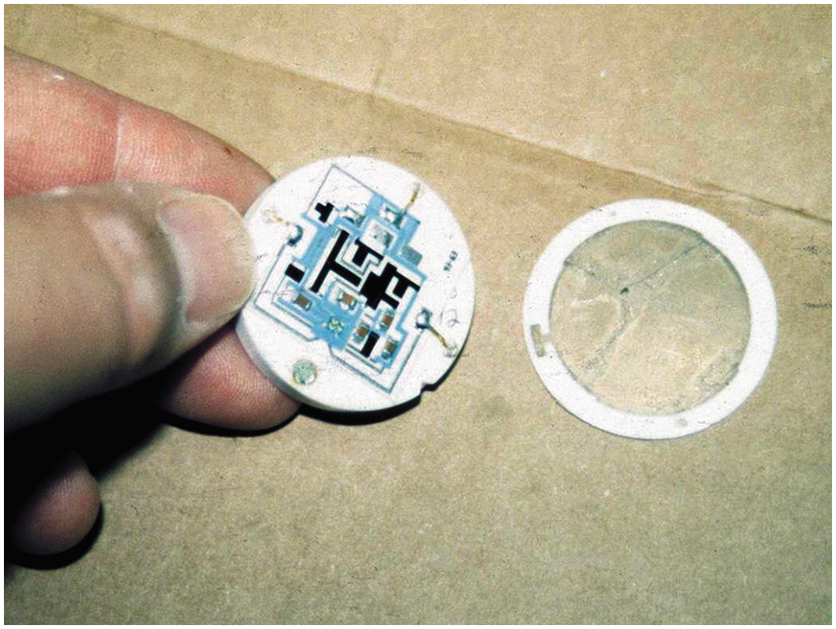
Figure 33.4 Shown is the electronic circuit inside a ceramic disc M A P sensor used on many Chrysler engines. The black areas are carbon resistors that are applied to the ceramic, and lasers are used to cut lines into these resistors during testing to achieve the proper operating calibration

Slide 6
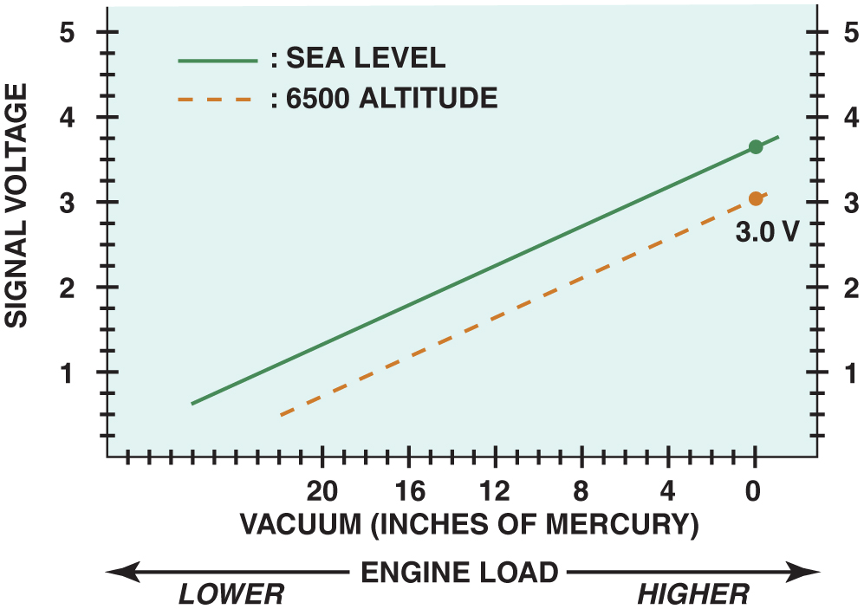
Figure 33.5 Altitude affects the MAP sensor voltage

Slide 7
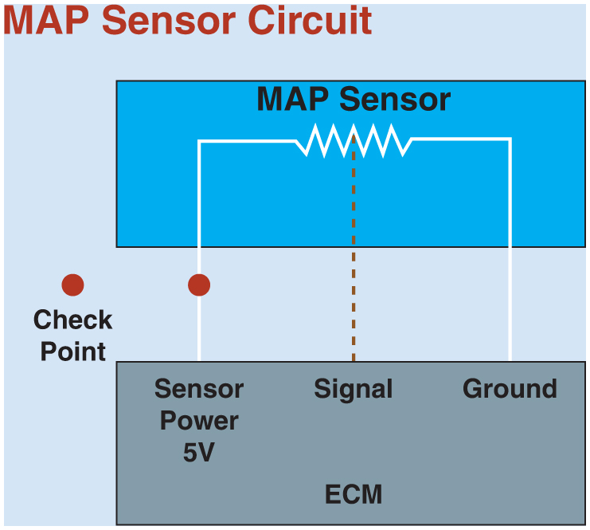
Figure 33.6 When checking a M A P sensor, first verify that the sensor is receiving a 5-volt reference voltage and then check for the output (signal) voltage

Slide 8
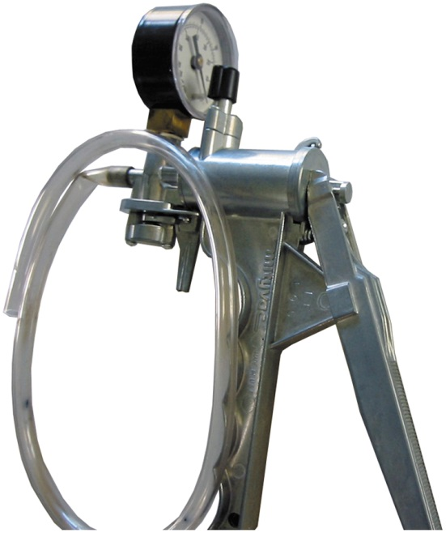
Figure 33.7 A typical hand-operated vacuum pump

Slide 9
Copyright

