Slide 1
Automotive Electrical and Engine Performance
Eighth Edition
Chapter 32
Throttle Position (T P) Sensors
Copyright © 2020, 2016 Pearson Education, Inc. All Rights Reserved

Slide 2
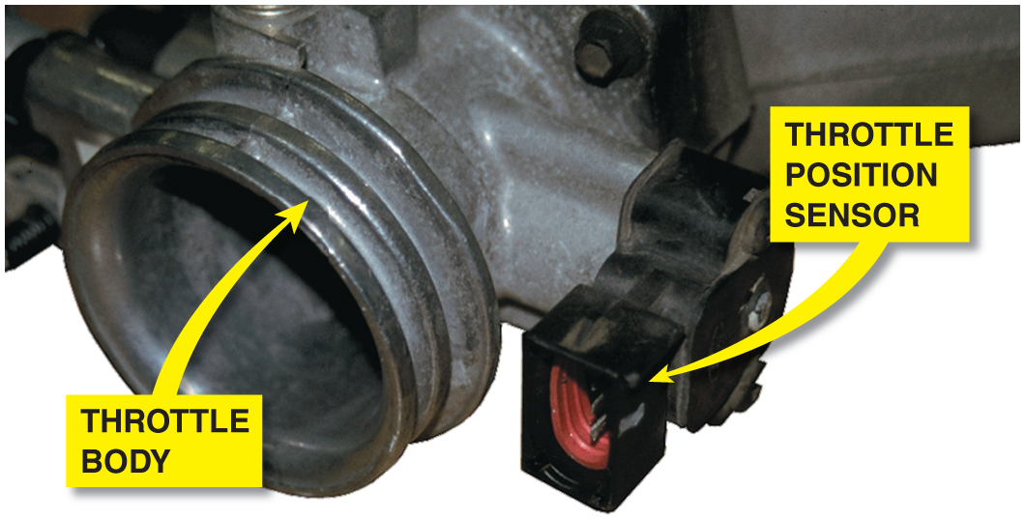
Figure 32.1 A typical T P sensor mounted on the throttle plate of this port-injected engine

Slide 3
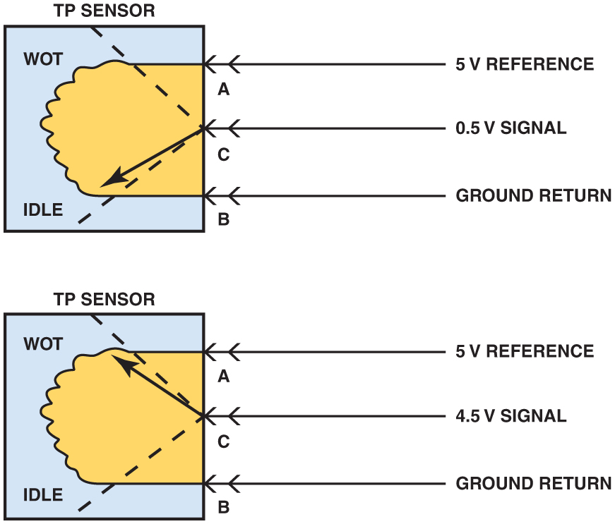
Figure 32.2 The signal voltage from a throttle position increases as the throttle is opened because the wiper arm is closer to the 5-volt reference. At idle, the resistance of the sensor winding effectively reduces the signal voltage output to the computer

Slide 4
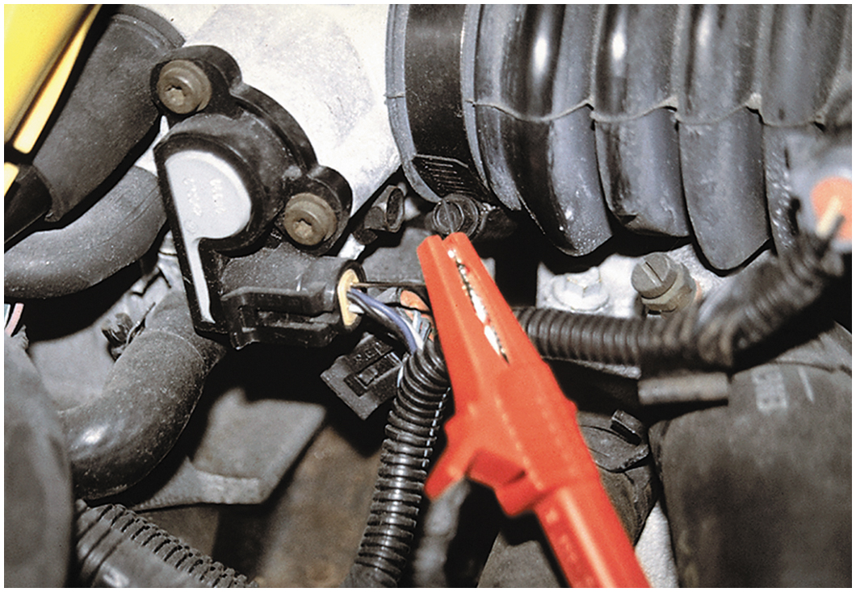
Figure 32.3 A meter lead connected to a T-pin that was gently pushed along the signal wire of the T P sensor until the point of the pin touched the metal terminal inside the plastic connector

Slide 5
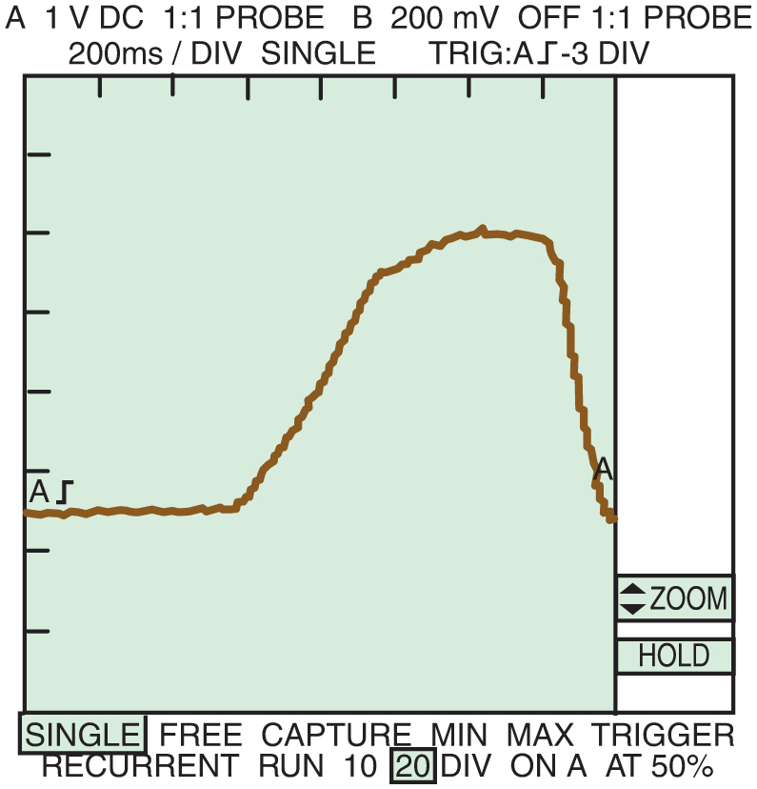
Figure 32.4 A typical waveform of a T P sensor signal as recorded on a D S O when the accelerator pedal was depressed with the ignition switch on (engine off). Clean transitions and the lack of any glitches in this waveform indicate a good sensor

Slide 6
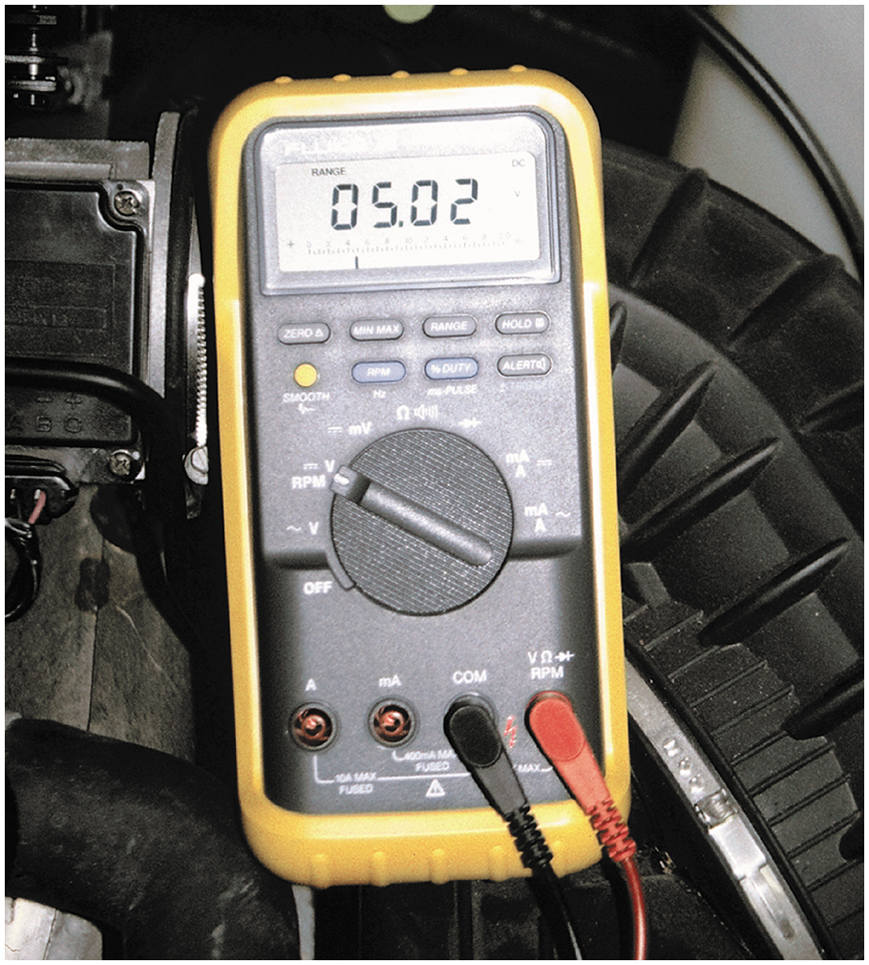
Figure 32.5 Checking the 5-volt reference from the computer being applied to the T P sensor with the ignition switch on (engine off)

Slide 7
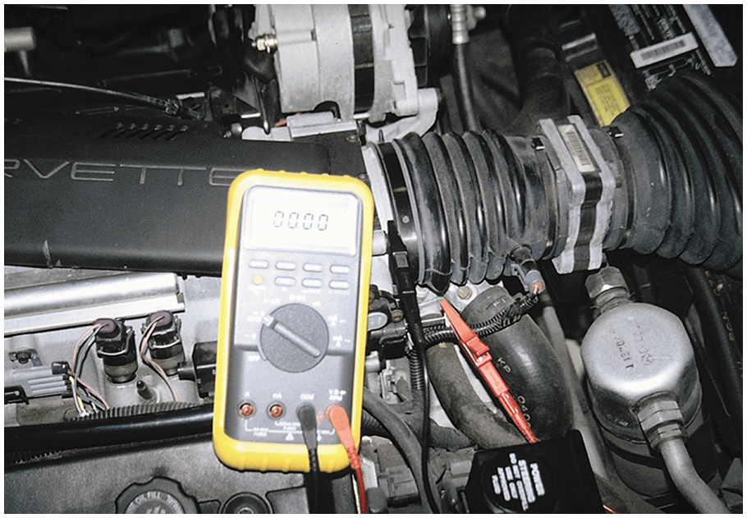
Figure 32.6 Checking the voltage drop between the T P sensor ground and a good engine ground with the ignition on (engine off). A reading of greater than 0.2 volt (200 mV) represents a bad computer ground

Slide 8
Copyright

