Slide 1
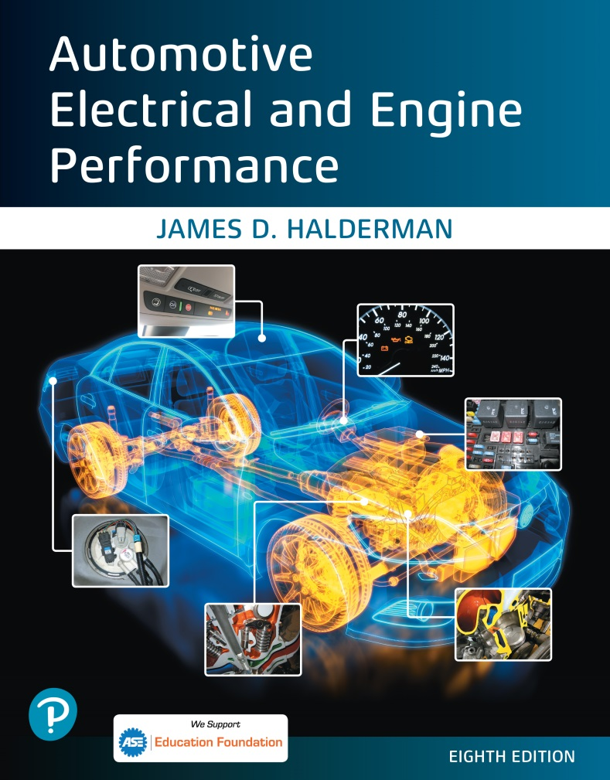
Automotive Electrical and Engine Performance
Eighth Edition
Chapter 29
Ignition System Components and Operation
Copyright © 2020, 2016 Pearson Education, Inc. All Rights Reserved

Slide 2
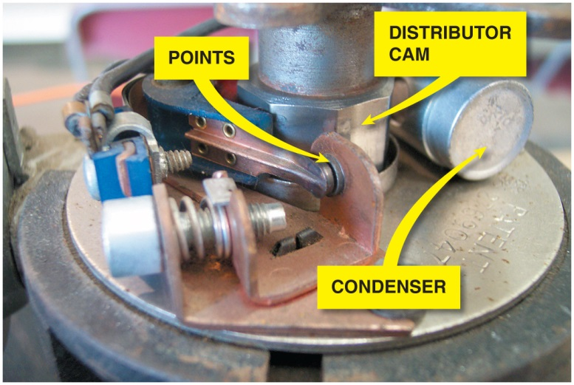
Figure 29.1 A point-type ignition system showing the distributor cam which opens the points

Slide 3
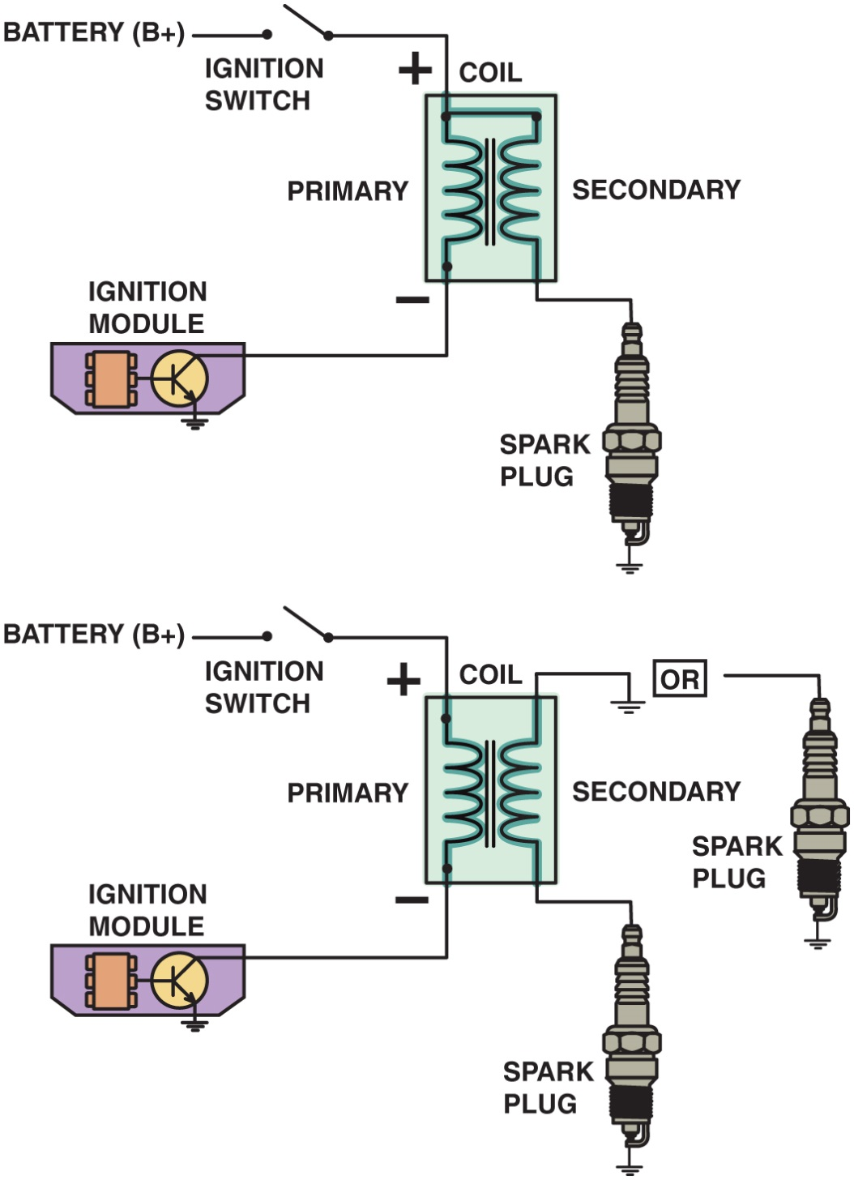
Figure 29.2 Some ignition coils are electrically connected, called married (top figure), whereas others use separate primary and secondary windings, called divorced (lower figure). The polarity (positive or negative) of a coil is determined by the direction in which the coil is wound

Slide 4
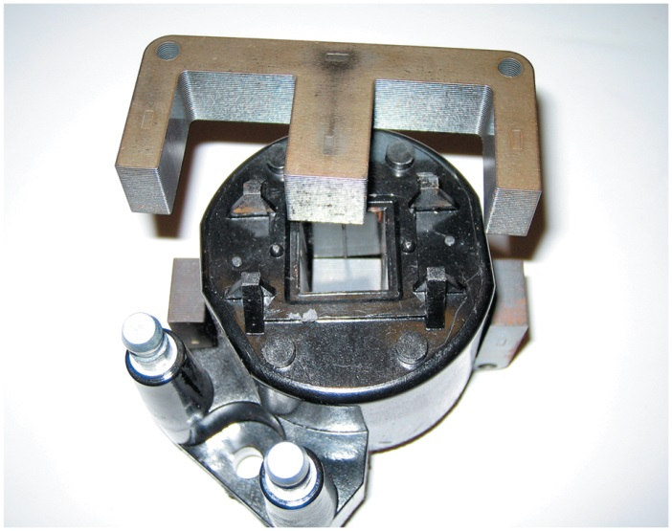
Figure 29.3 The steel lamination used in an E coil helps increase the magnetic field strength, which helps the coil produce higher energy output for a more complete combustion in the cylinders

Slide 5
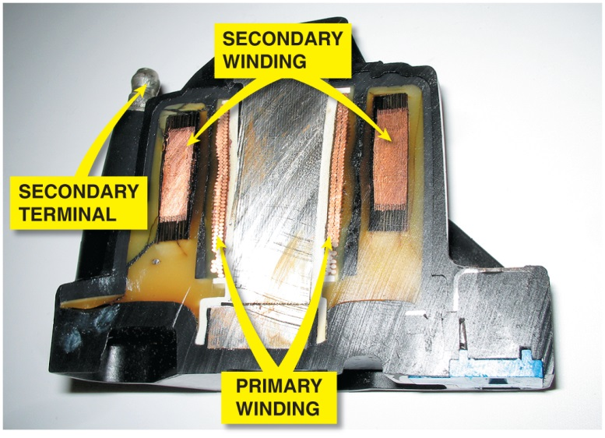
Figure 29.4 The primary windings are inside the secondary windings on this General Motors coil

Slide 6
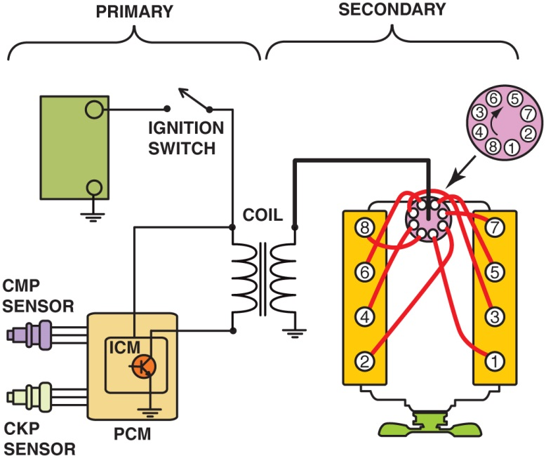
Figure 29.5 The primary ignition system is used to trigger, and therefore create the secondary (high-voltage) spark from the ignition coil

Slide 7
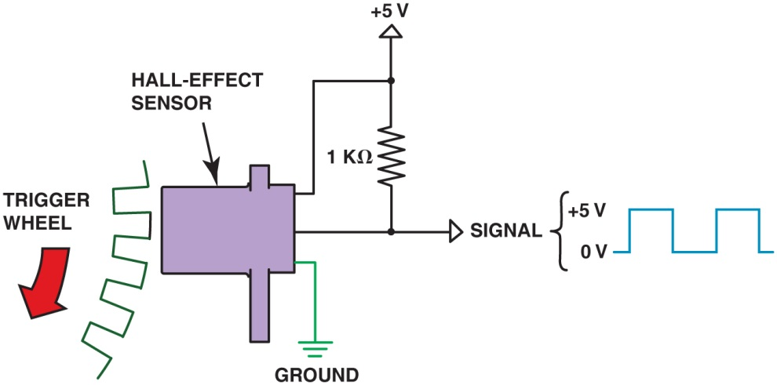
Figure 29.6 A Hall-effect sensor produces a digital on-off voltage signal whether it is used with a blade or a notched wheel

Slide 8
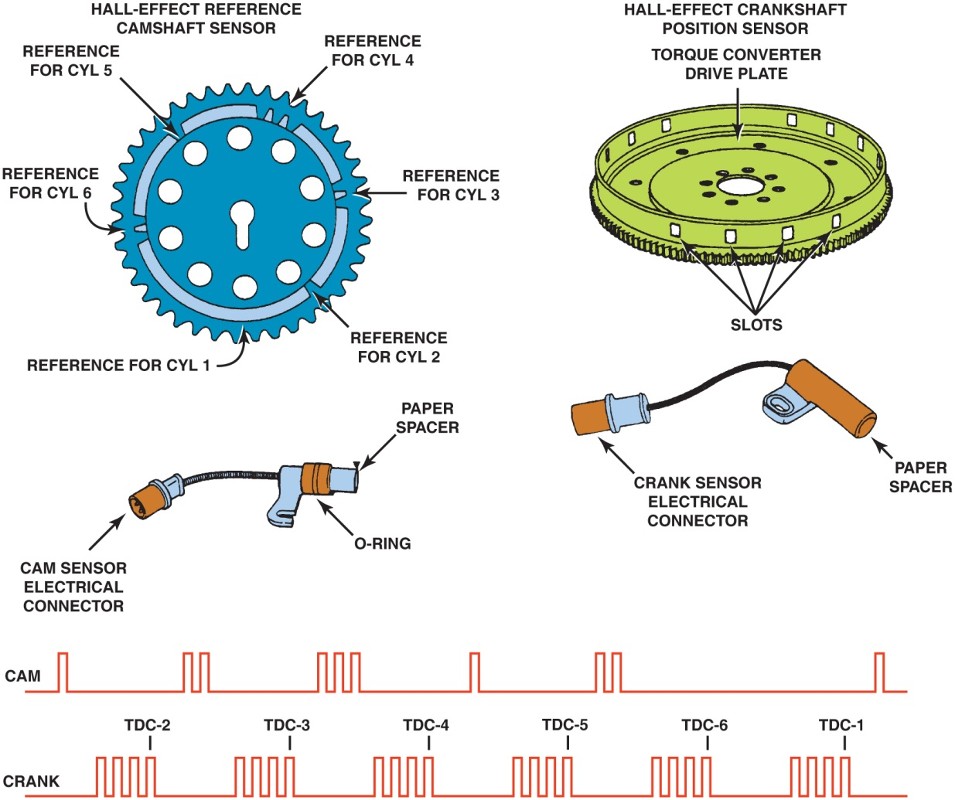
Figure 29.7 Some Hall-effect sensors look like magnetic sensors. This Hall-effect camshaft reference sensor and crankshaft position sensor have an electronic circuit built in that creates a 0 to 5 volt signal as shown at the bottom. These Hall-effect sensors have three wires: a power supply (8 volts) from the computer (controller); a signal (0 to 5 volts); and a signal ground

Slide 9
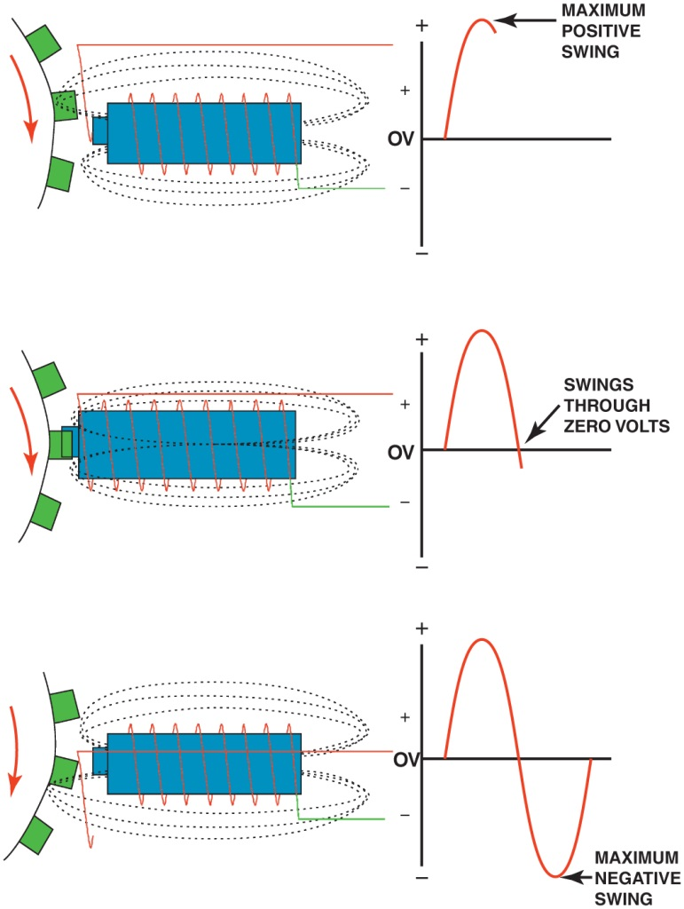
Figure 29.8 A magnetic sensor uses a permanent magnet surrounded by a coil of wire. The notches of the crankshaft (or camshaft) create a variable magnetic field strength around the coil. When a metallic section is close to the sensor, the magnetic field is stronger because metal is a better conductor of magnetic lines of force than air

Slide 10
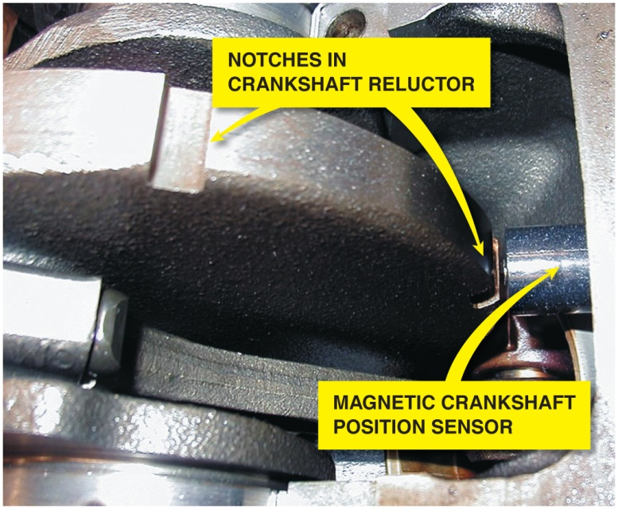
Figure 29.9 A typical magnetic crankshaft position sensor

Slide 11
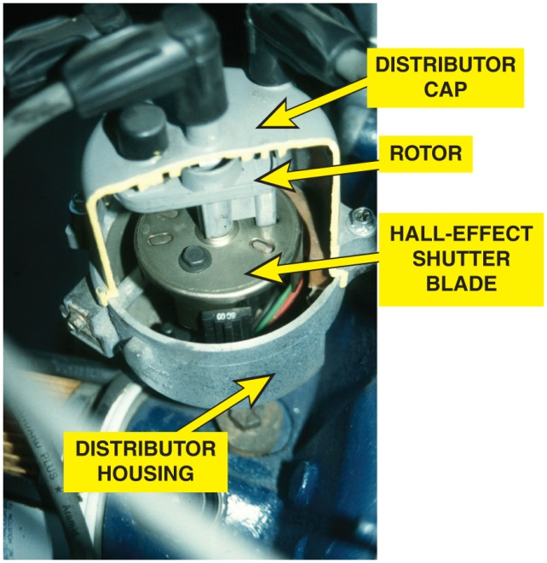
Figure 29.10 (a) A cutaway of a Ford distributor showing the Hall-effect shutter blade that is used to trigger the ignition control module and the rotor. (b) A rotor from a G M H E I system

Slide 12
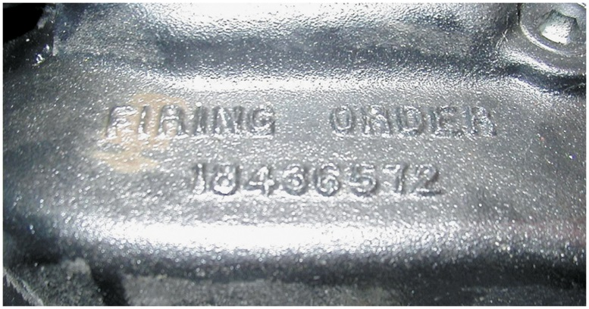
Figure 29.11 The firing order is cast or stamped on the intake manifold on most engines that have a distributor ignition

Slide 13
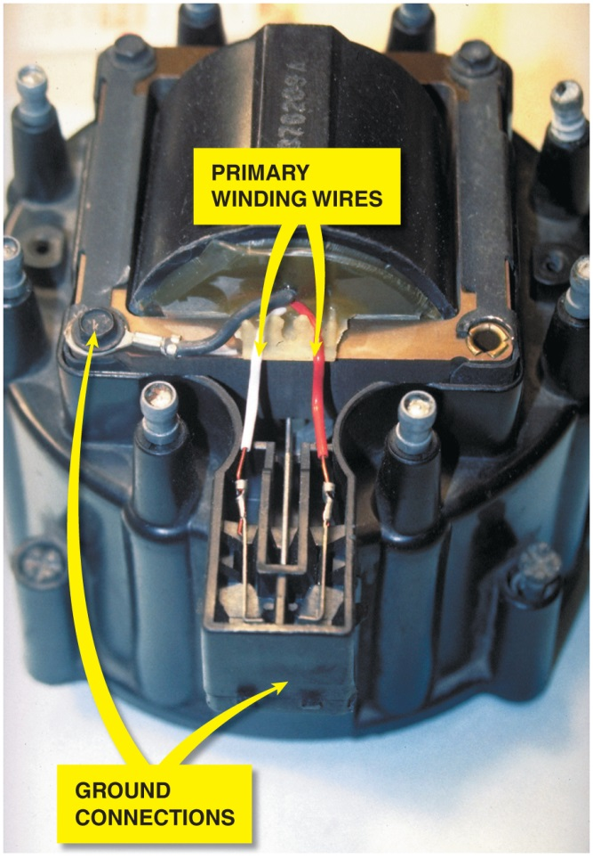
Figure 29.12 A typical General Motors H E I coil installed in the distributor cap. When the coil or distributor cap is replaced, check that the ground clip is transferred from the old distributor cap to the new. Without proper grounding, coil damage is likely. There are two designs of H E I coils. One uses red and white wire as shown, and the other design, which has reversed polarity, uses red and yellow wire for the coil primary

Slide 14
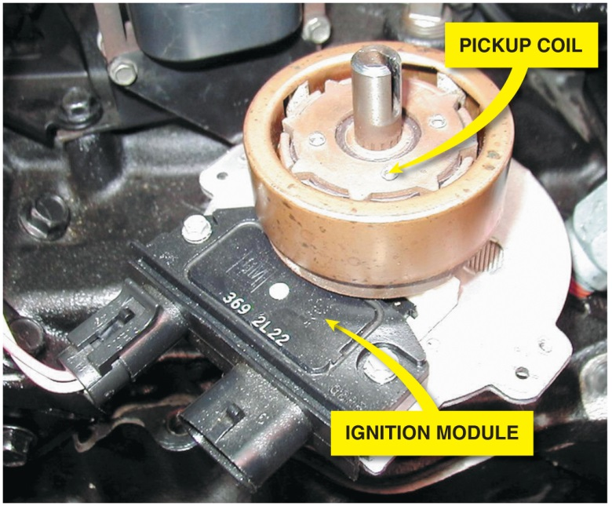
Figure 29.13 This distributor ignition system uses a remotely mounted ignition coil

Slide 15
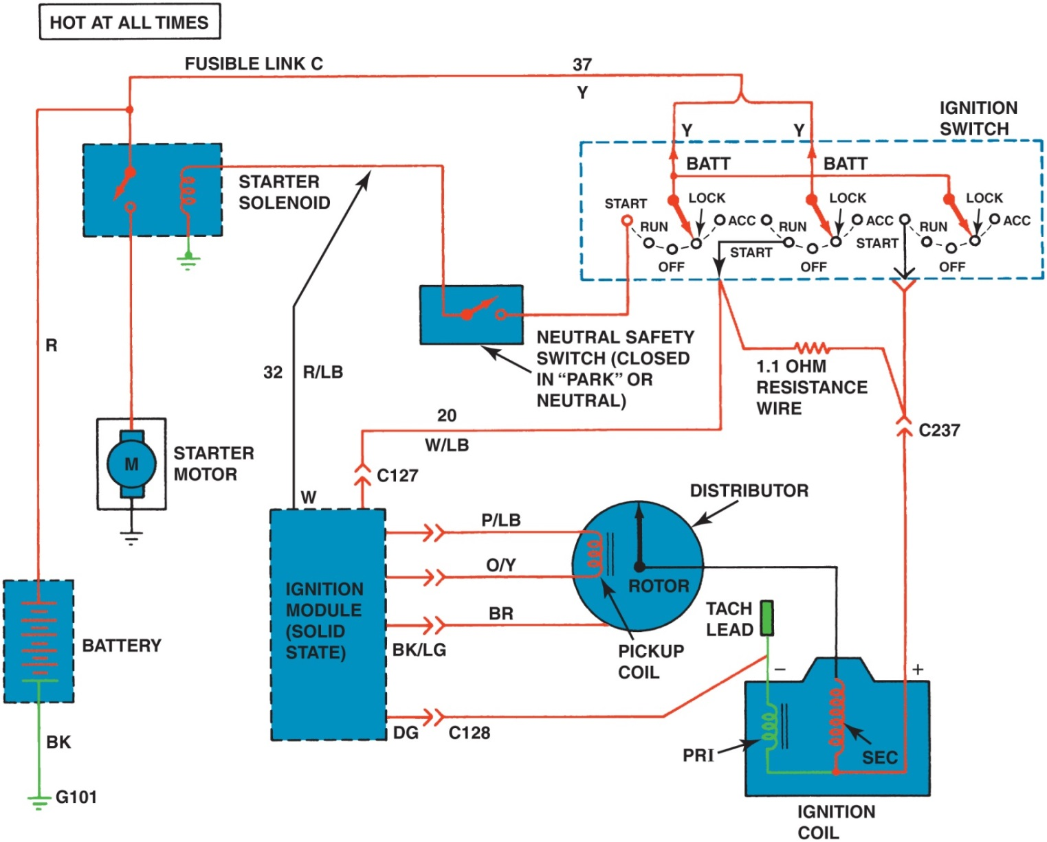
Figure 29.14 Wiring diagram of a typical Ford electronic ignition

Slide 16
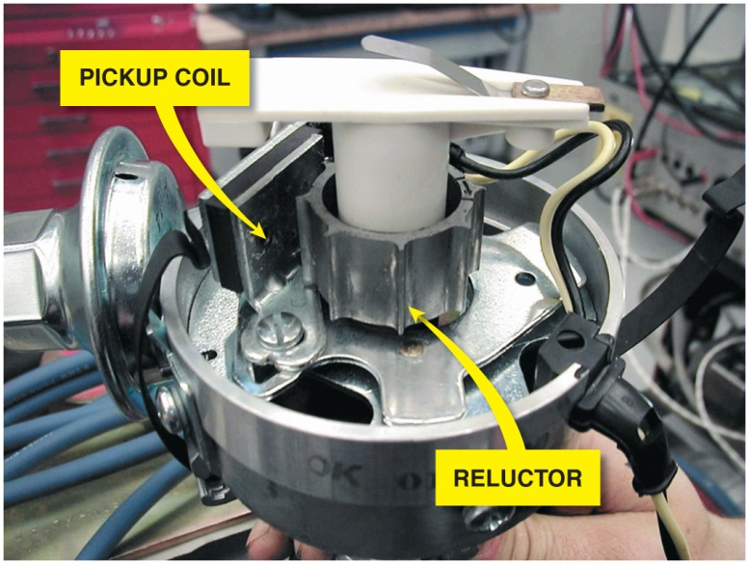
Figure 29.15 A Chrysler electronic ignition distributor. This unit is equipped with a vacuum advance mechanism that advances the ignition timing under light engine load conditions

Slide 17
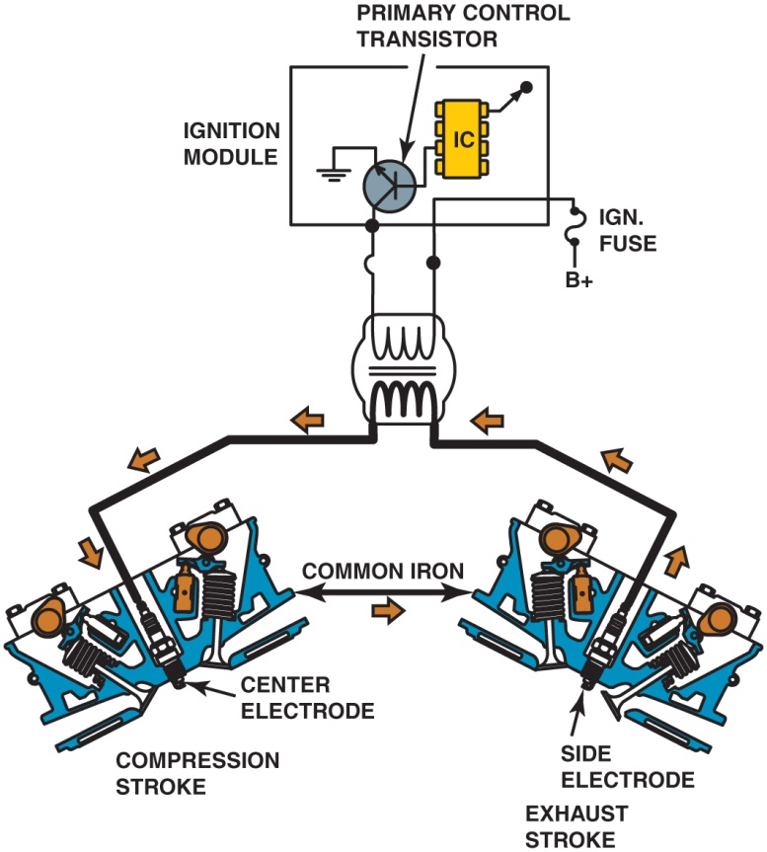
Figure 29.16 A waste-spark system fires one cylinder while its piston is on the compression stroke and into paired or companion cylinders while it is on the exhaust stroke. In a typical engine, it requires only about 2 to 3 kV to fire the cylinder on the exhaust strokes. The remaining coil energy is available to fire the spark plug under compression (typically about 8 to 12 kV)

Slide 18
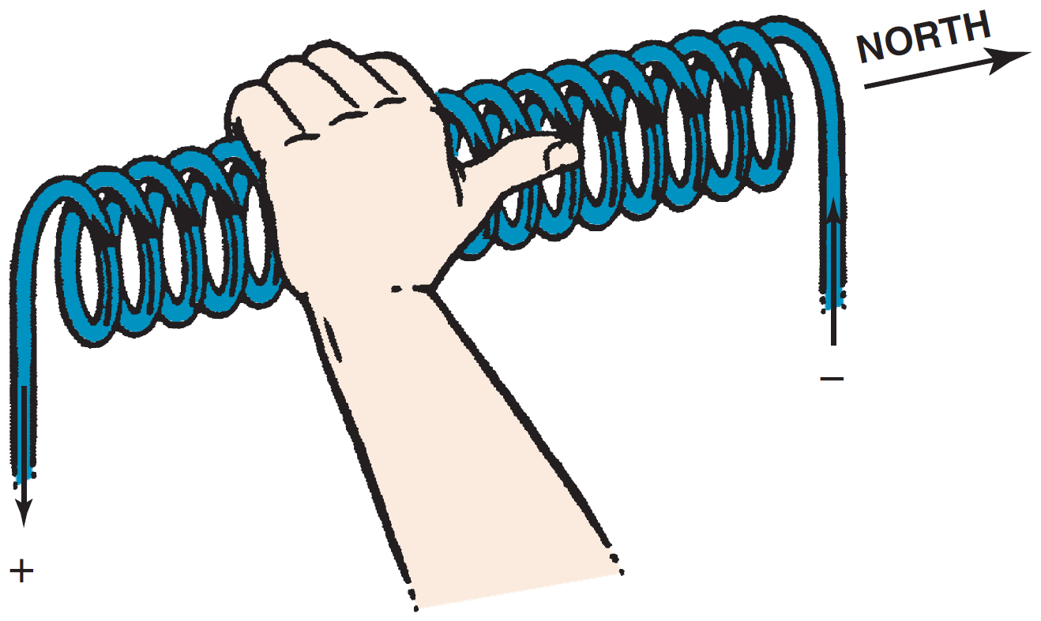
Figure 29.17 The left-hand rule states that if a coil is grasped with the left hand, the fingers will point in the direction of current flow and the thumb will point toward the north pole

Slide 19
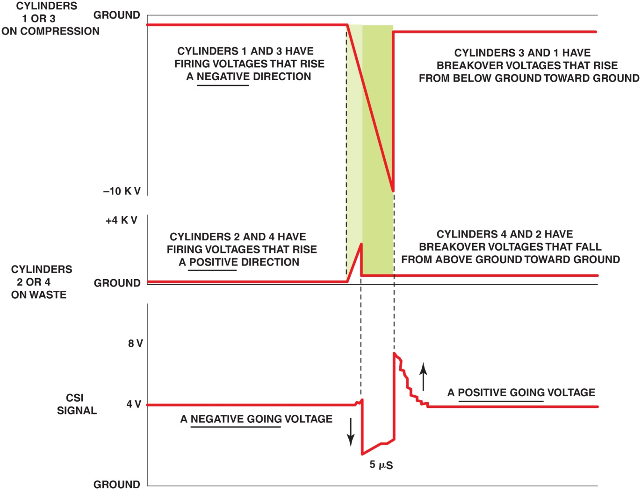
Figure 29.18 The slight (5 microsecond) difference in the firing of the companion cylinders is enough time to allow the P C M to determine which cylinder is firing on the compression stroke. The compression sensing ignition (C S I ) signal is processed by the P C M , which then determines which cylinder is on the compression stroke

Slide 20
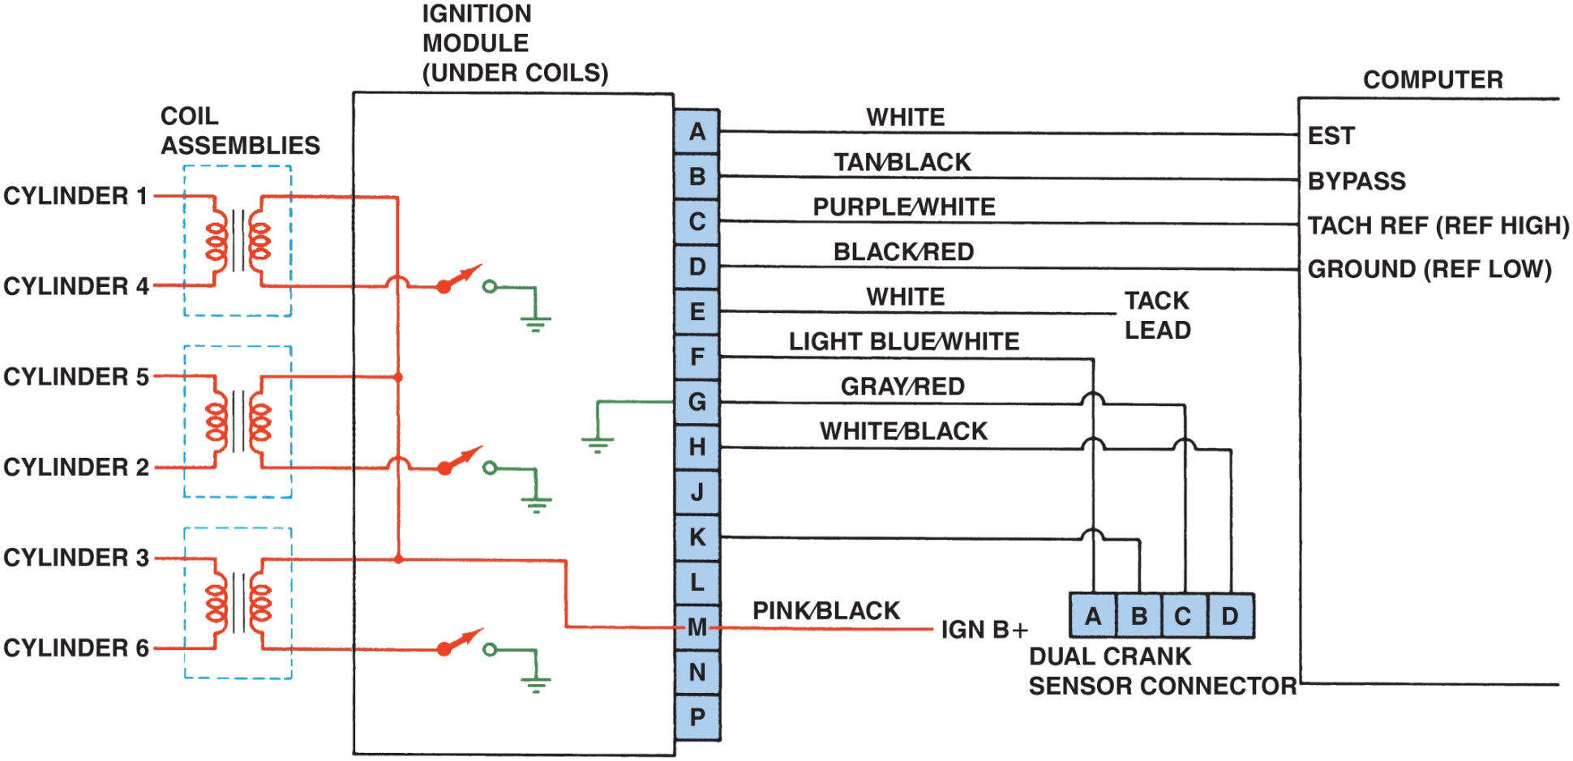
Figure 29.19 Typical wiring diagram of a V-6 distributorless (direct fire) ignition system

Slide 21
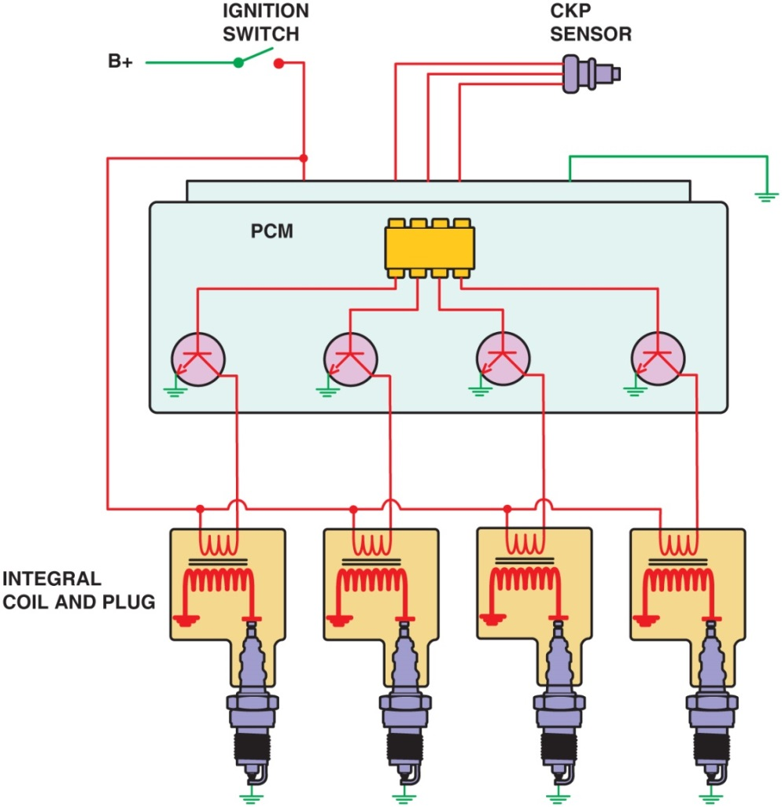
Figure 29.20 A typical two-wire coil-on-plug ignition system showing the triggering and the switching being performed by the P C M from input from the crankshaft position sensor

Slide 22
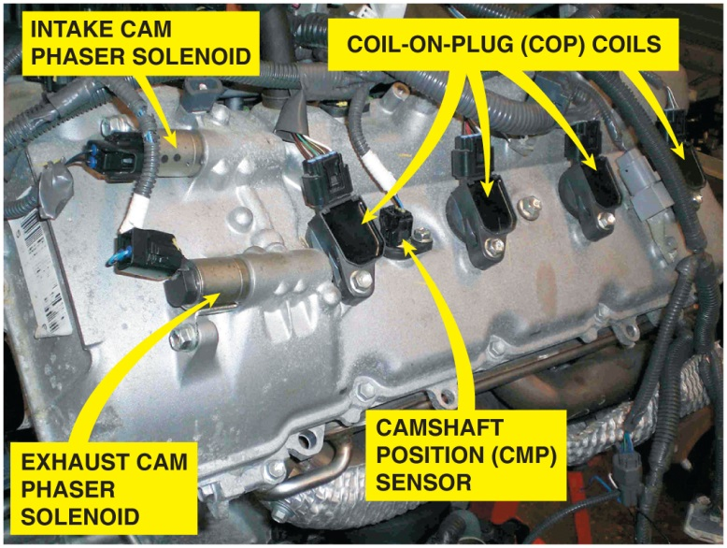
Figure 29.21 An overhead camshaft engine equipped with variable valve timing on both the intake and exhaust camshafts and coil-on-plug ignition

Slide 23
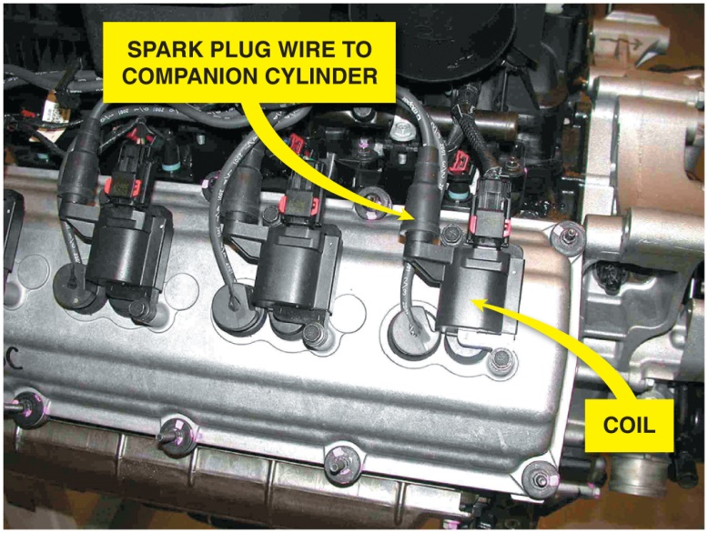
Figure 29.22 Chrysler Hemi V-8 that has two spark plugs per cylinder. The coil on top of one spark fires that plug plus, through a spark plug wire, fires a plug in the companion cylinder

Slide 24
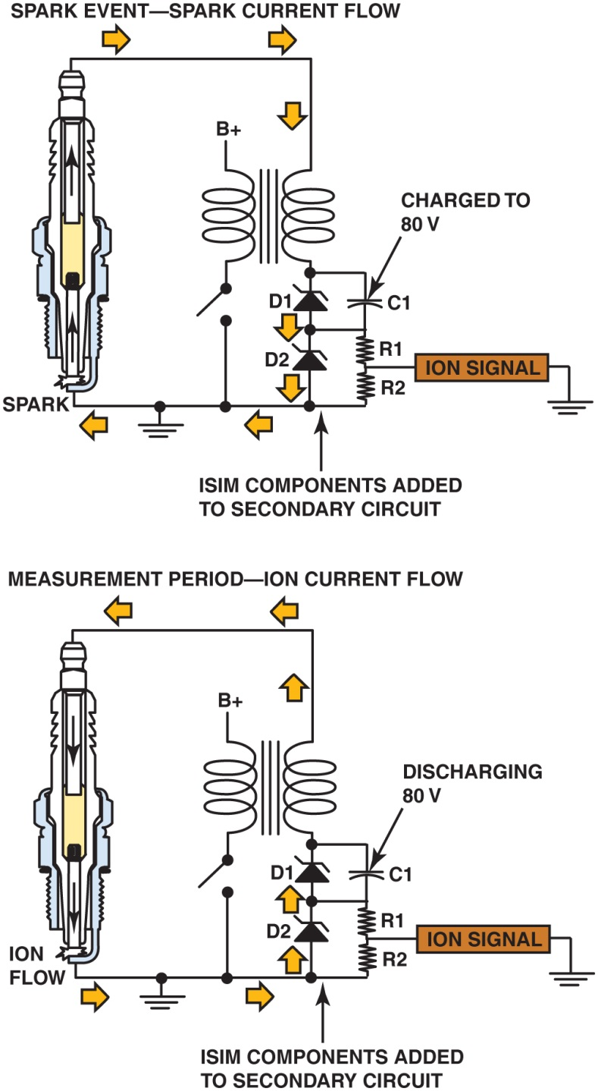
Figure 29.23 A D C voltage is applied across the spark plug gap after the plug fires and the circuit can determine if the correct air–fuel ratio was present in the cylinder and if knock occurred

Slide 25
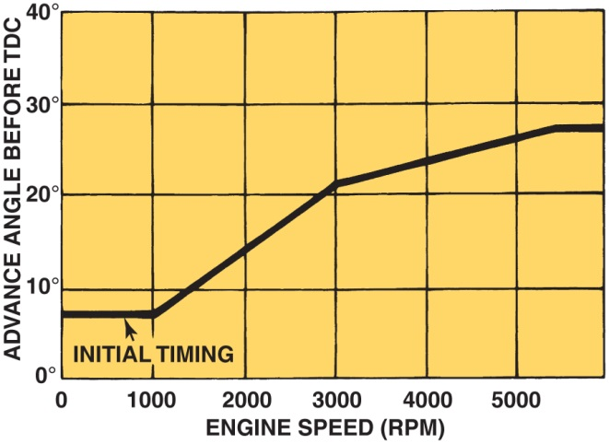
Figure 29.24 The initial timing is where the spark plug fires at idle speed. The computer then advances the timing based on engine speed and other factors

Slide 26
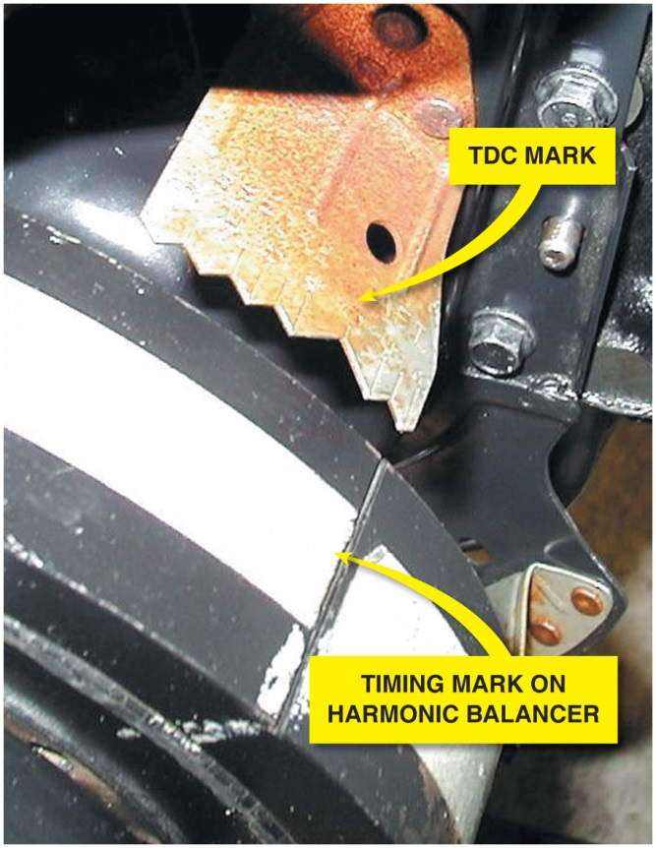
Figure 29.25 Ignition timing marks are found on the harmonic balancers that are equipped with distributor ignition

Slide 27
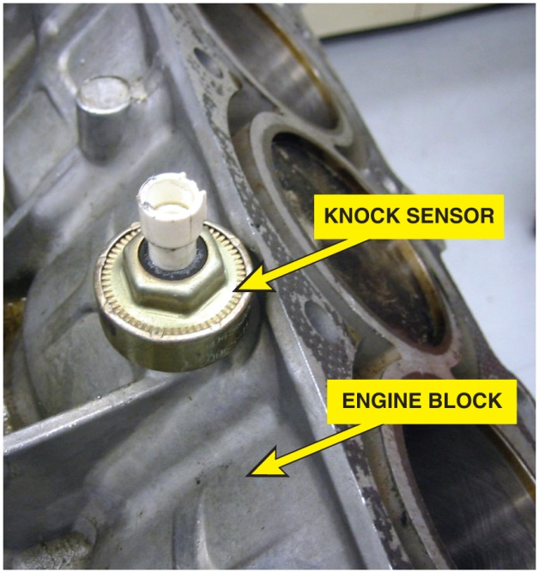
Figure 29.26 A knock sensor which is used by the powertrain control module (P C M) to detect engine detonation

Slide 28
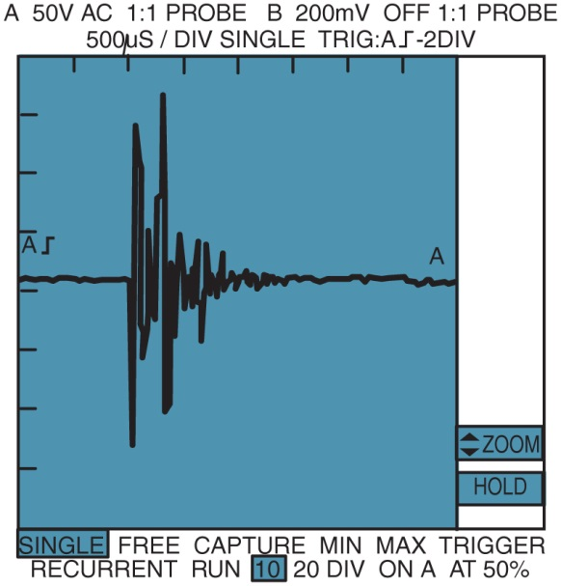
Figure 29.27 A typical waveform from a knock sensor during a spark knock event. This signal is sent to the computer which in turn retards the ignition timing. This timing retard is accomplished by an output command from the computer to either a spark advance control unit or directly to the ignition module

Slide 29
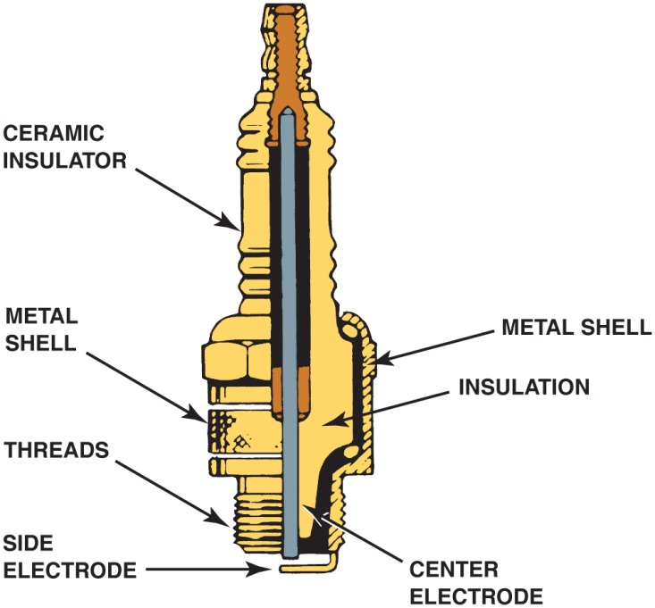
Figure 29.28 Parts of a typical spark plug

Slide 30
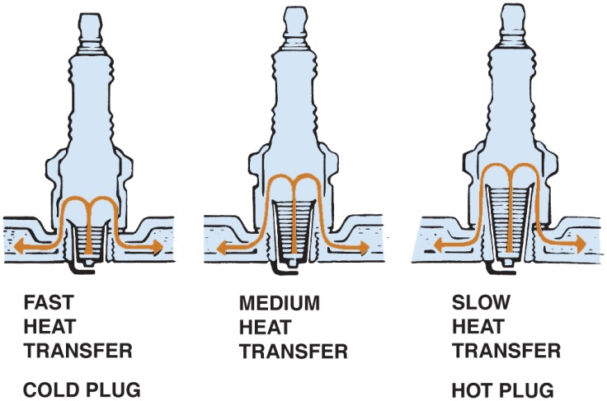
Figure 29.29 The heat range of a spark plug is determined by the distance the heat has to flow from the tip to the cylinder head

Slide 31
Copyright

