Slide 1
Automotive Electrical and Engine Performance
Eighth Edition
Chapter 27
Audio System Operation and Diagnosis
Copyright © 2020, 2016 Pearson Education, Inc. All Rights Reserved

Slide 2
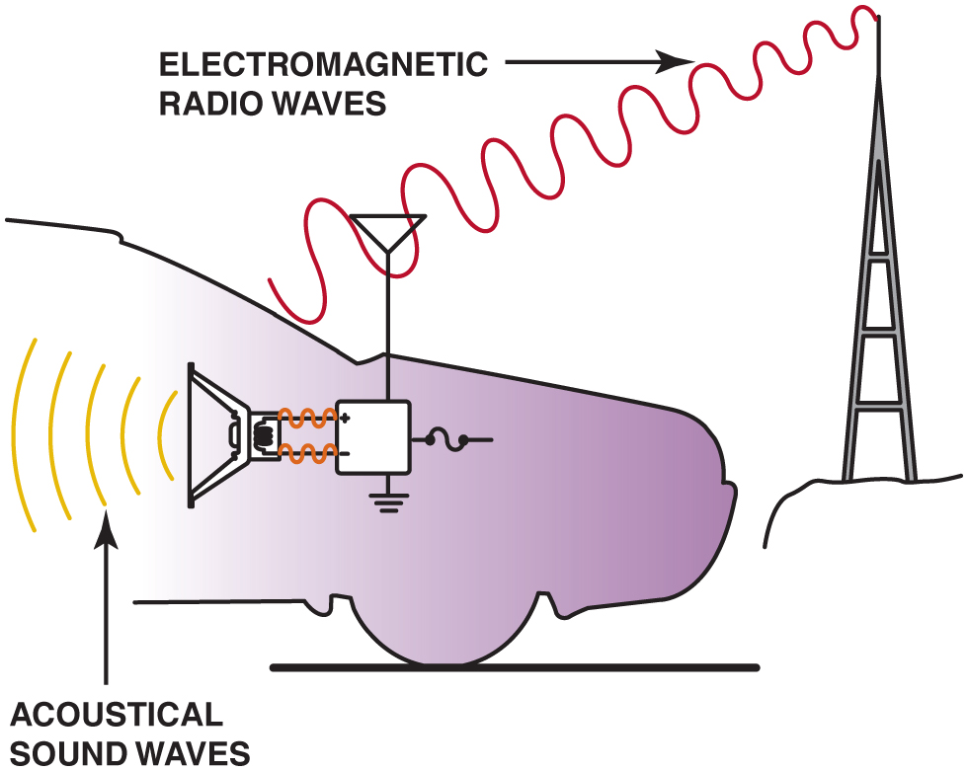
Figure 27.1 Audio systems use both electromagnetic radio waves and sound waves to reproduce sound inside the vehicle

Slide 3
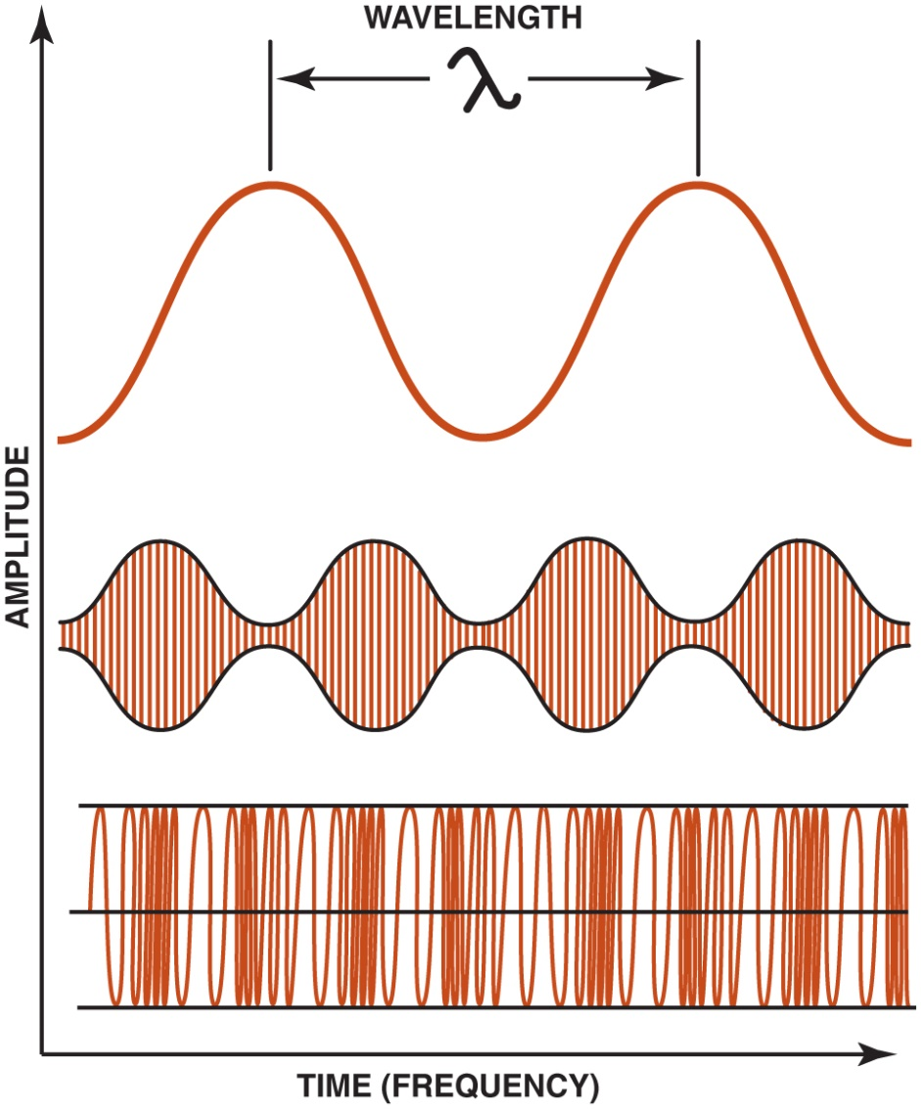
Figure 27.2 The relationship among wavelength, frequency, and amplitude

Slide 4
Figure 27.3 The amplitude changes in A M broadcasting

Slide 5
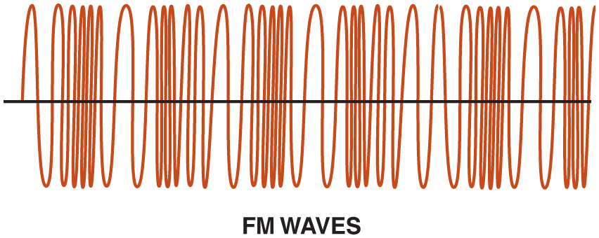
Figure 27.4 The frequency changes in F M broadcasting and the amplitude remains constant

Slide 6
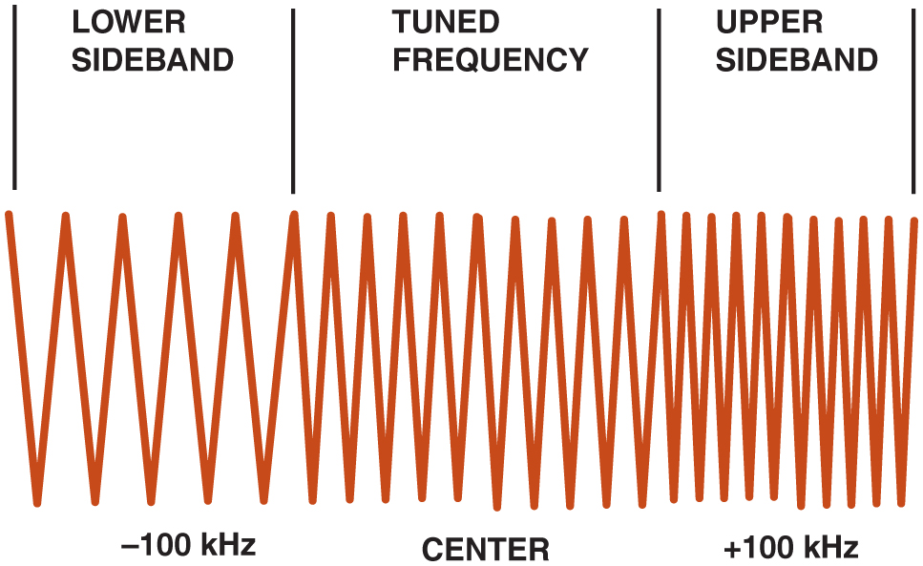
Figure 27.5 using upper and lower sidebands allows stereo to be broadcast. The receiver separates the signals to provide left and right channels

Slide 7
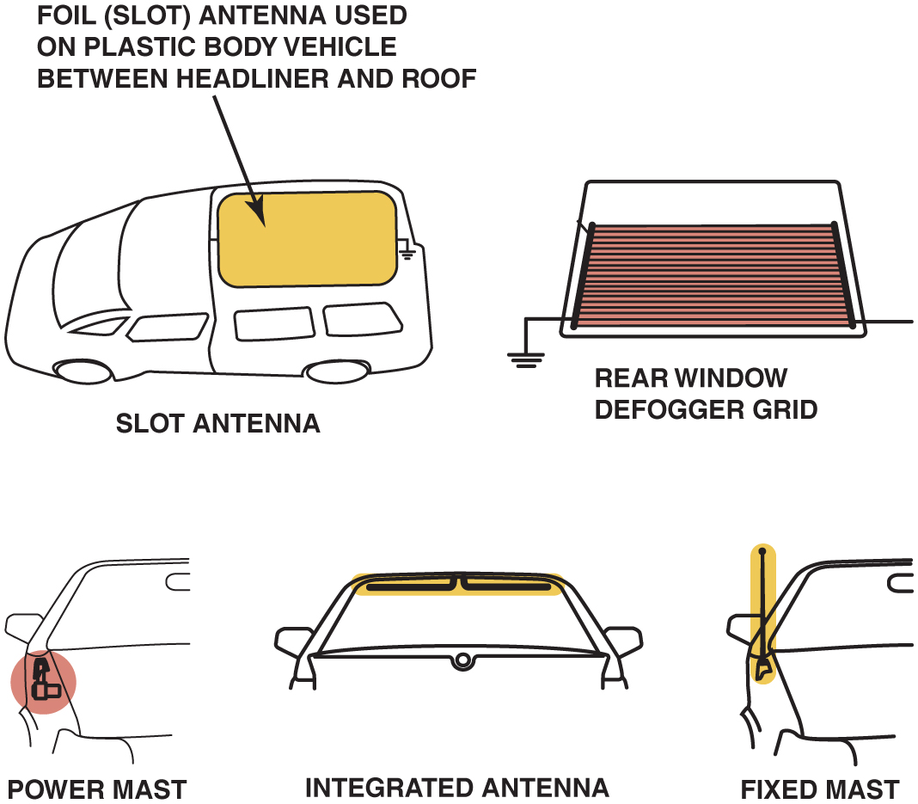
Figure 27.6 The five types of antennas used on General Motors vehicles include the slot antenna, fixed mast antenna, rear window defogger grid antenna, a powered mast antenna, and an integrated antenna

Slide 8
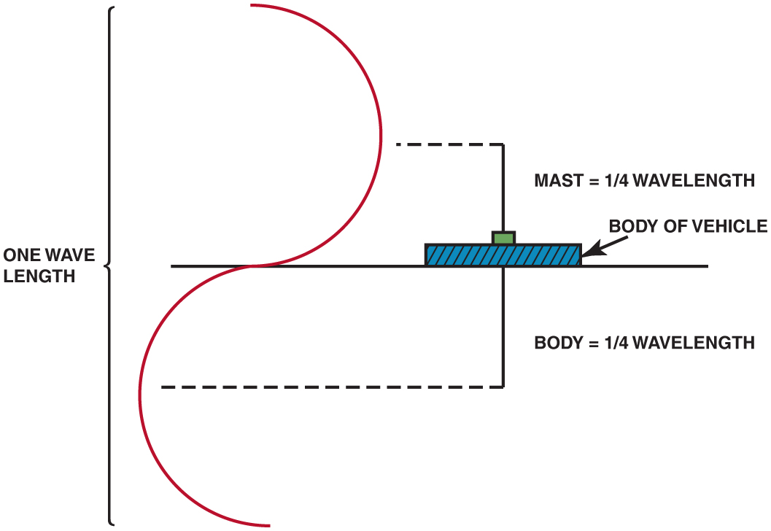
Figure 27.7 The ground plane is actually one-half of the antenna

Slide 9
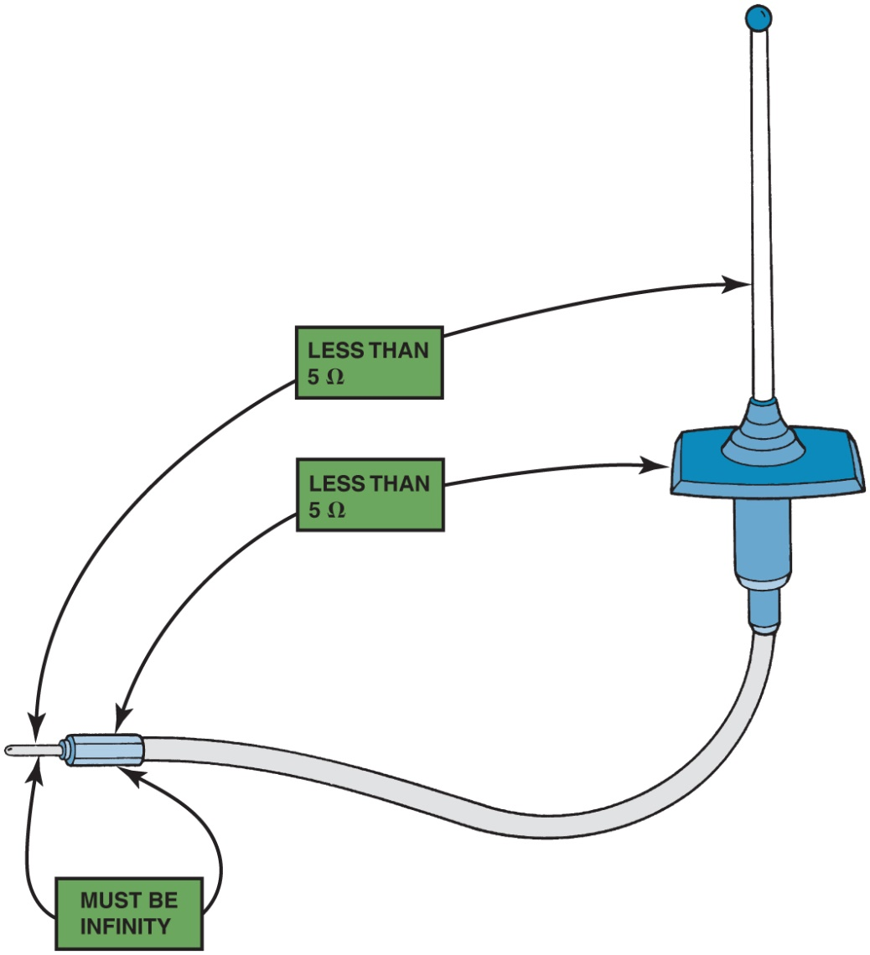
Figure 27.8 If all ohmmeter readings are satisfactory, the antenna is good

Slide 10
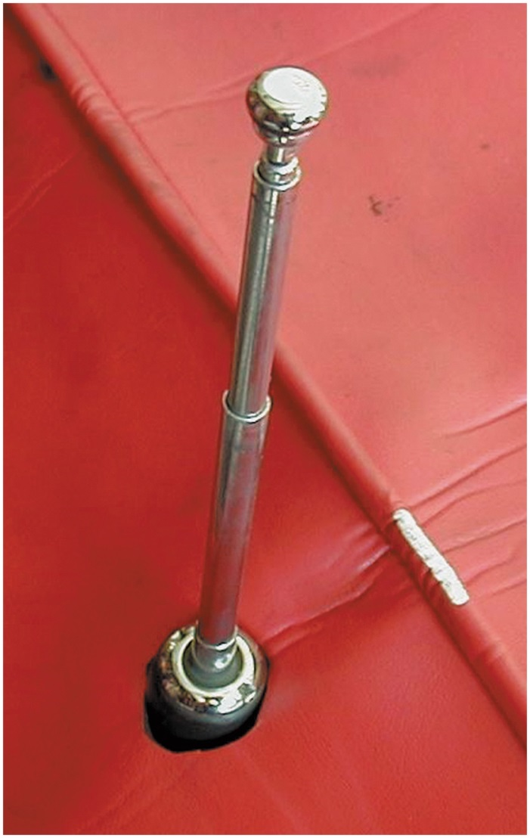
Figure 27.9 Cutting a small hole in a fender cover helps to protect the vehicle when replacing or servicing an antenna

Slide 11
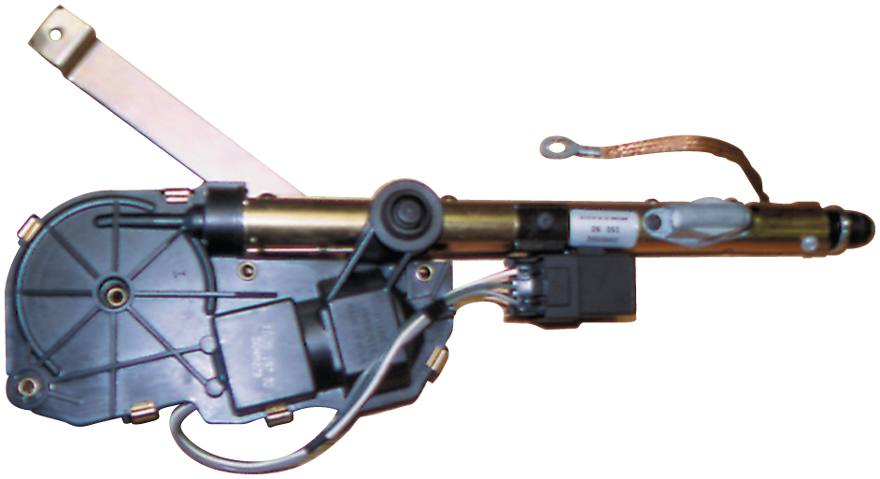
Figure 27.10 A typical power antenna assembly. note the braided ground wire used to ensure that the antenna has a good ground plane

Slide 12
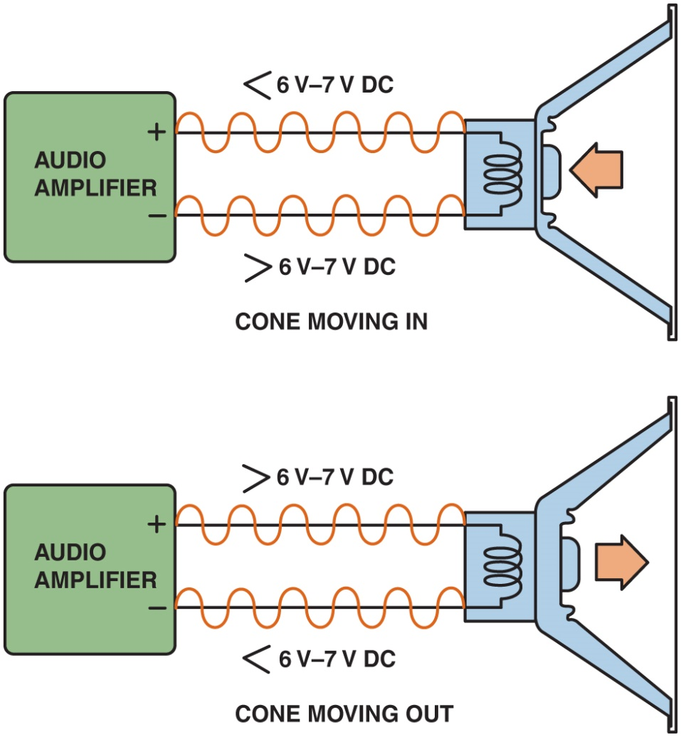
Figure 27.11 Between 6 and 7 volts is applied to each speaker terminal, and the audio amplifier then increases the voltage on one terminal and at the same time decreases the voltage on the other terminal causing the speaker cone to move. The moving cone then moves the air, causing sound

Slide 13
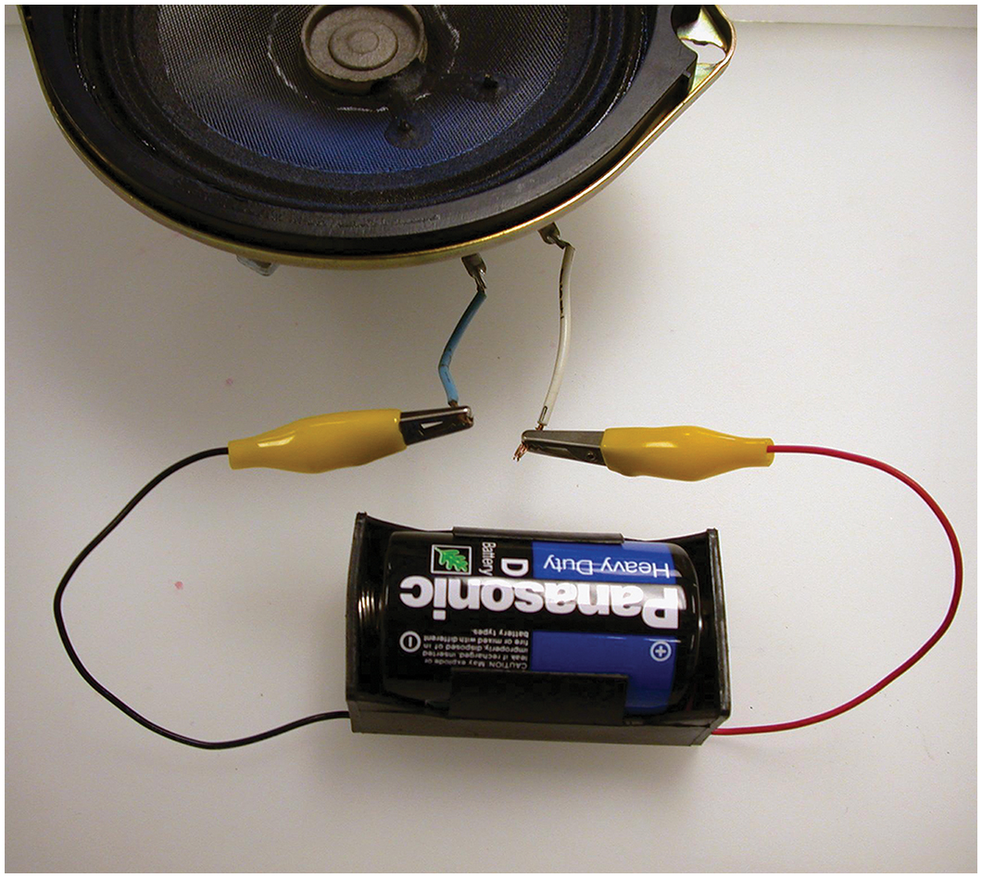
Figure 27.12 A typical automotive speaker with two terminals. The polarity of the speakers can be identified by looking at the wiring diagram in the service manual or by using a 1.5-volt battery to check. When the battery positive is applied to the positive terminal of the speaker, the cone will move outward. When the battery leads are reversed, the speaker cone will move inward

Slide 14
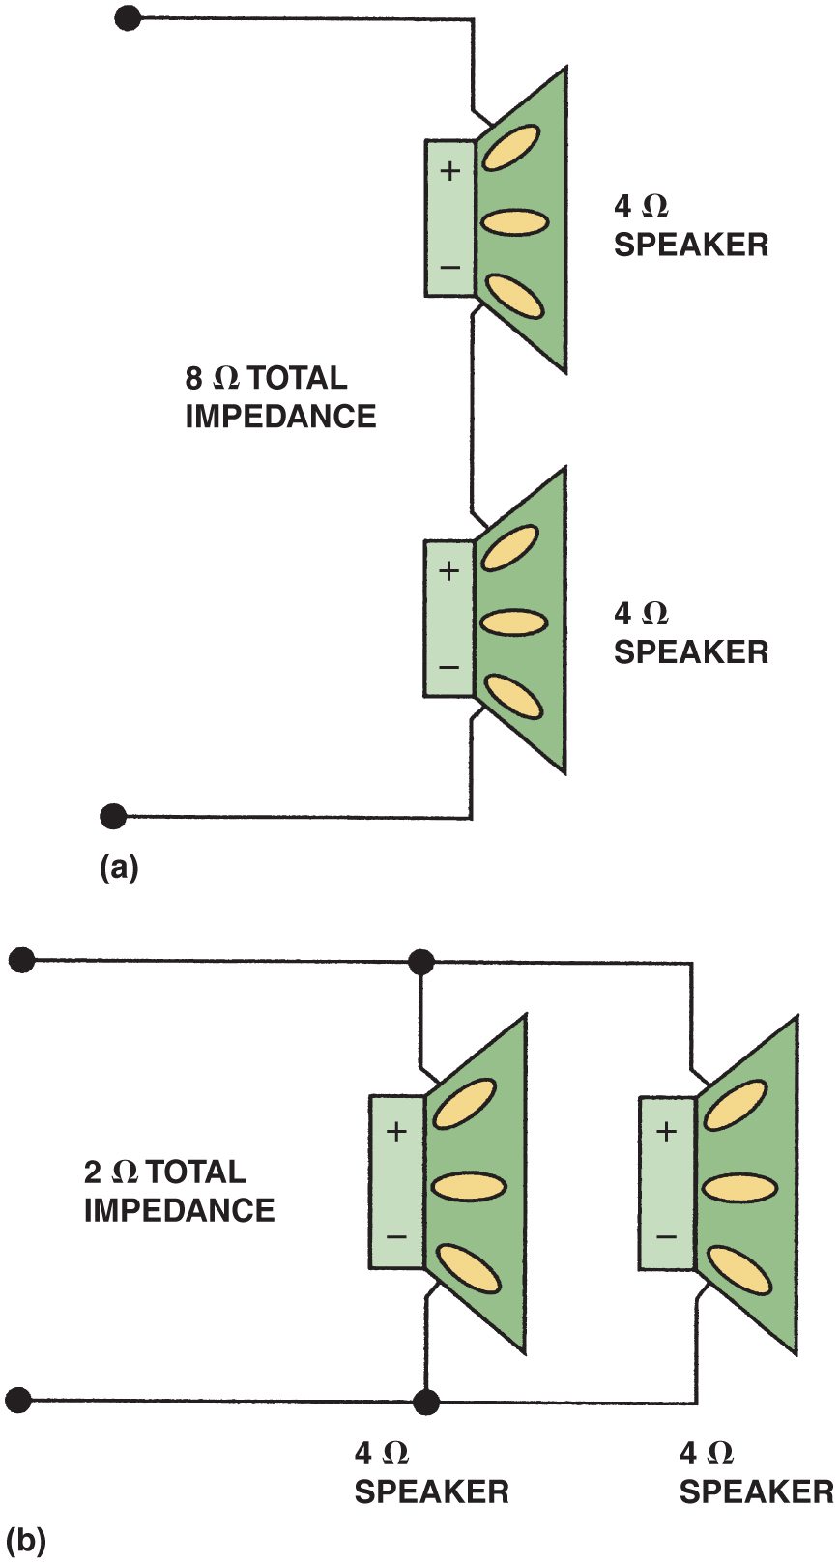
Figure 27.13 (a) Two 4-ohm speakers connected in series result in total impedance of 8 ohms

Slide 15
Figure 27.13 (b) Two 4-ohm speakers connected in parallel result in total impedance of 2 ohms

Slide 16
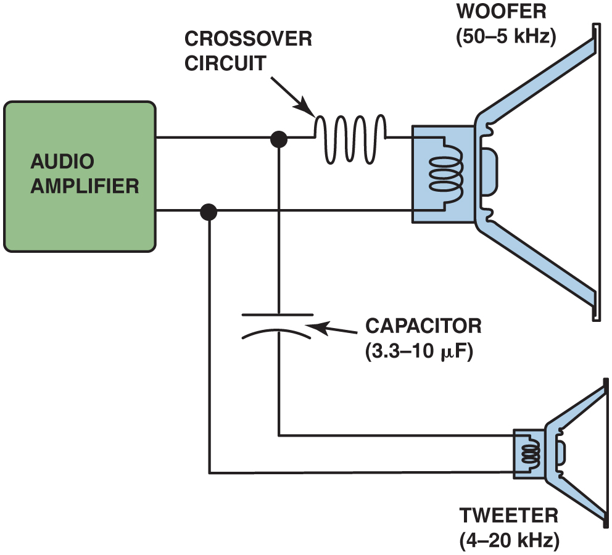
Figure 27.14 Crossovers are used in audio systems to send high-frequency sounds to the small (tweeter) speakers and low-frequency sounds to larger (woofer) speakers

Slide 17
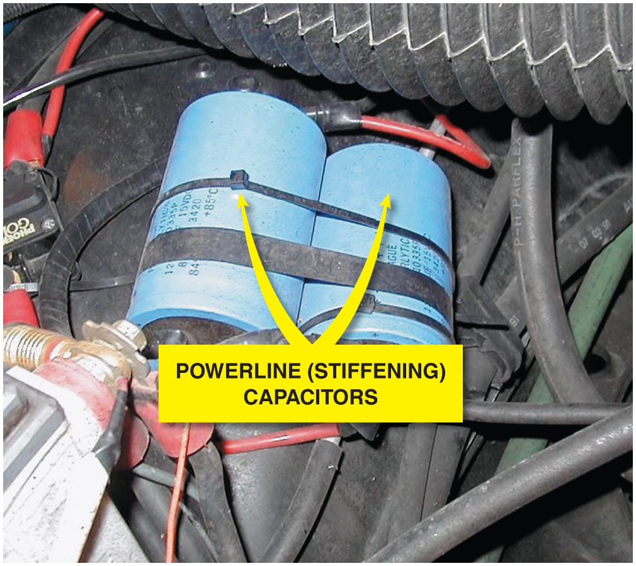
Figure 27.15 Two capacitors connected in parallel provide the necessary current flow to power large subwoofer speakers

Slide 18
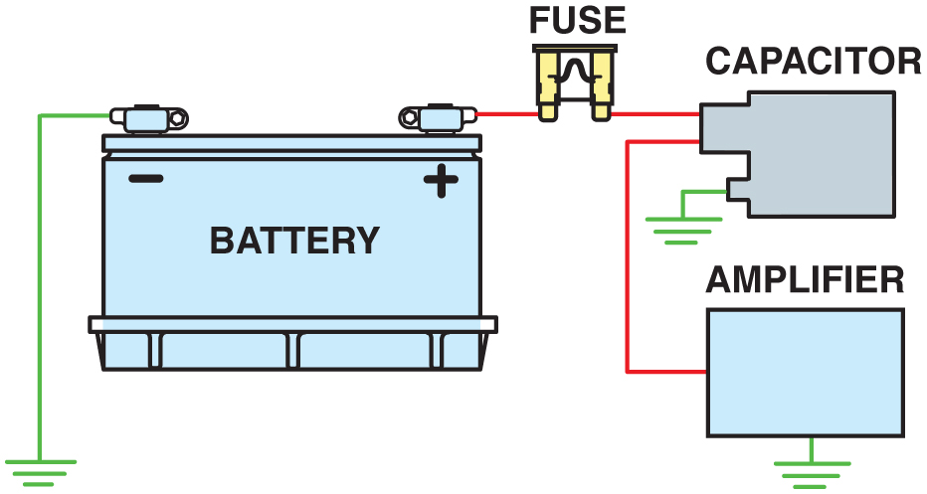
Figure 27.16 A powerline capacitor should be connected through the power wire to the amplifier as shown. When the amplifier requires more electrical power (watts) than the battery can supply, the capacitor will discharge into the amplifier and supply the necessary current for the fraction of a second it is needed by the amplifier. At other times when the capacitor is not needed, it draws current from the battery to keep it charged

Slide 19
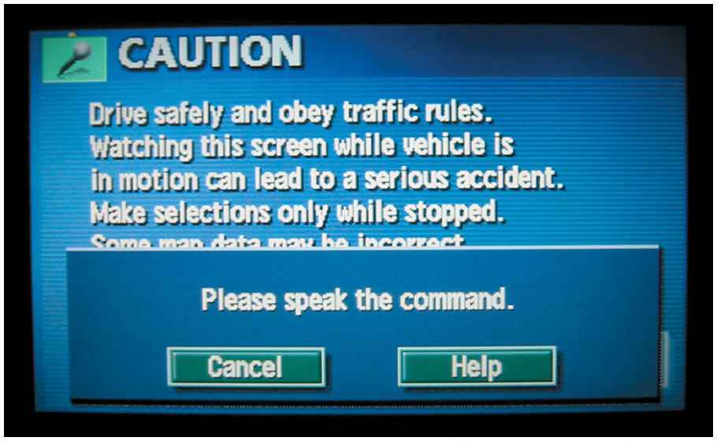
Figure 27.17 Voice commands can be used to control many functions, including navigation systems, climate control, telephone, and radio

Slide 20
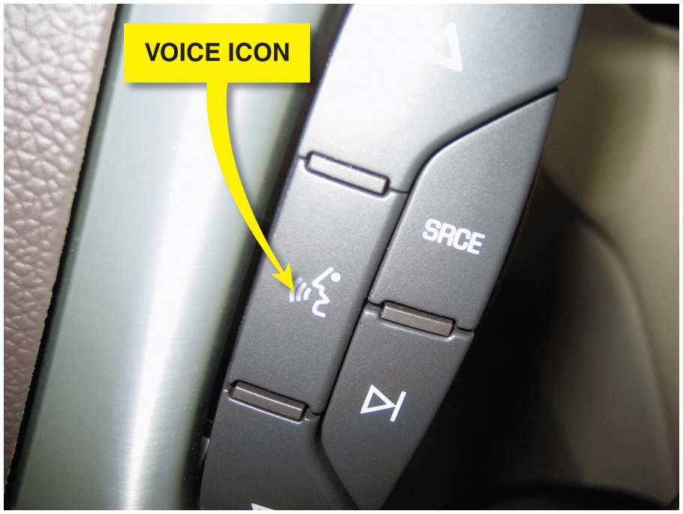
Figure 27.18 The voice command icon on the steering wheel of a Cadillac

Slide 21
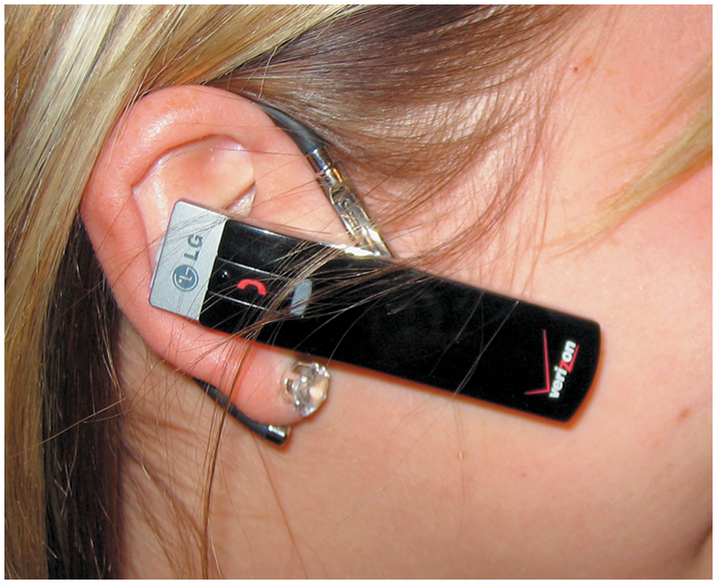
Figure 27.19 Bluetooth earpiece that contains a microphone and speaker unit that is paired to a cellular phone. The telephone has to be within 33 feet (10 m) of the earpiece

Slide 22
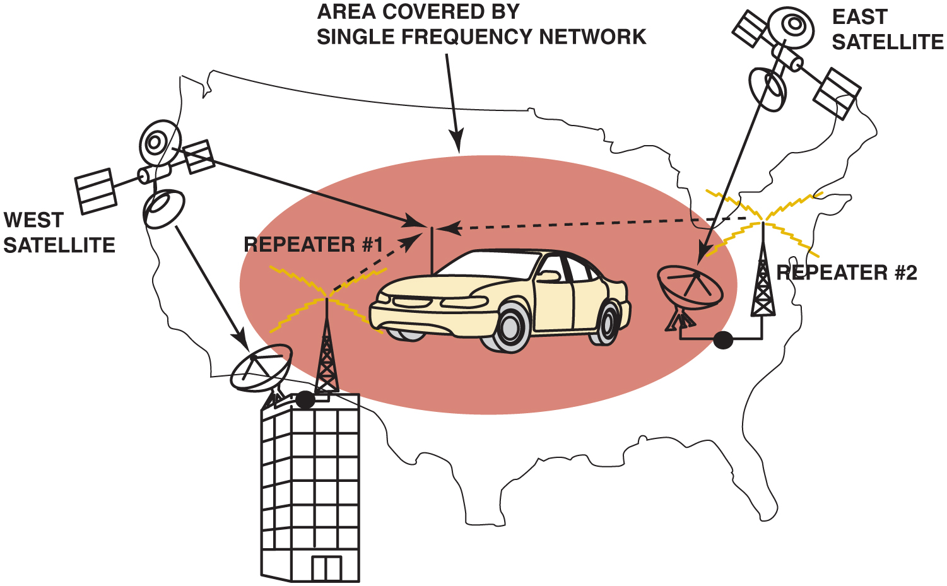
Figure 27.20 S D A R S uses satellites and repeater stations to broadcast radio

Slide 23
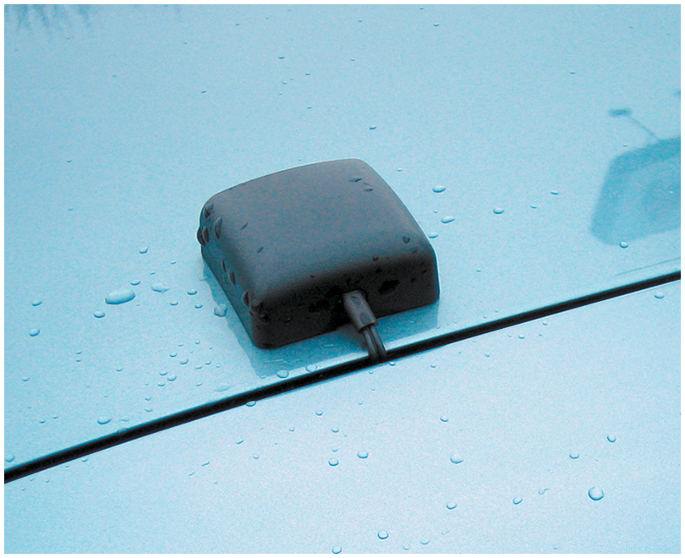
Figure 27.21 An aftermarket X M radio antenna mounted on the rear deck lid. The deck lid acts as the ground plane for the antenna

Slide 24
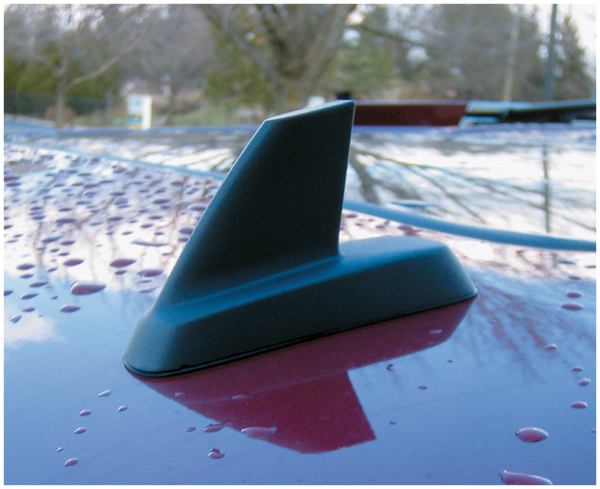
Figure 27.22 A shark-fin-type factory antenna used for both X M and OnStar

Slide 25
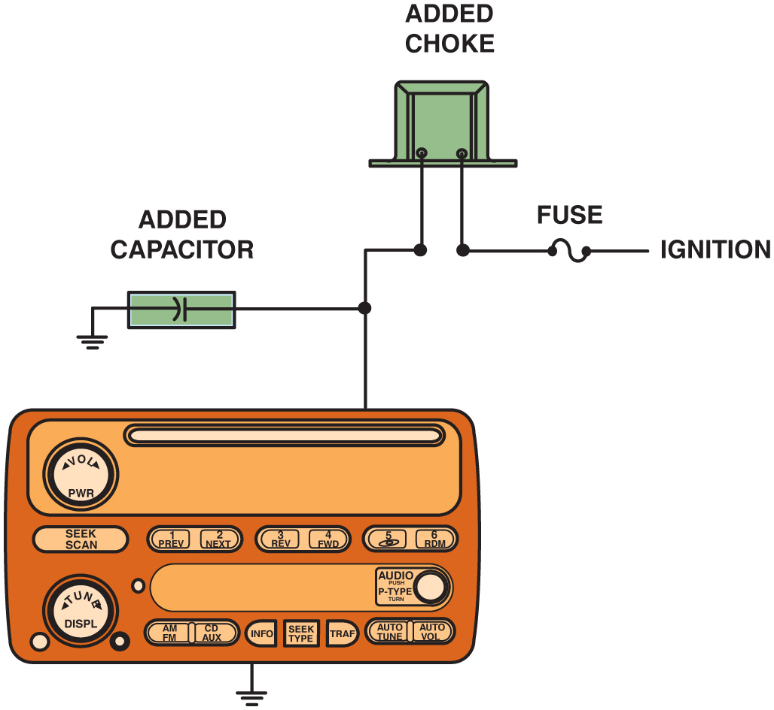
Figure 27.23 A radio choke and/or a capacitor can be installed in the power feed lead to any radio, amplifier, or equalizer

Slide 26
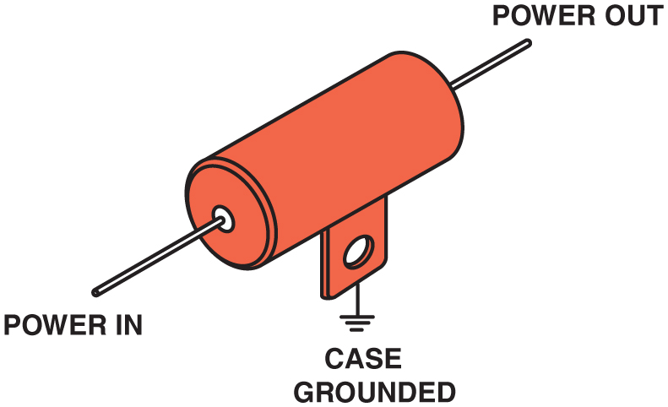
Figure 27.24 Many automobile manufacturers install a coaxial capacitor, like this one, in the power feed wire to the blower motor to eliminate interference caused by the blower motor

Slide 27
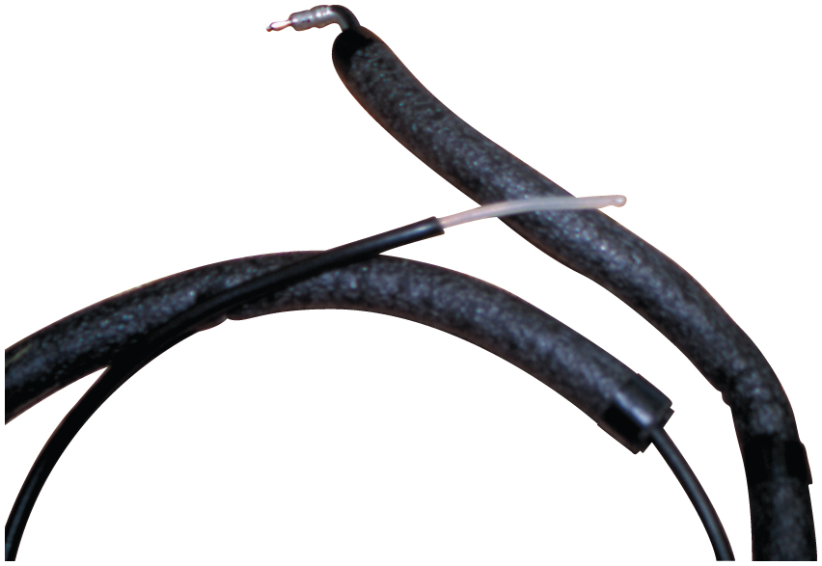
Figure 27.25 A “sniffer” can be made from an old antenna lead-in cable by removing about 3 inches of the outer shielding from the end. Plug the lead-in cable into the antenna input of the radio and tune the radio to a weak station. Move the end of the antenna wire around the vehicle dash area. The sniffer is used to locate components that may not be properly shielded or grounded and can cause radio interference through the case (housing) of the radio itself

Slide 28
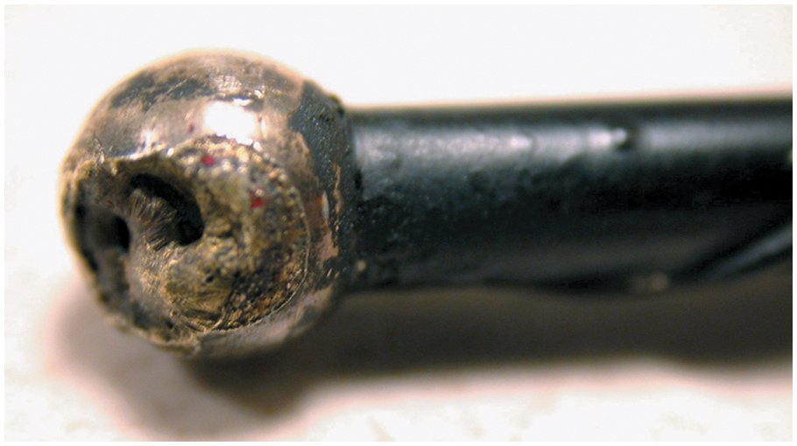
Figure 27.26 The tip of this antenna was struck by lightning

Slide 29
Copyright

