Slide 1
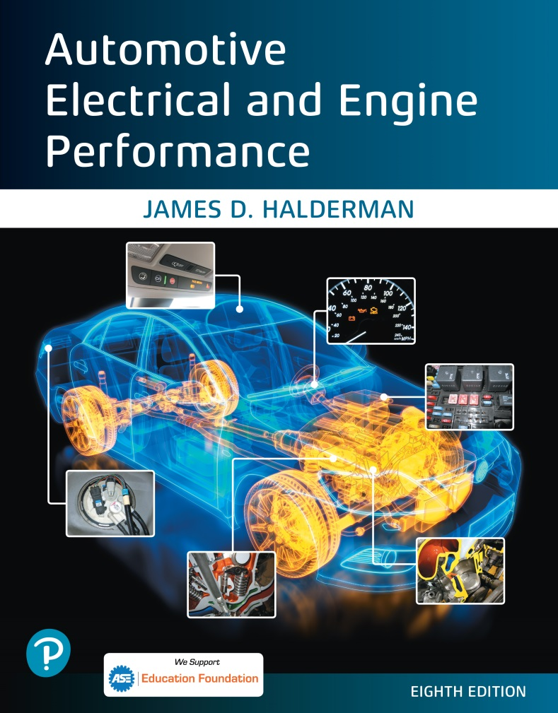
Automotive Electrical and Engine Performance
Eighth Edition
Chapter 26
Driver Information and Navigation Systems
Copyright © 2020, 2016 Pearson Education, Inc. All Rights Reserved

Slide 2
Figure 26.1 (a) Safety belts are the primary restraint system

Slide 3
Figure 26.1 (b) During a collision, the stretching of the safety belt slows the impact to help reduce bodily injury

Slide 4
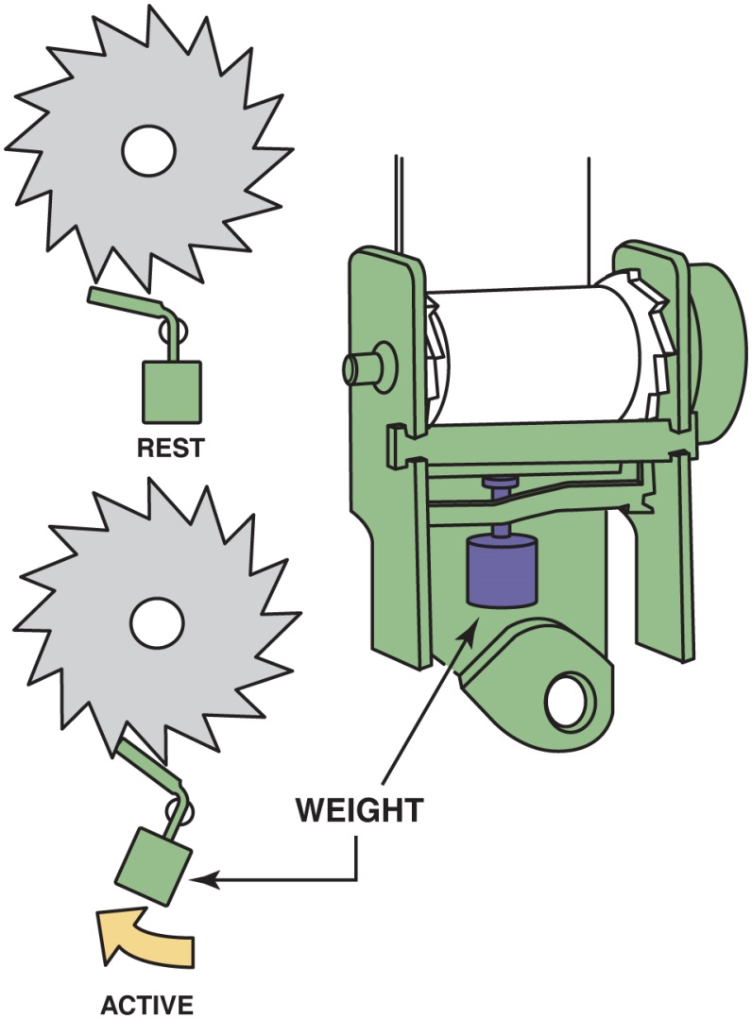
Figure 26.2 Most safety belts have an inertia-type mechanism that locks the belt in the event of rapid movement

Slide 5
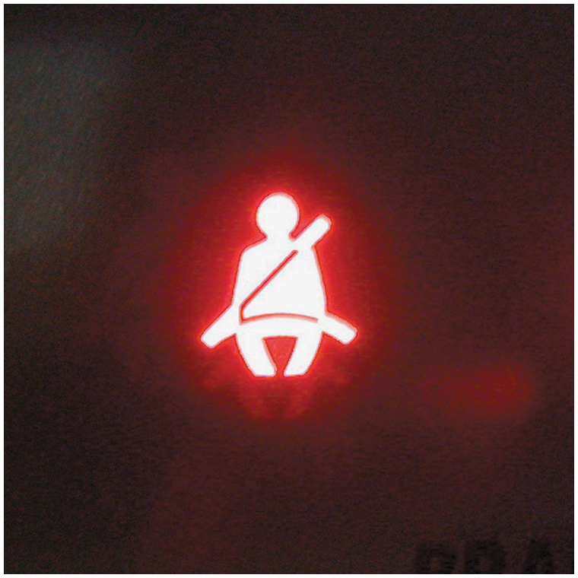
Figure 26.3 A typical safety belt warning light

Slide 6
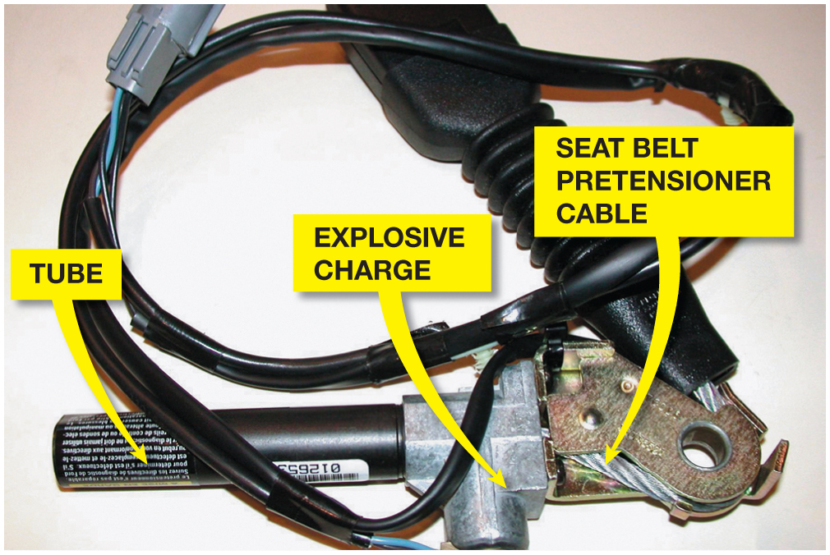
Figure 26.4 A small explosive charge in the pretensioner forces the end of the seat belt down the tube, which removes any slack in the seat belt

Slide 7
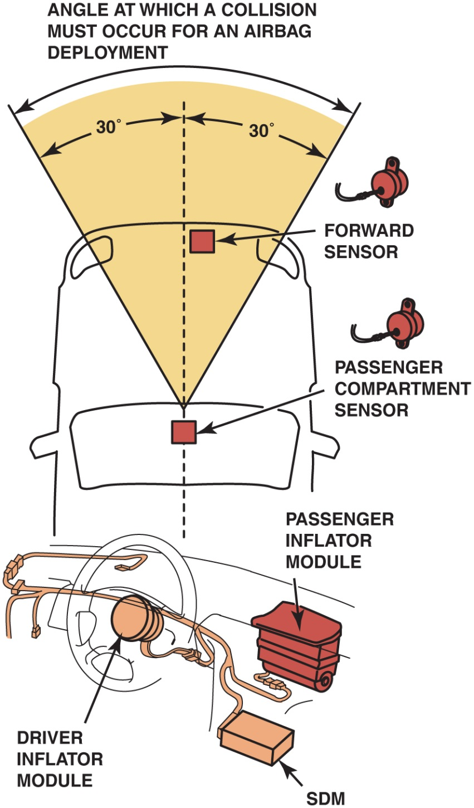
Figure 26.5 A typical airbag system showing many of the components. The S D M is the “sensing and diagnostic module” and includes the arming sensor as well as the electronics that keep checking the circuits for continuity and the capacitors that are discharged to deploy the airbags

Slide 8
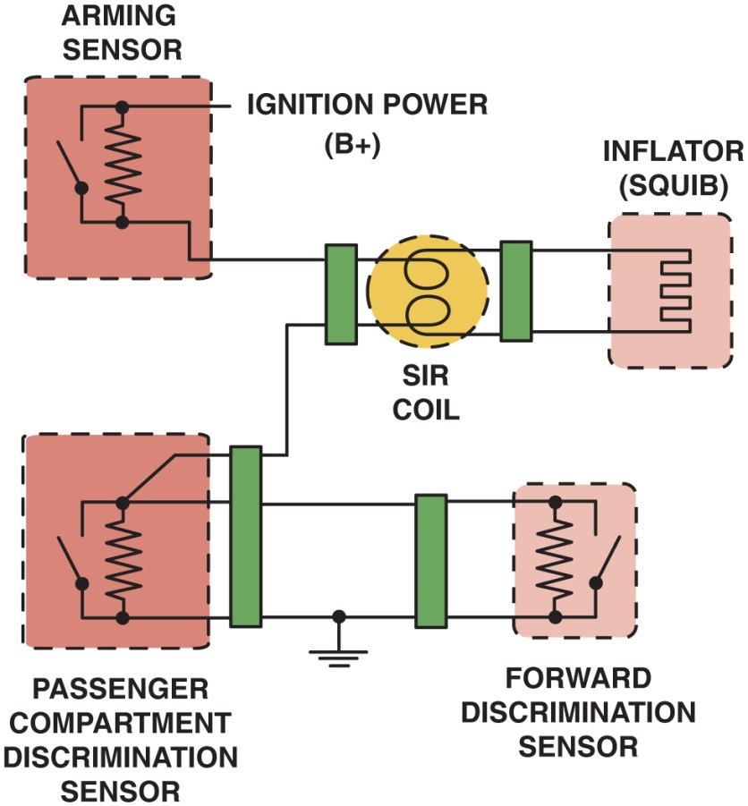
Figure 26.6 A simplified airbag deployment circuit. Note that both the arming sensor and at least one of the discriminating sensors must be activated at the same time. The arming sensor provides the power, and either one of the discriminating sensors can provide the ground for the circuit

Slide 9
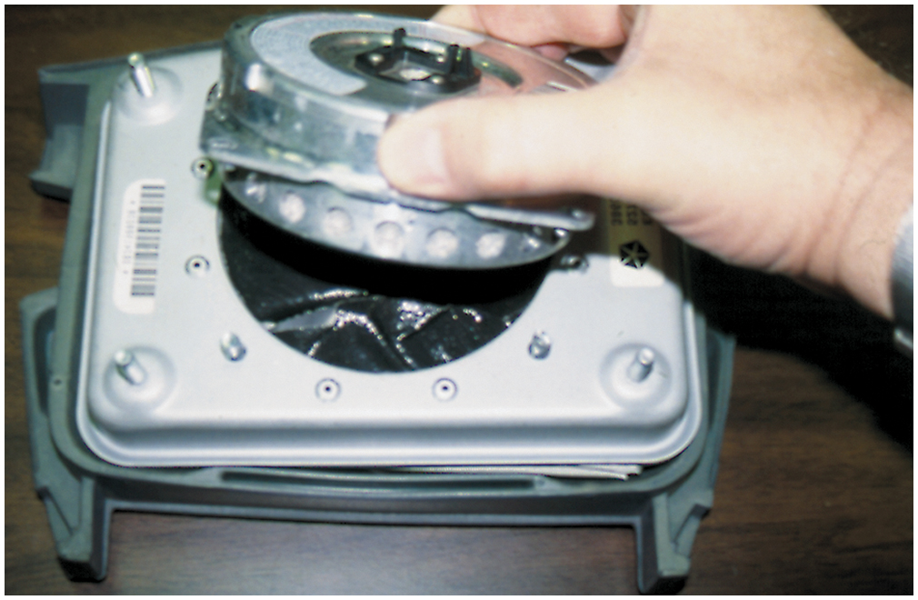
Figure 26.7 The inflator module is being removed from the airbag housing. The squib, inside the inflator module, is the heating element that ignites the pyrotechnic gas generator that rapidly produces nitrogen gas to fill the airbag

Slide 10
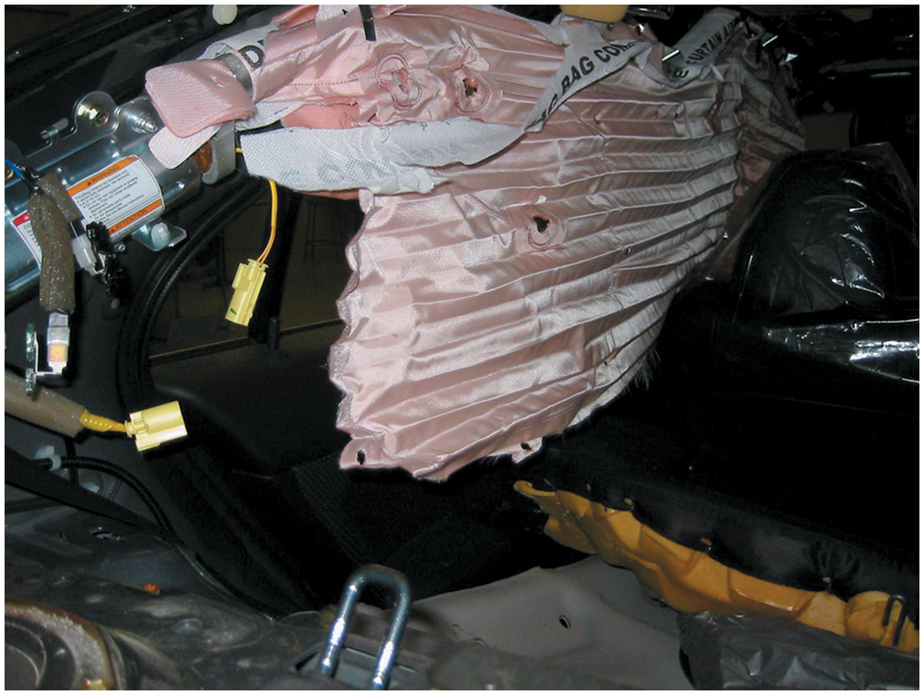
Figure 26.8 This figure shows a deployed side curtain airbag on a training vehicle

Slide 11
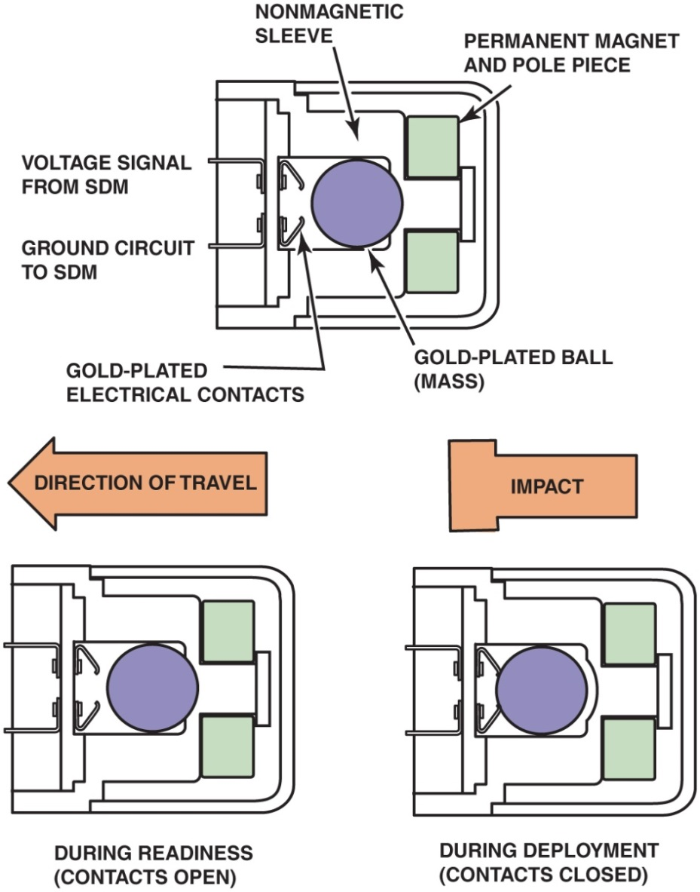
Figure 26.9 An airbag magnetic sensor

Slide 12
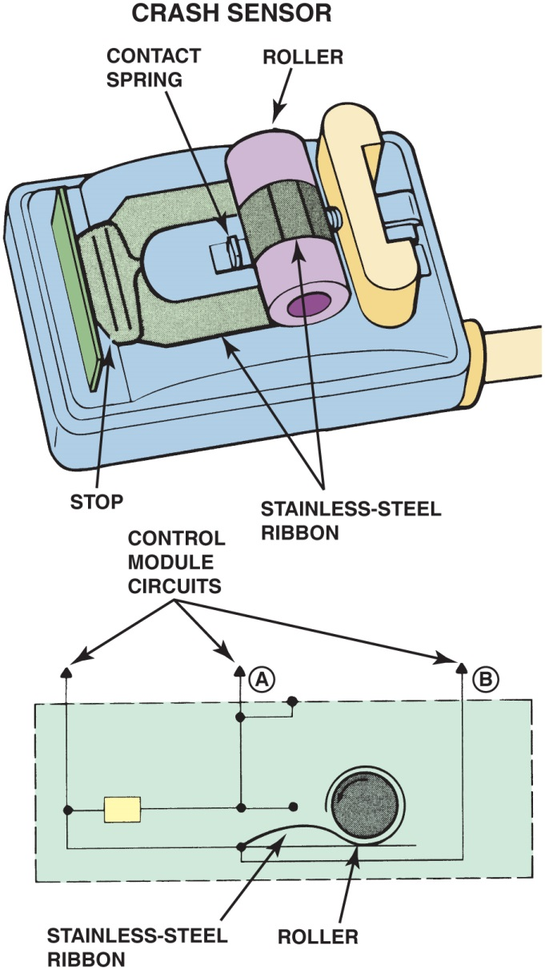
Figure 26.10 Some vehicles use a ribbon-type crash sensor

Slide 13
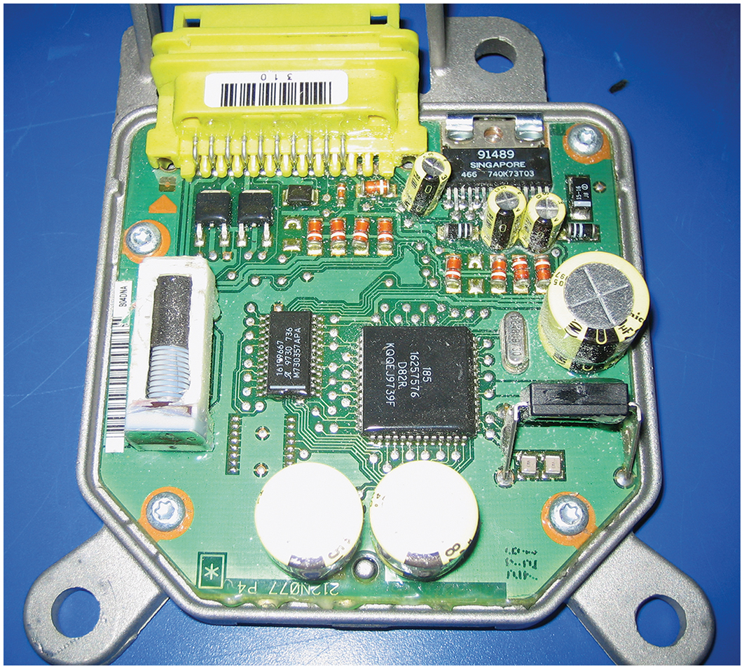
Figure 26.11 A sensing and diagnostic module that includes an accelerometer

Slide 14
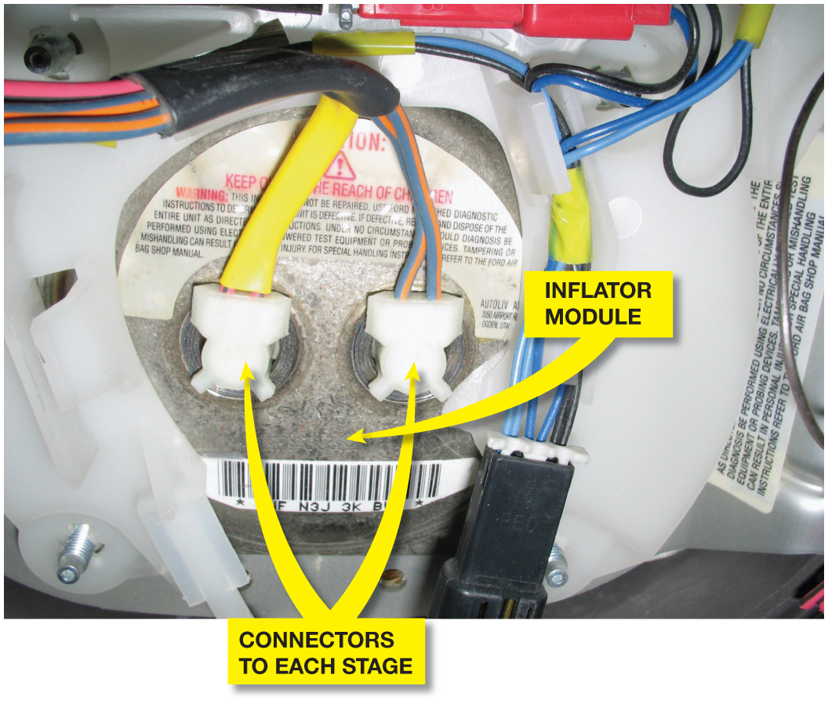
Figure 26.12 A driver’s side airbag showing two inflator connectors. One is for the lower force inflator and the other is for the higher force inflator. Either can be ignited or both at the same time if the deceleration sensor detects a severe impact

Slide 15
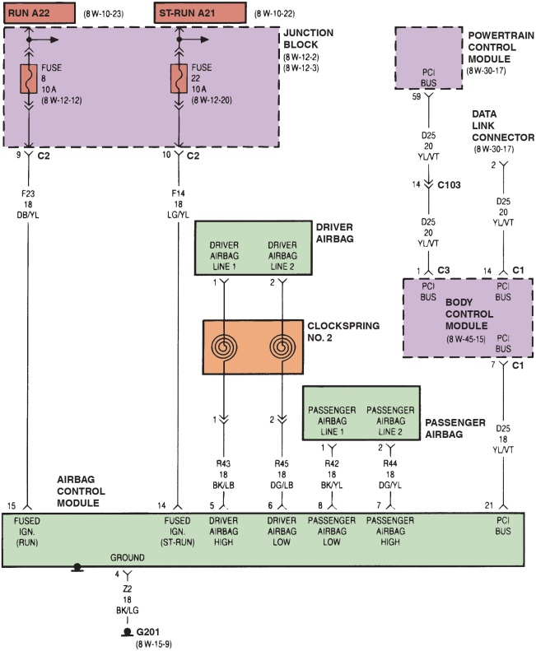
Figure 26.13 The airbag control module is linked to the powertrain control module (P C M) and the body control module (B C M) on this Chrysler system. Notice the airbag wire connecting the module to the airbag through the clockspring. Both power, labeled “driver airbag high,” and ground, labeled “driver airbag low,” are conducted through the clockspring

Slide 16
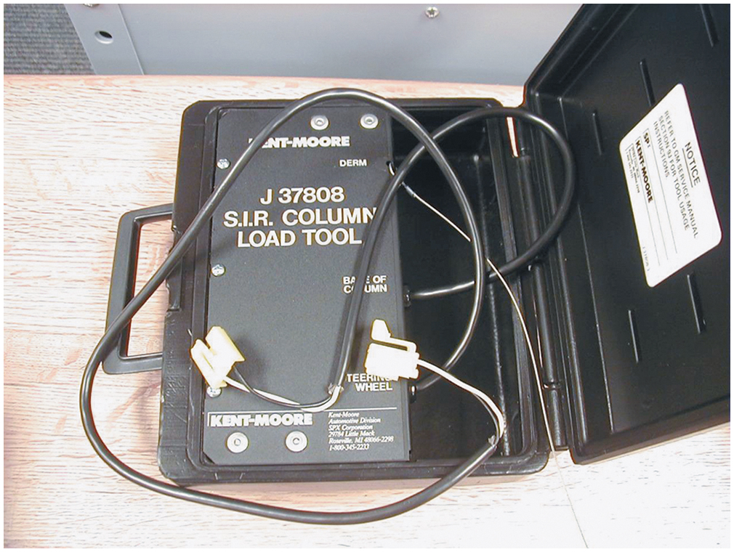
Figure 26.14 An airbag diagnostic tester. Included in the plastic box are electrical connectors and a load tool that substitutes for the inflator module during troubleshooting

Slide 17
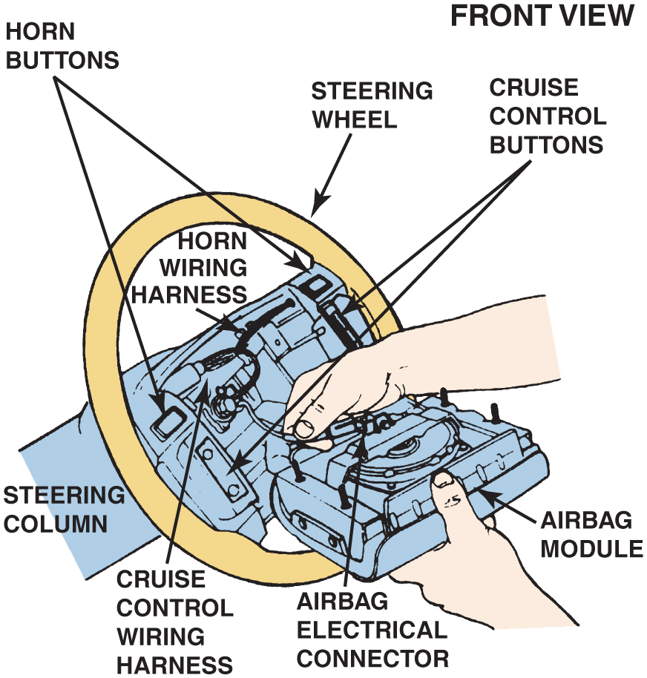
Figure 26.15 After disconnecting the battery and the yellow connector at the base of the steering column, the airbag inflator module can be removed from the steering wheel and the yellow airbag electrical connector at the inflator module can be disconnected

Slide 18
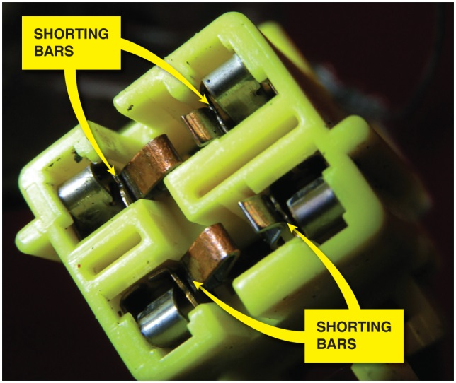
Figure 26.16 Shorting bars are used in most airbag connectors. These spring-loaded clips short across both terminals of an airbag connector when it is disconnected to help prevent accidental deployment of the airbag. If electrical power was applied to the terminals, the shorting bars would simply provide a low-resistance path to the other terminal and not allow current to flow past the connector. The mating part of the connector has a tapered piece that spreads apart the shorting bars when the connector is reconnected

Slide 19
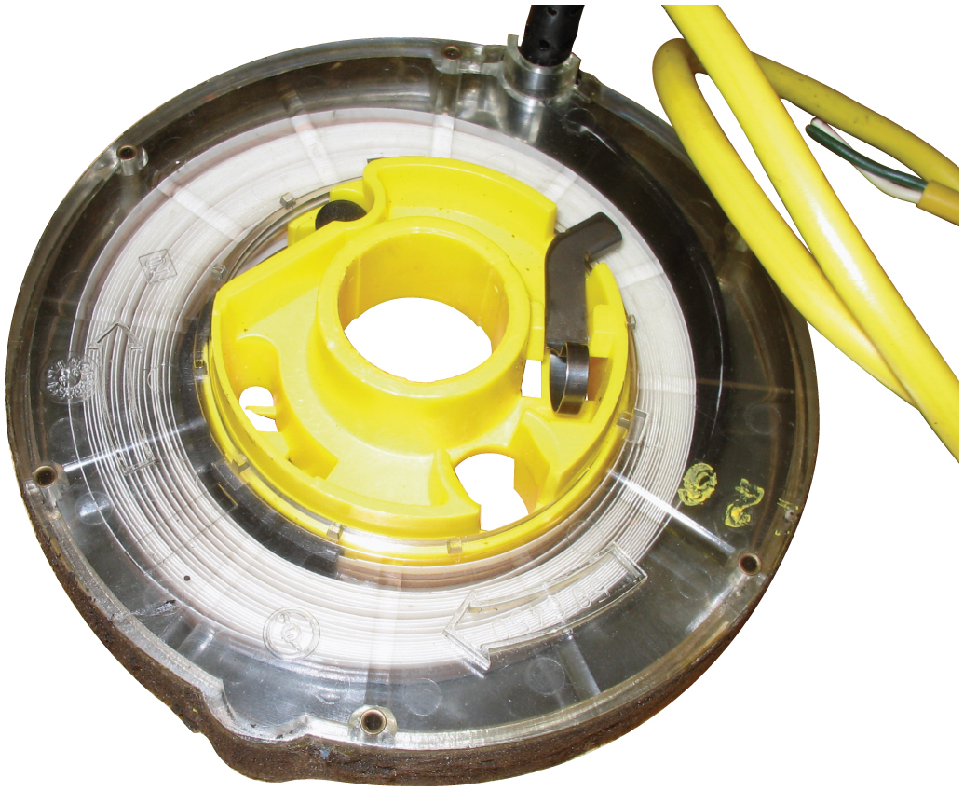
Figure 26.17 An airbag clockspring showing the flat conductor wire. It must be properly positioned to ensure proper operation

Slide 20
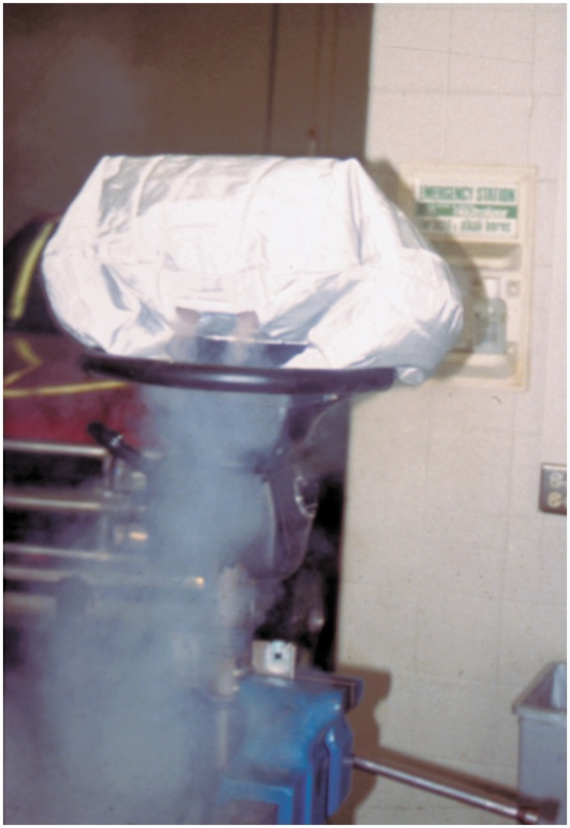
Figure 26.18 An airbag being deployed as part of a demonstration in an automotive laboratory. Notice that the airbag quickly deflates due to the large vent openings in the backside of the bag

Slide 21
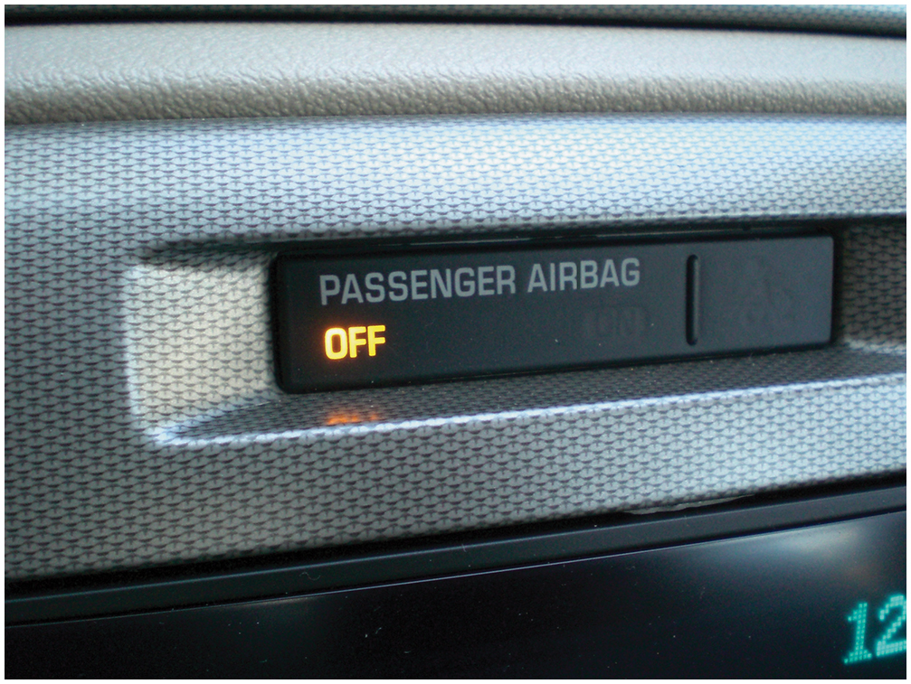
Figure 26.19 A dash warning lamp will light if the passenger side airbag is off because no passenger was detected by the seat sensor

Slide 22
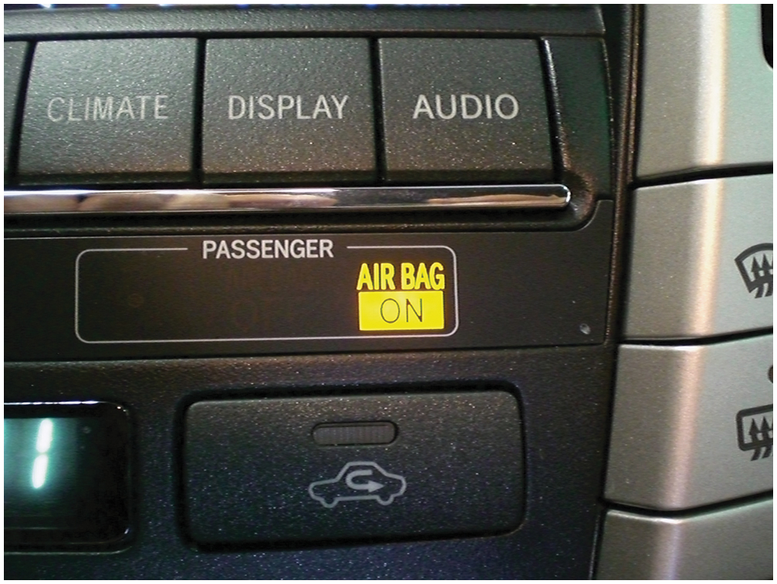
Figure 26.20 The passenger side airbag “on” lamp will light if a passenger is detected on the passenger seat

Slide 23
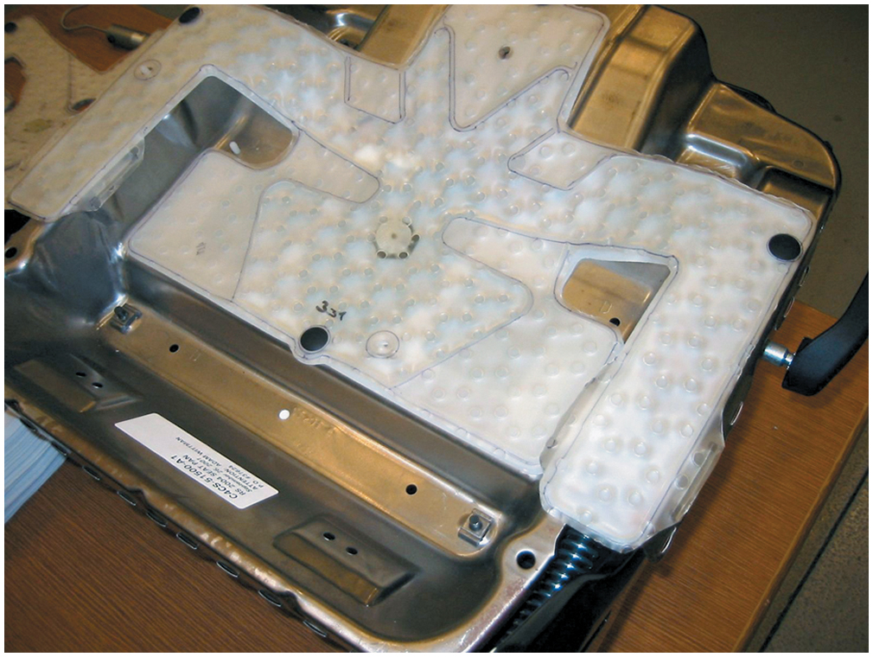
Figure 26.21 A gel-filled (bladder-type) occupant detection sensor showing the pressure sensor and wiring

Slide 24
Figure 26.22 A resistor-type occupant detection sensor. The weight of the passenger strains these resistors, which are attached to the seat, thereby signaling to the module the weight of the occupant

Slide 25
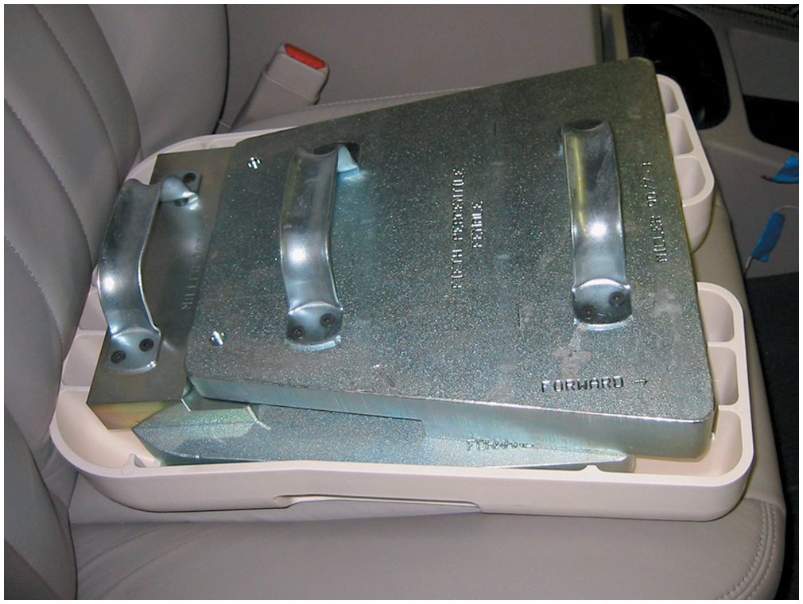
Figure 26.23 A test weight is used to calibrate the occupant detection system on a Chrysler vehicle

Slide 26
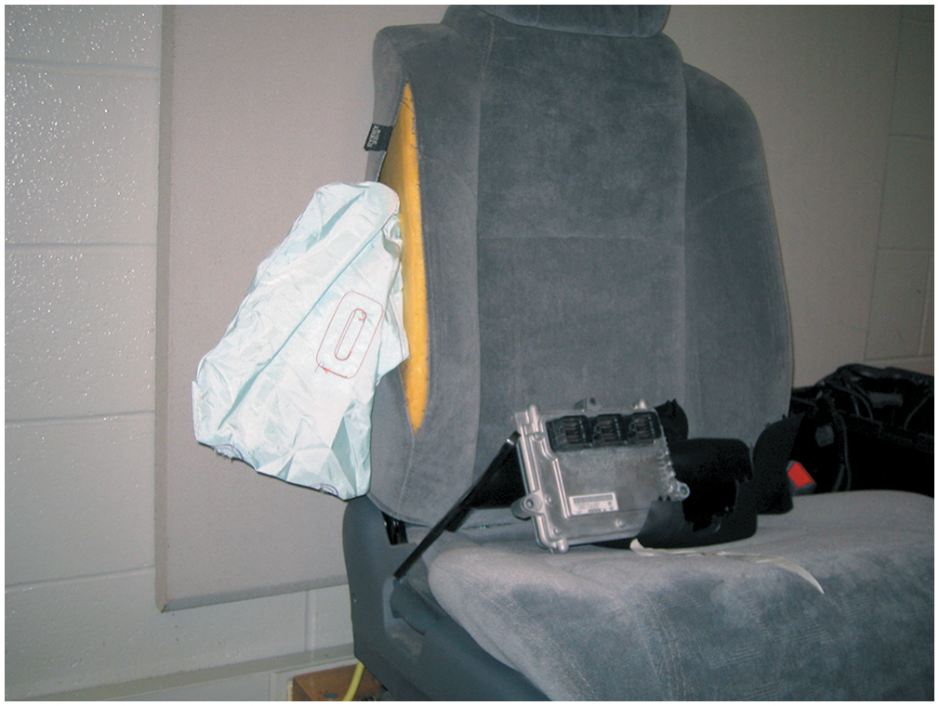
Figure 26.24 A typical seat (side) airbag that deploys from the side of the seat

Slide 27
Copyright

