Slide 1
Automotive Electrical and Engine Performance
Eighth Edition
Chapter 25
Immobilizer Systems
Copyright © 2020, 2016 Pearson Education, Inc. All Rights Reserved

Slide 2
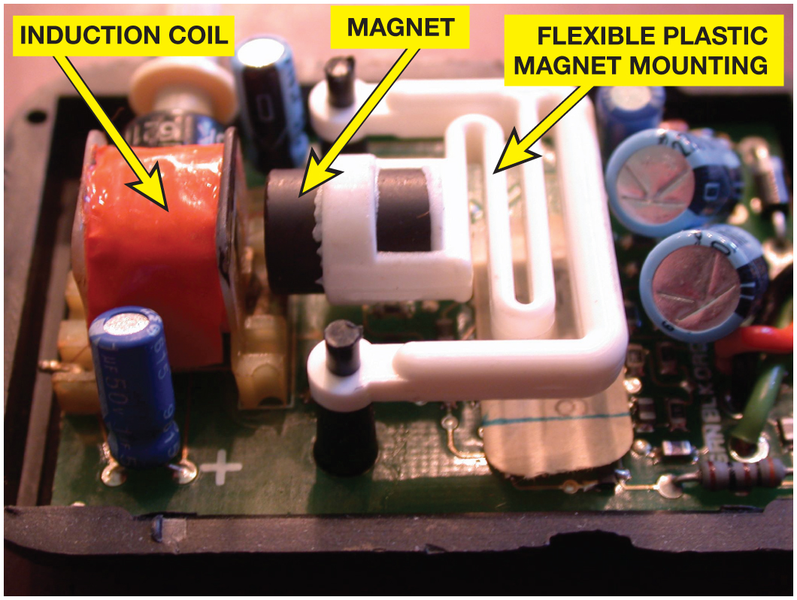
Figure 25.1 A shock sensor used in alarm and antitheft systems. If the vehicle is moved, the magnet will move relative to the coil, inducing a small voltage that will trigger the alarm

Slide 3
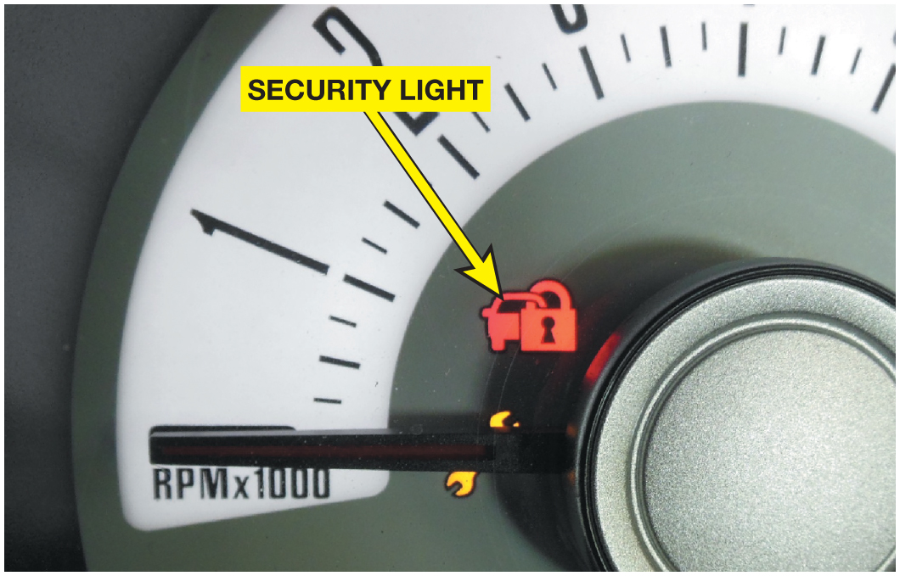
Figure 25.2 The security system symbol used on a Ford. The symbol varies by make, model, and year; so check service information to determine what symbol is used on the vehicle being diagnosed

Slide 4
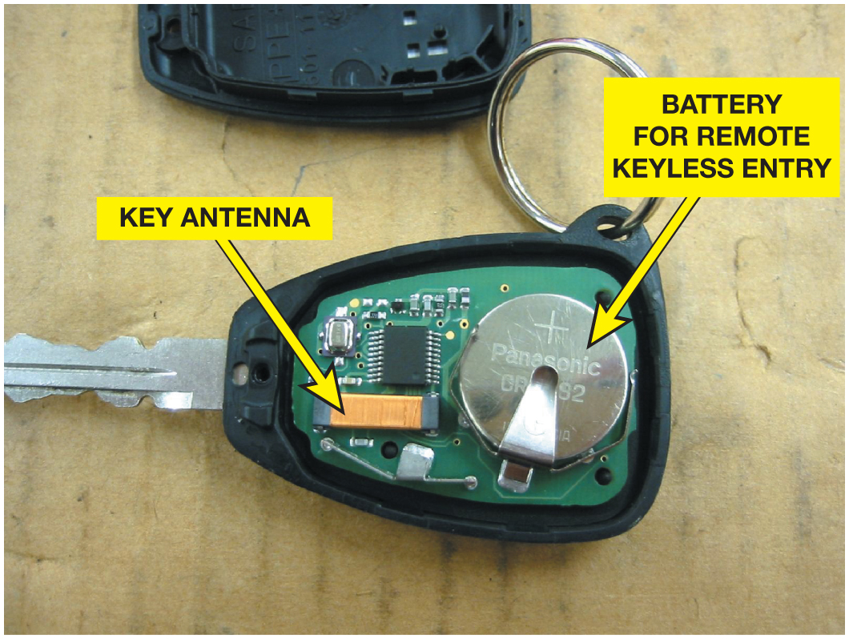
Figure 25.3 A typical key with the cover removed showing the battery used to power the door lock and the antenna used for the immobilizer system

Slide 5
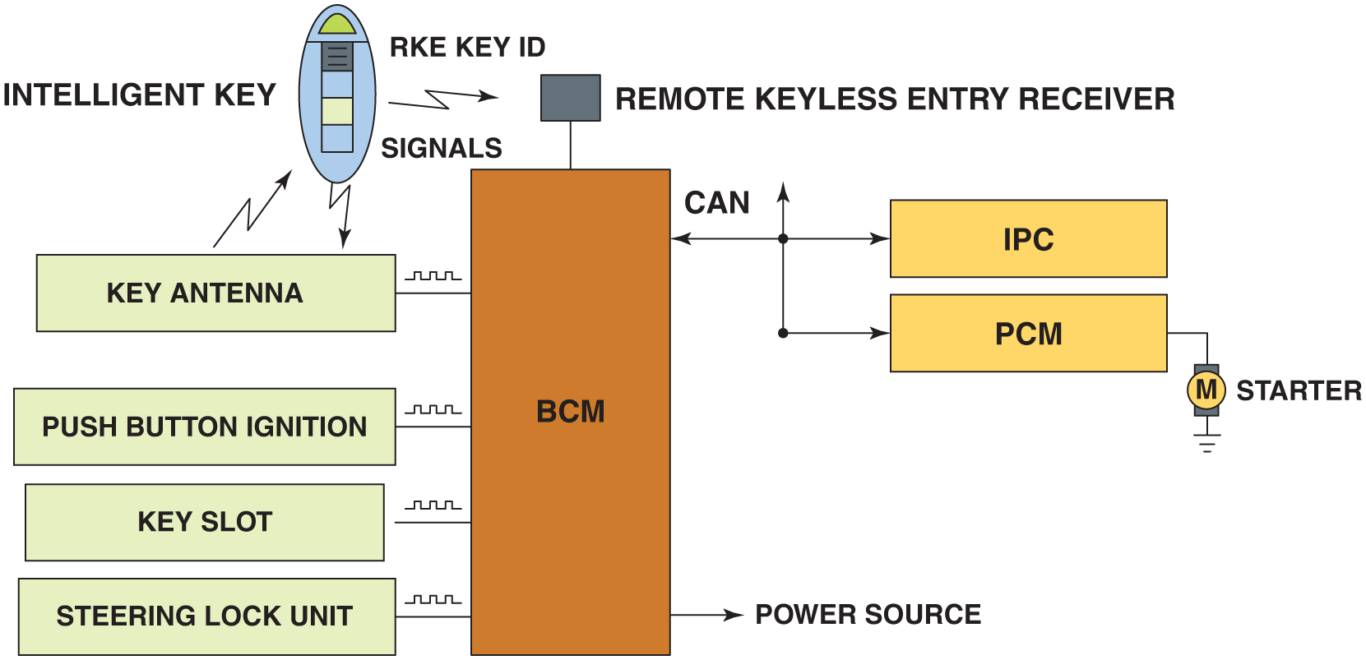
Figure 25.4 The remote keyless entry is used to unlock the doors, as well as create the signals to the powertrain control module (P C M) used to control the starter motor and/ or the fuel system and the warning lamp on the instrument panel cluster (I P C)

Slide 6
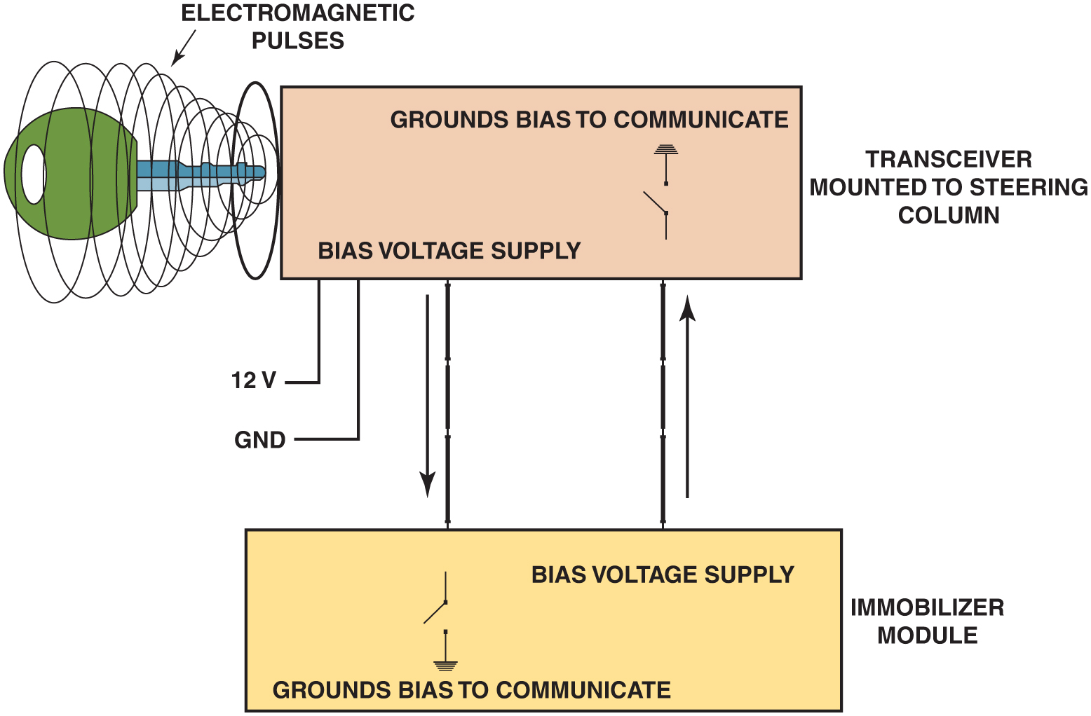
Figure 25.5 A typical immobilizer circuit showing the communication between the key and the transceiver. The transceiver then communicates with the immobilizer module over data lines

Slide 7
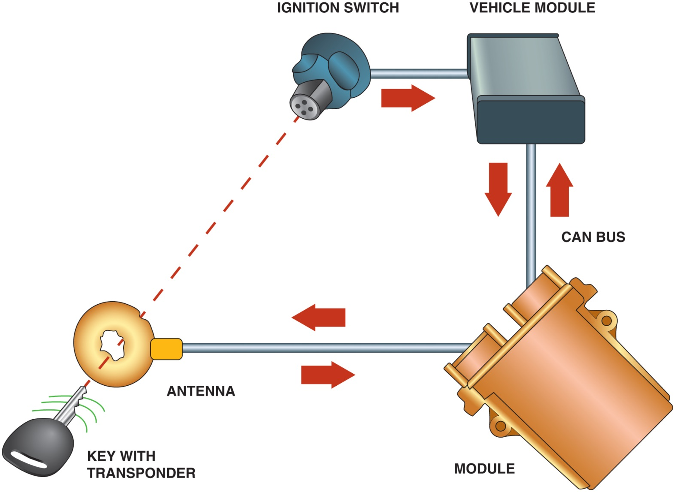
Figure 25.6 The communication between the components and modules of the security system use a combination of hard wired and data bus messages

Slide 8
Figure 25.7 (a) Avoid using a key where the key ring is over the top of the key, which can interfere with the operation of the immobilizer system. (b) Do not angle another key upward from the key being used to help prevent interference with the magnetic field used to energize the key. (c) Do not have the keys from another vehicle near the key being used

Slide 9
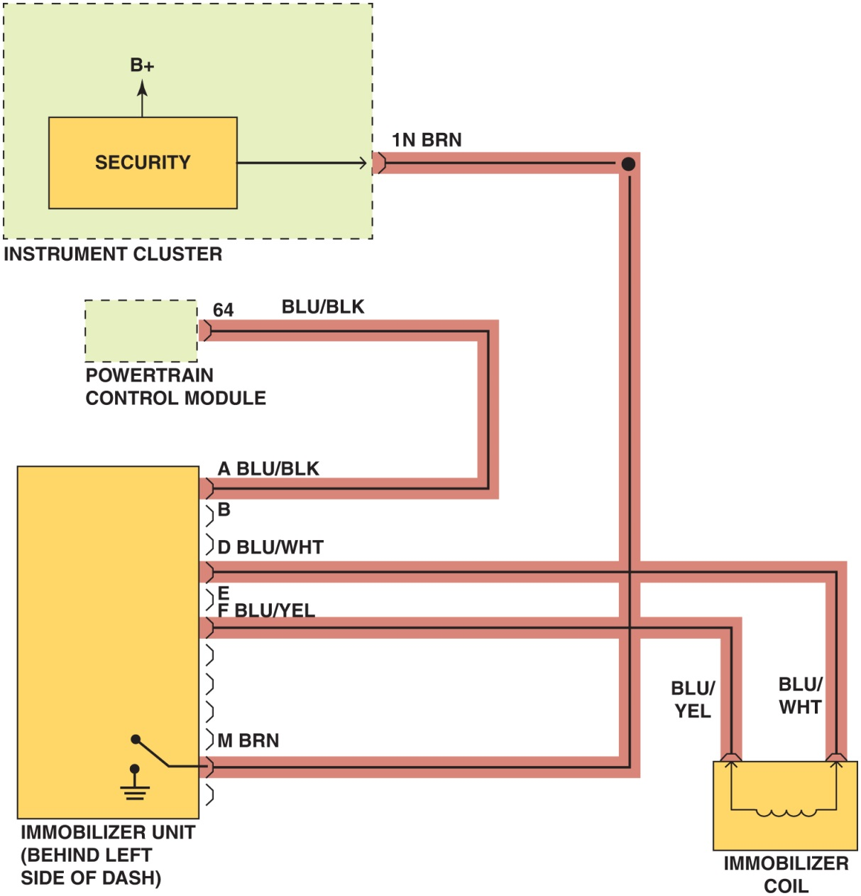
Figure 25.8 Check service information for the exact wiring diagram (schematic) for the vehicle being tested. Highlighting the wires and noting their color will help when following the specified testing procedures

Slide 10
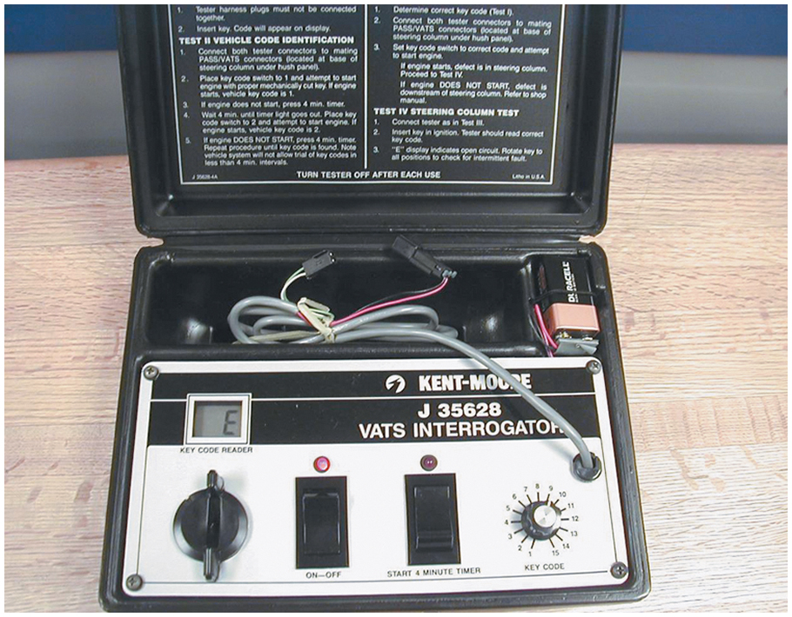
Figure 25.9 A special tool is needed to diagnose a General Motors V A T S security system and special keys that contain a resistor pellet

Slide 11
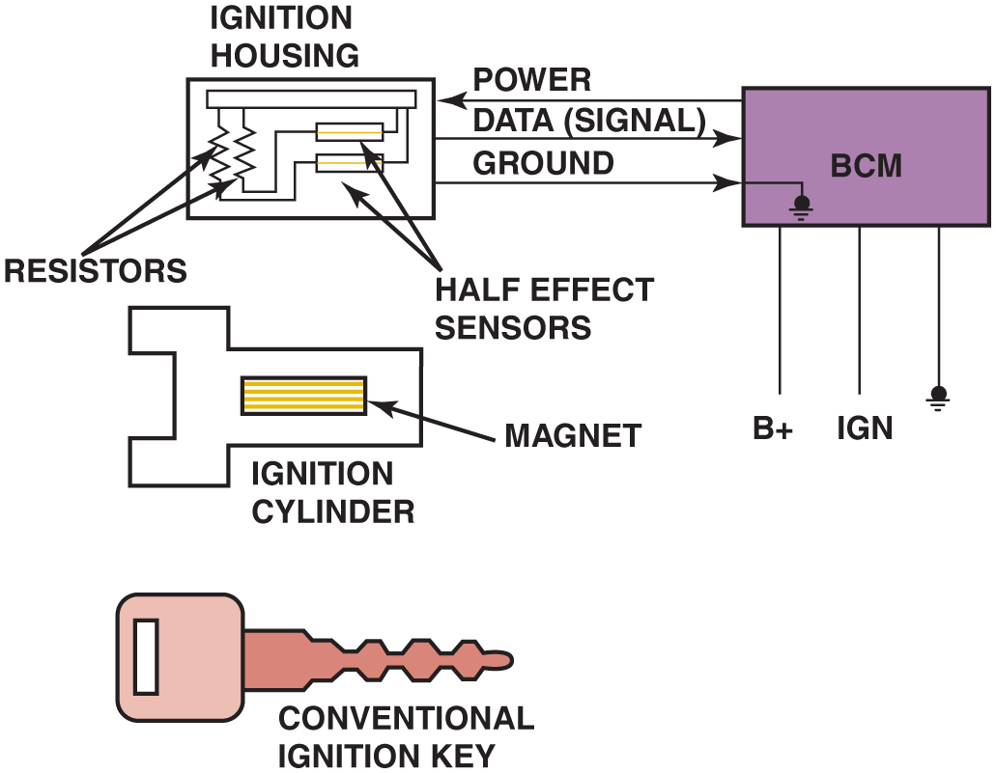
Figure 25.10 The Passlock series of General Motors security systems uses a conventional key. The magnet is located in the ignition lock cylinder and triggers the Hall-effect sensors

Slide 12
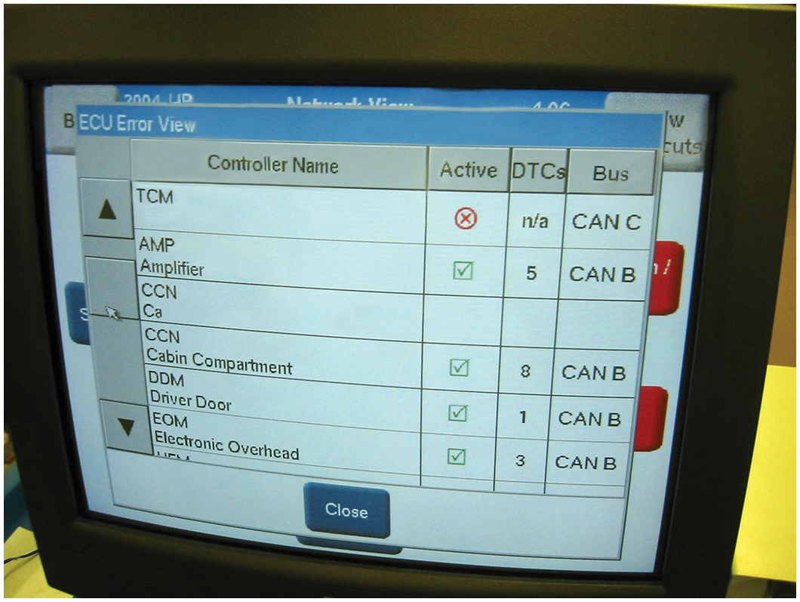
Figure 25.11 Scan tools, such as this factory tool being used on a B M W, are capable of many diagnostic functions that can help the technician zero in on the root cause of a problem

Slide 13
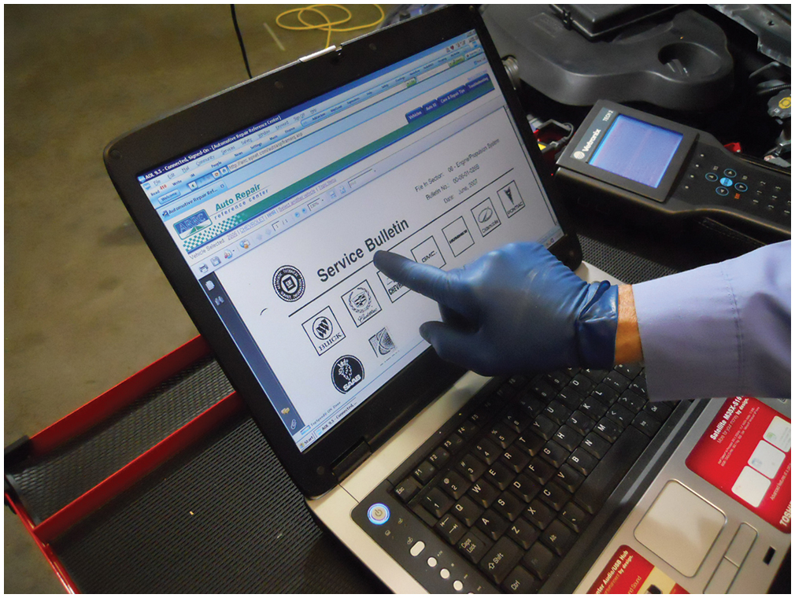
Figure 25.12 After checking for stored diagnostic trouble codes (D T C s), the wise technician checks service information for any technical service bulletins (T S B s) that may relate to the vehicle being serviced

Slide 14
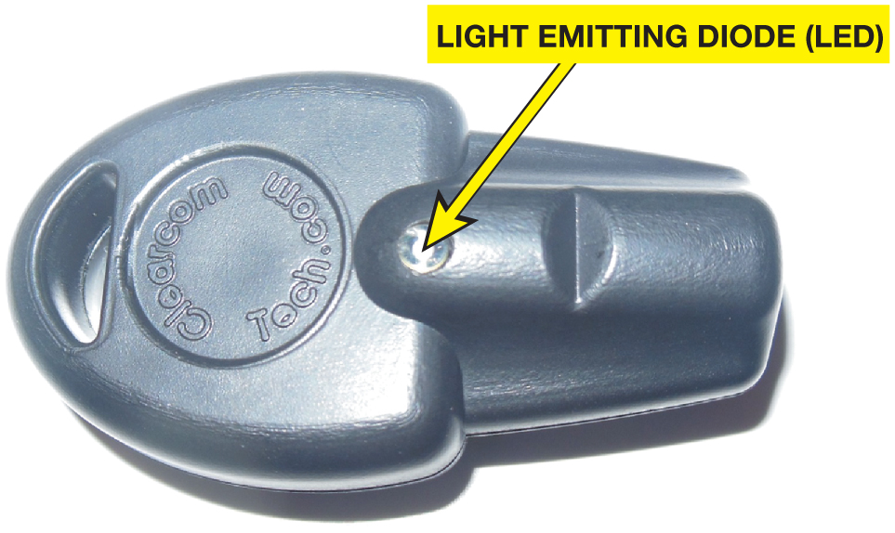
Figure 25.13 Immobilizer coil detectors can be found on line by searching for immobilizer transponder coil detector

Slide 15
Copyright

