Slide 1
Automotive Electrical and Engine Performance
Eighth Edition
Chapter 22
Driver Information and Navigation Systems
Copyright © 2020, 2016 Pearson Education, Inc. All Rights Reserved

Slide 2
Figure 22.1 Green and blue symbols are used to inform the driver what is in operation

Slide 3
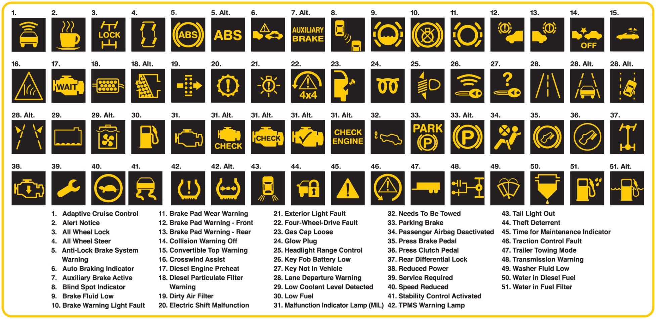
Figure 22.2 Amber warning symbols inform the driver of a potential concern

Slide 4
Figure 22.3 Red dash symbols are used to warn the driver of a fault requiring immediate action

Slide 5
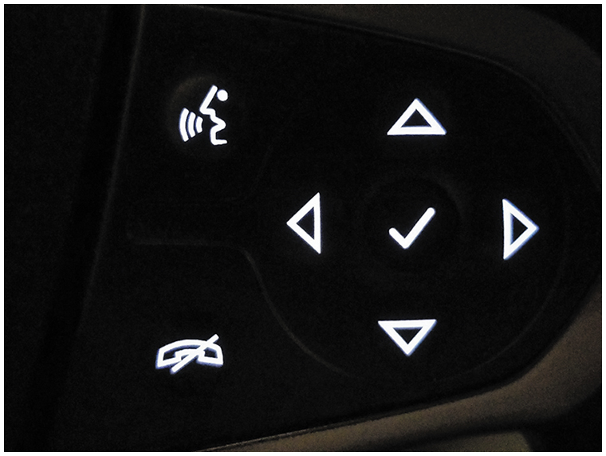
Figure 22.4 Steering wheel controls allow the driver to select a function while keeping their hands on the wheel and their eyes on the road

Slide 6
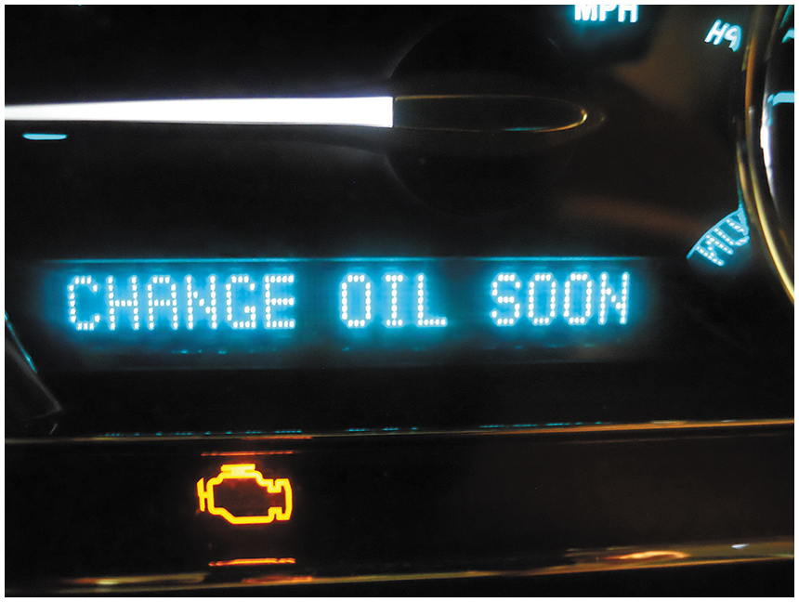
Figure 22.5 Maintenance reminders are often messages displayed on the instrument panel informing the driver of needed service, such as the need to change the engine oil

Slide 7
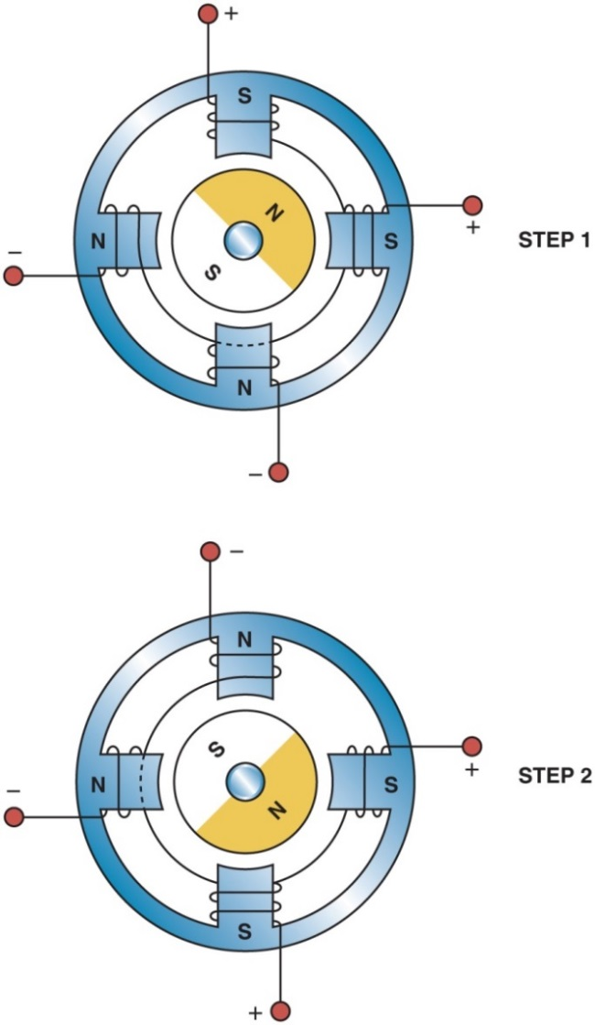
Figure 22.6 Most stepper motors use four wires which are pulsed by the computer to rotate the armature in steps

Slide 8
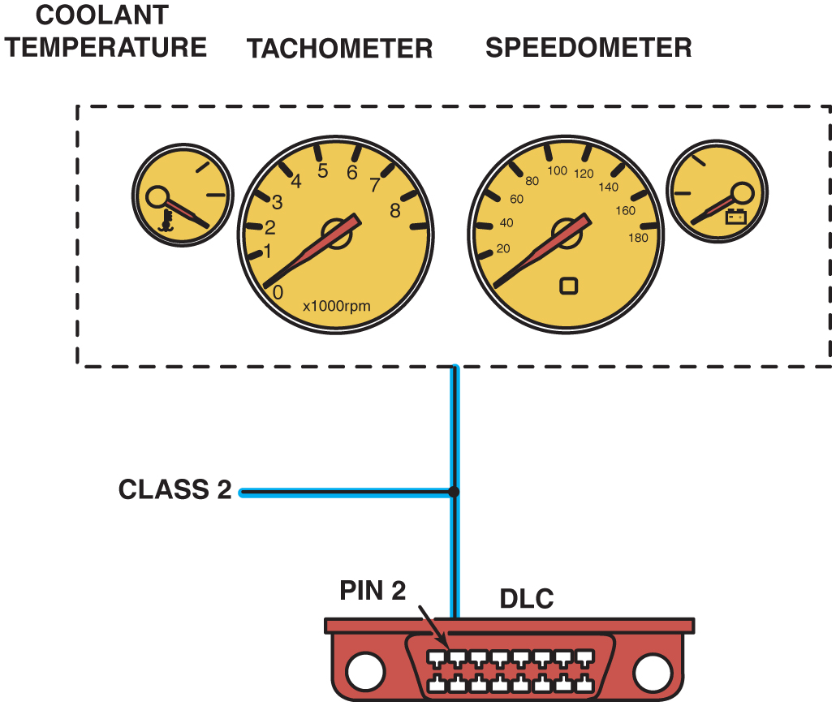
Figure 22.7 A typical instrument display uses data from the sensors over serial data lines to the individual gauges

Slide 9
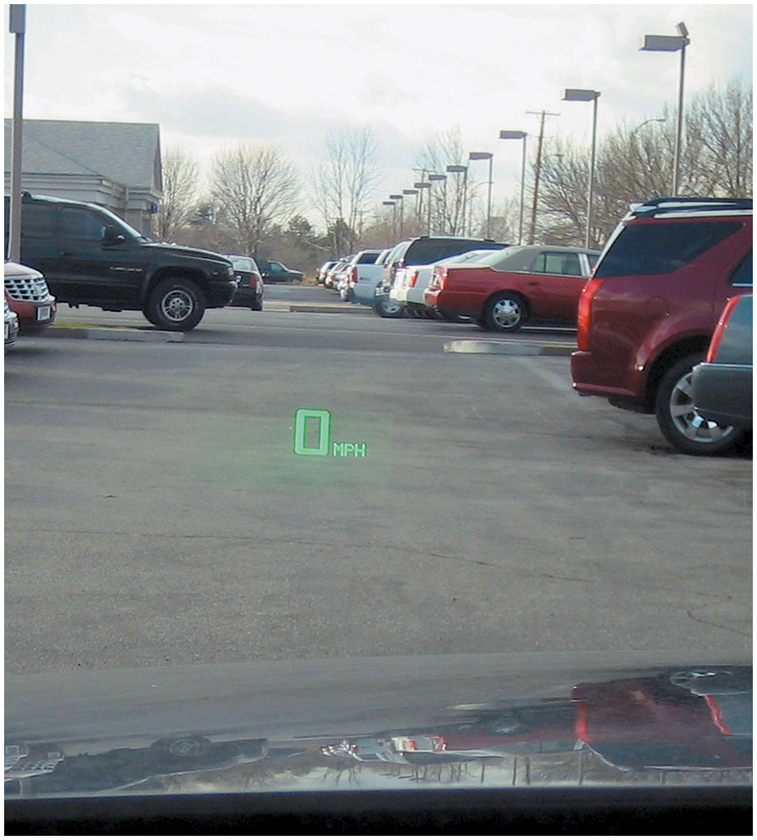
Figure 22.8 A typical H U D showing zero miles per hour, which is actually projected on the windshield from the head-up display in the dash

Slide 10
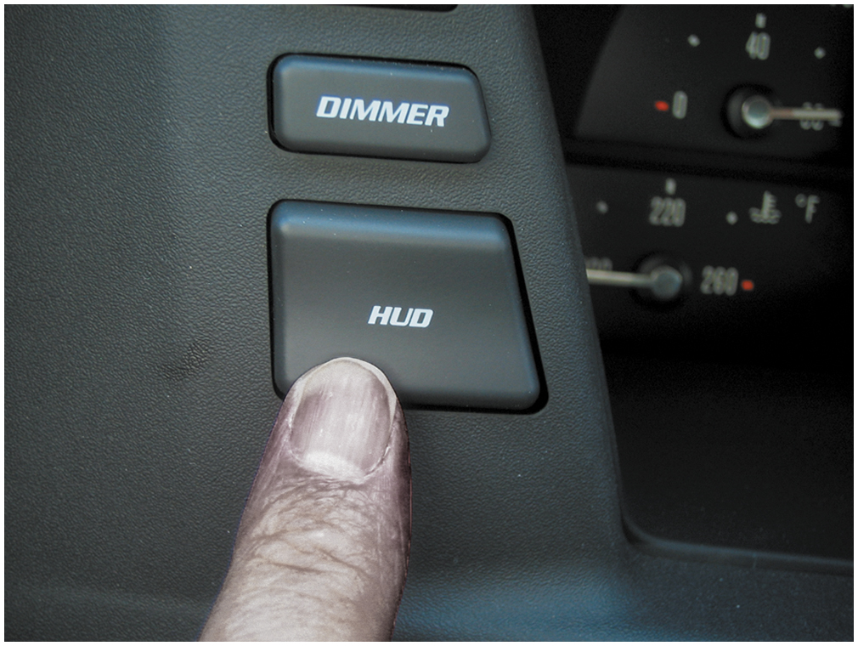
Figure 22.9 The dash-mounted control for the H U D on this Cadillac allows the driver to move the image up and down on the windshield for best viewing

Slide 11
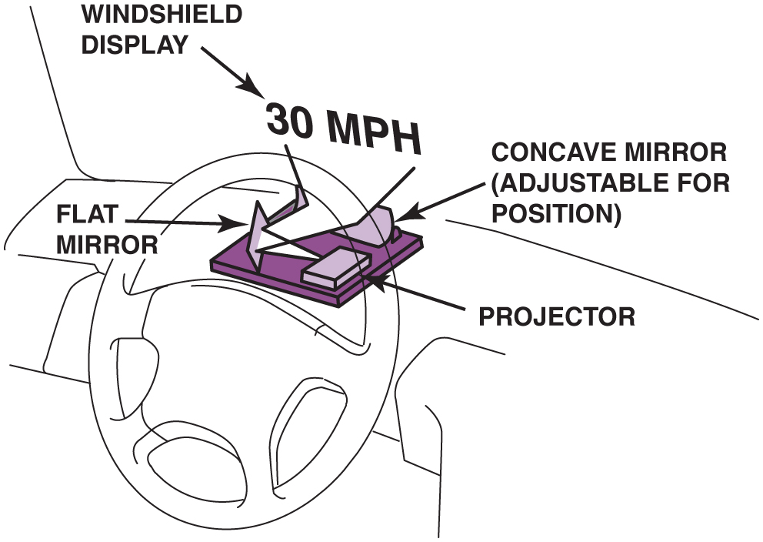
Figure 22.10 A typical H U D unit

Slide 12
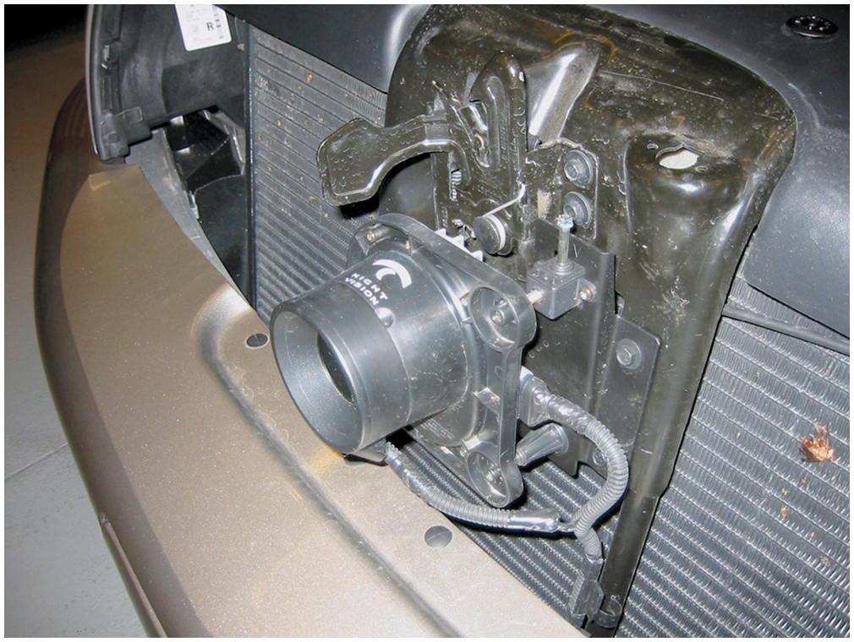
Figure 22.11 A night vision camera behind the grille of a Cadillac

Slide 13
Figure 22.12 (a) Symbol and line drawing of a typical light-emitting diode (L E D)

Slide 14
Figure 22.12 (b) Grouped in seven segments, this array is called a seven-segment L E D display with a common anode (positive connection). The dash computer toggles the cathode (negative) side of each individual segment to display numbers and letters. (c) When all segments are turned on, the number 8 is displayed

Slide 15
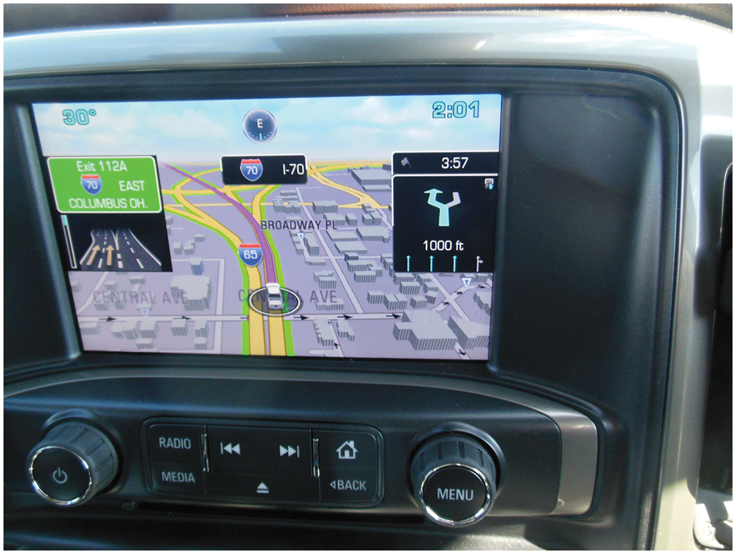
Figure 22.13 A typical LCD navigation system display

Slide 16
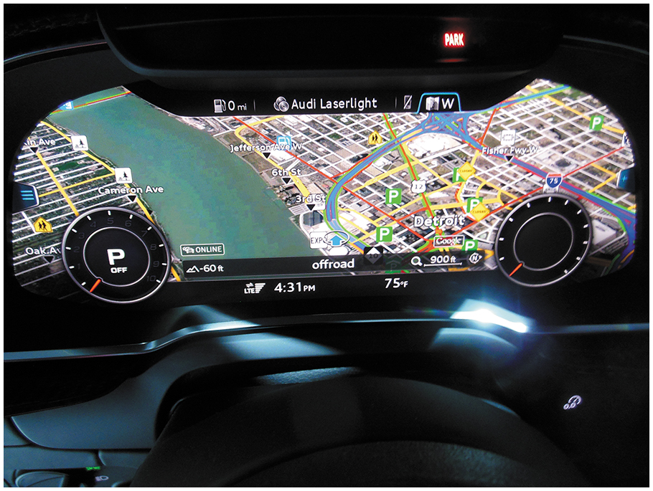
Figure 22.14 A virtual dash being used to show a navigation screen that takes up all of the center dash area. This driver selectable dash display can show almost any combination of dash instruments to meet the desires of the driver

Slide 17
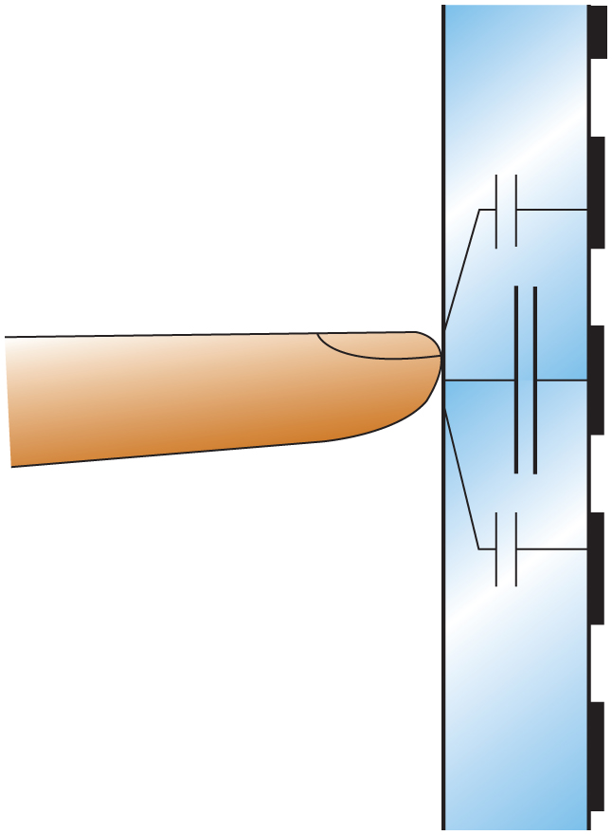
Figure 22.15 Schematic of a capacitive touch screen

Slide 18
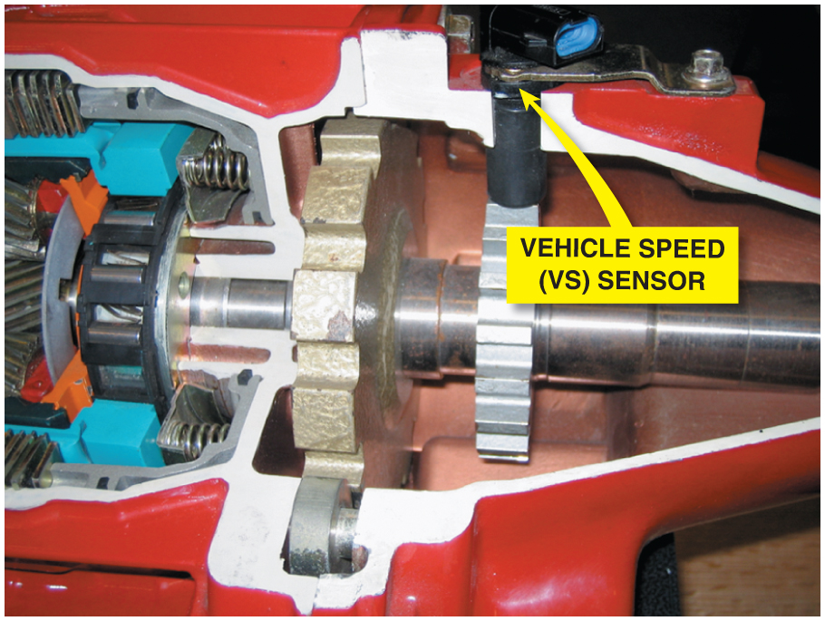
Figure 22.16 A vehicle speed sensor located in the extension housing of the transmission. Some vehicles use the wheel speed sensors for vehicle speed information

Slide 19
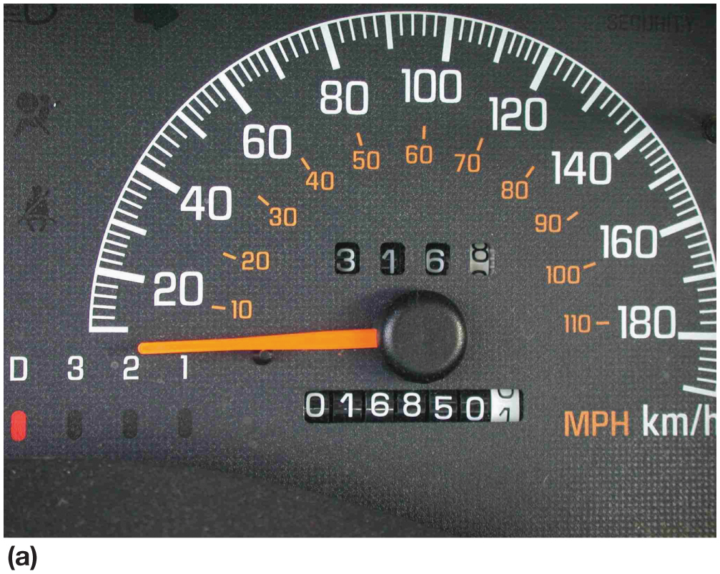
Figure 22.17 a) Some odometers are mechanical and are operated by a stepper motor

Slide 20
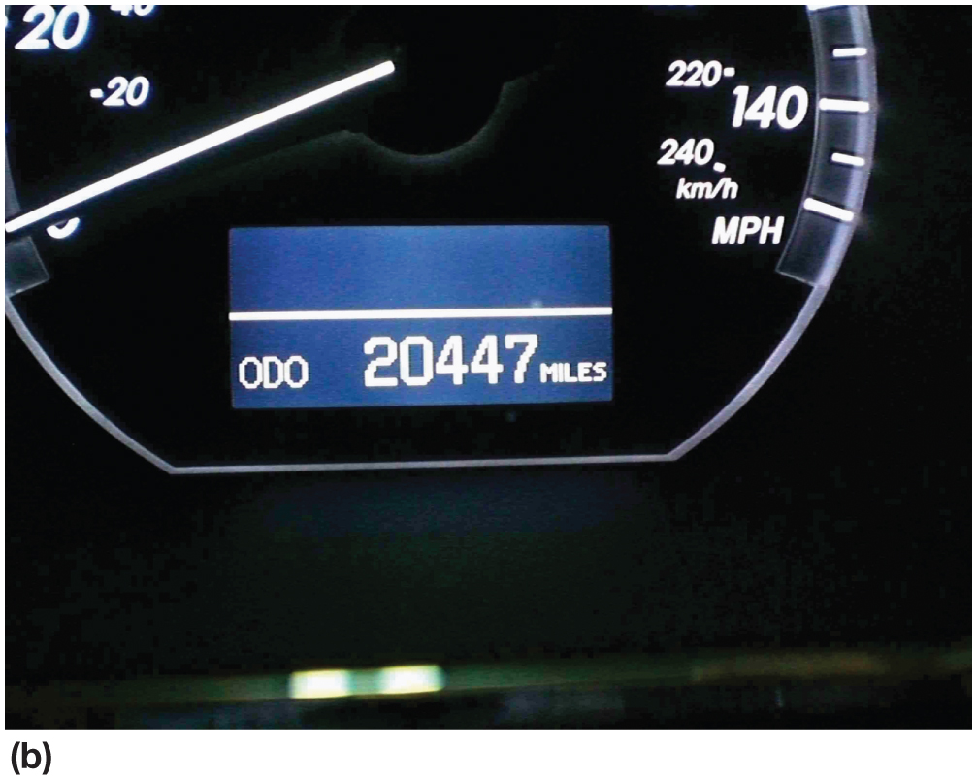
Figure 22.17 (b) Many vehicles are equipped with an electronic odometer

Slide 21
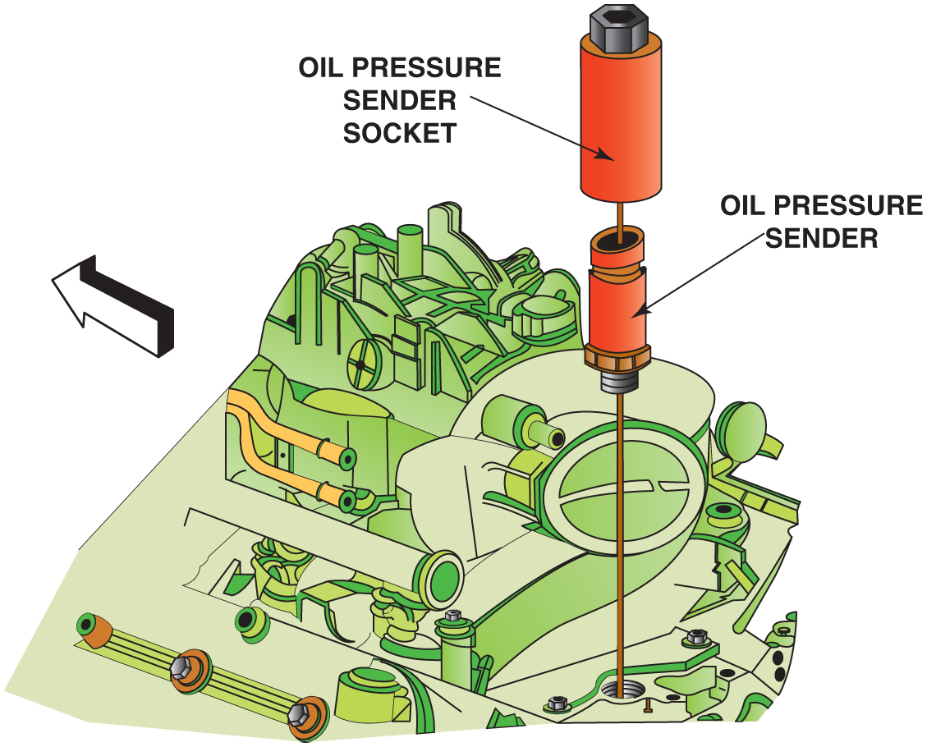
Figure 22.18 A sending unit socket being used to remove an oil pressure sender unit

Slide 22
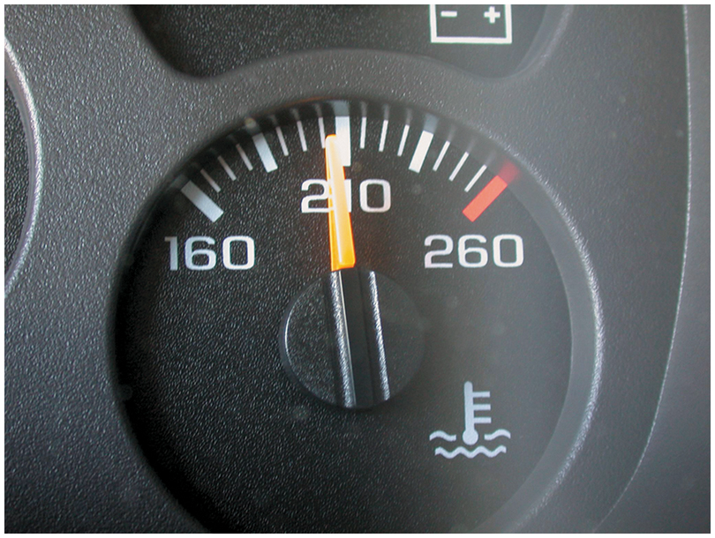
Figure 22.19 A temperature gauge showing normal operating temperature between 180°F and 215°F, depending on the specific vehicle and engine

Slide 23
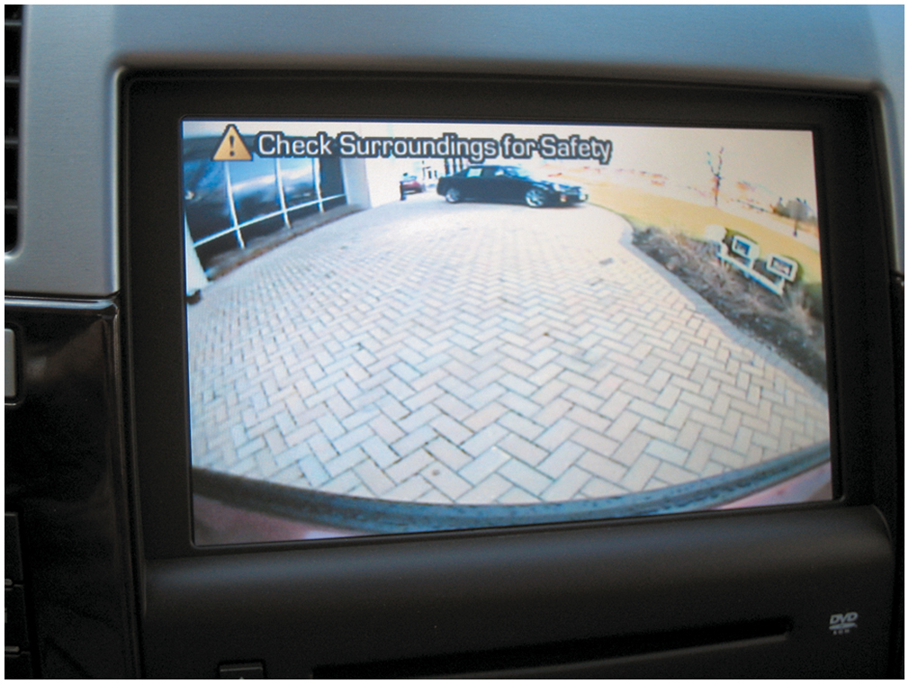
Figure 22.20 A typical view displayed on the navigation screen from the backup camera

Slide 24
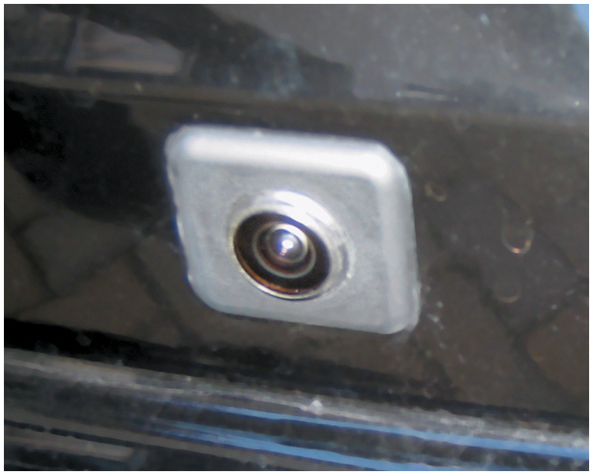
Figure 22.21 A typical fisheye-type backup camera usually located near the center on the rear of the vehicle near the license plate

Slide 25
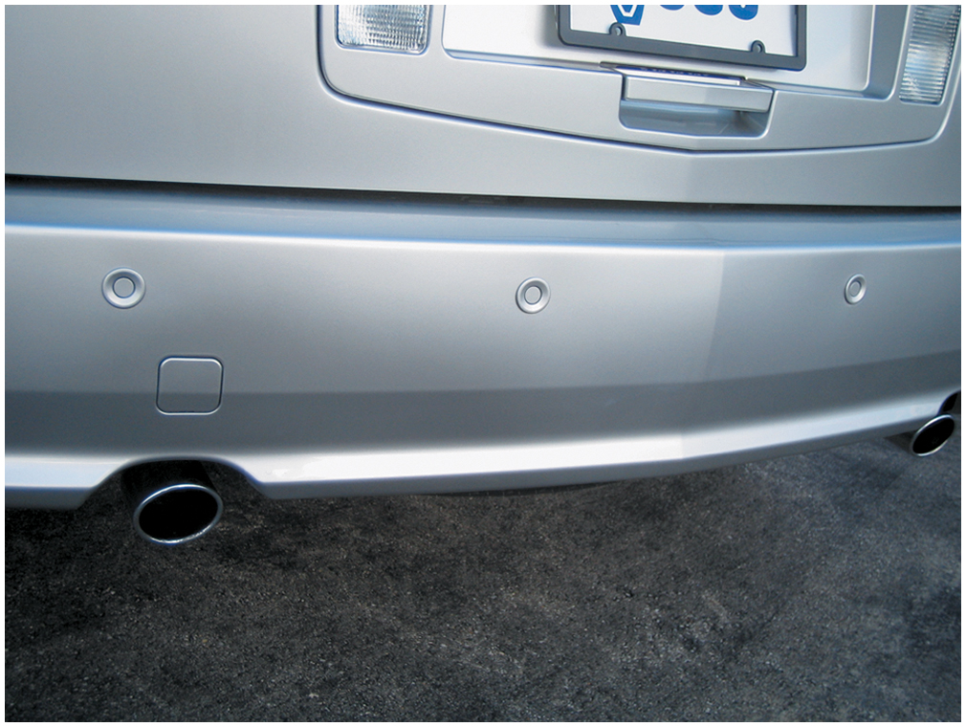
Figure 22.22 The small round buttons in the rear bumper are ultrasonic sensors used to sense distance to an object

Slide 26
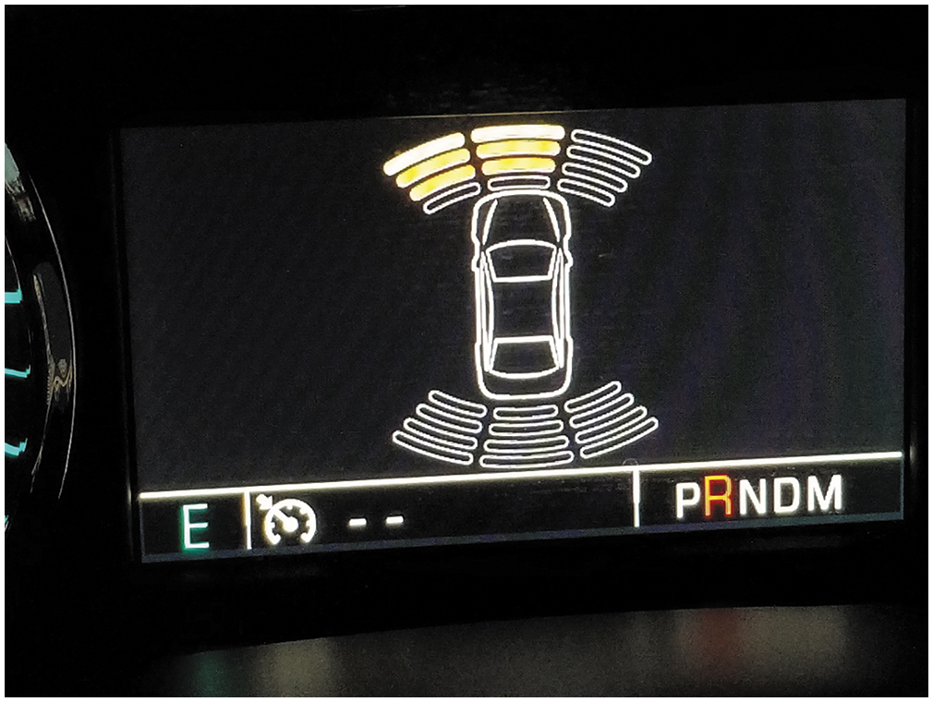
Figure 22.23 The dash display on a Chevrolet pickup truck showing that an object is being detected at the front and left-front of the vehicle

Slide 27
Figure 22.24 A lane departure warning system often uses cameras to sense the road lines and warns the driver if the vehicle is not staying within the lane, unless the turn signal is on

Slide 28
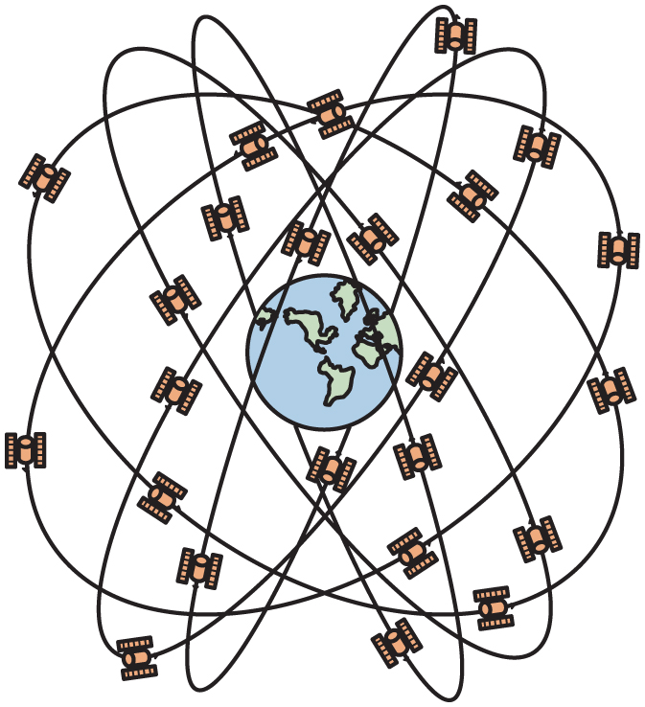
Figure 22.25 Global positioning systems use 24 satellites in high earth orbit whose signals are picked up by navigation systems. The navigation system computer then calculates the location based on the position of the satellite overhead

Slide 29
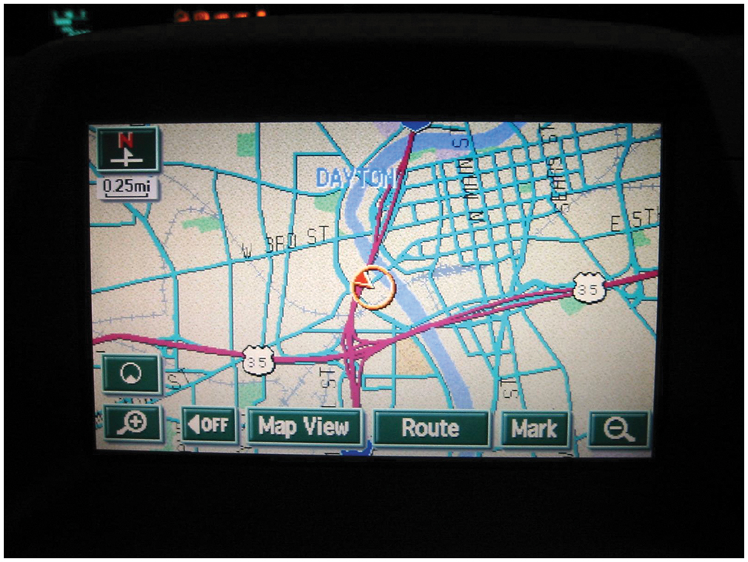
Figure 22.26 A typical GPS display screen showing the location of the vehicle

Slide 30
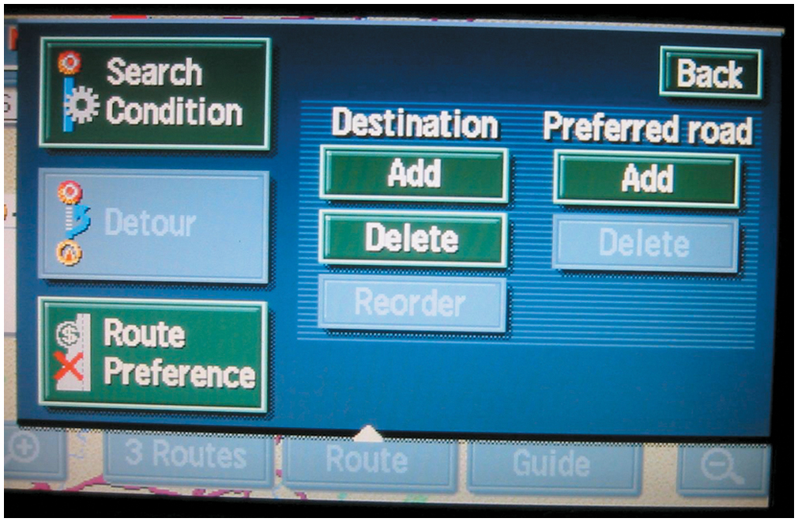
Figure 22.27 A typical navigation display showing various options. Some systems do not allow access to these if the vehicle is in gear and/or moving

Slide 31
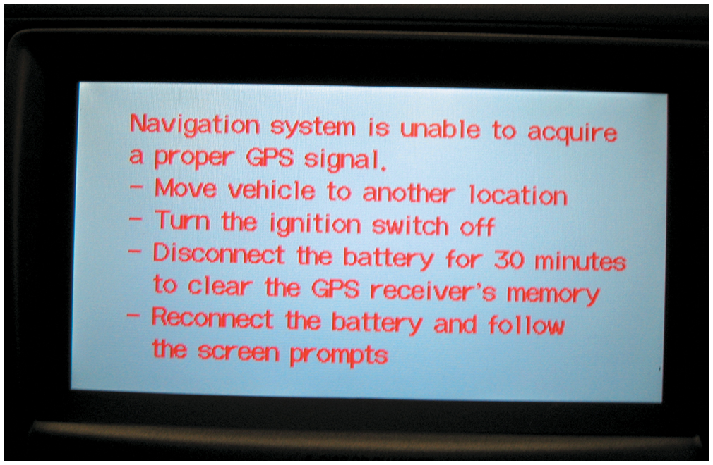
Figure 22.28 A screen display of a navigation system that is unable to acquire usable signals from GPS satellites

Slide 32
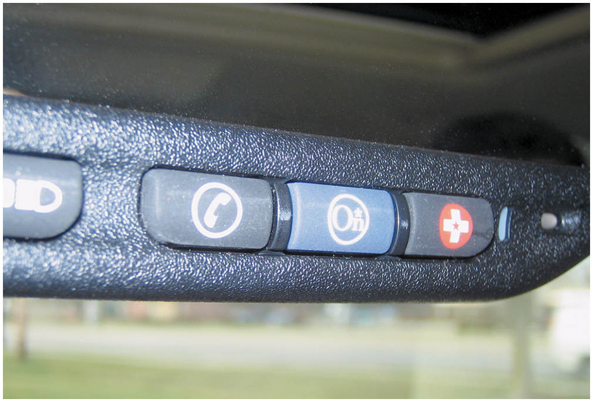
Figure 22.29 The three-button OnStar control is located on the inside rearview mirror. The left button (telephone handset icon) is pushed if a hands-free cellular call is to be made. The center button is depressed to contact an OnStar advisor and the right emergency button is used to request that help be sent to the vehicle’s location

Slide 33
Copyright

