Slide 1
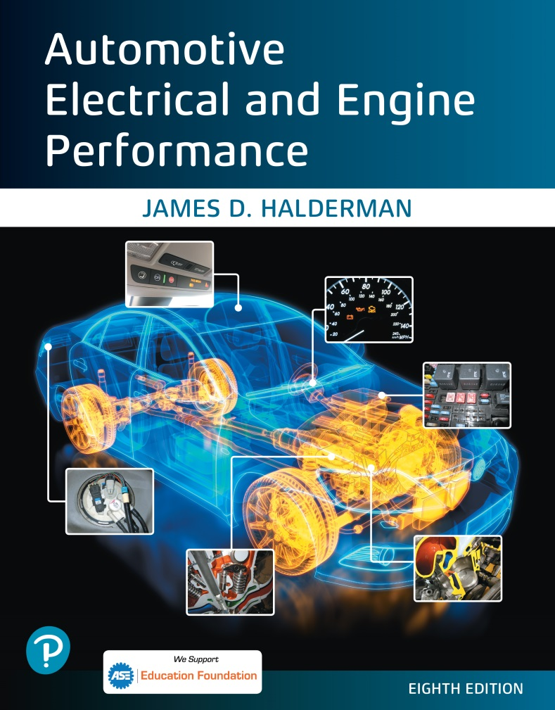
Automotive Electrical and Engine Performance
Eighth Edition
Chapter 01
Service Information, Tools, and Safety
Copyright © 2020, 2016 Pearson Education, Inc. All Rights Reserved

Slide 2
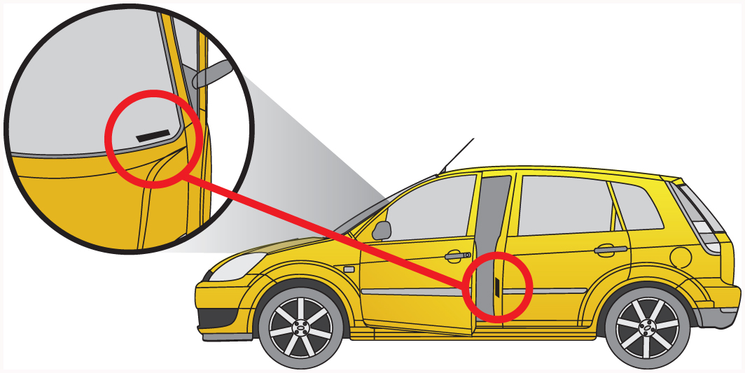
Figure 1.1 The vehicle identification number (V I N) is visible through the base of the windshield and on a decal inside the driver’s door

Slide 3
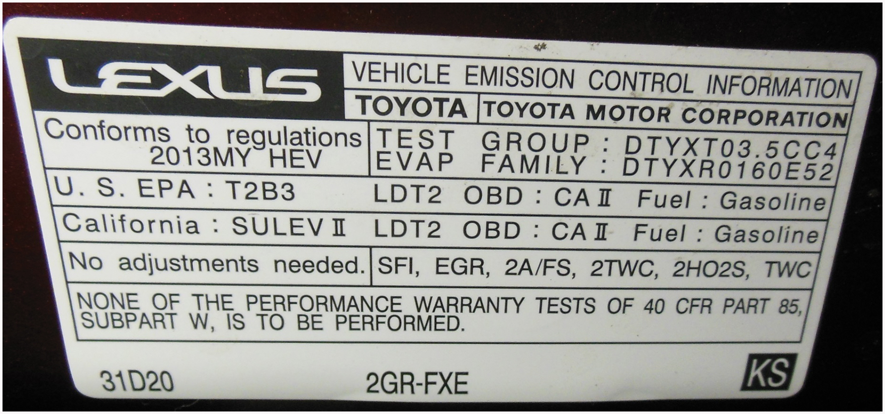
Figure 1.2 The vehicle emissions control information (V E C I) sticker is placed under the hood

Slide 4
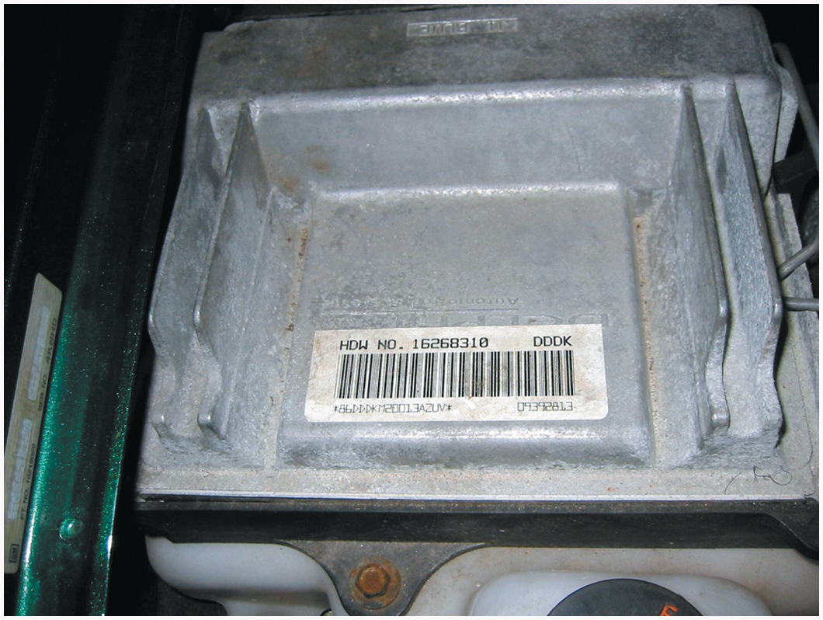
Figure 1.3 A typical calibration code sticker on the case of a controller. The information on the sticker is often needed when ordering parts or a replacement controller

Slide 5
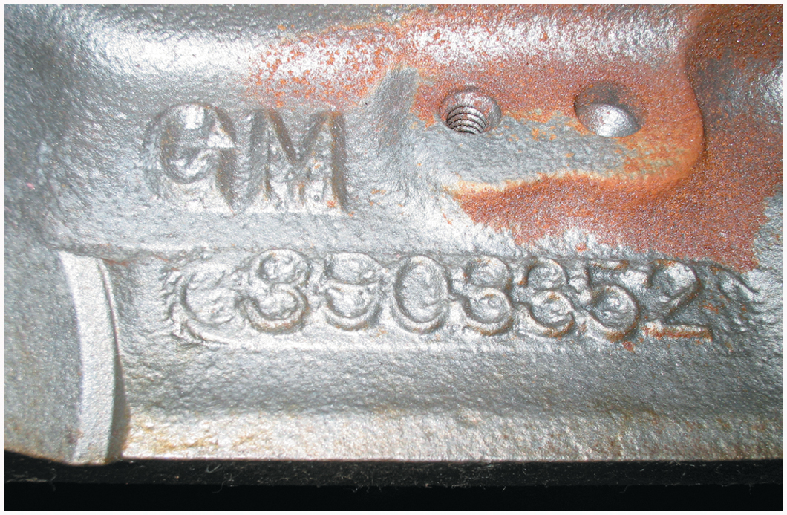
Figure 1.4 Casting numbers on major components can be either cast or stamped

Slide 6
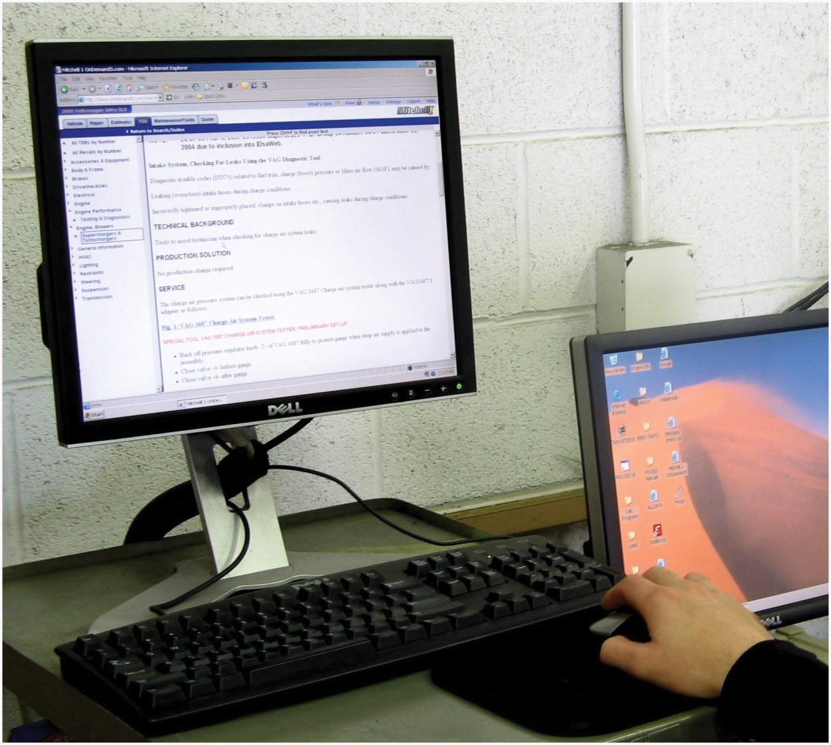
Figure 1.5 Electronic service information is available from aftermarket sources, such as ALLDATA and Mitchell On Demand, as well as, on websites hosted by vehicle manufacturers

Slide 7
Figure 1.6 Technical service bulletins (T S B s) are issued by vehicle manufacturers when a fault occurs that affects many vehicles with the same problem. The T S B then provides the fix for the problem including any parts needed and detailed instructions

Slide 8
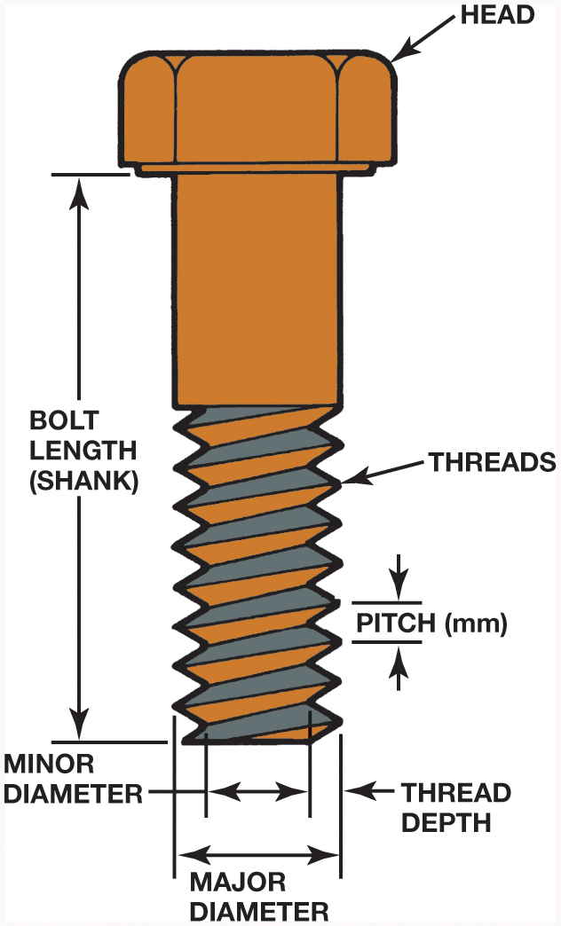
Figure 1.7 The dimensions of a typical bolt showing where sizes are measured

Slide 9
Figure 1.8 Thread pitch gauge used to measure the pitch of the thread. This bolt has 13 threads to the inch

Slide 10
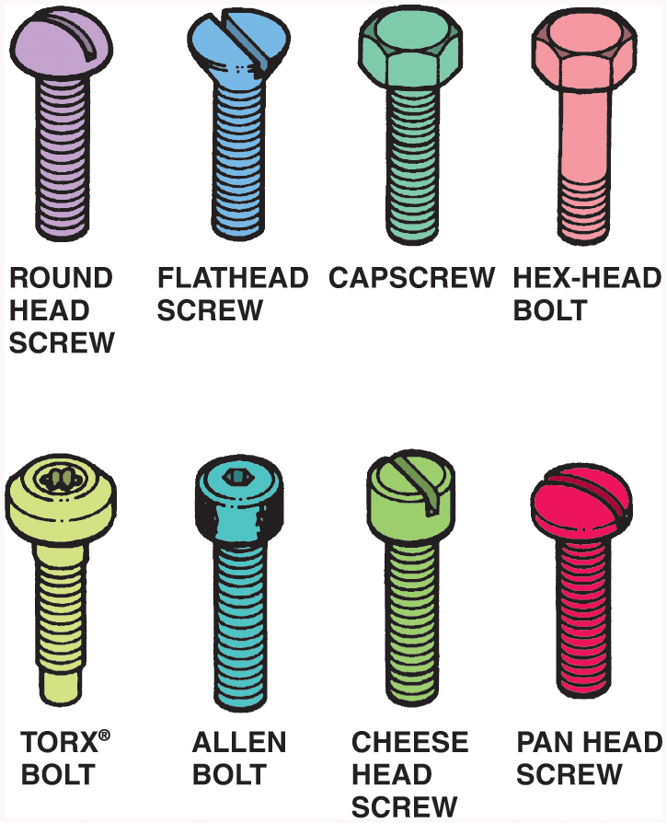
Figure 1.9 Bolts and screws have many different heads that determine what tool is needed

Slide 11
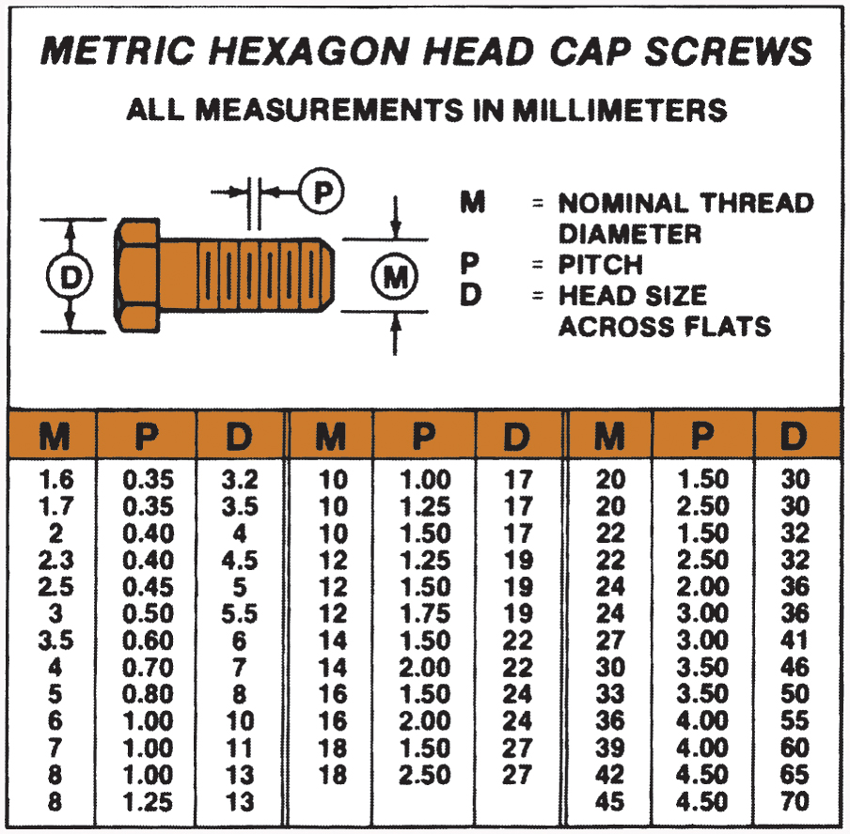
Figure 1.10 The metric system specifies fasteners by diameter, length, and pitch

Slide 12
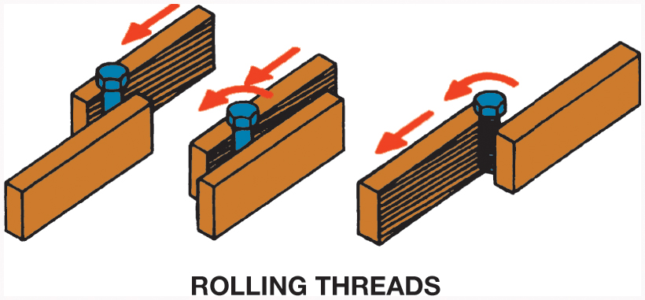
Figure 1.11 Stronger threads are created by cold-rolling a heat-treated bolt blank instead of cutting the threads, using a die

Slide 13
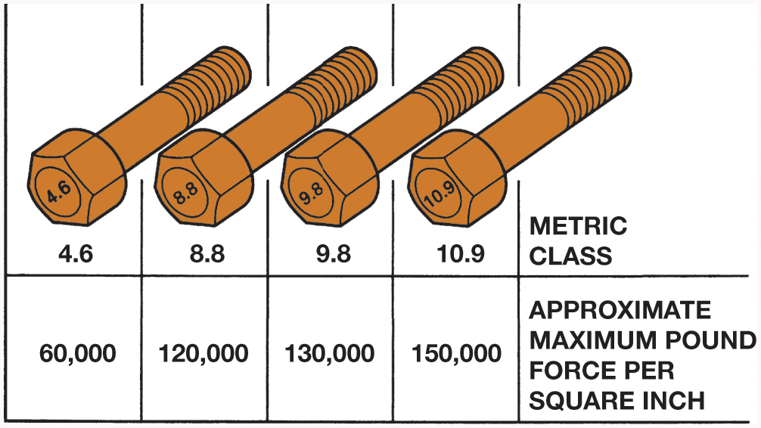
Figure 1.12 Metric bolt (cap screw) grade markings and approximate tensile strength

Slide 14
Figure 1.13 Nuts come in a variety of styles, including locking (prevailing torque) types, such as the distorted thread and nylon insert type

Slide 15
Figure 1.14 Washers come in a variety of styles, including flat and serrated used to help prevent a fastener from loosening

Slide 16
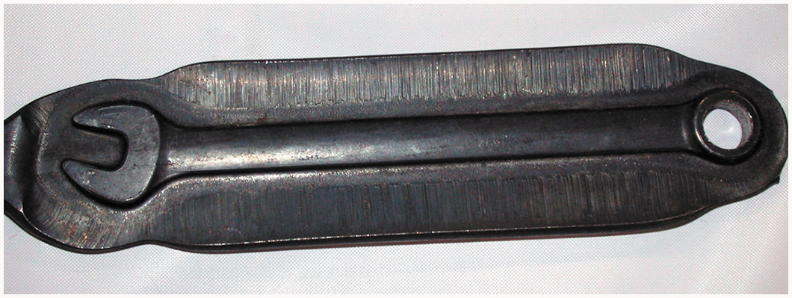
Figure 1.15 A wrench after it has been forged but before the flashing, extra material around the wrench, has been removed

Slide 17
Figure 1.16 A typical open-end wrench. The size is different on each end; notice that the head is angled 15 degrees at the end

Slide 18
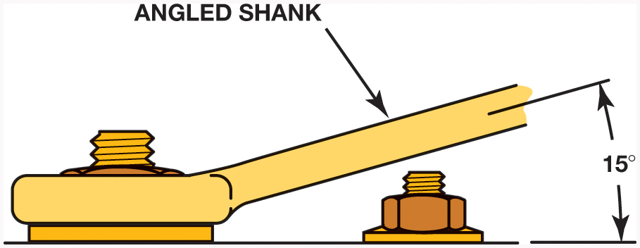
Figure 1.17 The end of a box-end wrench is angled 15 degrees to allow clearance for nearby objects or other fasteners

Slide 19
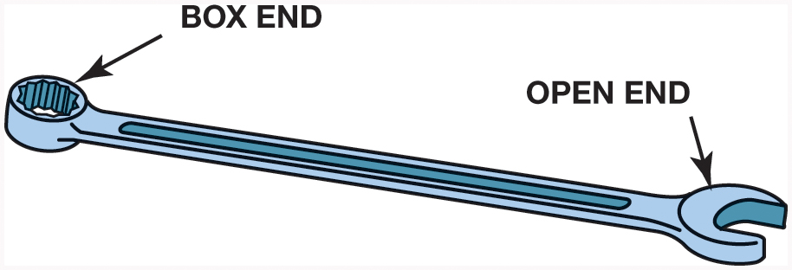
Figure 1.18 A combination wrench has an open end at one end and a box end at the other end

Slide 20
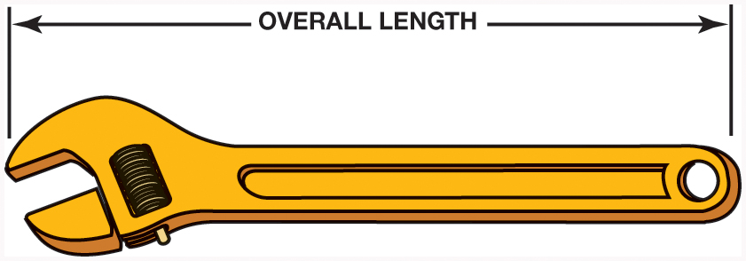
Figure 1.19 An adjustable wrench. Adjustable wrenches are sized by the overall length of the wrench and not by how far the jaws open. Common sizes of adjustable wrenches include 8, 10, and 12 inch

Slide 21
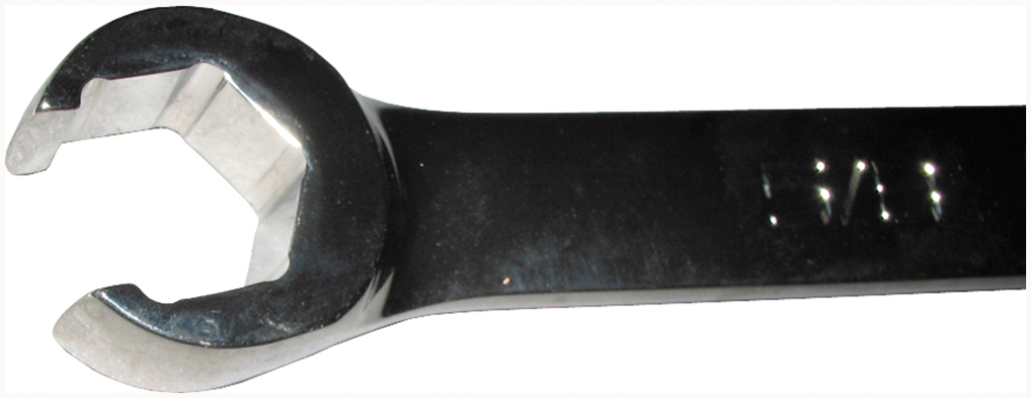
Figure 1.20 The end of a typical line wrench, which shows that it is capable of grasping most of the head of the fitting

Slide 22
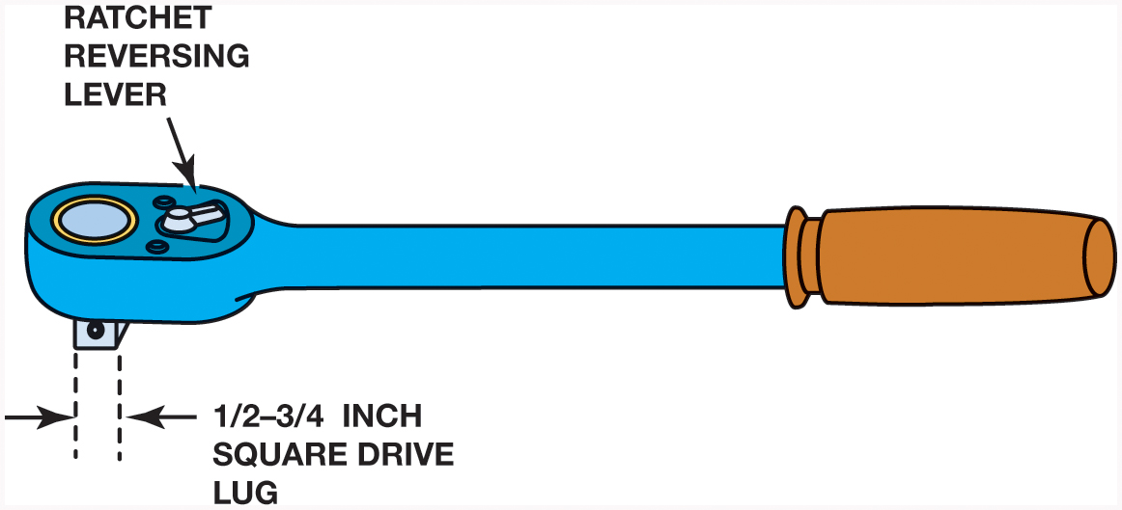
Figure 1.21 A typical ratchet used to rotate a socket. A ratchet makes a ratcheting noise when it is being rotated in the opposite direction from loosening or tightening. A knob or lever on the ratchet allows the user to switch directions

Slide 23
Figure 1.22 A typical flex handle used to rotate a socket, also called a breaker bar because it usually has a longer handle than a ratchet and, therefore, can be used to apply more torque to a fastener than a ratchet

Slide 24
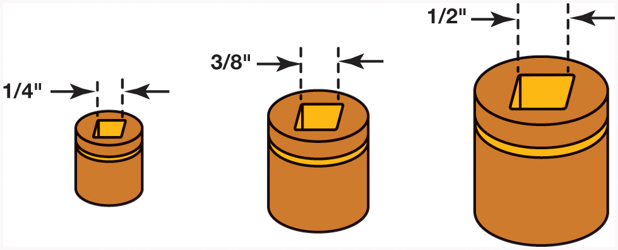
Figure 1.23 The most commonly used socket drive sizes include 1/4, 3/8, and 1/2 inch drive

Slide 25
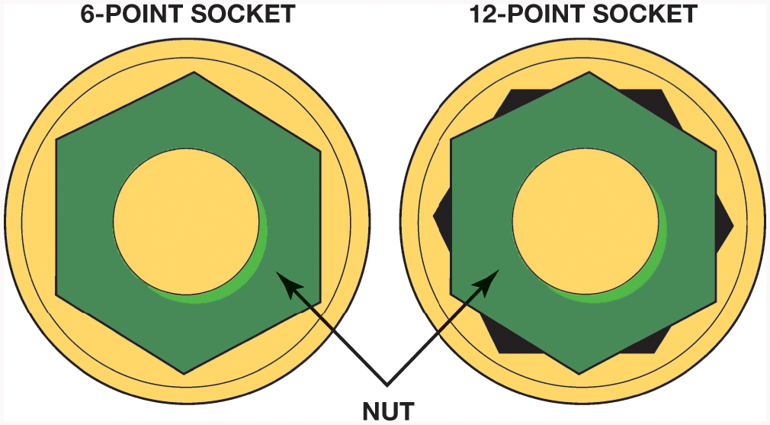
Figure 1.24 A 6-point socket fits the head of a bolt or nut on all sides. A 12-point socket can round off the head of a bolt or nut if a lot of force is applied

Slide 26
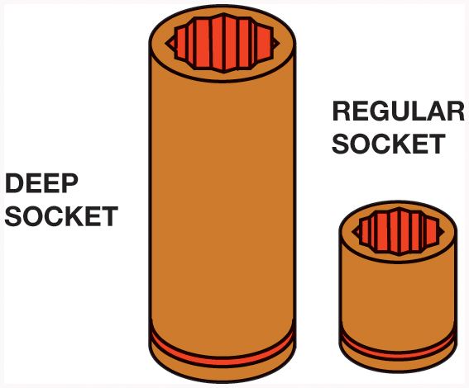
Figure 1.25 Allows access to the nut that has a stud plus other locations needing great depth, such as spark plugs

Slide 27
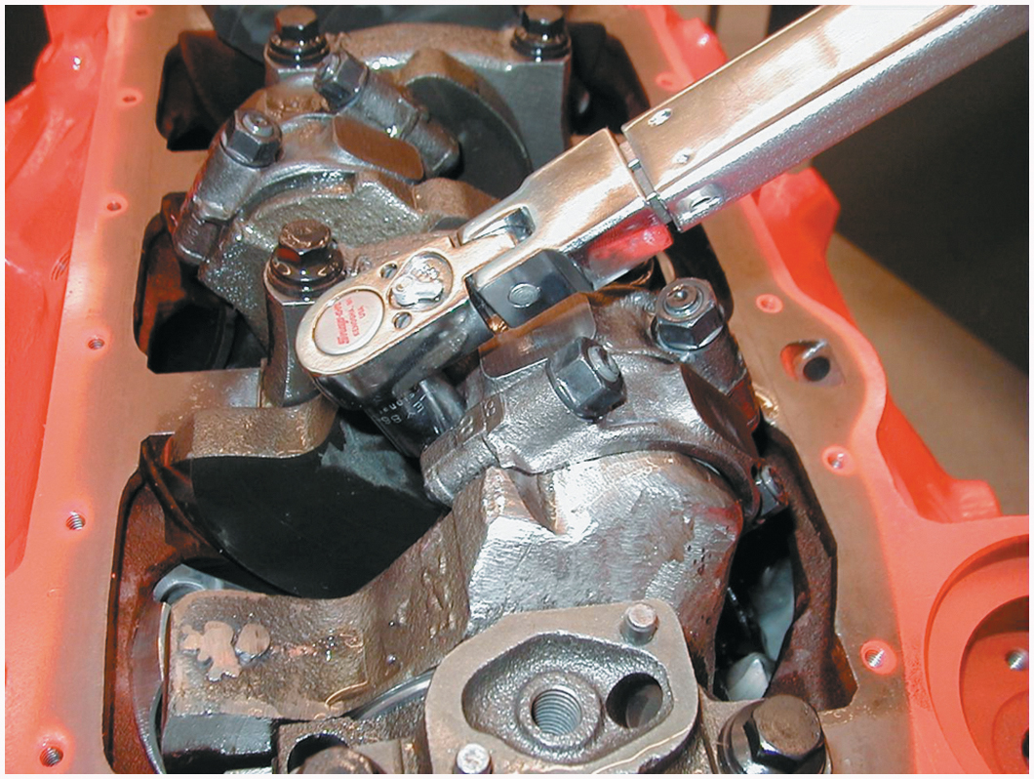
Figure 1.26 Using a clicker-type torque wrench to tighten connecting rod nuts on an engine

Slide 28
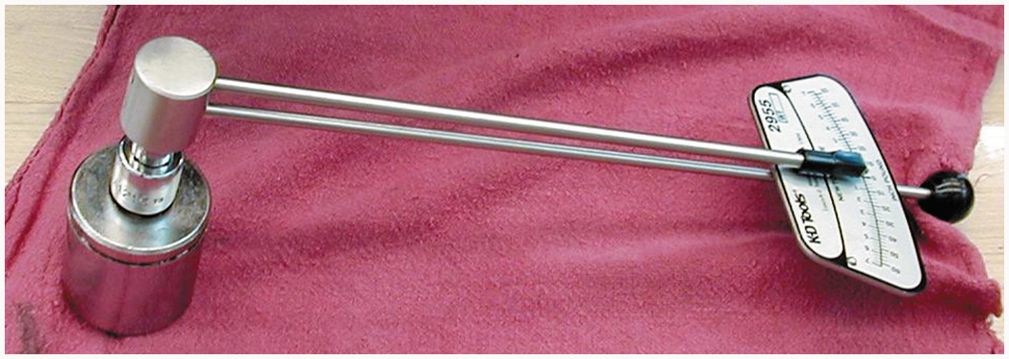
Figure 1.27 A beam-type torque wrench that displays the torque reading on the face of the dial. The beam display is read as the beam deflects, which is in proportion to the amount of torque applied to the fastener

Slide 29
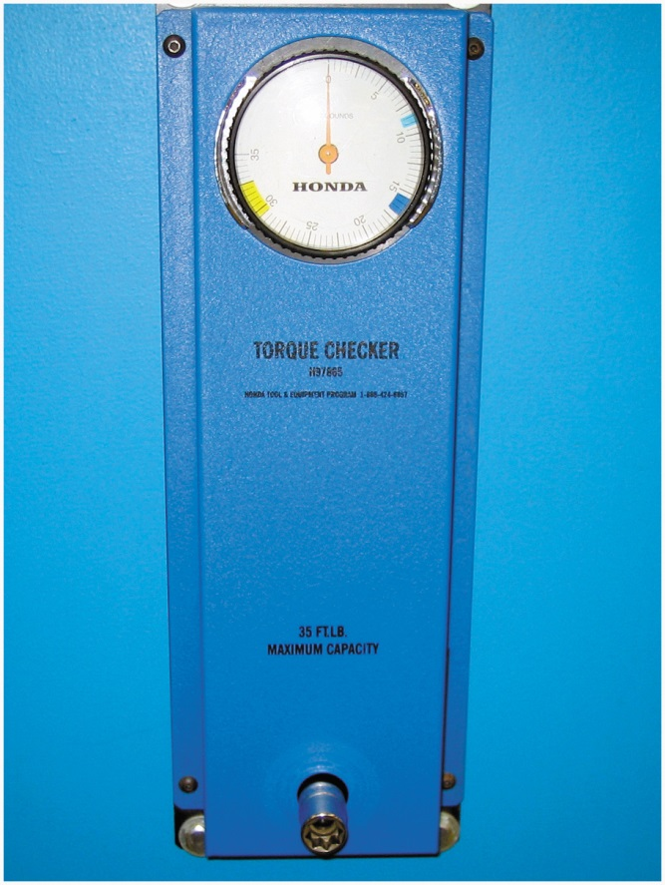
Figure 1.28 Torque wrench calibration checker

Slide 30
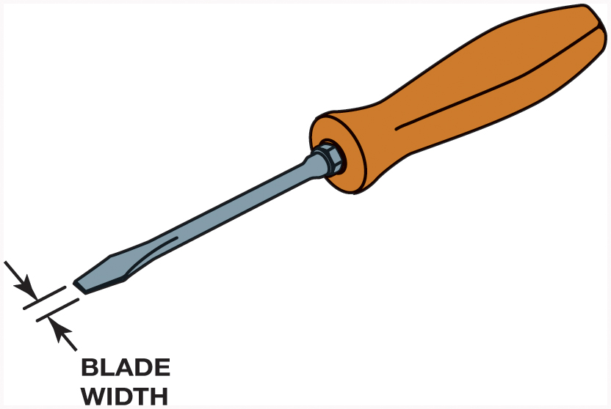
Figure 1.29 A flat-tip (straight-blade) screwdriver. The width of the blade should match the width of the slot in the fastener being loosened or tightened

Slide 31
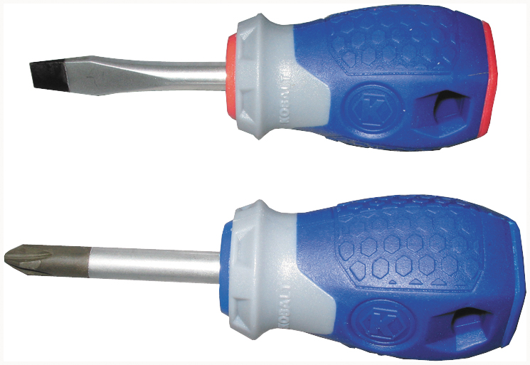
Figure 1.30 Two stubby screwdrivers that are used to access screws that have limited space above. A straight blade is on top and a #2 Phillips screwdriver is on the bottom

Slide 32
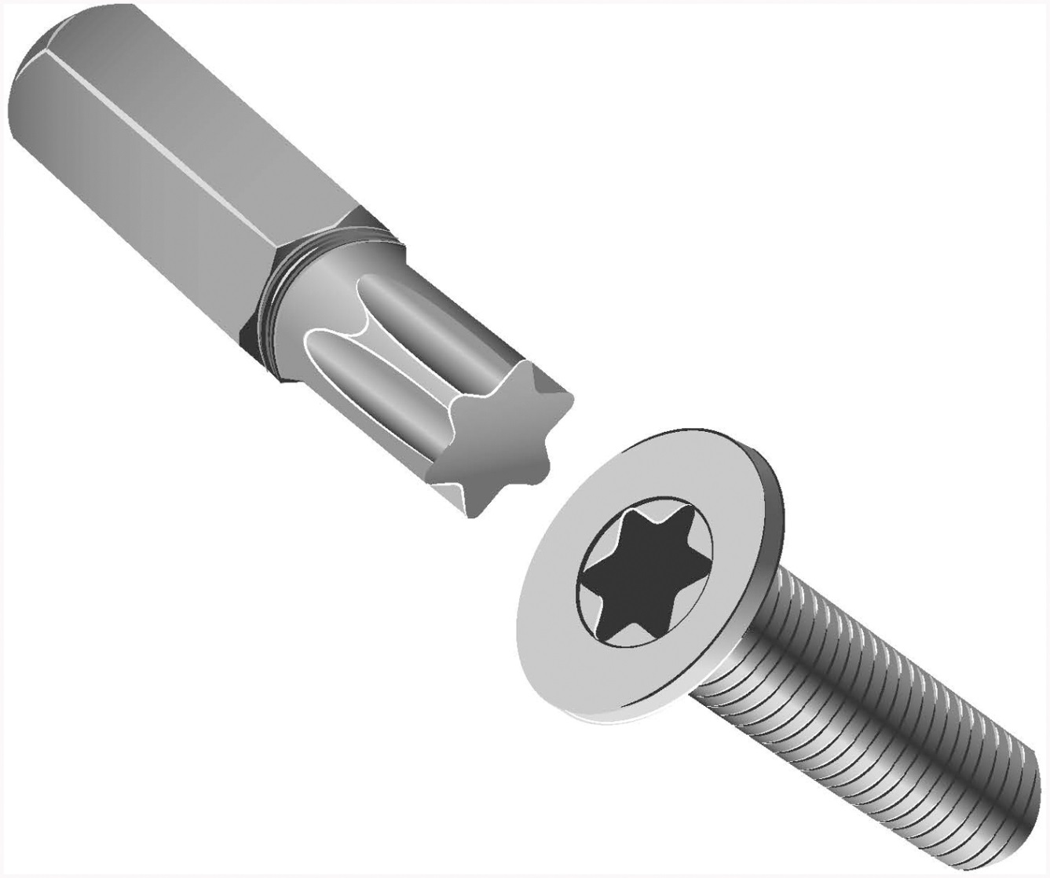
Figure 1.31 A Torx bit and fastener

Slide 33
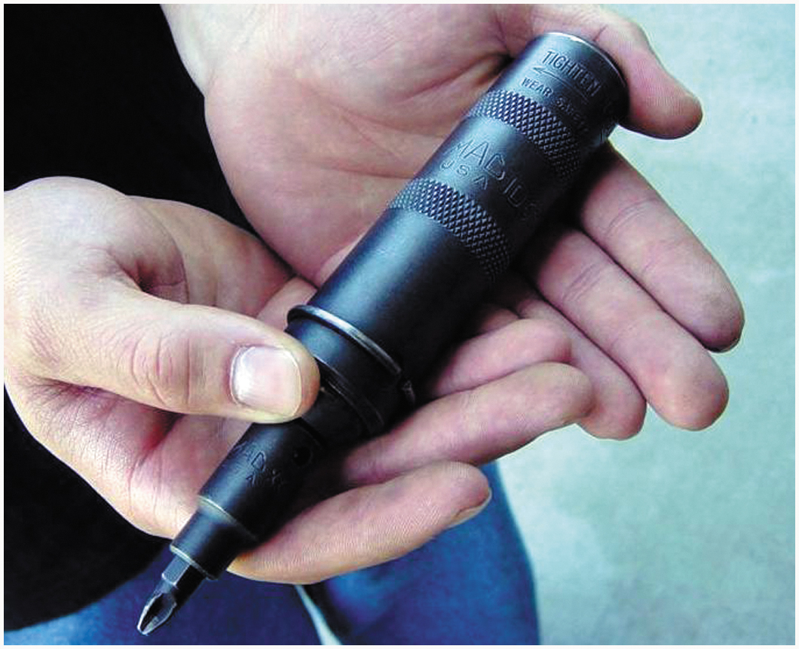
Figure 1.32 An impact screwdriver used to remove slotted or Phillips head fasteners that cannot be broken loose using a standard screwdriver

Slide 34
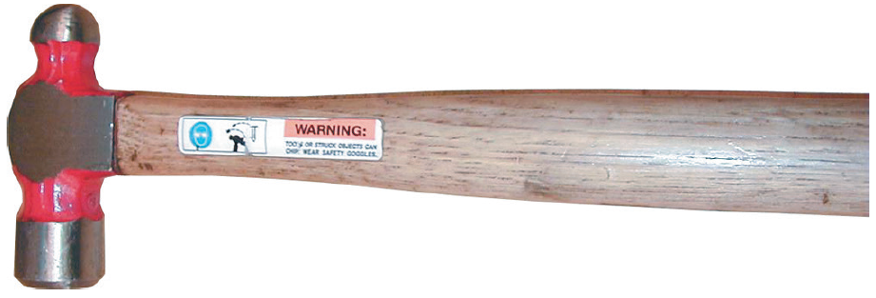
Figure 1.33 A typical ball-peen hammer

Slide 35
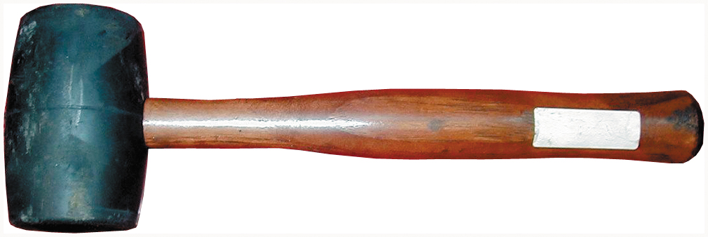
Figure 1.34 A rubber mallet used to deliver a force to an object without harming the surface

Slide 36
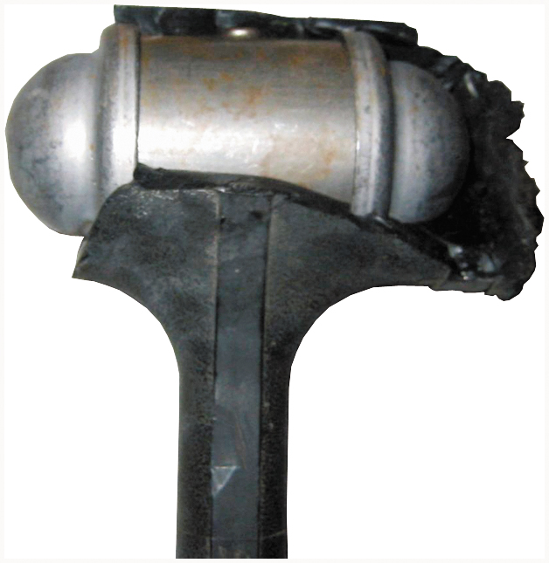
Figure 1.35 A dead-blow hammer that was left outside in freezing weather. The plastic covering was damaged, which destroyed this hammer. The lead shot is encased in the metal housing and then covered

Slide 37
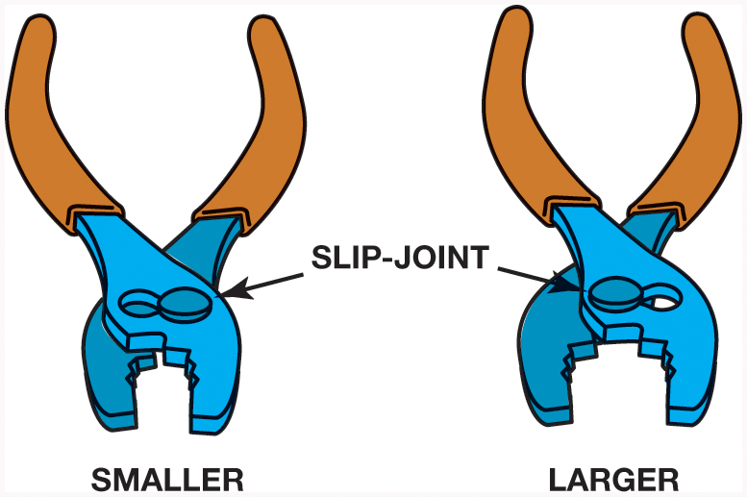
Figure 1.36 Typical slip-joint pliers are a common household pliers. The slip joint allows the jaws to be opened to two different settings

Slide 38
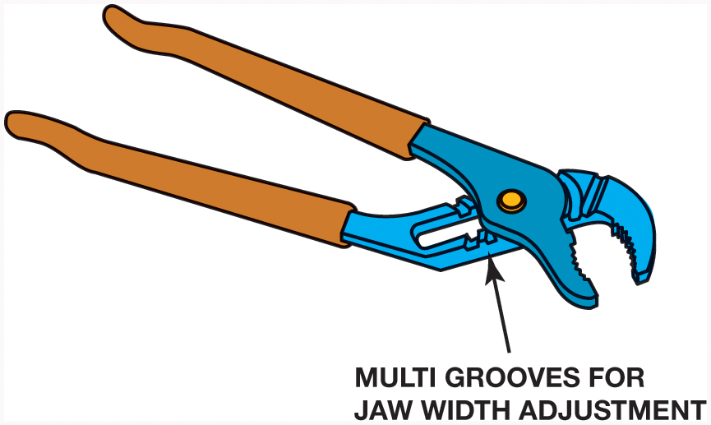
Figure 1.37 Multigroove adjustable pliers are known by many names, including the trade name “Channel Locks®”

Slide 39
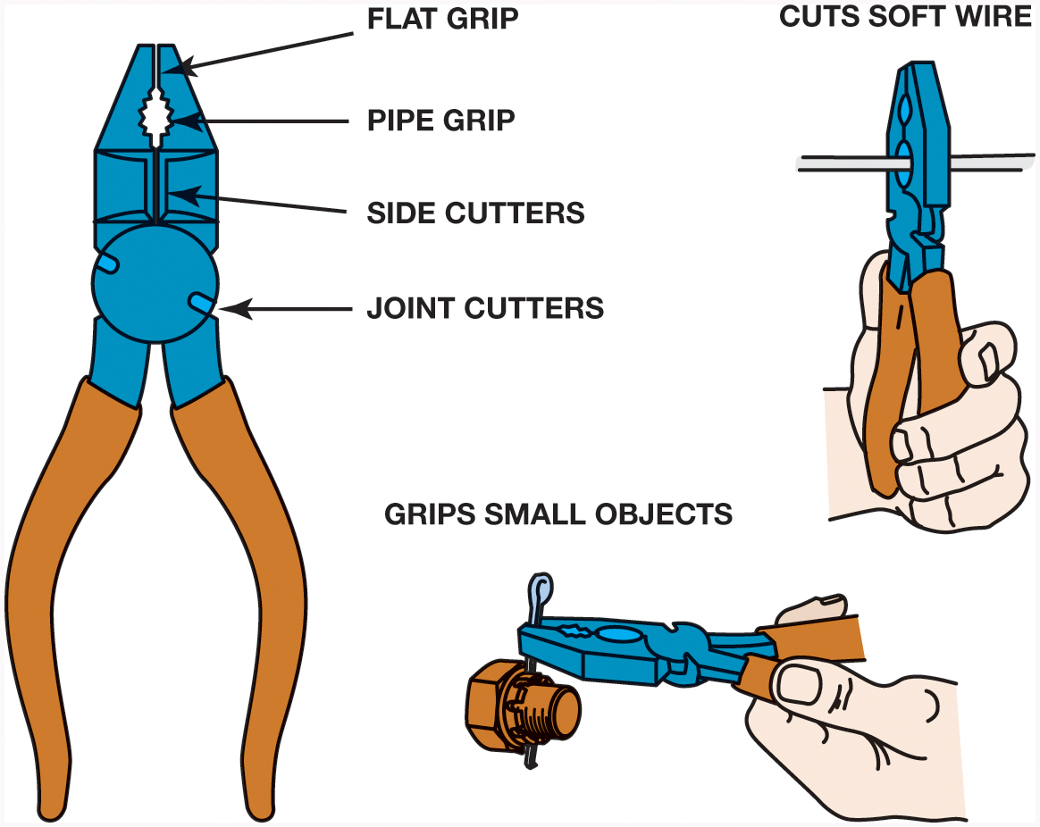
Figure 1.38 Linesman’s pliers are very useful because it helps perform many automotive service jobs

Slide 40
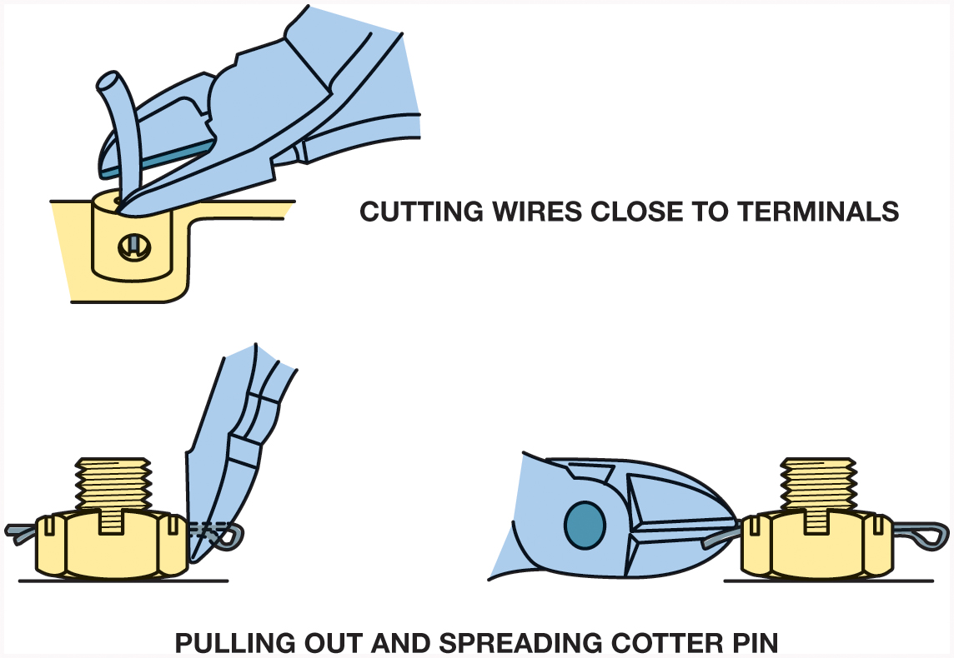
Figure 1.39 Diagonal-cut pliers are another common tool that has many names

Slide 41
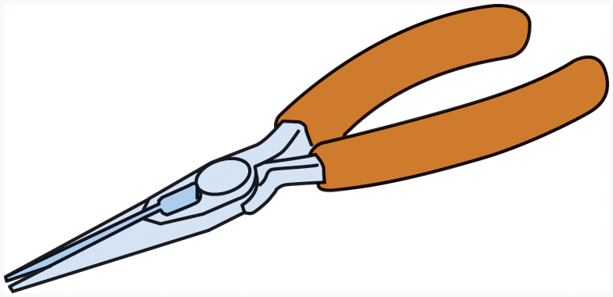
Figure 1.40 Needle-nose pliers are used where there is limited access to a wire or pin that needs to be installed or removed

Slide 42
Figure 1.41 Locking pliers are best known by their trade name Vise Grips®

Slide 43
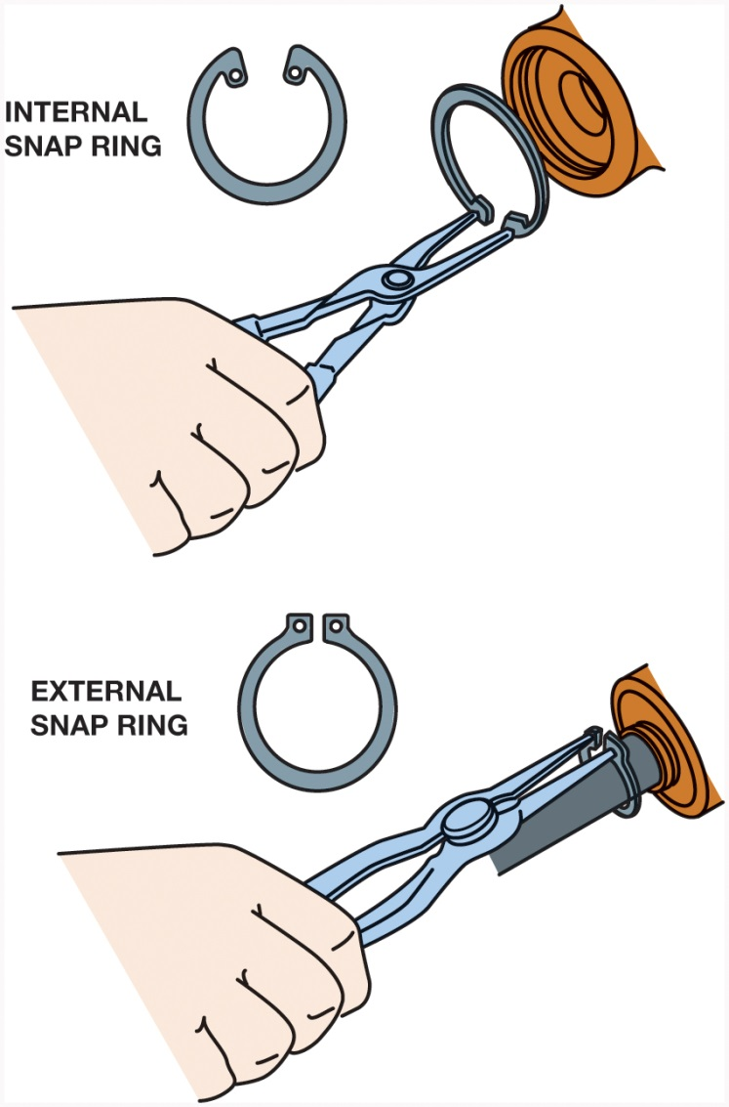
Figure 1.42 Snap-ring pliers are also called lock ring pliers and most are designed to remove internal and external snap rings (lock rings)

Slide 44
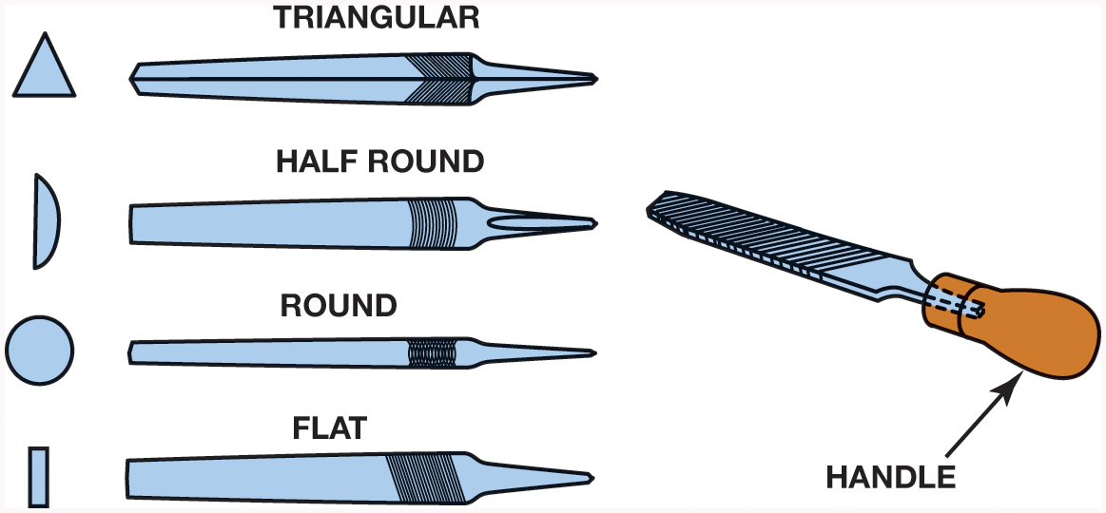
Figure 1.43 Files come in many different shapes and sizes. Never use a file without a handle

Slide 45
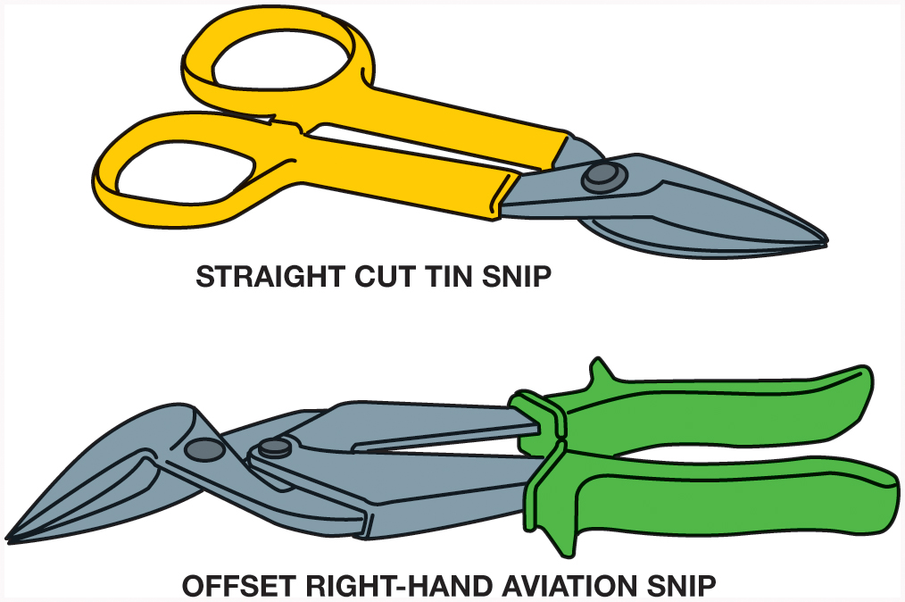
Figure 1.44 Tin snips are used to cut thin sheets of metal or carpet

Slide 46
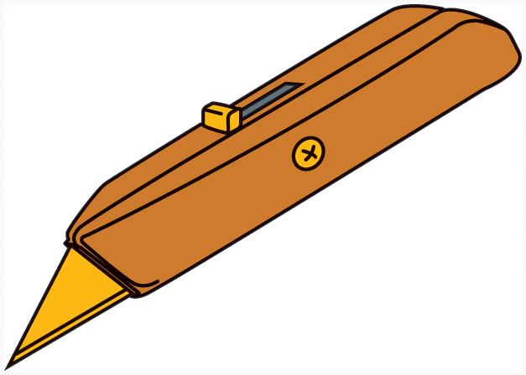
Figure 1.45 A utility knife uses replaceable blades and is used to cut carpet and other materials

Slide 47
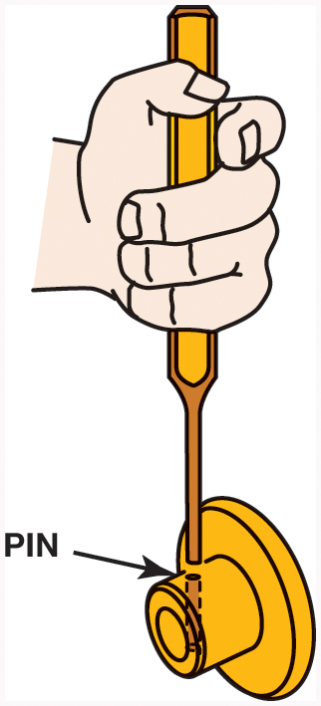
Figure 1.46 A punch used to drive pins from assembled components. This type of punch is also called a pin punch

Slide 48
Figure 1.47 Warning stamped on the side of a punch warning that goggles should be worn when using this tool. Always follow safety warnings

Slide 49
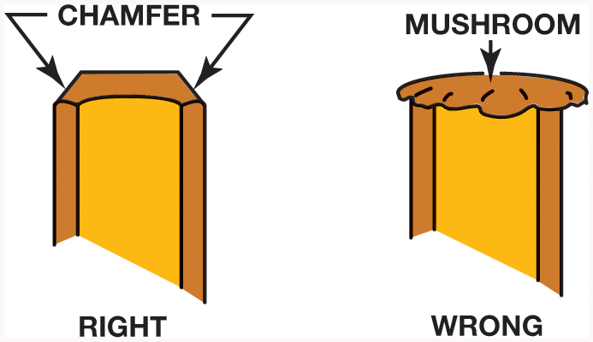
Figure 1.48 Use a grinder or a file to remove the mushroom material on the end of a punch or chisel

Slide 50
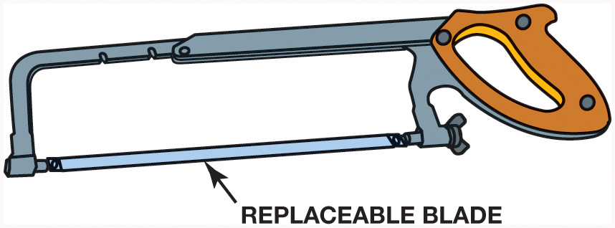
Figure 1.49 A typical hacksaw that is used to cut metal. If cutting sheet metal or thin objects, a blade with more teeth should be used

Slide 51
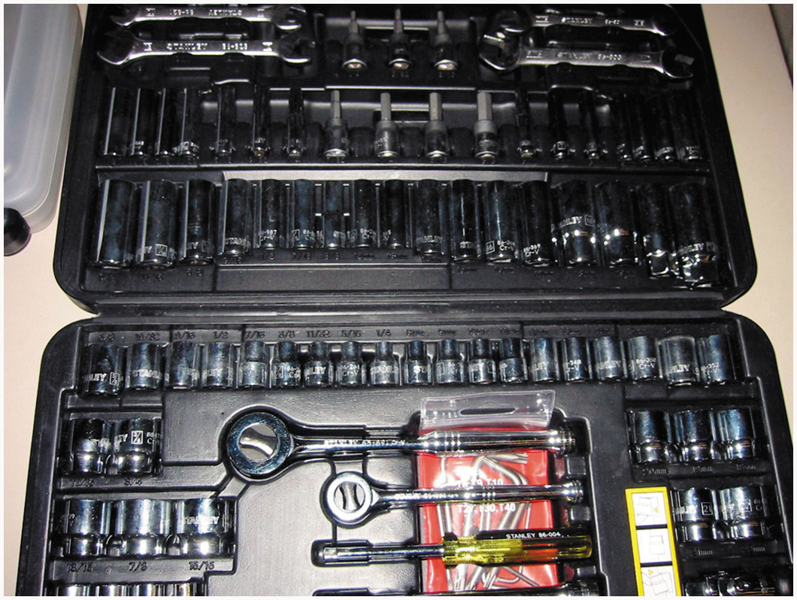
Figure 1.50 A typical beginning technician tool set that includes the basic tools to get started

Slide 52
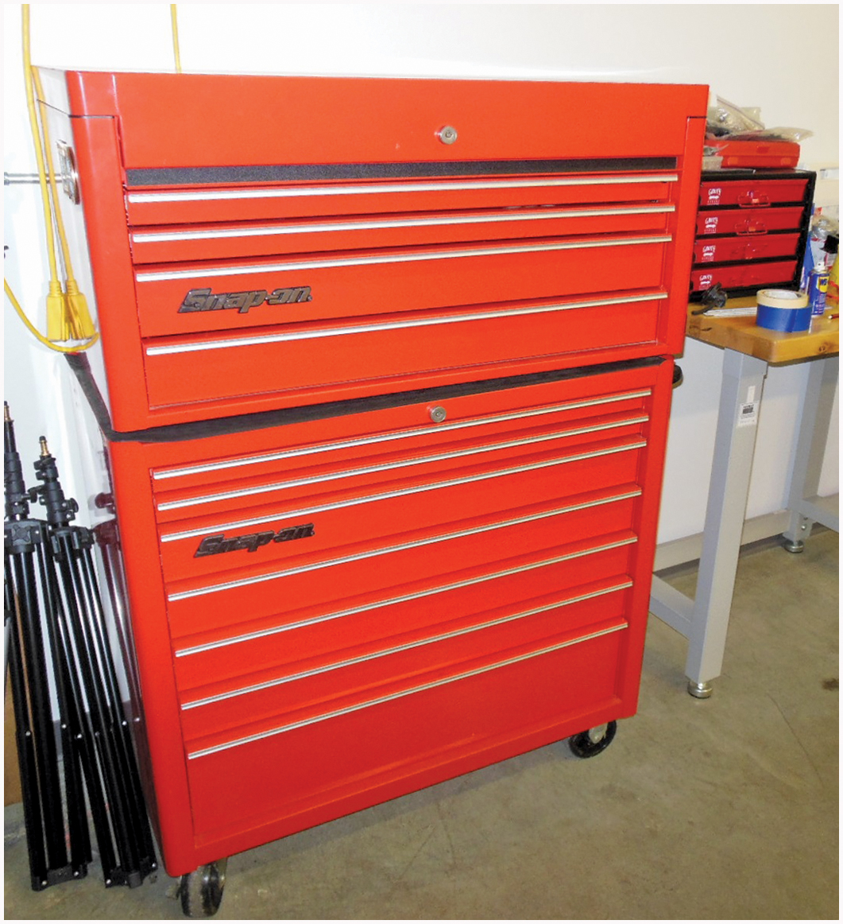
Figure 1.51 A typical 40 inch wide top and bottom professional tool box

Slide 53
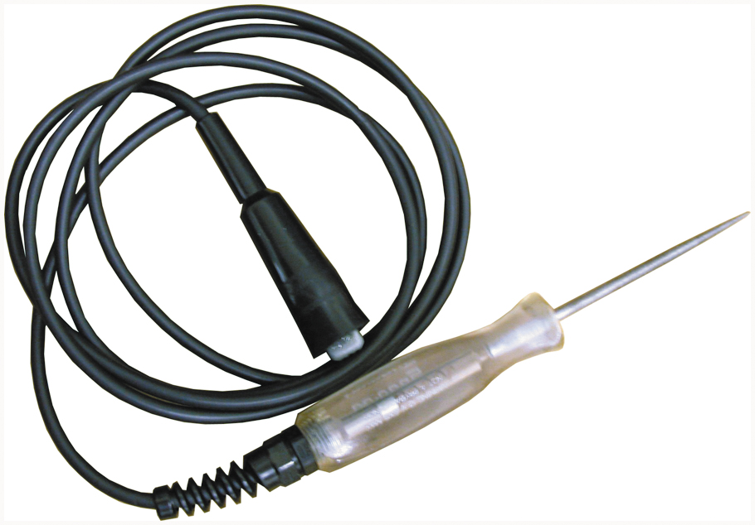
Figure 1.52 A typical 12 volt test light

Slide 54
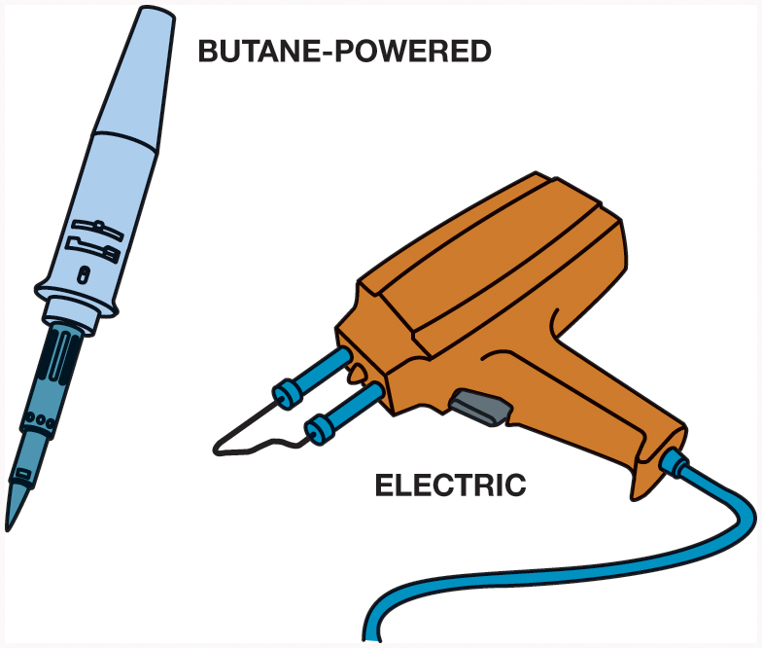
Figure 1.53 Electric and butane-powered soldering guns used to make electrical repairs. Soldering guns are sold by the wattage rating. The higher the wattage, the greater the amount of heat created. Most solder guns used for automotive electrical work usually fall within the 60 to 160 watt range

Slide 55
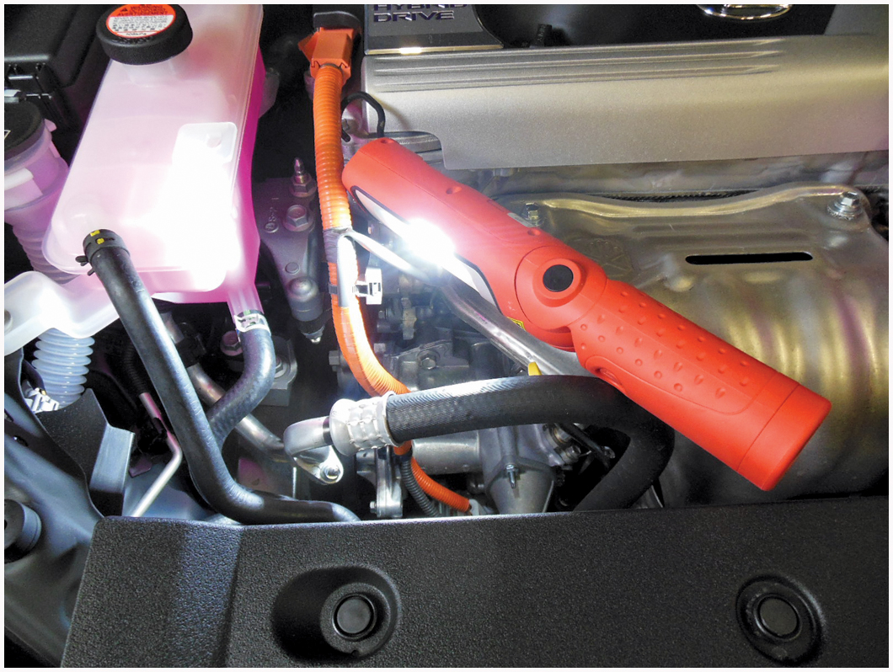
Figure 1.54 A battery-powered L E D trouble light

Slide 56
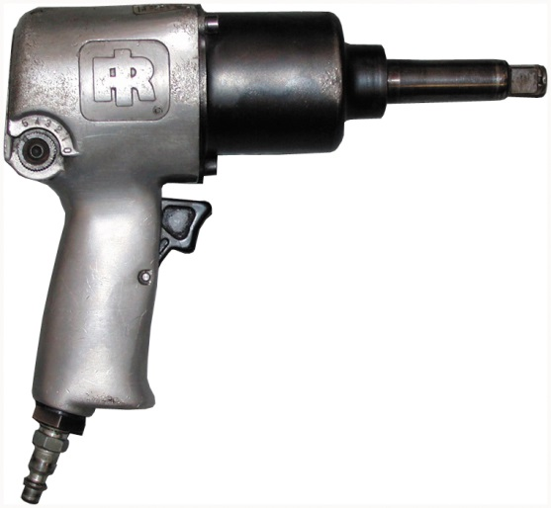
Figure 1.55 A typical 1/2 inch drive air impact wrench. The direction of rotation can be changed to loosen or tighten a fastener

Slide 57
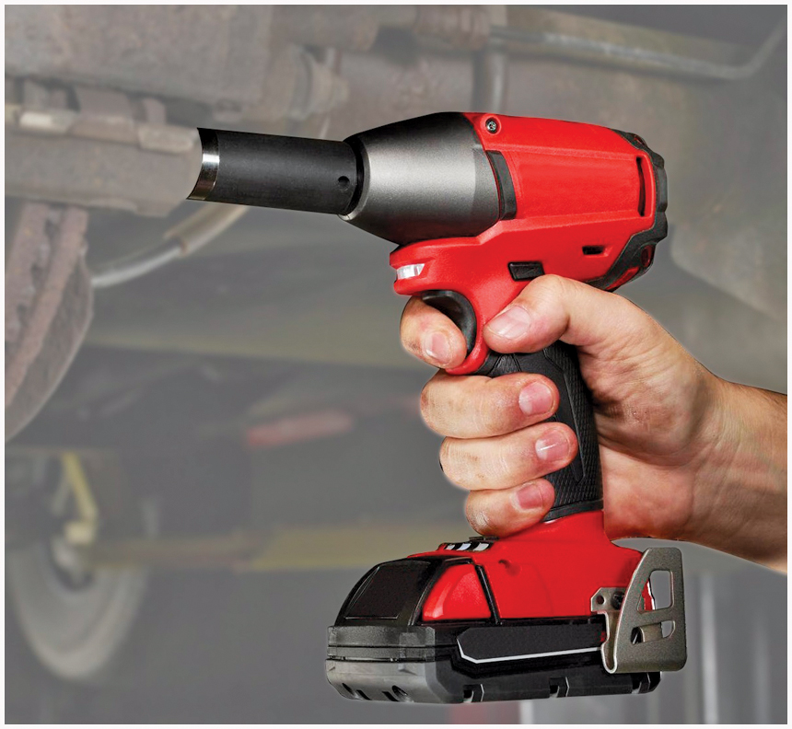
Figure 1.56 A typical battery-powered 1/2 inch drive impact wrench

Slide 58
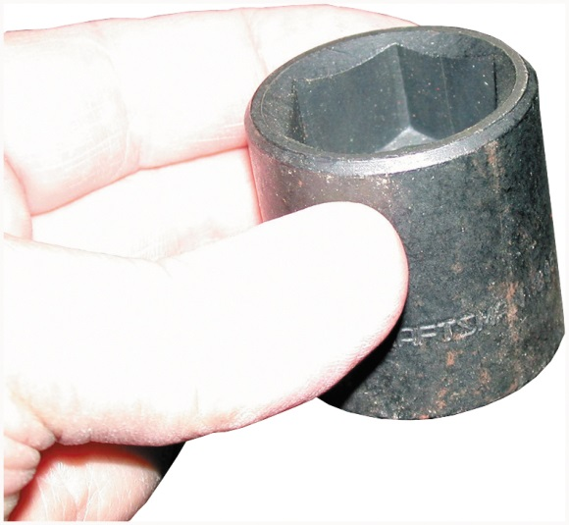
Figure 1.57 A black impact socket. Always use an impact-type socket whenever using an impact wrench to avoid the possibility of shattering the socket, which could cause personal injury. If a socket is chrome plated, it is not to be used with an impact wrench

Slide 59
Figure 1.58 An air ratchet is a very useful tool that allows fast removal and installation of fasteners, especially in areas that are difficult to reach or do not have room enough to move a hand ratchet or wrench

Slide 60
Figure 1.59 This typical die grinder surface preparation kit includes the air-operated die grinder, as well as, a variety of sanding disks for smoothing surfaces or removing rust

Slide 61
Figure 1.60 A typical pedestal grinder with a wire wheel on the left side and a stone wheel on the right side. Even though this machine is equipped with guards, safety glasses, or a face shield should always be worn whenever using a grinder or wire wheel

Slide 62
Figure 1.61 Safety glasses should be worn at all times when working on or around any vehicle or servicing any components

Slide 63
Figure 1.62 Steel-toed shoes are a worthwhile investment to help prevent foot injury due to falling objects. Even these well-worn shoes can protect the feet of this service technician

Slide 64
Figure 1.63 One version of a bump cap is a molded plastic insert that is worn inside a regular cloth cap

Slide 65
Figure 1.64 Protective gloves are available in several sizes and materials

Slide 66
Figure 1.65 Remove all jewelry before performing service work on any vehicle

Slide 67
Figure 1.66 Always connect an exhaust hose to the tailpipe of a vehicle to be run inside a building

Slide 68
Figure 1.67 A binder clip being used to keep a fender cover from falling off

Slide 69
Figure 1.68 Covering the interior as soon as the vehicle comes in for service helps improve customer satisfaction

Slide 70
Figure 1.69 All oily shop cloths should be stored in a metal container equipped with a lid to help prevent spontaneous combustion

Slide 71
Figure 1.70 Most newer vehicles have a triangle symbol indicating the recommended hoisting lift location

Slide 72
Figure 1.71 (a) Tall safety stands can be used to provide additional support for the vehicle while on the hoist. (b) A block of wood should be used to avoid the possibility of doing damage to components supported by the stand

Slide 73
Figure 1.72 This training vehicle fell from the hoist because the pads were not set correctly. No one was hurt but the vehicle was damaged

Slide 74
Figure 1.73 (a) An assortment of hoist pad adapters that are often needed to safely hoist many pickup trucks, vans, and sport utility vehicles (S U V s). (b) A view from underneath a Chevrolet pickup truck showing how the pad extensions are used to attach the hoist lifting pad to contact the frame

Slide 75
Figure 1.74 (a) The pad arm is just contacting the rocker panel of the vehicle. (b) The pad arm has dented the rocker panel on this vehicle because the pad was set too far inward underneath the vehicle

Slide 76
Figure 1.75 (a) A hydraulic hand-operated floor jack. (b) Whenever a vehicle is raised off the ground, a safety stand should be placed under the frame, axle, or body to support the weight of the vehicle

Slide 77
Figure 1.76 Drive-on-type ramps are dangerous to use. The wheels on the ground level must be chocked (blocked) to prevent accidental movement down the ramp

Slide 78
Figure 1.77 Jumper cable usage guide. Follow the same connections if using a portable jump box

Slide 79
Figure 1.78 The air pressure going to the nozzle should be reduced to 30 PSI or less to help prevent personal injury

Slide 80
Figure 1.79 A typical fire extinguisher designed to be used on type A, B, or C fires

Slide 81
Figure 1.80 A CO₂ fire extinguisher being used on a fire set in an open drum during a demonstration at a fire training center

Slide 82
Figure 1.81 A treated wool blanket is kept in an easy-to-open wall-mounted holder and should be placed in a central location in the shop

Slide 83
Figure 1.82 A first aid box should be centrally located in the shop and kept stocked with the recommended supplies

Slide 84
Figure 1.83 A typical eye wash station. Often a thorough flushing of the eyes with water is the first and often the best treatment in the event of eye contamination

Slide 85
Figure 1.84 A warning label on a Honda hybrid warns that a person can be killed due to the high-voltage circuits under the cover

Slide 86
Figure 1.85 The high-voltage disconnect switch is in the trunk area on a Toyota Prius. Insulated rubber lineman’s gloves should be worn when removing this plug

Slide 87
Figure 1.86 The high-voltage shut-off switch on a Ford Escape hybrid. The switch is located under the carpet at the rear of the vehicle

Slide 88
Figure 1.87 The shut-off switch on a G M parallel hybrid truck is green because this system uses 42 volts instead of higher, and possibly fatal, voltages used in other hybrid vehicles

Slide 89
HOISTING THE VEHICLE 1

Slide 90
HOISTING THE VEHICLE 2

Slide 91
HOISTING THE VEHICLE 3

Slide 92
HOISTING THE VEHICLE 4

Slide 93
HOISTING THE VEHICLE 5

Slide 94
HOISTING THE VEHICLE 6

Slide 95
HOISTING THE VEHICLE 7

Slide 96
HOISTING THE VEHICLE 8

Slide 97
HOISTING THE VEHICLE 9

Slide 98
HOISTING THE VEHICLE 10

Slide 99
HOISTING THE VEHICLE 11

Slide 100
HOISTING THE VEHICLE 12

Slide 101
Copyright

