Slide 1

Automotive Engines Theory and Servicing
Ninth Edition
Chapter 9
Vehicle Identification and Emission Ratings

Slide 2
OBJECTIVES
9.1 Discuss the parts of a vehicle, and differentiate between front-wheel drive and rear-wheel drive.
9.2 Explain vehicle identification, vehicle safety certification label, and the VECI label.
9.3 Discuss emission standards in the United States.
9.4 Explain calibration codes and casting numbers.

Slide 3
PARTS OF A VEHICLE
The names of the parts of a vehicle are based on the location and purpose of the component.
Left side of the vehicle
Right side of the vehicle
Front and rear

Slide 4
FRONT-WHEEL DRIVE VERSUS REAR-WHEEL DRIVE (1 OF 2)
Front-wheel drive (FWD) means that the front wheels are being driven by the engine, as well as turned by the steering wheel.
Rear-wheel drive (RWD) means that the rear wheels are driven by the engine.
If the engine is in the front, it can be either front or rear-wheel drive.

Slide 5
FRONT-WHEEL DRIVE VERSUS REAR-WHEEL DRIVE (2 OF 2)
A front engine vehicle can also drive all four wheels (4WD) or all-wheel drive (AWD).
If the engine is located at the rear of the vehicle, it can be rear-wheel drive or four-wheel (AWD) drive.

Slide 6
VEHICLE IDENTIFICATION
All service work requires that the vehicle, including the engine and accessories, be properly identified.
The most common identification is the make, model, and year of the vehicle.
Make: e.g., Chevrolet
Model: e.g., Trailblazer
Year: e.g., 2007

Slide 7
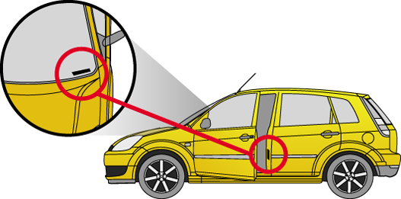
FIGURE 9–1 The vehicle identification number (VIN) is visible through the base of the windshield and on a decal inside the driver’s door.

Slide 8
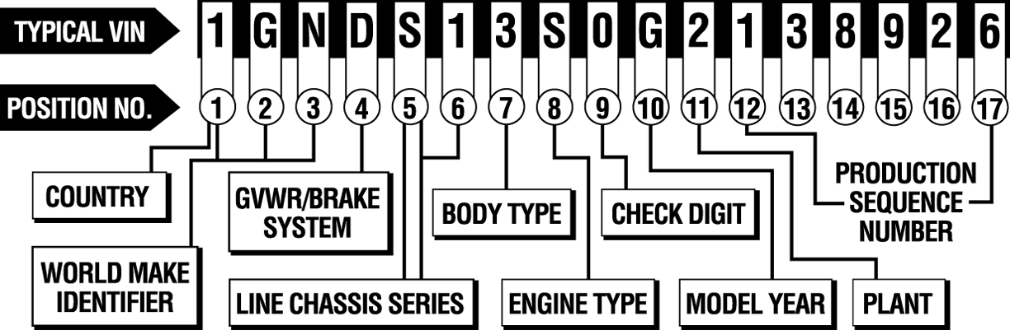
FIGURE 9-2 A typical VIN showing the information that is represented.

Slide 9
VEHICLE SAFETY CERTIFICATION LABEL
A vehicle safety certification label is attached to the left side pillar post on the rearward-facing section of the left front door.
This label indicates the month and year of manufacture as well as the:
Gross vehicle weight rating (GVWR)
Gross axle weight rating (GAWR)
Vehicle identification number (VIN).

Slide 10
VECI LABEL (1 OF 2)
The vehicle emissions control information (VECI) label under the hood of the vehicle shows informative settings and emission hose routing information.

Slide 11
VECI LABEL (2 OF 2)
The VECI label usually includes the following information.
Engine identification
Emissions standard that the vehicle meets
Vacuum hose routing diagram
Base ignition timing (if adjustable)
Spark plug type and gap
Valve lash
Emission calibration code

Slide 12
EMISSION STANDARDS IN THE UNITED STATES (1 OF 3)
In the United States, emissions standards are managed by the Environmental Protection Agency (EPA) as well as some U.S. state governments.
Some of the strictest standards in the world are formulated in California by the California Air Resources Board (CARB).

Slide 13
EMISSION STANDARDS IN THE UNITED STATES (2 OF 3)
TIER 1 AND TIER 2
TLEV—Transitional Low-Emission Vehicle.
LEV—(also known as LEV I)—Low-Emission Vehicle.
ULEV—(also known as ULEV I).
ULEV II—Ultra-Low-Emission Vehicle.
SULEV—Super-Ultra-Low-Emission Vehicle.

Slide 14
EMISSION STANDARDS IN THE UNITED STATES (3 OF 3)
ZEV—Zero-Emission Vehicle.
ILEV—Inherently Low-Emission Vehicle.
AT-PZEV—Advanced Technology Partial-Zero-Emission Vehicle.

Slide 15
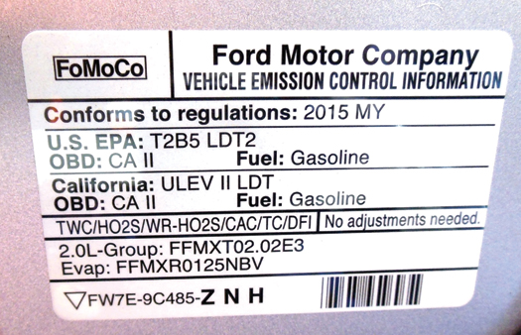
FIGURE 9–3 This vehicle emission control information (VECI) decal indicates this vehicle meets both national EPA Tier 2, Bin 5 (T2B5) and California (ULEV II) emission standards.

Slide 16
TIER 3 STANDARDS
What is Tier 3 designed to do?

Slide 17
EUROPEAN STANDARDS
Europe has its own set of standards that vehicles must meet, which includes the following tiers:
Euro I (1992–1995)
Euro II (1995–1999)
Euro III (1999–2005)
Euro IV (2005–2008)
Euro V (2008+)

Slide 18
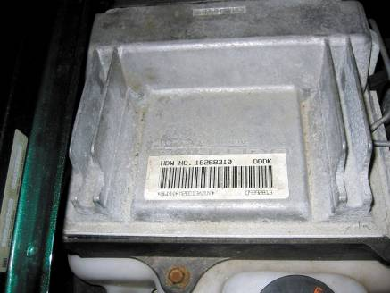
CALIBRATION CODES
Calibration codes are usually located on powertrain control modules (PCMs) or other controllers.
FIGURE 9–4 A typical computer calibration sticker on the case of the controller. The information on the sticker is often needed when ordering parts or a replacement controller.

Slide 19
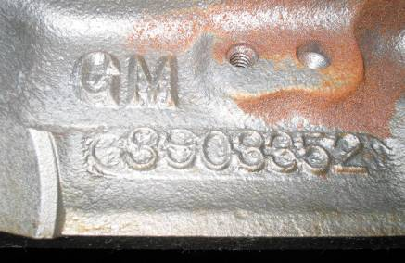
CASTING NUMBERS
Whenever an engine part such as a block is cast, a number is put into the mold to identify the casting.
FIGURE 9–5 Engine block identification number cast into the block is used for identification.

Slide 20
SUMMARY (1 OF 2)
The front, rear, left, and right side of a vehicle are as viewed from the driver's seat.
The VIN is very important as it includes when the vehicle was built, as well as the engine code and many other details about the vehicle.

Slide 21
SUMMARY (2 OF 2)
The VECI label under the hood needs to be checked by the technician to service the vehicle.
Other vehicle information that the technician may need for a service or repair include calibration codes, casting numbers, and emissions rating.

