Slide 1

Automotive Engines Theory and Servicing
Ninth Edition
Chapter 8
Service Information

Slide 2
OBJECTIVES (1 OF 2)
8.1 Discuss the importance of vehicle service records, owner's manuals, lubrication guides, and labor guide manuals.
8.2 Discuss the importance of service manuals.
8.3 Discuss the advantages and disadvantages of hard copy versus electronic service information.

Slide 3
OBJECTIVES (2 OF 2)
8.4 Explain electronic service information.
8.5 Explain hotline services, specialty repair manuals, and aftermarket supplies guides and catalogs.

Slide 4
VEHICLE SERVICE HISTORY RECORDS
Whenever service work is performed, a record of what was done is usually kept on file by the shop or service department for a number of years.
  The service technician will check the vehicle service history if working on a vehicle with an unusual problem.
  A previous repair may indicate the reason for the current problem or it could be related to the same circuit or components.

Slide 5
OWNER'S MANUALS (1 OF 2)
Most owner's manuals contain all or most of the following information.
  How to reset the maintenance reminder light
  Viscosity of oil needed and number of quarts (liters)
  Tire pressures and standard and optional tire sizes
  Maintenance schedule for all fluids

Slide 6
OWNER'S MANUALS (2 OF 2)
  How to program the remote control as well as the power windows and door locks
  How to reset the tire pressure monitoring system after a tire rotation

Slide 7
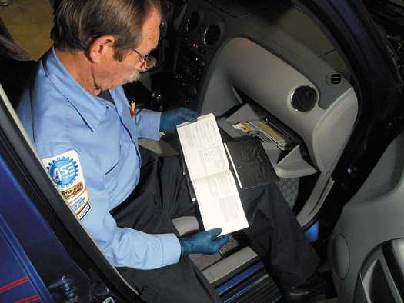
FIGURE 8–1 The owner’s manual has a lot of information pertaining to the operation as well as the maintenance and resetting procedures that technicians often need.

Slide 8
LUBRICATION GUIDES
Lubrication guides include all specifications for lubrication-related service including:
  Hoisting location
  Lubrication points
  Grease and oil specifications
  Capacities for engine oil, transmission fluid, coolant and differential fluid

Slide 9
SERVICE MANUALS (1 OF 3)
Included in most service manuals are the following:
  Capacities and recommended specifications for all fluids
  Specifications including engine and routine maintenance items
  Testing procedures

Slide 10
SERVICE MANUALS (2 OF 3)
  Service procedures including the use of special tools when needed
  Component location information
General Information
Maintenance And Lubrication Information
Engines

Slide 11
SERVICE MANUALS (3 OF 3)
Automatic Transmission/Transaxle
Electrical Systems
Heating, Ventilation, and Air Conditioning
Engine Performance (Driveability And Emissions)

Slide 12
HARD COPY VS. ELECTRONIC SERVICE INFORMATION (1 OF 2)
Advantages
  Hard Copy
    Easy to use—no hardware or expensive computers needed
    Can be taken to the vehicle for reference
    Can view several pages easily for reference

Slide 13
HARD COPY VS. ELECTRONIC SERVICE INFORMATION (2 OF 2)
Advantages
  Electronic Service Information
    Information can be printed out and taken to the vehicle
    Has a search function for information
    Internet or network access allows use at several locations in the shop

Slide 14
HARD COPY VS. ELECTRONIC SERVICE INFORMATION (1 OF 2)
Disadvantages
  Hard Copy
    Can be lost or left in the vehicle
    Cost is high for each manual
    Can get dirty and unreadable

Slide 15
HARD COPY VS. ELECTRONIC SERVICE INFORMATION (2 OF 2)
  Electronic Service Information
    Requires a computer and printer
    Internet or network access can be a challenge
    Cost can be high

Slide 16
LABOR GUIDE MANUALS
Labor guides list vehicle service procedures and the time it should take an average technician to complete the task.
  This flat-rate time is then the basis for estimates and pay for technicians.
Some manuals also include a parts list, including the price of the part to help service advisors create complete estimates for both labor and parts.

Slide 17
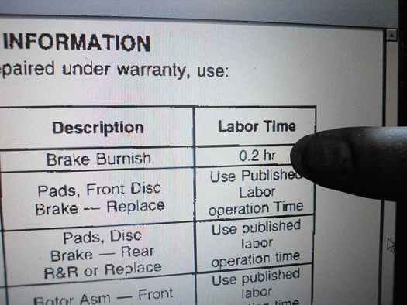
FIGURE 8–2 Some technical service bulletins also include the designated flat-rate time when specifying a repair procedure.

Slide 18
ELECTRONIC SERVICE INFORMATION
Home Screen
Toolbars
Electronic Service Information
Technical Service Bulletins
Internet
Recalls And Campaigns

Slide 19
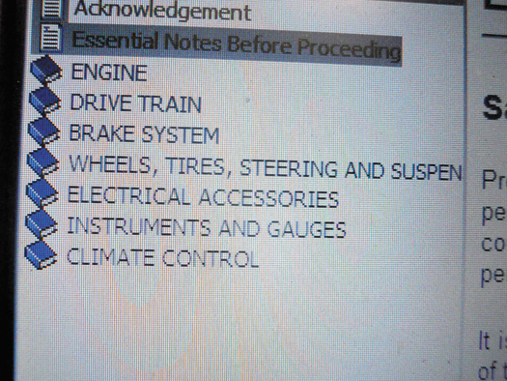
FIGURE 8–3 A main menu showing the major systems of the vehicle. Clicking on one of these major topics opens up another menu showing more detailed information.

Slide 20
HOTLINE SERVICES
A subscription-based helpline to assist service technicians solve technical problems.
  Most charge a monthly fee for a certain amount of time each month to talk to an experienced service technician

Slide 21
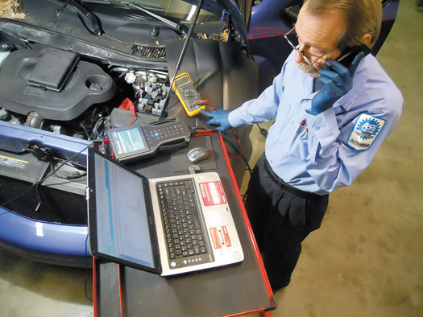
FIGURE 8–4 Whenever calling a hot line service be sure that you have all of the vehicle information ready and are prepared to give answers regarding voltage readings or scan tool data when talking to the vehicle specialist.

Slide 22
SPECIALITY REPAIR MANUALS
Examples of specialty repair manuals include unit repair for assembled components, such as:
  Automatic transmission/transaxle, manual transmission/transaxle, differentials, and engines.
Some specialty repair manuals cover older or antique vehicles.

Slide 23
AFTERMARKET SUPPLIES GUIDES AND CATALOGS
Aftermarket supplies guides and catalogs are usually free and include expanded views of assembled parts
Go to the following websites for examples of training conferences with trade shows.
  www.CARSevent.com
  www.avtechexpo.com
  www.visionkc.com (Vision Expo)

Slide 24
ADDITIONAL INFORMATION
What is the information the service advisor or shop owner should record about the customer?
Check the vehicle before work is started
Special service tools
  What tools are made by SPX?
  Other manufacturers of SST are…?

Slide 25
SUMMARY (1 OF 2)
Vehicle history records are sometimes very helpful in determining problems that may be related to a previous fault or repair.
The vehicle owner's manual is very helpful to the service technician.

Slide 26
SUMMARY (2 OF 2)
Lubrication guides provide information on the specified oil and lubricants needed along with the capacities and the location of lubrication points.
Hotline services are subscription based and allow a technician to talk to an experienced technician who has many resources.

