Slide 1
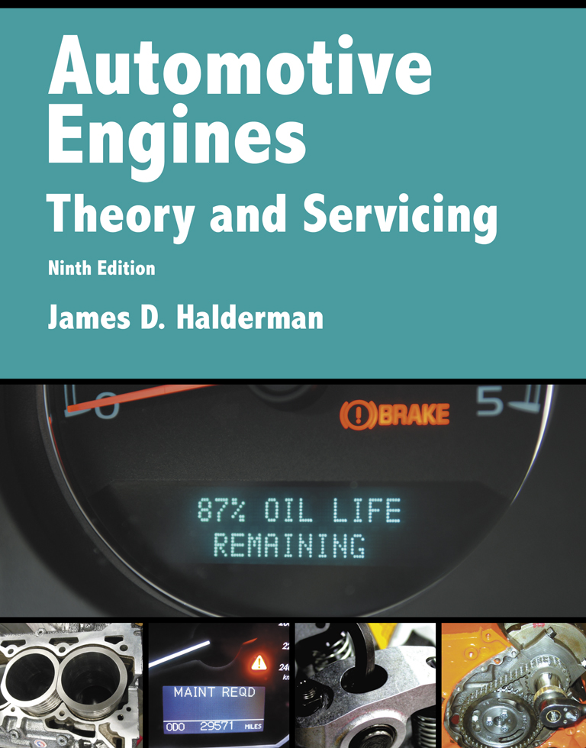
Automotive Engines Theory and Servicing
Ninth Edition
Chapter 6
Vehicle Lifting and Hoisting

Slide 2
OBJECTIVES
6.1 Discuss the purpose of floor jacks and creepers.
6.2 Describe vehicle hoists and drive-on ramps, and discus the proper methods to follow to safely hoist a vehicle.

Slide 3
FLOOR JACK
A floor jack is a hand-operated hydraulic device used to lift vehicles or components.
Most floor jacks use four casters, which allow the jack to be easily moved around the shop.
FIGURE 6–1 A hydraulic hand-operated floor jack.

Slide 4
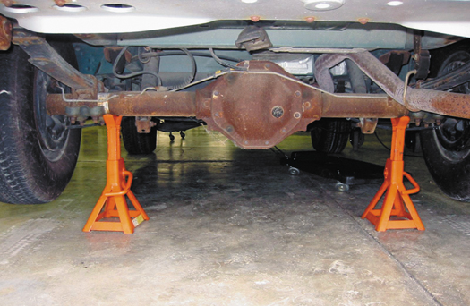
FIGURE 6–2 Safety stands are being used to support the rear of this vehicle.

Slide 5
CREEPERS
When working underneath a vehicle, most service technicians use a creeper
  A creeper is a flat or concaved surface equipped with low-profile casters.
  A creeper allows the technician to maneuver under the vehicle easily.

Slide 6
VEHICLE HOISTS (1 OF 5)
Vehicle hoists include older in ground pneumatic/hydraulic and above ground units.
Hoists are rated by the maximum weight that they can safely lift, such as 7,000 to 12,000 or more.
Many chassis and underbody service procedures require the vehicle be hoisted/lifted off the ground.

Slide 7
VEHICLE HOISTS (2 OF 5)
The simplest methods involve the use of drive-on ramps or a floor jack and safety (jack) stands
  Ground or surface-mounted lifts provide greater access.
The vehicle should be centered on the lift or hoist so as not to overload one side or put too much force either forward or rearward.

Slide 8
VEHICLE HOISTS (3 OF 5)
The pads of the lift should be spread as far apart as possible to provide a stable platform.
Each pad should be placed under a portion of the vehicle that is strong and capable of supporting the weight of the vehicle.
As soon as the pads touch the vehicle, check for proper pad placement.

Slide 9
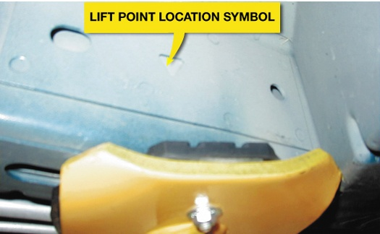
FIGURE 6–3 Most newer vehicles have a triangle symbol indicating the recommended hoisting lift points.

Slide 10
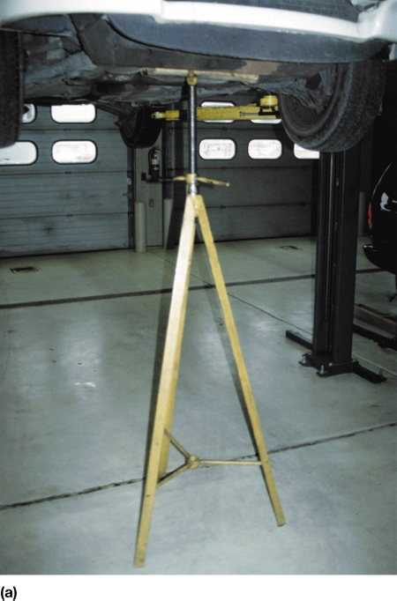
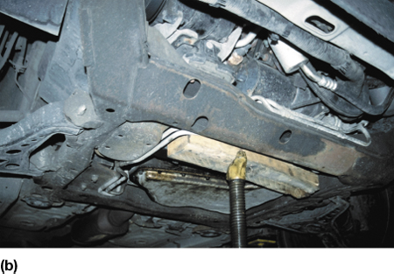
FIGURE 6–4 (a) Tall safety stands can be used to provide additional support for a vehicle while on a hoist. (b) A block of wood should be used to avoid the possibility of doing damage to components supported by the stand.

Slide 11
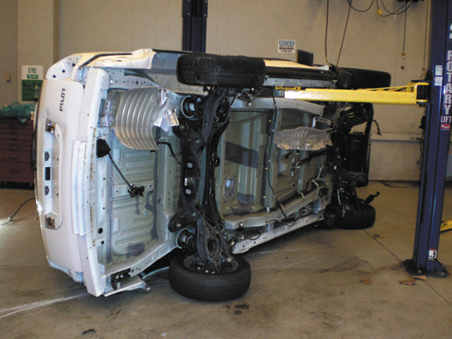
FIGURE 6–5 This training vehicle fell from the hoist when the pads were not set correctly. No one was hurt, but the vehicle was damaged.

Slide 12
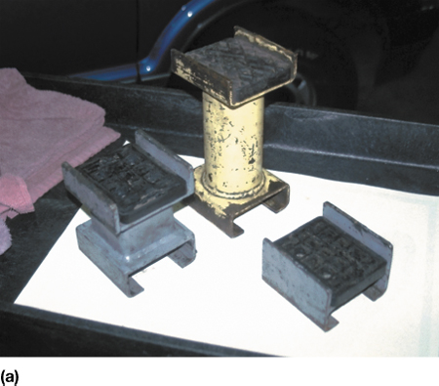
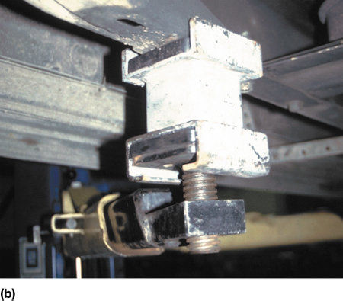
FIGURE 6–6 (a) An assortment of hoist pad adapters that are often necessary to safely hoist many pickup trucks, vans, and sport utility vehicles. (b) A view from underneath a Chevrolet pickup truck showing how the pad extensions are used to attach the hoist lifting pad to contact the frame.

Slide 13
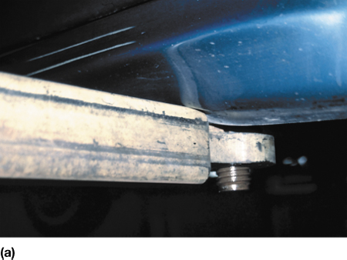
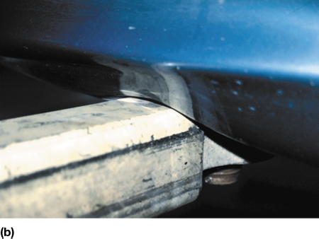
FIGURE 6–7 (a) In this photo the pad arm is just contacting the rocker panel of the vehicle. (b) This photo shows what can occur if the technician places the pad too far inward underneath the vehicle. The arm of the hoist has dented in the rocker panel.

Slide 14
VEHICLE HOISTS (4 OF 5)
The vehicle should be raised about 1 ft (30 cm) off the floor, then stopped and shaken to check for stability.
Continue raising the vehicle and continue to view the vehicle until it has reached the desired height.
The hoist should be lowered onto the mechanical locks, and then raised off of the locks before lowering.

Slide 15
VEHICLE HOISTS (5 OF 5)
Before lowering the hoist, the safety latch(es) must be released and the direction of the controls reversed.
The speed downward is often adjusted to be as slow as possible for additional safety.

Slide 16
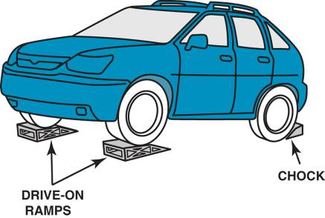
DRIVE-ON RAMPS
Ramps are an inexpensive way to raise the front or rear of a vehicle.
FIGURE 6–8 Drive-on-type ramps. The wheels on the ground level must be chocked (blocked) to prevent accidental movement down the ramp.

Slide 17
SUMMARY (1 OF 2)
Whenever a vehicle is raised off the ground using a floor jack, it must be supported using safety stands.
Creepers should be stored vertically to prevent the possibility of stepping on it, which could cause a fall and personal injury.

Slide 18
SUMMARY (2 OF 2)
Always adhere to the specified hoisting locations as found in service information.
Adapters or extensions are often needed when hoisting pickup trucks or vans.

Slide 19
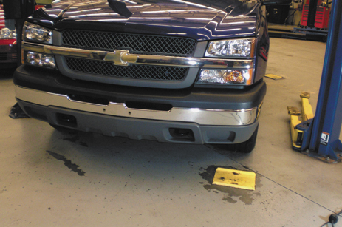
1 The first step in hoisting a vehicle is to properly align the vehicle in the center of the stall.

Slide 20
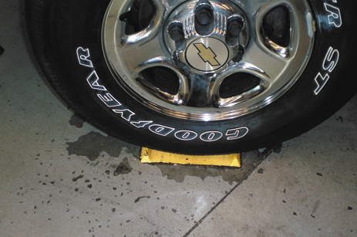
2 Most vehicles will be correctly positioned when the left front tire is centered on the tire pad.

Slide 21
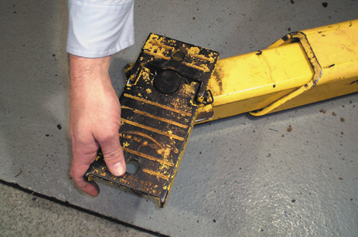
3 The arms can be moved in and out and most pads can be rotated to allow for many different types of vehicle construction.

Slide 22
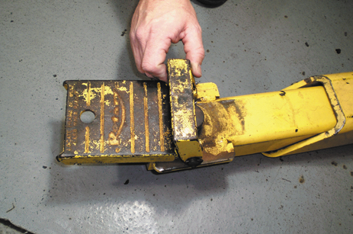
4 Most lifts are equipped with short pad extensions that are often necessary to use to allow the pad to contact the frame of a vehicle without causing the arm of the lift to hit and damage parts of the body.

Slide 23
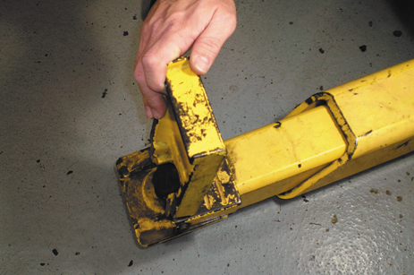
5 Tall pad extensions can also be used to gain access to the frame of a vehicle. This position is needed to safely hoist many pickup trucks, vans, and sport utility vehicles.

Slide 24
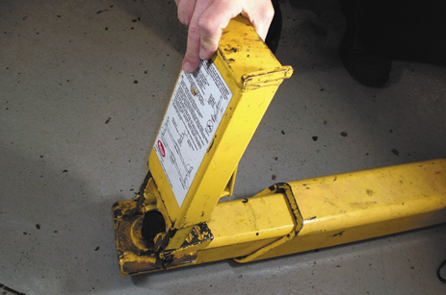
6 An additional extension may be necessary to hoist a truck or van equipped with running boards to give the necessary clearance.

Slide 25
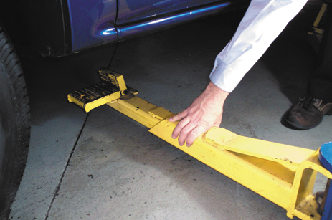
7 Position the pads under the vehicle under the recommended locations.

Slide 26
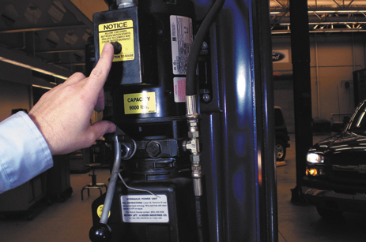
8 After being sure all pads are correctly positioned, use the electromechanical controls to raise the vehicle.

Slide 27
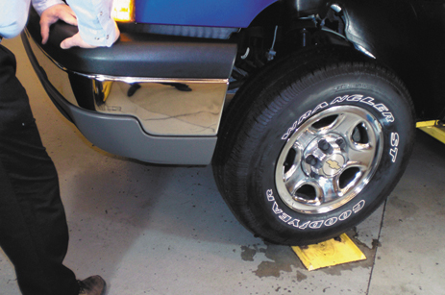
9 With the vehicle raised one foot (30 cm) off the ground, push down on the vehicle to check to see if it is stable on the pads. If the vehicle rocks, lower the vehicle and reset the pads. The vehicle can be raised to any desired working level. Be sure the safety mechanism is engaged before working on or under the vehicle.

Slide 28
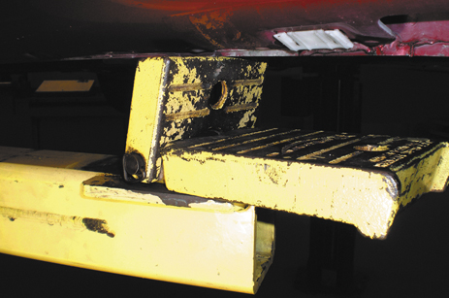
10 If raising a vehicle without a frame, place the flat pads under the pinch weld seam to spread the load. If additional clearance is necessary, the pads can be raised as shown.

Slide 29
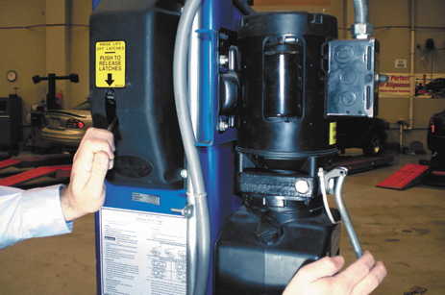
11 When the service work is completed, the hoist should be raised slightly and the safety mechanism released before using the hydraulic to lower the vehicle.

Slide 30
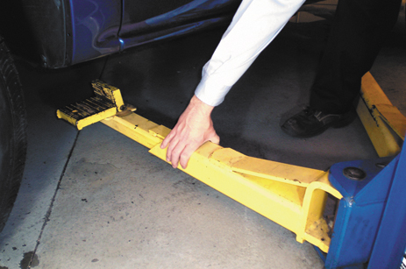
12 After lowering the vehicle, be sure all arms of the lift are moved out of the way before driving the vehicle out of the work stall.

