Slide 1

Automotive Engines Theory and Servicing
Ninth Edition
Chapter 5
Power Tools and Shop Equipment

Slide 2
OBJECTIVES
5.1 Describe the purpose of the air compressor, and other air and electrically operated tools.
5.2 Compare the different types of trouble lights.
5.3 Describe the purpose of the bench/pedestal grinder and the bench vise.
5.4 Discuss the purpose of hydraulic presses, portable crane and chain hoist, and engine stands.

Slide 3
AIR COMPRESSOR (1 OF 2)
A shop air compressor is usually located in a separate room or an area away from the customer area of a shop.

Slide 4
AIR COMPRESSOR (2 OF 2)
An air compressor is powered by a 220 V AC electric motor
Includes a storage tank and the compressor itself
As well as the pressure switches, which are used to maintain a certain minimum level of air pressure in the system.

Slide 5
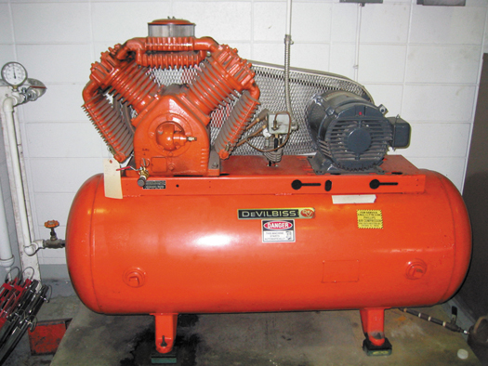
FIGURE 5–1 A typical shop compressor. It is usually placed out of the way, yet accessible to provide for maintenance to the unit.

Slide 6
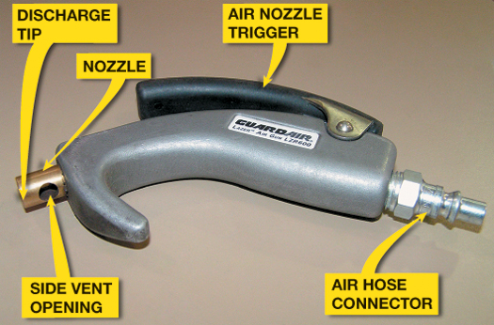
FIGURE 5–2 Always use an air nozzle that is OSHA approved. The openings in the side are used to allow air to escape if the nozzle tip were to become clogged.

Slide 7
AIR AND ELECTRICALLY OPERATED TOOLS
Impact Wrench
Air Ratchet
Die Grinder
Air Drill
Air-blow Gun
Air-operated Grease Gun
Battery-powered Grease Gun

Slide 8
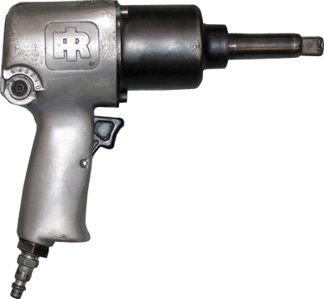
FIGURE 5–3 A typical 1/2 inch drive impact wrench.

Slide 9
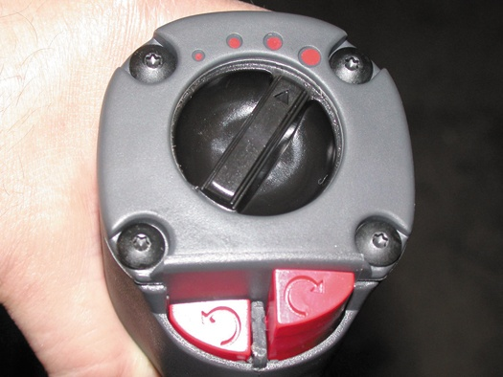
FIGURE 5–4 This impact wrench features a variable torque setting using a rotary knob. The direction of rotation can be changed by pressing the button at the bottom.

Slide 10
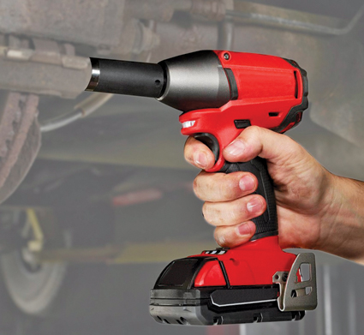
FIGURE 5–5 A typical battery-powered 1/2 inch drive impact wrench.

Slide 11
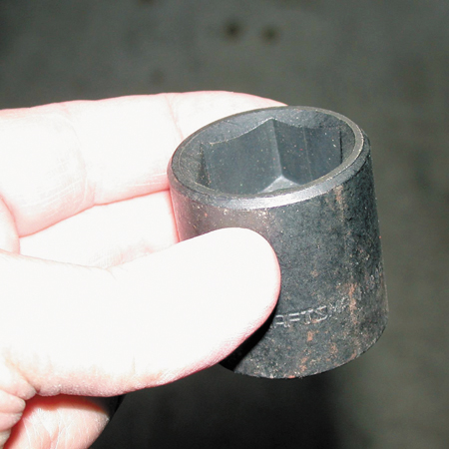
FIGURE 5–6 A black impact socket. Always use impact-type sockets whenever using an impact wrench to avoid the possibility of shattering the socket, which can cause personal injury.

Slide 12
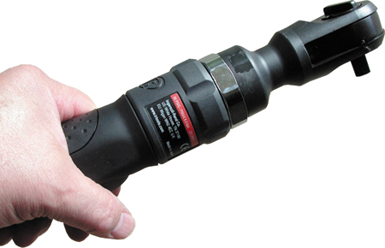
FIGURE 5–7 An air ratchet is a very useful tool that allows fast removal and installation of fasteners, especially in areas that are difficult to reach or do not have room enough to move a hand ratchet wrench.

Slide 13
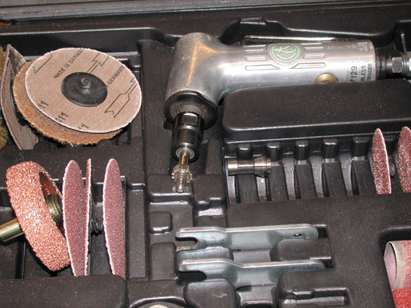
FIGURE 5–8 This typical die grinder surface preparation kit includes the air-operated die grinder, as well as a variety of sanding discs for smoothing surfaces or removing rust.

Slide 14
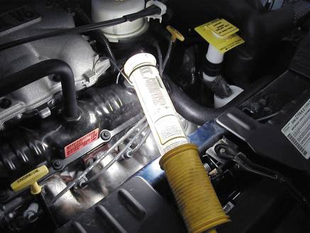
TROUBLE LIGHTS
Incandescent: standard trouble light (work light)
Fluorescent: essential light for shop safety
LED Trouble Light: excellent because they are shock resistant, long lasting, and do not pose a fire hazard
FIGURE 5–9 A fluorescent trouble light operates cooler and is safer to use in the shop because it is protected against accidental breakage where gasoline or other flammable liquids would happen to come in contact with the light.

Slide 15
BENCH/PEDESTAL GRINDER
Bench- or Pedestal-mounted Grinder
These high-powered grinders can be equipped with a wire brush wheel and/or a stone wheel.
A wire brush wheel is used to clean steel or sheet metal parts.
A stone wheel is used to grind metal or to remove the mushroom from the top of punches or chisels.

Slide 16
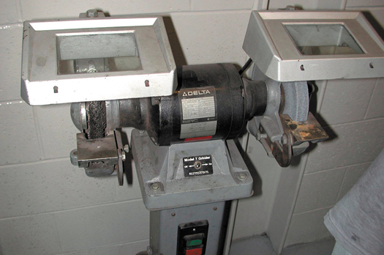
FIGURE 5–10 A typical pedestal grinder with a wire wheel on the left side and a stone wheel on the right side. Even though this machine is equipped with guards, safety glasses or a face shield should always be worn when using a grinder or wire wheel.

Slide 17
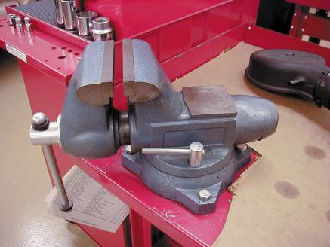
BENCH VISE
A bench vise is used to hold components so that work can be performed on the unit.
The size of a vise is determined by the width of the jaws.
Two common sizes of vises are 4 in. and 6 in. models.
FIGURE 5–11 A typical vise mounted to a workbench.

Slide 18
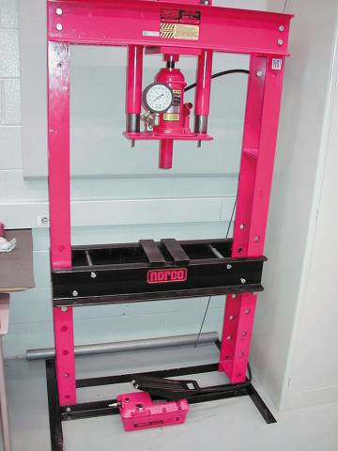
HYDRAULIC PRESSES
Hydraulic presses are hand-operated hydraulic cylinders mounted to a stand and designed to press bearings on or off of shafts and other components.
A bearing splitter is often required to apply force to the inner race of a bearing.
FIGURE 5–12 A hydraulic press is usually used to press bearings on and off of rear axles and transmissions.

Slide 19
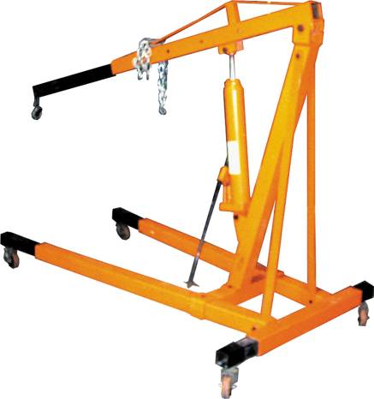
PORTABLE CRANE AND CHAIN HOIST
A portable crane is used to remove and install engines and other heavy vehicle components.
FIGURE 5–13 A typical portable crane used to lift and move heavy assemblies, such as engines and transmissions.

Slide 20
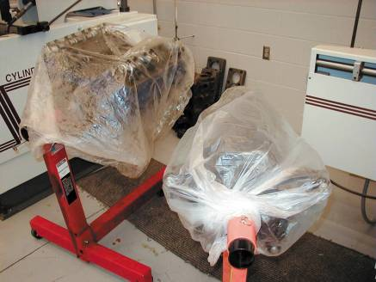
ENGINE STANDS
An engine stand is designed to safely hold an engine and to allow it to be rotated.
This allows the technician to easily remove, install, and perform service work to the engine.
FIGURE 5–14 Two engines on engine stands. The plastic bags over the engines help keep dirt from getting onto these engines and engine parts.

Slide 21
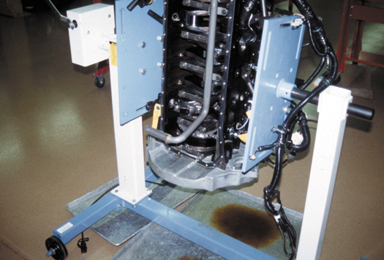
FIGURE 5–15 An engine stand that grasps the engine from the sides rather than the end.

Slide 22
CARE AND MAINTENANCE OF SHOP EQUIPMENT
Keep equipment clean
Keep equipment lubricated

Slide 23
SUMMARY (1 OF 3)
Most shops are equipped with a large air compressor that supplies pressurized air to all stalls for use by the technician.
An air impact wrench is the most commonly used power tool in the shop. It is used mostly to remove fasteners.
Other air-operated tools include an air ratchet and a die grinder.

Slide 24
SUMMARY (2 OF 3)
A bench or pedestal grinder usually has both a grinding stone and a wire brush wheel.
Trouble lights should be fluorescent or LED for maximum safety in the shop.
A hydraulic press is used to remove bearings from shafts and other similar operations.

Slide 25
SUMMARY (3 OF 3)
A portable crane is used to remove and install engines or engine/transmission assemblies from vehicles.
Engine stands are designed to allow the technician to rotate the engine to get access to the various parts and components.

Slide 26
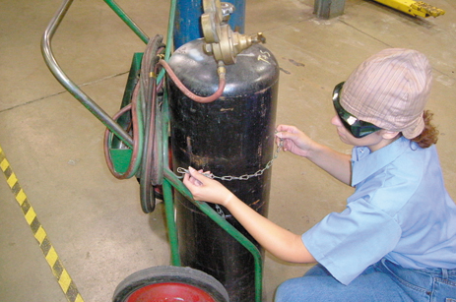
1 Inspect the cart and make sure the tanks are chained properly before moving it to the work location.

Slide 27
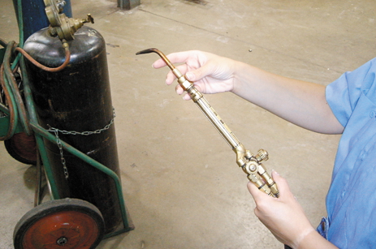
2 Start by attaching the appropriate work tip to the torch handle. The fitting should only be tightened hand tight. Make sure the valves on the torch handle are closed at this time.

Slide 28
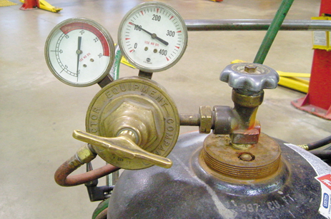
3 Each tank has a regulator assembly with two gauges. The high pressure gauge shows tank pressure, and the low pressure gauge indicates working pressure.

Slide 29
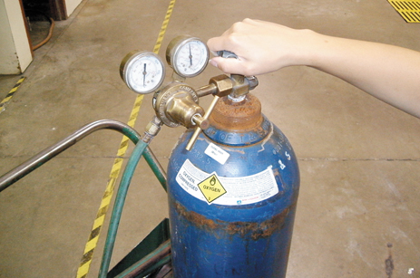
4 Open the oxygen tank valve fully open, and open the acetylene tank valve 1/2 turn.

Slide 30
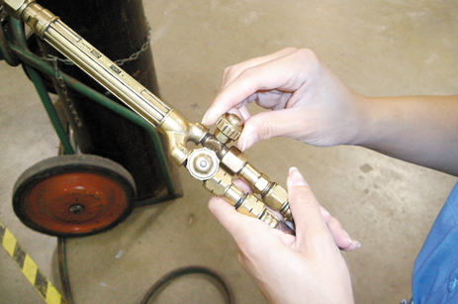
5 Open the oxygen valve on the torch handle 1/4 turn in preparation for adjusting oxygen gas pressure.

Slide 31
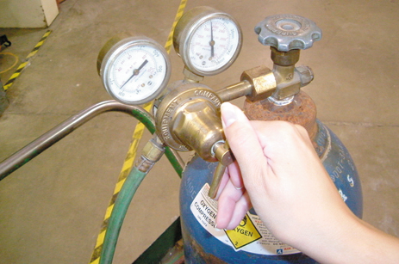
6 Turn the oxygen regulator valve clockwise and adjust oxygen gas pressure to 20 PSI. Close the oxygen valve on the torch handle.

Slide 32
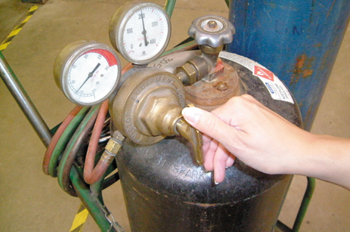
7 Open the acetylene valve on the torch handle 1/4 turn and adjust acetylene gas pressure to 7 PSI. Close the acetylene valve on the torch handle.

Slide 33
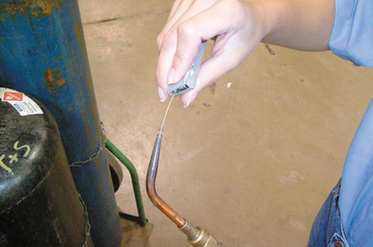
8 Open the oxygen valve on the torch handle 1/4 turn and use an appropriate size tip cleaner to clean the tip orifice. Finish by closing the oxygen valve.

Slide 34
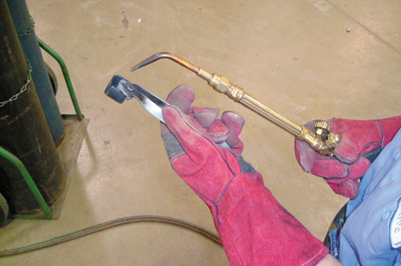
9 Put on leather gloves and open the acetylene valve on the torch handle 1/4 turn. Use a flint striker to ignite the acetylene gas exiting the torch tip.

Slide 35
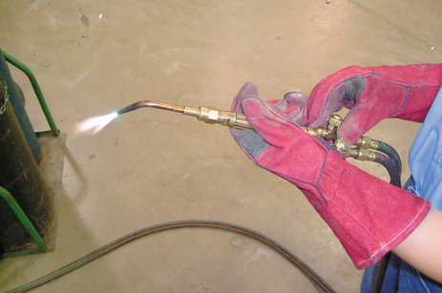
10 Adjust the acetylene valve until the base of the flame just touches the torch tip. Slowly open the oxygen valve on the torch handle and adjust for a neutral flame (blue cone is well-defined).

Slide 36
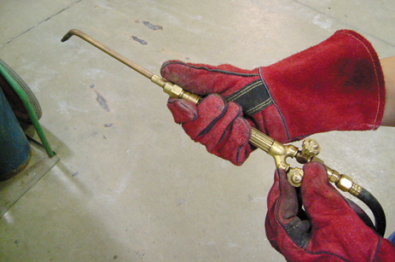
11 Once work is complete, extinguish the flame by quickly closing the acetylene valve on the torch handle. Be prepared to hear a loud “pop” when the flame goes out. Close the oxygen valve on the torch handle.

Slide 37
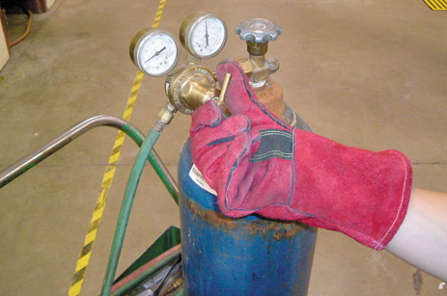
12 Close the valves on both tanks and turn the regulator handles CCW until they no longer contact the internal springs. Open the gas valves briefly on the torch handle to release gas pressure from the hoses. Close the gas valves on the torch handle and put away the torch assembly.

Slide 38
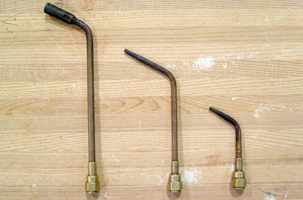
13 Heating attachments include ordinary heating tips, middle and right and a “rosebud” (left). Ordinary heating tips work fine for most purposes, but occasionally the rosebud is utilized when a great deal of heat is needed.

Slide 39
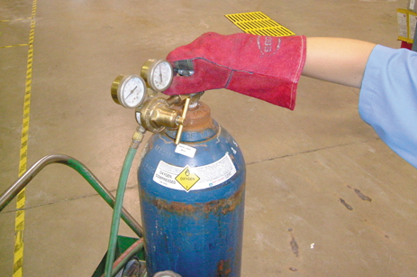
14 Note that while acetylene tank pressures are relatively low, the oxygen tank can be filled to over 2,000 PSI. This can represent a serious hazard if precautions are not taken. Be absolutely certain that the tanks are chained properly to the cart before attempting to move it!

Slide 40
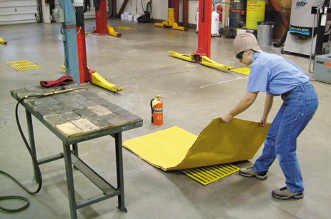
15 Any time heating or cutting operations are being performed, be sure that any flammables have been removed from the immediate area. A fire blanket may be placed over floor drains or other objects to prevent fires. A fire extinguisher should be on hand in case of an emergency.

Slide 41
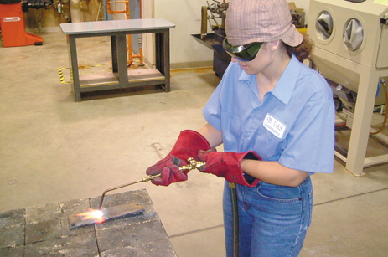
16 Be sure to wear appropriate personal protective equipment during heating and cutting operations.

Slide 42
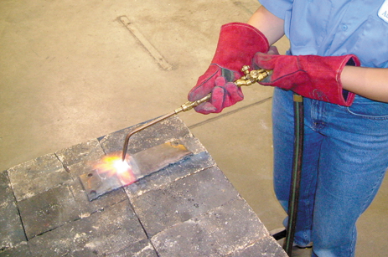
17 Note that heating operations should be performed over steel or firebrick. Never heat or cut steel close to concrete, as it could cause the concrete to explode.

Slide 43
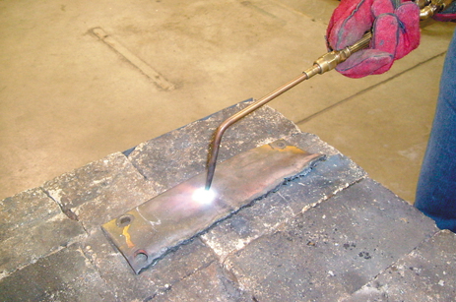
18 When heating steel, move the torch in a circular pattern to prevent melting of the metal. Don’t hold the torch too close to the work as this will cause a “snapping” or “backfire” that can extinguish the flame.

Slide 44
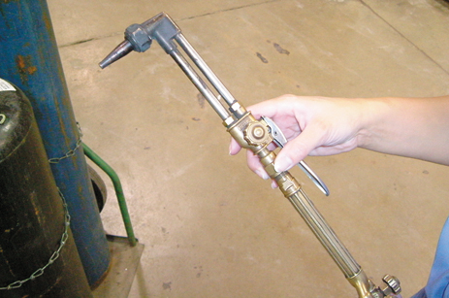
19 Affix the cutting attachment to the torch handle. Note that the cutting attachment has a cutting handle and a separate oxygen valve.

Slide 45
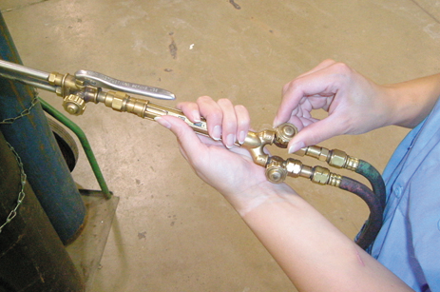
20 Fully open the oxygen valve on the torch handle. Oxygen flow will now be controlled with the valve on the cutting attachment.

Slide 46
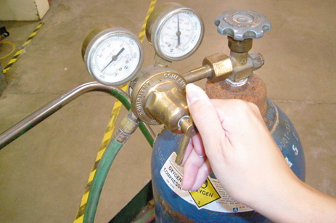
21 Oxygen gas pressure should be adjusted to 30 PSI whenever using the cutting attachment. Acetylene pressure is kept at 7 PSI.

Slide 47
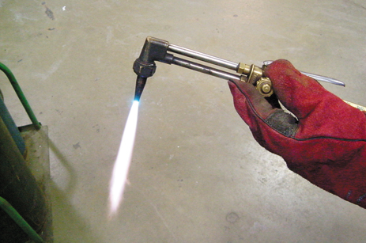
22 Open the acetylene valve on the torch handle 1/4 turn and light the torch. Adjust the flame until its base just touches the cutting tip. Slowly open the oxygen valve on the cutting attachment and adjust the flame until the blue cone is well-defined.

Slide 48
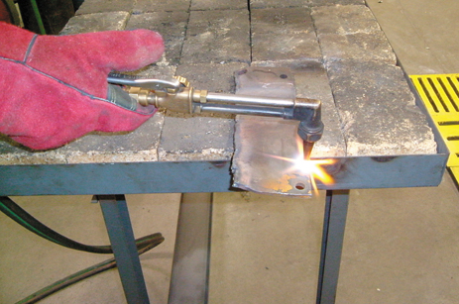
23 Direct the flame onto a thin spot or sharp edge of the metal to be cut. This will build the heat quicker in order to get the cut started.

Slide 49
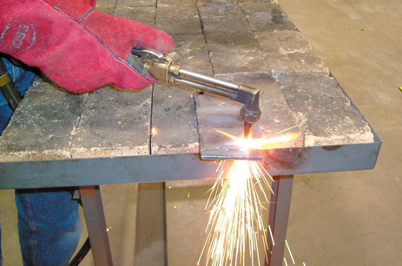
24 When the metal glows red, depress the cutting handle and move the torch to advance the cut. You will need to move the torch faster when cutting thinner pieces of steel. On thicker pieces, point the cutting tip into the direction of the cut.

