Slide 1
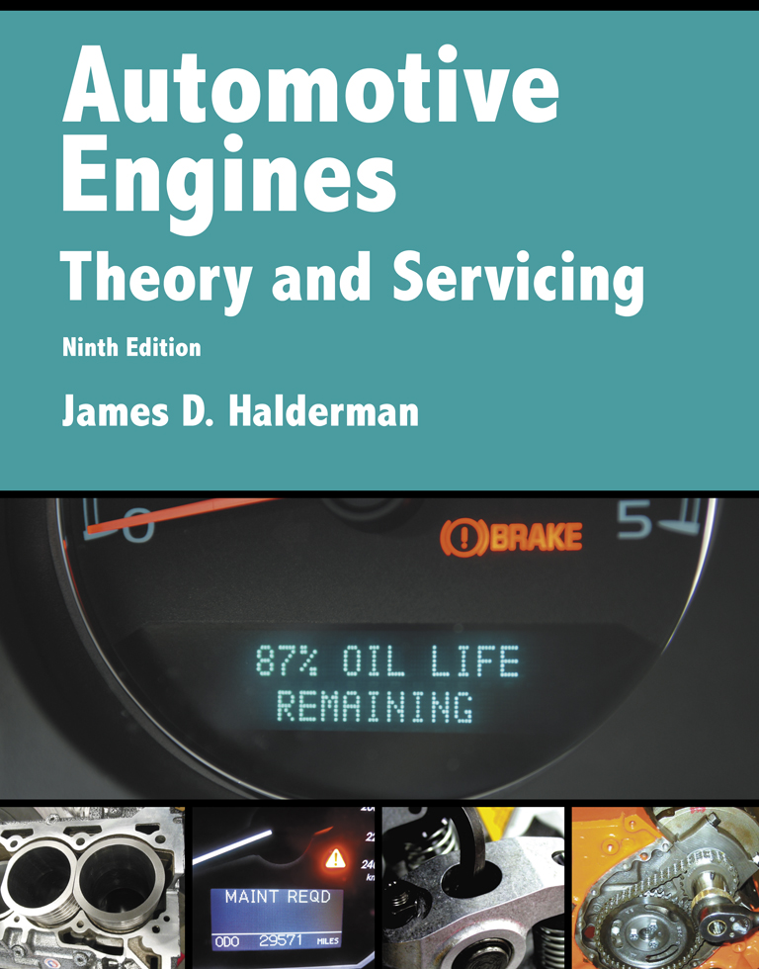
Automotive Engines Theory and Servicing
Ninth Edition
Chapter 33
Balancing and Blueprinting

Slide 2
OBJECTIVES (1 OF 2)
33.1 Explain the purpose of balancing an engine.
33.2 Describe the blueprinting process.
33.3 Discuss the importance of combustion chamber volume.
33.4 Discuss the purpose of flow testing cylinder heads.

Slide 3
OBJECTIVES (2 OF 2)
33.5 Discuss the purpose of degreeing the camshaft.
33.6 Explain the procedure of determining proper push rod length.
33.7 Discuss short block blueprinting.

Slide 4
BALANCING AN ENGINE (1 OF 5)
For any engine to operate with a minimum amount of vibration, all of the reciprocating parts must be close to the same weight.
Production engines use parts that are usually within 3 grams of each other and result in a relatively smooth operating engine.

Slide 5
BALANCING AN ENGINE (2 OF 5)
Whenever all rotating and reciprocating parts of an engine are to be balanced, the following components are needed to balance inline engines.
Crankshaft
Vibration damper (harmonic balancer)
Flywheel or flexplate
Pressure plate

Slide 6
BALANCING AN ENGINE (3 OF 5)
All bolts, lock washers, keys, and spacers needed to assemble the above parts on the crankshaft
Connecting rods
Pistons
Wrist pins
STEP 1 Equalize the reciprocating weight, which includes the pistons and rods.

Slide 7
BALANCING AN ENGINE (4 OF 5)
STEP 2 Connecting rods have a big end and a small end.
The big end of the rod is considered to be part of the rotating weight and the small end part of the reciprocating weight after the rod has been reconditioned.
The two ends should be weighed and matched separately.

Slide 8
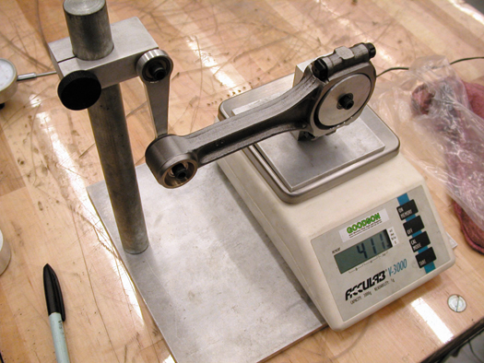
Figure 33–1 Weighing the big end of a connecting rod on a scale that keeps it perfectly horizontal so that each end can be weighed separately.

Slide 9
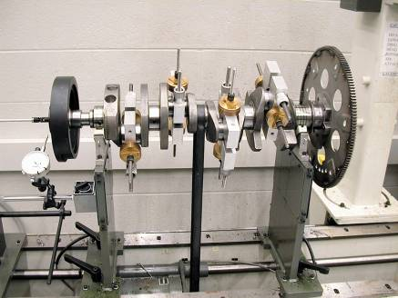
BALANCING AN ENGINE (5 OF 5)
Bob Weights
Balancing Factor
Balancing Machines
FIGURE 33–3 A crankshaft with bob weights attached as well as the flexplate and the harmonic balancer.

Slide 10
BLUEPRINTING PROCESS (1 OF 2)
General Use Questions
Blueprinting is the process used to custom fit and select variables to best match a predetermined level of performance.
Specific Requirement Needs
Block
Rotating assembly
Breathing system

Slide 11
BLUEPRINTING PROCESS (2 OF 2)
Size Matters
Boring the block
Stroking the engine
Parts Manufacturer Help
Follow Parts Manufacturer's Recommendations

Slide 12
COMBUSTION CHAMBER VOLUME
All cylinders should have the same compression.
The technician or engine builder needs to know the combustion chamber volume to accurately calculate the compression ratio.
To accurately measure the volume of the combustion chamber, a graduated burette is used with mineral spirits.

Slide 13
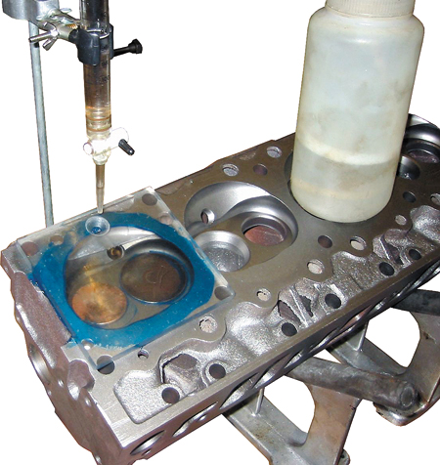
Figure 33–7 Setup needed to measure the combustion chamber volume in cubic centimeters (cc).

Slide 14
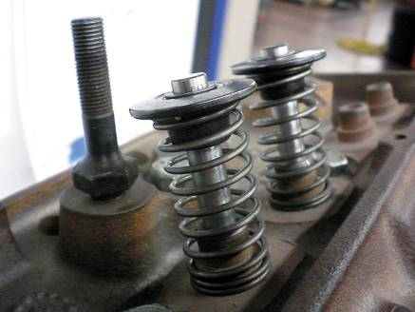
FLOW TESTING CYLINDER HEADS
Purpose
Used to measure the amount of air in cubic feet per minute that can flow through the valves at various valve openings
Flow Rate and Horsepower
FIGURE 33–8 Cylinder head setup for flow testing. Note the weak valve springs that are strong enough to keep the valves shut, yet weak enough to permit the flow bench operator to vary the intake valve opening amount.

Slide 15
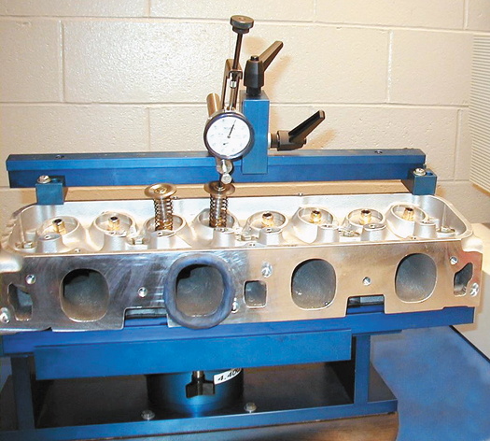
Figure 33–9 Modeling clay is installed around the port to duplicate the flow improvement characteristics of an intake manifold.

Slide 16
DEGREEING THE CAMSHAFT
Purpose
To locate the valve action exactly as the camshaft manufacturers intended
Procedure
Advanced Cam Timing
Retarded Cam Timing

Slide 17
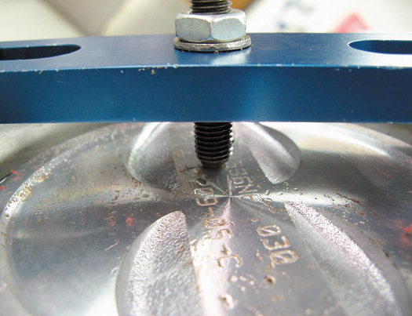
Figure 33–11 A piston stop is used to help determine top dead center.

Slide 18
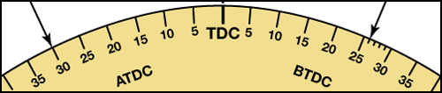
FIGURE 33–12 The degree wheel indicates where the piston stopped near top dead center. By splitting the difference between the two readings, the true TDC (28 degrees) can be located on the degree wheel.

Slide 19
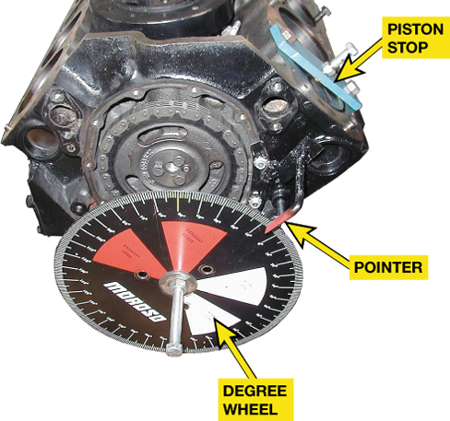
Figure 33–13 Note the setup required to degree a camshaft. The pointer, the degree wheel, and the piston stop are used to find exact top dead center.

Slide 20
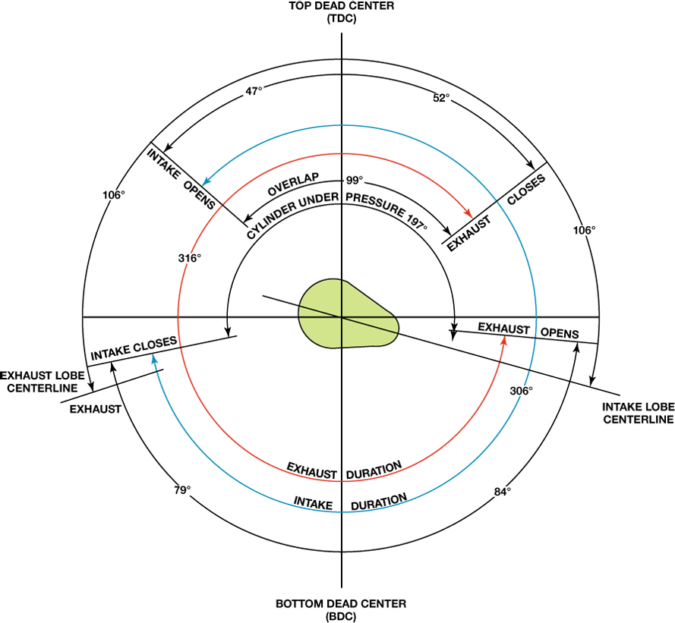
FIGURE 33–14 Typical valve timing diagram showing the intake lobe centerline at 106 degrees ATDC.

Slide 21
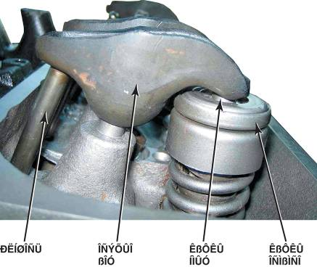
DETERMINING PROPER PUSHROD LENGTH
Purpose
The length of the pushrod is determined by the geometry of the engine when it was originally built
When Needed
Procedure
FIGURE 33–15 A side view of a small block Chevrolet engine showing that the rocker arm is contacting the top of the valve stem. A roller-tipped rocker arm will show a more definite line of contact than a stamped steel rocker.

Slide 22
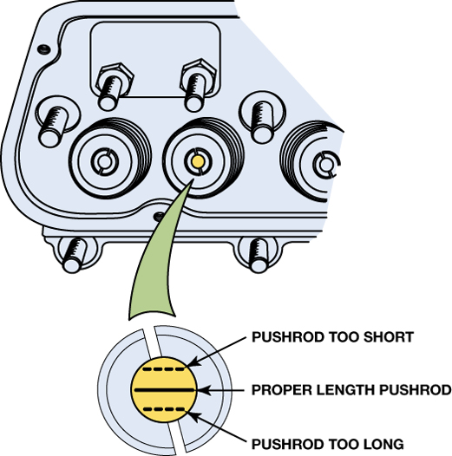
Figure 33–16 Checking where on the valve stem the marker has been worn off by the rocker arm, is the method to use to check for proper pushrod length.

Slide 23
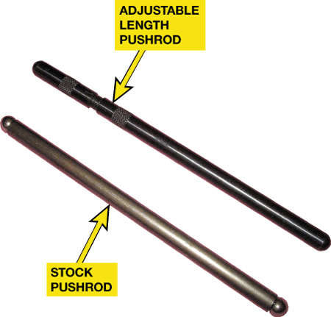
FIGURE 33–17 An adjustable pushrod is adjustable for length compared to a conventional stock pushrod.

Slide 24
SHORT BLOCK BLUEPRINTING
Determine Engine Use
Trial Assembly
Before the engine is assembled it should be partially assembled to double check all clearances

Slide 25
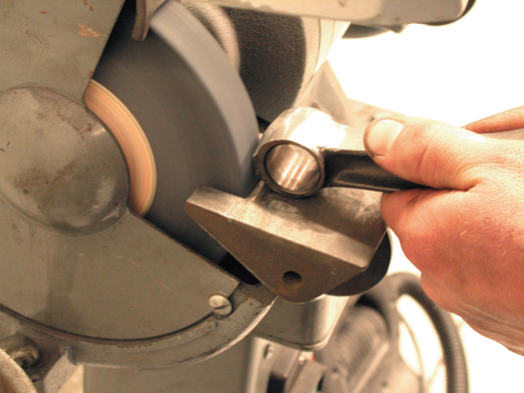
Figure 33–2 Removing material from the balancing pad on the small end of the rod to match it to the weight of the small end of the lightest rod being used in the engine.

Slide 26
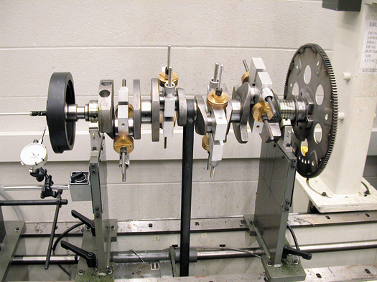
Figure 33–3 A crankshaft with bob weights attached as well as the flexplate and the harmonic balancer.

Slide 27
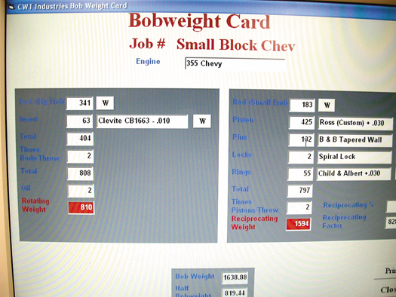
Figure 33–4 The display of a crankshaft balancer showing where weight needs to be removed to achieve a balanced assembly.

Slide 28
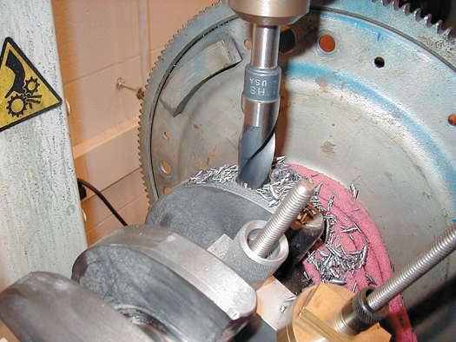
Figure 33–5 A drill is often used to remove weight from the crankshaft to achieve proper balance.

Slide 29
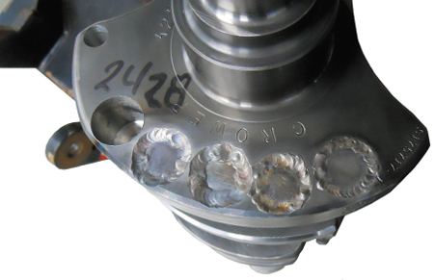
FIGURE 33–6 Heavy metal installed and welded in place.

Slide 30
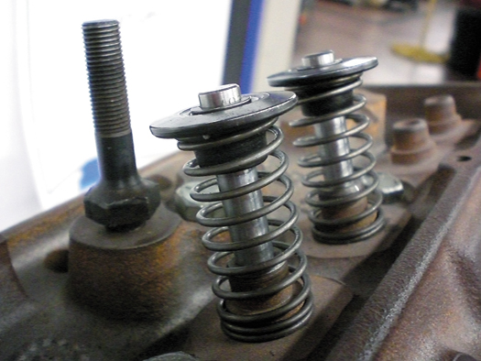
Figure 33–8 Cylinder head setup for flow testing. Note the weak valve springs that are strong enough to keep the valves shut, yet weak enough to permit the flow bench operator to vary the intake valve opening amount.

Slide 31
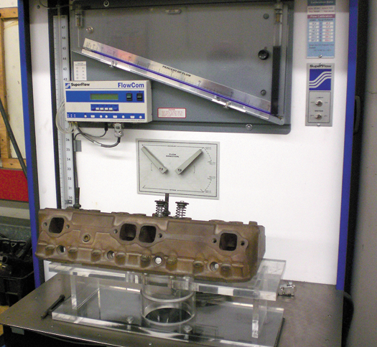
Figure 33–10 A flow bench that can measure and record the airflow through the intake and exhaust ports of each cylinder.

Slide 32
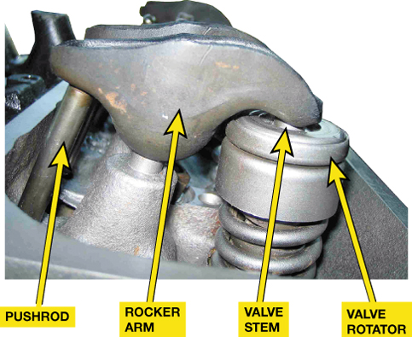
FIGURE 33–15 A side view of a small block Chevrolet engine showing that the rocker arm is contacting the top of the valve stem. A roller-tipped rocker arm will show a more definite line of contact than a stamped steel rocker.

Slide 33
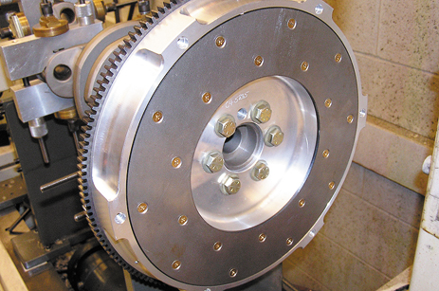
1 The crankshaft should always be balanced with the flywheel (or flexplate) and harmonic balancer installed.

Slide 34
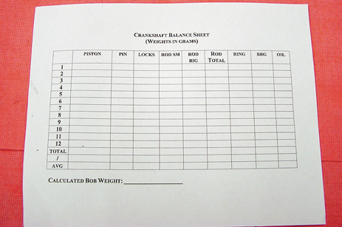
2 Use a worksheet so that all weights can be measured and recorded.

Slide 35
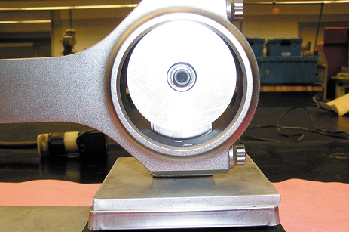
3 Using a fixture to hold the connecting rod horizontally, measure and record the weight of the big end of the rod.

Slide 36
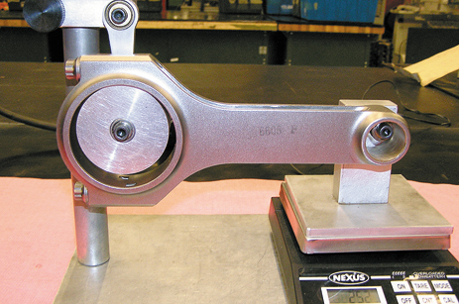
4 Using a fixture to hold the connecting rod horizontally, measure and record the weight of the small end of the rod.

Slide 37
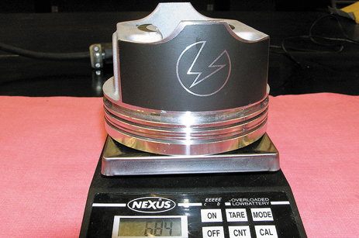
5 Weigh each piston. Remove some metal from the heaviest pistons to match their weight with the lightest.

Slide 38
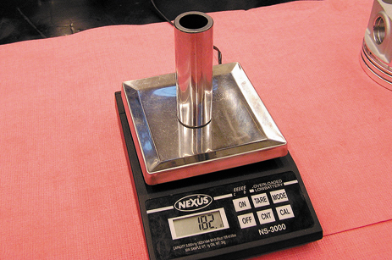
6 Weigh and record the weight of each piston pin.

Slide 39
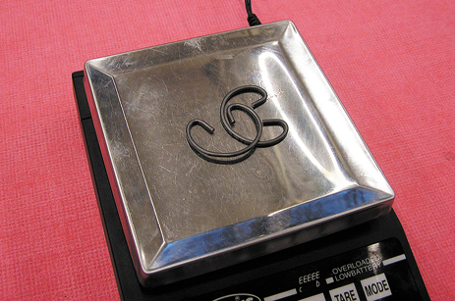
7 Weigh and record the weight of each piston pin locks if used.

Slide 40
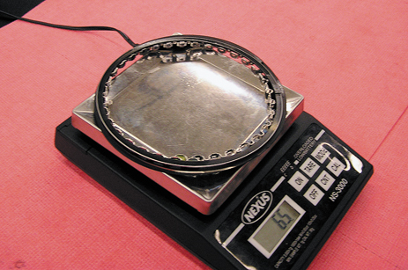
8 Weigh and record the weight of the piston rings for each piston.

Slide 41
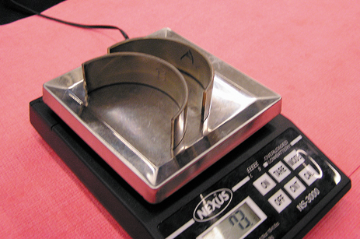
9 Weigh and record the weight of the rod bearings for each connecting rod.

Slide 42
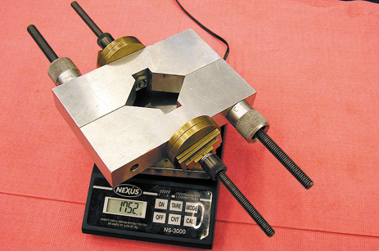
10 Using the worksheet and plugging the measured values into the balancer, adjust the BOB weight to the desired weight.

Slide 43
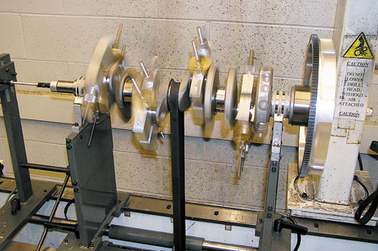
11 Install the BOB weights and operate the balancer according to the instructions for the balancer being used.

Slide 44
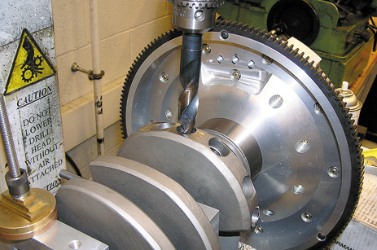
12 Use a drill and drill the counterweight in the designated location as indicated on the balancer.

Slide 45
SUMMARY (1 OF 2)
Proper balancing of the engine is important for smooth operation.
Both rotating weight and reciprocating weight are considered during the balancing procedure.
Blueprinting means following the exact procedures and specifications for the parts used.

Slide 46
SUMMARY (2 OF 2)
Checking combustion chamber volume is used to ensure that all cylinders have the exact same compression ratio.
Degreeing a camshaft is done to ensure that the valve events occur at the correct time.
Checking for proper pushrod length is important after the machining operations have changed the height of the cylinder head(s).

