Slide 1
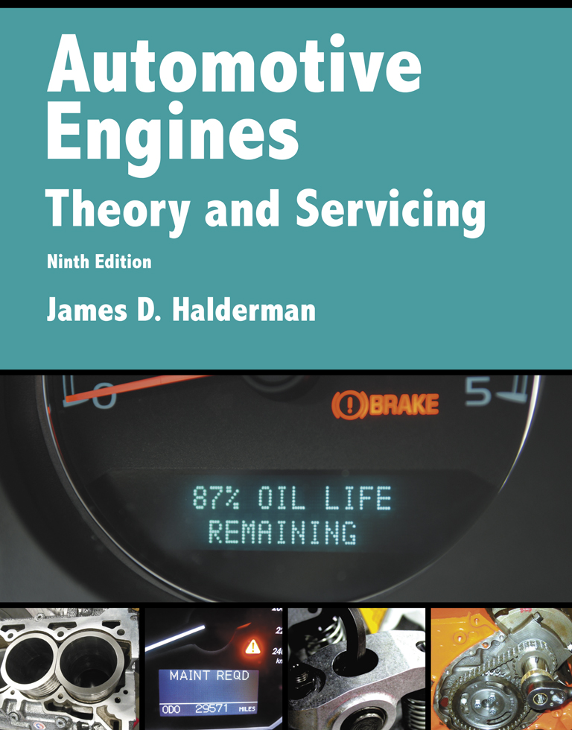
Automotive Engines Theory and Servicing
Ninth Edition
Chapter 31
Crankshafts, Balance Shafts, and Bearings

Slide 2
OBJECTIVES (1 OF 2)
31.1 Explain the purpose of crankshaft, crankshaft construction, and crankshaft oiling holes.
31.2 Discuss the different engine crankshaft types.
31.3 Explain the purpose and function of counterweights.
31.4 Discuss engine balance, and explain externally and internally balanced engines.

Slide 3
OBJECTIVES (2 OF 2)
31.5 Explain the purpose of balance shafts.
31.6 Discuss crankshaft service.
31.7 Describe engine bearings and discuss the importance of bearing clearance.
31.8 Discuss camshaft bearings.

Slide 4
CRANKSHAFT (1 OF 2)
Purpose and Function
  Power from expanding gases in the combustion chamber is delivered to the crankshaft through the piston, piston pin, and connecting rod
The crankshaft includes the following parts:
  Main bearing journals
  Rod bearing journals

Slide 5
CRANKSHAFT (2 OF 2)
  Crankshaft throws
  Counterweights
  Front snout
  Flywheel flange
  Keyways
  Oil passages

Slide 6
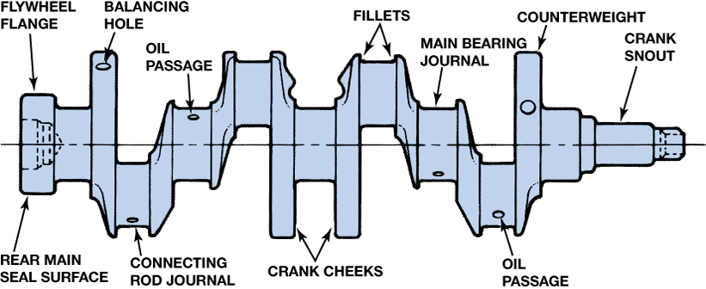
FIGURE 31–1 Typical crankshaft with main journals that are supported by main bearings in the block. Rod journals are offset from the crankshaft centerline.

Slide 7
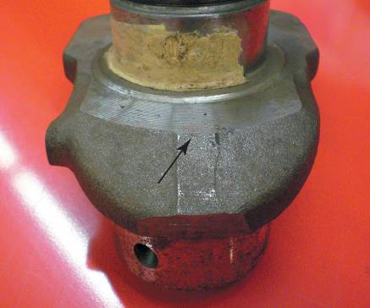
CRANKSHAFT CONSTRUCTION
Forged
Cast Crankshafts
Billet Crankshafts
FIGURE 31–5 Wide separation lines of a forged crankshaft.

Slide 8
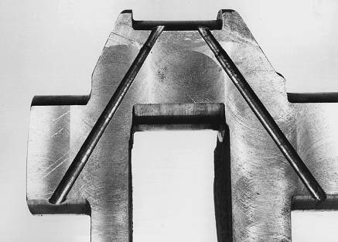
CRANKSHAFT OILING HOLES
The crankshaft is drilled to allow oil from the main bearing oil groove to be directed to the connecting rod bearings.
FIGURE 31–8 Crankshaft sawed in half, showing drilled oil passages between the main and rod bearing journals.

Slide 9
ENGINE CRANKSHAFT TYPES
V-8 Engine Arrangement
Four-cylinder Engine Crankshafts
Five-cylinder Engine Crankshafts
Three-cylinder Engine Crankshafts
Inline Six-cylinder Engine Crankshaft
90-degree V-6 Engine Crankshafts
60-degree V-6 Engine Crankshafts

Slide 10
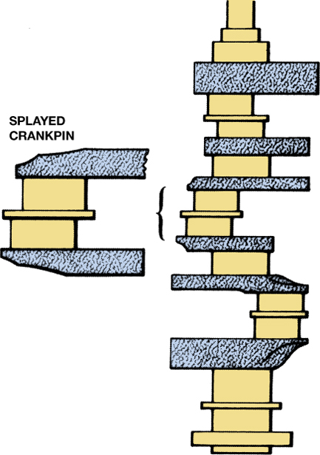
FIGURE 31–11 A splayed crankshaft design is used to create an even-firing 90 degree V-6.

Slide 11
COUNTERWEIGHTS
Crankshafts are balanced by counterweights, which are cast, forged, or machined as part of the crankshaft.
A crankshaft that has counterweights on both sides of each connecting rod journal is called fully counterweighted.

Slide 12
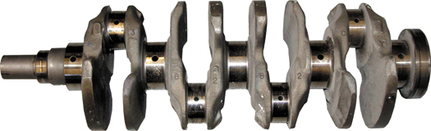
FIGURE 31–12 A fully counterweighted 4-cylinder crankshaft.

Slide 13
EXTERNALLY AND INTERNALLY BALANCED ENGINES (1 OF 2)
Most crankshaft balancing is done during manufacture.
Holes are drilled in the counterweight to lighten and improve balance.
Sometimes these holes are drilled after the crankshaft is installed in the engine.

Slide 14
EXTERNALLY AND INTERNALLY BALANCED ENGINES (2 OF 2)
Some manufacturers are able to control casting quality so closely that counterweight machining for balancing is not necessary.
Engine manufacturers balance an engine in one of two ways: Externally or internally balanced.

Slide 15
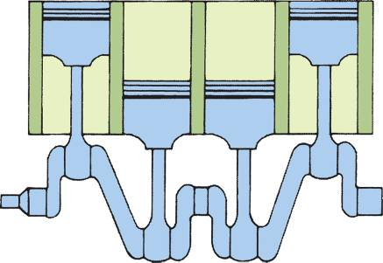
ENGINE BALANCE
Primary and Secondary Balance
FIGURE 31–17 In a 4-cylinder engine, the two outside pistons move upward at the same time as the inner pistons move downward, which reduces primary unbalance.

Slide 16
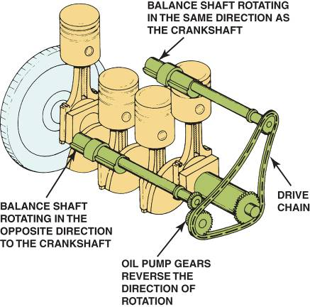
BALANCE SHAFTS
Purpose and Function
Balance Shaft Applications
FIGURE 31–19 Two counter-rotating balance shafts used to counterbalance the vibrations of a 4-cylinder engine.

Slide 17
CRANKSHAFT SERVICE (1 OF 2)
Crankshaft damage includes:
  Worn journals
  Scored bearing journals
  Bends or warpage
  Cracks
  Thread damage (flywheel flange or front snout)
  Worn front or rear seal surfaces

Slide 18
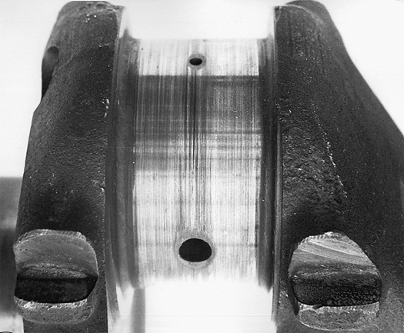
FIGURE 31–22 Scored connecting rod bearing journal.

Slide 19
CRANKSHAFT SERVICE (2 OF 2)
Measuring the Crankshaft
Crankshaft Grinding
Crankshaft Polishing
Welding a Crankshaft
Stress Relieving the Crankshaft
Storing Crankshafts

Slide 20
ENGINE BEARINGS (1 OF 2)
Introduction
Types of Bearings
Bearing Materials
Bearing Manufacturing
Bearing Sizes
Bearing Loads

Slide 21
ENGINE BEARINGS (2 OF 2)
Bearing Fatigue
Bearing Conformability
Bearing Embedability
Bearing Damage Resistance

Slide 22
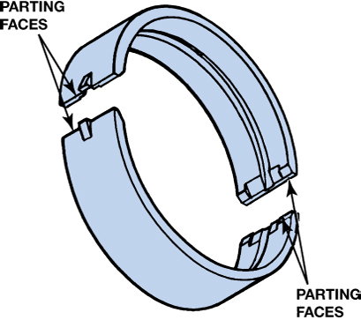
FIGURE 31–29 The two halves of a plain bearing meet at the parting faces.

Slide 23
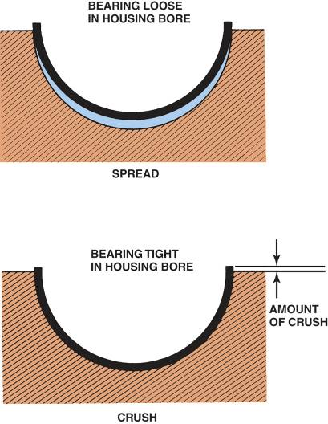
BEARING CLEARANCE
Importance of Proper Clearance
Checking Bearing Clearance
Bearing Spread and Crush
FIGURE 31–36 Bearing spread and crush.

Slide 24
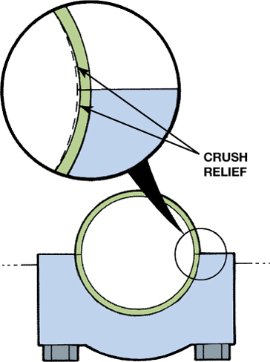
FIGURE 31–37 Bearings are thinner at the parting line faces to provide crush relief.

Slide 25
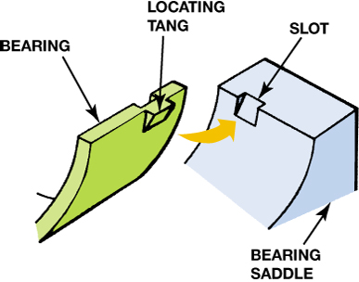
FIGURE 31–39 The tang (lug) and slot help index the bearing in the bore.

Slide 26
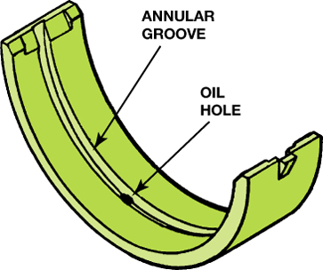
FIGURE 31–40 Many bearings are manufactured with a groove down the middle to improve the oil flow around the main journal.

Slide 27
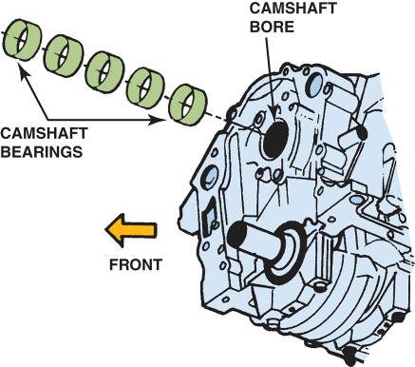
CAMSHAFT BEARINGS
Types of Camshaft Bearings
Camshaft Bearing Installation
FIGURE 31–41 Cam-in-block engines support the camshaft with sleeve-type bearings.

Slide 28
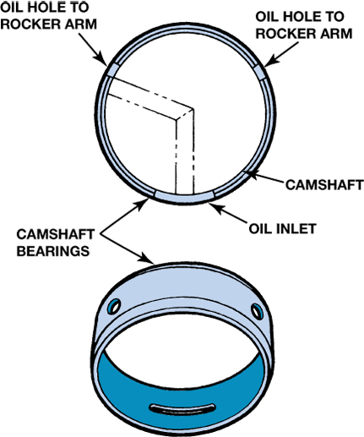
FIGURE 31–42 Camshaft bearings must be installed correctly so that oil passages are not blocked.

Slide 29
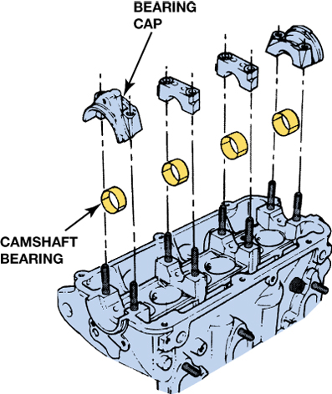
FIGURE 31–43 Some overhead camshaft engines use split bearing inserts.

Slide 30
SUMMARY (1 OF 3)
Cast crankshafts have a narrow mold parting line, and forged crankshafts have a wide parting line.
Even-fire 90-degree V-6 engines require that the crankshaft be splayed to allow for even firing.
Oil for the rod bearings comes from holes in the crankshaft drilled between the main journal and the rod journal.

Slide 31
SUMMARY (2 OF 3)
A vibration damper is used to dampen harmful twisting vibrations of the crankshaft.
Most crankshafts can be reground to be 0.01, 0.02, or 0.03 in. undersize.
Most engines are internally balanced.

Slide 32
SUMMARY (3 OF 3)
Most engine bearings are constructed with a steel shell for strength and are covered with a copper-lead alloy.
Bearings should have spread and crush to keep them from spinning when the crankshaft rotates.

