Slide 1

Automotive Engines Theory and Servicing
Ninth Edition
Chapter 29
Pistons, Rings, and Connecting Rods

Slide 2
OBJECTIVES (1 OF 2)
29.1 Explain the purpose and function of pistons and piston construction.
29.2 Discuss piston pins and piston pin retaining methods.
29.3 Explain piston rings and construction of piston rings.

Slide 3
OBJECTIVES (2 OF 2)
29.4 Discuss connecting rods and connecting rod service.
29.5 Explain piston and rod assembly and piston ring service.

Slide 4
PISTONS (1 OF 2)
All engine power is developed by burning fuel mixed with air in the combustion chamber.
  Heat from the combustion causes the burned gas to increase in pressure.
  The force of this pressure is converted into useful work through the piston, connecting rod, and crankshaft.

Slide 5
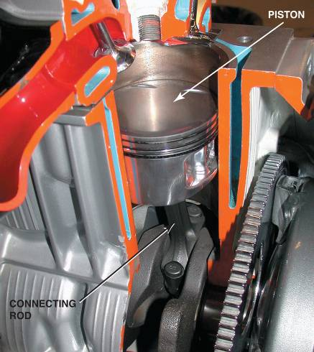
PISTONS (2 OF 2)
Therefore, the piston serves three purposes.
  Transfers force.
  Seals the combustion chamber.
  Conducts heat.
Parts Involved
Piston Operation
FIGURE 29–1 The piston seals the bottom of the combustion chamber and is attached to a connecting rod.

Slide 6
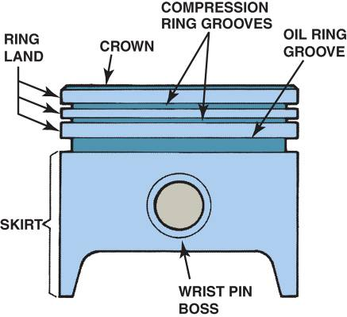
PISTON CONSTRUCTION (1 OF 2)
Piston Ring Grooves
Cast Pistons
Hypereutectic Pistons
Forged Pistons
Piston Head Designs
Slipper Skirt Pistons
FIGURE 29–2 All pistons share the same parts in common.

Slide 7
PISTON CONSTRUCTION (2 OF 2)
Cam Ground Pistons
Piston Finish
Piston Head Size
Piston Strut Inserts

Slide 8
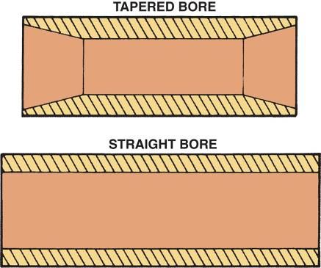
PISTON PINS (1 OF 2)
Piston pins are used to attach the piston to the connecting rod.
  The piston pin transfers the force produced by combustion chamber pressures and piston inertia to the connecting rod.
FIGURE 29–11 Most piston pins are hollow to reduce weight and have a straight bore. Some pins have a tapered bore to reinforce the pin.

Slide 9
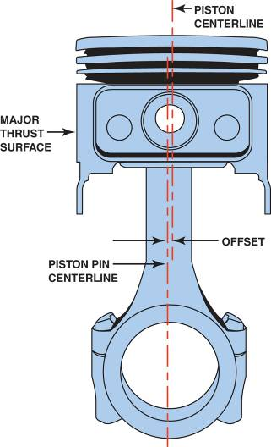
PISTON PINS (2 OF 2)
Piston Pin Offset
  Minor Thrust
  Major Thrust
Piston Pin Fit
FIGURE 29–12 Piston pin offset toward the major thrust surface.

Slide 10
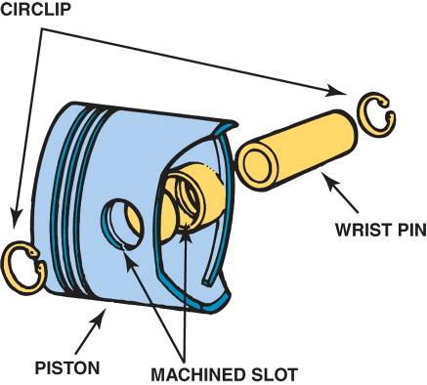
PISTON PIN RETAINING METHODS
Full Floating
  Full-floating piston pins are free to "float" in the connecting rod and the piston.
Interference Fit
FIGURE 29–14 Circlips hold full-floating piston pins in place.

Slide 11
PISTON RINGS (1 OF 2)
Piston rings serve several major functions in engines.
  They form a sliding combustion chamber seal that prevents the high-pressure combustion gases from leaking past the piston.
  They keep engine oil from getting into the combustion chamber.

Slide 12
PISTON RINGS (2 OF 2)
  The rings transfer some of the piston heat to the cylinder wall, where it is removed from the engine through the cooling system.
Classifications
Compression Rings
Oil Control Rings
Ring Gap
Piston Ring Shapes

Slide 13
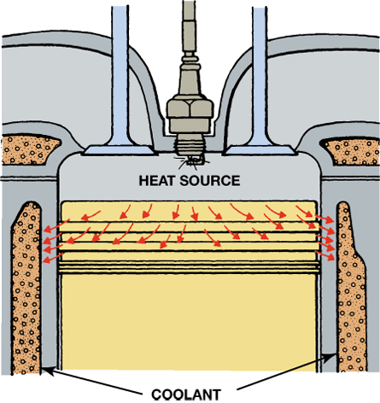
FIGURE 29–16 The rings conduct heat from the piston to the cylinder wall.

Slide 14
PISTON RING CONSTRUCTION (1 OF 3)
Piston Ring Materials
  Plain cast iron
  Pearlitic cast iron
  Nodular cast iron
  Steel
  Ductile iron

Slide 15
PISTON RING CONSTRUCTION (2 OF 3)
Chromium Piston Rings
Molybdenum Piston Rings
Moly-chrome-carbide Rings
Ceramic-coated Rings

Slide 16
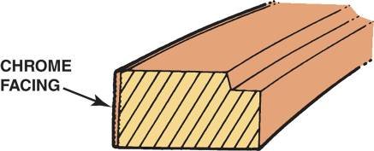
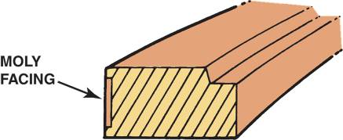
PISTON RING CONSTRUCTION (3 OF 3)
FIGURE 29–25 The chrome facing on this compression ring is about 0.004 in. (0.10 mm) thick.
FIGURE 29–26 The moly facing on this compression ring is about 0.005 in. (0.13 mm) thick.

Slide 17
CONNECTING RODS (1 OF 2)
The connecting rod transfers the force and reciprocating motion of the piston to the crankshaft.
  The small end of the connecting rod reciprocates with the piston.
  The large end rotates with the crankpin.

Slide 18
CONNECTING RODS (2 OF 2)
Connecting Rod Design
Cast Connecting Rods
Forged Connecting Rods
Powdered Metal Connecting Rods

Slide 19
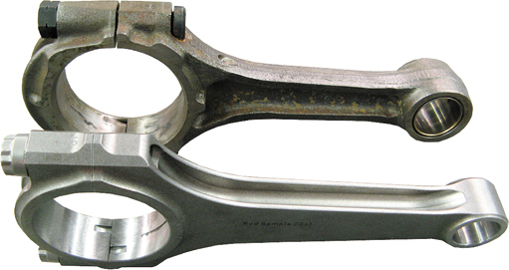
FIGURE 29–28 The I-beam shape is the most common (top connecting rod), but the H-beam shape is common in high-performance and racing engine applications.

Slide 20
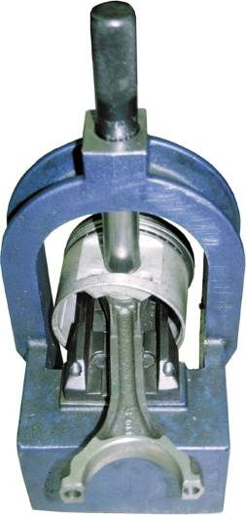
CONNECTING ROD SERVICE
Removing Pistons From Rods
Inspection
Reconditioning Procedure
FIGURE 29–36 A press used to remove the connecting rod from the piston.

Slide 21
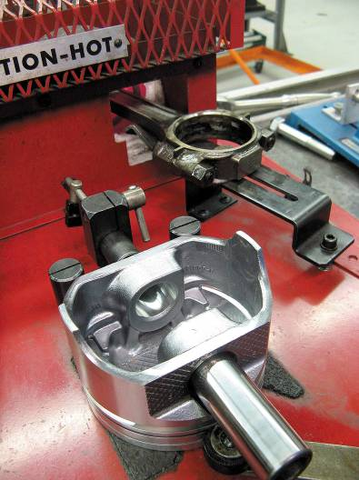
PISTON AND ROD ASSEMBLY
Interference Fit Rods
Full-floating Rods
FIGURE 29–41 The small end of the rod is being heated in an electric heater and the piston is positioned properly so the piston pin can be installed as soon as the rod is removed from the heater.

Slide 22
PISTON RING SERVICE
Each piston ring, one at a time, should be placed backward in the groove in which it is to be run.
  STEP 1 Check side clearance
  STEP 2 Check ring gap
  STEP 3 Installing the oil control ring
  STEP 4 Installing the compression rings
  STEP 5 Double-check everything

Slide 23
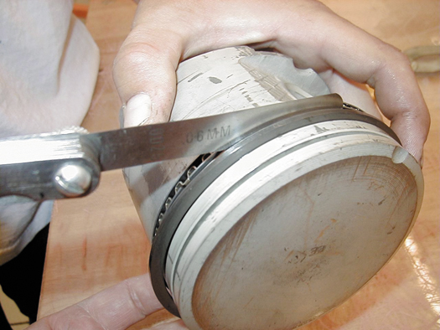
FIGURE 29–42 The side clearance of the piston ring is checked with a feeler gauge.

Slide 24
SUMMARY (1 OF 3)
Pistons are cam ground so that when operating temperature is reached, the piston will have expanded enough across the piston pin area to become round.
Replacement pistons should weigh the same as the original pistons to maintain proper engine balance.

Slide 25
SUMMARY (2 OF 3)
Some engines use an offset piston pin to help reduce piston slap when the engine is cold.
Piston rings usually include two compression rings at the top of the piston and an oil control ring below the compression rings.
If the ring end gap is excessive, blowby gases can travel past the rings and into the crankcase.

Slide 26
SUMMARY (3 OF 3)
Many piston rings are made of coated cast iron to provide proper sealing.
If the connecting rod is twisted, diagonal wear will be noticed on the piston skirt.
Powdered metal connecting rods are usually broken at the big end parting line.

