Slide 1

Automotive Engines Theory and Servicing
Ninth Edition
Chapter 26
Cylinder Head and Valve Guide Service

Slide 2
OBJECTIVES (1 OF 2)
26.1 Explain the design and construction of cylinder heads.
26.2 Discuss intake and exhaust ports.
26.3 Discuss cylinder head passages and cylinder head servicing.

Slide 3
OBJECTIVES (2 OF 2)
26.4 Explain aluminum cylinder head straightening, cylinder head resurfacing, and intake manifold alignment.
26.5 Explain valve guides and the procedure for valve guide replacement.

Slide 4
CYLINDER HEADS (1 OF 2)
Construction
Design Features
  Squish area
  Quench area
  Spark plug placement
  Surface-to-volume ratio
  Valve shrouding
  Crossflow valve placement

Slide 5
CYLINDER HEADS (2 OF 2)
Combustion Chamber Designs
  Wedge
  Pentroof
  Hemi
Four-valve Cylinder Heads

Slide 6
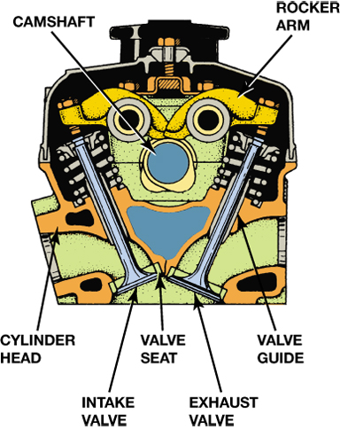
FIGURE 26–1 The seats and guides for the valves are in the cylinder head as well as the camshaft and the entire valve train if it is an overhead camshaft design.

Slide 7
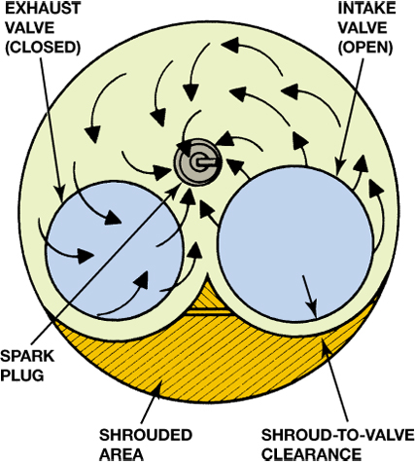
FIGURE 26–5 The shrouded area around the intake valve causes the intake mixture to swirl as it enters the combustion chamber.

Slide 8
INTAKE AND EXHAUST PORTS (1 OF 2)
Purpose and Function
  Allow the free flow of exhaust gases from the engine
Intake Ports
  The intake port in a cylinder head designed for use with a carburetor or throttle-body-type fuel injection is relatively long, whereas the exhaust port is short

Slide 9
INTAKE AND EXHAUST PORTS (2 OF 2)
Exhaust Ports
  The length of the exhaust ports is shorter than the intake ports to help reduce the amount of heat transferred to the coolant

Slide 10
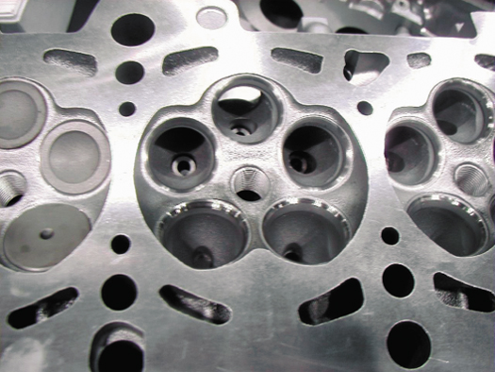
FIGURE 26–11 An Audi five-valve cylinder head, which uses three intake valves and two exhaust valves.

Slide 11
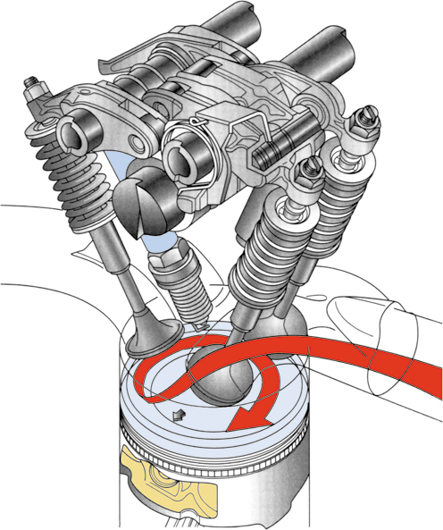
FIGURE 26–12 The intake manifold design and combustion chamber design both work together to cause the air-fuel mixture to swirl as it enters the combustion chamber.

Slide 12
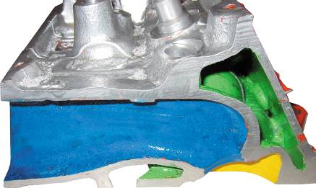
CYLINDER HEAD PASSAGES
Coolant Flow Passages
Head Gasket Holes
Lubricating Oil Passages
FIGURE 26–14 A cutaway head showing the coolant passages in green.

Slide 13
CYLINDER HEAD SERVICING
Cylinder Head Servicing Sequence
Disassembling Overhead Camshaft Head
Valve Train Disassembly
Cylinder Head Inspection

Slide 14
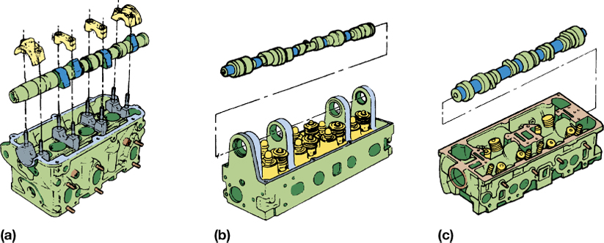
FIGURE 26–16 Overhead camshafts may be (a) held in place with bearing caps, (b) supported by towers, or (c) fitted into bearing bores machined directly into the head.

Slide 15
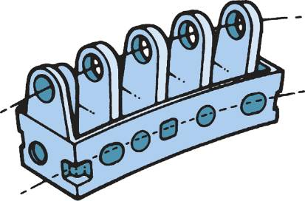
ALUMINUM CYLINDER HEAD STRAIGHTENING
The best approach to restore a warped aluminum cylinder head (especially an overhead camshaft head) is to relieve the stress that has caused the warpage and to straighten the head before machining
FIGURE 26–21 Warped overhead camshaft cylinder head. If the gasket surface is machined to be flat, the camshaft bearings will still not be in proper alignment. The solution is to straighten the cylinder head or to align bore the cam tunnel.

Slide 16
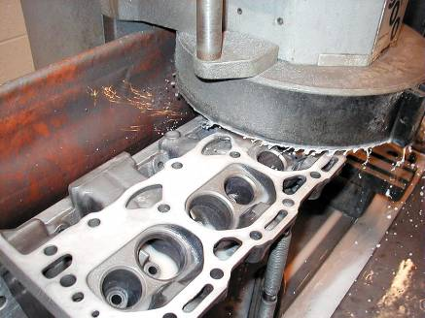
CYLINDER HEAD RESURFACING
Refinishing Methods
  Two common resurfacing methods are:
    Milling or broaching
    Grinding
Surface Finish
FIGURE 26–22 A cast-iron cylinder head being resurfaced using a surface grinder.

Slide 17
INTAKE MANIFOLD ALIGNMENT
The intake manifold surface must be resurfaced to remove enough metal to rematch the ports and bolt holes
Automotive machine shops that perform head resurfacing have tables that specify the exact amount of metal to be removed

Slide 18
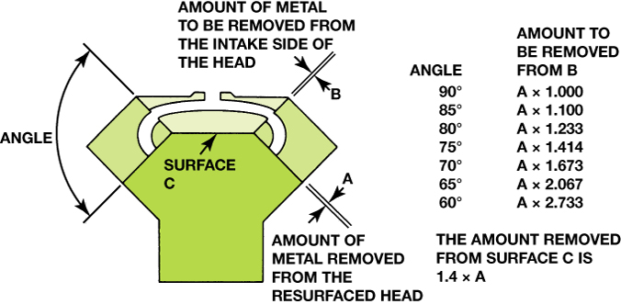
FIGURE 26–24 The material that must be removed for a good manifold fit.

Slide 19
VALVE GUIDES
Types
Valve Stem-to-guide Clearance
Measuring Valve Guides
Oversize Stem Valves

Slide 20
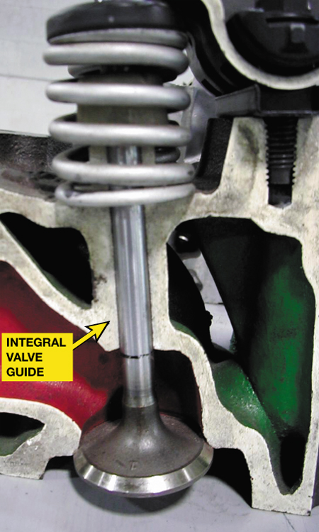
FIGURE 26–26 An integral valve guide is simply a guide that has been drilled into the cast-iron cylinder head.

Slide 21
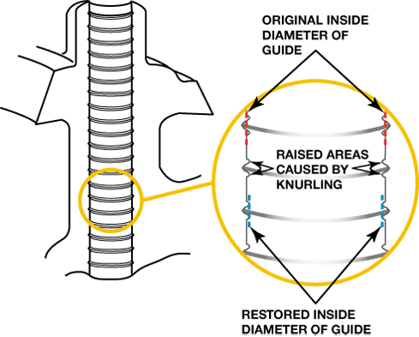
FIGURE 26–32 Sectional view of a knurled valve guide.

Slide 22
VALVE GUIDE REPLACEMENT (1 OF 2)
Purpose
  After the valve guide height is measured, the worn guide is pressed from the head with a proper fitting driver
  Replacement valve guides can also be installed to repair worn integral guides

Slide 23
VALVE GUIDE REPLACEMENT (2 OF 2)
Valve Guide Sizes
Valve Guide Inserts
Spiral Bronze Insert Bushings

Slide 24
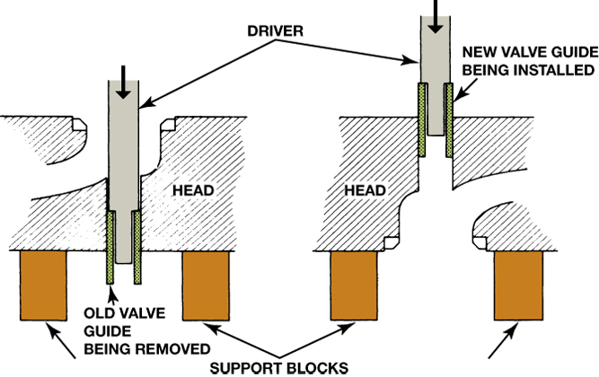
FIGURE 26–33 Valve guide replacement procedure.

Slide 25
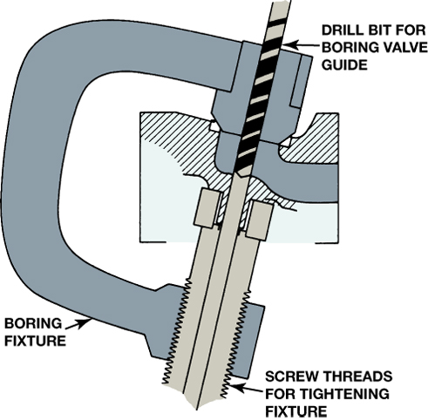
FIGURE 26–34 A type of fixture required to bore the valve guide to accept a thin-walled insert sleeve.

Slide 26
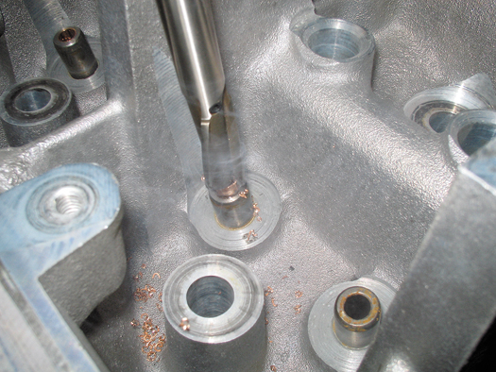
FIGURE 26–35 Trimming the top of the thin-walled insert.

Slide 27
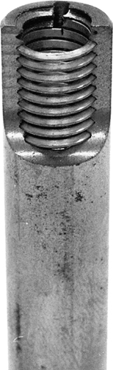
FIGURE 26–36 Installed spiral bronze insert bushing.

Slide 28
SUMMARY (1 OF 2)
The most commonly used combustion chamber types include hemispherical, wedge, and pentroof.
Coolant and lubricating openings and passages are located throughout most cylinder heads.
Cylinder head resurfacing machines include grinders and milling machines.

Slide 29
SUMMARY (2 OF 2)
Valve guides should be checked for wear using a ball gauge or a dial indicator.
Valve guide repair options include use of oversize stem valves, replacement valve guides, valve guide inserts, and knurling of the original valve guide.

