Slide 1

Automotive Engines Theory and Servicing
Ninth Edition
Chapter 24
Engine Removal and Disassembly

Slide 2
OBJECTIVES
24.1 Discuss the different engine repair options.
24.2 Explain the engine removal procedure.
24.3 Explain the engine disassembly procedure.
24.4 Explain disassembly of the short block, rotating engine assemblies removal, and cylinder head disassembly.

Slide 3
ENGINE REPAIR OPTIONS (1 OF 3)
Repairing an engine should be based on all the information about the engine that is available to the service technician and the vehicle owner.
  The customer, who is paying for the repair, must make the final decision on the reconditioning procedure to be used.

Slide 4
ENGINE REPAIR OPTIONS (2 OF 3)
Component replacement
Valve job
Minor overhaul
Major overhaul
Short block

Slide 5
ENGINE REPAIR OPTIONS (3 OF 3)
Long block
Crate engines
Remanufactured engines

Slide 6
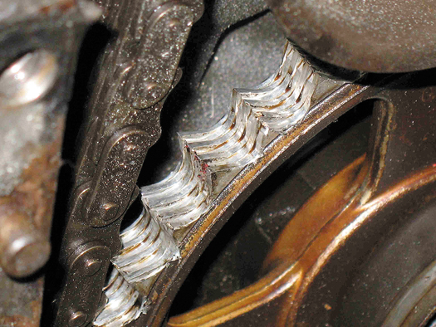
Figure 24–1 A worn timing sprocket that resulted in a retarded valve timing and reduced engine performance.

Slide 7
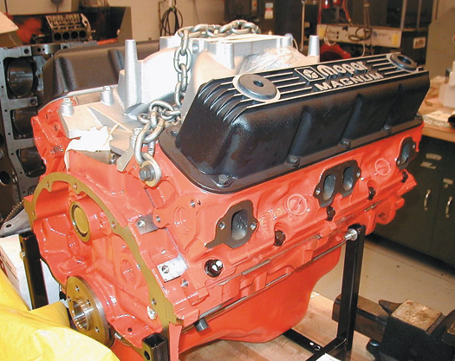
Figure 24–2 A crate engine from Chrysler to be used in a restored muscle car. Using a complete new engine costs more than rebuilding an existing engine, but it has a warranty and uses all new parts.

Slide 8
ENGINE REMOVAL (1 OF 3)
Check Service Information
Usual Engine Removal Procedures
  Remove the hood
  Clean the engine area
  Disconnect the negative (−) battery cable
  Remove the air cleaner assembly
  Remove all accessories

Slide 9
ENGINE REMOVAL (2 OF 3)
  Drain the coolant
  Remove the radiator
  Disconnect the exhaust system
  Recover the air-conditioning refrigerant
Usual Engine Removal Procedures
  Remove the power steering pump
  Drain the engine oil
  Disconnect fuel lines
  Disconnect wiring and vacuum hoses

Slide 10
ENGINE REMOVAL (3 OF 3)
Procedure For Engine Removal
  There are two ways to remove the engine.
    The engine can be lifted out of the chassis with the transmission/transaxle attached.
    The transmission/transaxle can be separated from the engine and left in the chassis.
  Rear-wheel-drive vehicle
  Front-wheel-drive vehicle

Slide 11
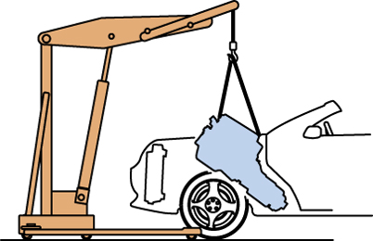
Figure 24–3 An engine must be tipped as it is pulled from the chassis.

Slide 12
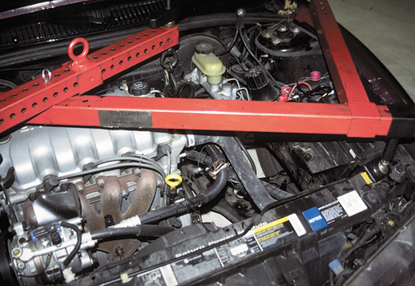
Figure 24–4 When removing just the engine from a front-wheel-drive vehicle, the transaxle must be supported. Shown here is a typical fixture that can be used to hold the engine if the transaxle is removed or to hold the transaxle if the engine is removed.

Slide 13
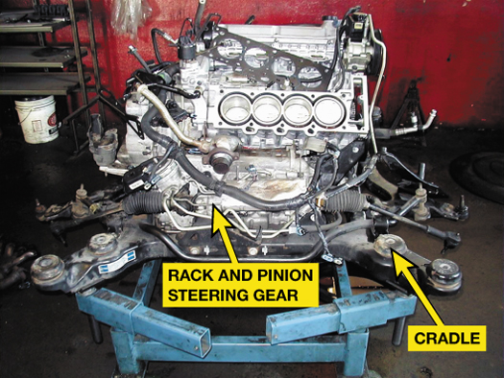
Figure 24–5 The entire cradle, which included the engine, transaxle, and steering gear, was removed and placed onto a stand. The rear cylinder head has been removed to check for the root cause of a coolant leak.

Slide 14
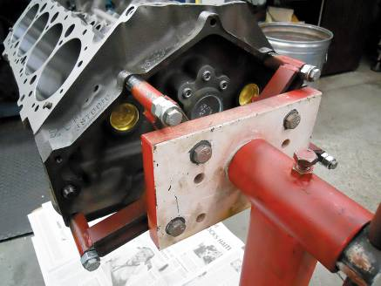
ENGINE DISASSEMBLY
Mounting the Engine On a Stand
Disassembling A Cam-in-block (OHV) Engine
Overhead Camshaft (OHC) Engine Disassembly
FIGURE 24–6 Always use graded bolts—either grade 5 or 8 bolts—whenever mounting an engine to a stand.

Slide 15
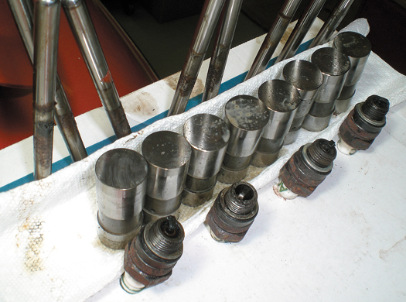
Figure 24–7 Keeping the pushrods and the lifters sorted by cylinder, including the spark plugs, is a wise way to proceed when disassembling the cylinder heads.

Slide 16
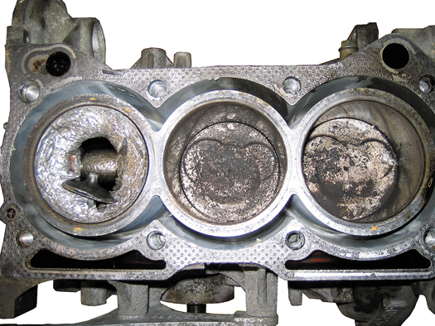
Figure 24–8 Sometimes after the cylinder head has been removed, the engine condition is discovered to be so major that the entire engine may need to be replaced rather than overhauled.

Slide 17
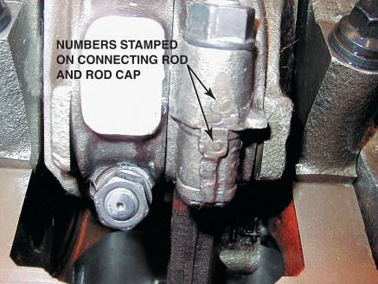
DISASSEMBLY OF THE SHORT BLOCK
Removing The Oil Pan
Marking Connecting Rods And Caps
Removing The Cylinder Ridge
Piston Removal
FIGURE 24–9 These connecting rods were numbered from the factory. If they are not, then they should be marked.

Slide 18
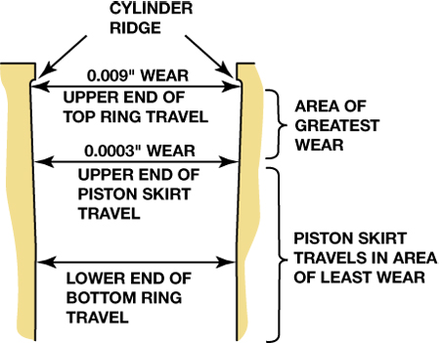
Figure 24–10 Most of the cylinder wear is on the top inch just below the cylinder ridge. This wear is due to the heat and combustion pressures that occur when the piston is near the top of the cylinder.

Slide 19
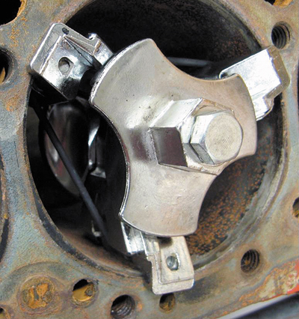
Figure 24–11 This ridge is being removed with one type of ridge reamer before the piston assemblies are removed from the engine.

Slide 20
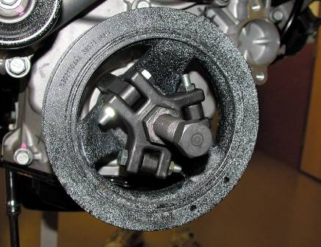
ROTATING ENGINE ASSEMBLIES REMOVAL
Harmonic Balancer Removal
Camshaft Removal
Crankshaft and Main Bearing Removal
Block Inspection
FIGURE 24–12 Puller being used to pull the vibration damper from the crankshaft.

Slide 21
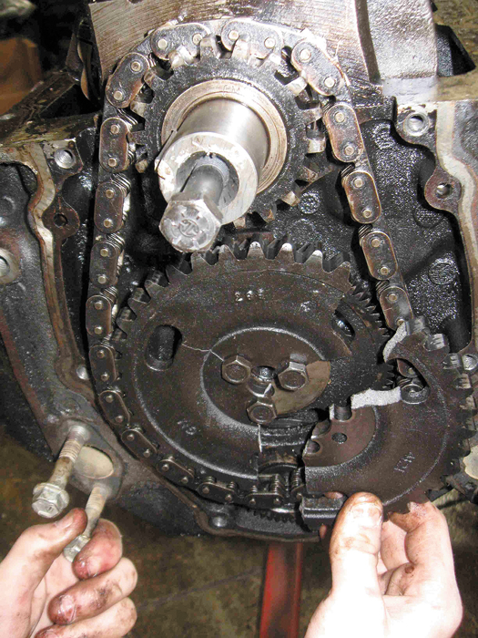
Figure 24–13 When the timing chain cover was removed, the broken timing gear explained why this GM 4.3 liter V-6 engine stopped running.

Slide 22
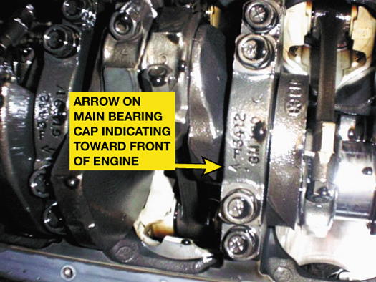
Figure 24–14 Most engines such as this Chevrolet V-8 with four-bolt main bearing caps have arrows marked on the bearing caps which should point to the front of the engine.

Slide 23
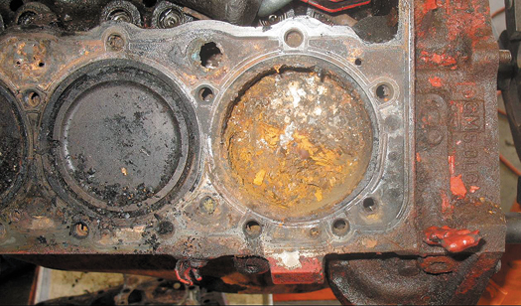
Figure 24–15 This small block Chevrolet V-8 had water standing in the cylinders, causing a lot of rust, which was discovered as soon as the head was removed.

Slide 24
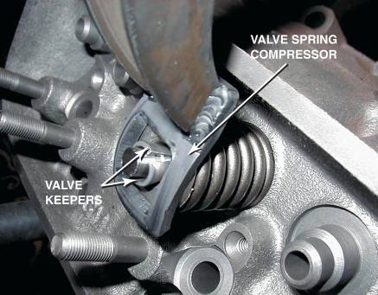
CYLINDER HEAD DISASSEMBLY
OHV Engine Cylinder Heads
OHC Engine Cylinder Heads
FIGURE 24–17 A valve spring compressor is used to compress the valve spring before removing the keepers (locks).

Slide 25
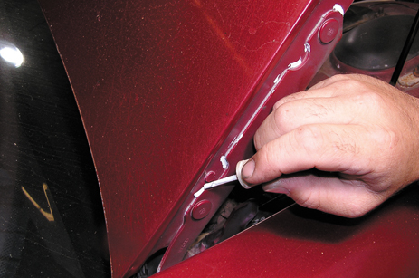
1 Before beginning work on removing the engine, mark and remove the hood and place it in a safe location.

Slide 26
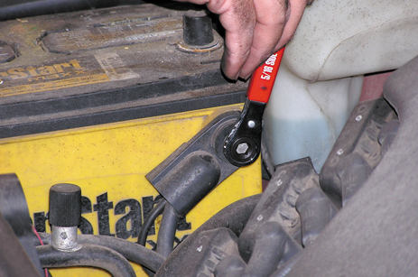
2 For safety, remove the negative battery cable to avoid any possible electrical problems from occurring.

Slide 27
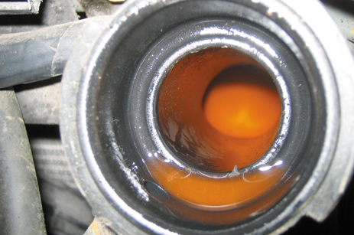
3 Drain the coolant and dispose of properly.

Slide 28
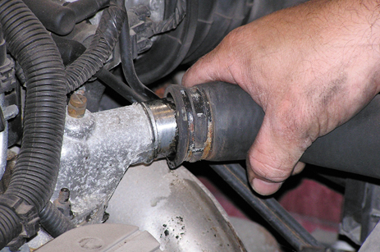
4 Disconnect all cooling system and heater hoses and remove the radiator.

Slide 29
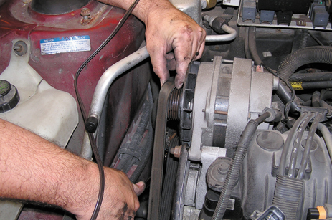
5 Remove the accessory drive belt(s) and set the alternator, power steering pump, and air-conditioning compressor aside.

Slide 30
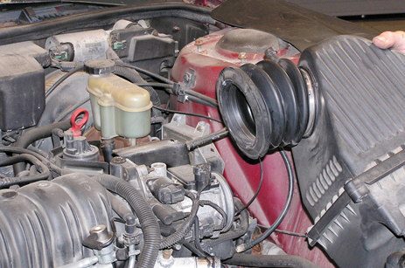
6 Remove the air intake system including the air filter housing as needed.

Slide 31
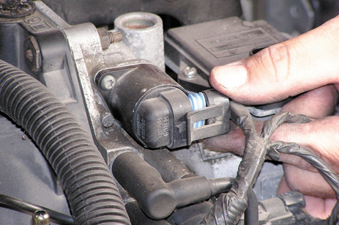
7 Remove the electrical connector from all sensors and label.

Slide 32
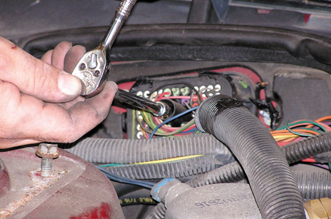
8 Disconnect the engine wiring harness connector at the bulkhead.

Slide 33
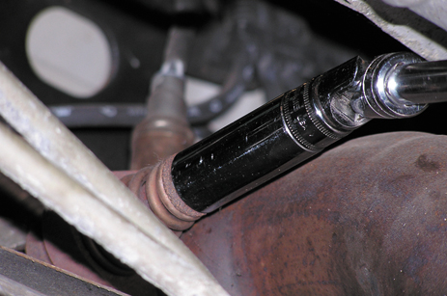
9 Safely hoist the vehicle and disconnect the exhaust system from the exhaust manifolds.

Slide 34
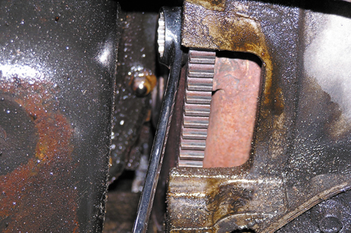
10 Mark and then remove the fasteners connecting the flex plate to the torque converter.

Slide 35
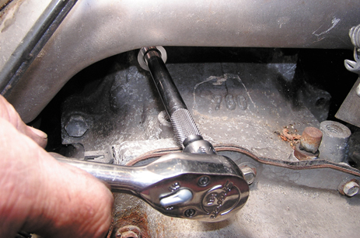
11 Lower the vehicle and remove the engine mount bolts and transaxle bell housing fasteners.

Slide 36
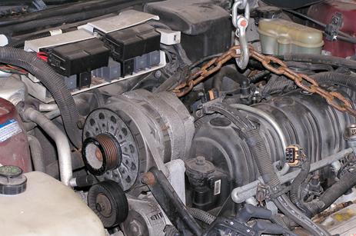
12 Secure the lifting chain to the engine hooks and carefully remove the engine from the vehicle.

Slide 37
SUMMARY (1 OF 3)
A repair, valve job, overhaul, and entire engine replacement are some of the solution options for an engine failure.
A short block is the block assembly with pistons and crankshaft. A long block also includes the cylinder head(s).

Slide 38
SUMMARY (2 OF 3)
Cylinder heads should only be removed when the engine is cold.
  Always follow the torque table backwards, starting with the highest-number head bolt and working toward the lowest number.
Factory lifting hooks should be used when hoisting an engine.

Slide 39
SUMMARY (3 OF 3)
The ridge at the top of the cylinder should be removed before removing the piston(s) from the cylinder.
The connecting rod and main bearing caps should be marked before being removed.
The tip of the valve stem should be filed before removing valves from the cylinder head to help prevent damage to the valve guide.

