Slide 1

Automotive Engines Theory and Servicing
Ninth Edition
Chapter 2
Environmental and Hazardous Materials

Slide 2
OBJECTIVES (1 OF 2)
2.1 Identify hazardous waste materials in accordance with federal and state laws.
2.2 Discuss asbestos hazards and asbestos handling guidelines

Slide 3
OBJECTIVES (2 OF 2)
2.3 Explain the storage and disposal of break fluid, used oil, coolants, lead-acid batteries, used tires, and air-conditioning refrigerant oil.
2.4 Explain the characteristics of hazardous solvents, fuel safety and storage, and airbag handling.

Slide 4
HAZARDOUS WASTE
What is the definition of hazardous waste?
What is PPE? What are some examples and why is it important?

Slide 5
FEDERAL AND STATE LAWS
Occupational Safety and Health Act
EPA
Right-to-know Laws
Resource Conservation And Recovery Act (RCRA)
Clean Air Act

Slide 6
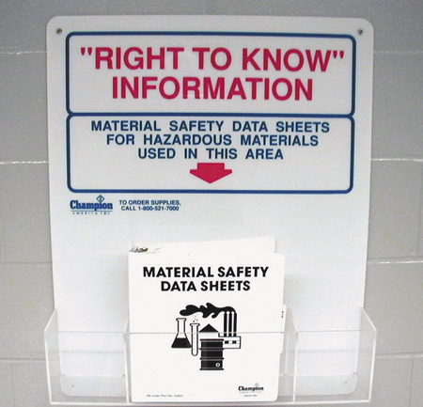
FIGURE 2–1 Safety Data Sheets (SDS) should be readily available for use by anyone in the area who may come into contact with hazardous materials.

Slide 7
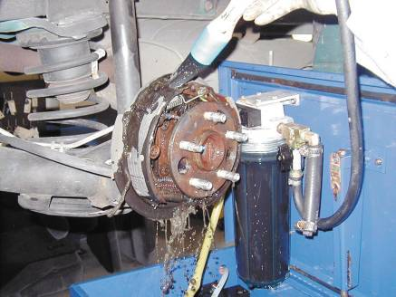
ASBESTOS HAZARDS
Asbestos OSHA Standards
Asbestos Handling Guidelines
  HEPA Vacuum
  Solvent Spray
  Disposal of Brake Dust and Brake Shoe
FIGURE 2–3 All brakes should be moistened with water or solvent to help prevent brake dust from becoming airborne.

Slide 8
USED BRAKE FLUID (1 OF 2)
Collect brake fluid in a container clearly marked to indicate that it is designated for that purpose.
If the waste brake fluid is hazardous, be sure to manage it appropriately and use only an authorized waste receiver for its disposal.
If the waste brake fluid is nonhazardous, determine from your local solid waste collection provider what should be done for its proper disposal.

Slide 9
USED BRAKE FLUID (2 OF 2)
Do not mix brake fluid with used engine oil.
Do not pour brake fluid down drains or onto the ground.
Recycle brake fluid through a registered recycler.

Slide 10
USED OIL
Storage and disposal of used oil
  Keep used oil storage drums in good condition
  Never store used oil in anything other than tanks and storage containers
  Used oil filter disposal regulations

Slide 11
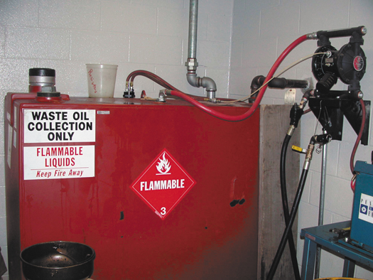
FIGURE 2–4 A typical aboveground oil storage tank.

Slide 12
SOLVENTS
What are the effects of chemical poisoning?
Hazardous solvents and regulatory status
Use solvents
  What are the requirements?

Slide 13
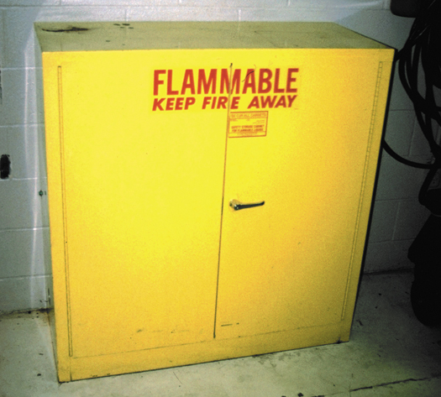
FIGURE 2–6 Typical fireproof flammable storage cabinet.

Slide 14
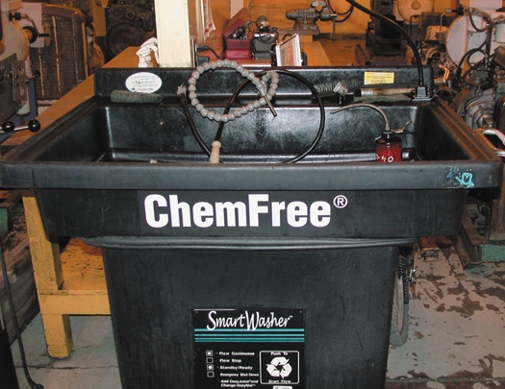
FIGURE 2–7 Using a water-based cleaning system helps reduce the hazards from using strong chemicals.

Slide 15
COOLANT DISPOSAL
Coolant should be disposed of in one of the following ways:
  Coolant should be recycled either onsite or offsite.
  Used coolant should be stored in a sealed and labeled container.
  Used coolant can often be disposed of into municipal sewers with a permit.

Slide 16
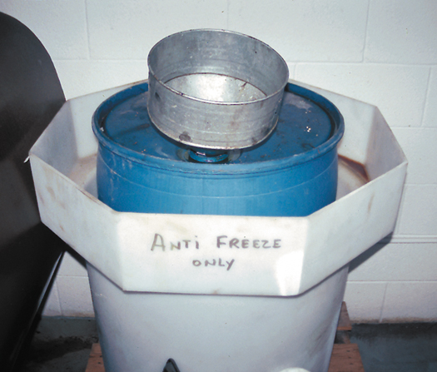
FIGURE 2–8 Used antifreeze coolant should be kept separate and stored in a leakproof container until it can be recycled or disposed of according to federal, state, and local laws. Note that the storage barrel is placed inside another container to catch any coolant that may spill out of the inside barrel.

Slide 17
LEAD-ACID BATTERY WASTE
Battery Disposal
  What are the rules?
Battery Handling and Storage

Slide 18
FUEL SAFETY AND STORAGE
Gasoline is a very explosive liquid and vapors are dangerous.
Some basic rules apply to diesel fuel and gasoline storage. What are they?

Slide 19
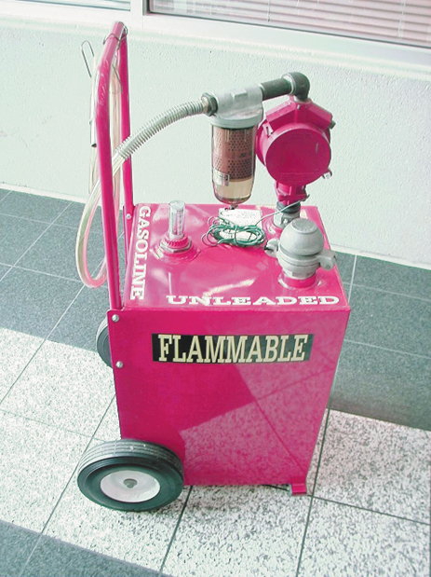
FIGURE 2–9 This red gasoline container holds about 30 gallons of gasoline and is used to fill vehicles used for training.

Slide 20
AIRBAG HANDLING (1 OF 2)
Airbag safety should include the following precautions.
  Disarm the airbag(s) if you will be working in the area where a discharged bag could make contact with any part of your body.
  If disposing of an airbag, the usual procedure is to deploy the airbag using a 12 volt power supply, such as a jump-start box, using long wires to connect to the module to ensure a safe deployment.

Slide 21
AIRBAG HANDLING (2 OF 2)
  Do not expose an airbag to extreme heat or fire.
  Always carry an airbag pointing away from your body.
  Place an airbag module facing upward.
  Always follow the manufacturer's recommended procedure for airbag disposal or recycling
  Wear protective gloves if handling a deployed airbag.
  Always wash your hands or body well if exposed to a deployed airbag.

Slide 22
USED TIRE DISPOSAL (1 OF 2)
Used tires should be disposed of in one of the following ways.
  Used tires can be reused until the end of their useful life.
  Tires can be retreaded.
  Tires can be recycled or shredded for use in asphalt.
  Derimmed tires can be sent to a landfill

Slide 23
USED TIRE DISPOSAL (2 OF 2)
Used tires should be disposed of in one of the following ways.
  Tires can be burned in cement kilns or other power plants where the smoke can be controlled.
  A registered scrap tire handler should be used to transport tires for disposal or recycling.

Slide 24
AIR-CONDITIONING REFRIGERANT OIL DISPOSAL
Air-conditioning refrigerant oil contains dissolved refrigerant and is therefore considered to be hazardous waste.
This oil must be kept separated from other waste oil or the entire amount of oil must be treated as hazardous.
Used refrigerant oil must be sent to a licensed hazardous waste disposal company for recycling or disposal.

Slide 25
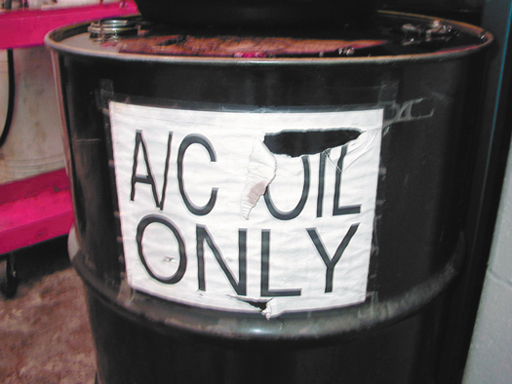
FIGURE 2–10 Air-conditioning refrigerant oil must be kept separated from other oils because it contains traces of refrigerant and must be treated as hazardous waste.

Slide 26
SUMMARY (1 OF 2)
Hazardous materials include common automotive chemicals, liquids, and lubricants, especially those whose ingredients contain chlor or fluor in their name.
Right-to-know laws require that all workers have access to material safety data sheets (MSDS).
Asbestos fibers should be avoided and removed according to current laws and regulations.

Slide 27
SUMMARY (2 OF 2)
Used engine oil contains metals worn from parts and should be handled and disposed of properly.
Solvents represent a serious health risk and should be avoided as much as possible.
Coolant should be disposed of properly or recycled.
Batteries are considered to be hazardous waste and should be discarded to a recycling facility.

