Slide 1

Automotive Engines Theory and Servicing
Ninth Edition
Chapter 1
Shop Safety

Slide 2
OBJECTIVES
1.1 Describe the personal protective equipment used by technicians.
1.2 Explain the safety tips for technicians and the cleaning methods and processes used in vehicle service.
1.3 Discuss shop safety procedures.
1.4 Describe the purpose of fire extinguishers, fire blankets, and fire aid and eye washing stations.

Slide 3
PERSONAL PROTECTIVE EQUIPMENT (1 OF 2)
Safe work habits can reduce accidents and injuries, ease the workload, and keep employees pain free.
  Safety Glasses
  Steel-toed Shoes

Slide 4
PERSONAL PROTECTIVE EQUIPMENT (2 OF 2)
  Gloves
    Latex surgical gloves; Vinyl gloves; Polyurethane gloves; Nitrile gloves; Mechanic's gloves
  Bump Cap
  Hands, Jewelry, and Clothing

Slide 5
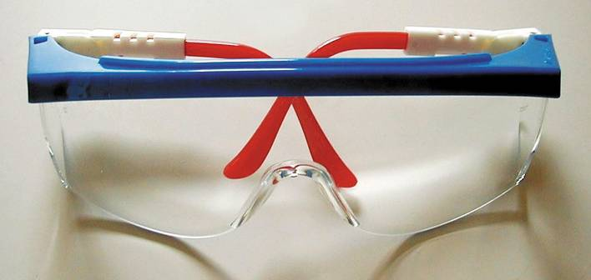
FIGURE 1–1 Safety glasses should be worn at all times when working on or around any vehicle or servicing any component.

Slide 6
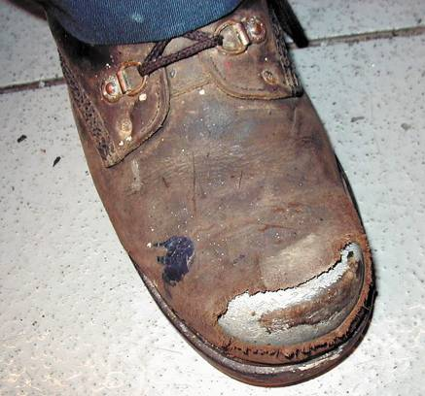
FIGURE 1–2 Steel-toed shoes are a worthwhile investment to help prevent foot injury due to falling objects. Even these well-worn shoes can protect the feet of this service technician.

Slide 7
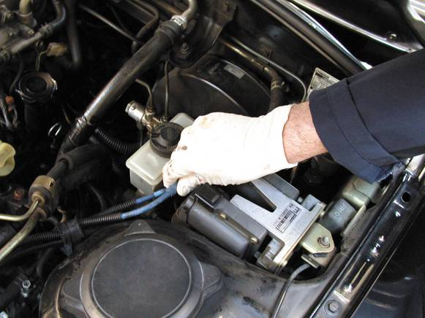
FIGURE 1–3 Protective gloves such as these vinyl gloves are available in several sizes. Select the size that allows the gloves to fit snugly. Vinyl gloves last a long time and often can be worn all day to help protect your hands from dirt and possible hazardous materials.

Slide 8
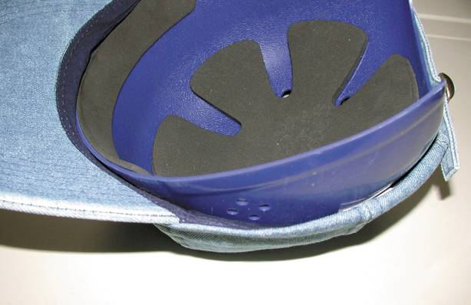
FIGURE 1–4 One version of a bump cap is this padded plastic insert that is worn inside a regular cloth cap.

Slide 9
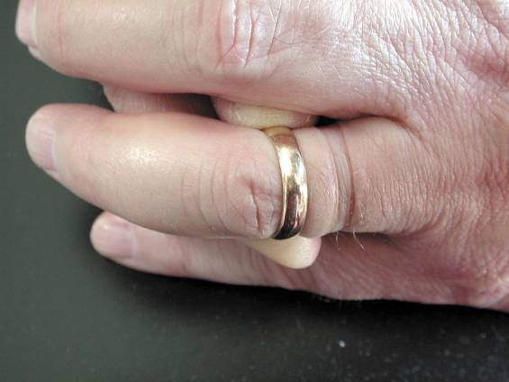
FIGURE 1–5 Remove all jewelry before performing service work on any vehicle.

Slide 10
SAFETY TIPS FOR TECHNICIANS (1 of 3)
When lifting any object, get a secure grip with solid footing.
  Keep the load close to your body to minimize the strain. Lift with your legs and arms, not your back.
Do not twist your body when carrying a load. Instead, pivot your feet to help prevent strain on the spine.

Slide 11
SAFETY TIPS FOR TECHNICIANS (2 OF 3)
Ask for help when moving or lifting heavy objects.
Push a heavy object rather than pull it.
Always connect an exhaust hose to the tailpipe of any running vehicle to help prevent the buildup of carbon monoxide inside a closed garage space.

Slide 12
SAFETY TIPS FOR TECHNICIANS (3 OF 3)
When standing, keep objects, parts, and tools with which you are working between chest height and waist height.
  If seated, work at tasks that are at elbow height.
Ask for help when pushing or vehicle or use a motorized pusher.

Slide 13
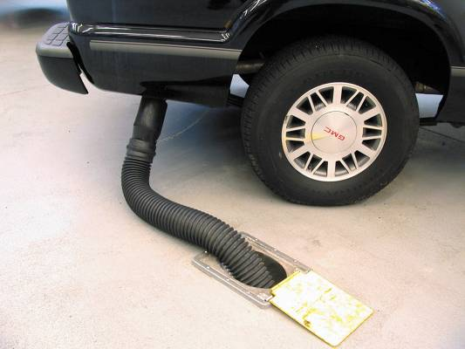
FIGURE 1–6 Always connect an exhaust hose to the tailpipe of the engine of a vehicle to be run inside a building.

Slide 14
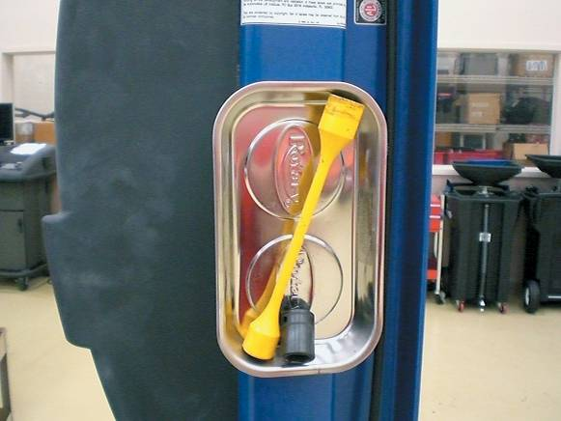
FIGURE 1–7 A magnetic tray is a helpful item to keep tools needed up where they can be easily reached without having to bend over saving time and energy over the course of a long day in the shop.

Slide 15
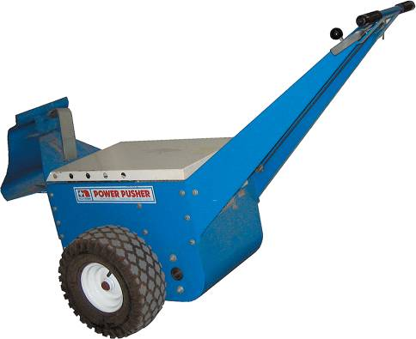
FIGURE 1–8 An electric pusher used to push vehicles into or around the shop.

Slide 16
CLEANING METHODS AND PROCESSES
There are four basic types of cleaning methods and processes used in vehicle service.
  Power Washing
  Chemical/Microbe Cleaning
  Abrasive Cleaning
  Thermal Ovens

Slide 17
ELECTRICAL CORD SAFETY (1 OF 2)
Use correctly grounded three-prong sockets and extension cords to operate power tools.
  Some tools use only two-prong plugs.
  Make sure these are double insulated and repair or replace any electrical cords that are cut or damaged to prevent the possibility of an electrical shock.

Slide 18
ELECTRICAL CORD SAFETY (2 OF 2)
    When not in use, keep electrical cords off the floor to prevent tripping over them.
    Tape the cords down if they are placed in high foot traffic areas.

Slide 19
JUMP-STARTING AND BATTERY SAFETY
To jump-start another vehicle with a dead battery, connect good-quality copper jumper cables or use a jump box.
The last connection made should always be on the engine block or an engine bracket as far from the battery as possible.

Slide 20
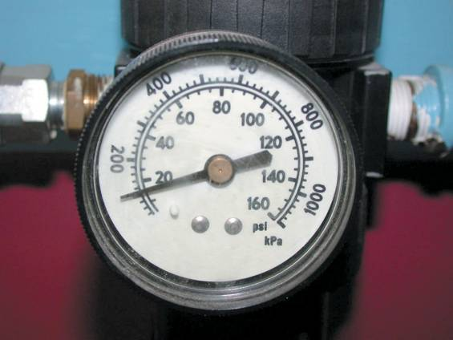
FIGURE 1–11 The air pressure going to the nozzle should be reduced to 30 PSI or less.

Slide 21
FIRE EXTINGUISHERS (1 OF 3)
There are four classes of fire extinguishers.
  Class A is designed for use on general combustibles, such as cloth, paper, and wood.
  Class B is designed for use on flammable liquids and greases, including gasoline, oil, thinners, and solvents.
  Class C is used only on electrical fires.

Slide 22
FIRE EXTINGUISHERS (2 OF 3)
  Class D is effective only on combustible metals such as powdered aluminum, sodium, or magnesium.
The class rating is clearly marked on the side of every fire extinguisher.
Many extinguishers are good for multiple types of fires.

Slide 23
FIRE EXTINGUISHERS (3 OF 3)
Remember the word "PASS."
  P Pull the safety pin.
  A Aim the nozzle of the extinguisher at the base of the fire.
  S Squeeze the lever to actuate the extinguisher.
  S Sweep the nozzle from side to side.

Slide 24
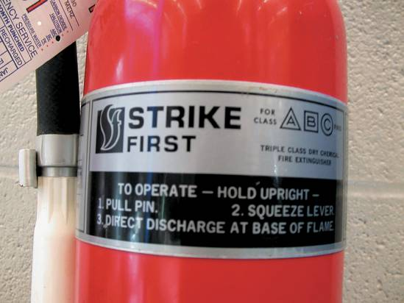
FIGURE 1–12 A typical fire extinguisher designed to be used on type class A, B, or C fires.

Slide 25
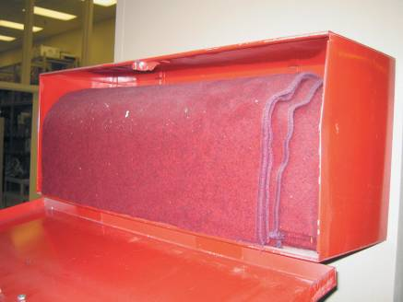
FIRE BLANKETS
Fire blankets are required to be available in the shop areas.
If a person is on fire, a fire blanket should be removed from its storage bag and thrown over and around the victim to smother the fire.
FIGURE 1–14 A treated wool blanket is kept in this easy-to-open wall-mounted holder and should be placed in a centralized location in the shop.

Slide 26
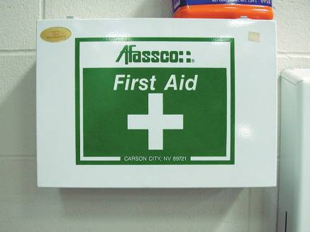
FIRST AID AND EYE WASH STATIONS
All shop areas must be equipped with a first aid kit and an eye wash station centrally located and kept stocked with emergency supplies.
  First Aid Kit
  Eye Wash Station
FIGURE 1–15 A first aid box should be centrally located in the shop and kept stocked with the recommended supplies.

Slide 27
SUMMARY (1 OF 2)
All service technicians should wear safety glasses that meet standard ANSI Z87.1.
Ear protection should be worn anytime the noise level is at 90 decibels (dB) or higher.
Safety should be exercised when working with electrical cords or when jump-starting another vehicle.

Slide 28
SUMMARY (2 OF 2)
If a fire extinguisher is needed, remember: Pull the safety pin, aim the nozzle, squeeze the lever, and sweep the nozzle from side-to-side.

