Slide 1


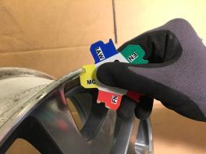

Teaching Tires and Wheels
Jim Halderman
Brad Halderman

Slide 2
Introductions
Jim Halderman
Former flat-rate technician and college instructor
Author of many automotive books and lives in Dayton, Ohio.
www.jameshalderman.com
Brad Halderman
Tire development engineer
The Goodyear Tire & Rubber Co – 16 yrs
Hankook Tire Co. – 5 yrs
Lives in Akron, Ohio

Slide 3
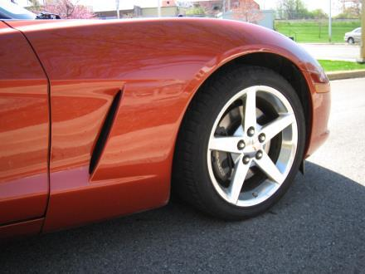
Topics to be Discussed
Tire construction
Tire sizes/Rim widths
Load rating
Speed rating
Match mounting
Balancing
Wheel weights
Wheels
TPMS

Slide 4

Akron, Ohio- The Rubber City
Location of Research and Development Centers for 13 Global tire companies
Goodyear
Bridgestone/Firestone
Hankook
Nexen
GiTi (GT Radial brand)
Kenda
Kumho
Linglong
Triangle
etc
No tires are now built in Akron except race tires
Cooper Tire R&D and tire mfr in Findley

Slide 5
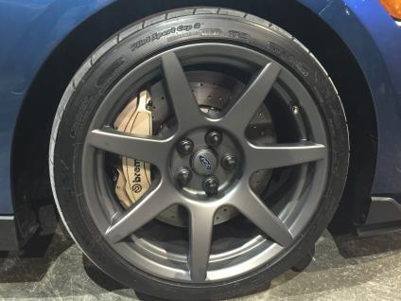
What is a Tire?
Round, black and full of air
A container for air
Supports the weight of the vehicle
Is the first part of the suspension system
All of the above?

Slide 6
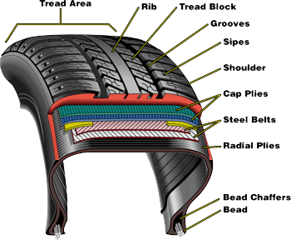
Radial Tire Construction
Complex, highly engineered product containing 13+ components
Tread
Wearing surface of tire
1-4 different compounds
Vary across the tire or as depth changes
Cap ply (1-4 layers separating belts and undertread)
2 layers of steel belts
Radial body plies (1 or 2)
Beads
Strands of wound high strength steel
Bead filler/apex
Gives strength and rigidity to sidewall
Inner liner
Air retention
Prevents moisture from contaminating inner components of the tire (fabrics, belt and bead wires)

Slide 7
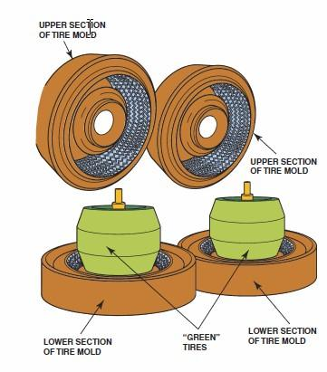
Tire Molding
After the tire has been assembled, it is called a green tire.
The completed green tire is then placed in a mold where its shape, tread design, and all sidewall markings are formed.
About 300° F for 30 minutes to vulcanize the tire.

Slide 8
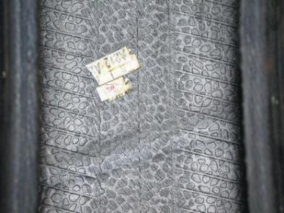
Major Splice
When the tire is assembled, the body plies, belts, and tread rubber are spliced together.
The fabric overlaps.
The point where the majority of these overlaps occur is called the major splice.

Slide 9
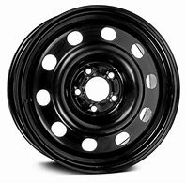
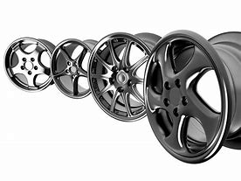
Steel vs Alloy Wheels
Often not round
Valve stem hole drilled at the smallest diameter of the wheel.
Valve stem/TPMS sensor weighs about 1.5 oz.
Alloy wheels are usually very round.
Valve stem hole is drilled anywhere that is logical and not aligned with the wheel diameter.

Slide 10
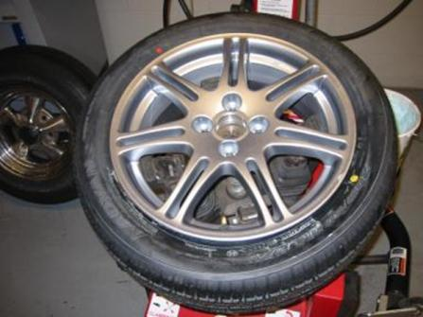
Red and Yellow Dots
Yellow Dot- Indicates “the light (static) balance point of the “
Red Dot- Indicates the “radial force variation first harmonic maximum”
If a tire has both red and yellow dots, the red dot has priority. Match it to the wheel low point dimple or valve stem. Ignore the yellow dot.

Slide 11
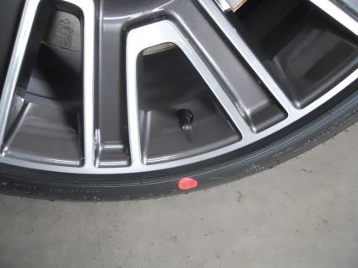
RED DOT
The red dot would more or less correspond to the “high point” or place where radial runout forces are greatest.
“Red Rules”

Slide 12
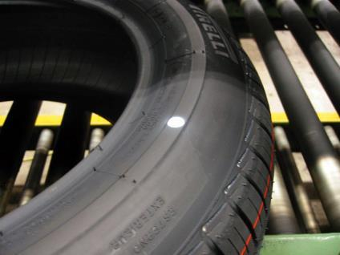
DOTS of any other color
Blue, green, purple, white, pink or orange dots?
Just ignore them.
They are ``mystery'' dots and are there for factory purposes. Once the tire leaves the manufacturing plant, dots of those colors have no use.

Slide 13
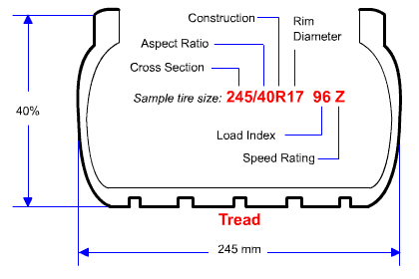
Tire Size Designation
P= passenger vehicle
LT= light truck
245= cross-sectional
width in mm
40= aspect ratio
Sidewall height is 40% of the width (245 x 0.40 = 98mm)
17 = rim diameter in inches
96 = load index
Z = speed rating

Slide 14
“C” Tires
The new generation of vans such as the Ford Transit and MB Sprinter use “C” tires.
The Transit uses 235/65R16C tires. Not P-metric (P235), not LT (LT235). The kicker is that the “C” stands for Commercial, NOT C load rating.
This is causing a lot of consumer confusion because people may buy a P235/65R16 (101 load index) 1819lbs at 35psi. The proper 235/65R16C tire has a load index of 115 (5357lbs at 69 psi !!).

Slide 15
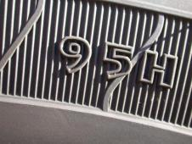
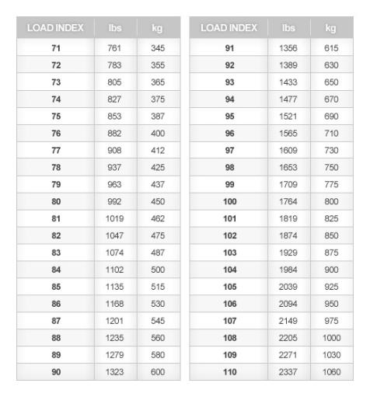
Load Index
The greater the amount (volume) of air in a tire, the greater the load carrying capacity
Using larger diameter wheels with a shorter aspect ratio can result in an overloaded tire.

Slide 16
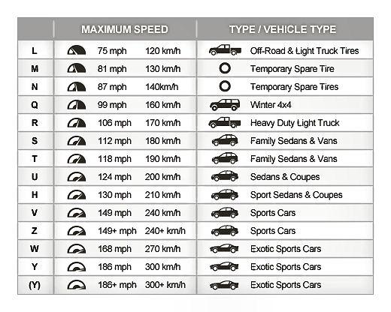
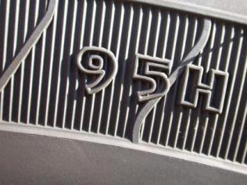
Speed Rating

Slide 17
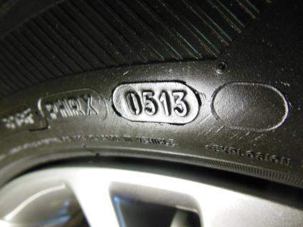
Date Code
Four numbers
The first two= week of the year
05 = Fifth week
Last two = year
13 = 2013
Many vehicle and tire manufacturers says that tires over 6 years old should be replaced

Slide 18
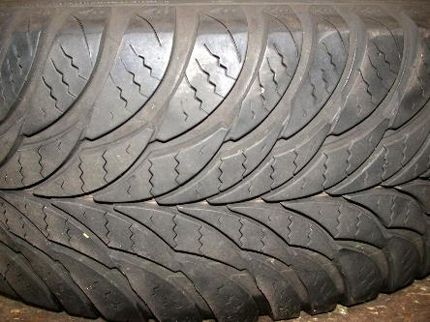
Life of Tires
Many Vehicle manufacturers recommend replacing tires after six years regardless of tread depth.
Consumer's Digest recommends after ten years.

Slide 19

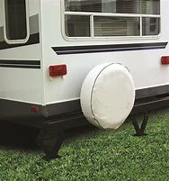
Factors that Affect Tire Life
Good for Tires
Cool and dry
Away for heat and the sun.
Away from ozone sources such as electric motors
Bad for Tires
Exposure to the sun
High temperatures
Exposed to ozone

Slide 20
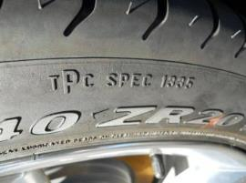
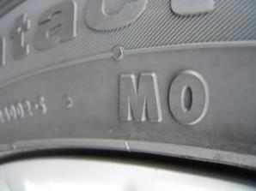
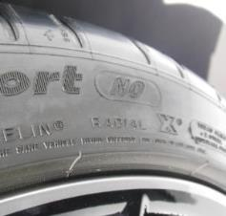
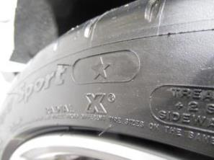
OE Tire Markings
TPC (Tire Performance Criteria)-GM
MO- Mercedes Original
NO- Porsche
Star- BMW

Slide 21
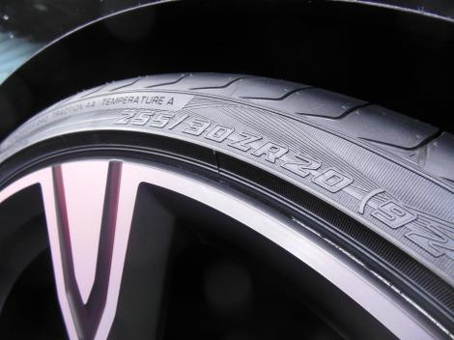
What is a “Rim Protector”?
Many vehicle manufacturers specify a tire that has an extended sidewall to help protect the wheel from curb damage.
Try to purchase replacement tires with this feature.

Slide 22
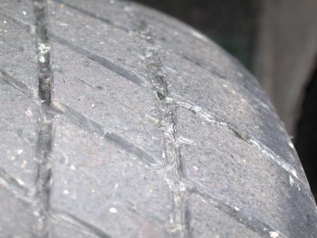
Tire Inspection
Check inflation pressure
Check tread depth
Visual inspection
Rotate wheels and observe tread and sidewall checking for shifted belts or bulges etc.

Slide 23
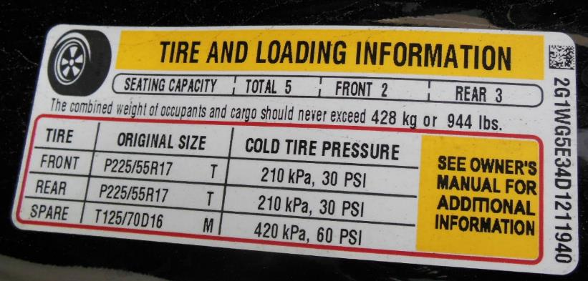
Placard Inflation Pressure

Slide 24
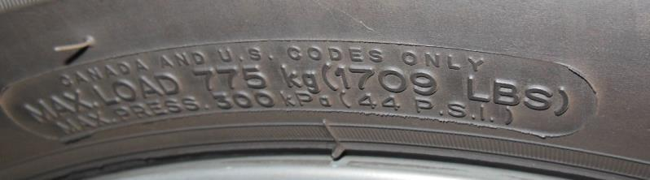
MAX Pressure on Sidewall
Higher inflations most likely create a smaller footprint area and will change the wear characteristics (not always for the better) but can also reduce braking traction available.
Keep to the door placard inflation pressure

Slide 25
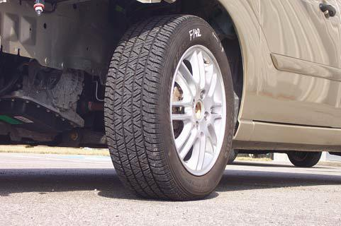
100% Inflation

Slide 26
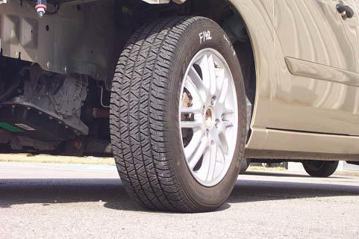
90% Inflation

Slide 27
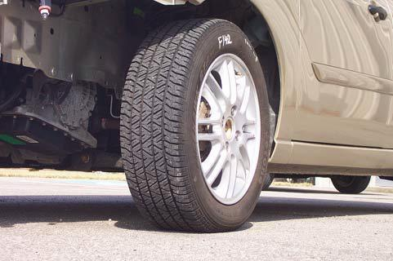
80% Inflation

Slide 28
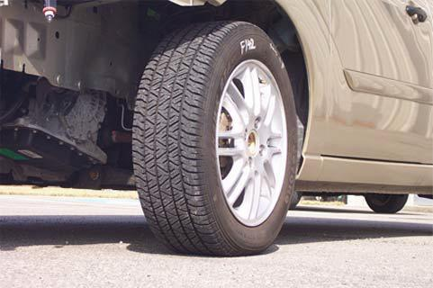
70% Inflation

Slide 29
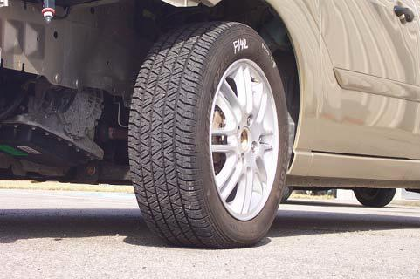
60% Inflation

Slide 30
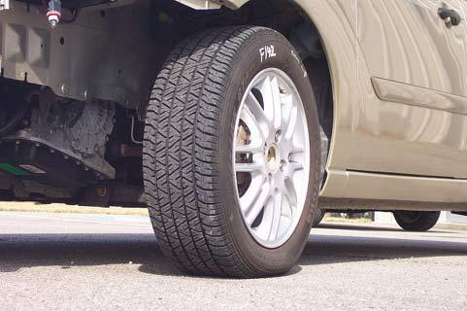
50% Inflation

Slide 31
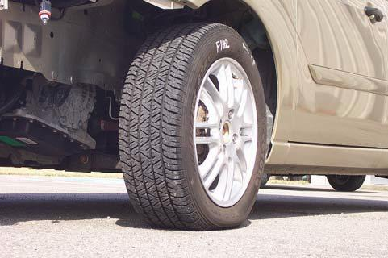
40% Inflation

Slide 32
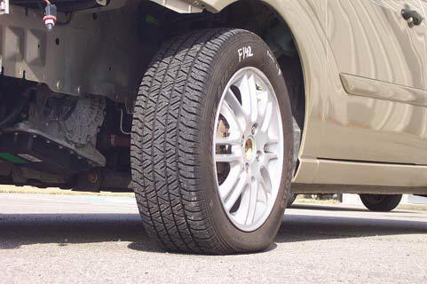
30% Inflation

Slide 33
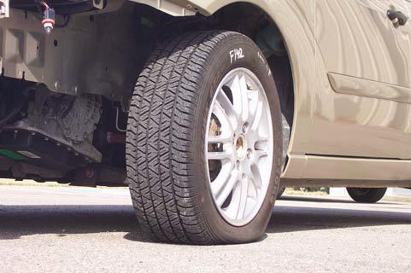
20% Inflation

Slide 34
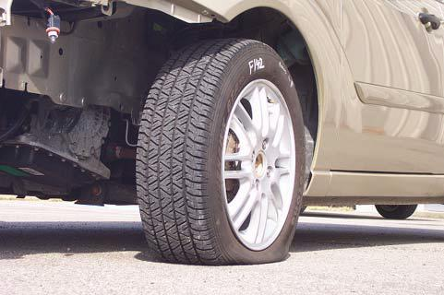
10% Inflation

Slide 35
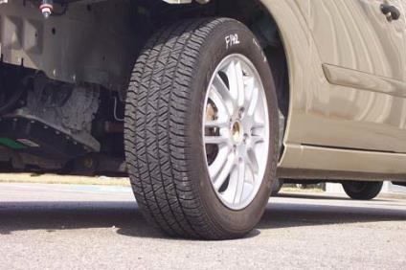
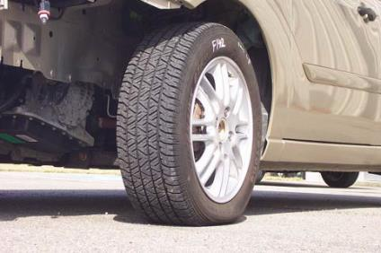
100% vs 40%

Slide 36
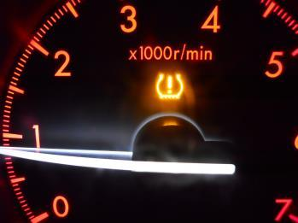
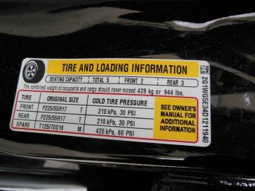
TREAD ACT
Effective 2007 and newer model year (MY).
Requires that a warning light when pressure drops 25% of the cold inflation pressure as shown on the door placard

Slide 37
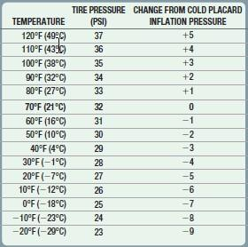
Pressure and Temperature
Cold Placard Inflation pressure
Tire pressure changes 1 PSI for each 10 degree (F) change in temperature.
From 70 degrees down to 30 degrees means a drop of 4 PSI.

Slide 38
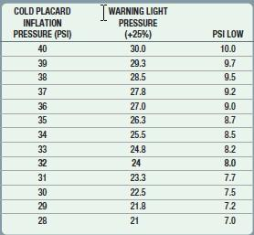
TPMS Warning Pressure
The tread act specifies that the warning light come on when the pressure drops 25%.
This usually means when the pressure drops 8 PSI.

Slide 39
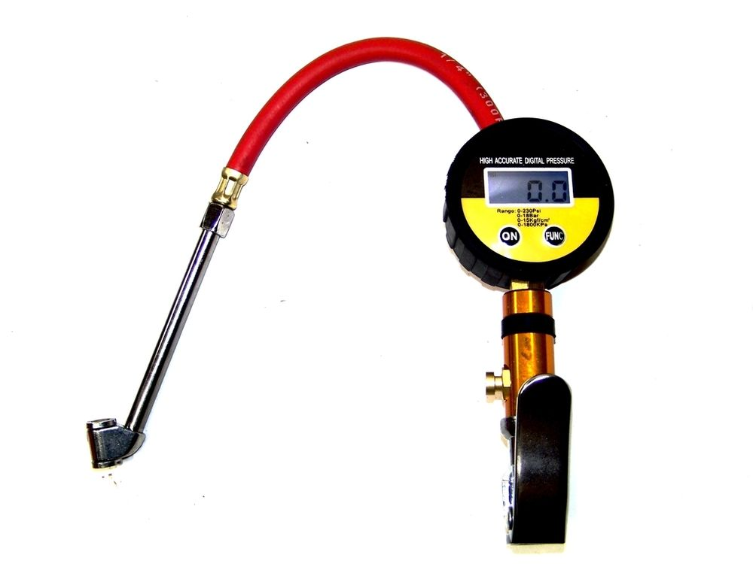
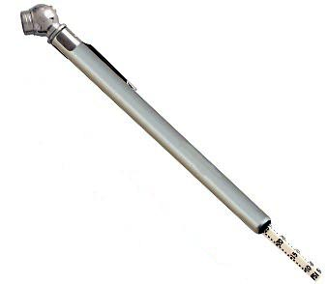
Tire Pressure Gauge
Avoid using this pencil type pressure gauge
Digital gauges are best and most accurate

Slide 40
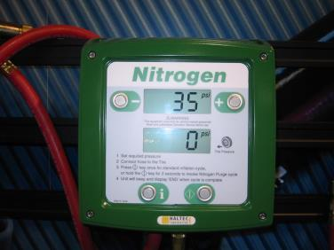
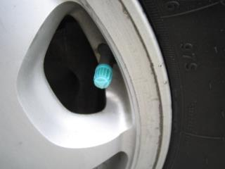
Nitrogen Inflation
Air contains about 78% nitrogen, 21% oxygen, and 1% other gases.
The nitrogen molecule is slightly larger than the oxygen molecule
An oxygen molecule is 0.29 nanometers in diameter and a nitrogen molecule is 0.31 nanometers. A nanometer is a billionth of a meter.
Compressed nitrogen contains less moisture than compressed air.

Slide 41
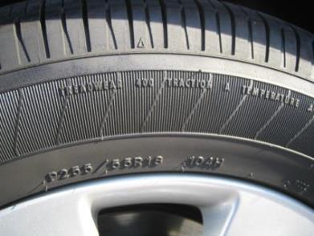
Tire Quality Rating
UTQG (Uniform Tire Quality Grade)
Treadwear-
200, 360, etc.
Relative ranking of wear rate
100 has 2X wear rate of 200
Some correlation to mfr tread wear warranties, little correlation to actual tread wear
Traction- AA, A, B or C (wet braking traction only!)
Temperature (Temperature build-up)-
A, B or C

Slide 42
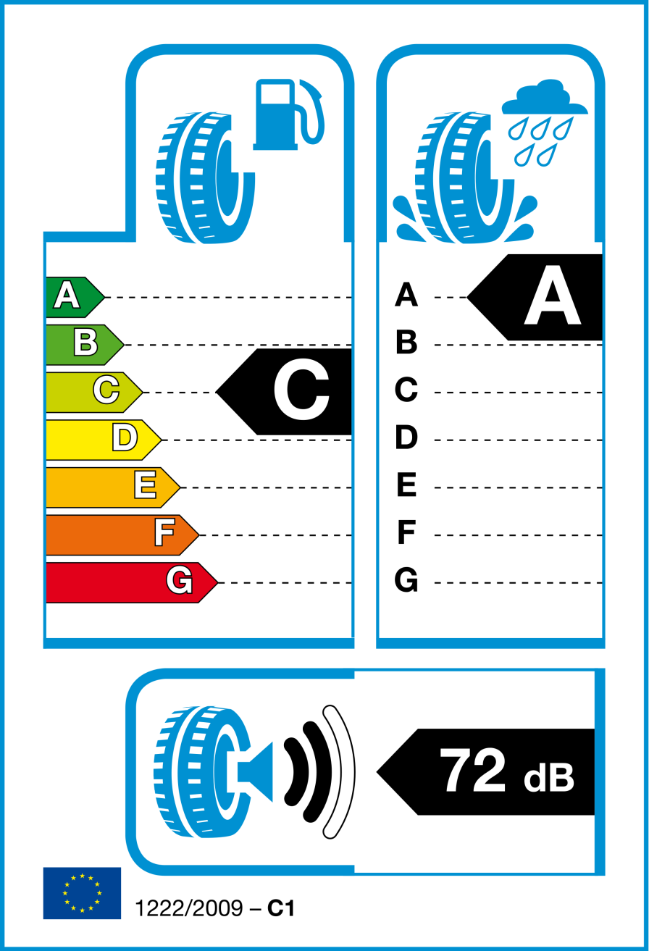
New Tire Labeling standards coming
Details still under discussion (Maybe 2017?)
Patterned after current labeling rules in the EU
Rolling Resistance
Energy lost when a tire is rolling
Difference from A to G is 7.5%
Approximately 2 mpg for a typical car
Wet Grip
Combination of actual vehicle stopping distance testing and skid trailer testing = WGI (wet grip index)
Difference from A to G is approximately 4 car lengths
Noise levels
Tires exterior noise level
Environmental noise pollution
Measured at side of test track as vehicle coasts by (engine off) at 50mph
USA most likely to use a 1-5 star rating

Slide 43
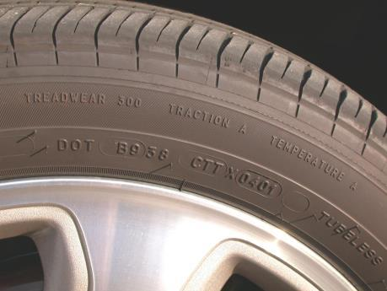
Mandatory Tire Registration
Congress has passed a bill (2015)requiring:
Tire registration for sellers not owned by a tire manufacturer
Creation of a public tire recall database for consumers
No timeline was included

Slide 44


Tread Depth
New tires = 11/32 inch+
6/32 inch or more= OK
5/32 - 4/32 inch= Consider replacement
( Washington’s head on a quarter)
3/32 inch or less= Replace
2/32 inch is the legal limit
(Lincoln’s head on a penny)

Slide 45

AWD Concerns
All tires must be within 1/16 (2/32)inch of tread depth for the proper operation on an all-wheel drive (AWD)vehicle.
If a tire has 2/32 in. less tread depth, this means the circumference is 0.4 inches smaller and the tire over one mile of travel will make four additional rotations than the other tires.

Slide 46


Wear Bars
Molded into the tread
Designed to be level with the tread at a depth of 2/32 inch

Slide 47



Hunter Tread Measuring Unit

Slide 48

Questions
Summer tires- Always above 45 ° F then summer-type tires can be used.
Winter tires- Always below 45 ° F then winter tires can be used.
All-Season tires- Both above and below 45 ° F then all-season type tires should be selected.
M + S rated tires- Does NOT indicate the tires work well in mud and snow. It’s ONLY based on void ratio of the tread pattern (tread to groove ratio)

Slide 49
Questions-Continued
All Terrain tires- AT designates a performance category for marketing differentiation, not actual performance
AS, Touring, AS HP, SU Touring, SU HP, AT, HWY, XAT, MT, etc.
4-Season tires?- Isn’t that ALL the seasons?
“New” category created by tire companies
Same as All-Season tires except most of these are also 3 Peak Mountain Snowflake (3PMSF)
Has a minimum snow traction ability tested vs an industry standard reference test tire (SRTT) - minimum 110 rating
Dec 15-March 15 Quebec: All vehicles must have 3PMSF marked tires

Slide 50


Same Tire Design
If winter tires are needed (below 45 degrees), install on all four wheels.
Russ Ferguson found out what happens when winter tires are only used on the drive wheels

Slide 51

Tires Chains
All vehicles are designed to work with tire chains.
If the vehicle has been lowered or larger wheels and/or tires installed, this may be an issue.
Most effective when installed on the drive wheels.

Slide 52

If only two new tires?
Mount them at the rear
The driver has “direct control” of the front wheels
The driver only has “indirect control” of the rear wheels.
May be a legal issue if two new tires are mounted in the front.

Slide 53

Overall Diameter
Wheel and tire diameter affects the speedometer and odometer readings.
• Larger diameter tires. The speed showing on the speedometer is slower than the actual speed.
The odometer reading will show fewer miles than actual.
• Smaller diameter tires. The speed showing on the speedometer is faster than the actual speed.
The odometer reading will show more miles than actual.

Slide 54


Tire and Wheel Size
Rotational Inertia
Larger wheels and tires weigh more
Can affect braking distance
Requires more force to accelerate

Slide 55

Wheel Installation
Make sure that the wheels are installed correctly.
Holes in the wheel are tapered.
Tapered end of the lug nut TOWARD the wheel.

Slide 56

Lug Nut Tightening Sequence
Star pattern
Tighten one, skip one
Repeat clockwise
Best to do in two steps
Tighten lug nuts to the specified torque.
Check under “Jim's favorites” and “A4” for lug nut chart at www.jameshalderman.com

Slide 57


Use a Torque Wrench

Slide 58

Tire Rotation
Front to rear
X pattern
Modified X

Slide 59
Wheels
Forging is the metalworking process in which a slug of heated metal is forced into the desired shape over a die by the impact of a mating die driven by a machine.
The resulting grain structure adds strength.
Casting is where molten metal is poured or forced under pressure into a mold to create the desired shape.
Casting wheels is relatively easier and cheaper than forging.

Slide 60


Japan Wheel Light Metal Mark
The symbol JWL, for the Japan Wheel Light Metal Standard Mark, means that the wheel meets the technical standards for passenger-car light-alloy wheels

Slide 61

Dimensions of Wheels
If replacing wheels, try to keep the same:
Backspacing
Offset
If going larger in diameter, keep tire size the same outside diameter (O.D.)

Slide 62


Use same Offset and Backspacing
If not, it affects:
Handling
Scrub radius
Tire wear
Wheel bearing life

Slide 63


Check Bolt Circle
Use measuring tool if looking for wheels at a flea market or wrecking (recycling) yard

Slide 64

How much bigger can I go?
Each tire has it own designated rim width.
Rule-of-thumb is width of rim width times 33.55 equals cross-sectional width of tire.
7 inch wide rim X 33.55 = 234.9 mm(235 mm)

Slide 65

Plus One Concept
If a wheel diameter is increased one inch, then the aspect ratio has to be reduced to keep the same outside diameter.
Use a tire calculator found on the Internet
www.jameshalderman.com

Slide 66

O.D. should be within 3%
The Tire Industry Association (TIA) recommends that replacement tires should be within 3% of the of the diameter of of the original equipment tire.
Could be a legal issue if not within 3%.

Slide 67

If nothing rubs, you are good to go! Right?

Slide 68

CASE STUDY
Winter tires mounted on aftermarket rims. Customer hit a curb and took it the dealer to check the suspension due to a vibration. Was told wheel was cracked. A new wheel was ordered and installed. The vibration problem continued in spite of alignment, balancing, etc.

Slide 69


CASE STUDY- Root Cause
Three different service departments pulled the wheels since this started.
Finally an independent shop discovered the “hub centric ring” was missing.
Customer retrieved the ring from the cracked wheel and problem solved.

Slide 70

Clean the Wheels
Use a fiber pad
Avoid using a steel wire brush.
Clean both tire bead seats and flanges.

Slide 71

TPMS Sensors
Use new sensors or a “kit” that includes new washers and nuts.
Install correctly
Use torque wrench

Slide 72
Mounting Tires
Asymmetric tires have sidewall lettering indicating which side of the tire has to face outward.
Directional and asymmetric tires have “side facing outwards”
and a rotation arrow.

Slide 73

No Lead Wheel Weight States
CALIFORNIA
ILLINOIS
MAINE
NEW YORK
WASHINGTON
VERMONT
New Jersey
MINNESOTA
Many fleets ban lead, including the government fleets in Lexington, Kentucky; Ann Arbor, Michigan; Clark County, Nevada and others.
There are also policies in place for the United States Post Office and the United States Air Force.

Slide 74


Wheel Weights
• Lead (Chemical symbol Pb) - Being phased out. (stick-on and clip-on designs)
• Zinc (Chemical symbol Zn) - (stick-on and clip-on designs)
• Steel (Chemical symbol Fe) - (stick-on and clip-on designs)

Slide 75


Plastic Wheel Weights
3M Thermoplastic Polypropylene- high specific gravity plastic (stick-on only)
Reduces the number SKUs (stock keeping units)
Very cost effective

Slide 76

Wheel Flange Gauge
“MC” is the wheel flange shape that is used on most domestic alloy rims(“most cars”).
“AW” which is used on older GM, Ford and Chrysler alloy rim
“FN” which is used on many Acura, Honda, Nissan and Toyotas since about 1990.

Slide 77


Plastic Clad Wheels

Slide 78

Pin Plate
All chrome clad wheels must use a pin plate.
Tire Rack always use pin plates when balancing wheels.
It takes the operator out of the balancing process.

Slide 79

Air Leak Detection
Soapy water from a spray bottle works
Visual Inspection
Valve stem area
Bead area

Slide 80

Tire Repair
Tread punctures, nail holes, or cuts up to 1/4 inch (2.6 mm) can be repaired only within the tire repair area.
Repairs should be done from the inside of the tire using plugs or patches.
The tire should be removed from the rim to
make the repair.

Slide 81


Tire Patch or Plug

Slide 82

Tire Repair
Tire looses its speed rating when repaired
Disclaimer:
“Depending on the severity of the puncture, the patch plug may not seal properly and the tire will need to be replaced”.

Slide 83
Noise Reducing Tires
Purpose is to reduce a VERY SPECIFIC frequency range: 130-240Hz
Structure-borne noise path
Not airborne noise (which is an airborne noise)
“Coke bottle” resonance
The sound you get when blowing across a partially filled glass Coke bottle
More noticeable with EV vehicles (no drivetrain noise to drown out the resonance

Slide 84

Noise Reducing Tires
Sometimes combined with sealant tire technology
Conti Silent + Conti Seal

Slide 85


Noise Reducing Tires

Slide 86


Noise Reducing Tires

Slide 87



Noise Reducing Tires

Slide 88

Vehicles Storage
When storing a vehicle:
Overinflate tires
Raise vehicle off the ground
Use a curved foam cushion block (Flat-Stoppers™)
If tires only, store in a black plastic bag in a cool dry place.

Slide 89

The Future?

Slide 90

Summary
Check tire Inflation and use the cold inflation pressure placard pressure.
Check tread depth and record on work order
Mount new tires using the specified rim width

Slide 91

Contact Information

