Slide 1


Teaching Advanced Engine Performance
Jim Halderman

Slide 2
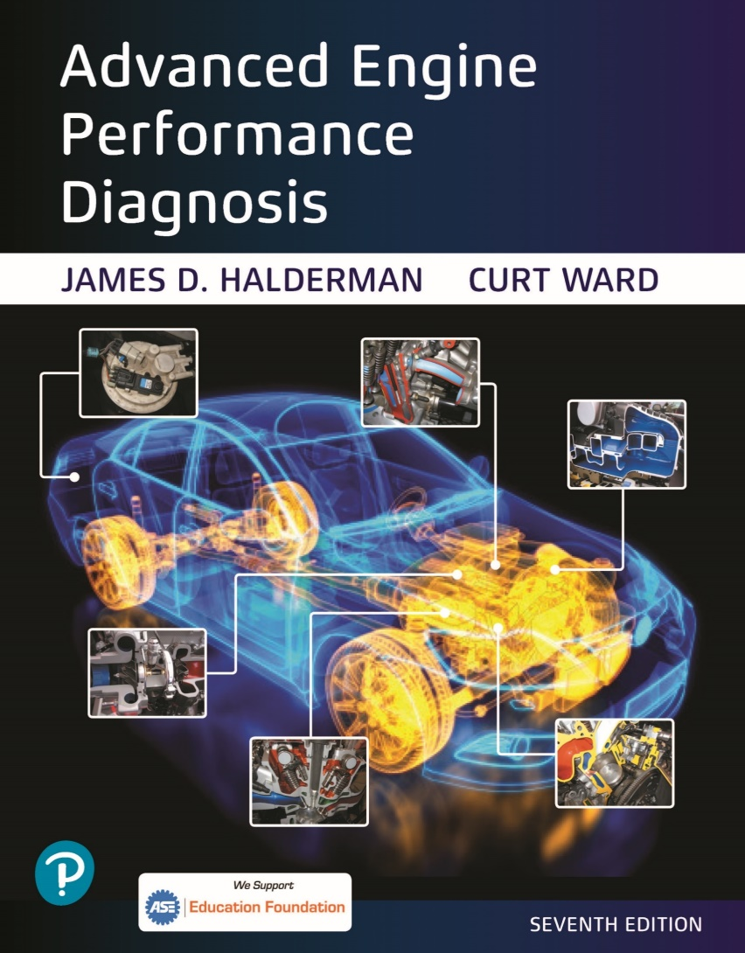
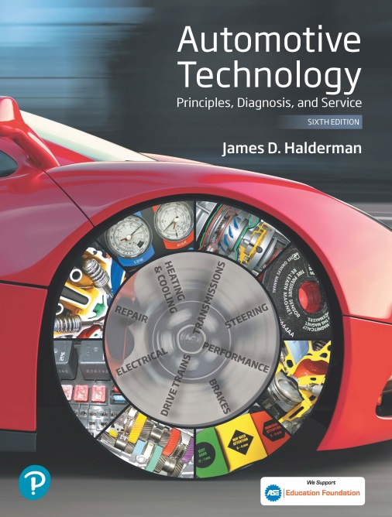
Introduction
Jim Halderman
Former college instructor and flat-rate technician.
Author of many automotive textbooks.

Slide 3
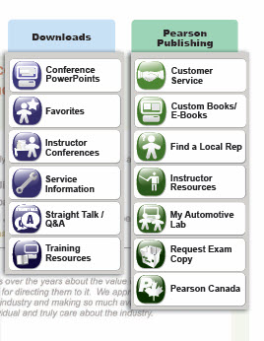
FREE copy of the Power Point
Visit:
www.jameshalderman.com
Click on “Downloads”
Select “Teaching Advanced Engine Performance”

Slide 4
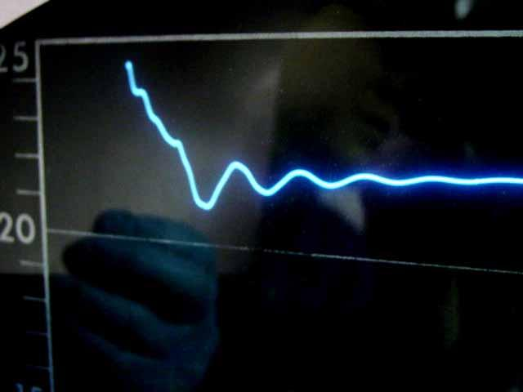
Topics to be Discussed
Teaching a diagnostic routine (strategy-based diagnosis)
Performing again and again the same process of diagnosis
Using case studies
Test drive tips and tricks
DTCs
TSBs
General tests
Pinpoint tests

Slide 5
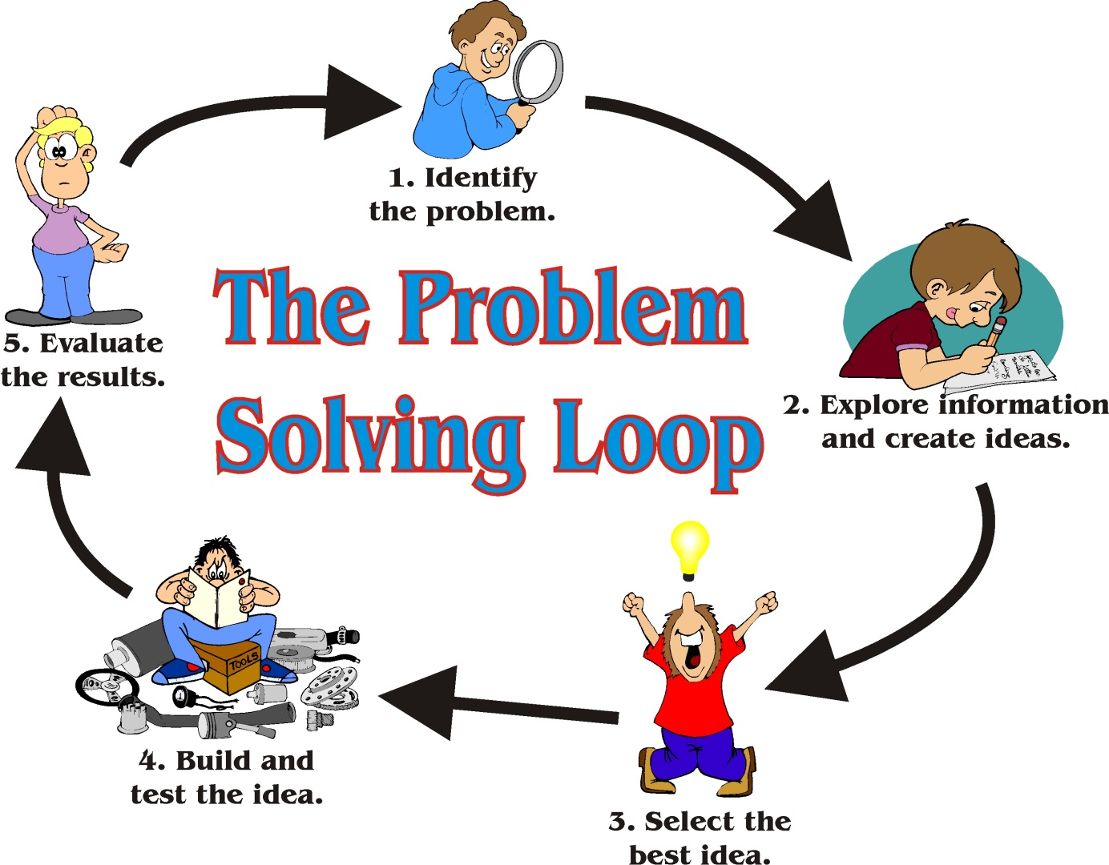
Problem Solving
3 people walk into a Mall looking for the Apple store.
The first person goes straight to the store directory, finds the Apple store location and heads straight to the store.
The second person begins randomly walking around looking for the store among the many stores and other shoppers.
The third person begins a trek following the wall to the right of the entrance door and walking the entire perimeter of the mall until he finds the store.
Which person do you want to be?

Slide 6
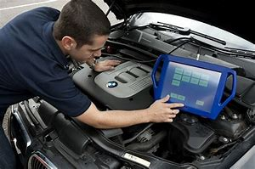
Logical Diagnostics
The Art of Having a Plan and Following It
A Systematic Approach
Repeated every time
Don’t skip a step!

Slide 7
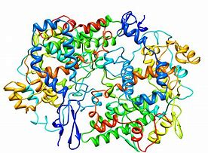
Complex Problems
Require a deductive path to diagnosis
Have a sound game plan ready and established
Get the most information with the least effort
Make the strategy repeatable

Slide 8
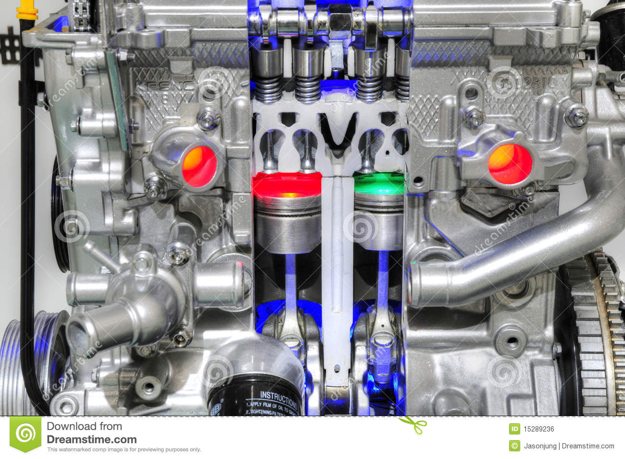
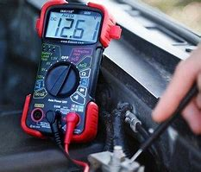
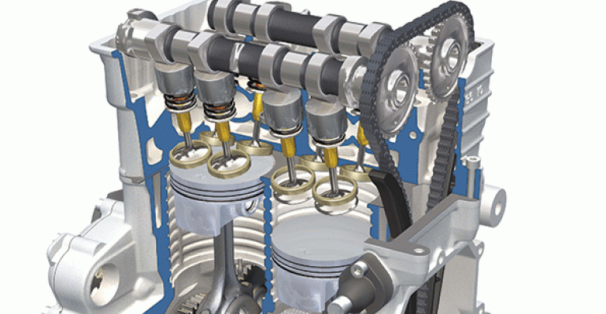
Advanced Engine Performance
First, the students should have taken:
Engines
Electrical
Engine Performance

Slide 9
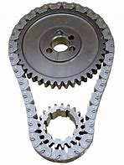
But First, the Basics
Do your students really know how an engine operates?
Give a pretest:
What are the four strokes of a four-stroke cycle engine?
Why is the camshaft sprocket twice as large as the crankshaft sprocket?
What opens the valves?
What closes the valves?

Slide 10
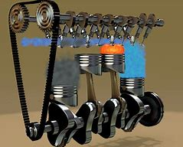
Basics- Answers
1. Intake, Compression, Power
Exhaust
2. The camshaft opens the valves
and these operate on half of the
strokes, therefore, at half
crankshaft speed.
3. The camshaft lobes force the
valves open.
4. The valve springs close the valves

Slide 11
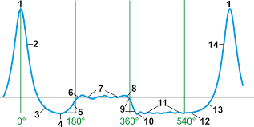
Cylinder Waveform

Slide 12
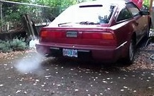
Why steam only when cold?
Steam is often seen from the tailpipe, but not all the time.
Why?
Any ideas?

Slide 13
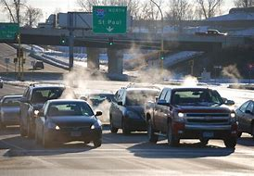
Steam seen, but only when the engine is cold.
Water in the fuel rail
Condensed water in the crankcase (drawn into the combustion chamber through the PCV)
Leaking intake manifold gasket
Other

Slide 14
Steam seen, but only when the engine is cold.
Water in the fuel rail
Condensed water in the crankcase (drawn into the combustion chamber through the PCV)
Leaking intake manifold gasket
Other

Slide 15
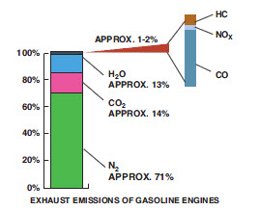
Steam Answer
Water is formed by the combustion process (H₂O). The H (hydrogen) comes from the fuel.
The O₂ is from the air.
The two combine in the combustion chamber.
Steam itself is invisible.
The cold exhaust system causes the steam to condense into water droplets, and this is seen as “steam.”

Slide 16
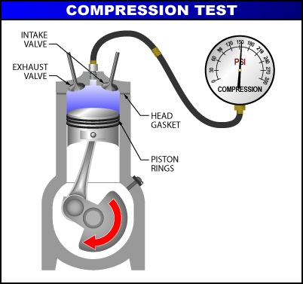
More Questions To See If Everyone Remembers The Basics
What is normal engine vacuum at idle?
2. What is normal compression
reading during cranking?
3. What should happen to the
compression reading when
the engine is started?

Slide 17
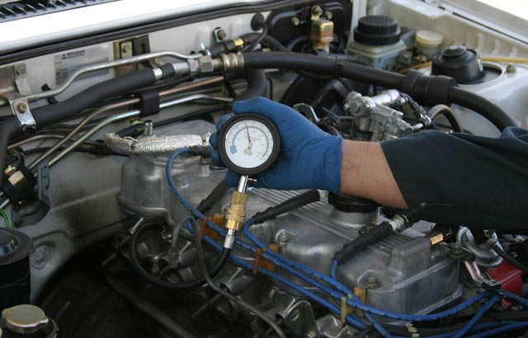
Answers to more questions
17-21 in. Hg
120-150 + PSI
The compression reading drops to about half due to reduced volumetric efficiency.

Slide 18
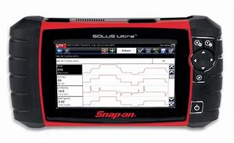
The Basic Four
Procedure - Repeated the same way each time so steps are not skipped.
Knowledge - Service information, TSBs etc.
Tools - The right tools,
including scan tools and
scopes etc.
Direction - Ignition, fuel, engine mechanical, etc.

Slide 19
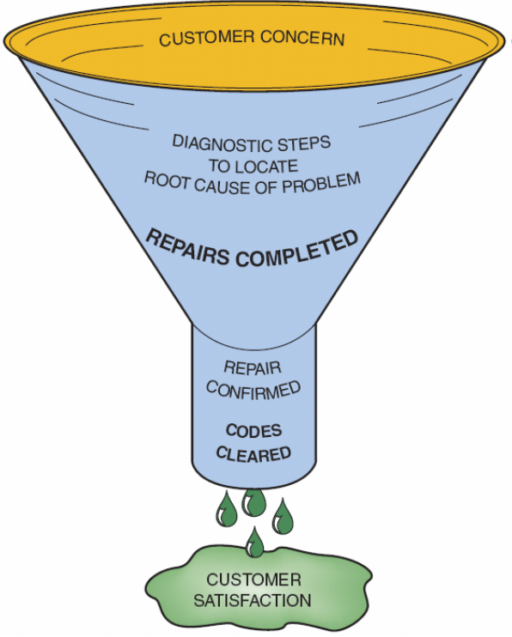
Diagnostic Process
A process that is designed to ensure something is not overlooked.
In many cases, you determine what it is NOT overlooked, and see what is left!

Slide 20
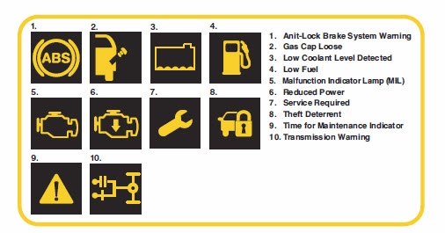
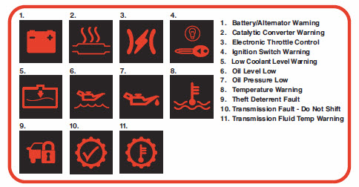
Any dash warning lights on?

Slide 21
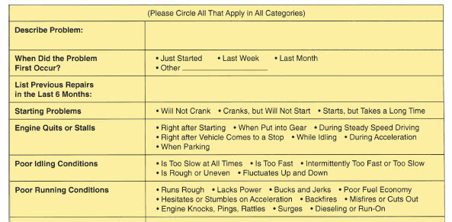
Ask the Customer to Describe the Concern (may be normal operation if a new vehicle).
Interview the customer.
Test drive the vehicle.
Preform a pre and post scan tool scan of all modules.
Document, document, document

Slide 22
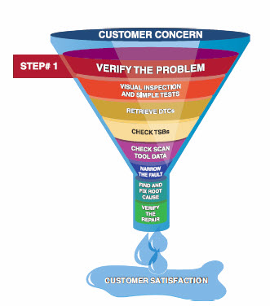
Verify the Customer Concern
If the concern can’t be verified, the repair can’t be verified.
There may be a legal issue if a service is performed or a part replaced without a confirmed issues.

Slide 23
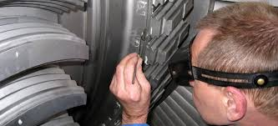
Visual Inspection
According to GM, about 20% of all customer concerns are found using a visual inspection.
Check everything, including the fuel level and the engine oil.
Look for evidence of previous repairs.
Look for any aftermarket accessories or an insurance dangle in the DLC.

Slide 24
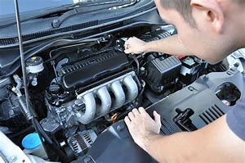
Ask Students to Perform a Visual Inspection
Most students will simply give a quick glance.
Try this:
Install the MAF sensor with the arrow pointing away from the engine instead of toward the engine.
Say: “Customer states that the engine does not seem to run right after I had the oil changed and the air filter replaced.”

Slide 25
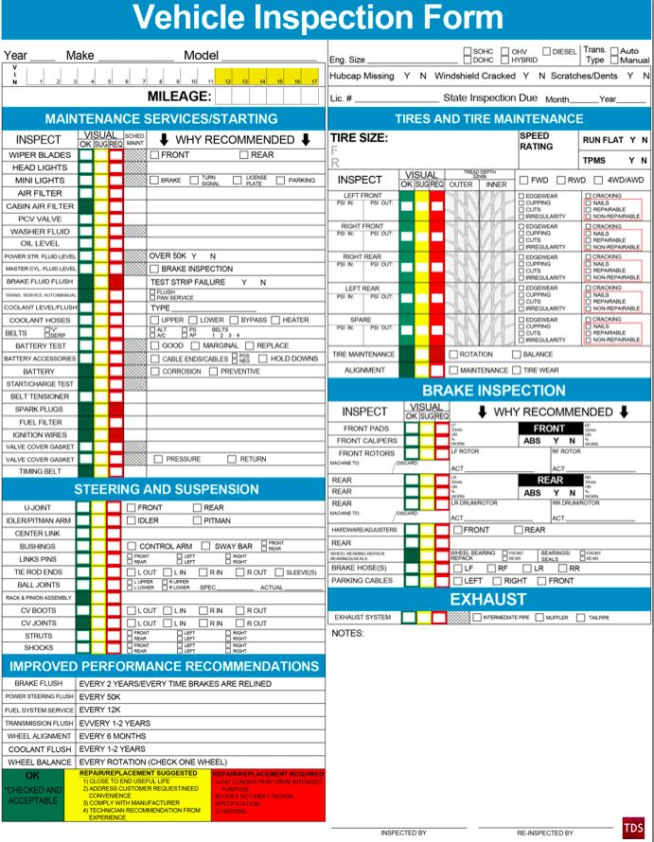
Include a Check List
The check list should include:
Oil level and condition
Accessory drive belt
Coolant level in reservoir
Air filter
Plus……..

Slide 26
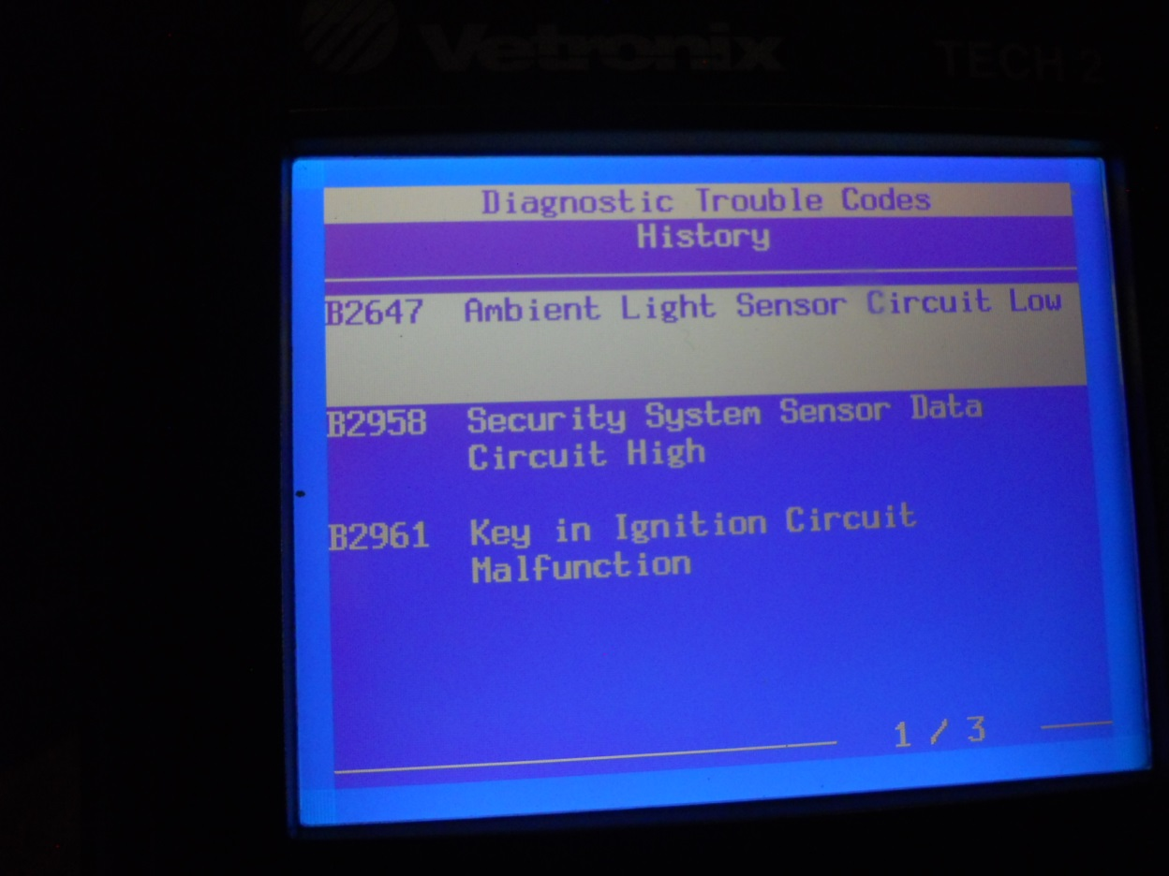
DTCs
Retrieve any stored or pending diagnostic trouble code(s).
Check for DTCs in all modules.
Document all pre and post repair scan results.
Check all P codes, as well as B, C, and U (communication) codes.

Slide 27
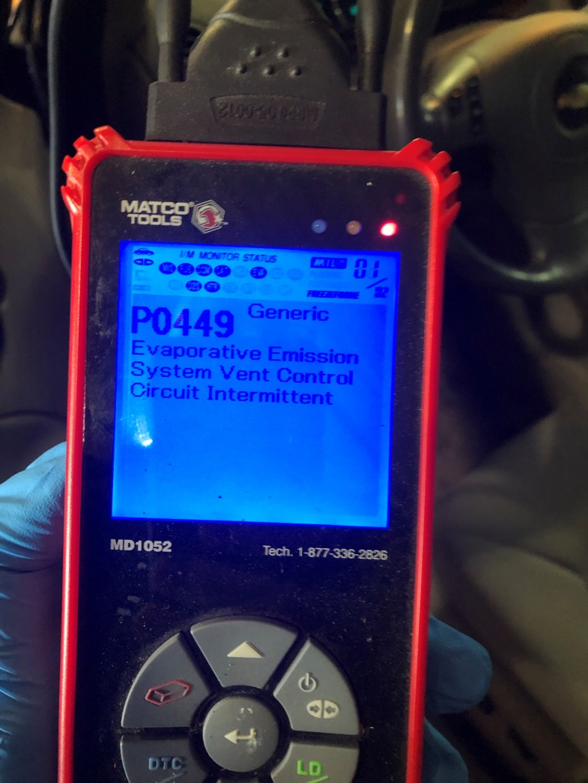
CASE STUDY Remote Start Does Not Work
2006 Chevrolet HHR 2.2L
Customer came to the shop because the “remote start is inoperative.”
MIL on
Stored P0449 DTC
Code P0449 indicates that the evaporative control (EVAP) system vent valve solenoid is malfunctioning.

Slide 28
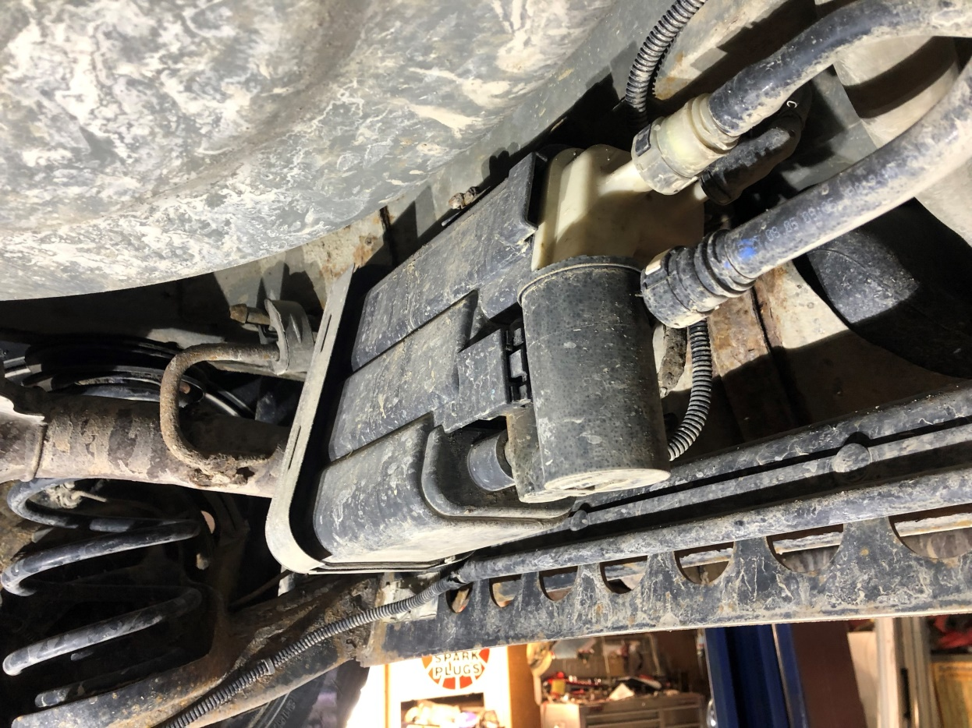
Case Study- continued
No codes for remote start related functions.
Customer authorized fixing the EVAP issue.
Cannister vent valve was full of contaminants.

Slide 29
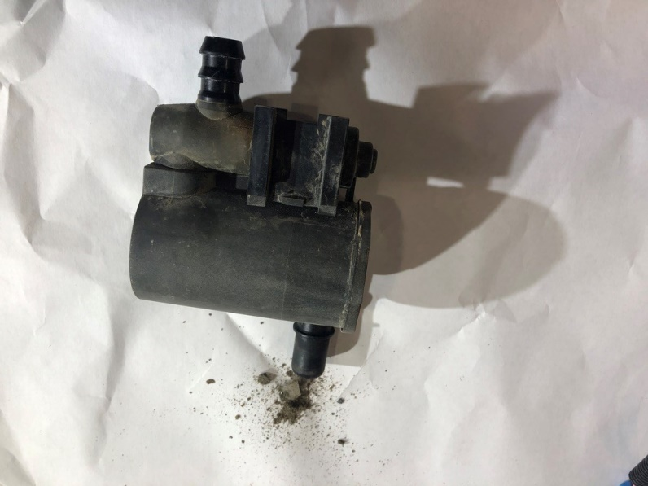
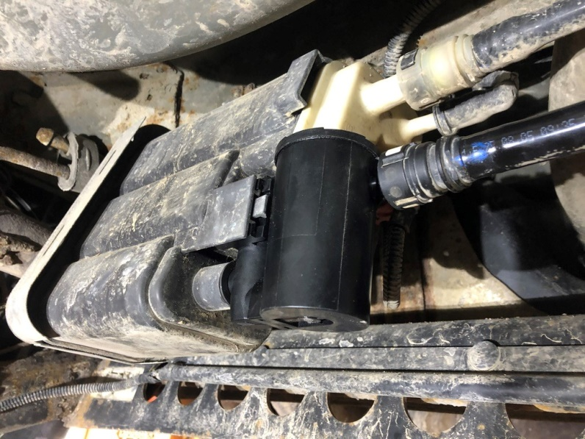
CASE Study- Solution
Replace cannister vent valve and fuel filler neck. Cleared the lines to the cannister and clear codes.
Remote start now works.
Remote start was disabled due to “P” codes present.

Slide 30
Check TSBs
Check TSBs after knowing what DTCs are present.
Check TSBs for FREE on www.jameshalderman.com
Look under “Service Information”

Slide 31
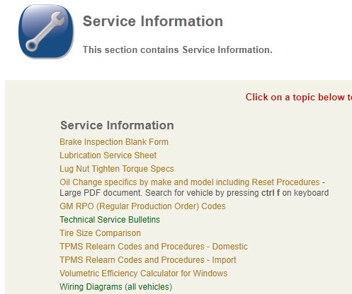
FREE TSBs

Slide 32

CASE Study Transmission was slow to go into gear (five seconds).
The owner of a Subaru Legacy complained that the CVT (TR580) transmission was slow to engage from park to reverse, and from drive to reverse.
No DTCs and the fluid level and condition were normal.
What would you do next?

Slide 33
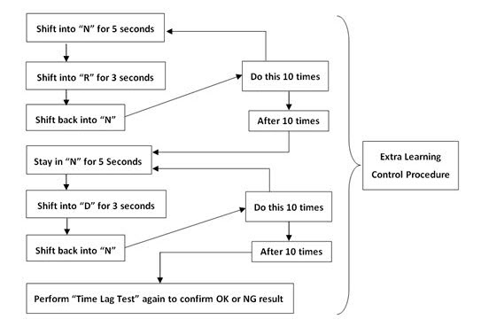
Subaru Case Study
Found a TSB (#16-97-15) that addressed this issue.
A relearn of the TCM was performed.

Slide 34
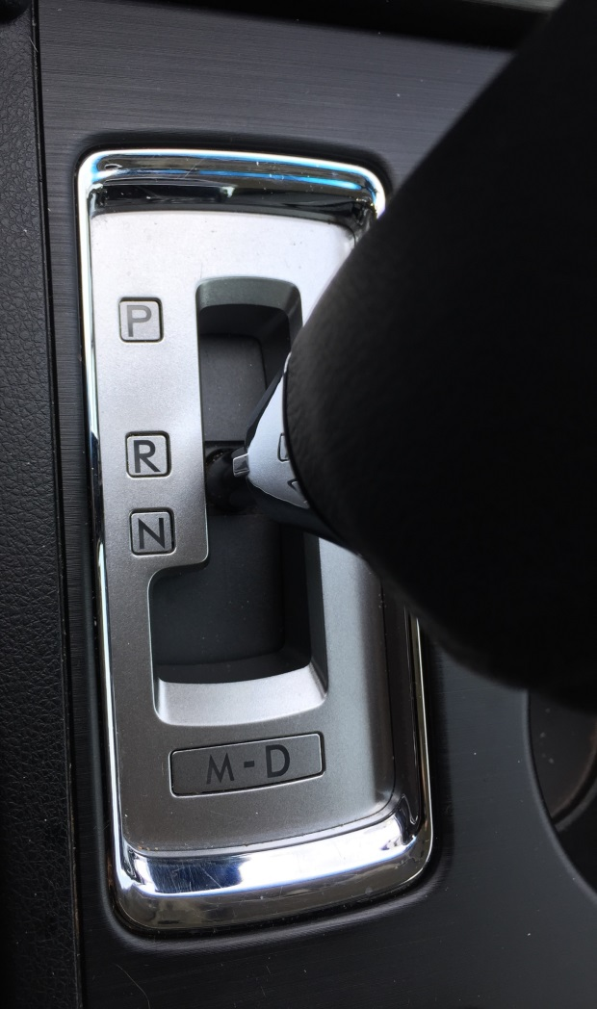
Case Study- Solution
The technician performed the relearn control procedure that included the following steps:
Shift into “N” for 5 seconds, shift into “R” for 3 seconds, and shift back into “N”. Repeat 10 times.
Stay in “N” for 5 seconds, shift into “D” for 3 seconds, and shift back into “N”. Repeat 10 times.
After 10 times, perform the “time lag test” again to confirm.

Slide 35
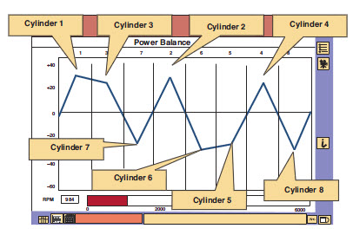
General Tests
Check scan tool data to try to find areas that are not within normal range.
Use Mode$06 if possible.
Check monitor status.

Slide 36
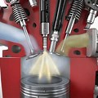
Systems to Check
Electrical
Mechanical
Fuel
Ignition
Emissions
Other?

Slide 37
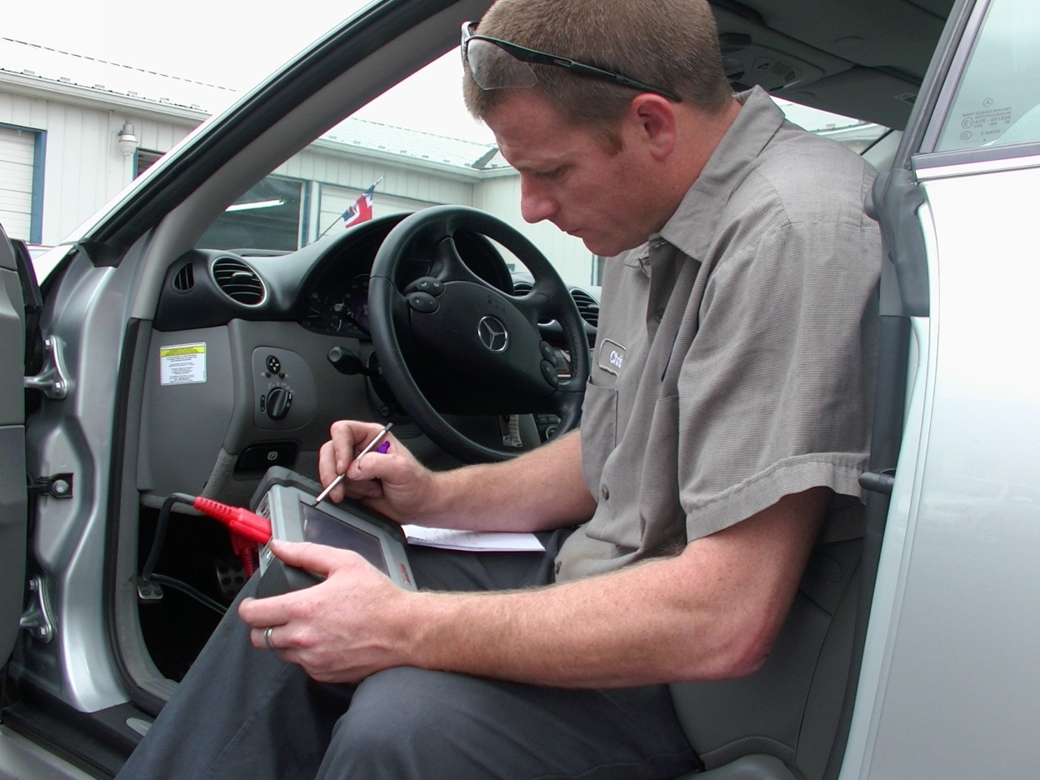
Look Carefully at Scan Tool Data
Look at KOEO:
IAT= ECT
MAP= BARO
Look at all of the “high-authority sensors” and commands.

Slide 38
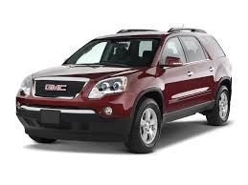
No Crank-No Codes
2011 GMC Acadia 3.4L
This vehicle was towed in with a “no-crank” condition.
With a scan tool, it shows that it has a crank request at the PCM when the key is turned.
No stored DTCs

Slide 39
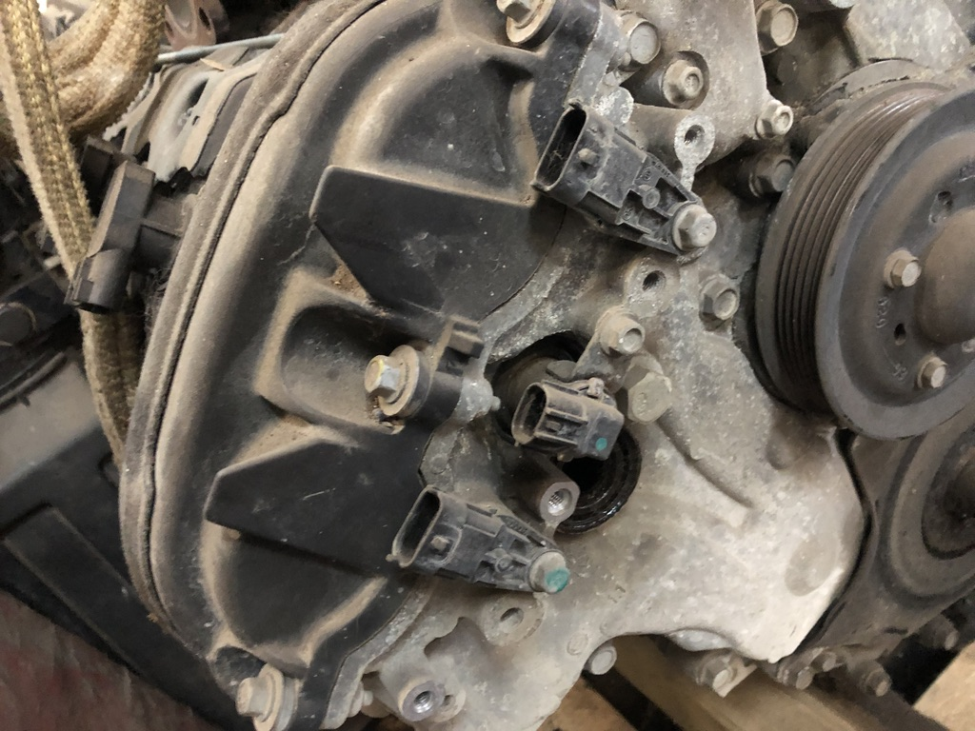
No Crank- No codes
The exhaust CMP was counting with key on/engine off (KOEO).
This prevents the PCM from sending power to the starter relay even though there is a crank request coming from the BCM via serial data.
Why? Because the PCM thought that the engine was running already.
Replaced the CMP sensor.

Slide 40
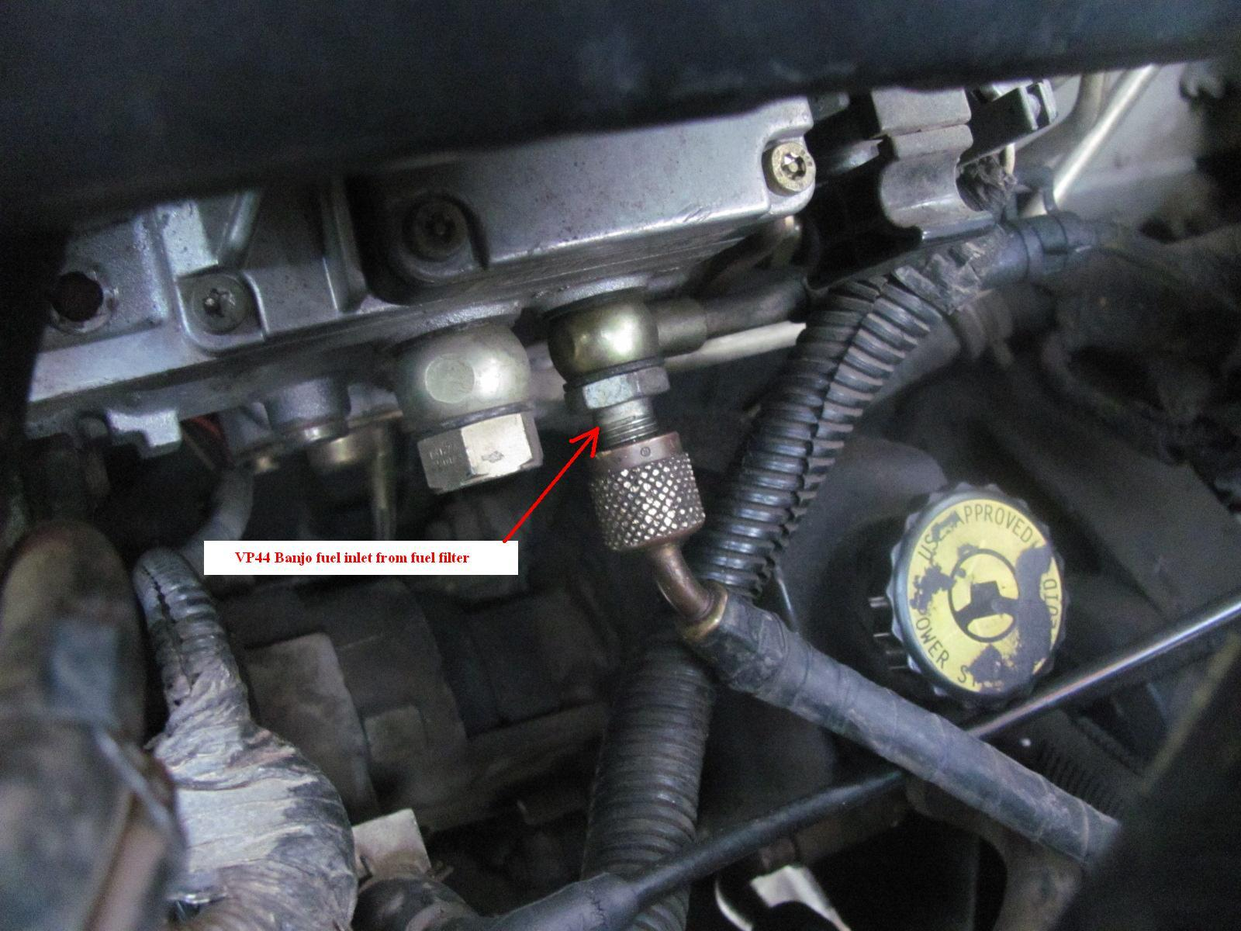
Lack of Power Concern
What tests would you perform?
Fuel pressure test?
Vacuum test?
Fuel volume test?
Compression test?
Cylinder leakage test?
Exhaust backpressure test?
Other?

Slide 41
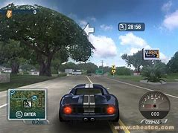
Power Test Drive
Accelerate-
If O₂ goes low – the fuel system is lean.
Check for MAF reporting error,
clogged fuel filter, or weak fuel
pump.
If O₂ goes high - something is
restricted.
Check intake and exhaust.

Slide 42
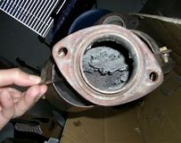
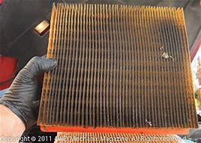
Test Drive- Continued
O₂ high -
BARO PID stays steady. Exhaust system is restricted.
O₂ High-
BARO PID rachets down. Intake is restricted

Slide 43
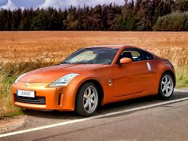
CASE Study- Nissan Z car
Lack of power
No DTCs
Multiple shops looked at it.
Many (unnecessary) parts were replaced.
Verified restricted intake, yet no faults found.

Slide 44
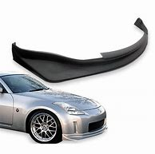
Nissan Z350 Case Study
Hoisted car to see the entire intake system.
Noticed that the front spoiler was loose.
When driving, the spoiler would move and pivot rearward, blocking the airflow to the underneath opening to the air filter housing.

Slide 45




Resources- OE
Requires subscription, often three or 30 days.
The “good” stuff.
Wiring diagrams are actual and not redrawn and show all of the connectors.

Slide 46

Resources- Aftermarket
Usually requires a subscription for access.
Often includes “Silver Bullets” and technician confirmed fixes.
These are often valuable resources.

Slide 47





Resources- Others Useful= ?

Slide 48
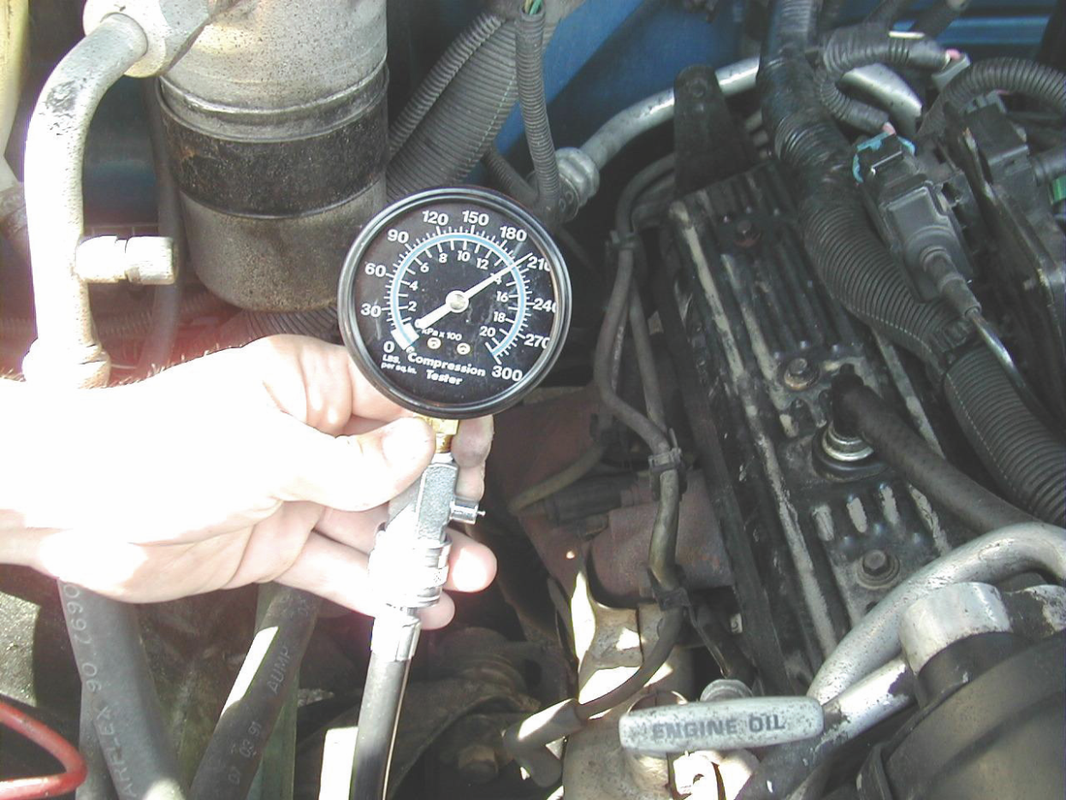
Pinpoint Tests
Narrow the cause to a system or a cylinder.
Fuel or ignition?
Check fuel pressure and volume.
Check for spark.
Perform a compression test.
Plus?

Slide 49
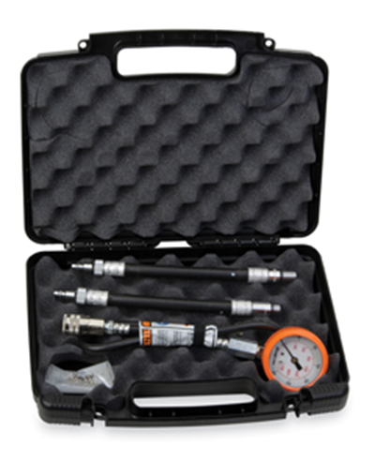
Compression Test Old school or new school?

Slide 50
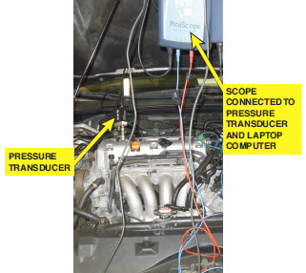
Pico Scope

Slide 51
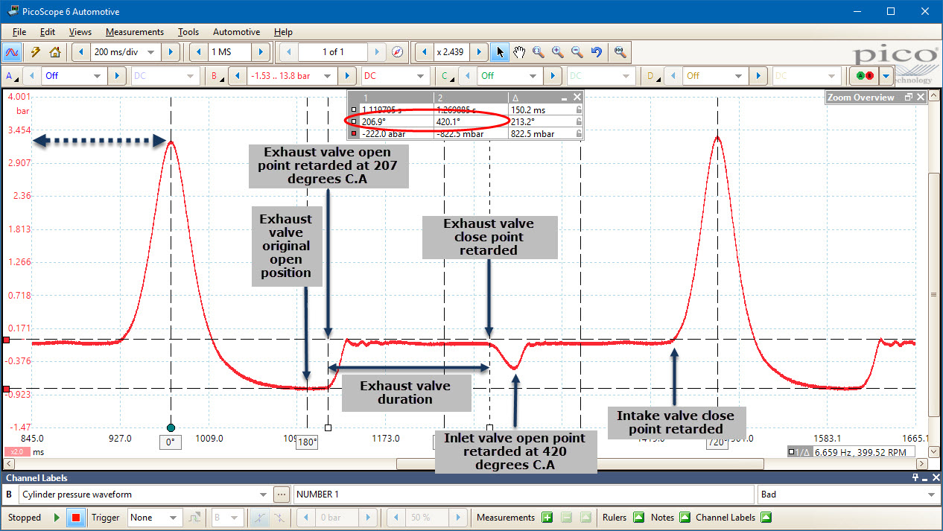
Cylinder Waveform

Slide 52


Which is more accurate?
DVOM
Oscilloscope

Slide 53


More Technology
Spark Tester
Inductive Ignition Probe

Slide 54

Waveform from Inductive Probe
Pico scope waveform
Can be saved for reference
Can be used to verity fault
Can be used to verity the correction

Slide 55

Network Communication Testing
Accurate high-speed CAN Bus communication requires a high-speed high-capacity scope. (Test pins 6 and 14)
MOST Networks can be troublesome.
Ethernet communication systems are present on some 2018 models.

Slide 56

Module Programming
An everyday repair.
Most replacement modules require programming.
Current hardware and subscription access a must.
Advantages to both generic and manufacturer specific J2534 pass through devices.

Slide 57

CASE STUDY
Buick LaCrosse 3.8 L
Customer states that the battery goes dead overnight.
Customer says that a “humming” sound is heard from under the dash.

Slide 58

CASE STUDY- Solution
Used a thermal image camera to locate which module was powered up all the time.
The HVAC module was not shutting down.
Controlled by the BCM.
Replaced the BCM and programmed.

Slide 59

Lesson Learned
Use a thermal imaging camera when diagnosing electrical issues.
Can be used to find issues that no other tool can do.

Slide 60

Logical Lessons
Never assume anything, more often than not, accurate service history is not available.
Follow the testing procedure and make decisions based on the results.
Trust the data being produced, if the PCM says the engine is rich (for example) and the sensors test good, the engine is probably rich.

Slide 61

Intermittent No-start Condition
2007 Chevrolet Equinox 3.4L
Complaint: This vehicle has an intermittent no-start condition. When the symptom occurs, the engine will crank normally until it times out.
If the key is returned to the start position from the on position after time-out, the engine will start normally.

Slide 62

Intermittent No-start Condition
PCM is faulty and is not supplying the ground necessary to turn on the ignition coils during the no start event.
Tough to diagnosis because there were not diagnostic trouble codes to help guide the diagnosis.
Replaced the PCM.
Fixed the customer concern.

Slide 63

Verify the Repair
Test-drive to verify that the original problem (concern) is fixed.
Verify that no additional problems have occurred during the repair process.
Check for and clear all diagnostic trouble codes.
Changes are based on a stored DTC, but should not be performed if the vehicle is going to be tested for emissions, because all of the monitors will need to be run and pass.

Slide 64

Good Things to Do
Figuring out how a system and component operates is readily available in the service information.
Following the data will lead to the problem and the correct repair.

Slide 65
Conclusion
Diagnosis is a practiced skill - the more vehicles tested and more use of equipment, the better you become.
Research is critical, and understanding system operation cannot be by-passed.
Continued technical training and networking will keep your skills sharp.
Logical diagnostics fixes vehicles.
Try teaching using case studies to help your students learn the process until it becomes second nature.

Slide 66

Contact Information
Jim Halderman
jim@jameshalderman.com

