Slide 1
Teaching Advanced Electronics
Jim Halderman
Curt Ward

Slide 2
Introductions
Jim Halderman
Author and former automotive instructor
Curt Ward
Automotive Instructor
Joliet Junior College
Co-author of Light Vehicle Diesel Engines

Slide 3
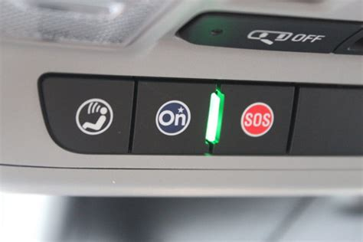
Topics to be Discussed
Where we are today
Tools
High Voltage
Advanced Driver Assistance Systems
Telematics
Autonomous vehicles

Slide 4
ASE Comfort Tasks Today
power window, power seats, power locks, remote start, sun roof, remote keyless entry

Slide 5
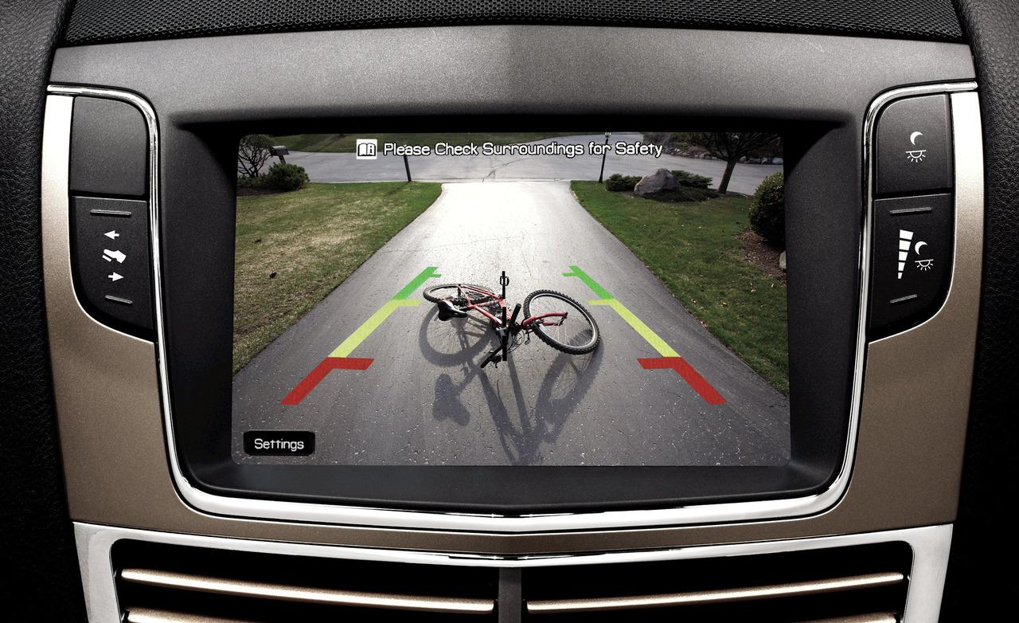
Safety Systems Specified by ASE
Horn, airbags, seat belt pretensioners, wipers, washers, speed control, heads-up display, park assist, and back-up camera

Slide 6
More Tasks Specified Today
Security/anti-theft systems and related circuits (theft deterrent, door locks, remote keyless entry, remote start, and starter/fuel disable)

Slide 7
ASE High Voltage Tasks
Identify safety precautions for high voltage systems on electric, hybrid, hybrid-electric, and diesel vehicles.
Identify hybrid vehicle auxiliary (12v) battery service, repair, and test procedures.

Slide 8
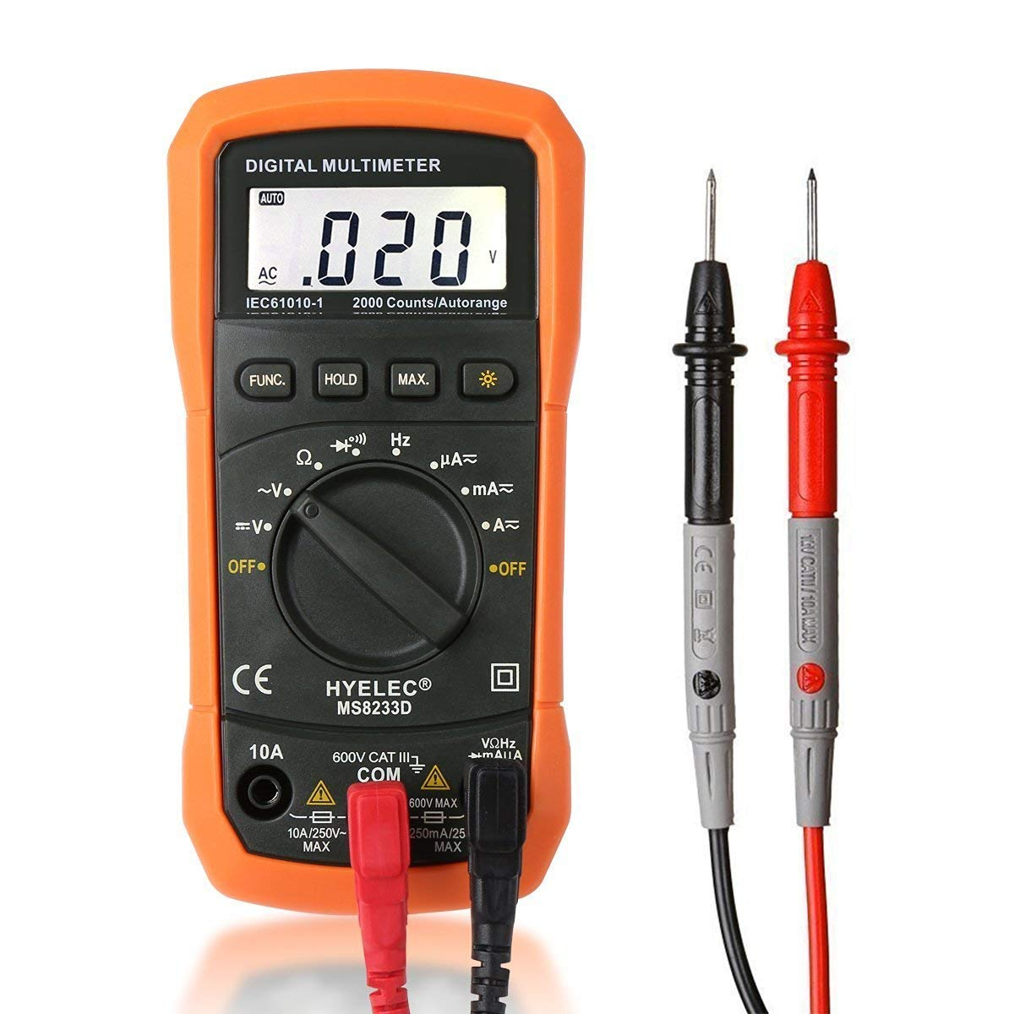
Teaching Today
Test light
DMM

Slide 9
DMM
Voltage Drop
Resistance – Only uses when spec is above 1 ohm
Current – within limitations of the meter

Slide 10
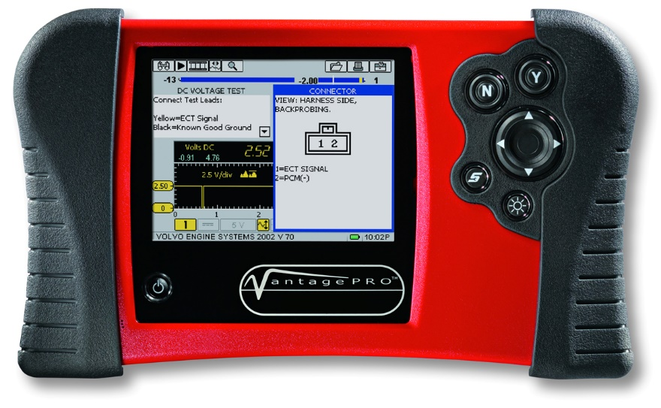
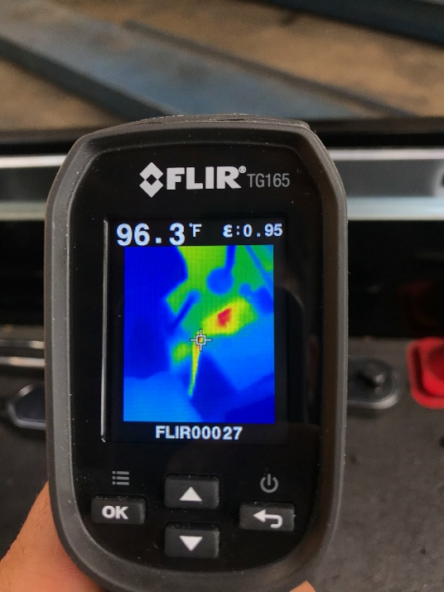
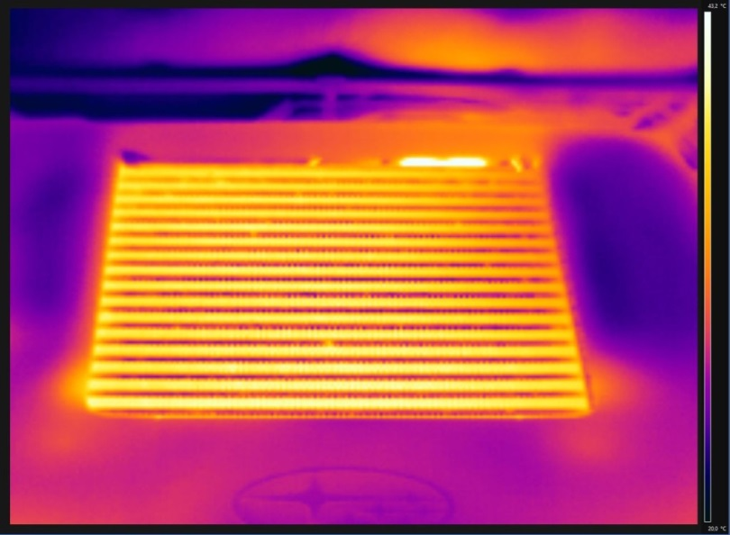
Teaching Today?
Scope?
Infrared Camera?

Slide 11
What we are currently teaching

Slide 12
What the student needs to understand

Slide 13
Historical Look at Ohms Law
Electromotive Force = Voltage
Intensity = Amperage = Current
Resistance = Resistance = Ohms
Old model was:
Volts = water pressure in a hose
Current = the flow of the water
Resistance = opposes flow of the water
(How does the water get back in the hose? Complete circuit?)

Slide 14
Basic Electricity Can be Confusing!
The old model of water didn’t make it
90% of techs can’t do a voltage drop test, why?
DC is often misunderstood at the ground side
AC is not taught
We can’t see electricity!!

Slide 15
Print out a wiring diagram
Color your power circuits with a light blue highlighter or any color you like
Keep it simple
Draw your own diagram if the print out is too complicated
Color your ground circuits with a yellow (another color?) highlighter
Some techs are red/green color blind

Slide 16
What Special Tools Might Need to be Purchased?
Are there new tasks?
How can we keep from damaging the vehicle?
How do we keep the student/technician safe?

Slide 17
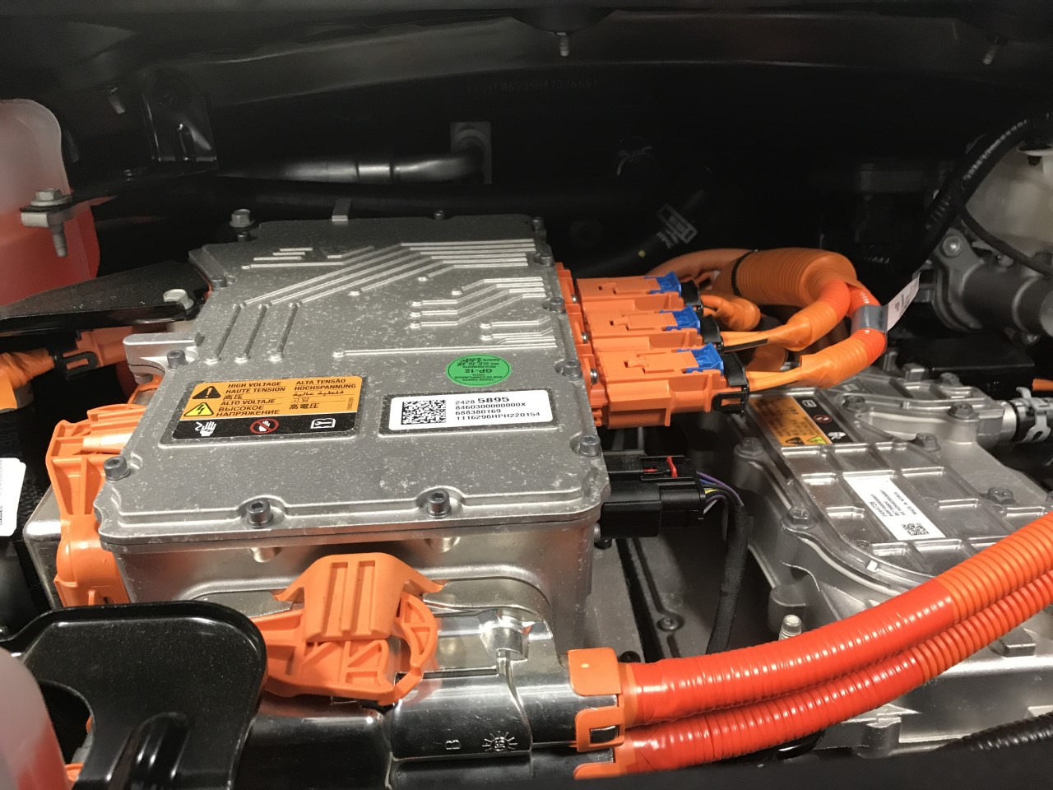
High Voltage Orange Cables

Slide 18
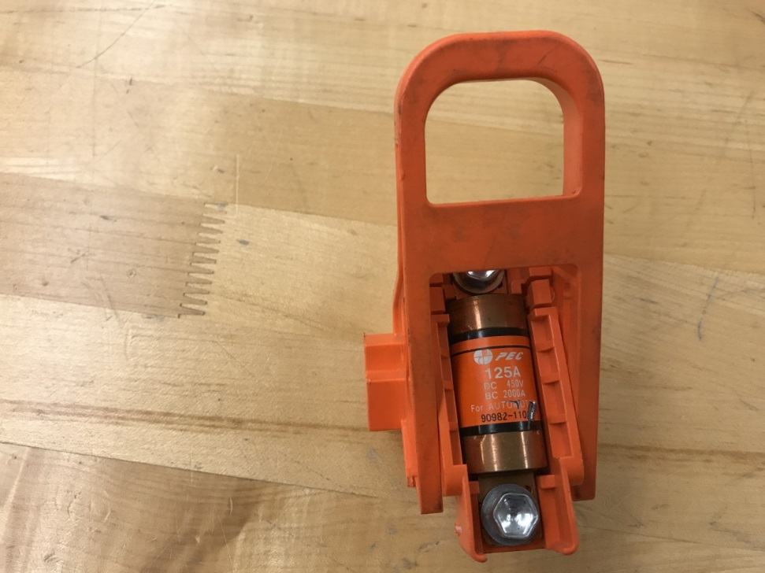
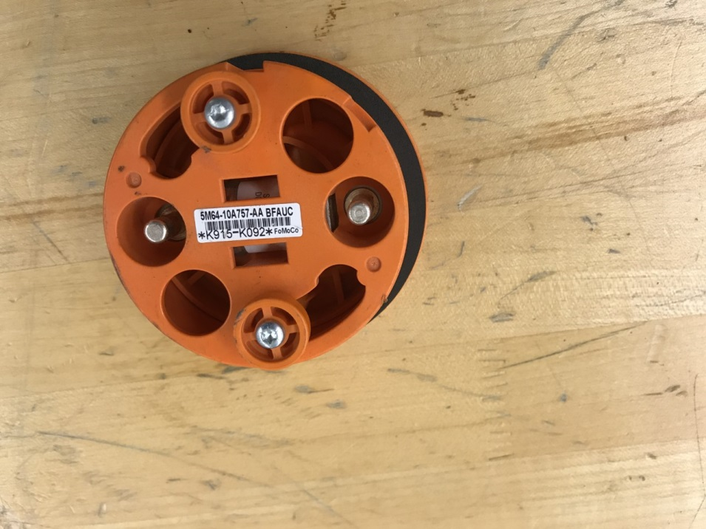
Service Disconnect
Typical Toyota (cover removed)
Typical Ford

Slide 19
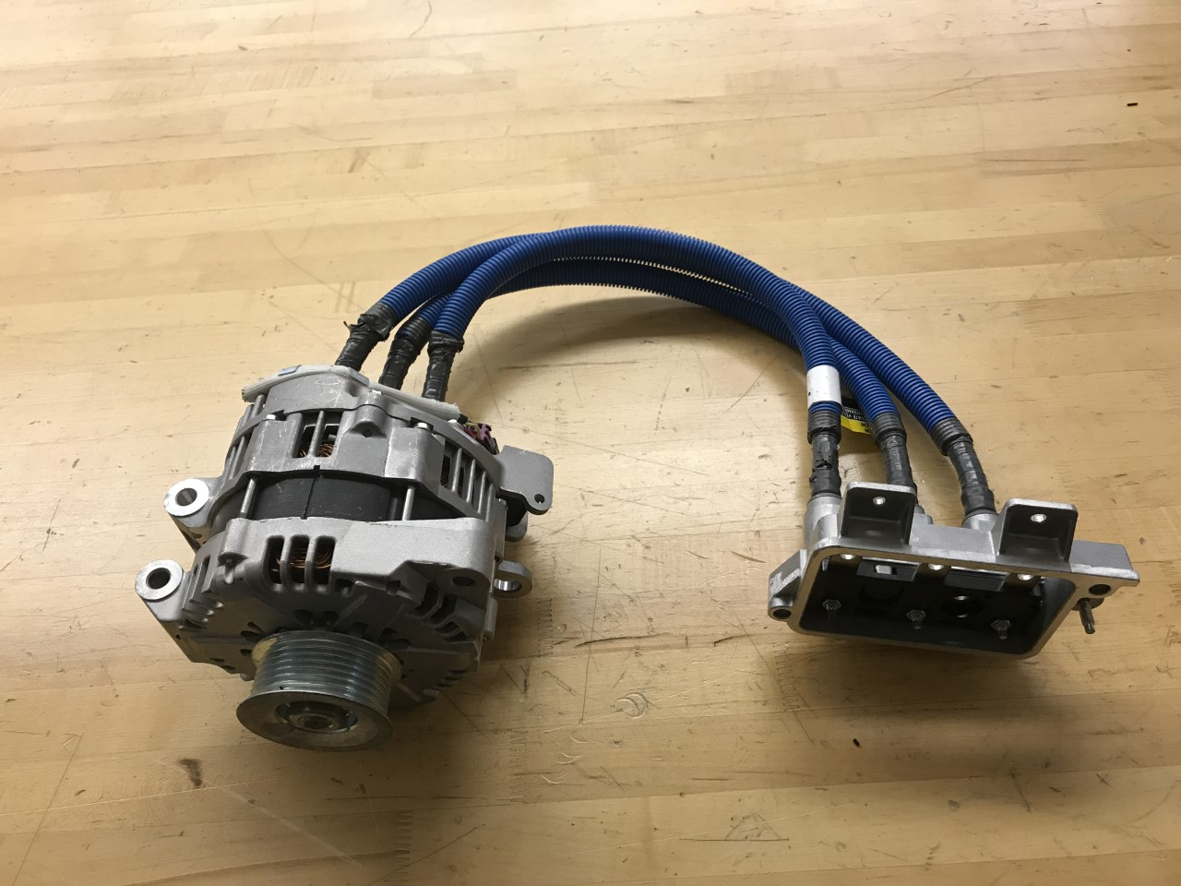
“Blue” Cables

Slide 20
1000 Volt Rated Gloves

Slide 21
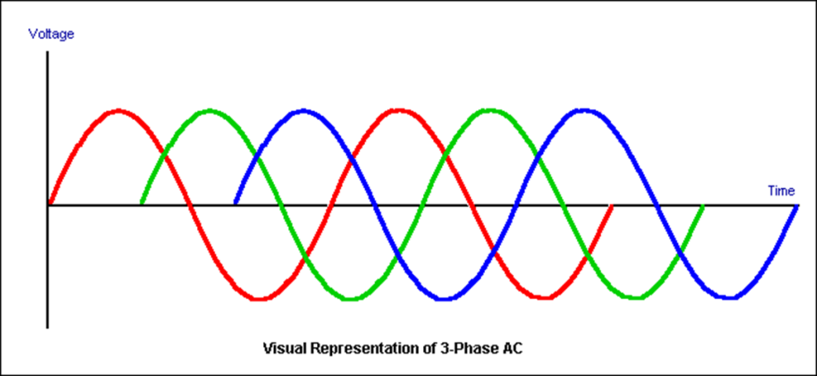
High Current Clamp
200/2000A Rating
Hybrid and EV Electric Motor Current
Relative Compression Testing
Starter and Alternator

Slide 22
Relative Compression Test

Slide 23
Parasitic Draw Using a Clamp-on Meter

Slide 24
Low Ohms Cannot be Measured Using a DMM
Even the best meters are not capable of measuring resistance less than one Ohm
Check the meter by selecting Ohms
Touch the two test leads together.

Slide 25
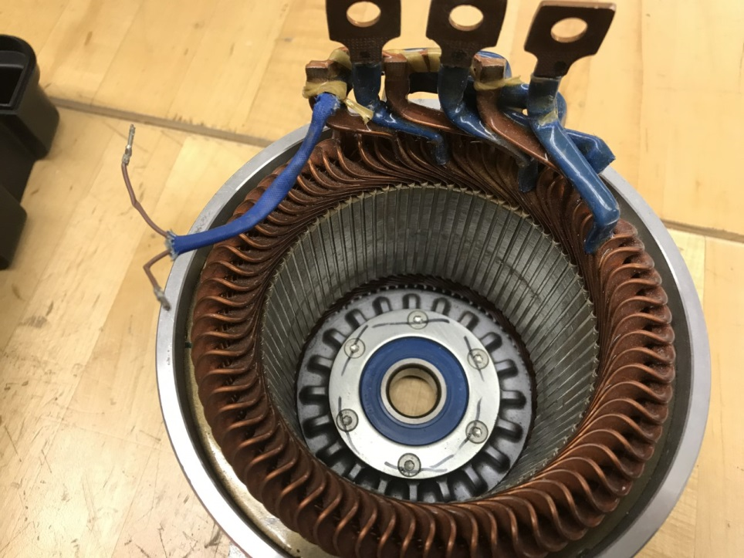
Milli-Ohm Meter
Electric Motor Winding (balance) Testing

Slide 26
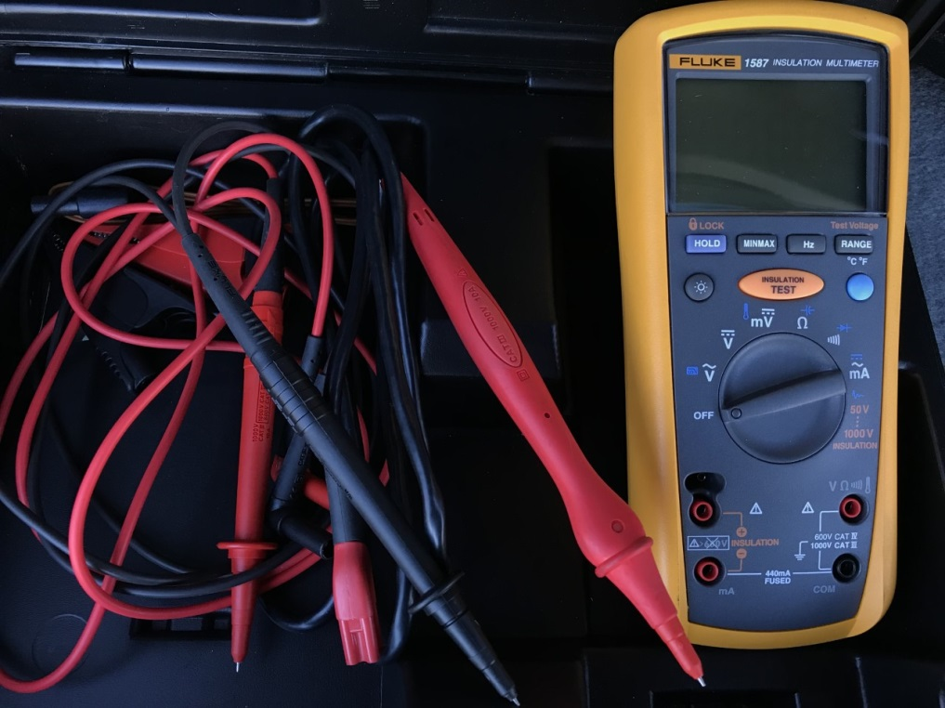
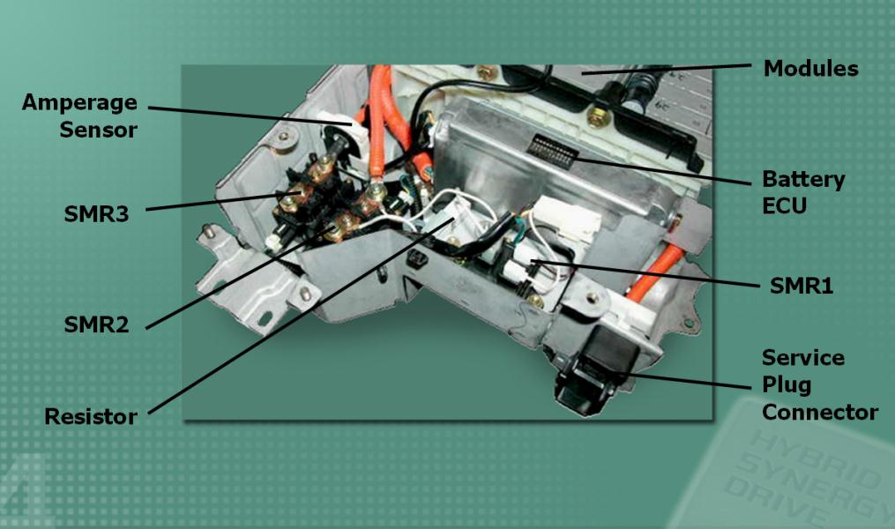
Meg-Ohm Meter
Loss of Isolation Testing

Slide 27
DC Loss of Isolation

Slide 28
High Speed/ Capacity Scope

Slide 29
Upgraded Scan Tool

Slide 30
J2534 Device – Module Reprogramming

Slide 31
Why are we going to higher volts?
42 Volt Lithium Battery
With more voltage (strength) you can use less Amps and get the same amount of work done (watts)
Less amps = smaller wires, less weight, less heat

Slide 32
High Voltage Battery
Prius
Tesla

Slide 33
Tesla Super Chargers

Slide 34
Making Sure Both Contactors Opened

Slide 35
Improper Test Procedure
The good news: Nobody died!
The bad news: The car would not start and a loss of isolation code was set.
The expensive news: High voltage cables had to be replaced.

Slide 36
Corrosion on the High Voltage Connections

Slide 37
Electric Motors

Slide 38
Electric Motors
3 Phase
Brushless
AC
Synchronous
Asynchronous

Slide 39
Why is AC Important?
Because we can lower and raise the voltage with much less heat than DC
Smaller Wires
Constantly changing amplitude
Periodically changes direction
Flows in cycles

Slide 40
AC Loss of Isolation

Slide 41
Inverters and Converters

Slide 42
Other High Voltage Components

Slide 43
ADAS

Slide 44
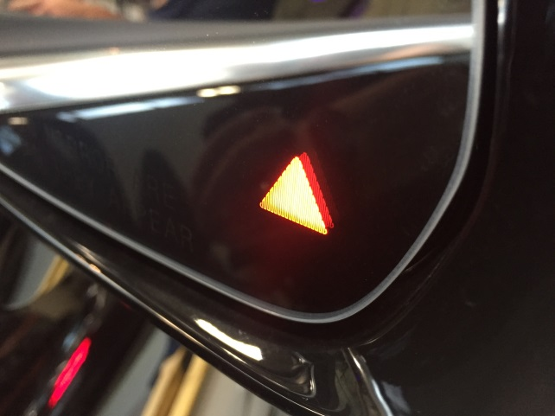
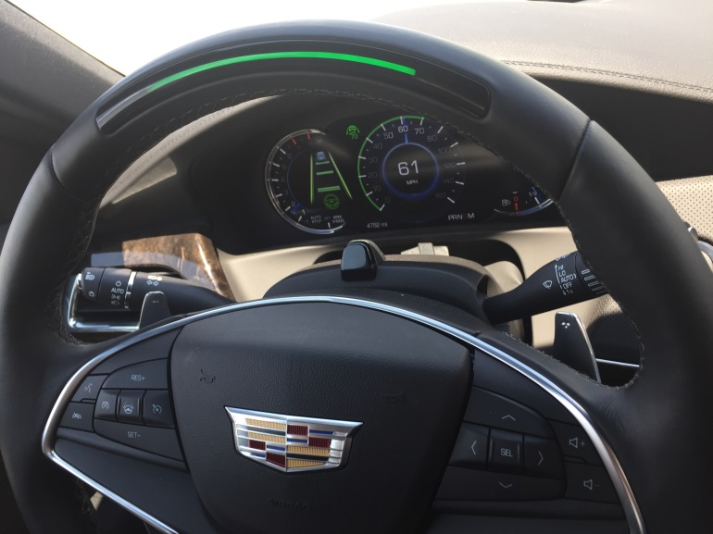
2 Levels of ADAS
System Warnings (Base Models)
System Intervention (Higher Trim Levels)
Visual
Audio
Haptic
Maintains Vehicle Speed
Automatically Brakes and Accelerates
Gently Turns Vehicle
Keeps Vehicle Centered in Lane

Slide 45
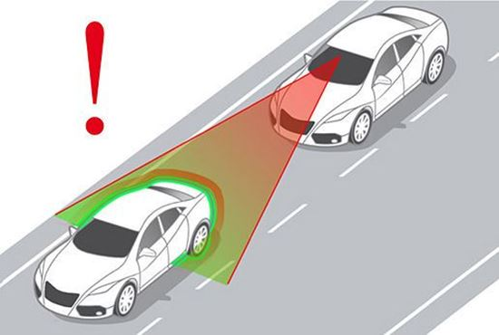
ADAS Acronym Decoder
ACC: Adaptive Cruise Control
DSRC: Dedicated Short Range Communication
EPS: Electronic Power Steering
ESR: Electronically Scanning Radar
HMI: Human Machine Interface
HMW: Headway Monitoring and Warning
IFV: Intelligent Forward View
LDW: Lane Departure Warning
LiDAR: Light Imaging Detection and Ranging
LRR: Long Range Radar
MRR: Medium Range Radar
PCW: Pedestrian Collision Warning
Radar: Radio Detection and Ranging
SAE: Society of Automotive Engineers
SLI: Speed Limit Indication
TSR: Traffic Signal Recognition
V2I: Vehicle to Infrastructure
V2V: Vehicle to Vehicle

Slide 46
Radar (Adaptive) Cruise Control

Slide 47
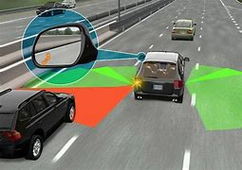
Blind Spot Warning
Very commonly found on most newer vehicles.

Slide 48
Lane Departure Warning
Just a warning if too close to lane marking line.
center line and the right lane line is often called the “fog line”

Slide 49
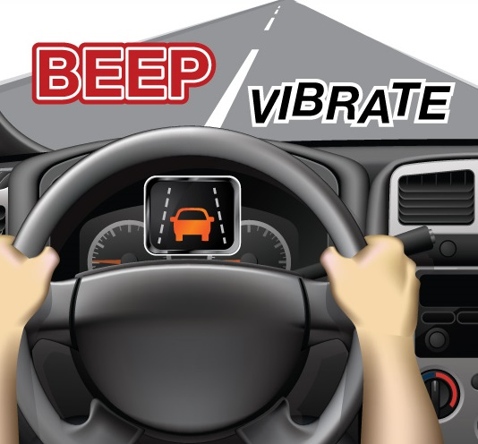
Lane Keep Assist
More than a warning.
This system uses the electric power steering (EPS) to steer the vehicle back into the lane
Can be intrusive

Slide 50
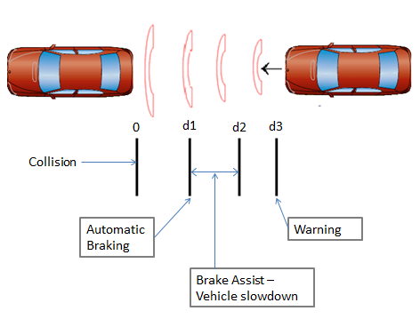
Automatic Braking
Gives an audible and a visual warning.

Slide 51
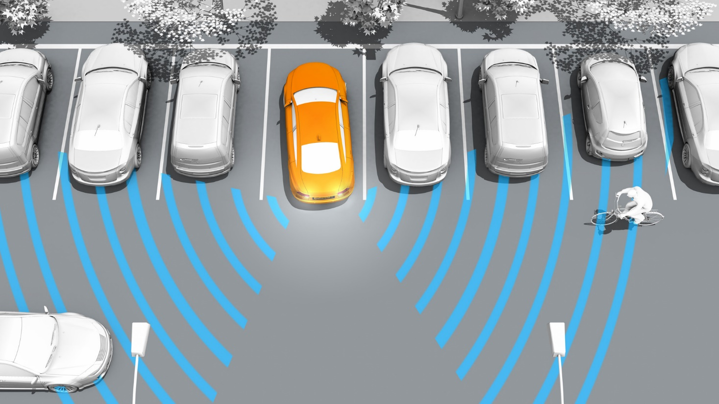
Cross Traffic Alert
Uses short range radar

Slide 52
Parking Assist Systems

Slide 53
Night Vision Infrared Camera

Slide 54
Multiple sensors

Slide 55
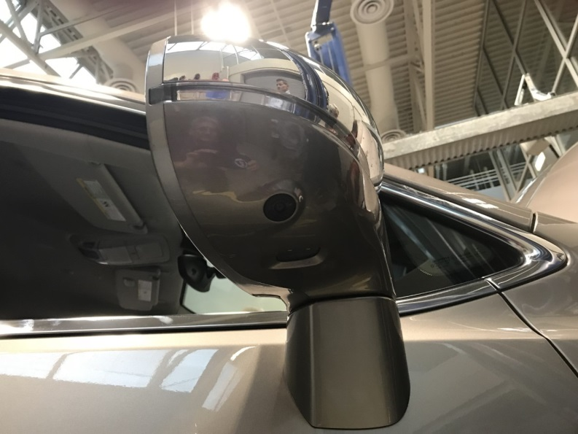
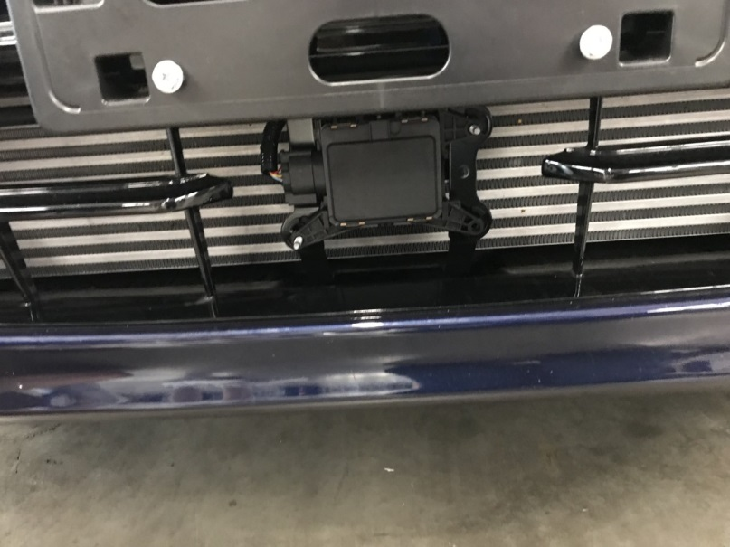
Most Current ADAS Systems Technology

Slide 56
Haptic Sensor
Uses a vibration in the seat or steering wheel to notify the driver. Uses DC motor with a attached weight that is out-of-balance to create the vibration.

Slide 57
Lidar Sensor
Also called “laser radar”
Uses lasers to “paint” a picture of the surrounding area
Use TBD!

Slide 58
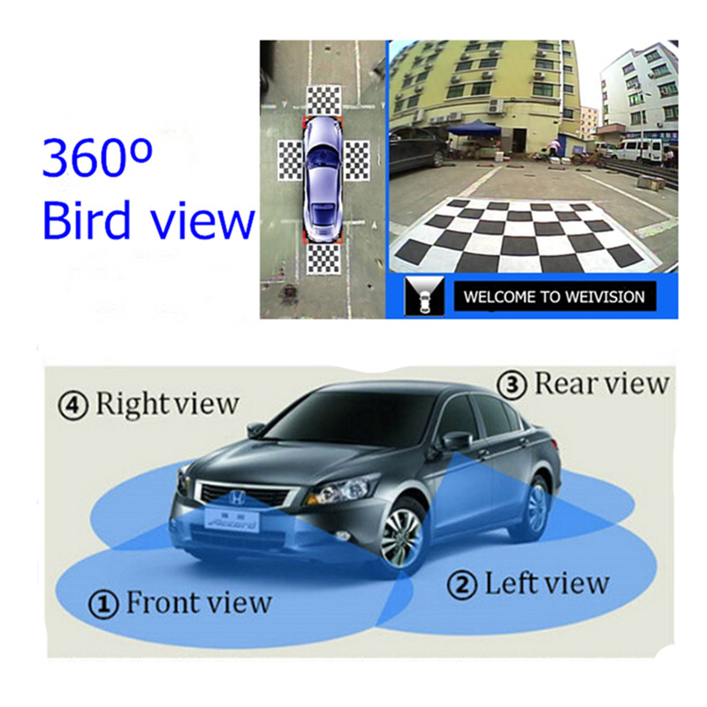
Cameras
Backup –Required in all 2018+ vehicle.

Slide 59
Cameras
Used to replace the human eye
Able to recognize objects better than radar
Affected by rain, snow, mud, ice,
Can’t see in the dark or when looking directly into the sun
Static and Dynamic calibration procedures

Slide 60
Camera Service
Very few replaceable components
Mounting bracket position is critical
Aftermarket replacement windshield glass quality a concern
Windshield chip repair may affect operation
Special cleaning procedures

Slide 61
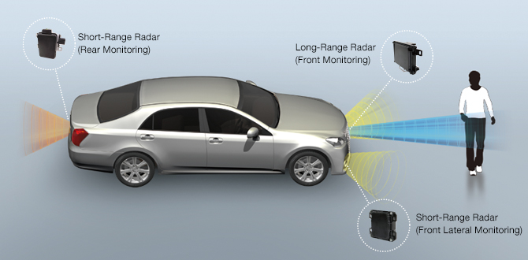
Radar
Short range and long range
Long range extends to over two football fields ahead

Slide 62
Radar
25 GHz Ultra Wide Band Radar
24 GHz Narrow Band Radar
77 GHz Multi Mode Radar
Detection Distance dependent on angle
< 100 ft. - angle 30 degrees
100-325 ft. – angle 20 degrees
325-650 ft. – angle 12 degrees

Slide 63
Case Study
Message on Dash
Sensor behind Grill Emblem

Slide 64
Steering Torque Sensor

Slide 65
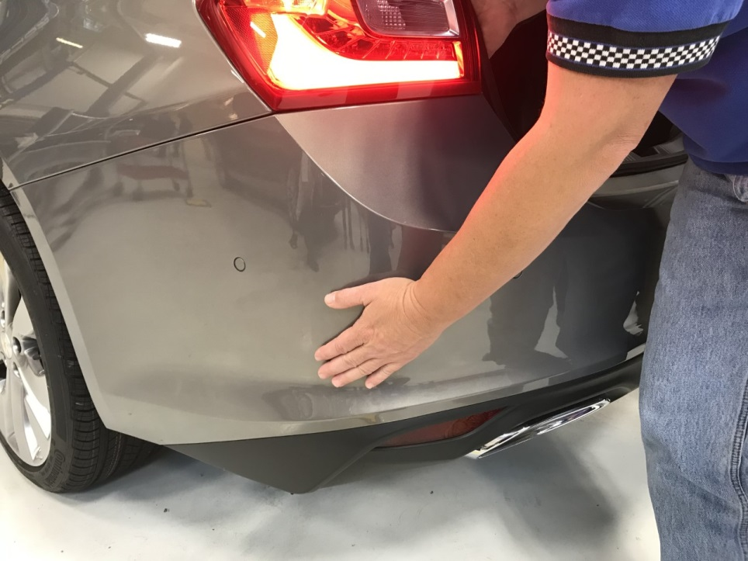
Tech Tip
Rear radar unit communication concern
Bumper Cover Cool to Touch on Left Side
Bumper Cover Warm to Touch on Right Side
Right Side Operating Normally – Left Side Inoperative

Slide 66
Ultrasonic Technology
Ultrasonic sound waves used to detect objects near the vehicle
Early vehicles only had rear sensors
Current systems can detect both forward and reverse
System can detect both distance and direction of the object

Slide 67
Module Electrical Diagnosis
Does it have power?
Does it have ground?
Is communication present?
Replace Module and
Program Module

Slide 68
Ultrasonic Sensors
Short range
Used for parking assist systems

Slide 69
Ultrasonic Sensor Diagnosis using Pico Scope

Slide 70
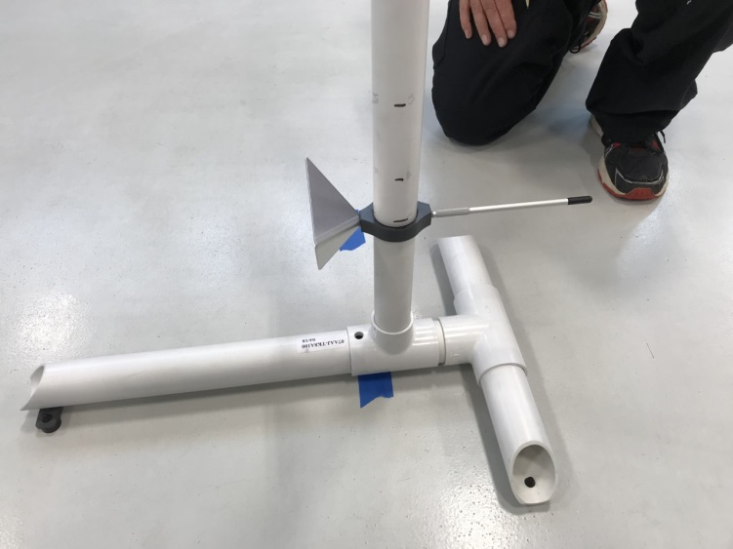
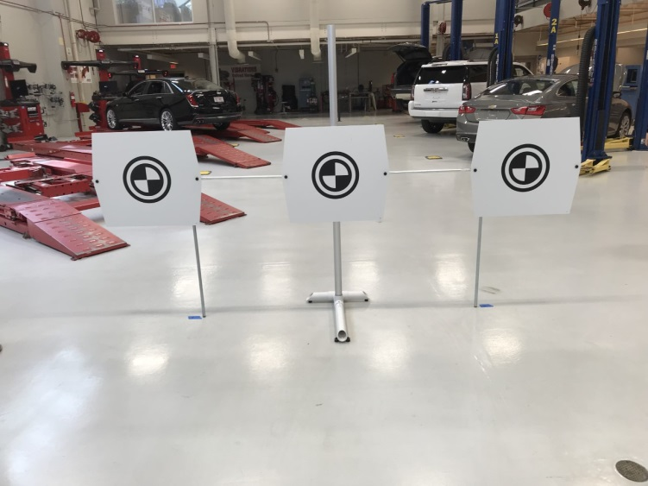
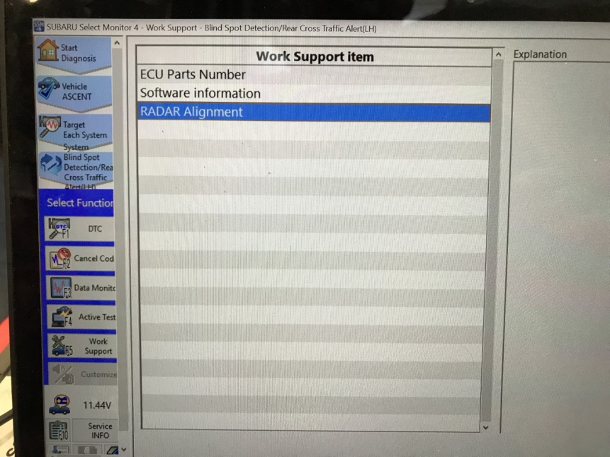
Sensor (Camera and Radar) Calibration

Slide 71
Static Calibration
Physical measurements on flat surfaces to place targets
Scan tool procedures to aim radar and cameras
Some systems static calibration only
Most systems require static and dynamic calibration

Slide 72
Dynamic Calibration
System in calibration mode using scan tool
Radar and/or Cameras
Specific types of driving
Minimum speed
Specific items along route
Drive time depends on accuracy of static calibration
May be difficult to complete in urban areas

Slide 73
Network Communication
CAN Bus
Flex Ray
Increased fault tolerance for safety systems
More bandwidth
10 megabits per second per channel
Isolated Networks for Cyber Security
Firewall against malicious software and commands
Ethernet for Infotainment

Slide 74
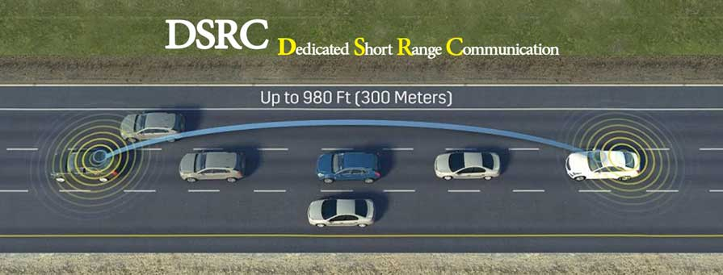
Vehicle-to-Vehicle Communication
300 M (980 ft.) Range
5.9 GHz frequency and 75 MHz bandwidth to transmit
Alerts: Hard Braking, Disabled Vehicles, Slippery Roads

Slide 75
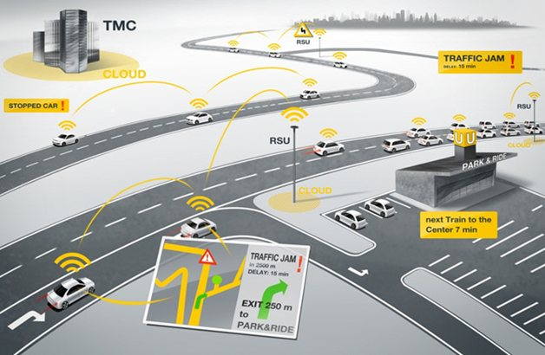
Vehicle-to-Infrastructure
V2X
Can include 5G and used before cell phone use.

Slide 76
Putting it all Together

Slide 77
Telematics

Slide 78
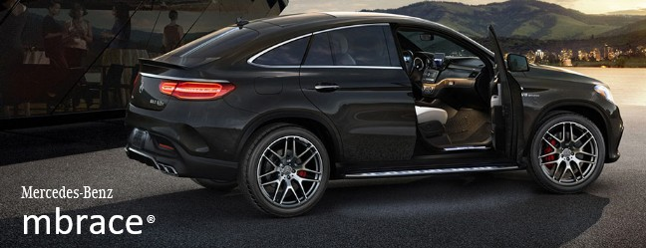
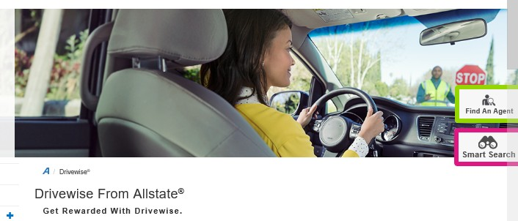
Telematics Companies

Slide 79
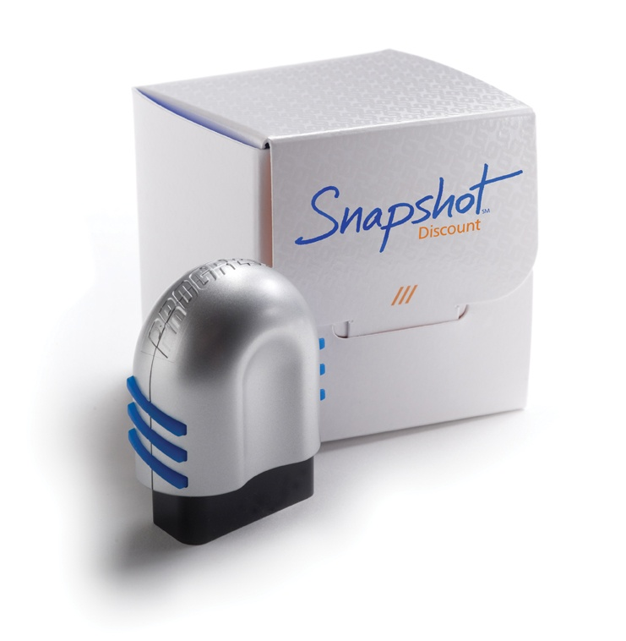
Dongle Issues
Data Corruption
Security Issues
Hackers

Slide 80
Six Levels of Automation

Slide 81
What is the Future?
The major change to the automotive industry will be what is being referred to as:
ACES Vehicles
Autonomous Connected Electrified Shared

Slide 82
Peek Preview 6th edition coming out in early January, 2019

Slide 83
Summary
ASE Tasks are changing
Plan Budgets to include new technology
Stay Safe – High Voltage is here to stay
ADAS systems are widely available for class now
Try to experience level 2-3 autonomous vehicles if possible. (It is really awesome!)
Until that time:
“Keep your hands on the wheel and your eyes on the road”

Slide 84
Contact Information
Jim Halderman- jim@jameshalderman.com
Curt Ward- curt@curtward.net

Slide 85
May You Enjoy Safe Travels
We hope to see you at a conference in the future
Thanks for attending
Don’t forget to thank our hosts

