Slide 1
Have Fun Teaching an Intro Class
Darrell Deeter
Jim Halderman

Slide 2
Introductions
Darrell Deeter- Professor at Saddleback College in beautiful Mission Viejo, CA.
Jim Halderman- Automotive Author and Professor at Sinclair College
You-

Slide 3
Topics to be Discussed
The three types of students who take an Intro course
What students want out of an Intro course
How much depth and breath is enough?
How to present content but not give them too much.
Remember, they need to take other, more advanced, courses.

Slide 4
First Type of Student
Consumer Interest
Car maintenance and general knowledge
Wants to know how things work
Willing to do basic inspections
Wants to know enough to know what to do and when

Slide 5
Second Type of Student
Entering Program
To get ready to take the automotive program courses.
To get them ready all of the basic services should be presented
All safety concerns should be addressed.

Slide 6
Third Type of Student
Entry-Level Job
Wants to work at a service department or shop.
Needs basic skills so they are productive employees

Slide 7
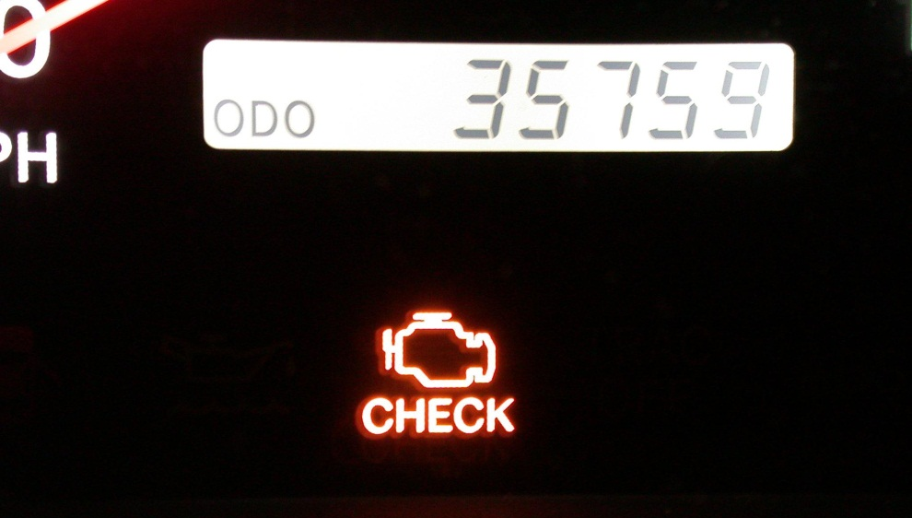
They want to learn… EVERYTHING!
It seems that they want to learn how to fix their brakes, repair a dent in the door and know what the fault is that is causing the “Check Engine” light to come on.

Slide 8
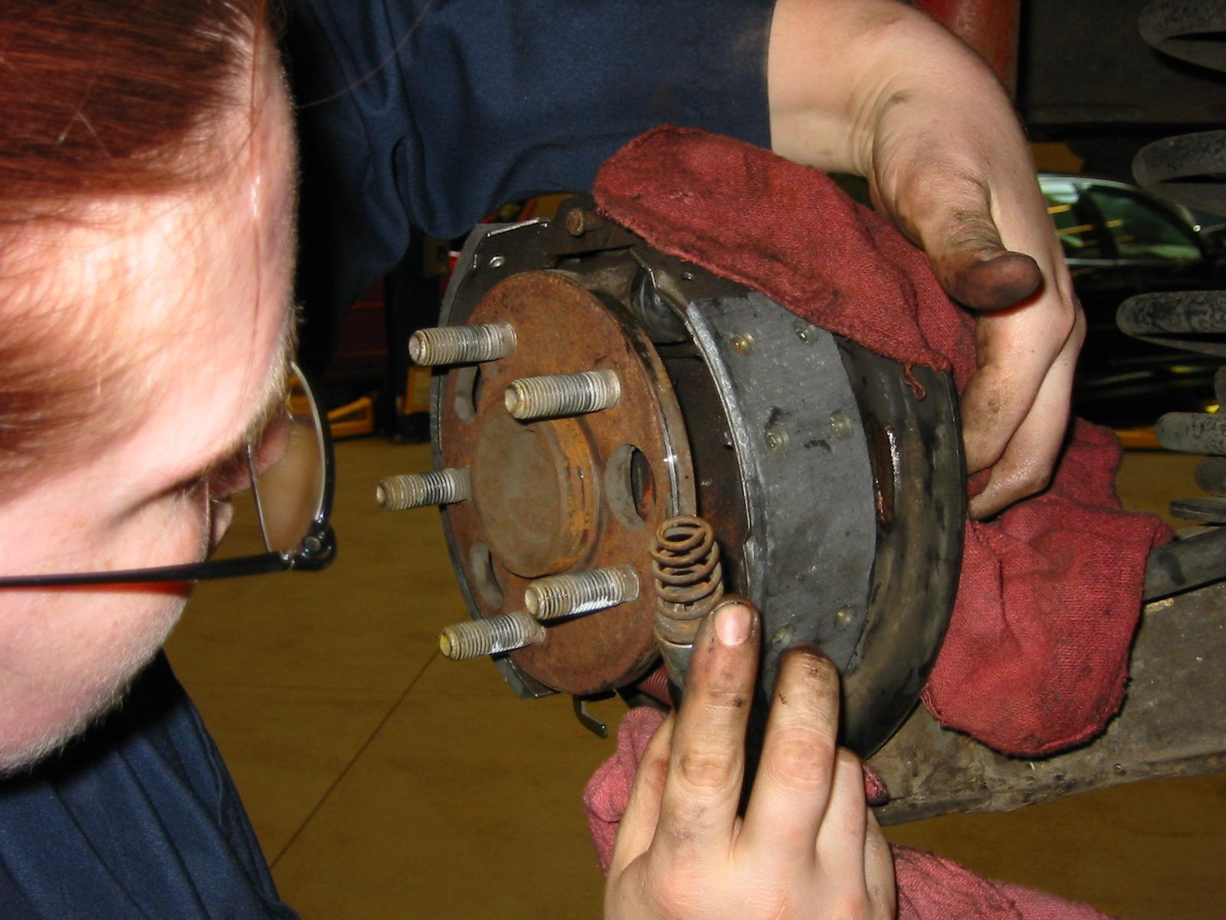
Tip
After introductions and quickly reviewing the scope of the course, I go around the class and ask what THEY would like to learn.
I write their requests on the white board.

Slide 9
TIP (Continued)
If the request is beyond what we will be covering, I tell them right then that it is beyond the scope of this course and that it is covered in AUTO XXX.
This stops them from thinking that we did not meet their needs

Slide 10
Purpose and Function
Remember that most students in an Intro class do not know the parts or what they do.
Gets the students involved and makes for some good quiz questions such as: “What is the purpose and function of engine oil?”

Slide 11
Parts and Operation
After describing the purpose and function, then show the parts involved and how the unit works.
Remember KISS: Keep It Simple for Students.

Slide 12
Parts and Operation (Cont.)
Pretend you are explaining something to your grandmother
Do not be condescending
Try to make lab assignments something they can do in their driveway

Slide 13
Is it Working as Designed?
Instead of diagnosis, what is important for the beginning student to know is if it working as designed.
Is the air conditioning working?
Is the battery being charged?
Are all of the lights working?

Slide 14
Project-based Learning
Include used vehicle project to help them get used to looking at all aspects of the vehicle.
Discussed how to perform a vehicle inspection after midterm and made the project due the last week in the term.

Slide 15
What Jim does the first day
I ask students to bring their vehicle into the shop
I get to associate the vehicle with the student
We do a safety check
I end up giving a lot of bulbs away

Slide 16
What Darrell does on the first day(s)
Introduce the course
School regulations require students to have completed the safety test before they are allowed into the shop area. After that..
I have them change a tire on their car, using only the spare tire tools in the car

Slide 17
Hoisting
Demonstration
Always demonstrate how to safely hoist a vehicle.
Show how to use a floor jack and safety stands too.

Slide 18
Oil Change
Discuss oil and Specs
Demonstration
The week before everyone is to change their oil, I discuss oil and where to find what their vehicle needs.
This gives them a week to get the correct oil. (hopefully)

Slide 19
Under Vehicle Inspection
Show things that should be checked
Demonstrate
Exhaust
CV joint boots
Fuel lines
Brake lines
Fluid leaks
Show different fluid colors and smells

Slide 20
Students “nest”
What IS “NESTING”?
How to prevent IT
When students sit down they surround themselves with their “stuff”.
They seldom want to move from their “nest”
After each short piece of information, I get them out of their seats and into the shop to do something.
This can be a show and tell or a demonstration

Slide 21
TIP
Again, get the students involved.
Get them out of their seats as much as possible.
Avoid “Death by PowerPoint”

Slide 22
Using their own vehicles
They can pair up
Increases Interest

Slide 23
Topics
All Fluids
Accessory drive belts
Tire pressures
Dash warning lights and what they mean

Slide 24
Topics
Electrical basics like volts and ohms
Basic meter usage such as measuring a light bulb filament for resistance and battery voltage
I avoid discussing amperes and electrical laws at this stage.

Slide 25
HVAC
Is the system working as designed?
Feel the heater hoses and the A/C lines
Check vent temperatures

Slide 26
What else do you teach?
Tire changing?
Brake pad replacement?
Auto transmission service?
Tire balancing?
Engine rebuilding? ☺

Slide 27
Summary
Interview your students
Get to know them and their vehicles
Great place to get more students into your program
Try to keep it simple and easy
Try to avoid getting them or yourself over worked or too far into a project.

Slide 28
IMPORTANT!!
This class must be successful or your advanced classes won’t matter because you won’t have any students!

Slide 29
MOST IMPORTANT!!
Have fun teaching your beginning automotive class!

Slide 30
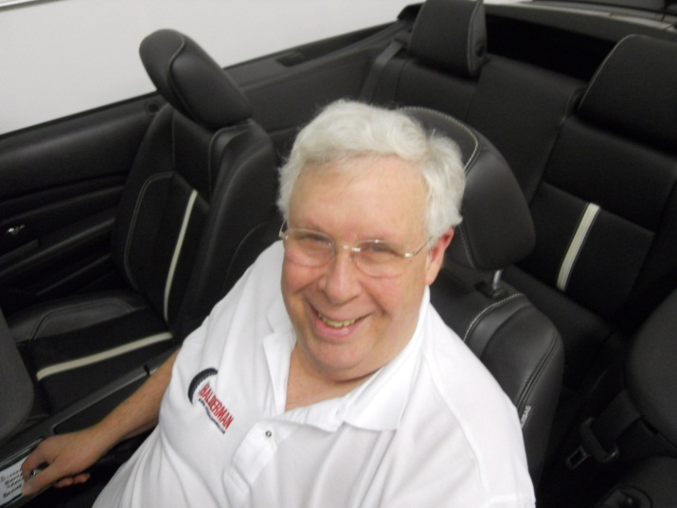
Contact Information
jim@jameshalderman.com
drdeeter@gmail.com

