Slide 1
HVAC Tips, 2014
Tom Birch
Jim Halderman

Slide 2
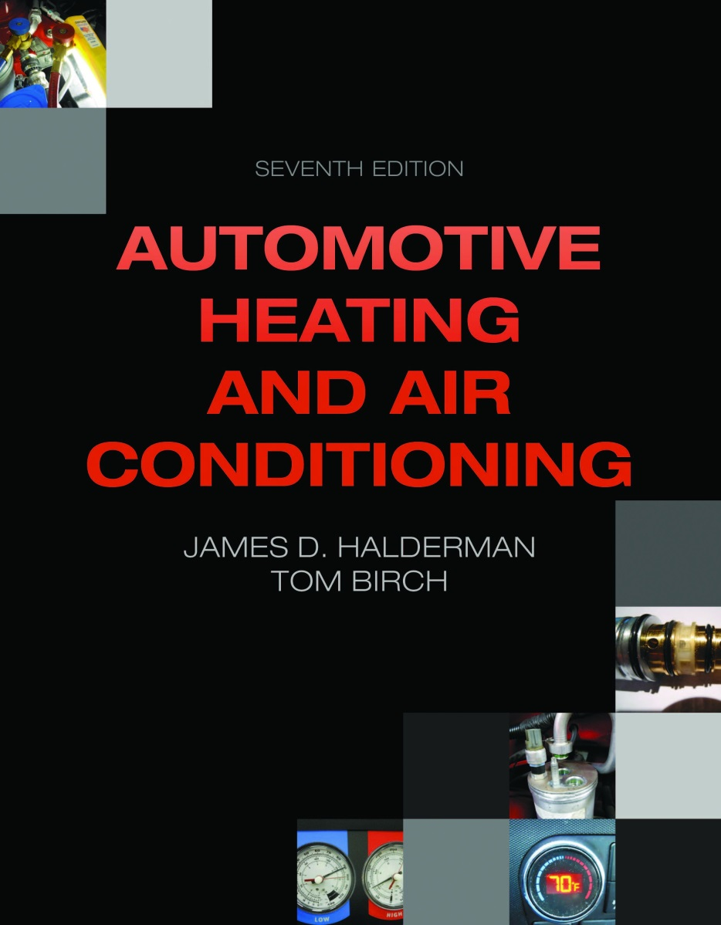
Introductions
Tom Birch-Retired Instructor, Yuba College and automotive textbook author, CAT Member: 34 years and NACAT Member
Jim Halderman-Former flat-rate technician and college instructor
Author of many automotive books and lives in Dayton, Ohio.

Slide 3
Why the push to R-1234yf?
Has a lower global warming potential (GWP) than R-134a
R-134a=1,300
R-1234yf =4
BUT how much refrigerant is discharged into the atmosphere anyway?
In Europe- a LOT
In Europe they do not use a recovery machine!

Slide 4
Refrigerants, Background
Europe does not require R-134a recycling, it is vented for service.
2006: The European Commission, EC, rules that beginning 1/2011, new design platforms must have GPW >150, All new vehicles in 1/2017.
2009: The EC accepts R-1234yf (GWP: 4) as meeting requirements
2011: R-1234yf availability is delayed so enforcement is postponed to 1/2013

Slide 5
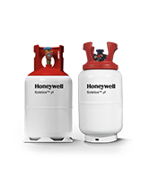
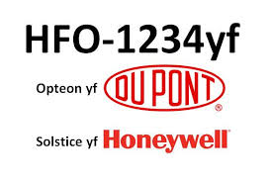
R-1234yf
HFO-1234yf is an azeotrope-like composition of tetrafluoropropene and pentafluoropropene; a joint development of DuPont and Honeywell. Named Opteon by DuPont and Solstice by Honeywell.
CF₃CF = Ch₂
A concern is that if burned, Hydrogen
fluoride (a volatile gas) can be produced.

Slide 8
Verband der Automobilindustrie

Slide 9
Daimler/Mercedes
9/25/2012: The IC has accepted R-1234yf, but Daimler announced that
in-house testing shows it can cause a fire and stays with R-134A.
10/2012: SAE International launches a fourth Cooperative Research Program, CRP, to address Daimler’s claims.
Other German manufacturers announce solidarity with Daimler.
Spring 2013; The German KBA (federal motor transport authority) begins their own testing program while Daimler is granted an extension.
6/2013: The EU begins formal procedures that give the German authorities 10 weeks to begin sanctions against Daimler.
The CRP reports that R-1234yf risks are Well Below those commonly accepted.
7/2013: France refuses to register 3 Mercedes-Benz models
Germany requests EU to weaken or delay CO₂ emission limits.

Slide 10
Daimler/Mercedes 2
8/2013: The German KBA finds no serious risk with R-1234yf, but supports
Daimler and begins formal process with EC to delay action.
Toyota announces they will delay changeover.
11/2013: The EC is reviewing German KBA request.
Daimler is said to be working on R-744, CO₂ systems.

Slide 11
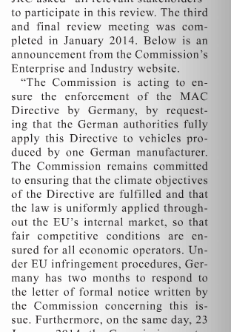
EC to Daimler
MACS Action, March 2014

Slide 12
Toyota: Me Too
Toyota boycotts R1234yf coolant for air conditioning
"Toyota regards it as the duty of individual companies within the automotive industry to ensure that vehicles meet current safety standards," Toyota Germany said. "Unfortunately, there is no consensus on this issue on the European market. As soon as the situation has been clarified and a consensus found, we will comply with the outcome. For this reason, we have decided, as a temporary measure, to use R134a so as to dispel any possible concerns our customers might have.“ August, 2013 (Technical Article)

Slide 13
Carbon Dioxide, CO₂
CO₂ for motor vehicles presents several problems:
The pressures have to be very high, 7 to 10 times that of an R-134a system.
A closed vehicle with 4 or 5 people can have very high CO₂ levels.
A leak in the evaporator will increase these levels.
Concentrations up to 1% (10,000 ppm) will make people drowsy, 7 to 10% may cause suffocation.

Slide 14
Proposed Future HVAC Change
An EPA proposal for the near-future: A/C operation with ambient temperatures above 75º F will cause the outside air door to shift to Recirc. This will cause the driver and passengers to re-breath the inside air, increasing the CO₂ concentration.
There is a report of an increase in single-vehicle, multi-passenger, fatal accidents on I-8, Phoenix to L.A., possibly caused by the driver falling to sleep.

Slide 15
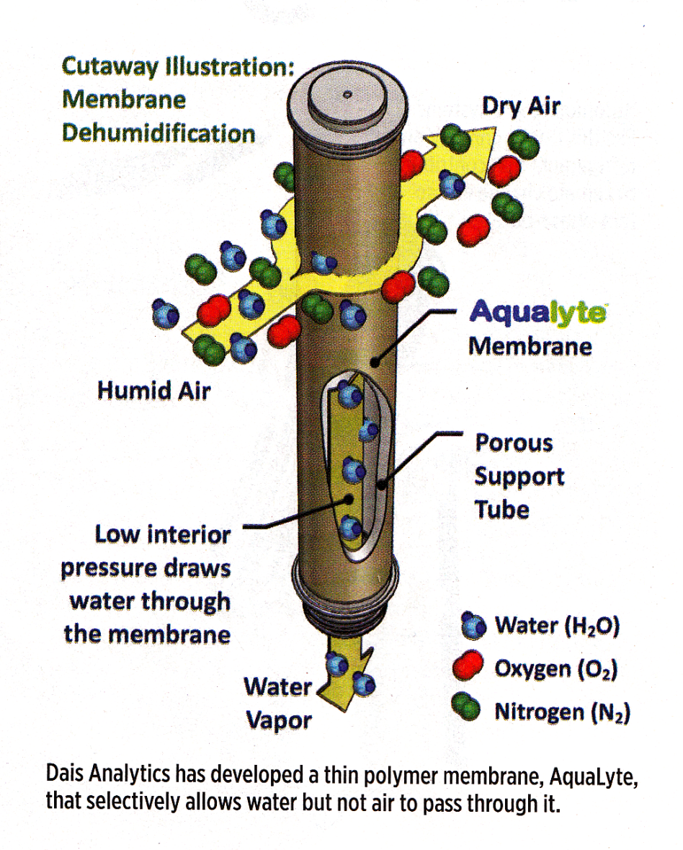
H₂O Absorbing Membrane
Humid air can loose water to become drier as it passes by Acualyte.
SAE

Slide 16
CO₂ plus Ionic Liquid
SAE magazine, Sept. 2, 2014 has an article “Next-gen A/C” concerning an alternate refrigerant that could work in modified A/C units: CO₂ plus ionic liquid.
Wikipedia definition:
An ionic liquid (IL) is a salt in the liquid state.

Slide 17
R-1234yf and SNAP
R-1234yf is SNAP approved.
R-134a is SNAP approved for new vehicles until about
2020. SNAP approval for vehicle service will not change.

Slide 18
EPA Announcement, 2/11/2013
According to the agency, a proposed rule will be issued this summer to withdraw approval for 134a for use in new motor vehicles and as an aerosol in consumer products. EPA pointed to the availability of substitutes for 134a in both motor vehicles and consumer products including 1234yf which was approved under SNAP for use on vehicles. EPA did clarify that the upcoming action will not impact the use of 134a in the servicing of motor vehicles already on the road. As part of the announcement, EPA did not specify a timeline for ending use of 134a, but stated that such action would be determined based on each specified use case.

Slide 19
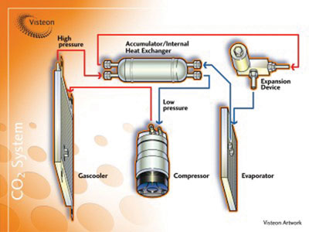
R-1234yf System

Slide 20
Internal Heat Exchanger (IHX)
The major difference in a 2014 Jeep Cherokee A/C system is the addition of a High/Low Side double-wall heat exchanger to improve efficiency.

Slide 21
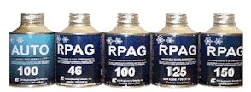
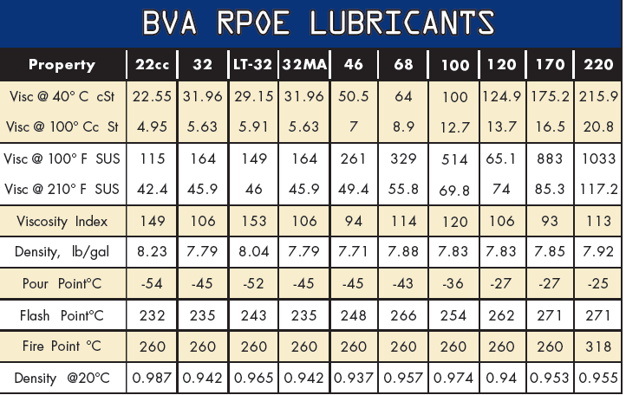
Refrigerant Oil
Most R-134a systems use a PAG oil to suit compressor needs.
And new oils are developed for our new refrigerants
Bvaoils.com

Slide 22
Refrigerant Oil 2
A new PAG oil was developed for R-1234yf
Chrysler is using PAG ND-12 which is backwards compatible with their R-134a systems

Slide 23
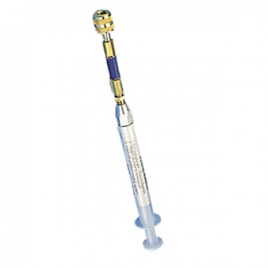
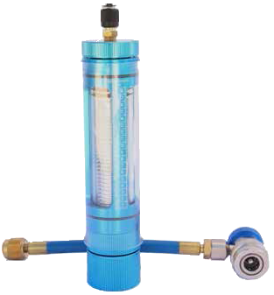
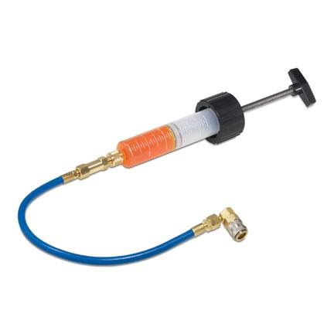
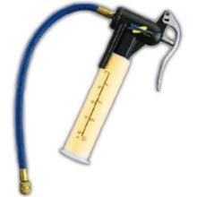
Oil Injectors
Robinair
Airsept
Mastercool
Tracerline
Viper

Slide 24
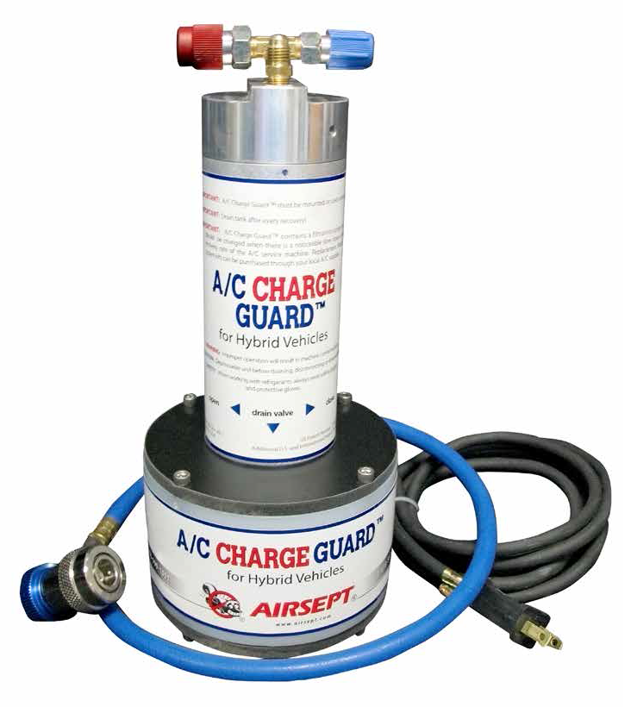
Hybrid Help
The Charge Guard can separate oil remaining in the R-R-R machine from a refrigerant charge.

Slide 25
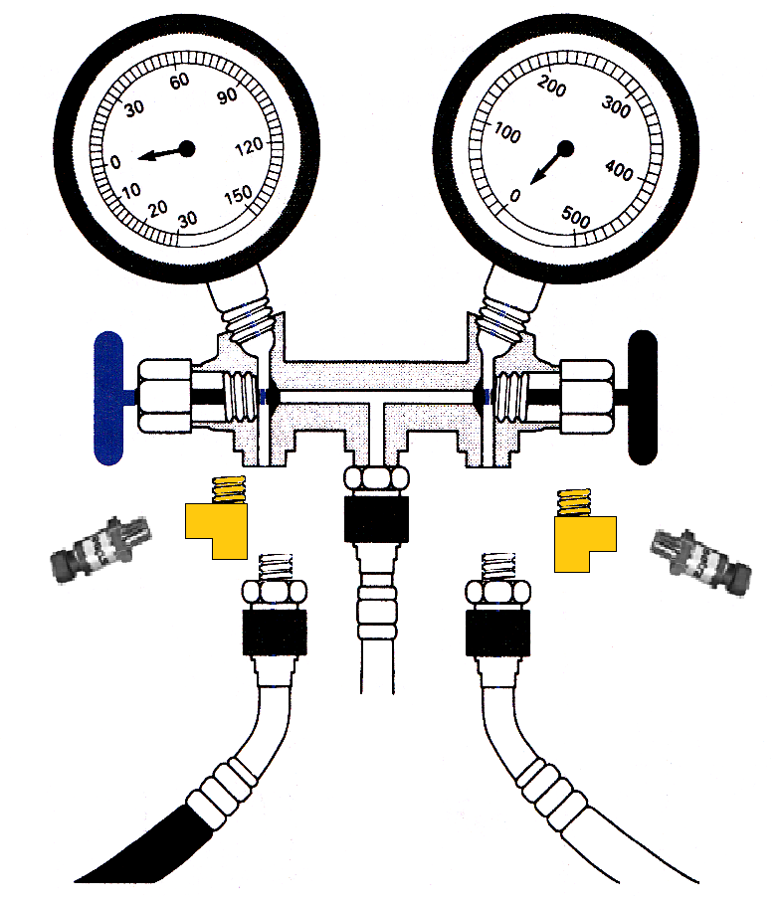
Manifold + Transducers
T fitting
T fitting
The transducers can be connected to a lab scope to record the High and Low Side pressures.
PSIA Transducer
PSIG Transducer

Slide 26
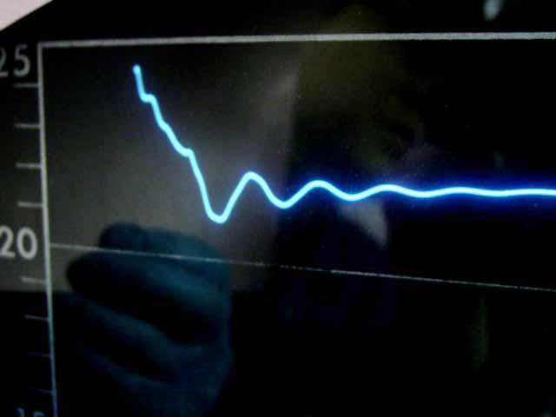
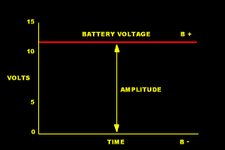
Scope Display

Slide 27
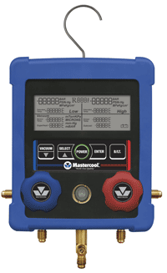
Mastercool Digital Manifold
#99103
This manifold offers a large easy to read LCD that displays Pressures, Saturated Temperatures, Actual temperatures, Superheat and Subcooling temperatures for over 60 refrigerants. When used with the Clamp-on Thermocouple connector it will display the actual temperature and automatically calculate the superheat or subcool temperature. When the vacuum sensor cable is attached to the manifold it will display deep vacuum. To insure lasting performance and durability the manifold case is constructed of ABS material and protected by a rugged rubber boot.

Slide 28
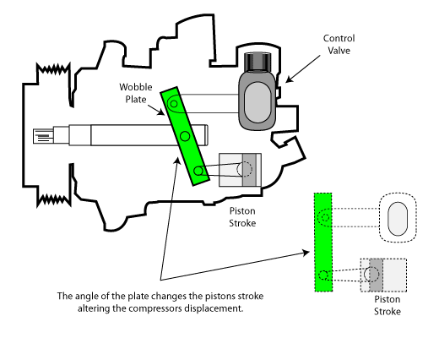
Variable Displacement Compressor
What’s wrong with this pic?
ASE Study Guide

Slide 29
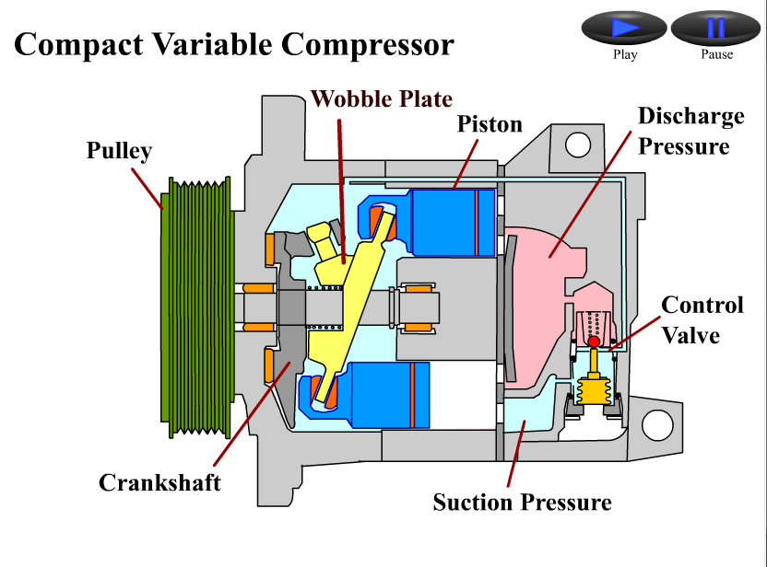
Animation: CVC & CVC Elec. Cntrl.

Slide 30
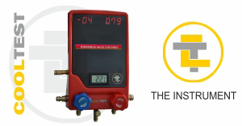
Cooltest 711

Slide 31
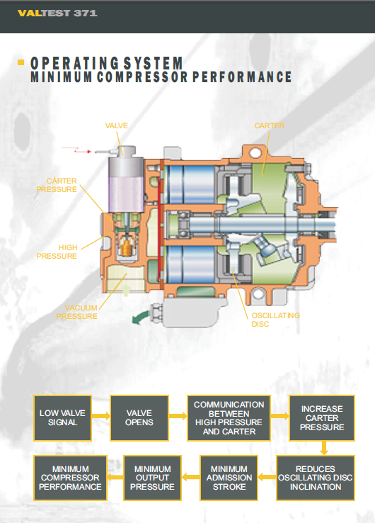
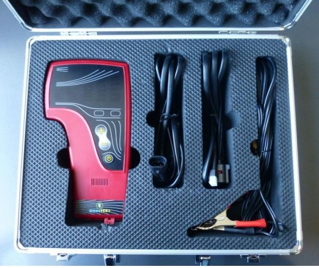
Valtest 371

Slide 32
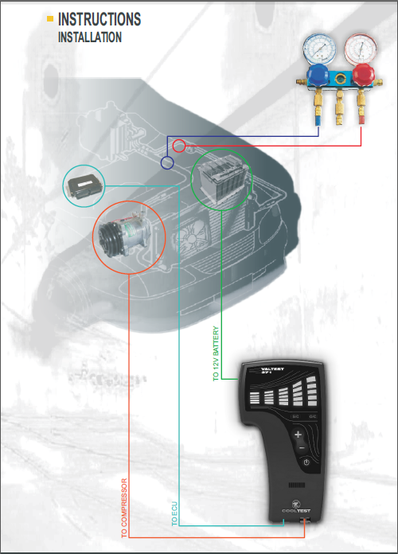
Allows the technician to increase or decrease the electronic signal to the pressure control solenoid while watching for pressure changes.

Slide 33
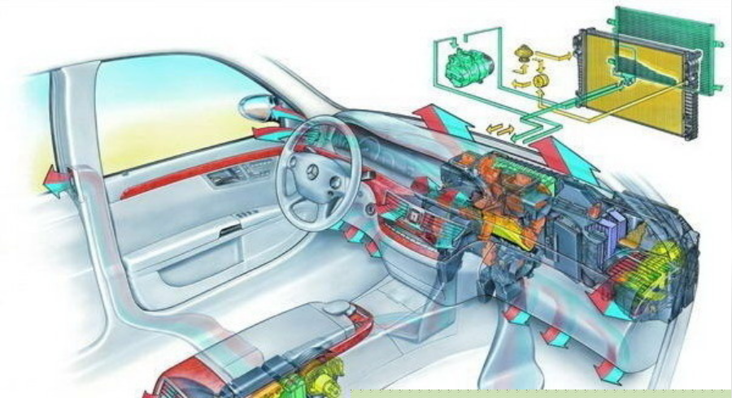
HVAC System

Slide 34
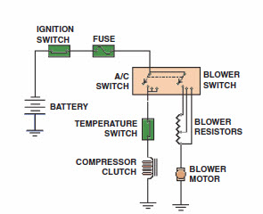
HVAC Circuit Schematics
Once upon a time they looked like this

Slide 35
HVAC Sensors
Windshield Temp. & Inside Moisture
Relative Humidity
Outside Air Quality
In-Car Temp.
Ambient Air Temp.
Duct Temp. ( Upper Duct & Lower Duct)
Evaporator Temp. (Downstream or Fin)
Sun Load

Slide 36
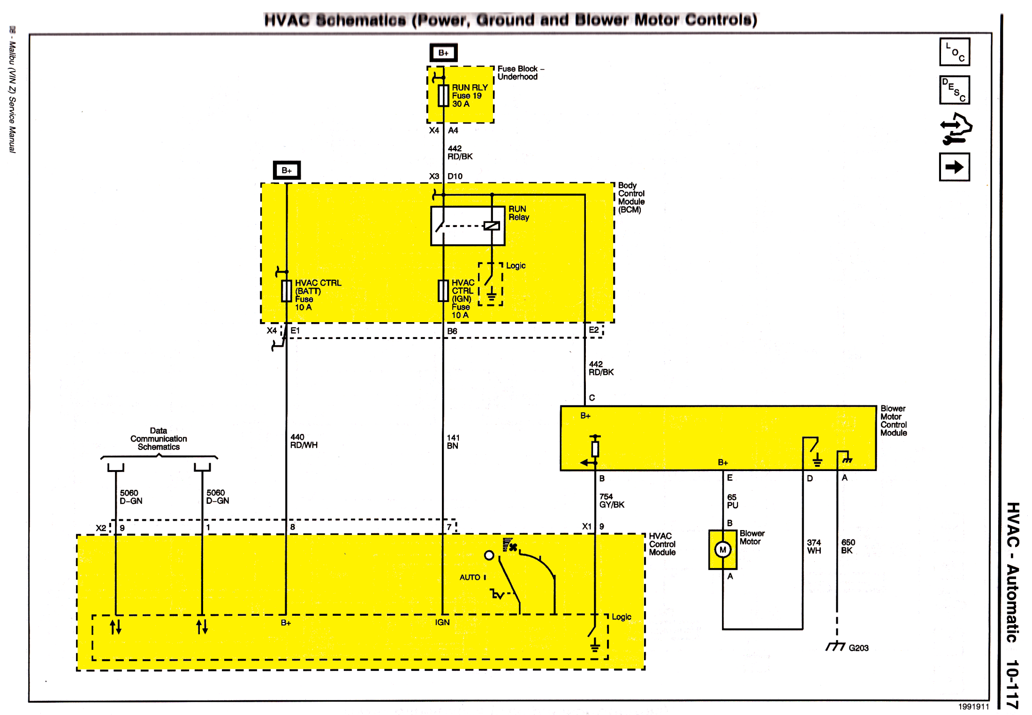
Blower Circuit

Slide 37
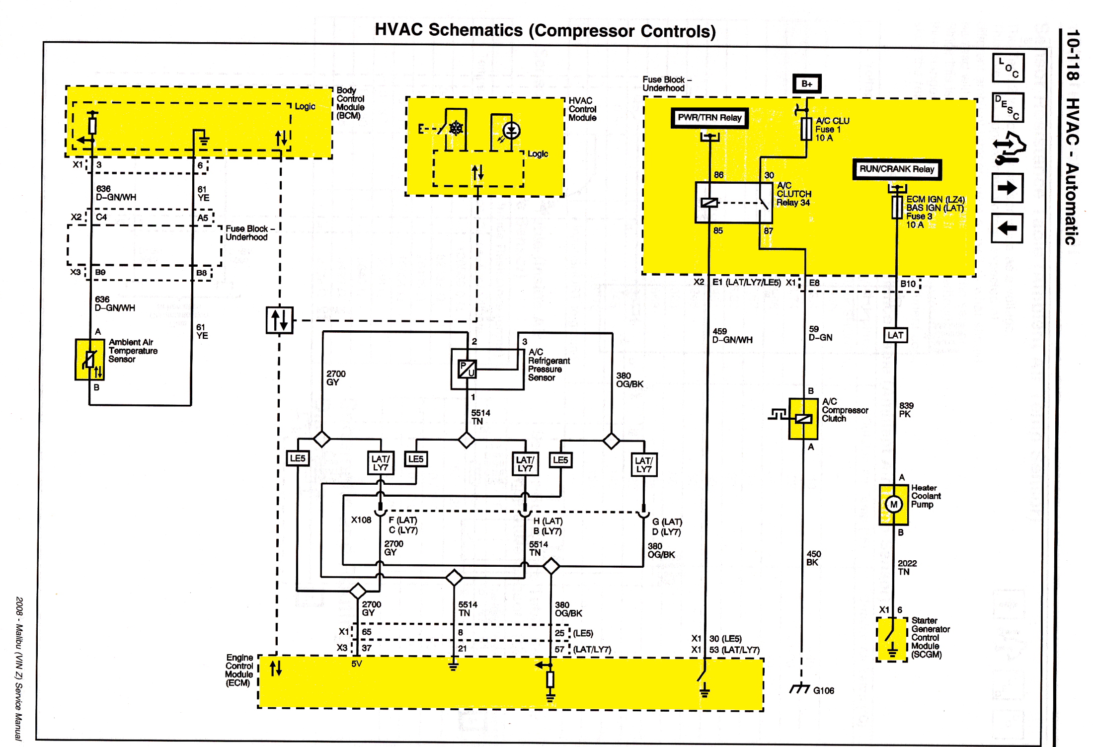
Compressor Clutch

Slide 38
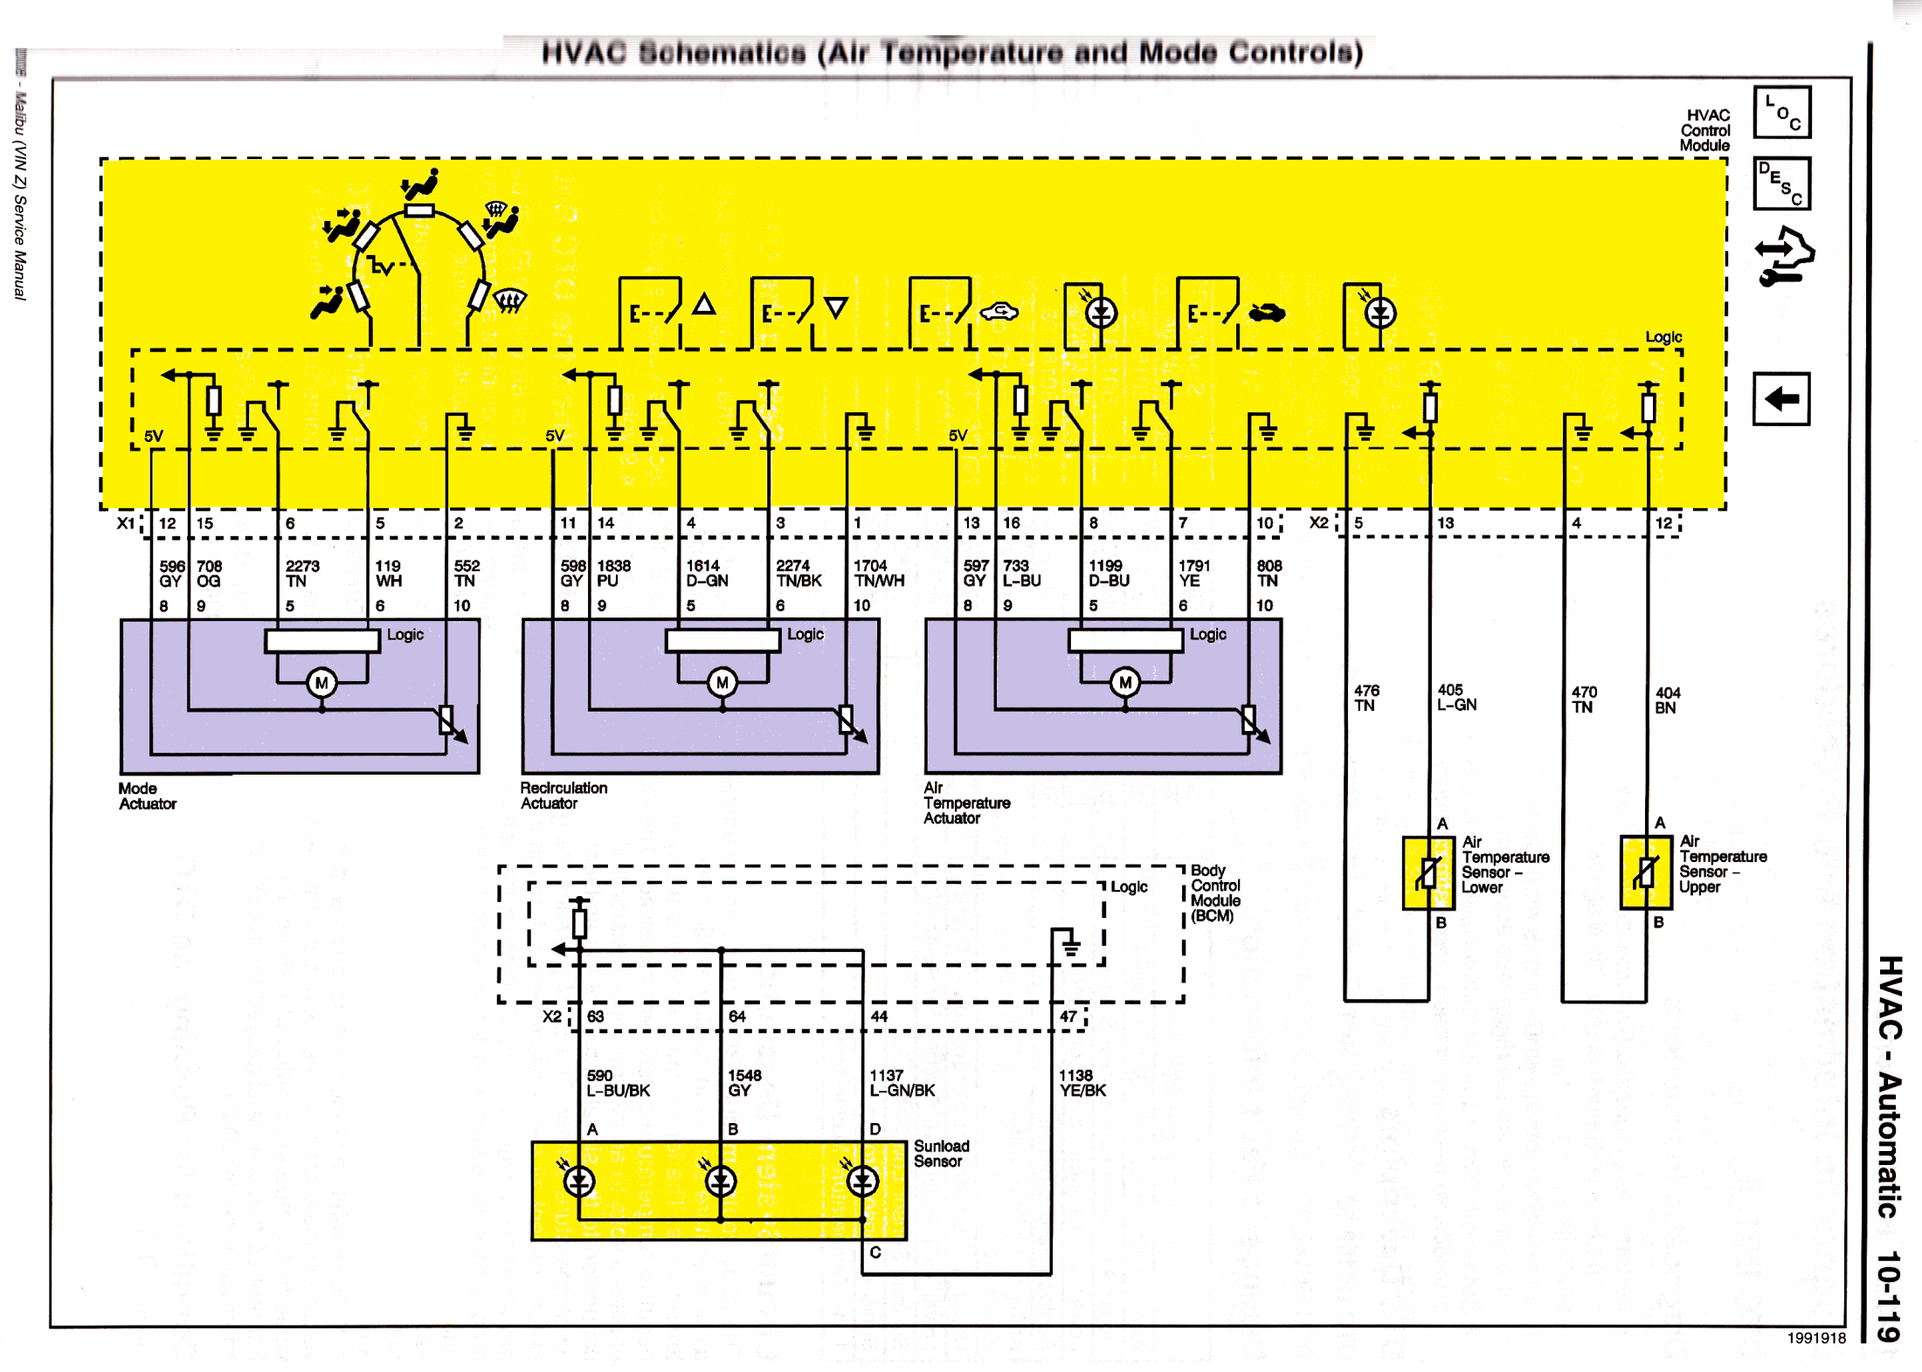
Temp. & Mode Control

Slide 39
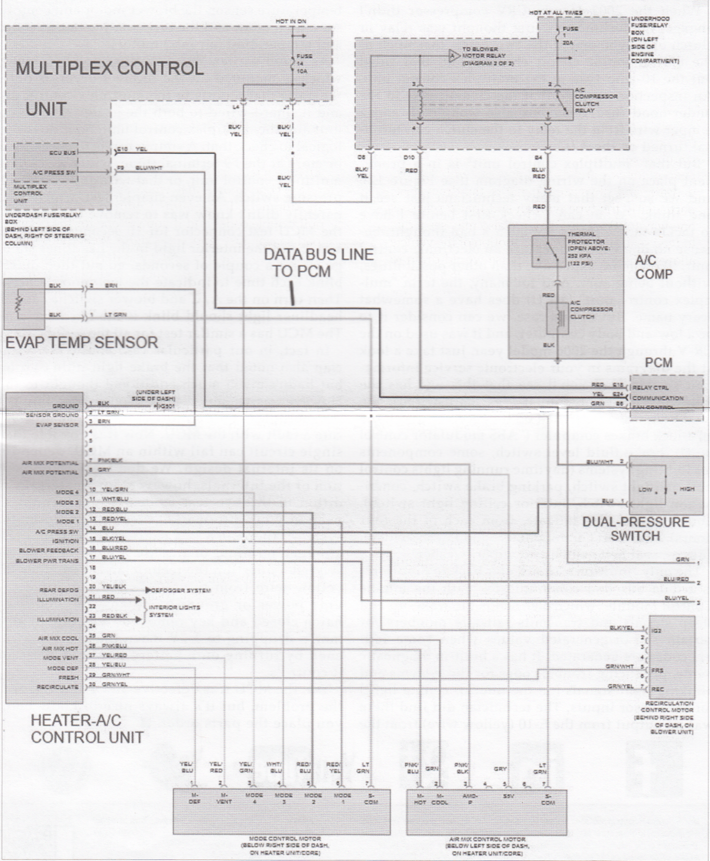
Honda, Multiplex Control

Slide 40
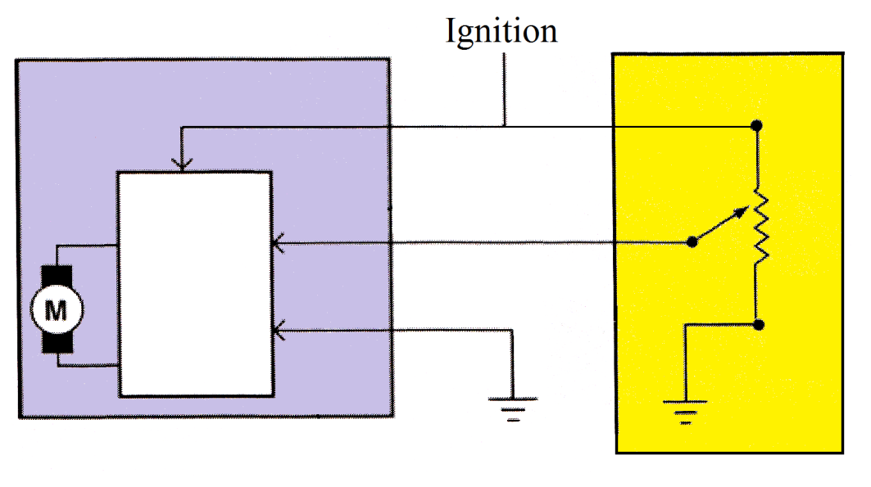
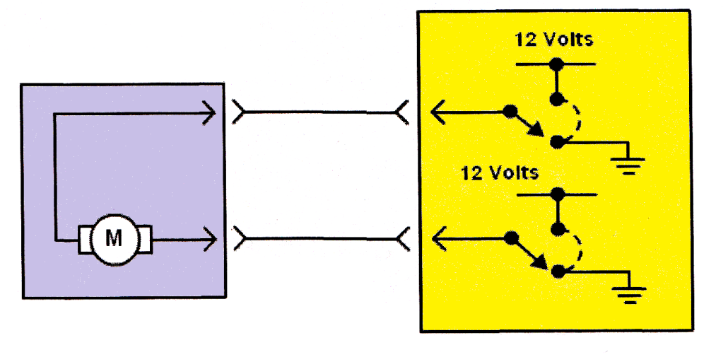
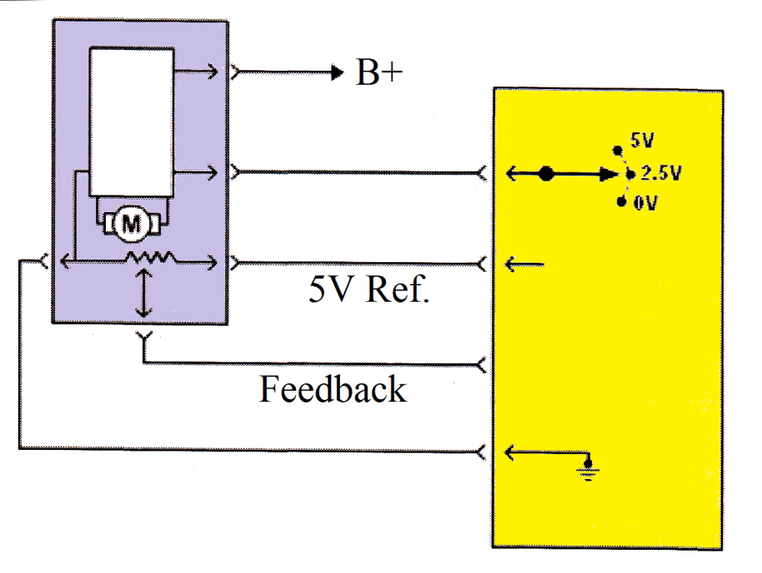
Actuators
2 Wire
3 Wire
5 Wire

Slide 42
HVAC DTCs
2008 Chevrolet Malibu, 34 pages of DTC List
B0158 Outside Air Temperature Sensor
B0163 Passenger Compartment Temperature Sensor Circuit
B0173 Output Air Temperature Sensor Circuit
B0178 Output Air Temperature Sensor 2 Circuit
B0183 Solar Load Sensor 1 Circuit
B0248 Air Flow Control 3 Circuit
B0268 Air Flow Control 7 Circuit
B0408 Temperature Control 1 Circuit
P0116 Engine Coolant Temperature (ECT) Sensor Performance
P0117 Engine Coolant Temperature (ECT) Sensor Circuit Low Voltage
P0118 Engine Coolant Temperature (ECT) Sensor Circuit High Voltage
P0128 Engine Coolant Temperature (ECT) Below Thermostat Regulated Temp.
P0480 Cooling Fan Relay 1 Control Circuit
P0481 Cooling Fan Relay 2 Control Circuit
P0532 Air Conditioning (A/C) Refrigerant Pressure Sensor Circuit Low Voltage
P0533 Air Conditioning (A/C) Refrigerant Pressure Sensor Circuit High Voltage
P0645 Air Conditioning A/C Clutch Relay Control Circuit

Slide 43
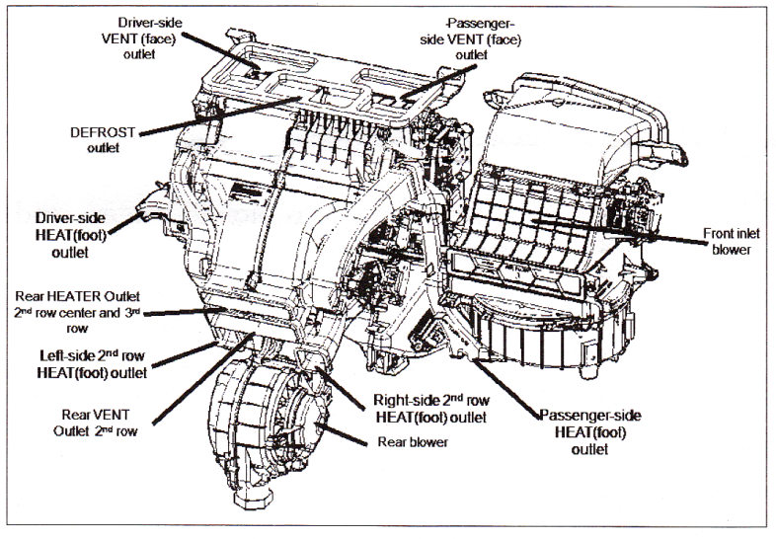
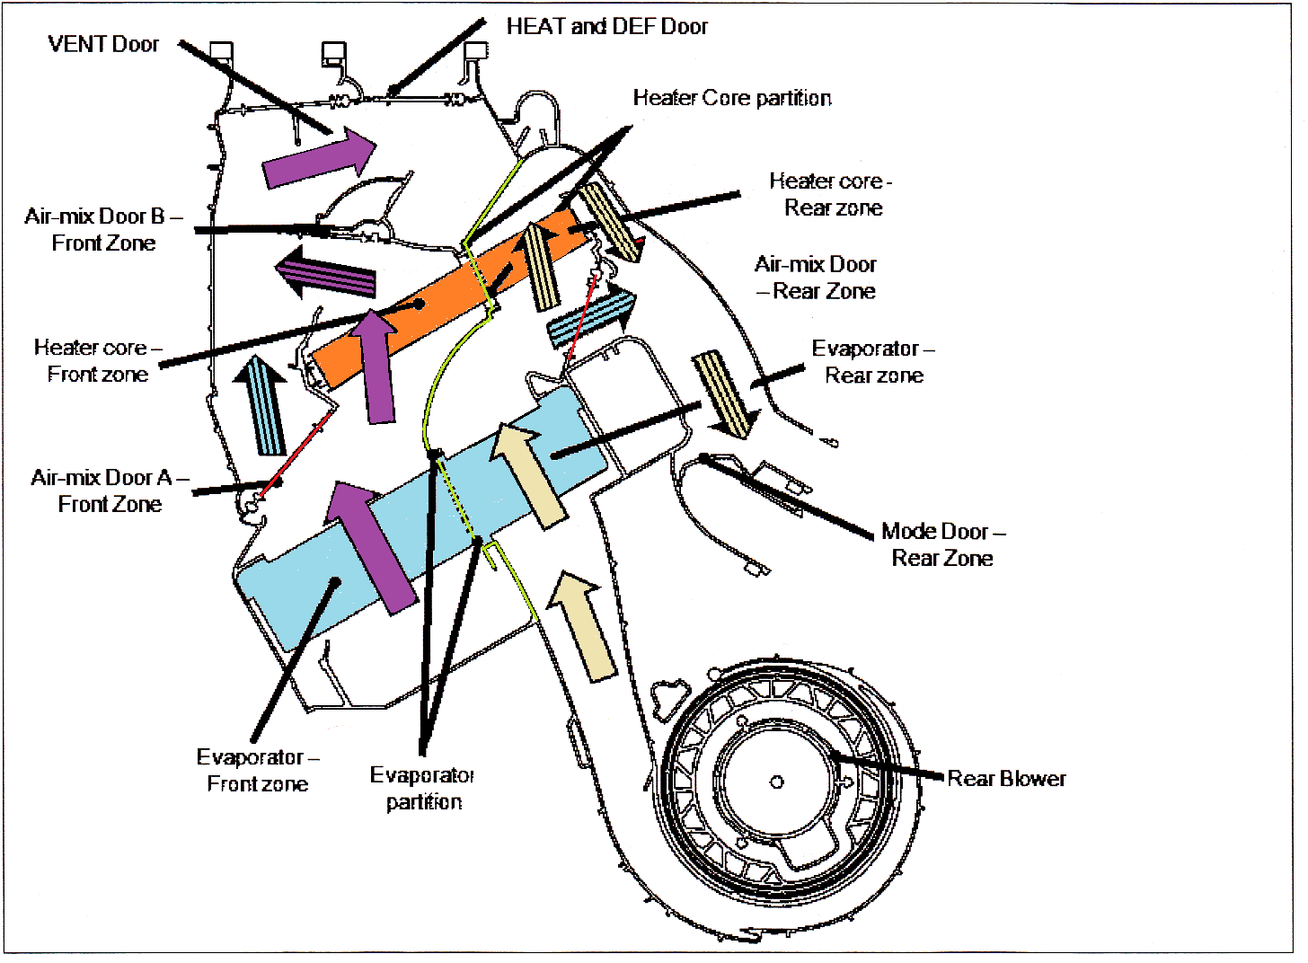
Acura MDX with Rear HVAC

Slide 44
Textbook Upgrades
http://tombirch.com
Email: tbirch@sebastiancorp.net
http://www.jameshalderman.com

